Slide 1

Welcome
These challenges were developed by Derrick Willer MBE and colleagues.
They are free to download and use in an education environment.
Please ensure that there is adult supervision, complete adherence to Health and Safety, and adequate PPE.
Derrick is a STEM Ambassador and volunteer STEM Ambassador.
He has supported education in schools and colleges for over 30 years, initially as a Neighbourhood Engineer in the 1980’s, leading the local Year of Engineering Success campaign in 1996 and the Campaign to Promote Engineering from 1997 to 2004.
He was awarded an MBE for services to Education in 2018.

Slide 2
Guide
This activity is for pupils to identify animals in danger and discover the reasons.
Risks
Mandatory: close supervision by a competent adult
Item | Risk | Avoidance Action
Aggression between pupils | Injury | Close supervision and immediate action to defuse aggression

Slide 3

Animals In Danger
Across the world many animals are in danger of extinction.
Do you know where they live and what they eat?
Click for next slide

Slide 4
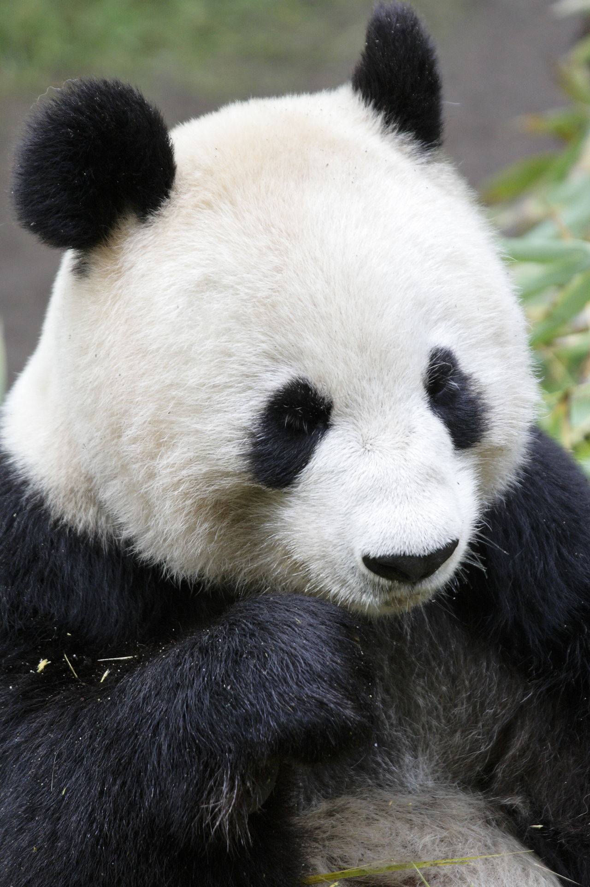


Name this animal?
Where do they live?
What do they eat?
Click for the answers
Bamboo and other plants
Giant Panda
Eastern and Southern China.
Click for next slide

Slide 5
What is the danger?
Click for the answers
Habitat Loss
Caused by humans cutting down the forests
to make farms
Caused by taking bamboo for products such
as scaffolding and window blinds
Giant Panda
Click for next slide

Slide 6
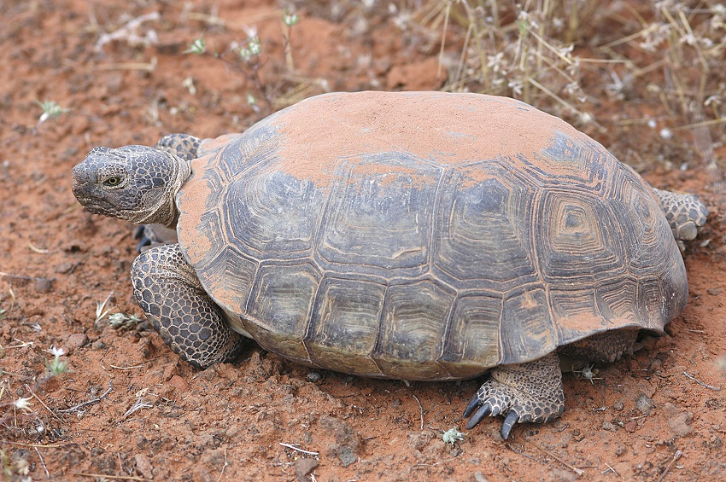

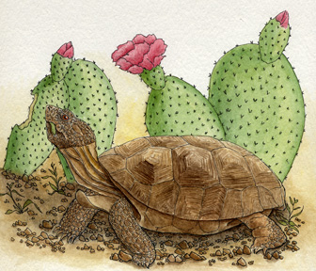
Name this animal?
Where do they live?
What do they eat?
Click for the answers
Desert Tortoise
Arizona and New Mexico USA.
Desert Plants
Hint – Lives
In Very Dry Places
Hint – Lives
In N. America
Click for next slide

Slide 7
What is the danger?
Click for the answers
Habitat Loss
New homes for humans
New roads limiting access across the road
Off-road car activities destroying habitat
Non-native animals being introduced
Desert Tortoise
Click for next slide

Slide 8
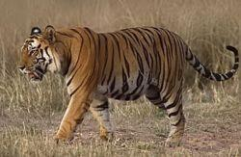
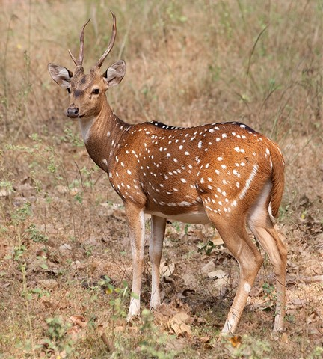
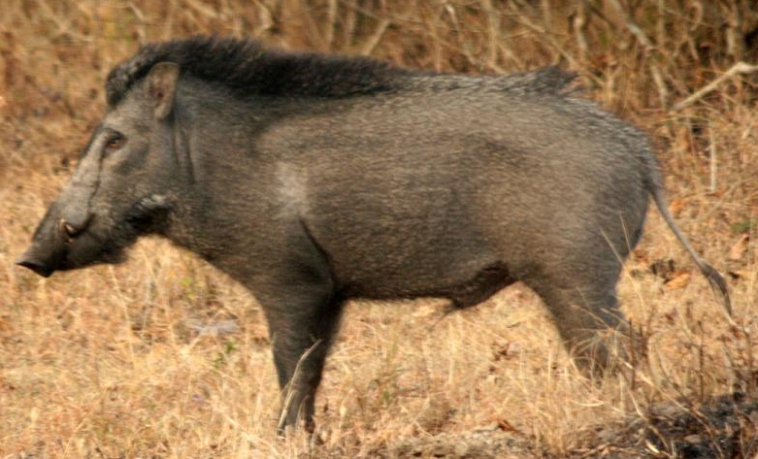
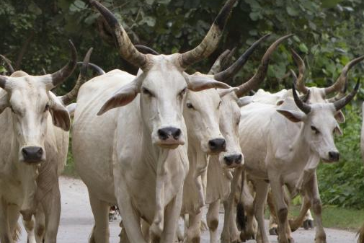

Name this animal?
Where do they live?
What do they eat?
Click for the answers
Deer, Wild Pigs, Cattle
Bengal Tiger
Northern Indian
Click for next slide

Slide 9
What is the danger?
Click for the answers
Habitat Loss
Caused by humans cutting down the forests to
make farms and new houses
Killing
Caused by humans protecting their cattle
Bengal Tiger
Click for next slide

Slide 10
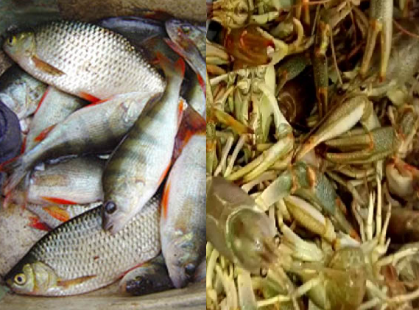
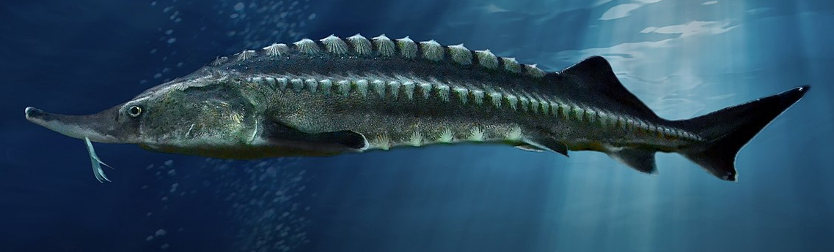
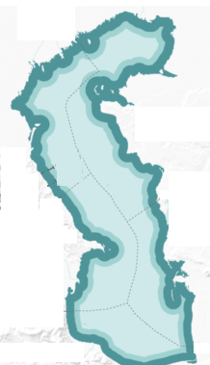
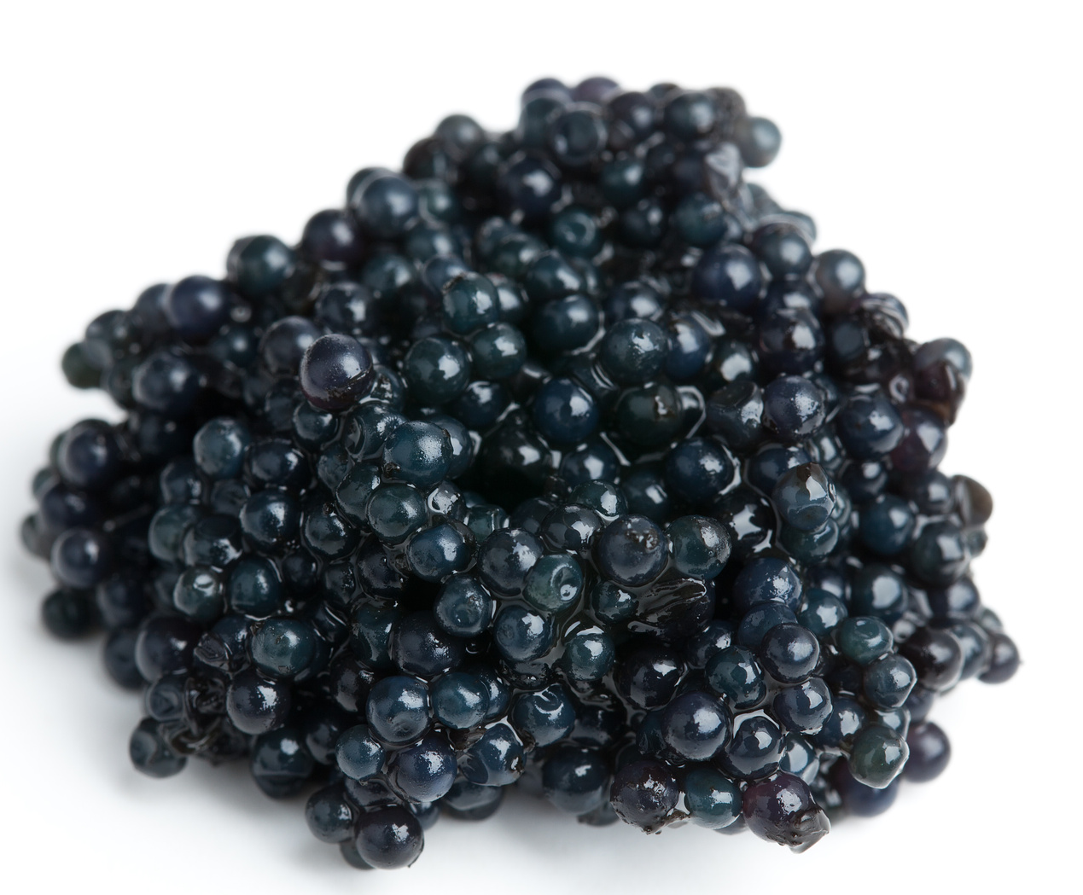
Name this animal?
Where do they live?
What do they eat?
Click for the answers
Beluga Sturgeon
for
Caviar
Caspian Sea
Fish, Crayfish
Click for next slide

Slide 11
What is the danger?
Click for the answers
Over fishing for Caviar
Cause by humans killing female
Sturgeons to get the Caviar
Preventing access to spawning areas
New dams on rivers, etc.
Beluga Sturgeon
for
Caviar
Click for next slide

Slide 12
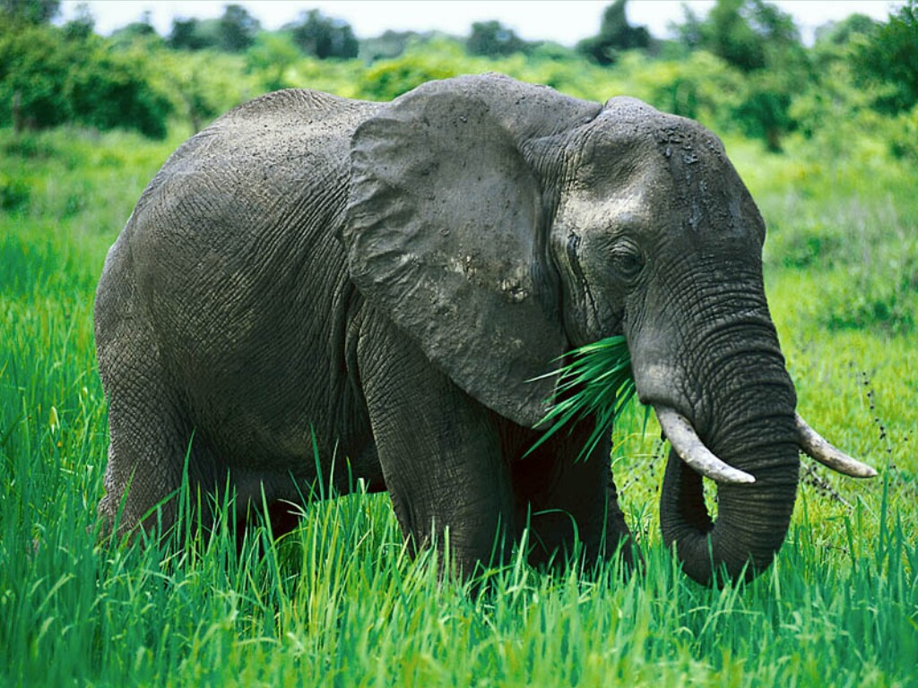
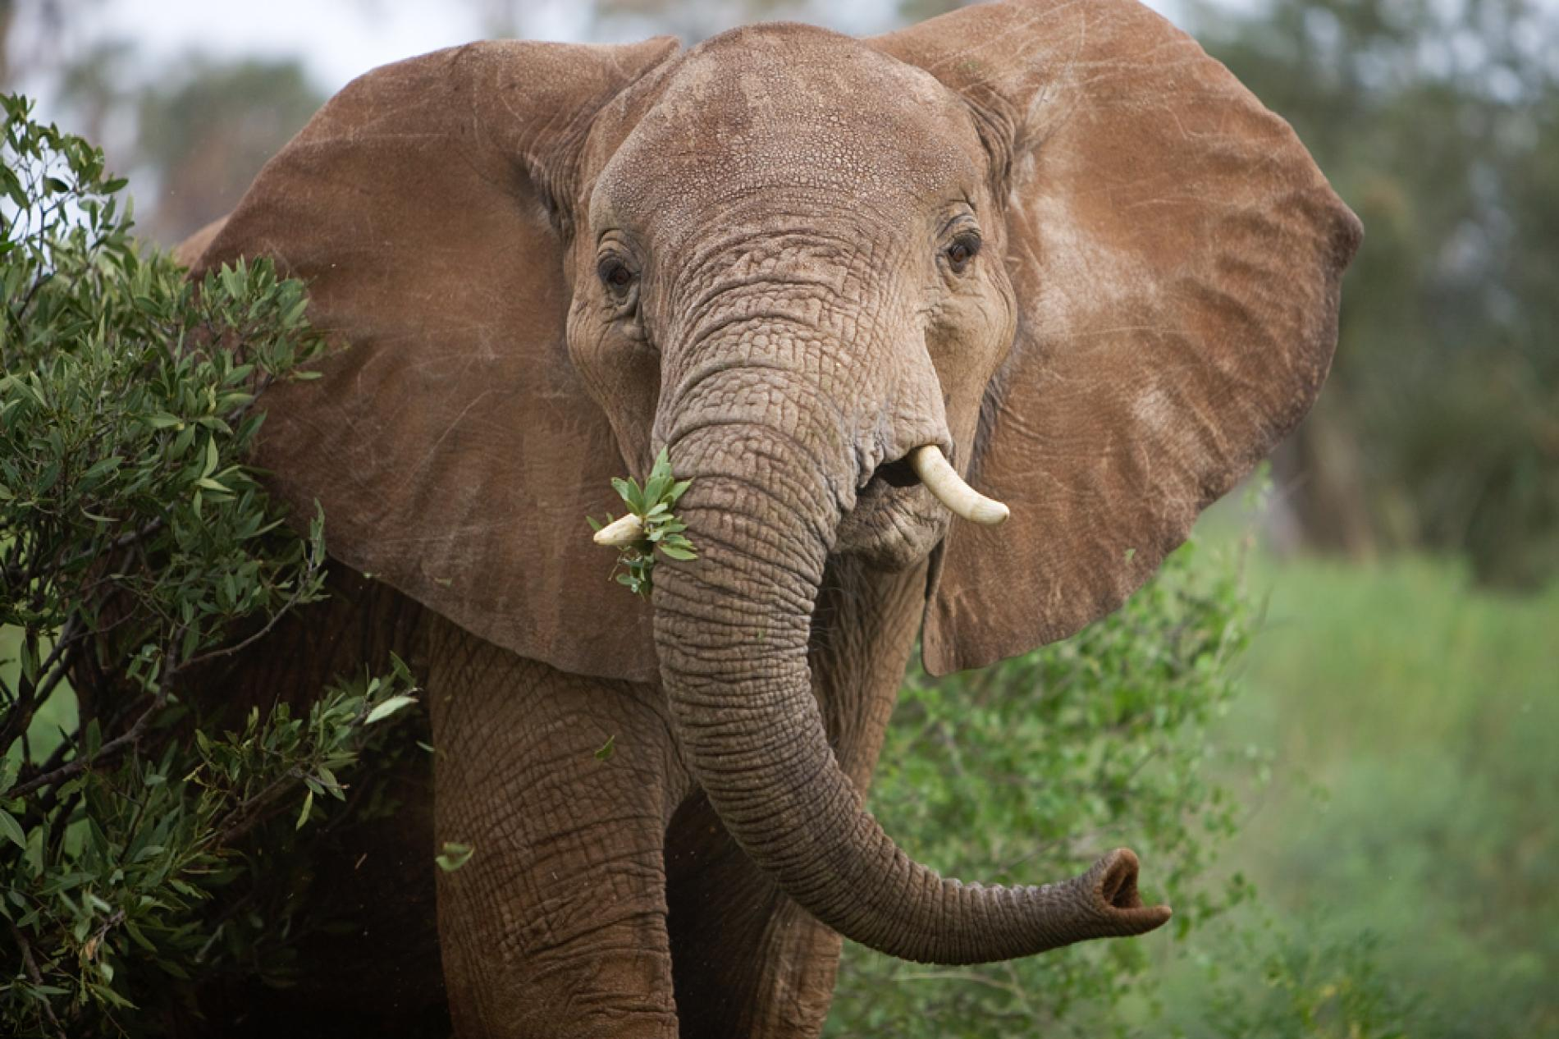
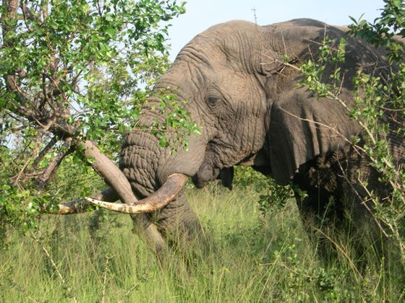
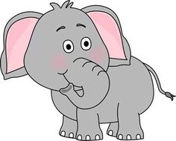
Name this animal?
Where do they live?
What do they eat?
Click for the answers
Grass, Tree Leaves
African Elephant
African Elephant has large ears
Indian Elephant has smaller ears
Central and Southern Africa
Click for next slide

Slide 13
What is the danger?
Click for the answers
Habitat Loss
Caused by humans cutting down the forests
to make farms
Killing
Caused by humans killing them for their
ivory tusks
African Elephant
Click for next slide

Slide 14
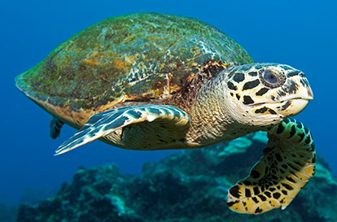
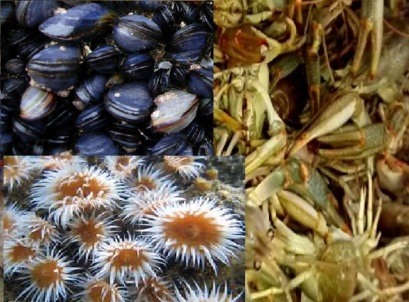
Name this animal?
Where do they live?
What do they eat?
Click for the answers
Crustaceans
Anemones
Molluscs
Loggerhead Turtle
Mediterranean, Northern Atlantic, Indian and Pacific Oceans
Click for next slide

Slide 15
What is the danger?
Click for the answers
Habitat Loss
To the beaches where they lay their eggs
Disturbance by road noise, artificial lighting
Ingesting Bad Products
Plastics, oil spillages
Capture and drowning
In fishing nets
Loggerhead Turtle
Click for next slide

Slide 16
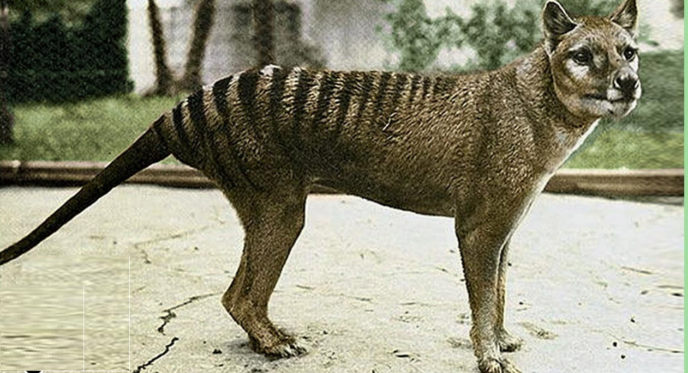
Name this animal?
Where do they live?
What do they eat?
Click for the answers
It does not eat because it is EXTINCT
Tasmanian Tiger
Tasmania
Hint – A
Marcupial
Marcupials include Kangaroos
all have pouches for newborn
Click for next slide

Slide 17
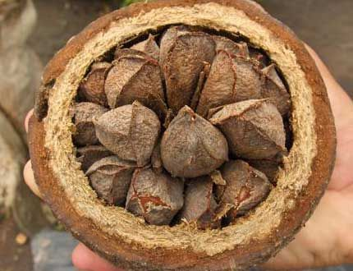
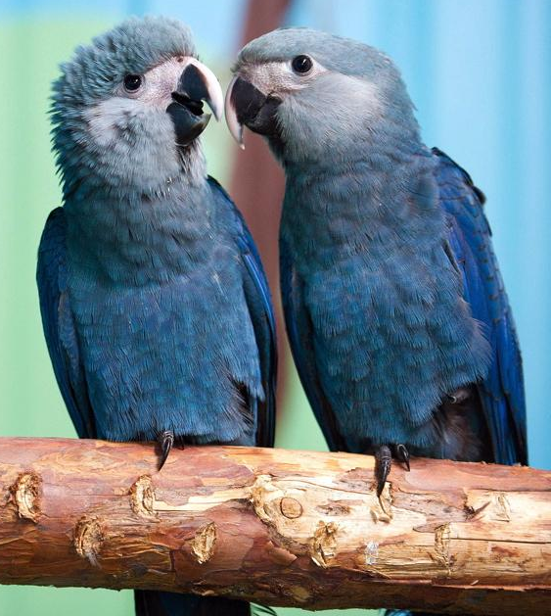
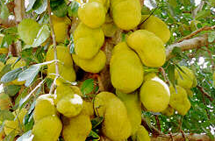
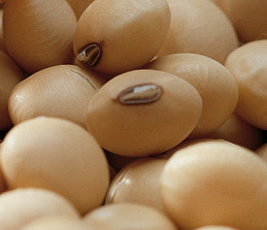
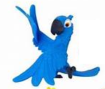
Name this animal?
Where do they live?
What do they eat?
Click for the answers
Seeds and
Fruits
Spix’s Macaw
Brazil
The Most Endangered Bird
Click for next slide

Slide 18
What is the danger?
Click for the answers
Habitat Loss
Caused by humans cutting down the
forests to make farms or for timber
Capture
For the pet trade
Spix’s Macaw
Click for next slide

Slide 19
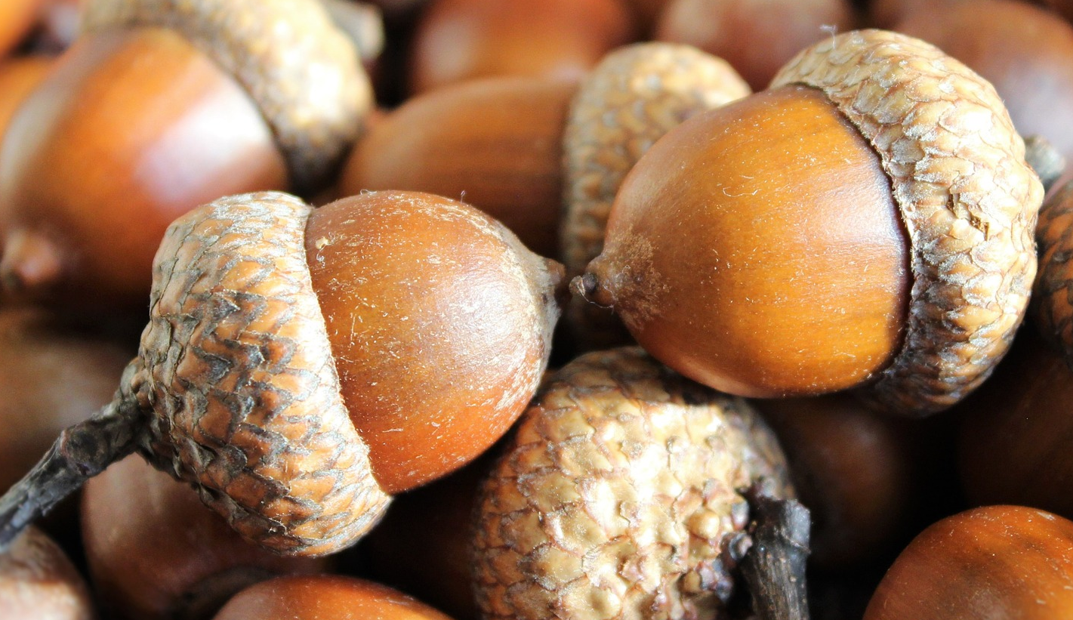
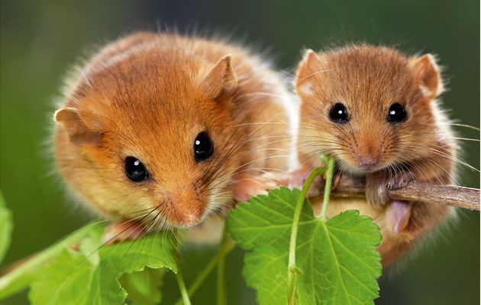

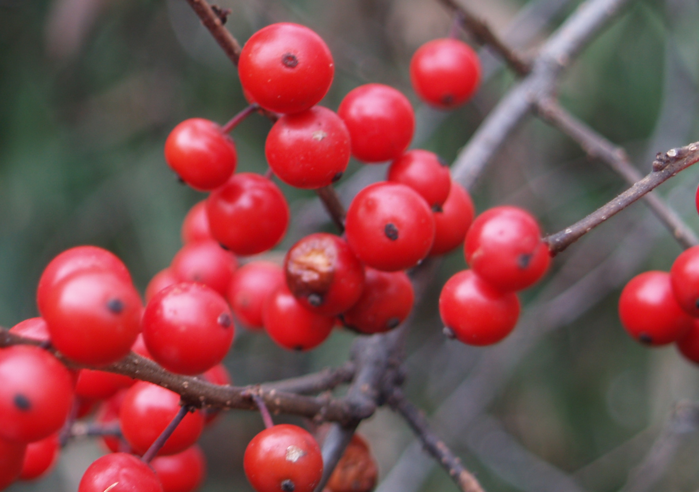
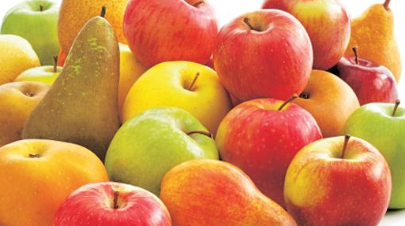
Name this animal?
Where do they live?
What do they eat?
Click for the answers
Berries, Nuts, and
Fruits
Hazel Dormice
England
Northern Europe and Asia
Click for next slide

Slide 20
What is the danger?
Click for the answers
Habitat Loss
Caused by humans changing how they
look after woodland, hedgerows, farming
New housing developments
Hazel Dormice
Click for next slide

Slide 21

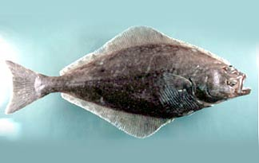



Name this animal?
Where do they live?
What do they eat?
Click for the answers
Atlantic Halibut
North Atlantic Ocean
Fish especially Cod, Haddock, Pollock
Click for next slide

Slide 22
What is the danger?
Click for the answers
Over Fishing
Line fishing and deep trawling
Because the Atlantic Halibut lives mainly
at the bottom of the ocean
The young have a slow growth rate and do
not mature as adults for about ten years
However they can live up to 50 years
Atlantic Halibut
Hint – you can buy it from fishmongers but it is expensive
Click for next slide

Slide 23
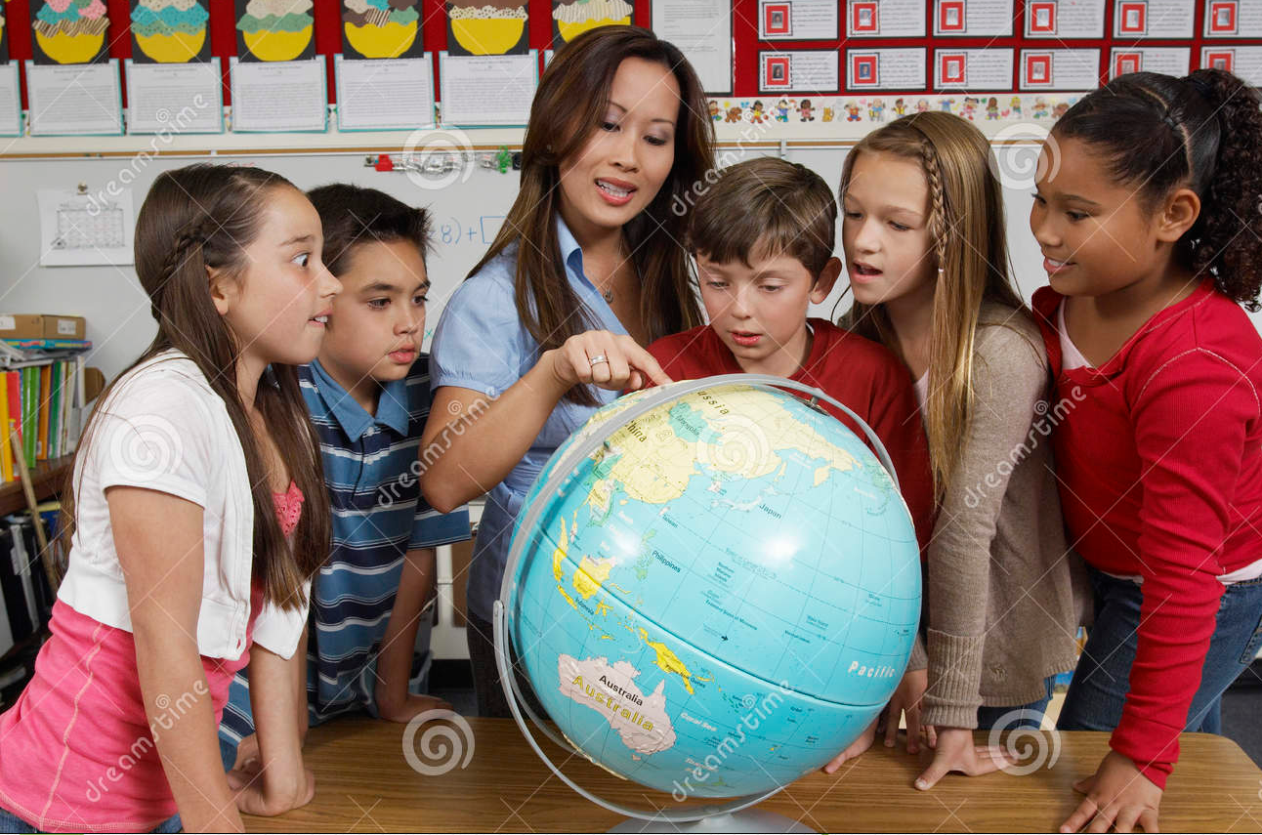
More Animals In Danger
Why don’t you all work in teams to discover more endangered animals
Mammals, Marcupials, Reptiles, Fish, Birds, Molluscs, Insects, Corals, Amphibians, etc.
What is their name? Where do they live?
What do they eat? What is causing the danger?
Click for next slide

Slide 24

Well Done

Slide 25

Thank you
Over 170,000 Members World-Wide

Slide 26
These challenges were developed by Derrick Willer MBE and colleagues.
They are free to download and use.
Please ensure that there is adult supervision, complete adherence to Health and Safety, and adequate PPE.
Derrick is a STEM Ambassador and volunteer Schools Liaison Officer for the IET Coventry and Warwickshire Network.
He has supported education in schools and colleges for some 30 years, initially as a Neighbourhood Engineer in the 1980’s, leading the local Year of Engineering Success campaign in 1996 and the Campaign to Promote Engineering from 1997 to 2004.
Derrick was awarded an MBE for services to Education in 2019.

