Slide 1
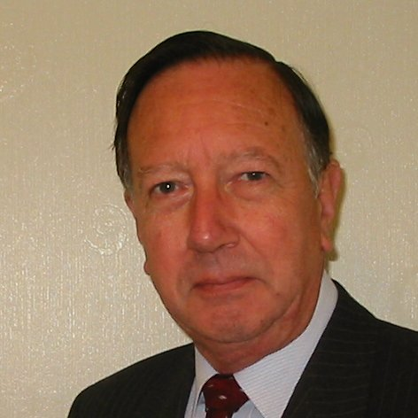
Welcome
These challenges were developed by Derrick Willer MBE and colleagues.
They are free to download and use in an education environment.
Please ensure that there is adult supervision, complete adherence to Health and Safety, and adequate PPE.
Derrick is a STEM Ambassador and volunteer Liaison Officer for Schools.
He has supported education in schools and colleges for over 30 years, initially as a Neighbourhood Engineer in the 1980’s, leading the local Year of Engineering Success campaign in 1996 and the Campaign to Promote Engineering from 1997 to 2004.
He was awarded an MBE for services to Education in 2018.

Slide 2
Guide
This activity is for pupils to make a balloon powered car from recycled materials.
Risks
Mandatory: close supervision by a competent adult
Item | Risk | Avoidance Action
Tools | Injury | Close supervision, Wear protective glasses
Glue | Damage to Clothing Injury | Close supervision, sponge and water. If glue is ingested rinse mouth with water and give water to drink.
Aggression between those present | Injury | Close supervision and immediate action to defuse aggression

Slide 3
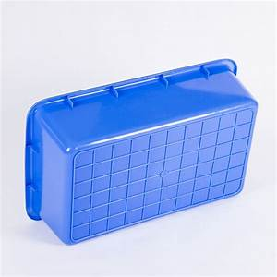

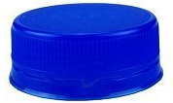
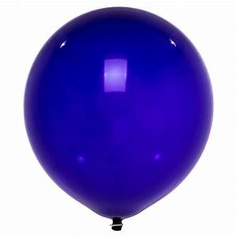
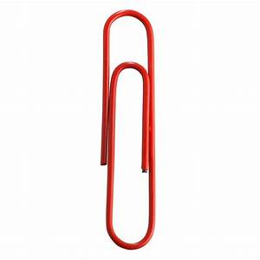
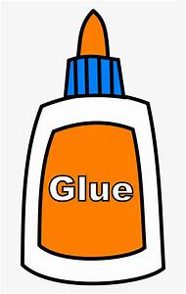
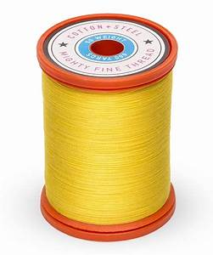
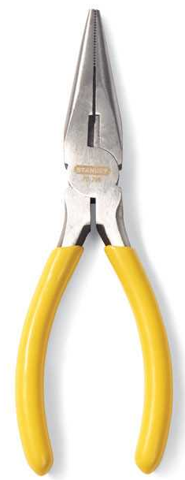
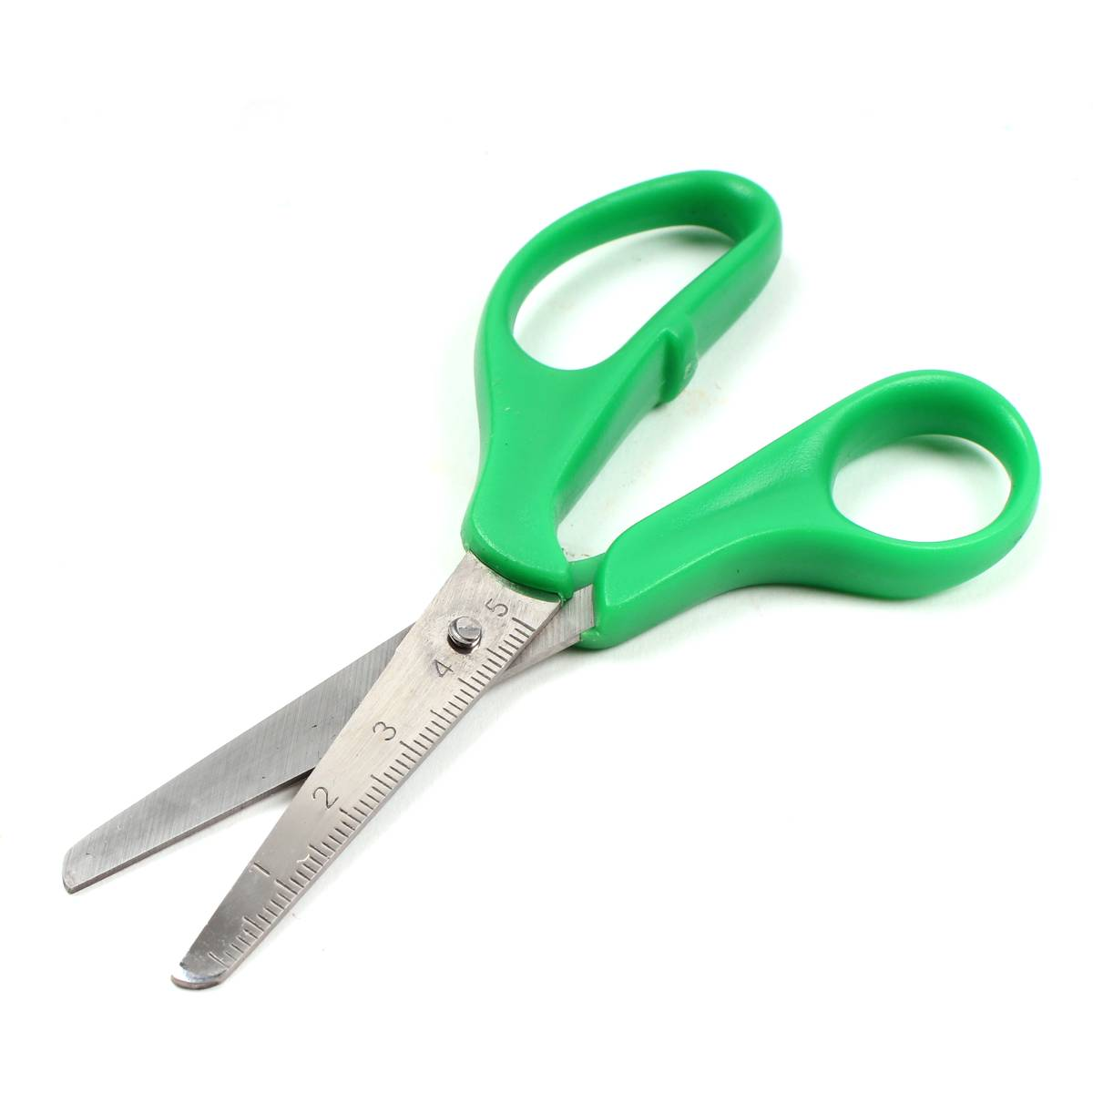
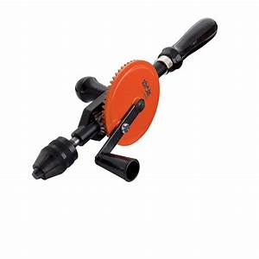
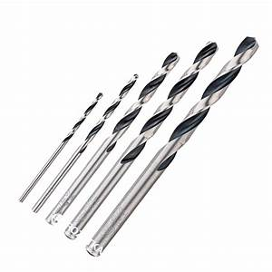
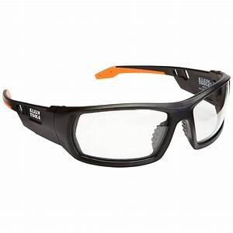
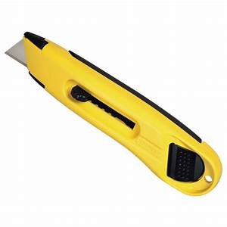
What you need
Recycled plastic tray or bottle
Eight recycled milk bottle tops
Balloon
Four paper Clips
Glue
Strong cotton
Recycled card
Tools

Slide 4
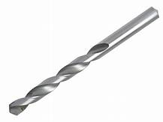
Make the wheels
Draw two diameters on the wheels to find the centre.
Using a drill just larger than the thickness of the paper clips.
Drill holes in the exact centre of each wheel.

Slide 5

Make the pivots
Straighten the paper clips.
Bend one end into a circle.
Then bend it at right angles.
Fit onto the wheels.
You can choose which way the wheels are mounted.
Bend the ends so that you can mount onto the outside of the car.

Slide 6
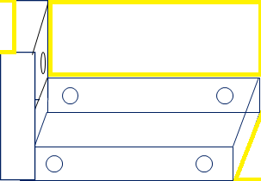
Make the body from plastic tray
Drill holes where the wheels are to go.
Carefully cut out a rectangular section from the end of the tray.
Make a round hole in the centre of this section about 8mm diam. for the nozzle.
Glue the section to the end of the tray.
Let the glue dry.
You can also make the body from two recycled trays

Slide 7
Decorate the body
You prepare card to stick onto the tray to represent a car.
Design and colour your own.
Do not stick this onto the car until you have fitted the wheels.

Slide 8
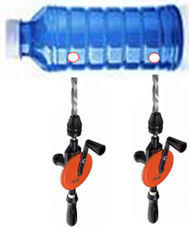
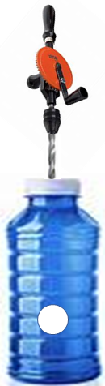
Make the body from plastic bottle
Drill holes where the wheels are to go.
Make a round hole in the centre of the side for the jet.

Slide 9
Make and mount the nozzle.
Cut a piece of paper 4cm wide and 29cm long
Glue one side except the first
1½ cm.
Wrap round a pen or pencil.
Remove and allow glue to dry.
Glue the end and fix onto the balloon and secure with cotton.
Glue this area

Slide 10
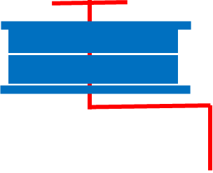
Make and mount the wheels.
Glue the wheels to the outside
of the car.
Reinforce them with card glued
over the join.
Blow up the balloon through the nozzle and stop the air escaping.
Push the nozzle trough the hole.
Release the balloon and see your
car race across the floor.
Glue to side of car

Slide 11
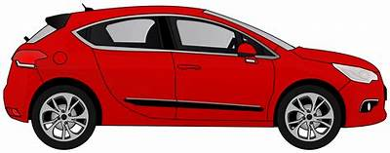

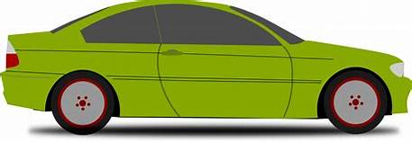
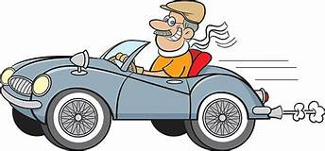
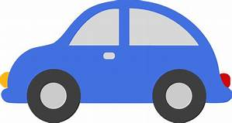
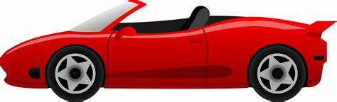
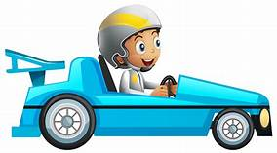
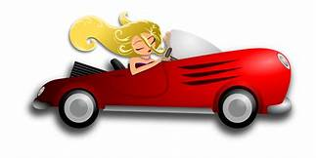
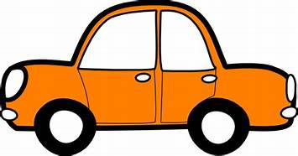
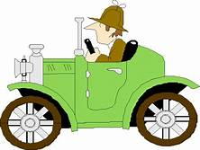
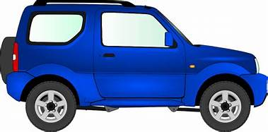

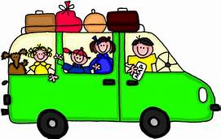
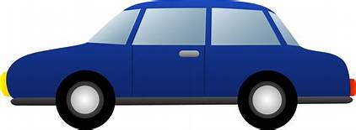
Mount your own design.

Slide 12
Who had the fastest car?
Time the car across a 5m length!
Who’s car went the farthest?
Who’s car was the best made?
Who’s car was best decorated?
Who’s car is best overall?
Category | My Vote
Fastest Car
Farthest Distance
Best made
Best Decorated
Best Overall

Slide 13
We have learnt:
- to make a balloon car out of recycled materials.
about thrust pushing the car forward.
to work like engineers.
to have fun while learning.

Slide 14

Well Done

