Slide 1

Welcome
These challenges were developed by Derrick Willer MBE and colleagues.
They are free to download and use in an education environment.
Please ensure that there is adult supervision, complete adherence to Health and Safety, and adequate PPE.
Derrick is a STEM Ambassador and volunteer STEM Ambassador.
He has supported education in schools and colleges for over 30 years, initially as a Neighbourhood Engineer in the 1980’s, leading the local Year of Engineering Success campaign in 1996 and the Campaign to Promote Engineering from 1997 to 2004.
He was awarded an MBE for services to Education in 2018.

Slide 2
Guide
This activity is for pupils to make a simple burglar alarm with a buzzer but using a clothes peg as the switch.
The exercise introduces pupils to circuits and measuring voltage and current.
They are warned about the lethal aspects of mains voltages and the need to be careful.
The make a series circuit and then a parallel circuit.
Risks
Mandatory: close supervision by a competent adult
Item | Risk | Avoidance Action
Crocodile Clips | Injury | Close supervision
Multimeters | Misuse | Close supervision
 |  | Turn off when not in use
Batteries | Injury | Close supervision
 |  | Do not allow batteries to short out causing heat and possible fire
 |  | Store batteries separately when not in use
Aggression between those present | Injury | Close supervision and immediate action to defuse aggression

Slide 3


Make a
Burglar
Alarm
SWAG
Trip Wire

Slide 4
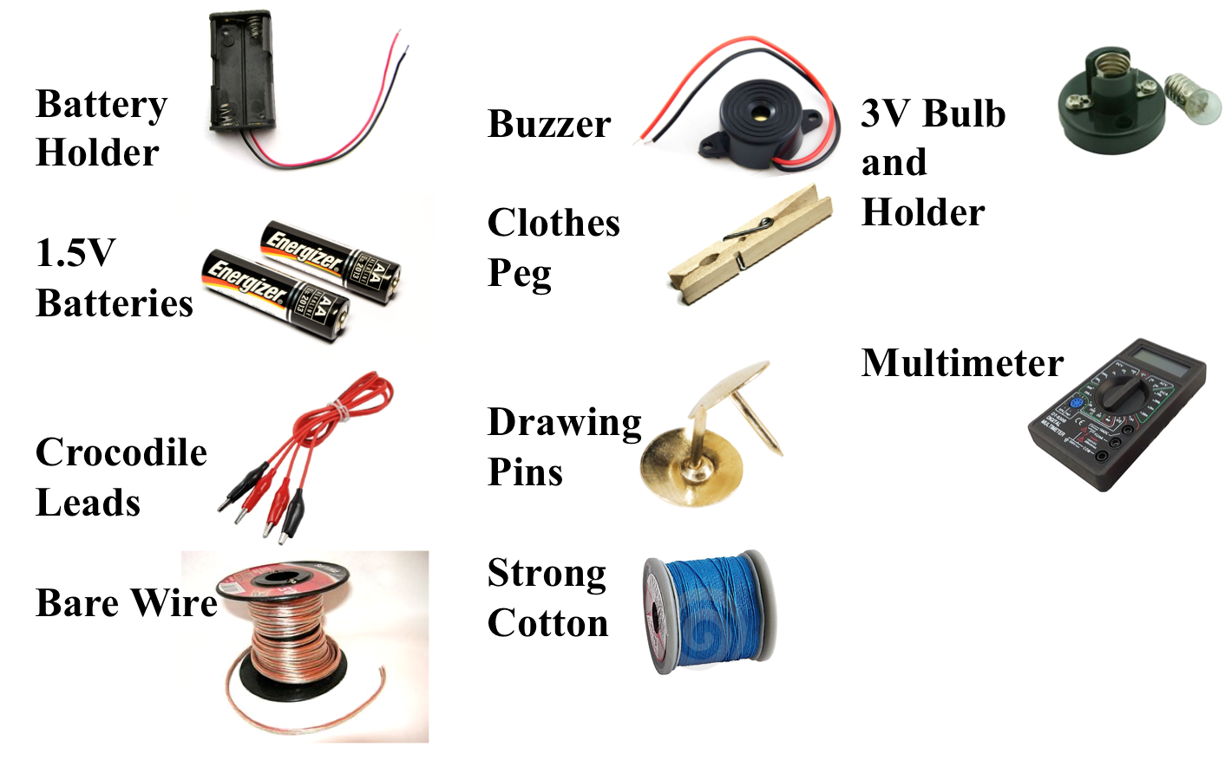
What You Need
Please keep batteries separately and ensure the multimeters are turned off

Slide 5
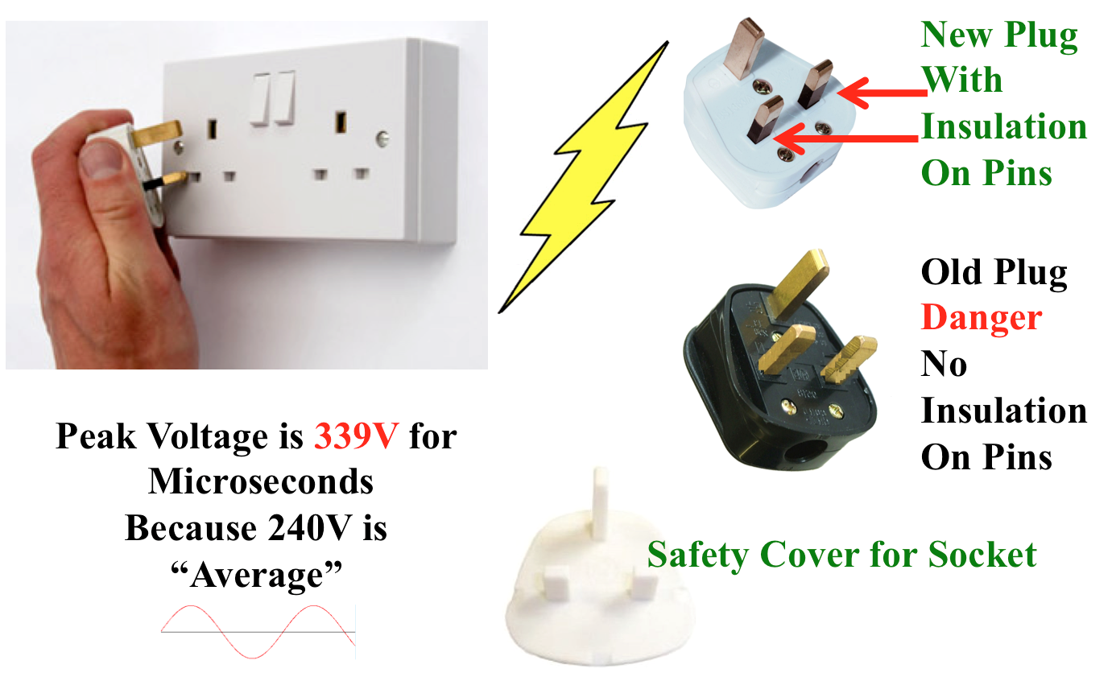
Danger – 240 Volts AC

Slide 6
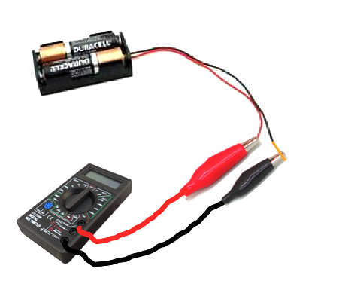
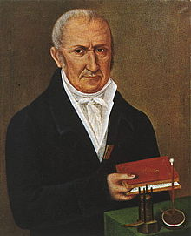
Volt
(like “force”)
Named after Italian Count Allessandro Volta

Slide 7
Volt
(like “force”)
Named after Italian Count Allessandro Volta
Never connect the battery before a teacher has checked the circuit !!
If you get it wrong the battery will get hot and burn !!

Slide 8
Volt
(like “force”)
Named after Italian Count Allessandro Volta
First turn the selector to 20 Volts DC
(be careful)
Connect the Multimeter
How much Voltage is there?

Slide 9
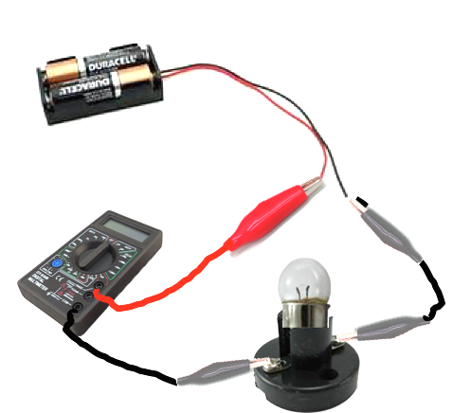
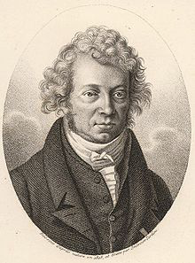
Amp
for current
Named after Frenchman André-Marie Ampere
First turn the selector to 10 A
(be careful)
Connect the lamp and
Multimeter
How much Current is there?

Slide 10
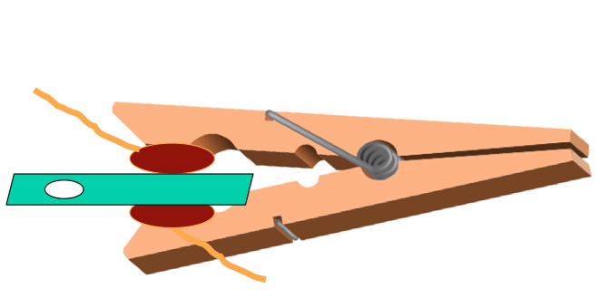
Make a clothes peg switch!
Using the clothes peg,
the wire and the drawing pins
make a switch
with the plastic between the pins.
See the next slide.

Slide 11
Push the pins
into the clothes
peg – make sure
the leads go in
opposite directions
Cut a short
length of
bare wire
and wrap
around
drawing pin
Do this twice
Punch hole in the plastic strip
Push plastic between pins
and close the peg so it
grips the plastic

Slide 12
Push the pins
into the clothes
peg – make sure
the leads go in
opposite directions
Cut a short
length of
bare wire
and wrap
around
drawing pin
When you pull out the plastic the pins touch and act as an electric switch
Do this twice
Punch hole in the plastic strip
Push plastic between pins
and close the peg so it
grips the plastic

Slide 13

Circuit 1
Circuit 2
Circuit 3
-
-
Lamp
-
Battery
Battery
Battery
+
+
+
Switch
Switch
Switch
Buzzer
Buzzer
Buzzer
Circuit 1
+ goes to long lead on the buzzer.
Measure the Voltages.
Circuit 2 has the lamp in SERIES with the buzzer.
Is there a problem?
Measure the Voltages.
Circuit 3 has the lamp in PARALLEL with the buzzer.
Measure the Voltages.
Do not connect the batteries until your circuit has been checked.
Short circuiting the batteries can cause burning

Slide 14
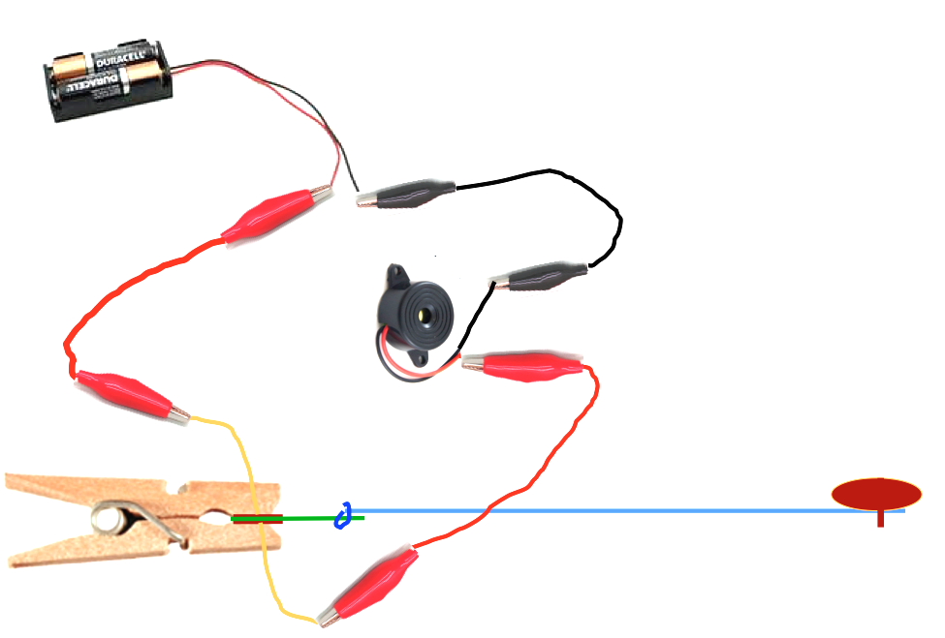
Connect The Circuit as Shown
Buzzer
Pin To
Wood
Cotton

Slide 15
Connect The Circuit as Shown
When you trip the cotton it pulls the plastic out of the peg and the
peg-switch closes and sounds the alarm
Buzzer
Pin To
Wood
Cotton

Slide 16
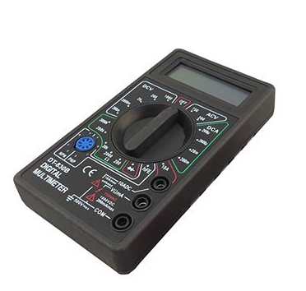
Pull out the plastic so the
buzzer sounds
Measure the voltage across the buzzer

Slide 17
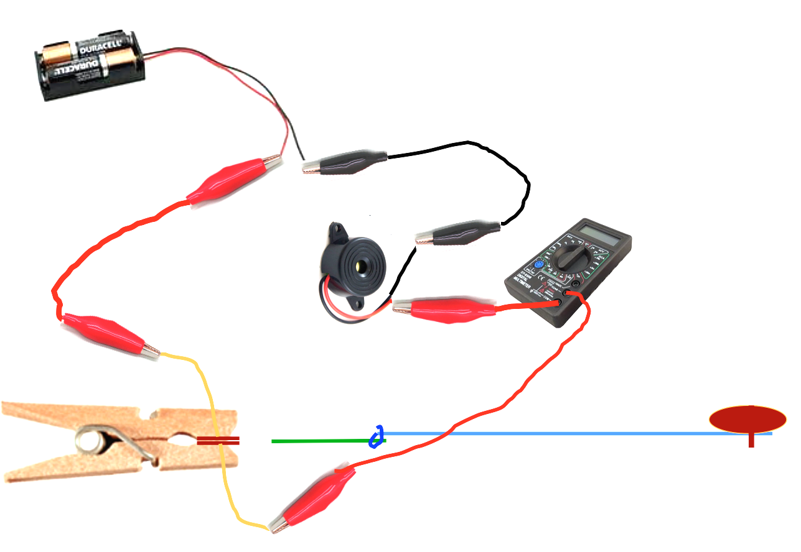
Pull out the plastic so the
buzzer sounds
Select 10 A DC
on the Multimeter
Measure the current
through the buzzer

Slide 18
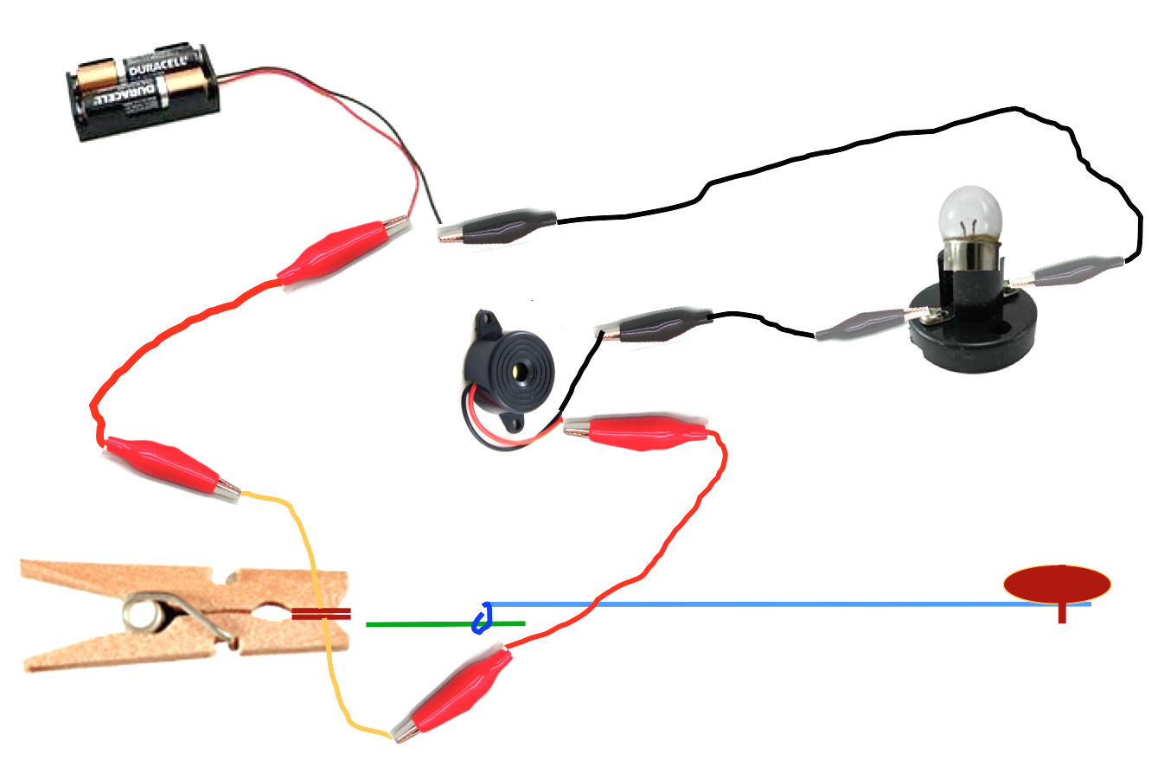
Now connect the lamp in
“series” with the buzzer
Pin To
Wood
Cotton
The lamp hardly lights and the buzzer is very quiet
because the 3V is shared 1½V each

Slide 19
Now connect the lamp in
“series” with the buzzer
So you now know what
“Connect In Series” means
Pin To
Wood
Cotton
The lamp hardly lights and the buzzer is very quiet
because the 3V is shared 1½V each

Slide 20
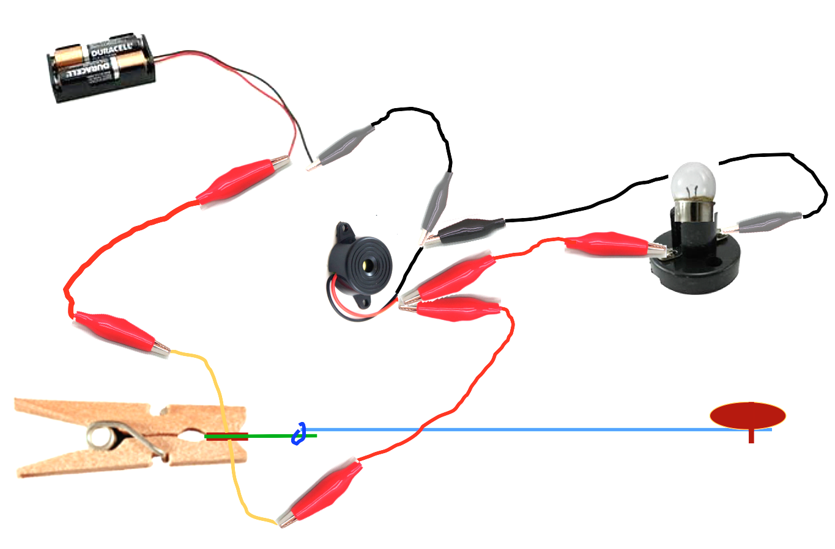
Now connect the lamp in
“parallel” with the buzzer
Pin To
Wood
Cotton
The lamp lights properly and the buzzer is noisy
because the 3V is across each

Slide 21
Now connect the lamp in
“parallel” with the buzzer
So you now know what
“Connect In Parallel”
means
Pin To
Wood
Cotton
The lamp lights properly and the buzzer is noisy
because the 3V is across each

Slide 22
Now connect the lamp in
“parallel” with the buzzer
Measure the new voltage across the buzzer
and the lamp
And then the current
through them
Pin To
Wood
Cotton
The lamp lights properly and the buzzer is noisy
because the 3V is across each

Slide 23


More Switch Ideas
Pressure Mat
Material
Representing a Mat
Aluminium
Foil
Cardboard
Stick Together Carefully
So Air Is Trapped Inside
30 cm or more
Stretch the Top
And Bottom So They
Do Not Touch
Make Two
Make Two
Cut Out The Middle
When
Stepped On Makes the Circuit
Stick Each Set Together
Carefully
Connect Circuit To Aluminium Foil

Slide 24
We have learnt to:
Work and think as engineers
Understand Basic Electric Circuits
Build with the resources available
Work in teams

Slide 26

Thank You

Slide 28
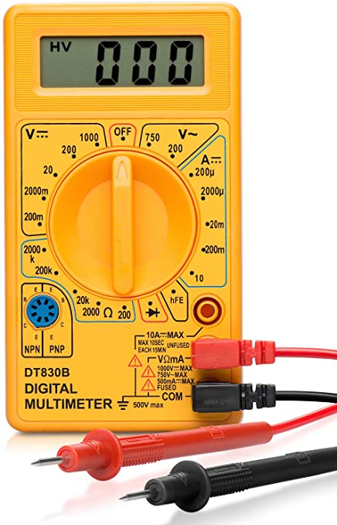
Ensure batteries are disconnected when not in use
Ensure multimeter is turned off when on in use

Slide 29
Circuit 1
Circuit 2
Circuit 3
-
-
Lamp
-
Battery
Battery
Battery
+
+
+
Switch
Switch
Switch
Buzzer
Buzzer
Buzzer
Circuit 1
+ goes to long lead on the buzzer.
Measure the Voltages.
Circuit 2 has the lamp in SERIES with the buzzer.
Is there a problem?
Measure the Voltages.
Circuit 3 has the lamp in PARALLEL with the buzzer.
Measure the Voltages.
Please provide copies for each child to take home

