Slide 1

Welcome
These challenges were developed by Derrick Willer MBE and colleagues.
They are free to download and use in an education environment.
Please ensure that there is adult supervision, complete adherence to Health and Safety, and adequate PPE.
Derrick is a STEM Ambassador and volunteer Liaison Officer for Schools.
He has supported education in schools and colleges for over 30 years, initially as a Neighbourhood Engineer in the 1980’s, leading the local Year of Engineering Success campaign in 1996 and the Campaign to Promote Engineering from 1997 to 2004.
He was awarded an MBE for services to Education in 2018.

Slide 2
Guide
This activity is for pupils to make a rotating table with lights.
Risks
Mandatory: close supervision by a competent adult
lectriciy | Risk | Avoidance Action
Electricity | Injury | Low voltage batteries, close supervision
Tools | Injury | Close supervision, Wear protective glasses
Glue | Damage to Clothing Injury | Close supervision, sponge and water. If glue is ingested rinse moth with water and give water to drink.
Fire | Injury | Adult supervision especially when lighting the candles
Aggression between pupils | Injury | Close supervision and immediate action to defuse aggression

Slide 3


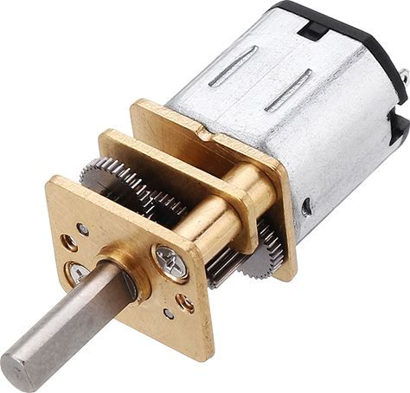
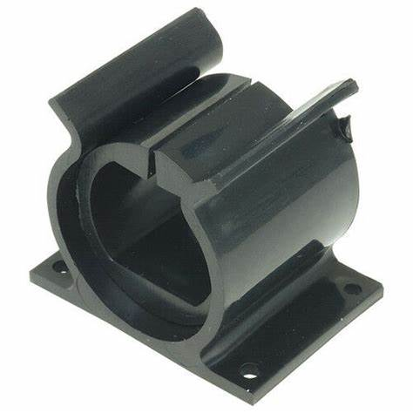
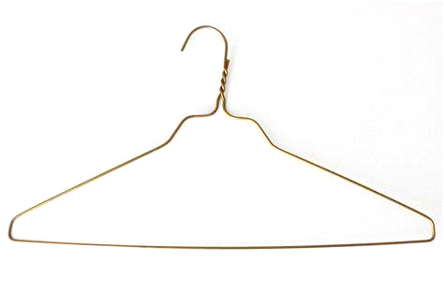
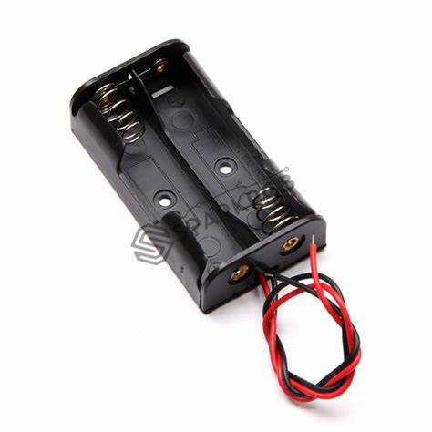

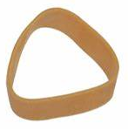
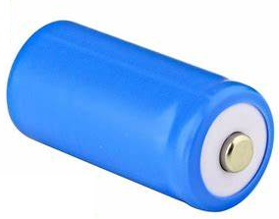
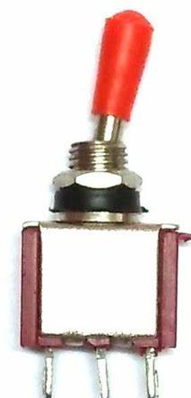
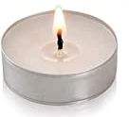
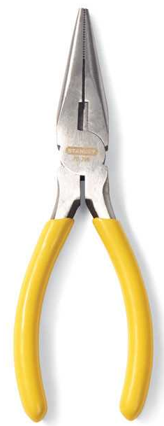
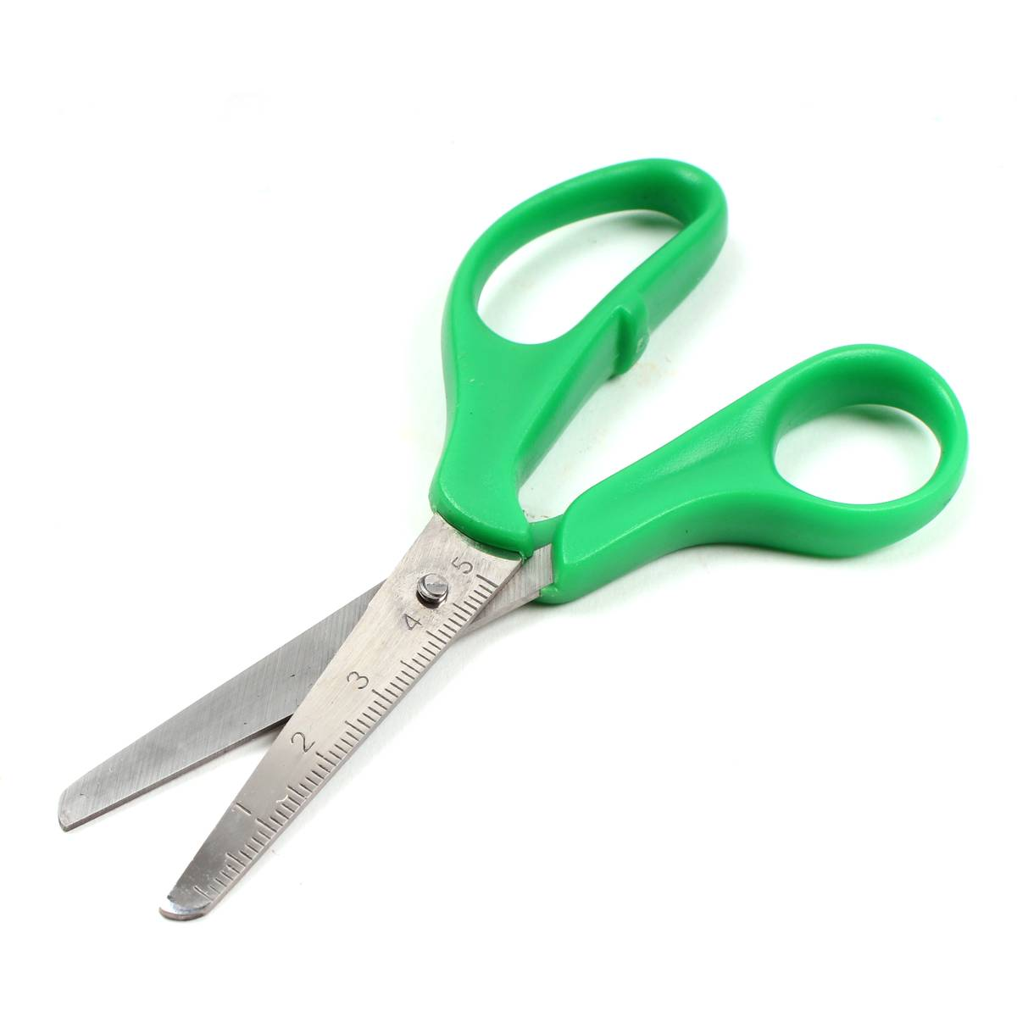
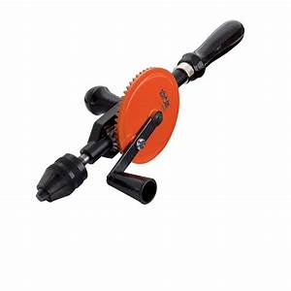
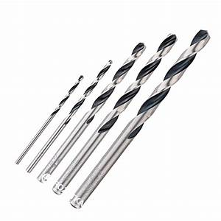
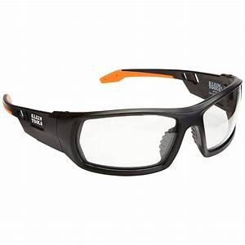
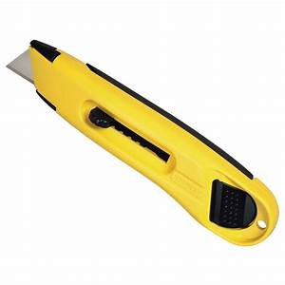
What you need
Hardboard
0.5cm diam. dowel 1m50cm long
and 2.5cm diam. dowel 90cm long
Thick card (e.g. 200gsm)
Geared motor and holder
Aluminium foil
Coat hanger
3 elastic bands
1.5 V batteries and holder
Seven candle lights Switch
Glue and tools including safety glasses

Slide 4


Make the rotating trays
Using the hardboard
Draw two circles 33cm and 40 cm diameter
Cut them out with the hacksaw
Mark the exact centre
Drill a 0.5cm hole in the exact centre of the larger circle and a 6cm hole in the other
Cut a length of 0.5cm dowel 10cm long to support them but keep for later
33cm
40cm
10cm

Slide 5

Make the motor mounting
Cut several thicknesses of the hardboard 5cm x 2cm to mount the motor exactly 1.5cm above the smaller wheel
Place the five together and onto the smaller wheel 5cm from the edge but do not glue
Glue the 3cm long dowel into the hole in the smaller circle so it does not protrude below the circle
5cm x 2cm pieces
10cm
5cm

Slide 6
Make the motor mounting
Measure the diameter of the motor spindle
Cut a 0.5cm diam. 0.5cm thick circle from the smaller dowel to make a wheel
Drill a hole in the exact centre of this to fit the motor spindle
Cut two 1cm diam. Circles from the card and glue them to the wheel, make the hole again.
Fit to the motor spindle but do not glue it
.

Slide 7
Make the motor mounting
Remove the 0.5cm diam. wheel from the spindle
Cut an axle from the coat hanger 7cm long
Cut three 0.5cm thickness from the larger dowel
Cut two circles from the hardboard 2cm diam.
Glue to the centre of the two wheels
Drill a hole just larger than the diameter of the axle in the exact centre
2.5cm
2cm

Slide 8
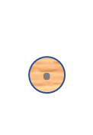
The Wheels
Make the motor mounting
.
.
.
Cut two sections of hardboard 5cm x 5cm and drill a hole the same size as the axle in the centre – see the blue shapes
Align these to the motor assembly front and back
Judge exactly where to drill two holes for the motor spindle and the axle for the 2.5cm wheels
Fit the blue shapes to stop the axle moving and glue them to the axle
Motor Position
Drive Wheel and Axle Position

Slide 9
Make the motor assembly
.
.
When you are sure of the positioning glue all the items in place
Wrap an elastic band round the motor spindle wheel and a 2cm wheel so it is tight
Wrap the three other elastic bands round the two 2.5cm wheels on top of one another and glue them to the wheel
This wheel is now larger than the wheel driven by the other elastic band
.
.

Slide 10
Make the rotating top tray
30^{O}
There are twelve years in the Chinese calendar
Measure the twelve position equally spaced around the edge of the wheel
Use 30^{O} apart using a protractor
Drill a 0.5 cm hole exactly 1cm. from the edge at the twelve places
Glue twelve 10cm dowels into the holes

Slide 11

Make the rotating top tray
Cut 13 0,5 cm. lengths from the 2.5cm diam. dowel (keep one for later)
Drill a 0.5cm hole at the exact centre of each
Cut 12 lengths of 33cm, 1cm wide from the aluminium foil
Glue one side and fold into four equal lengths 8.25cm long
Glue these to the edge of the 2.5cm dowels level with the bottom of the dowel
Glue the 2.5cm dowls to the top of the 0.5cm dowels

Slide 12

Test the wheel rotates
Connect the motor, switch and batteries
Turn on to check the wheel rotates
If too fast remove one battery and short out its connections so there is only 1.5 volts
If it works get an adult to light the candles

Slide 13








Lastly glue the year symbols to the vertical posts

Slide 14
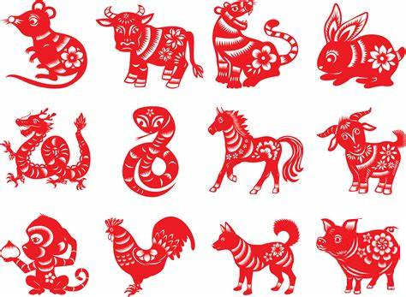
Enjoy the wheel
When the wheel works well
Ask an adult to light the candles
Turn out the room lights
Enjoy The New Year

Slide 15
We have learnt:
- To make a rotating light table
How to connect the circuit
To work like engineers
To have fun while learning
To enjoy Chinese New Year

Slide 16

Well Done

