Slide 1

Welcome
These challenges were developed by Derrick Willer MBE and colleagues.
They are free to download and use in an education environment.
Please ensure that there is adult supervision, complete adherence to Health and Safety, and adequate PPE.
Derrick is a STEM Ambassador and volunteer Liaison Officer for Schools.
He has supported education in schools and colleges for over 30 years, initially as a Neighbourhood Engineer in the 1980’s, leading the local Year of Engineering Success campaign in 1996 and the Campaign to Promote Engineering from 1997 to 2004.
He was awarded an MBE for services to Education in 2018.

Slide 2
Guide
This activity is for pupils to making a car that is driven by compressed air.
Risks
Mandatory: close supervision by a competent adult
Item | Risk | Avoidance Action
Equipment | Misuse, Injury | Close supervision
Aggression between those present | Injury | Close supervision and immediate action to defuse aggression

Slide 3
Welcome
I very much hope that you will enjoy making the car and learn new things

Slide 4
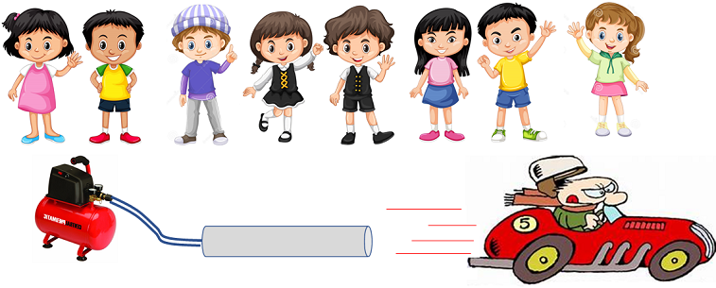
Use compressed air to drive a car made from recycled materials

Slide 5
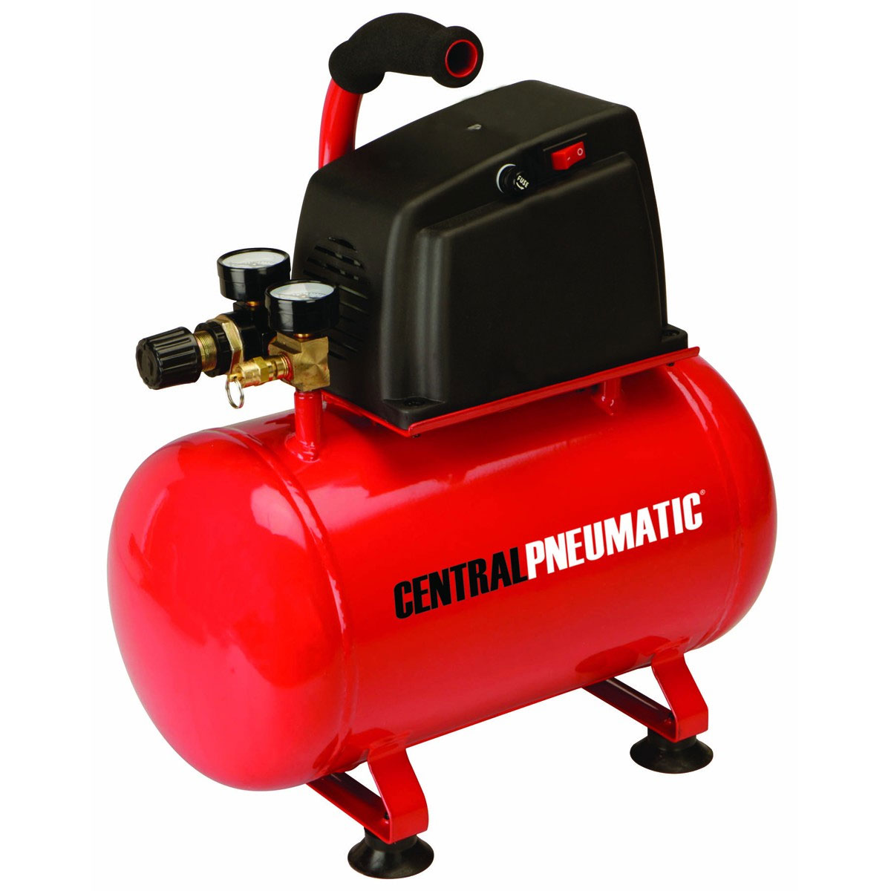
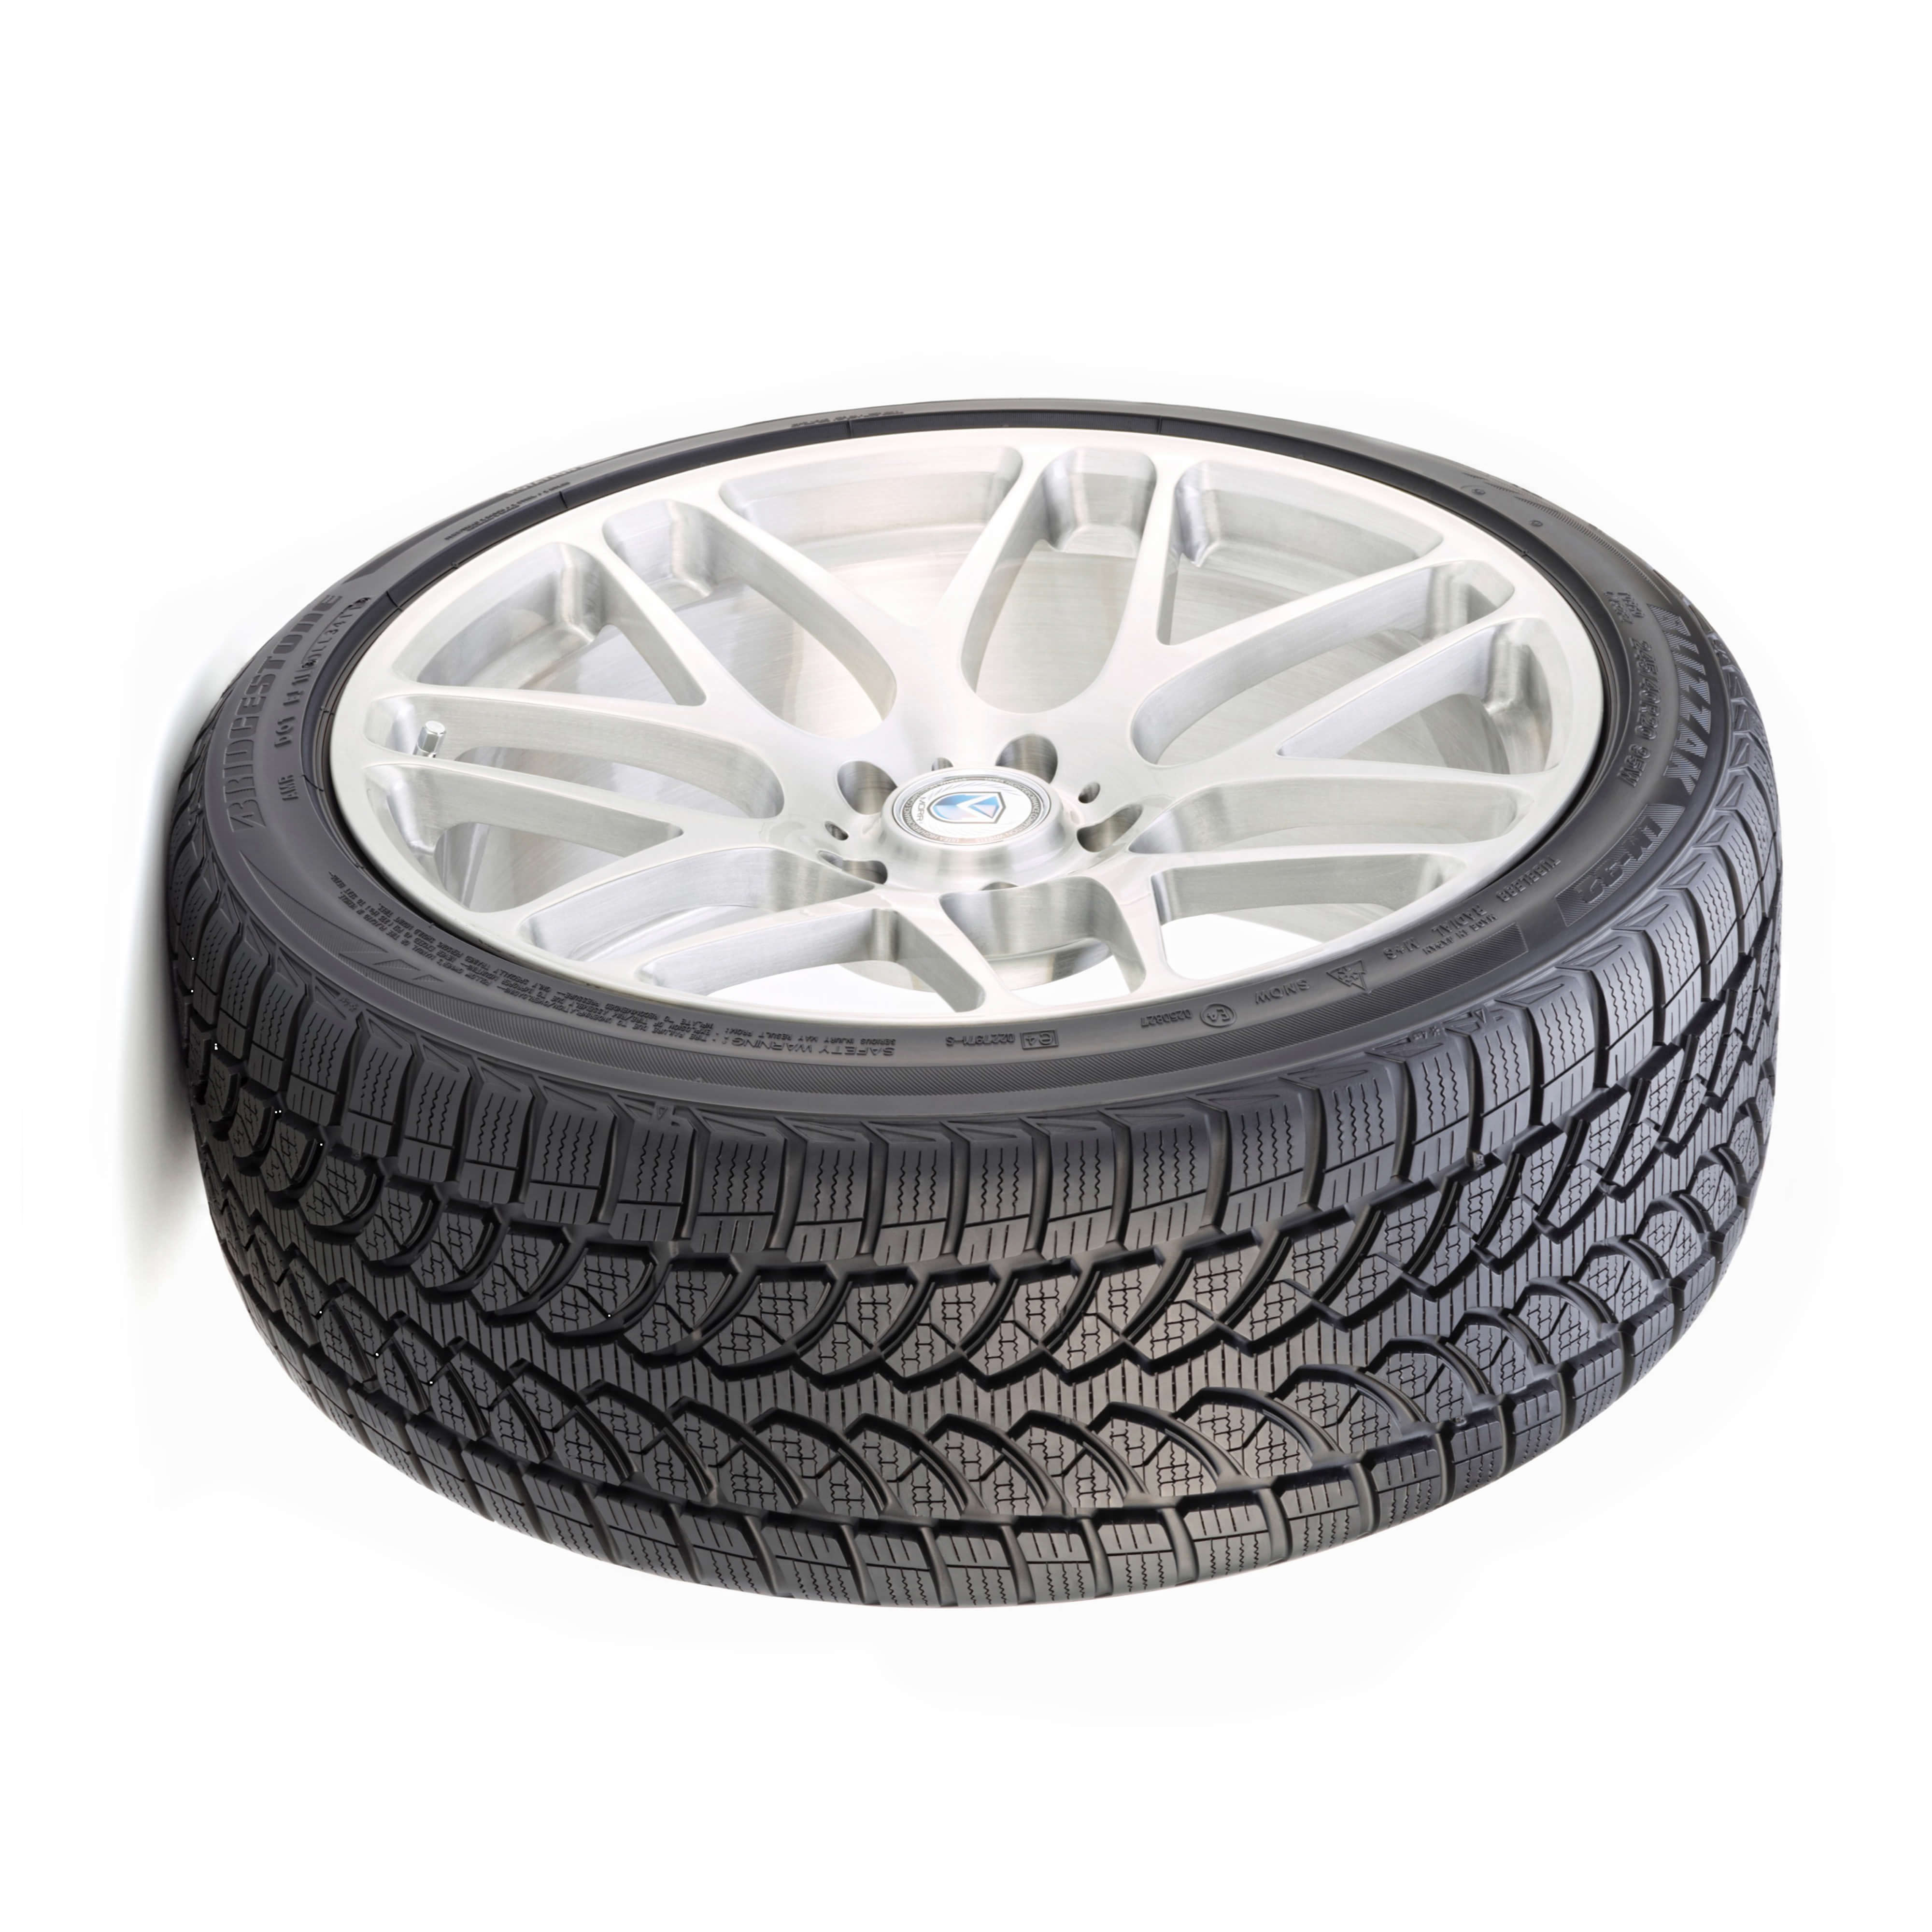
What you need
Compressed Air Supply
Plastic
Tube
About 2cm dia
30 to 50 cm long
Reinforced
Tube
Compressor
or Car Tyre

Slide 6
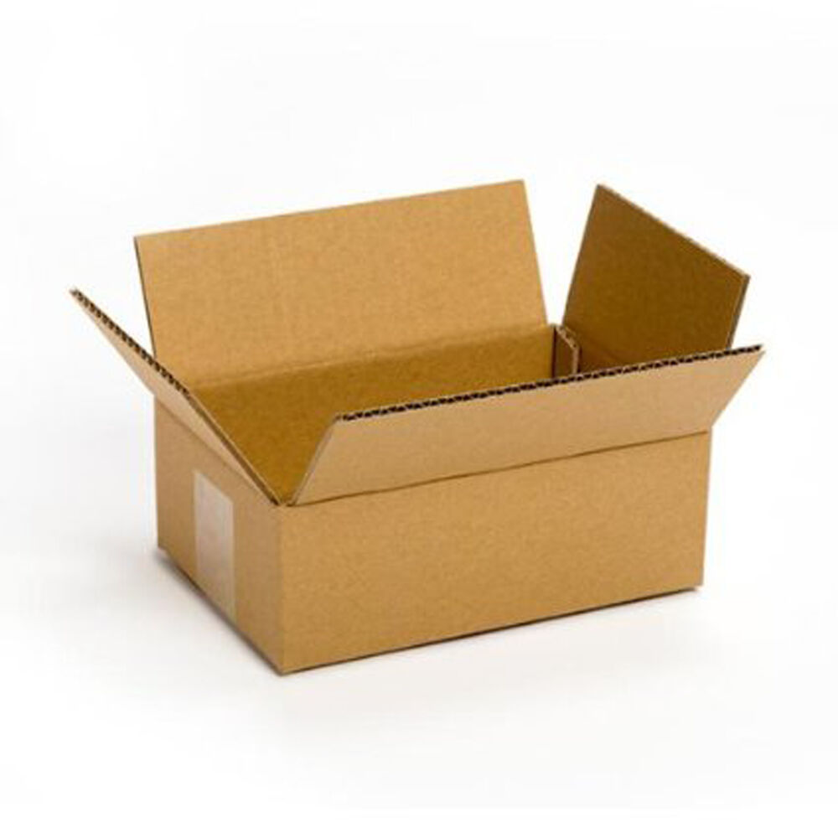
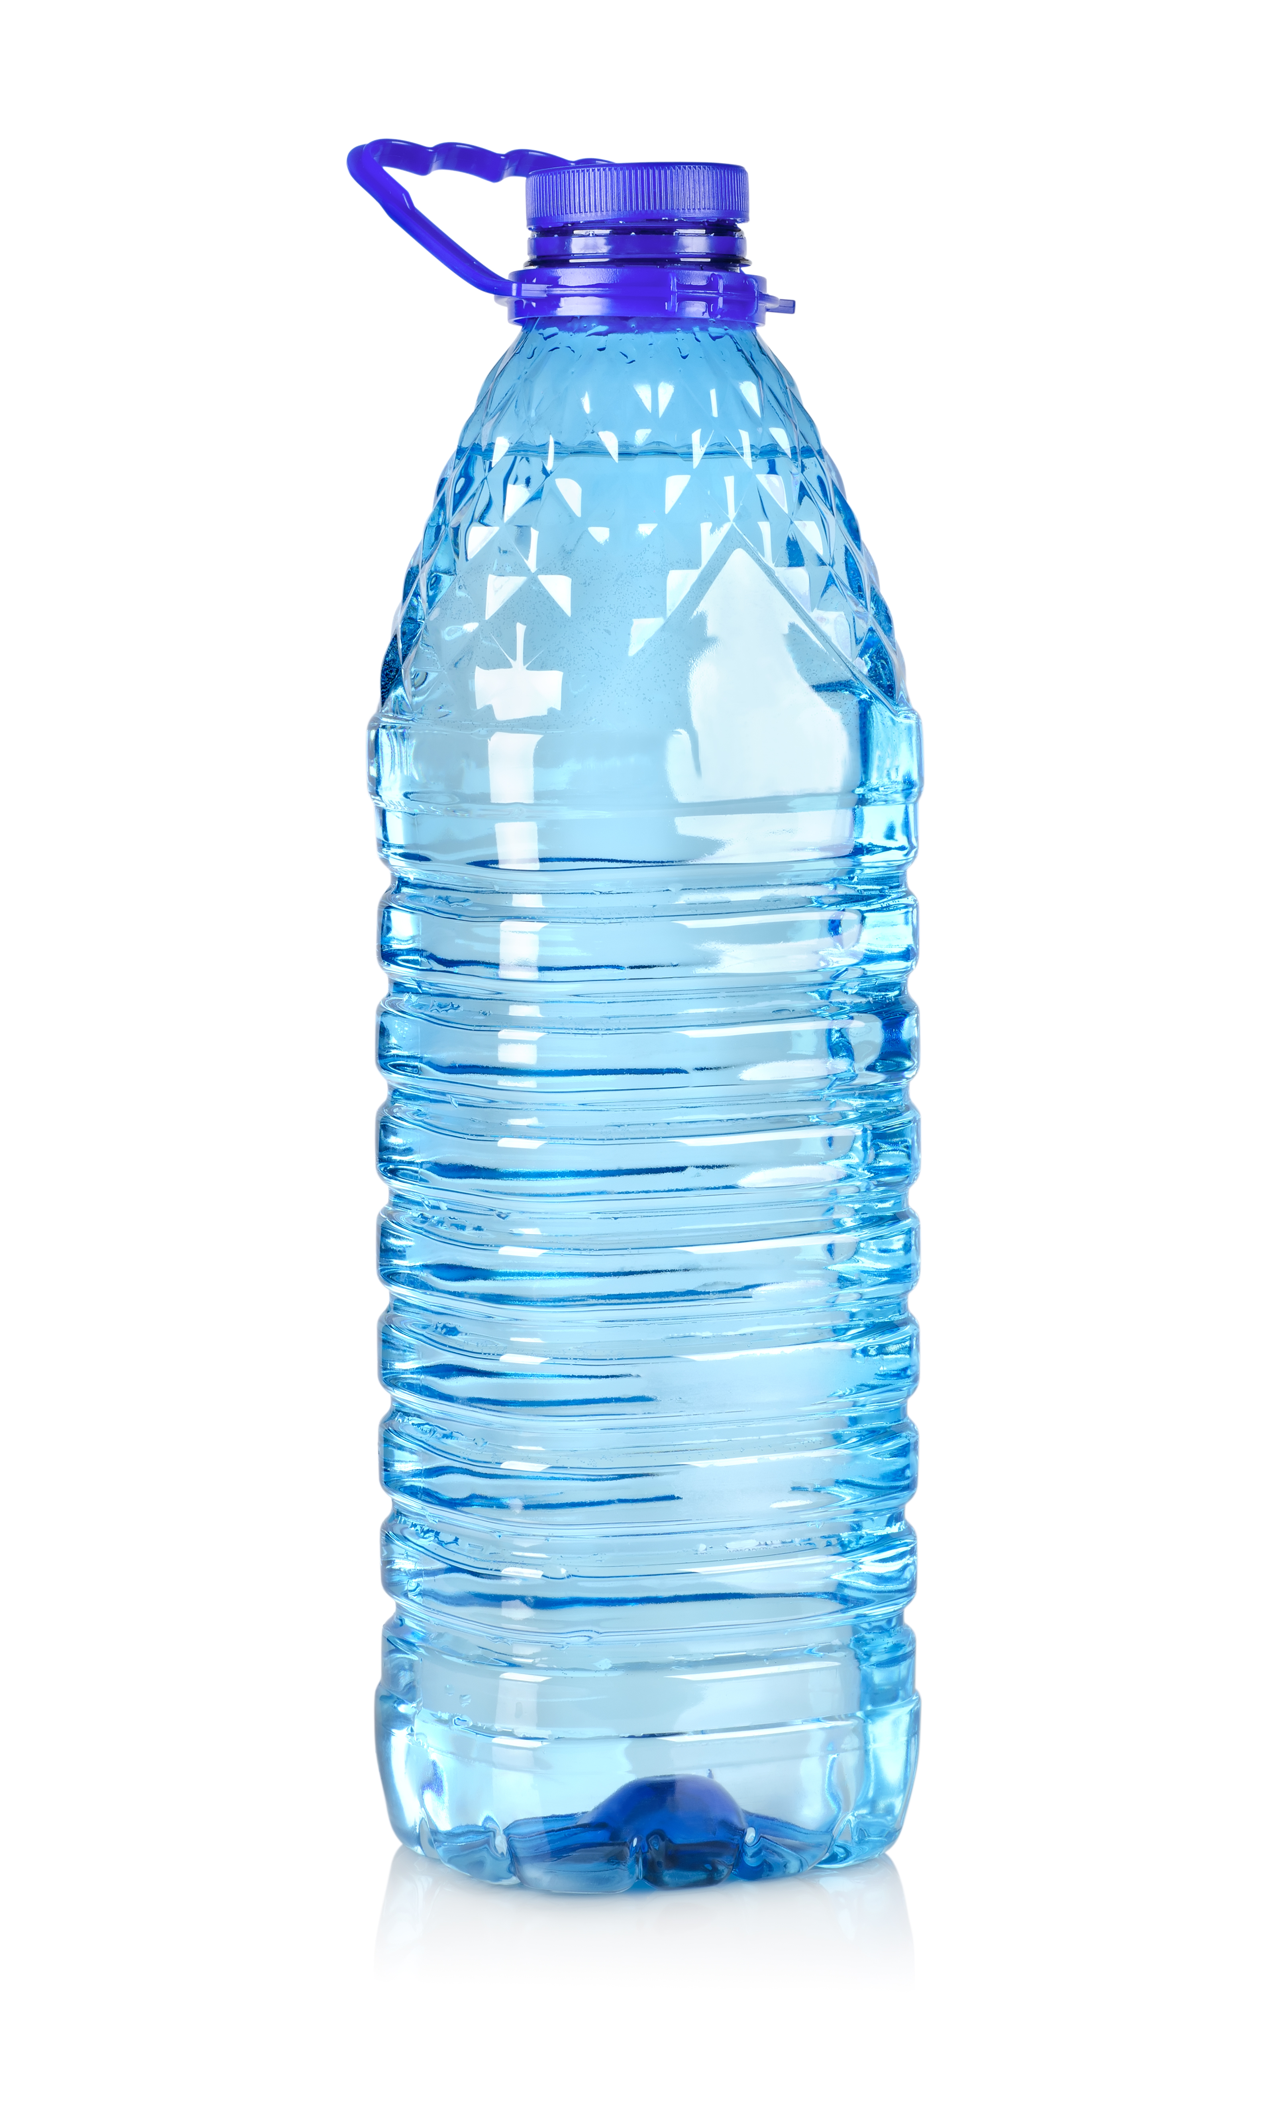
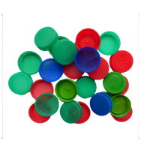


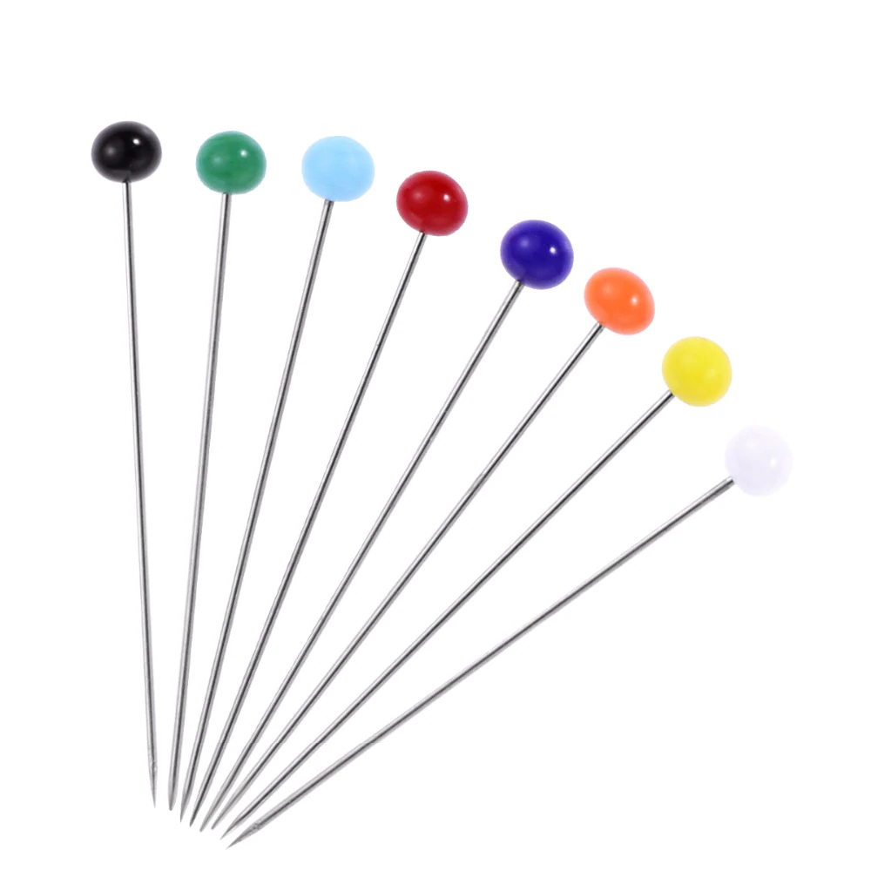
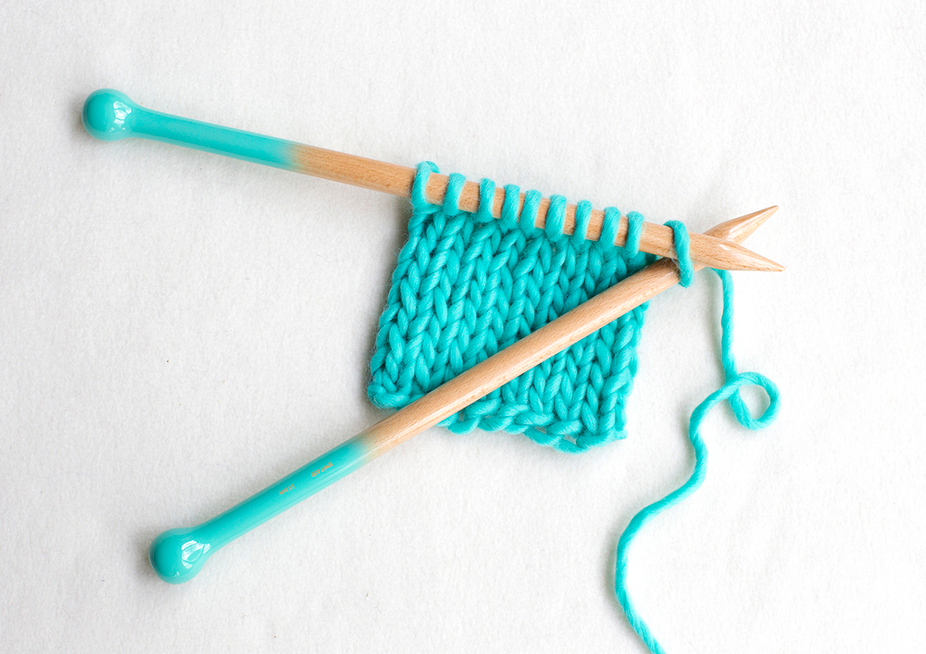
What you need
Recycled Materials
you may need
to make the Car
Plastic
Bottle Tops
Cardboard
Plastic Bottles
Card
Pins or Knitting Needles

Slide 7
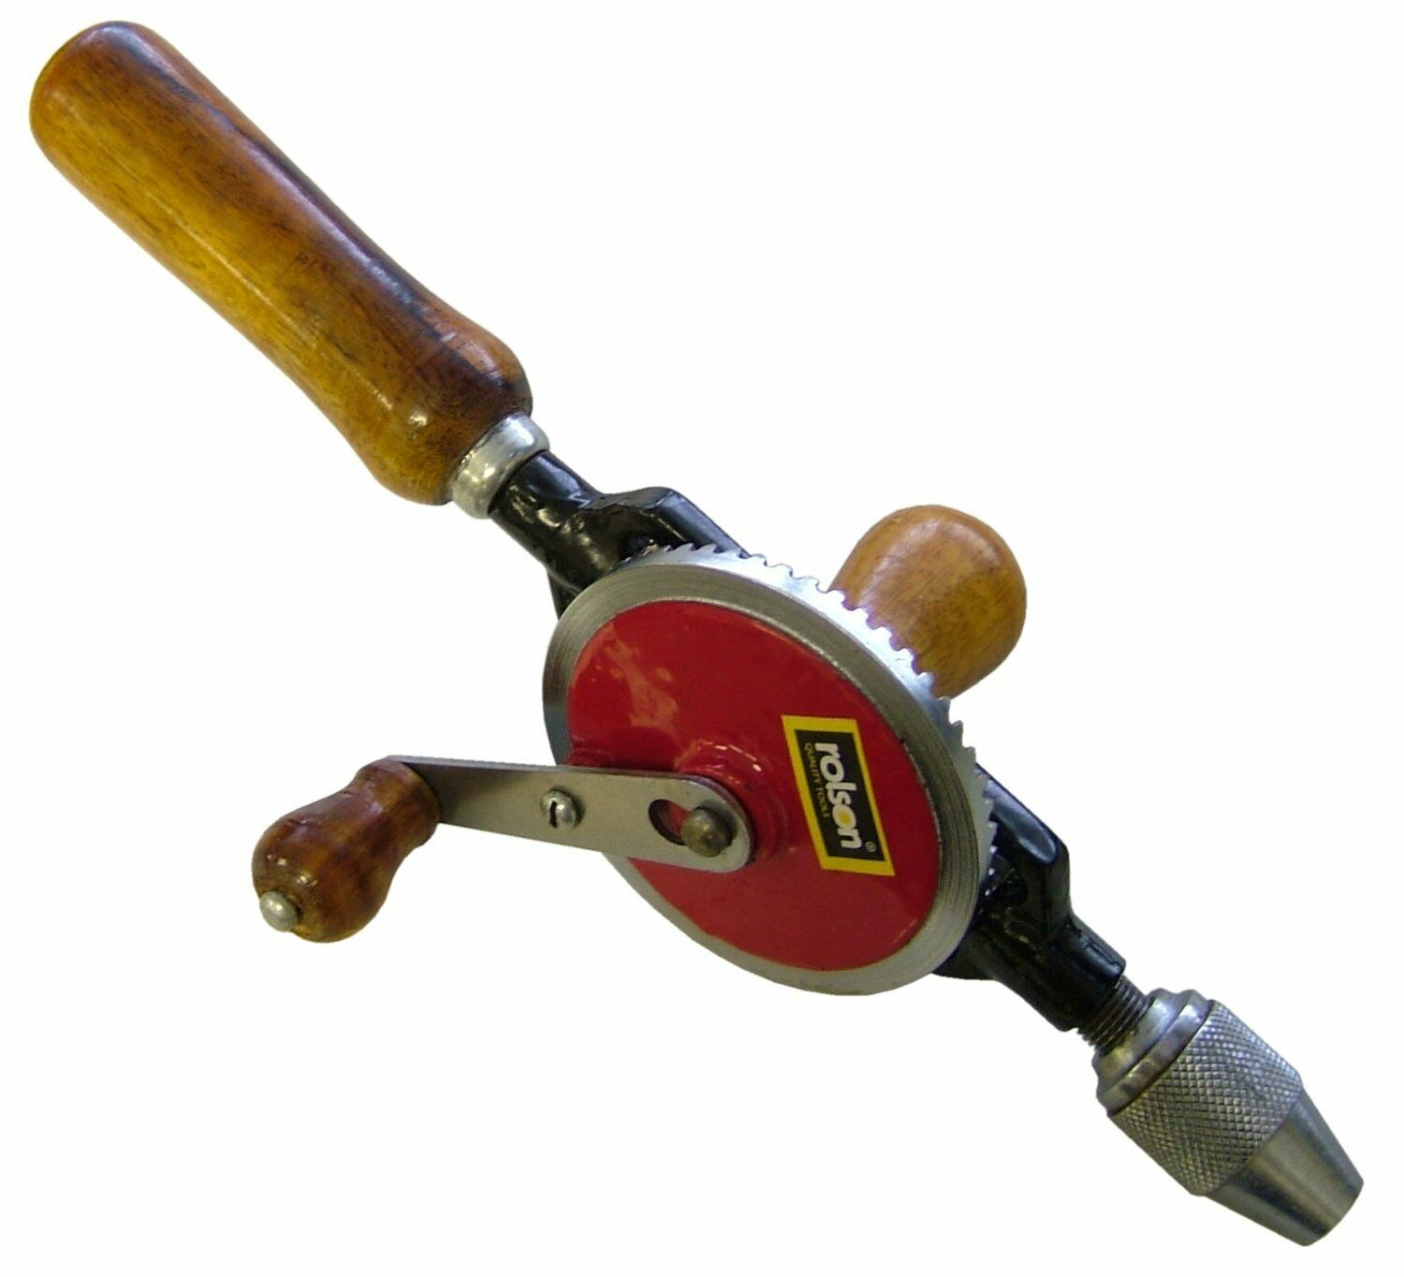
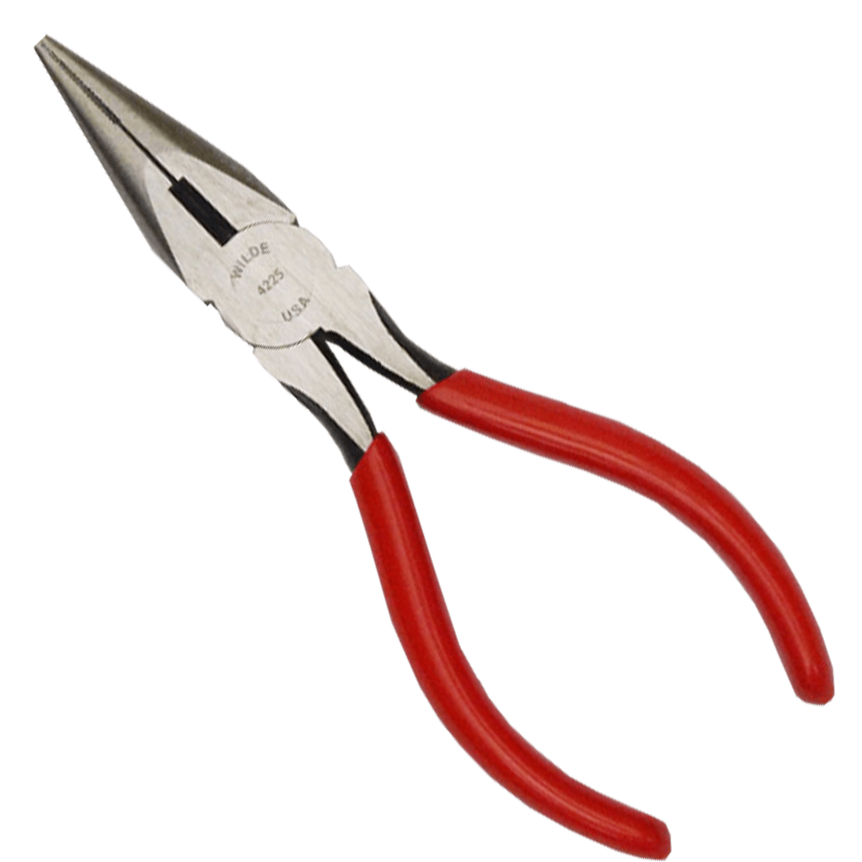
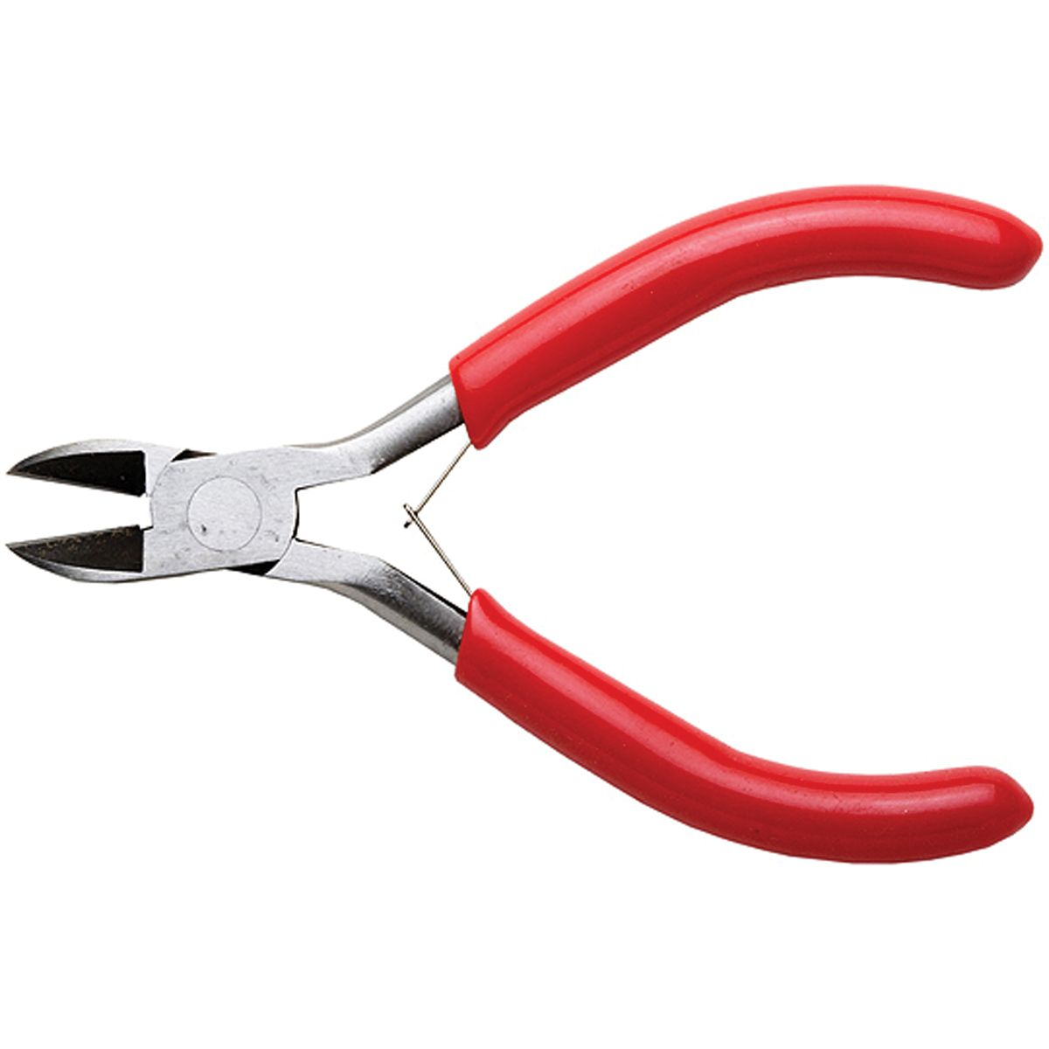
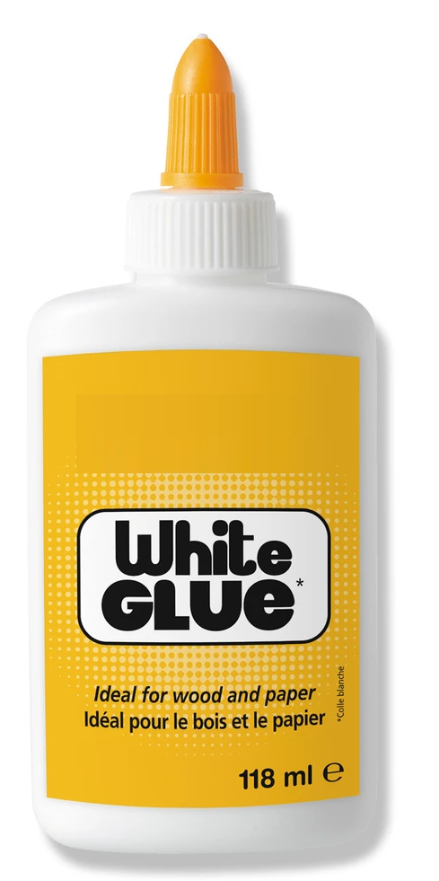
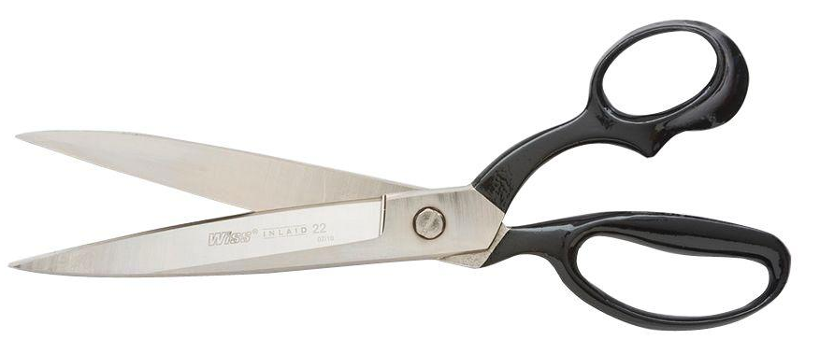
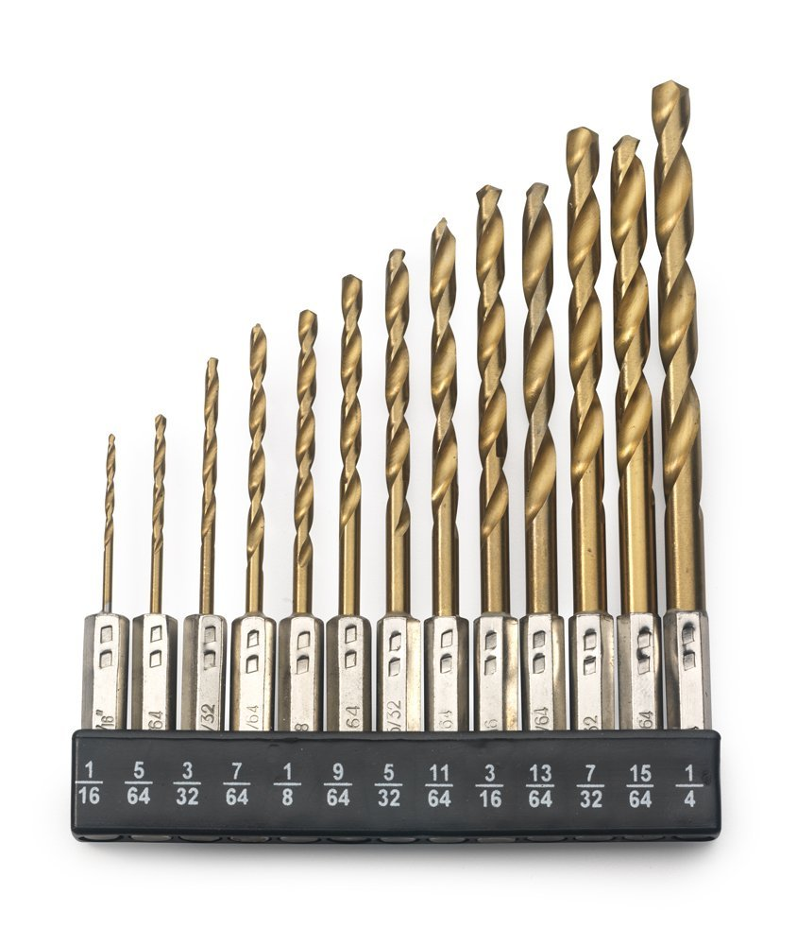
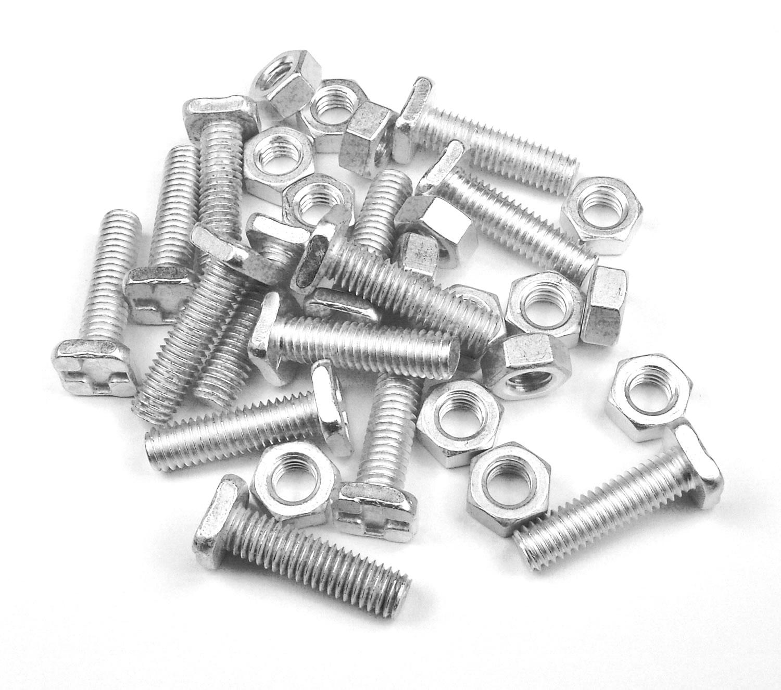
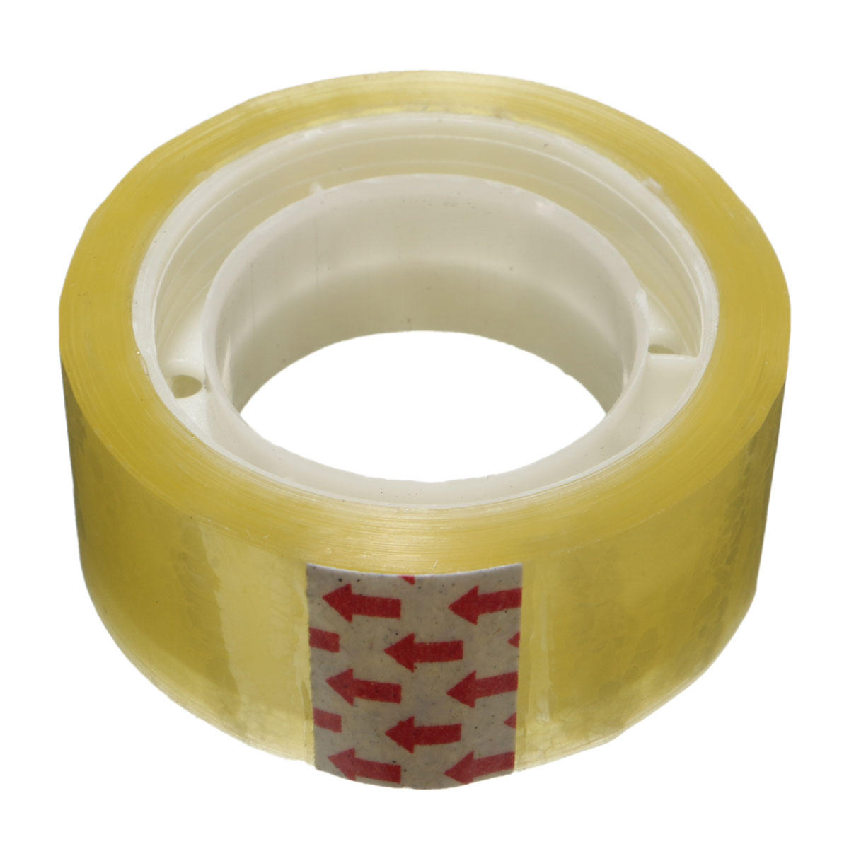
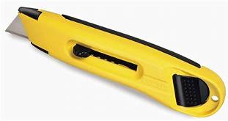
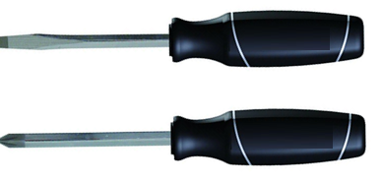
What you need
Scissors
Drill
Pliers
Cutters
Glue
Tools you may need
Sticky
Tape
Drill
Bits
Sharp
Knife
Screw
drivers
Nuts &
Bolts

Slide 8

Now design and make your car
Plastic
Tube
The car must have the cardboard
tube which is used to propel the car
Card
Roll the card around the plastic tube
and glue it to form another tube.
Squash and seal one end

Slide 9
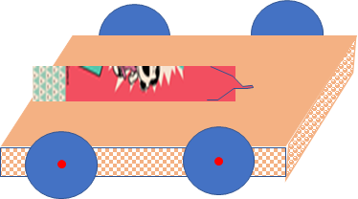
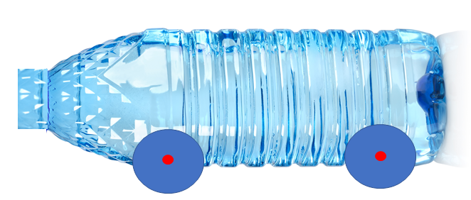
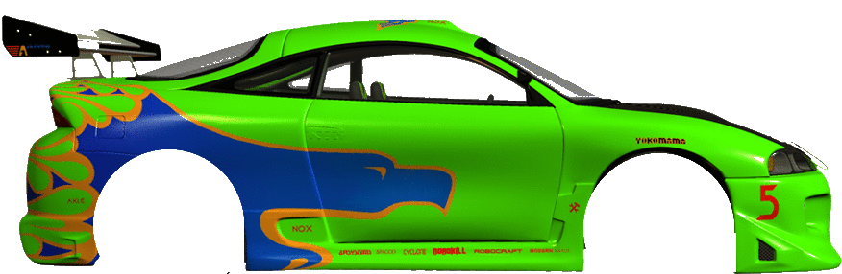

Some ideas
Click on the picture

Slide 10
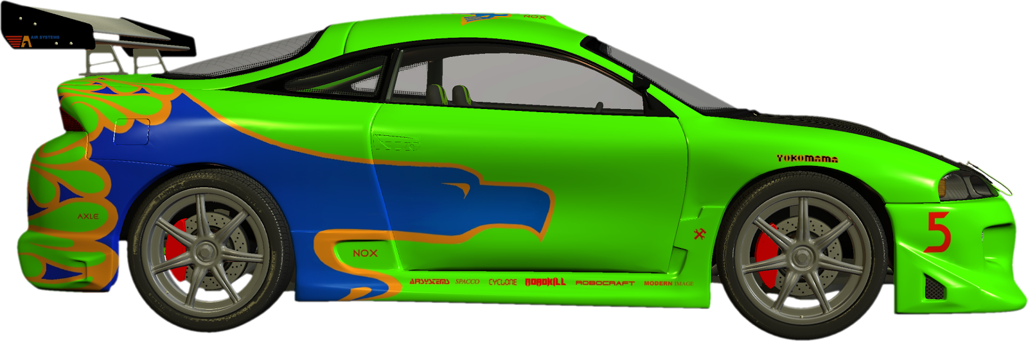
An idea
Car made from coloured/painted card
Glue to Base
Tube made from card for propelling the car
Glue to Base
Base made from Corrugated Cardboard
Bottle Tops Drilled and Pinned to Base

Slide 11

Another idea
Tube made from card for propelling the car
Glue into Bottle
Bottle Tops Drilled and Pinned to Bottle

Slide 12
Now try out your designs to see how far your can can go

Slide 13

Thank You

