Slide 1
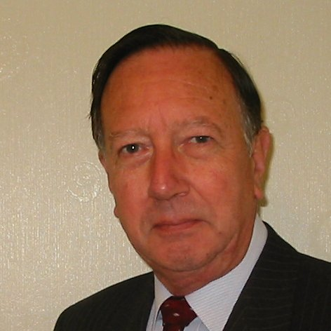
Welcome
These challenges were developed by Derrick Willer MBE and colleagues.
They are free to download and use in an education environment.
Please ensure that there is adult supervision, complete adherence to Health and Safety, and adequate PPE.
Derrick is a STEM Ambassador and volunteer Liaison Officer for Schools.
He has supported education in schools and colleges for over 30 years, initially as a Neighbourhood Engineer in the 1980’s, leading the local Year of Engineering Success campaign in 1996 and the Campaign to Promote Engineering from 1997 to 2004.
He was awarded an MBE for services to Education in 2018.

Slide 2
Guide
This activity is for pupils to make a plane or rocket powered by compressed air
Risks
Mandatory: close supervision by a competent adult
Item | Risk | Avoidance Action
Equipment | Misuse Injury | Close supervision
Aggression between those present | Injury | Close supervision and immediate action to defuse aggression

Slide 3
Welcome
I very much hope that you will enjoy making the ‘plane and learn new things

Slide 4
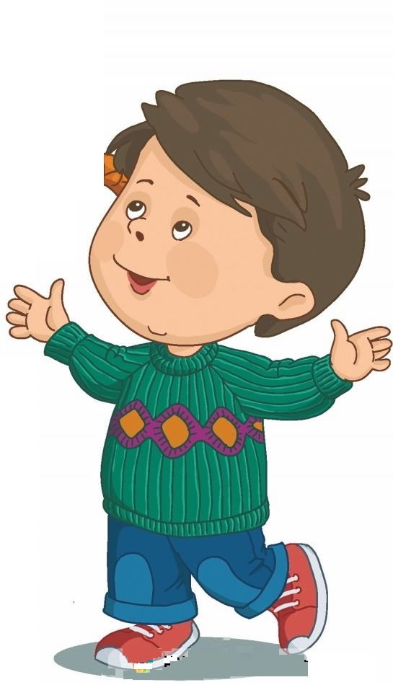
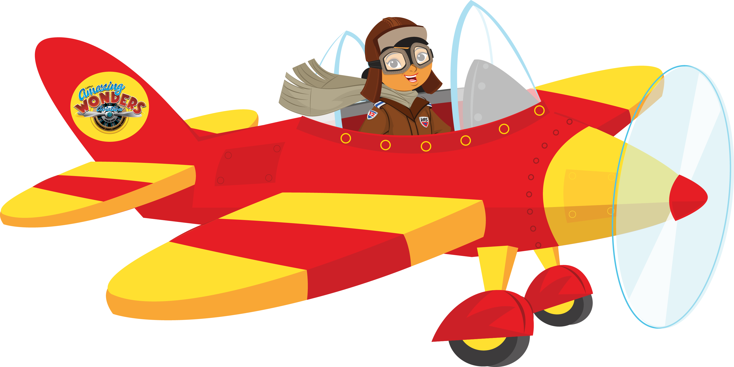


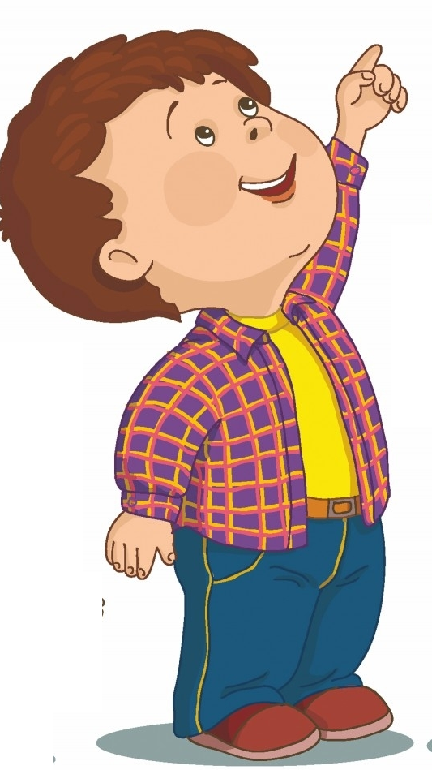
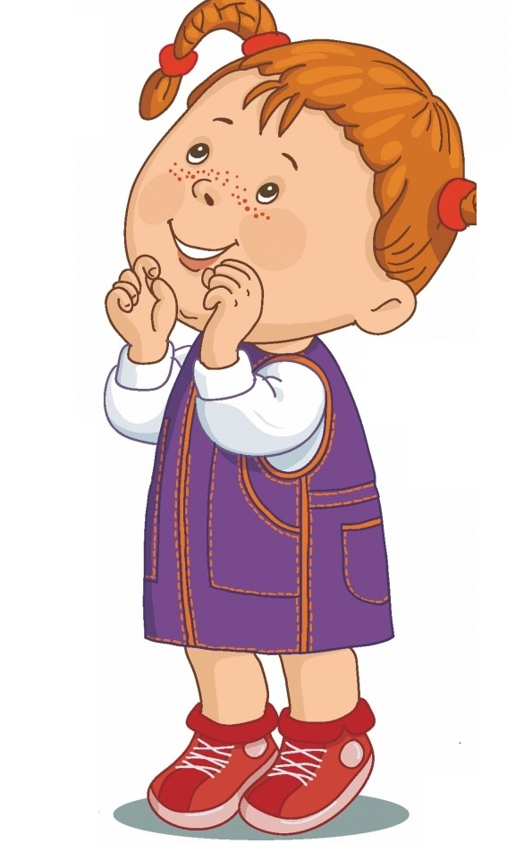
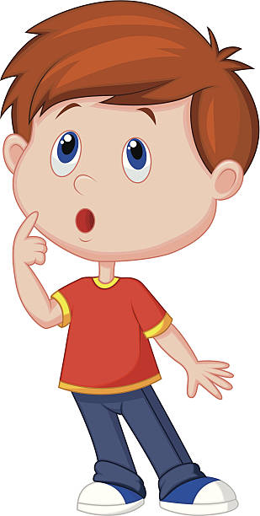
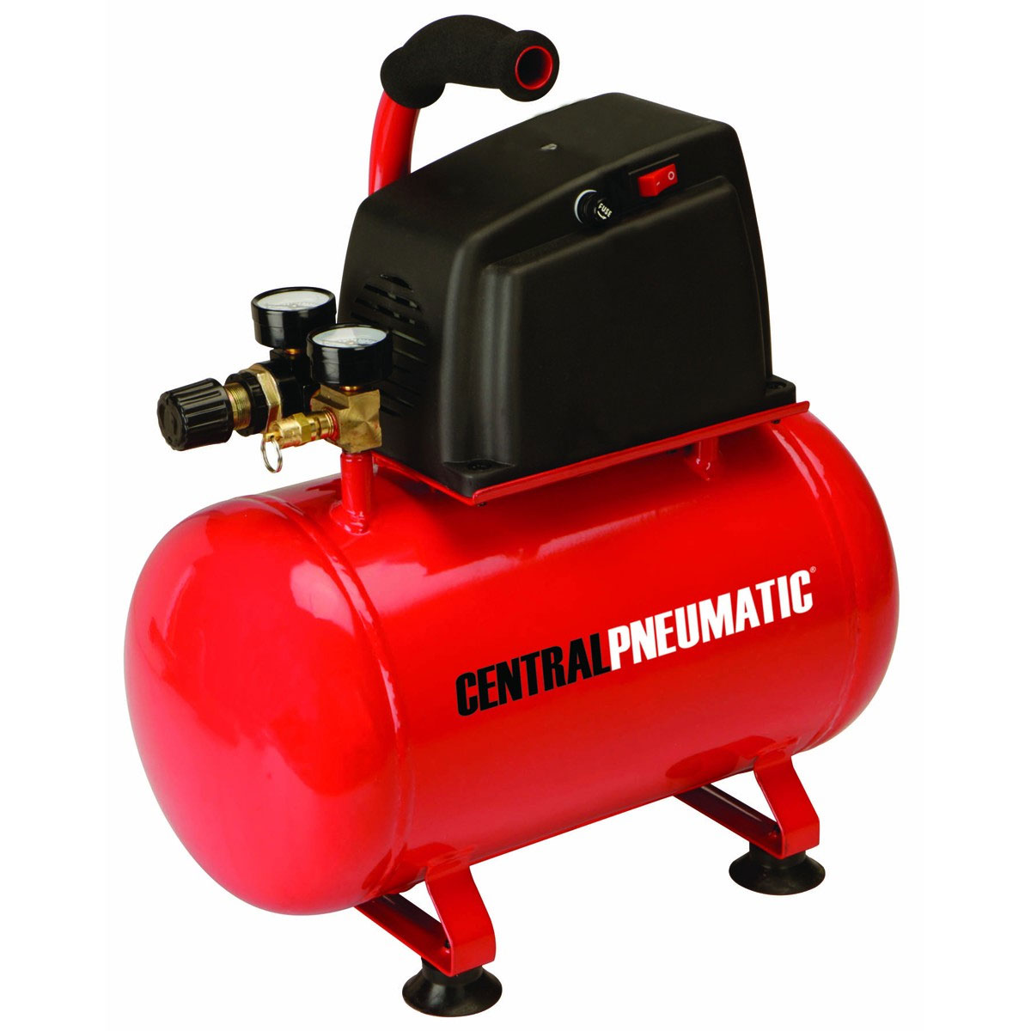
Use compressed air to fly a plane made from recycled materials

Slide 5
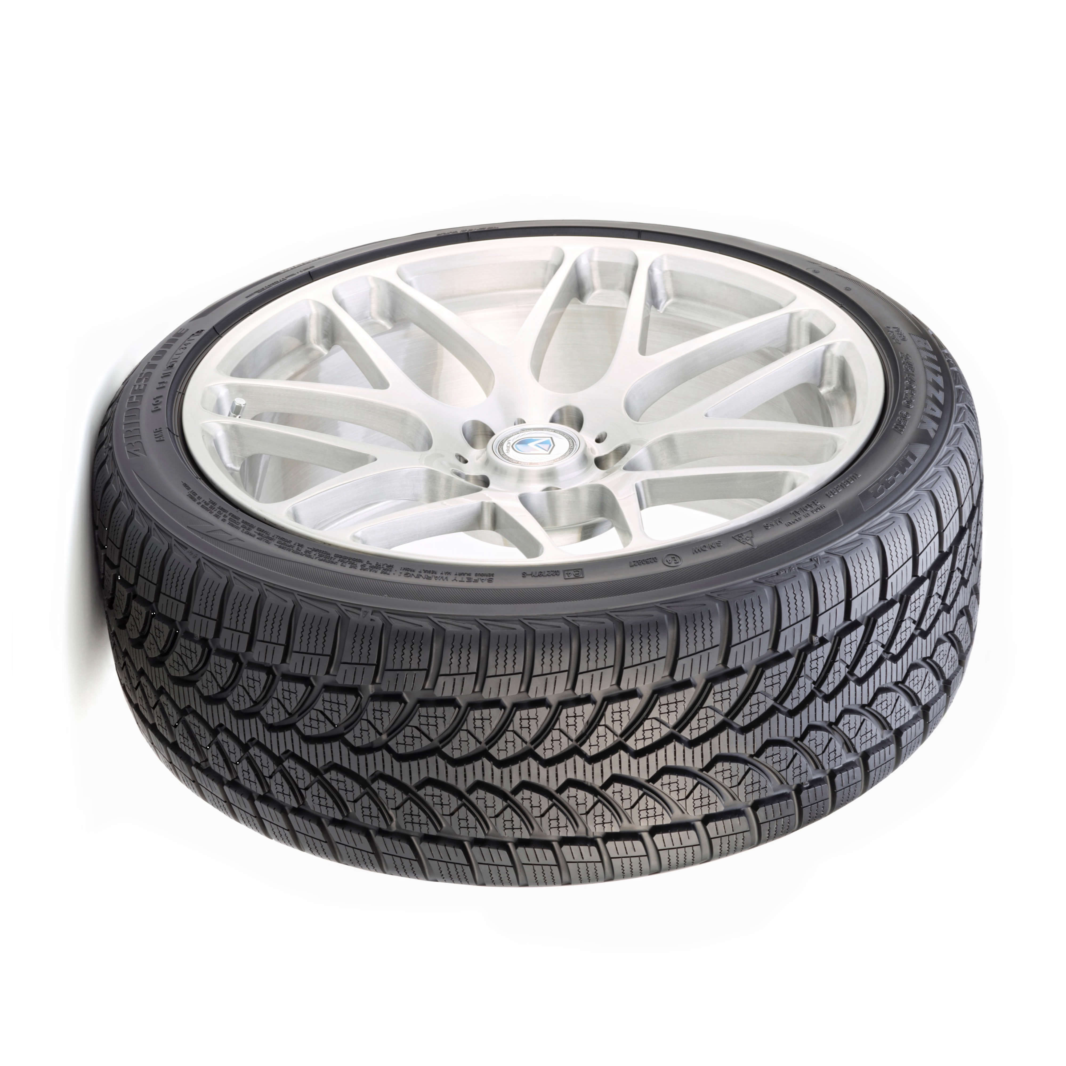
What you need
Compressed Air Supply
Plastic
Tube
About 2cm dia
30 to 50 cm long
Reinforced
Tube
Compressor
or Car Tyre

Slide 6
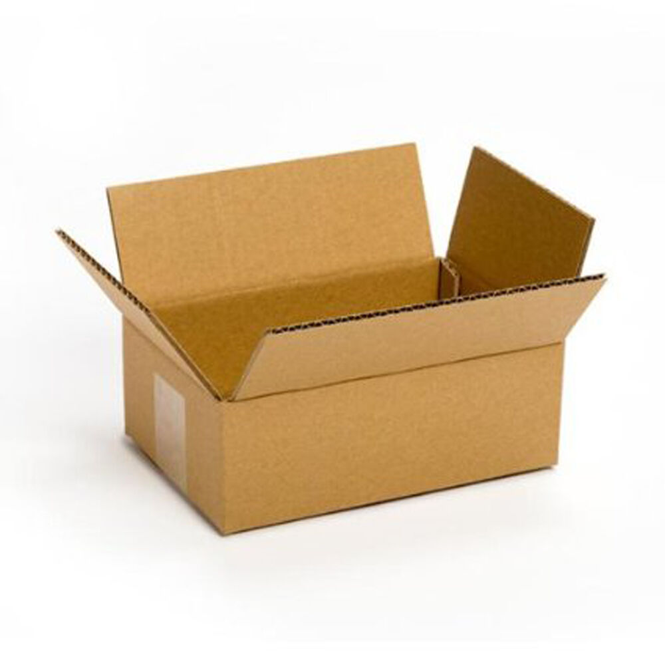
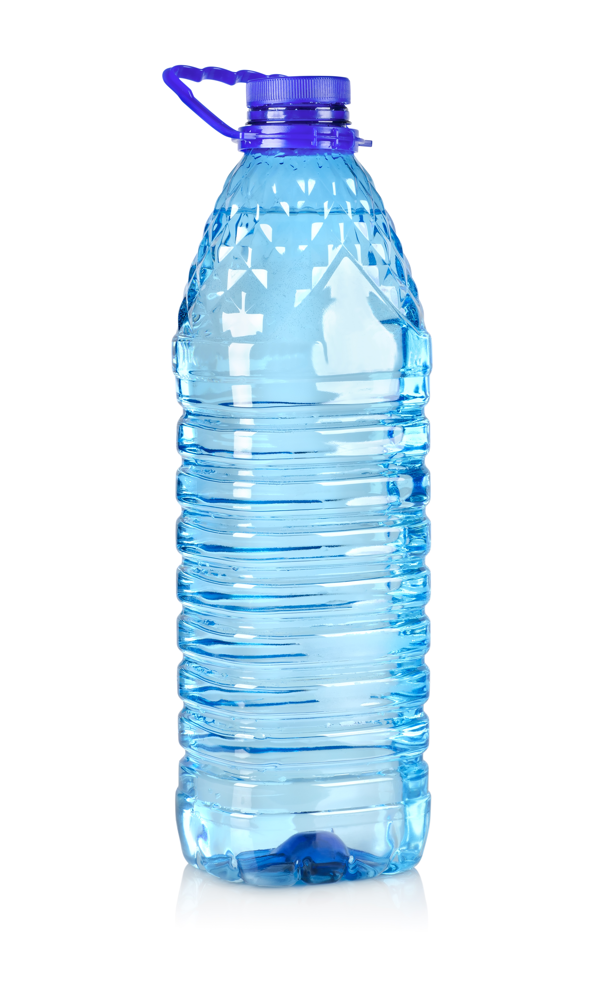

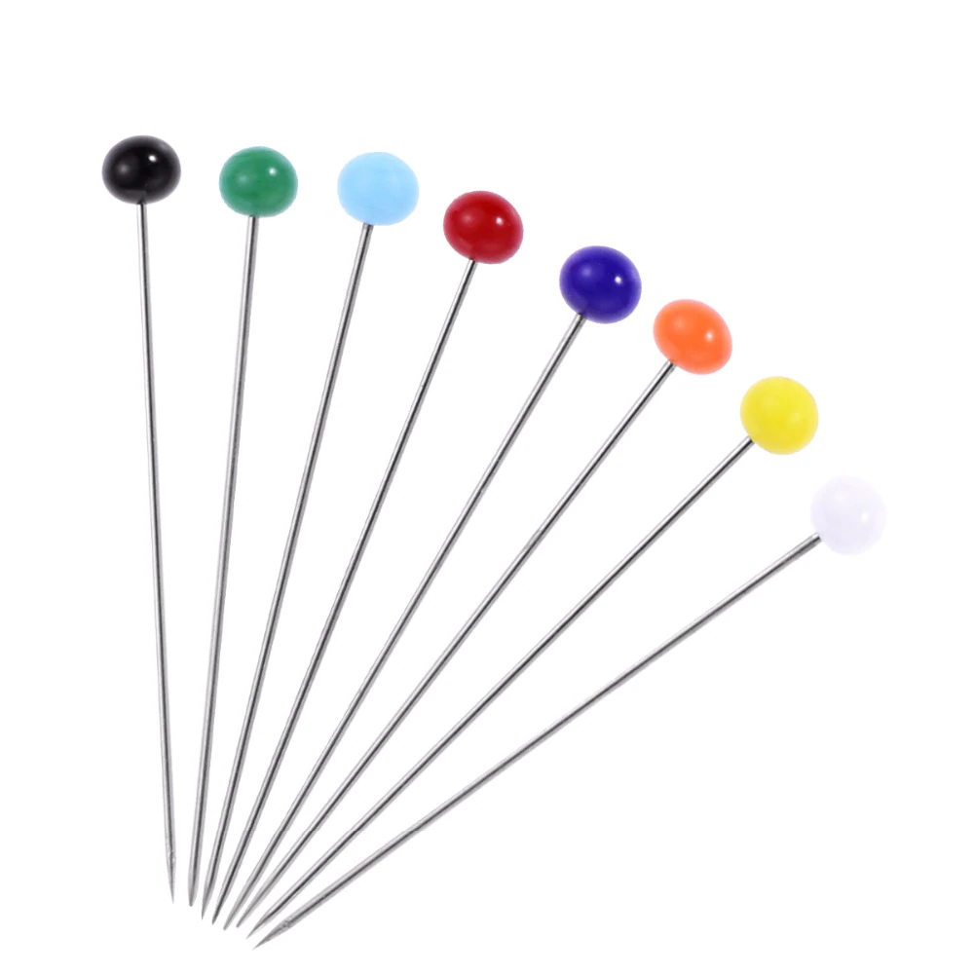
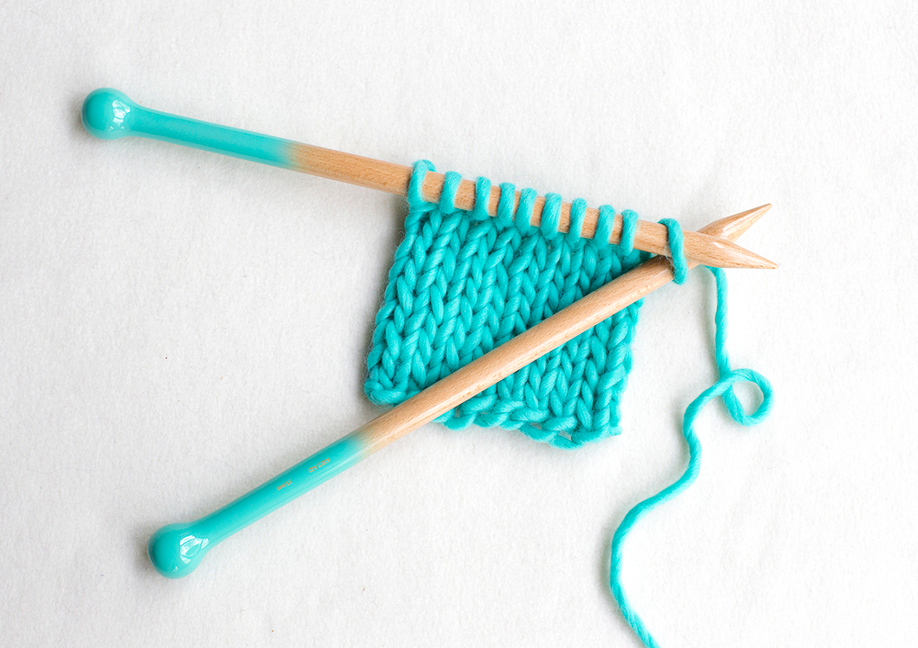
What you need
Recycled Materials
you may need
to make the Plane
Cardboard
Plastic Bottle
Card
Pins or Knitting Needles

Slide 7
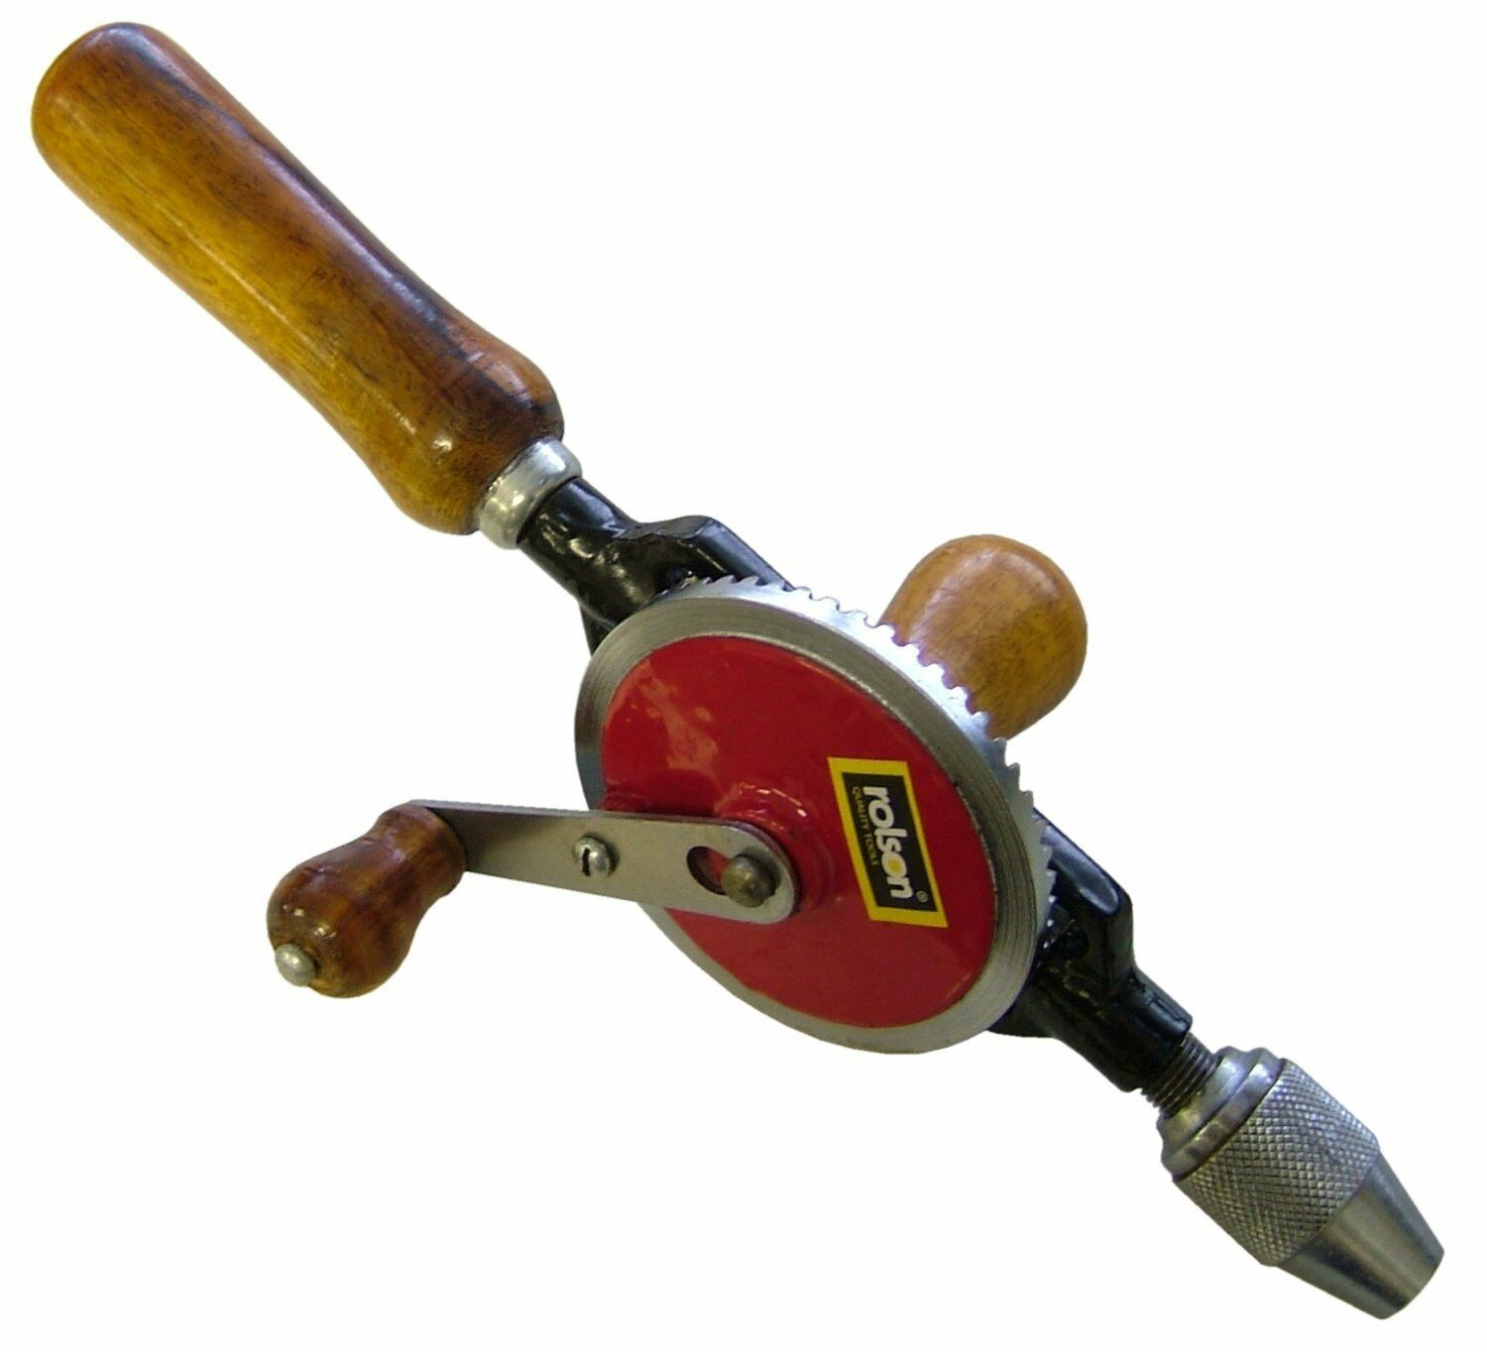
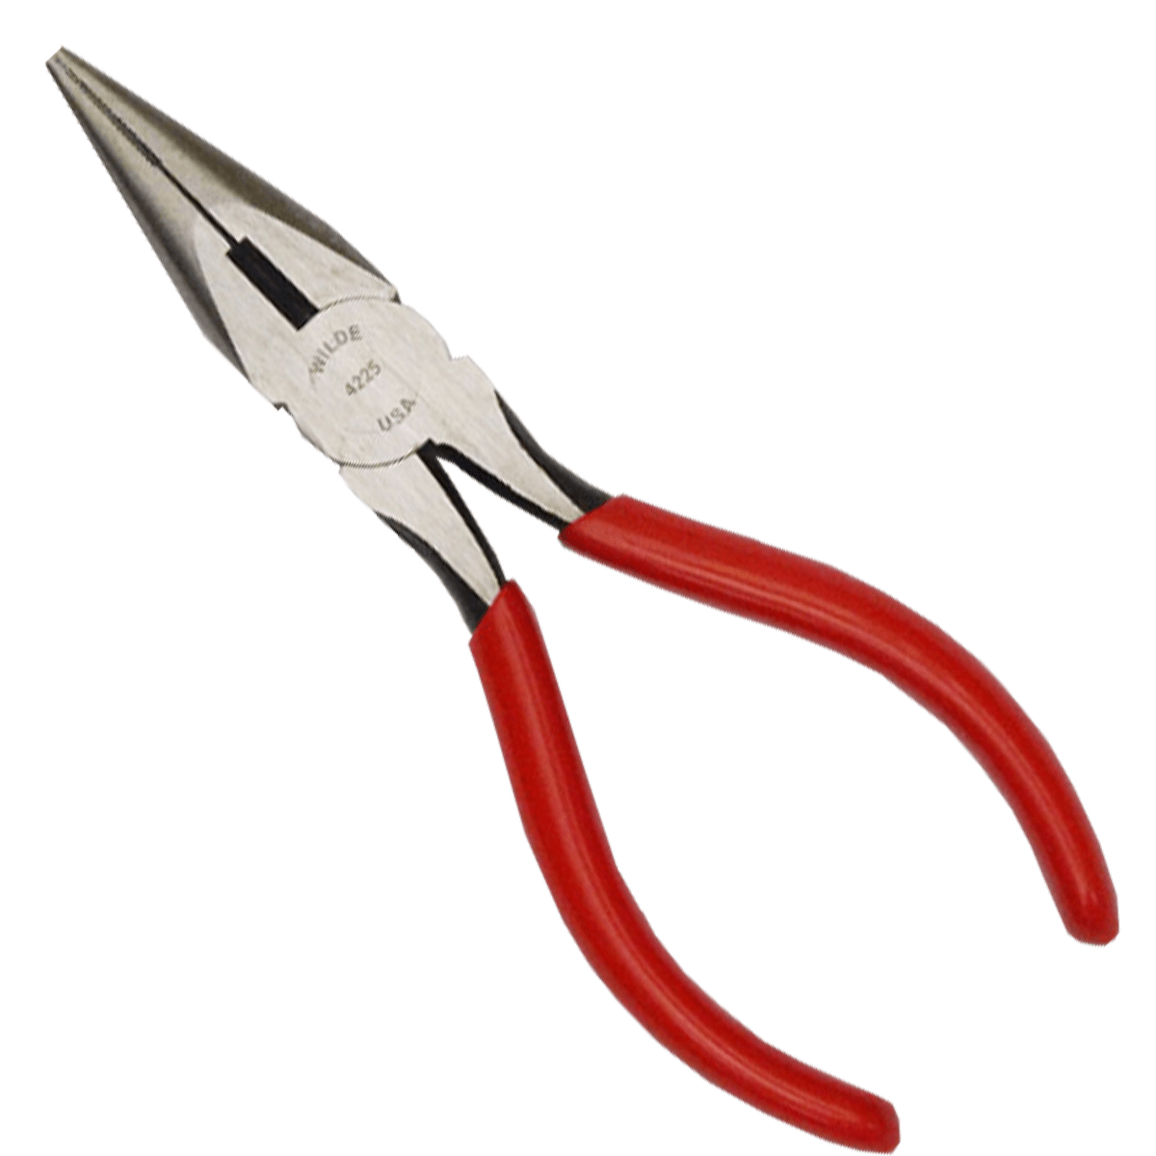
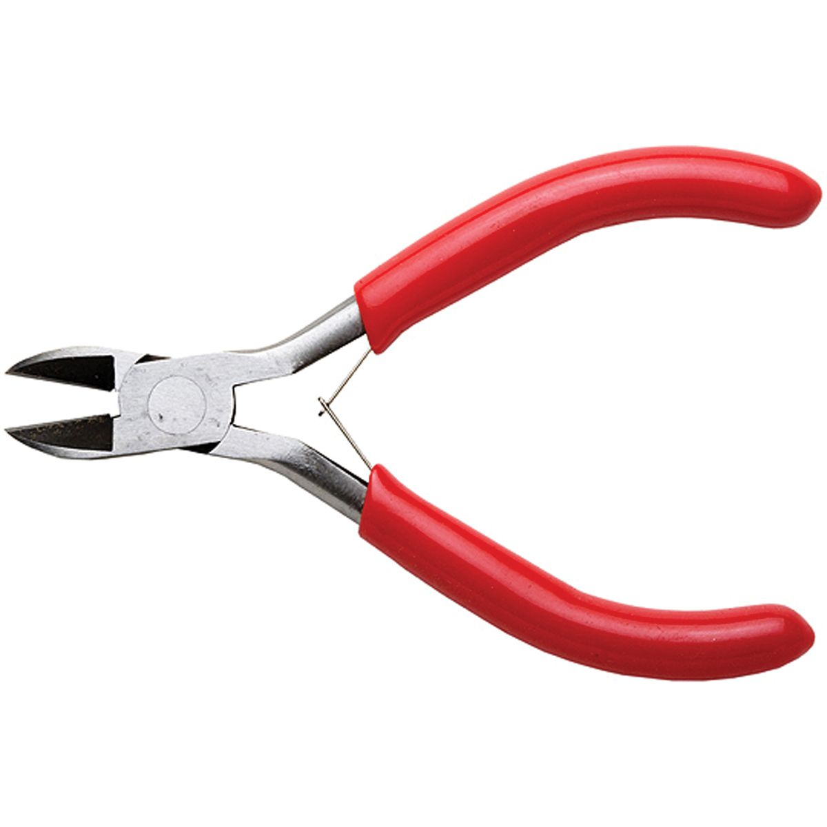
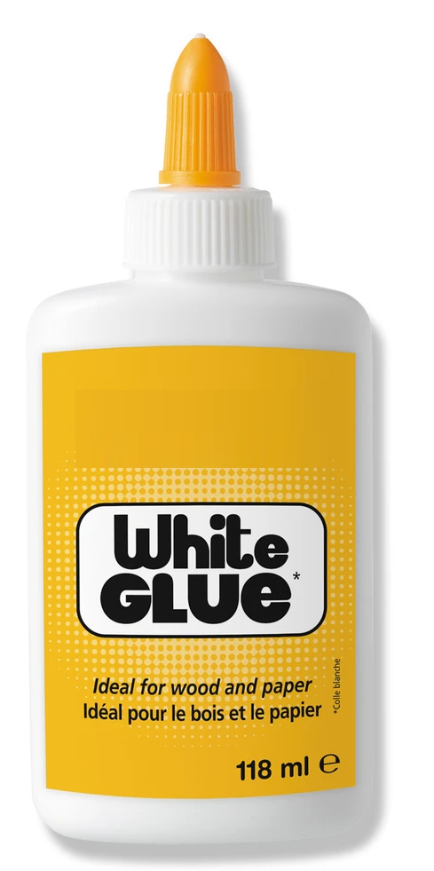
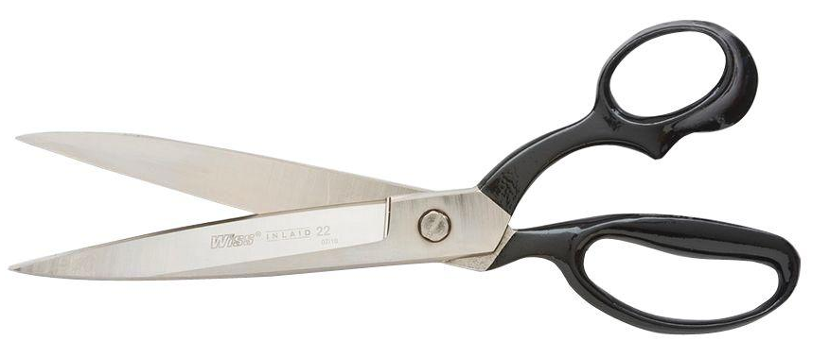
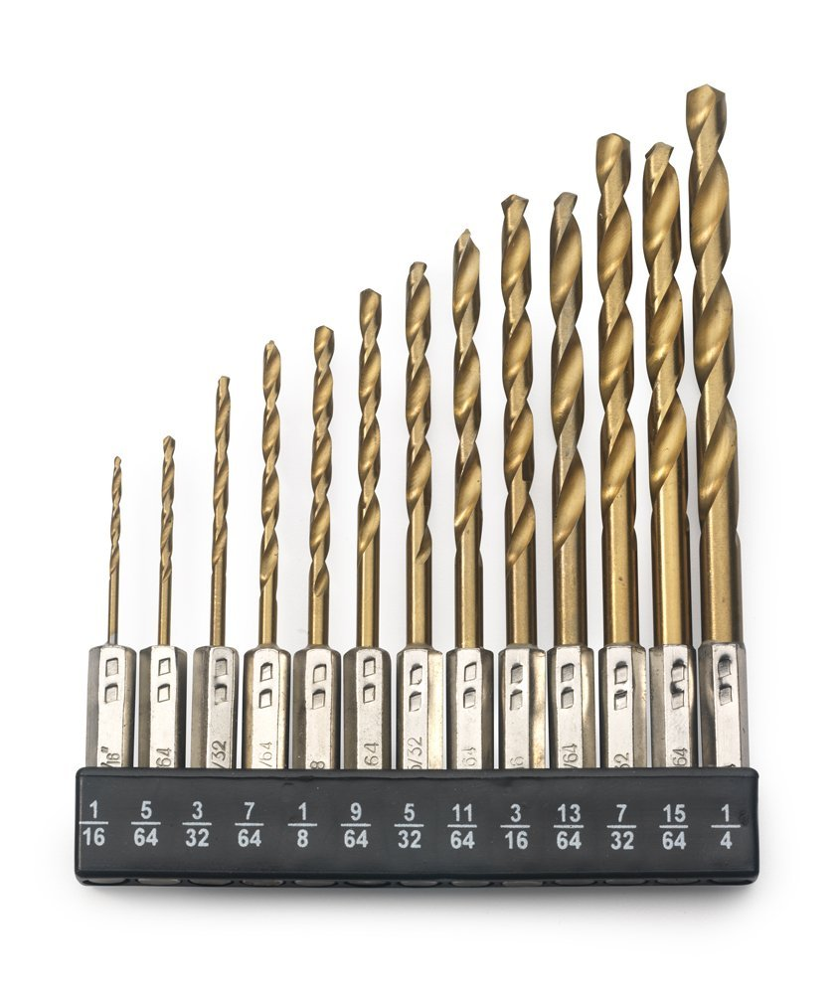
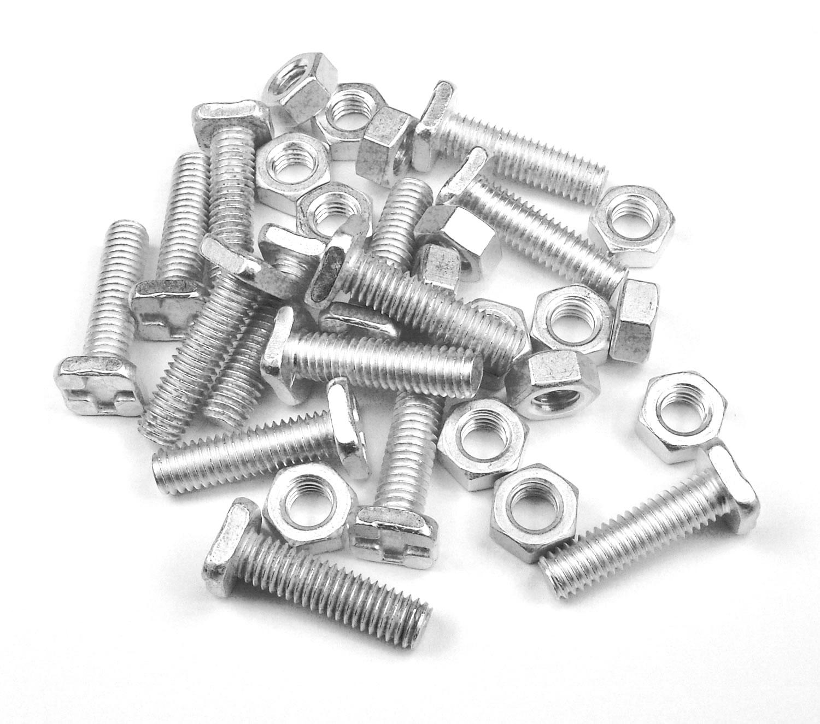
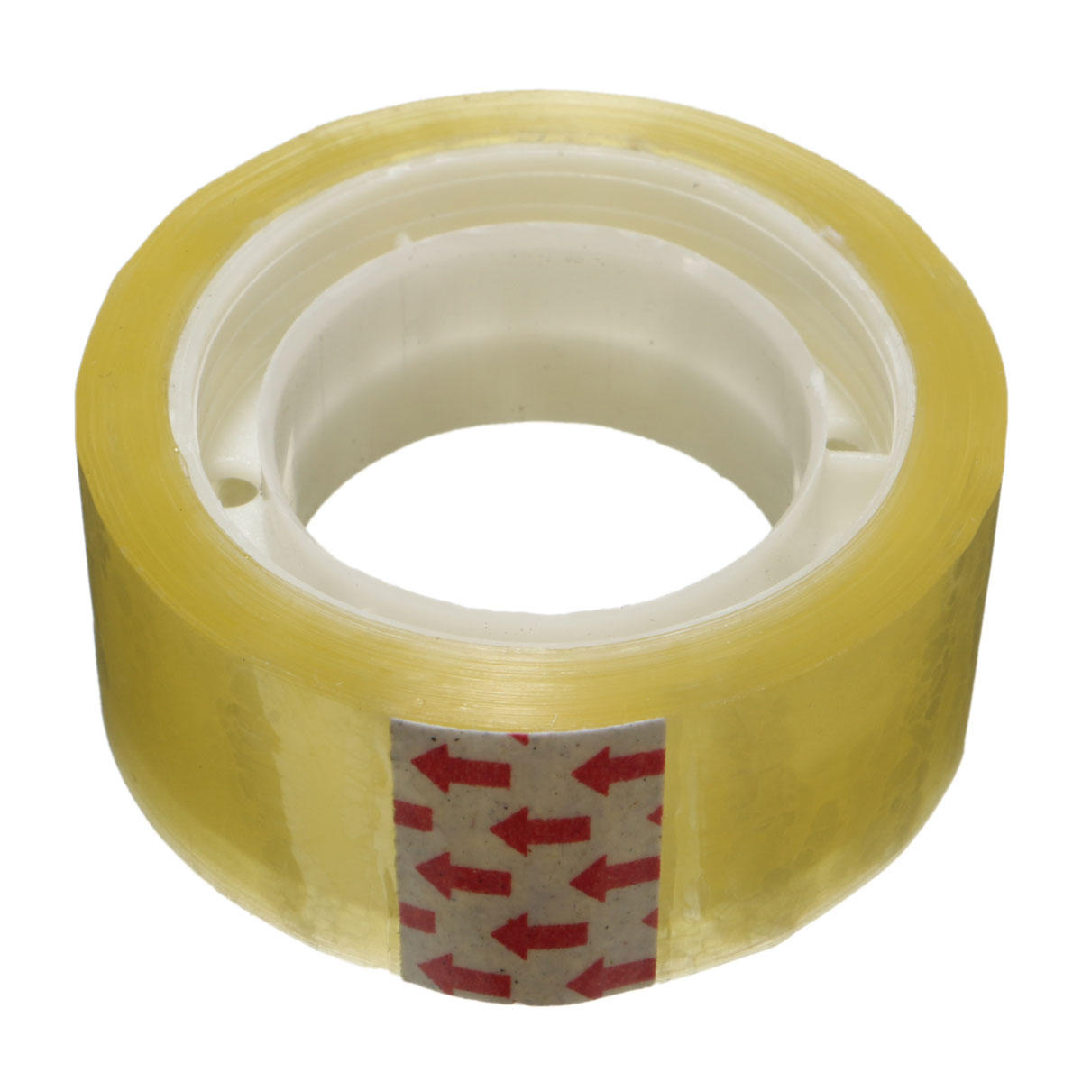
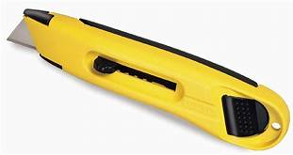
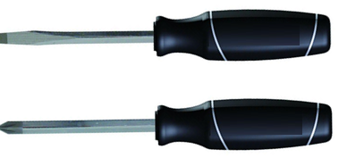
What you need
Scissors
Drill
Pliers
Cutters
Glue
Tools you may need
Sticky
Tape
Drill
Bits
Sharp
Knife
Screw
drivers
Nuts &
Bolts

Slide 8
Now design and make your plane
Plastic
Tube
The plane must have the cardboard
tube which is used to propel the plane
Card
Roll the card around the plastic tube
and glue it to form another tube.
Squash and seal one end

Slide 9


Some Ideas
Will you choose a straight wing, swept back wing, delta wing
And a regular tailplane or canard

Slide 10
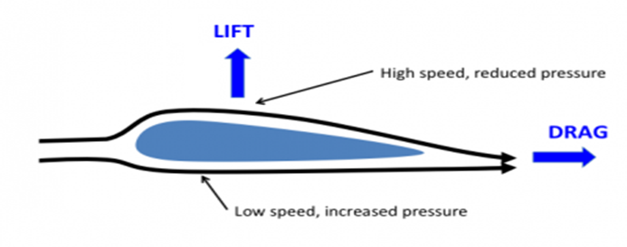
Some Ideas
Plane wings are made as aerofoil sections
The top of the wing is a slightly longer distance than the base
So the air has to travel farther over the top
So it has to be faster and less dense
So there will be a higher pressure on the base than on the top
The LIFT can be assumed to be at about 1/3rd. along the wing

Slide 11

Some Ideas
Try gliding your plane to ensure it flies level.
Adjust the elevators and wing position to help.
You can use the card tube used to propel the plane as the fuselage
Tailplane
You may need to
bend the elevators
up or down to
Ensure level flight
You should try to position the 1/3rd. point of the wing under the centre of gravity of the plane

Slide 12
Some Ideas
Try gliding your plane to ensure it flies level.
Adjust the elevators and wing position to help.
You can use the card tube used to propel the plane as the fuselage
Canard
You should try to position the 1/3rd. point of the wing under the centre of gravity of the plane
You may need to
bend the elevators
up or down to
Ensure level flight

Slide 13
Some Ideas
Fly your plane – which one flies farthest ?

Slide 14

Thank You

