Slide 1
Welcome
These challenges were developed by Derrick Willer MBE and colleagues.
They are free to download and use in an education environment.
Please ensure that there is adult supervision, complete adherence to Health and Safety, and adequate PPE.
Derrick is a STEM Ambassador and volunteer Liaison Officer for Schools.
He has supported education in schools and colleges for over 30 years, initially as a Neighbourhood Engineer in the 1980’s, leading the local Year of Engineering Success campaign in 1996 and the Campaign to Promote Engineering from 1997 to 2004.
He was awarded an MBE for services to Education in 2018.

Slide 2
Guide
This activity is for pupils to make some Christmas or Party Crackers
Risks
Mandatory: close supervision by a competent adult
Item | Risk | Avoidance Action
Tools, Scissors, etc. | Injury | Close supervision.
Glue | Spillage Injury | Close supervision, sponge and water. If glue is ingested rinse moth with water and give water to drink.
Aggression between those present | Injury | Close supervision and immediate action to defuse aggression

Slide 3
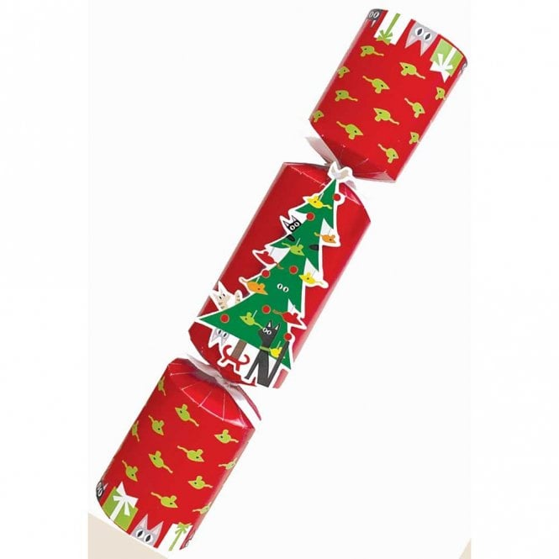
Lets get together to make some Christmas and Party Crackers

Slide 4
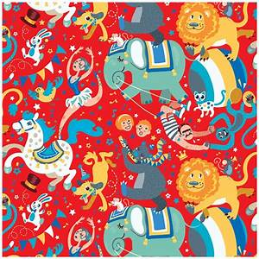
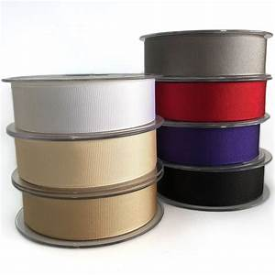
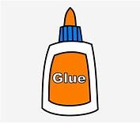
What You Need
Decorated party paper or plain white paper for you to decorate.
Green paper
Ribbon
Scissors
Glue

Slide 5
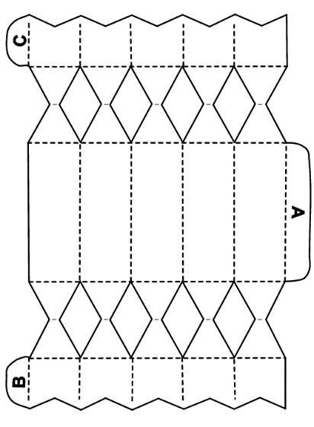
What You Do
First carefully and accurately copy the pattern onto the white paper or onto the reverse of the party paper if you are using this.
A full size pattern is on the next slide.

Slide 7
What You Do
Carefully and accurately cut out the pattern on the solid lines.
Also cut out the yellow diamond sections.
Do not cut any dotted lines.

Slide 8
What You Do
If you used a white sheet please decorate the parts of the cracker on the opposite side to the letters A, B and C.

Slide 9
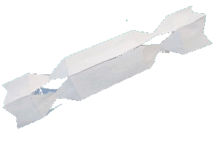
What You Do
Put glue onto tabs A, B and C.
Now stick tab A to the opposite side of the cracker.
Stick tabs B and C to form the ends of the cracker.
The cracker will look like this ► ► ►

Slide 10
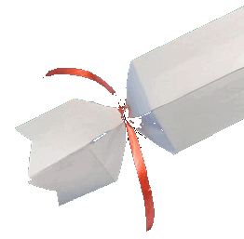
What You Do
Now tie some ribbon onto the two cracker sections pulling the sections together.
You can put a “present” such as a party hat into the cracker before you tie the second end.

Slide 11
What You Do
Now make some holly leaves to attach to your cracker.
Copy the leaf diagrams onto the green paper.
Cut them out carefully.
Cut out or hole punch circles from your white paper and colour them red.
Glue the circles onto the leaves
Glue the leaves onto your cracker.

Slide 12
We have learnt
How to make a Christmas or Party Cracker.
We have used scissors and glue.
We have coloured some of the parts ourselves.
You can take them home to show your family.

Slide 13
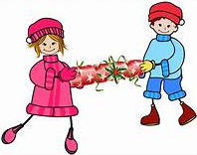
Enjoy The Festive Season

