Slide 1


Welcome
These challenges were developed by Derrick Willer MBE and colleagues.
They are free to download and use in an education environment.
Please ensure that there is adult supervision, complete adherence to Health and Safety, and adequate PPE.
Derrick is a STEM Ambassador and volunteer STEM Ambassador.
He has supported education in schools and colleges for over 30 years, initially as a Neighbourhood Engineer in the 1980’s, leading the local Year of Engineering Success campaign in 1996 and the Campaign to Promote Engineering from 1997 to 2004.
He was awarded an MBE for services to Education in 2018.

Slide 2
Guide
This activity is for pupils to make a downhill racing car out of pre-prepared materials.
The car that goes farthest is the winner
Risks
Mandatory: Competent adult supervision
Item | Risk | Avoidance Action
Tools | Misuse Injury | Close supervision
Aggression between those present | Injury | Close supervision and immediate action to defuse aggression

Slide 3


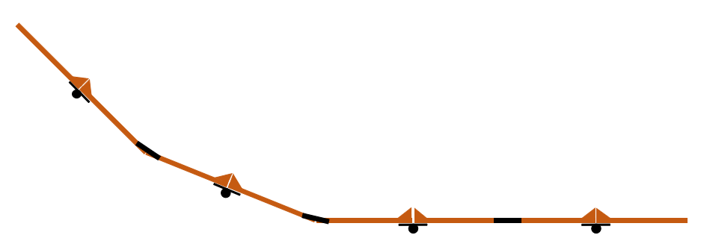
Parts Required
The school, etc. should make kits of parts each kit containing:
The base
The wheels
Dowel Posts
The nuts, bolts and washers (60mm and 80mm M4)
Slope
Please see slides at end of presentation for guidance

Slide 4

Using the available parts
And any others you can get for free
Create Your Own Downhill Racer
The Winner Is The One That Goes The Farthest Distance
\
\
You can choose your car from the slides at the end or design your own
\
\
\
\

Slide 5
Four Wheels In Line
Posts supporting your car
\
\

Slide 6
Four Wheels Not In Line
Posts supporting your car
\

Slide 7
Three Wheels – One At Front
Posts supporting your car

Slide 8
Three Wheels – One At Rear
Posts supporting your car

Slide 9

Assemble the car to your design.
Glue the two halves of the cut-out car together around the
two vertical dowels but do not glue them to the dowels

Slide 10
\
\
Now race your car against the others
The Winner Is The One That Goes The Farthest Distance
\
\
\
\

Slide 11
The Winner

Slide 12


Slide 14


Slide 15

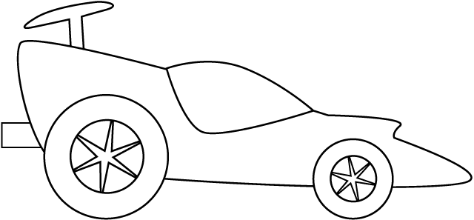

Slide 16

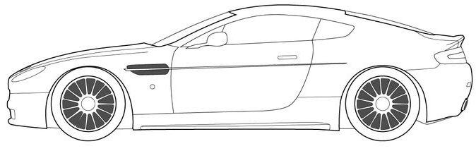
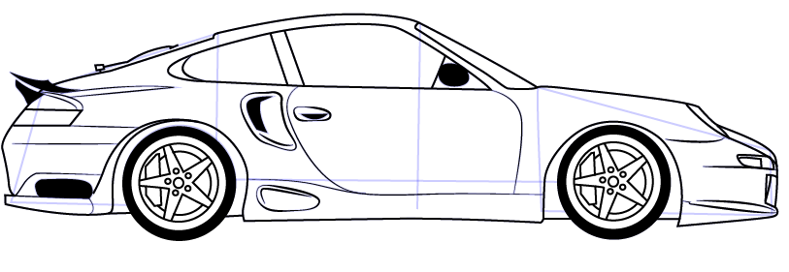

Slide 17
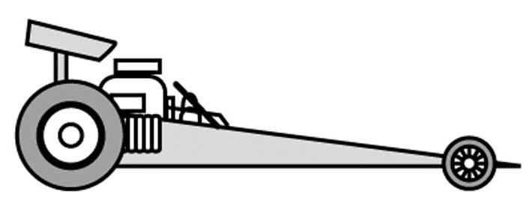
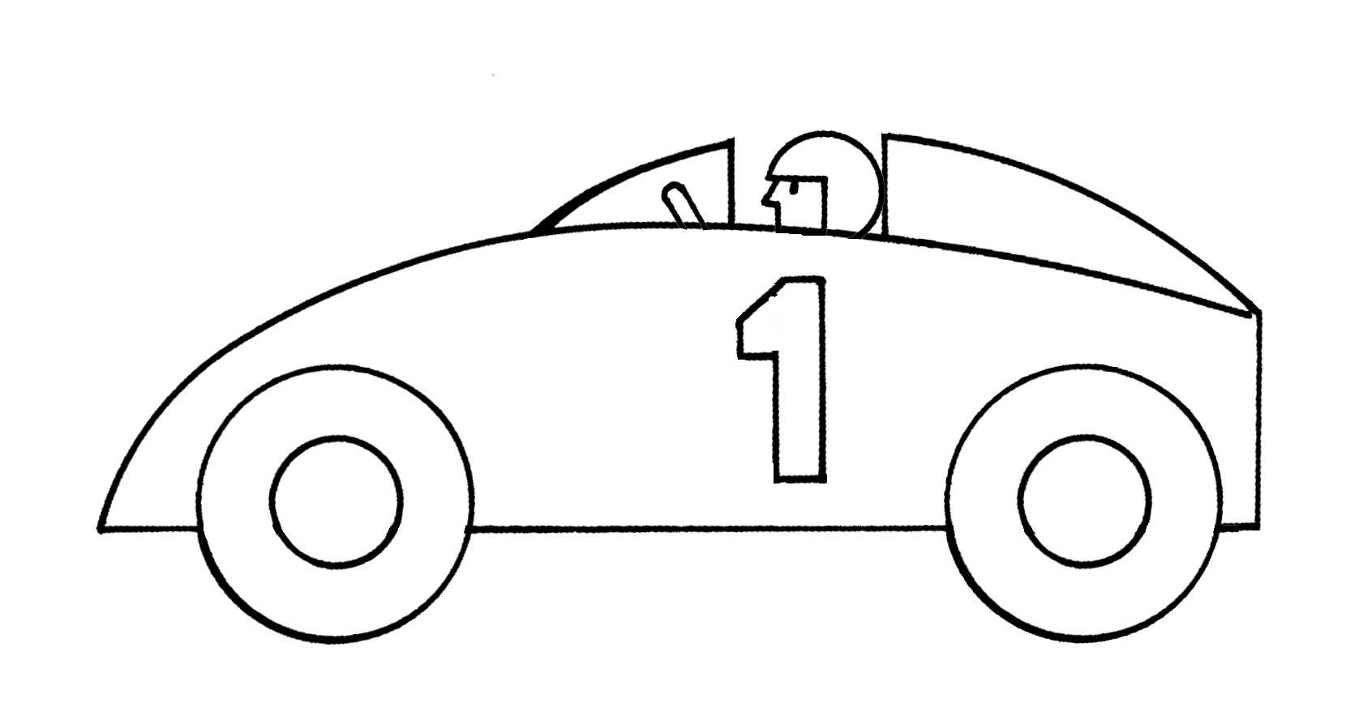


Slide 18
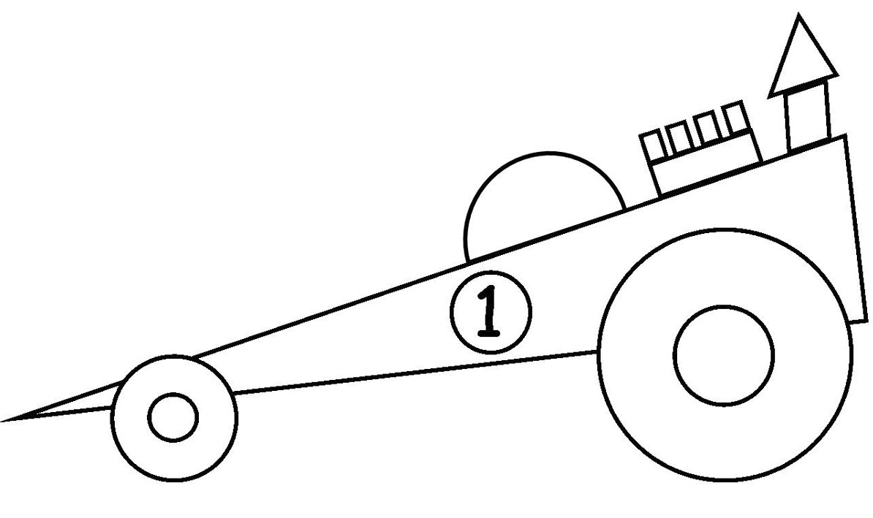


Slide 19
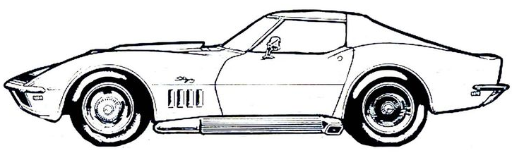
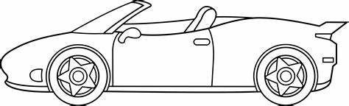
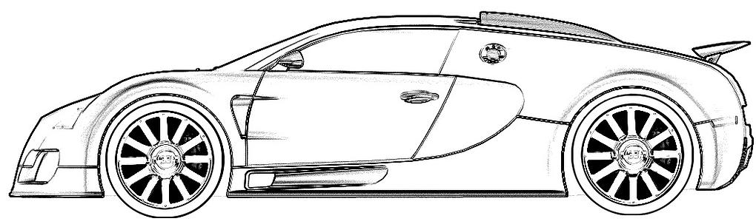

Slide 20
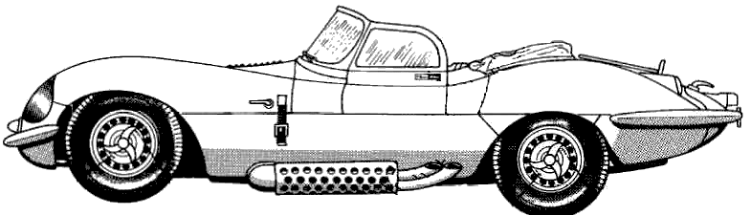
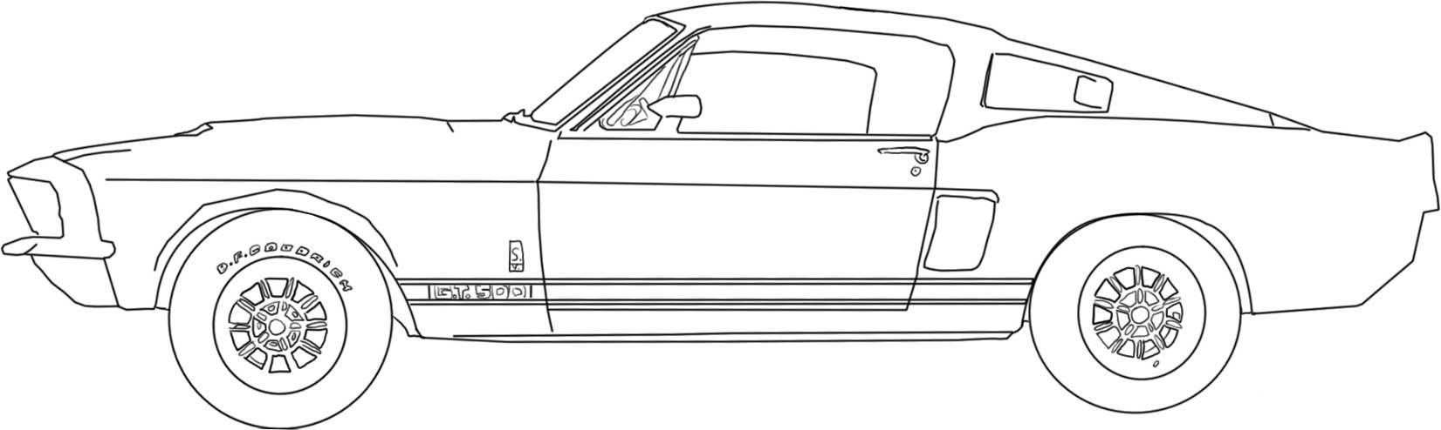


Slide 21
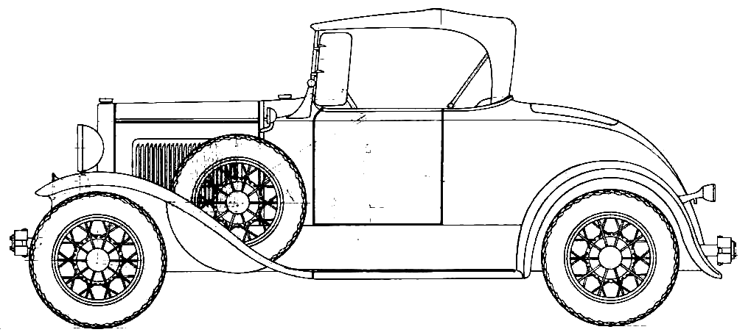
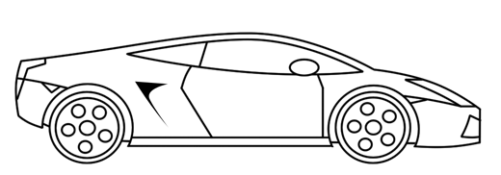
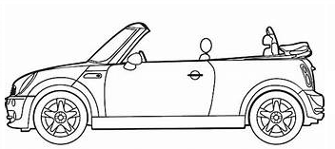

Slide 22
Approximate Costs
Item | No per | No Off | £
Timber For Cars 2.4M x 69mm x 18mm | 16 | 2 | £14
Tmber for Ramp 100mm x 12mm 2.4M | 0.50 | 2 | £14
M4 Bolts 60mm | 4 | 80 | £3
M4 Bolts 80mm | 4 | 80 | £3
M4 Nuts | 4 | 80 | £2
M4 Washers | 8 | 160 | £2
Dowels 90mm | 9 | 3 | £6
Other |  |  | £10
 |  |  | £54
Cost Per Single Car Kit |  |  | £2.70

Slide 23
Parts Required
The school should make kits of parts each kit containing:
The base
The wheels
Dowel Posts
The nuts, bolts and washers (60mm and 80mm M4)
Slope
Please see following slides for guidance

Slide 24
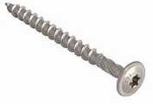
Wood sections 40cm long x 10cm wide
- So they fit into a 45cm long box
- Connected by hinges and plates
- With grooves to guide the wheels
Approximate Dimensions
Three 1.5cm wide grooves 0.5cm deep to guide the wheels
10cm
1cm
Hole for screw through connecting plate 5mm dia.
1cm
Triangle 1cm Wide on one side only
2.4cm
Hinge
10cm Wide 1cm Thick
Connecting Plate
40cm
5cm
Holes for screws through connecting plate 5mm dia.

Slide 25

15cm
Approximate Dimensions
5cm
Wheels
2cm Dia Approx
1cm Max Width
5mm hole
(e.g. Milk Tops)
5cm
1.4cm
1 cm thick
Base
Dowel Posts
60mm Long
6mm Dia
M4 Bolts
60mm Long
M4 Bolts
80mm Long
M4 Nuts
M4 Washers

Slide 26
Approximate Dimensions
The Base
Holes for upright dowels, 5mm Dia
15cm
5cm
5cm
5cm
1.4cm
1.4cm
Holes for axles (M4 Bolts) 5mm Dia

Slide 27
Approximate Dimensions
Vertical Dowels
6mm dia.
60mm long
1cm
approx
2cm
Or More
\
15cm
5cm
5cm
1.4cm

Slide 28
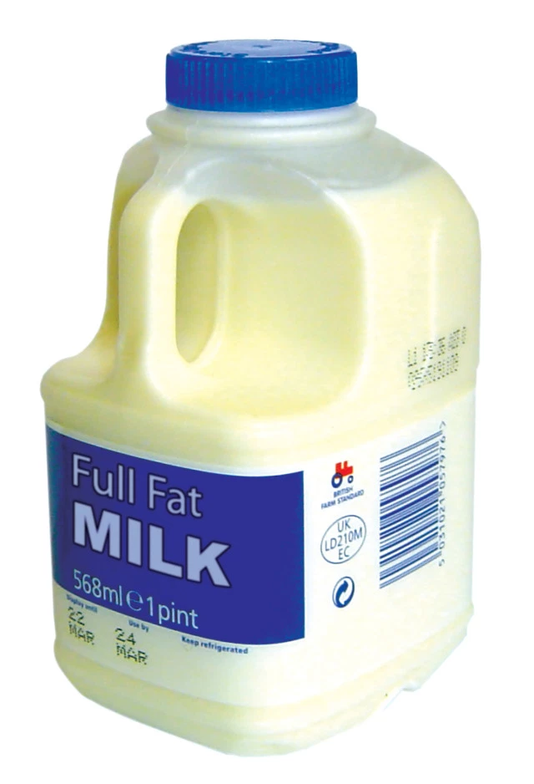
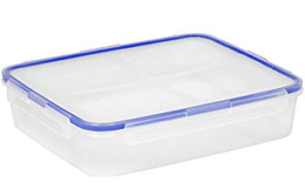

Some Ideas
Use milk container tops as wheels
drill 5mm holes in the centre
Use plastic food containers as the base
drill 5mm holes for the axles and uprights
Use wire from coat-hanger as axles
- change the diameter of the holes to suit
The heavier the car the more is it’s potential energy at the slope top
- so it will have more kinetic energy at the bottom

