Slide 1

Welcome
These challenges were developed by Derrick Willer MBE and colleagues.
They are free to download and use in an education environment.
Please ensure that there is adult supervision, complete adherence to Health and Safety, and adequate PPE.
Derrick is a STEM Ambassador and volunteer Liaison Officer for Schools.
He has supported education in schools and colleges for over 30 years, initially as a Neighbourhood Engineer in the 1980’s, leading the local Year of Engineering Success campaign in 1996 and the Campaign to Promote Engineering from 1997 to 2004.
He was awarded an MBE for services to Education in 2018.

Slide 2
Guide
This activity is for pupils to see how they can reduce the carbon footprint of their home.
Then to scale this up for their school.
Risks
Mandatory: close supervision by a competent adult
Item | Risk | Avoidance Action
OnLine Activity | Eyestrain | Close supervision. All to take a break from looking at the screen for at least 10 minutes in every hour. All to look away from the screen for at least 10 seconds every five minutes.
Aggression between those present | Injury | Close supervision and immediate action to defuse aggression

Slide 3


How big are your electricity and gas bills?
How can you reduce them to save carbon footprint?
Solar Panels?
Wind Turbine?
Heat Pumps (Air Source Heating? Ground Source Heating)?
Combined Heat and Power?
Carbon Free Electricity?
Home and/or School

Slide 4
Warning
The detailed answers are based on estimates having researched some items using the internet.
The pupils must not take these as being correct !!
They should do their own research.

Slide 5

How is energy measured and how much does it cost?
Electricity
Electric power is measured in Watts, usually in Kilowatts – 1Kw = 1000w
Electric energy is measured in Kilowatt-Hours
= 1 kilowatt for 1 hour = 1kWh
If you have a 1Kw iron and used it to iron clothes for 2 hours you would use 2kWh
What are today’s prices for your electricity?
(e.g. 16 pence per kWh)

Slide 6
How is energy measured and how much does it cost?
Gas
Gas energy on your gas bill is measured in Kilowatt-Hours
= 1 kilowatt for 1 hour = 1kWh
The old method used BTUs = British Thermal Units
A BTU is the energy used to heat 1pound of water 1DegFarenheight
= 00293 kWh or IkWh = 3,412 BTUs
There is also a relationship with Joules where I Joule is the energy used
to pass a current of 1Amp through 1 Ohm for 1 Second.
so it is very small. About 2.78 x 10⁻⁷ kWh (2.78 divided by 10 million)
What are today’s prices for your gas? (e.g. 6 pence per kWh)

Slide 7
How is energy measured and how much does it cost?
Heating oil
Oil is paid for in litres.
I litre of heating oil provides about 11 kWh of heating.
What are today’s prices for your heating oil? (e.g. 55 pence per litre).
So it costs about 5p per kWh (2020 prices).
Slightly cheaper than gas.
But subject to world prices which
fluctuate a great deal

Slide 8
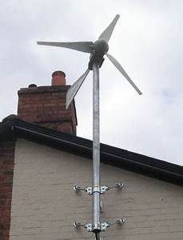
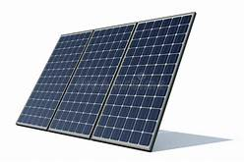
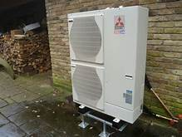
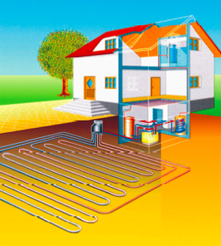
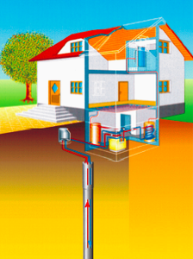
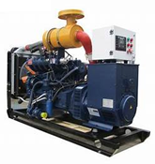

Which systems are available?
Solar Panels
Wind turbines
Air source heat pumps
Shallow ground source heat pumps
Deep borehole ground source
heat pumps
Combined Heat and Power
Carbon neutral electricity

Slide 9
First get all the facts.
How much electricity and gas or oil do you use each year – in kWh (Kilowatt-hours).
How much is 1 kWh for each type of system?
Size of solar panels for 1 kWh
Size of wind turbine for 1 kWh
Size of air source heat pump for 1 kWh
Size of shallow ground source heat pump for 1 kWh
Size of deep borehole ground source het pump for 1 kWh
- Size of combined heat and power system for 1 kWh
How much carbon footprint does each method use to make and install the product.

Slide 10
First get all the facts.
If you change from one power source to another what do you need to replace in your house or school?
e.g.
Cookers from gas to electric,
Water heaters from gas to heat pumps,
Central heating boilers from gas to electric,
Central heating radiators.

Slide 11
First get all the facts.
For a typical semi-detached house with 3 bedrooms, lounge/dining and kitchen (5 rooms) with insulated walls and loft. (Base House) @ 1st Jan. 2020 prices
Annual electricity = 4,500 kWh = £612 @ 13.6p per kWh
Annual gas = 11,000 kWh = £660 @ 6p per kWh
Total = 15.500 kWh = £1,272 per annum
If you do not have insulated walls and loft then this is the first thing to do because it saves so much energy and therefore carbon footprint and £cost.

Slide 12

Lets look at each option in turn.
Solar Panels
Wind turbines
Air source heat pumps
Shallow ground source heat pumps
Deep borehole ground source
heat pumps
Combined Heat and Power
Carbon neutral electricity

Slide 13

Solar Panels
You need to find out lots of facts.
Power output?
Efficiency?
Light availability?
How energy much do you need?
How many solar panels
How much will that cost?
How much will you save?
Payback period?
And more?

Slide 14
Find out how to generate 5000 kWh per annum spread over the year for our base house
kWh
700
600
500
400
300
200
100
0
Jan Feb Mar Apr May Jun Jly Aug Sep Oct Nov Dec

Slide 15




Solar Panel Efficiency And Available Light
How much maximum power does a 1M square solar panel produce?
You need to estimate the efficiency of a solar panel to convert ambient light in kW.
This varies from about 12% in winter to about 75% in summer.
Also the effective number of light hours per day varying from 5 hours to 15 hours.
And the angle of the roof and direction that the solar panels face (between SSE and SSW).
Noon
Dawn
Dusk
SSW
SSE

Slide 16
Create a table like this
Month | Efficiency | Effective Sunshine Hours Per Day | Days Per Month | Monthly Generation er 1M x 1M panel | Average Monthly Usage | Monthly Generation Per 7 Panels
Jan | 12% | 5 | 31 | 7.44 | 375 | 52.08
Feb | 15% | 7 | 28 | 11.76 | 375 | 82.32
Mar | 40% | 9 | 31 | 44.64 | 375 | 312.48
Apr | 50% | 11 | 30 | 66.00 | 375 | 462
May | 60% | 13 | 31 | 96.72 | 375 | 677.04
Jun | 75% | 15 | 30 | 135.00 | 375 | 945
Jul | 70% | 14 | 31 | 121.52 | 375 | 945
Aug | 60% | 13 | 31 | 96.72 | 375 | 677.04
Sep | 50% | 11 | 30 | 66.00 | 375 | 462
Oct | 40% | 9 | 31 | 44.64 | 375 | 312.48
Nov | 15% | 7 | 30 | 12.60 | 375 | 88.2
Dec | 12% | 5 | 31 | 7.44 | 375 | 52.08
 |  |  |  | 710 | 4500 | 5067.72
 |  |  |  | So you need 7 panels

Slide 17
Solar Panels
For the base house
2.5 M²
About £333
Replace the electric power
= 2.5*4500/(365*12) ≈ 3sqM = £999
Replace the gas power?
= 2.5*11,000/(365*12) ≈ 7sqM = £2,331
How many solar panels to provide 1 Kw of power?
How much does a 1M square panel cost?
How many are needed to:
Replace the electric power?
Replace the gas power?
Total Cost = £2,331
Annual Saving = £1,272
Payback ≈ 2 years @ 2020 Prices
On average there are 12 hours of daylight during the year so you pay for the electricity during the winter and recover these costs in the summer
The solar panel systems include batteries to store the power for when you need it at night and at peak times.
Don’t forget to add in the cost of replacing boilers, cookers, etc.

Slide 18

Wind turbines for house
You need to find out lots of facts.
Power output?
Efficiency?
Wind strength and availability?
How energy much do you need?
How big a wind turbine
How much will that cost?
How much will you save?
Payback period?
And more?

Slide 19
Wind turbines for house
Average monthly wind speed for UK Midlands
M/s
15
10
5
0
12 11 10 10 10 10 10 10 10 10 10 10 10 11 12

Slide 20
Wind turbines for house
Numbers of Turbine Blades
Betz Law
  2 blades give about 75% efficiency and weigh less
  3 blades give about 80% efficiency but weigh more
3 Blades 1M diameter
- The relationship is not linear
  Wind speed 10 M/s gives output of about 450W
- Wind speed 11 M/s gives output of about 596W
- Wind speed 12 M/s gives output of about 774W

Slide 21
Wind turbines for house

Slide 22
Wind turbines for house
For the base house
You need one to make 3Kw because it the wind is only sufficient for 33% of the year. (33% = 8 hour per day)
About £350 for 1Kw average output
Replace the electric power
= 3*4,500/(365*8) ≈ 5 Kw ≈ £1,750
Replace the gas power?
= 3*11,000/(365*8) ≈ 11Kw ≈ £3,850
Total Cost ≈ £5,600
Annual Saving = £1,272
Payback ≈ 4.4 years @ 2020 Prices
How big a wind turbine is needed to provide 1 Kw of power?
How much does a 3 Kw turbine cost?
How many are needed to:
Replace the electric power?
Replace the gas power?
Don’t forget to add in the cost of replacing boilers, cookers, etc.

Slide 23
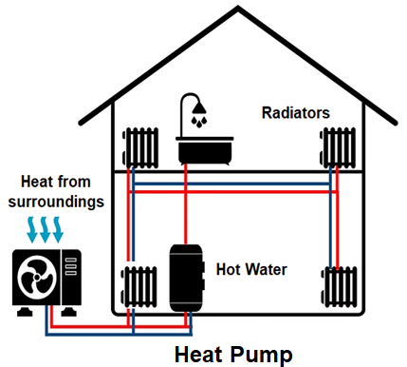
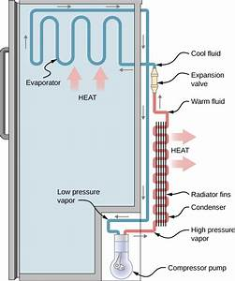
Heat Pumps
Heat pumps are used for generating heat for hot water and central heating.
They are really refrigerators in reverse.
A refrigerator uses electrical energy to cool the inside and dump the heat outside the refrigerator.
Inside The Refrigerator
Outside The Refrigerator
Heat pumps for houses, etc., do the reverse.
They cool their surrounds and pump the heat into the hot water cylinder, etc.

Slide 24
Don’t forget to add in the cost of replacing boilers, cookers, etc.
Air source heat pumps
For the base house
You need to cover maximum demand during the day when the heating is on during the winter, so you need at least 3Kw
About £350 for 1Kw output
Replace the gas power?
= 3*11,000/(365*8) ≈ 12Kw ≈ £7,000
You would only replace the gas.
However the pump needs 0.25 Kw to pump 1Kw so the electricity cost increases by 11000*13.6p/4 = £374
How big a heat pump is needed to provide 1 Kw of heating?
How much does 1 Kw heat pump cost?
How many are needed to:
Replace the gas power?
Replace the Electric power?
Costs
Capital cost = £7000
Gas cost = Nil
Electricity Cost = Original cost plus driving the heat pump
= £720 + £374 = £1094 pa
Savings
Saving = £1380 - £1094 = £286 pa
Payback
Payback ≈ 24 years

Slide 25
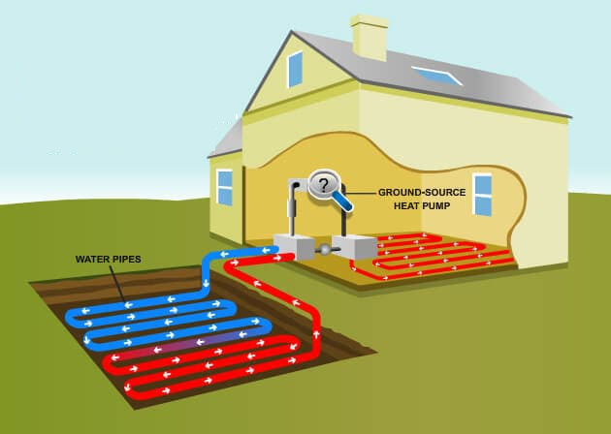
Shallow ground source heat pumps
These calculations are similar
to Air Source Heat Pumps
but there is one big drawback.
If your house is 100sqM area
then you need 500sqM for
the pipes under the ground.
That is 22M x 22M which is
probably more than 5 times
the size of your garden!
How big a heat pump is needed to provide 1 Kw of power?
How much does 1 Kw heat pump cost?
How many are needed to:
Replace the gas power?
Replace the Electric power?

Slide 26
Borehole ground source heat pumps
Costs
Capital cost = £17000
Gas cost = Nil
Electricity Cost = Original cost plus driving the heat pump
= £720 + £374 = £1094 pa
Savings
Saving = £1380 - £1094 = £286 pa
Payback
Payback ≈ 60 years
For the base house
You need one to make 3Kw because it t wind is only sufficient for 33% of the year. (33% = 8 hour per day)
About £350 for 1Kw output
But the borehole costs about £10,000
Replace the gas power?
= 2.5*11,000/(365*8) ≈ 19Kw
≈ £7,000 + £10,000 = £17,000
You would only replace the gas however
the pump needs 0.25 Kw to pump 1Kw so the electricity cost increases by 11000*13.6p/4 = £374
How big a heat pump is needed to provide 1 Kw of power?
How much does 1 Kw heat pump cost?
How many are needed to:
Replace the gas power?
Replace the Electric power?
Don’t forget to add in the cost of replacing boilers, cookers, etc.

Slide 27
Combined heat and power (CHP)
This is where you use one type of power to create the other.
e.g. Solar power to create the heat for your hot water and central heating.
e.g. Heat Pumps to create steam to power an electricity generator.
e.g. Mechanical power (car engine) to create heat and electricity.
Don’t discount the mechanical power method until you have researched this fully

Slide 28
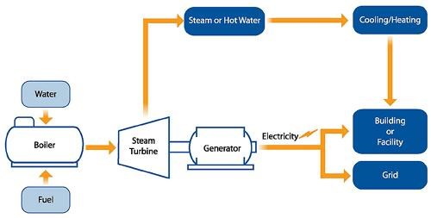
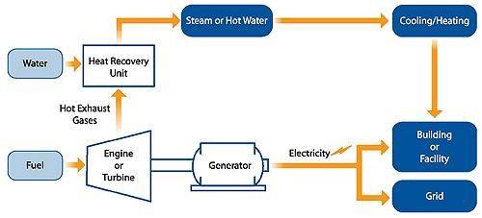
CHP schematic using heat energy to create electric power.
CHP schematic using mechanical energy to create electric power and heat.

Slide 29
CHP using heat energy to create electric power.
Problem
Heat Pumps cannot produce both hot water for your house and high pressure steam.
You will need
A boiler to produce steam
– how much does this cost?
A steam engine or steam turbine to produce the power to drive a generator
How much does this cost?
A generator to produce the electric power for your house/school
How many kW do you need for peak demand?
How much does this cost?

Slide 30
CHP using solar energy to create electric power.
You already have the electrical power so you do not need this type of CHP.

Slide 31
CHP using mechanical energy to create electric power.
You immediately though of a petrol or diesel engine which are very bad for the environment.
Is there another fuel source to power the engine?
Hydrogen?

Slide 32
CHP using mechanical energy to create electric power.
How much is the CHP.
For the base house you need to generate 15.500 kWh annually and have a method of providing for peak demand which is typically 3 times the average.
How much is the hydrogen and the storage tank?

Slide 33
CHP using mechanical energy to create electric power.
For the base house
CHP costs about £1000 per kW and you need about 7kW to cover maximum demand.
Also the cost of a 2000 litre storage tank is about £2000
How much is the CHP.
For the base house you need to generate 15.500 kWh annually and have a method of providing for peak demand which is typically 3 times the average.

Slide 34
CHP using mechanical energy to create electric power.
For the base house
Liquid hydrogen provides about 3.3kWh of energy per litre.
Hydrogen will cost about 15,500 x 90p per litre divided by 3.3 ≈ £5,200 per annum.
In total about £9,000
£5.200 is more than almost all the other options for the fuel alone and the capital cost is about £9,000
How much does the hydrogen cost per annum?

Slide 35
Carbon neutral electricity
No Money Is Saved
In fact if you convert the gas to electric
the cost increases because the
price of electricity is 4 times that of gas
Don’t forget to add in the cost of replacing boilers, cookers, etc.

Slide 36
What are your answers?
Which supply system is best?
For electricity
For gas
For oil
For everything
What are you going to do to save carbon footprint?
For electricity
For gas
For oil
For everything

Slide 37
What have you learnt?
To research the methods of providing energy.
To work like scientists and engineers
To work in teams
And much more !!!
What are you going to do now?
Convince your family to reduce carbon footprint?
Convince your school to reduce carbon footprint?
Help to convince governments to reduce carbon footprint?
And much more !!!

Slide 38
Well Done !!!
and
Thank You

