Slide 1

Welcome
These challenges were developed by Derrick Willer MBE and colleagues.
They are free to download and use in an education environment.
Please ensure that there is adult supervision, complete adherence to Health and Safety, and adequate PPE.
Derrick is a STEM Ambassador and volunteer Liaison Officer for Schools.
He has supported education in schools and colleges for over 30 years, initially as a Neighbourhood Engineer in the 1980’s, leading the local Year of Engineering Success campaign in 1996 and the Campaign to Promote Engineering from 1997 to 2004.
He was awarded an MBE for services to Education in 2018.

Slide 2
Guide
This exercise introduces pupils to gravity and how to protect an egg against the force when it hits the floor.
Risks
Mandatory: close supervision by a competent adult
Item | Risk | Avoidance Action
Falling from Height | Injury | Close supervision. Barriers on stairs and upper floor. Pupils below the stairs to stand back. Use plastic sheet to protect floor.
Components | Misuse and Mistakes | Close supervision
Glue | Spillage Injury | Close supervision, sponge and water. If glue is ingested rinse moth with water and give water to drink.
Aggression between those present | Injury | Close supervision and immediate action to defuse aggression

Slide 3
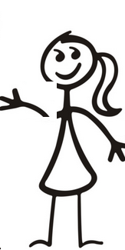

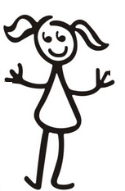



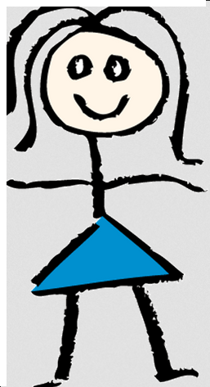
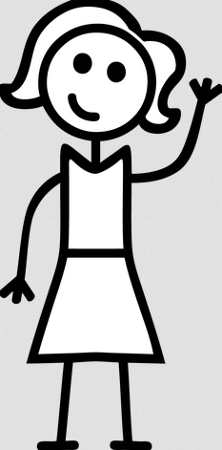


Please work in teams
Will Your Egg
Survive
The Drop?
Plastic Sheet

Slide 4
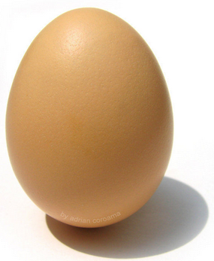
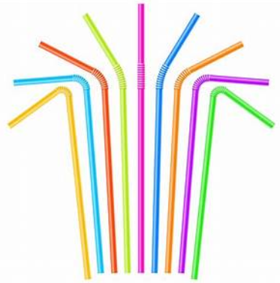
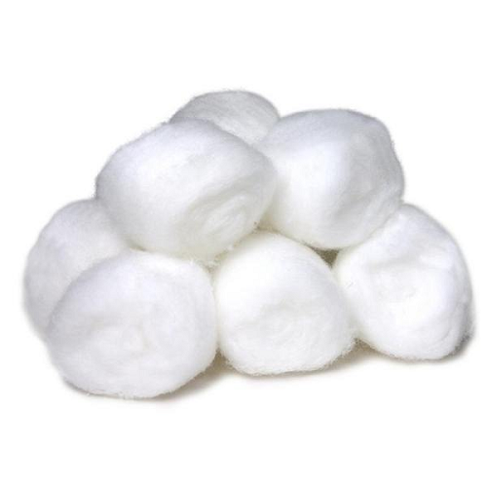
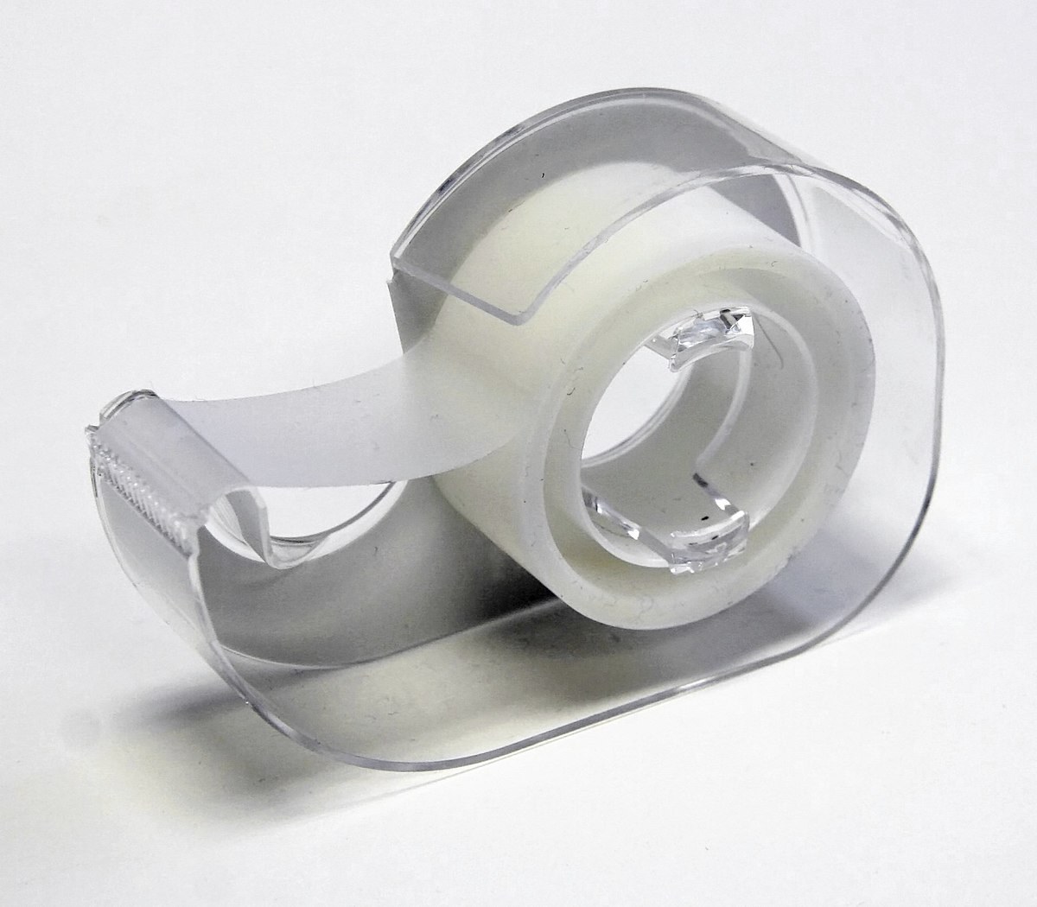
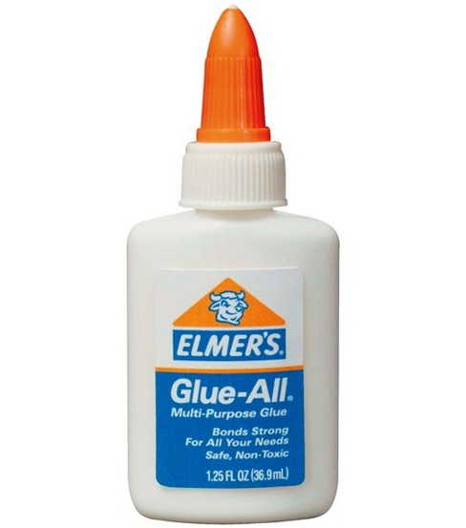
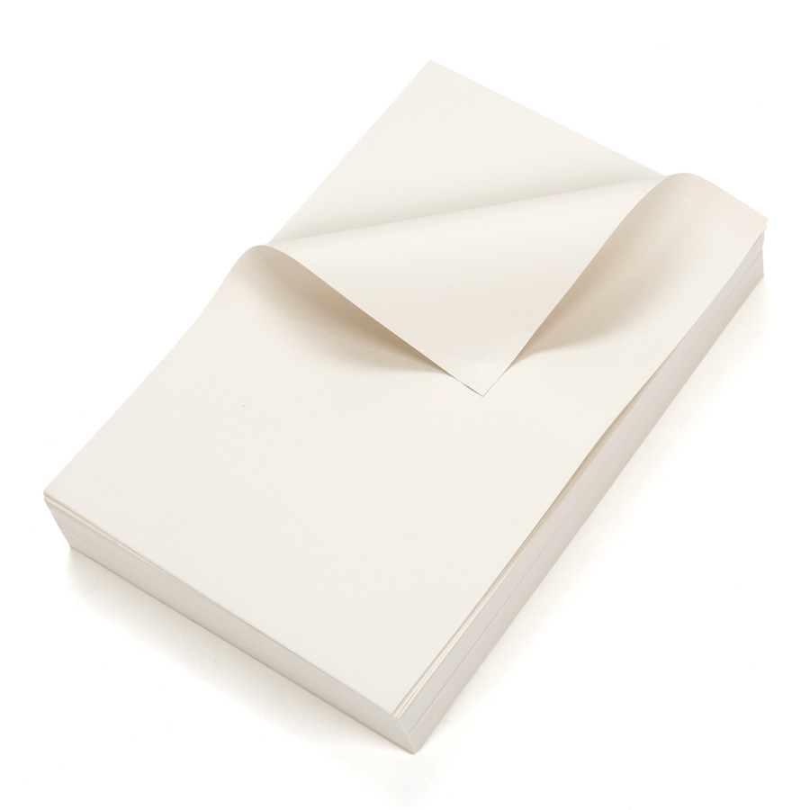
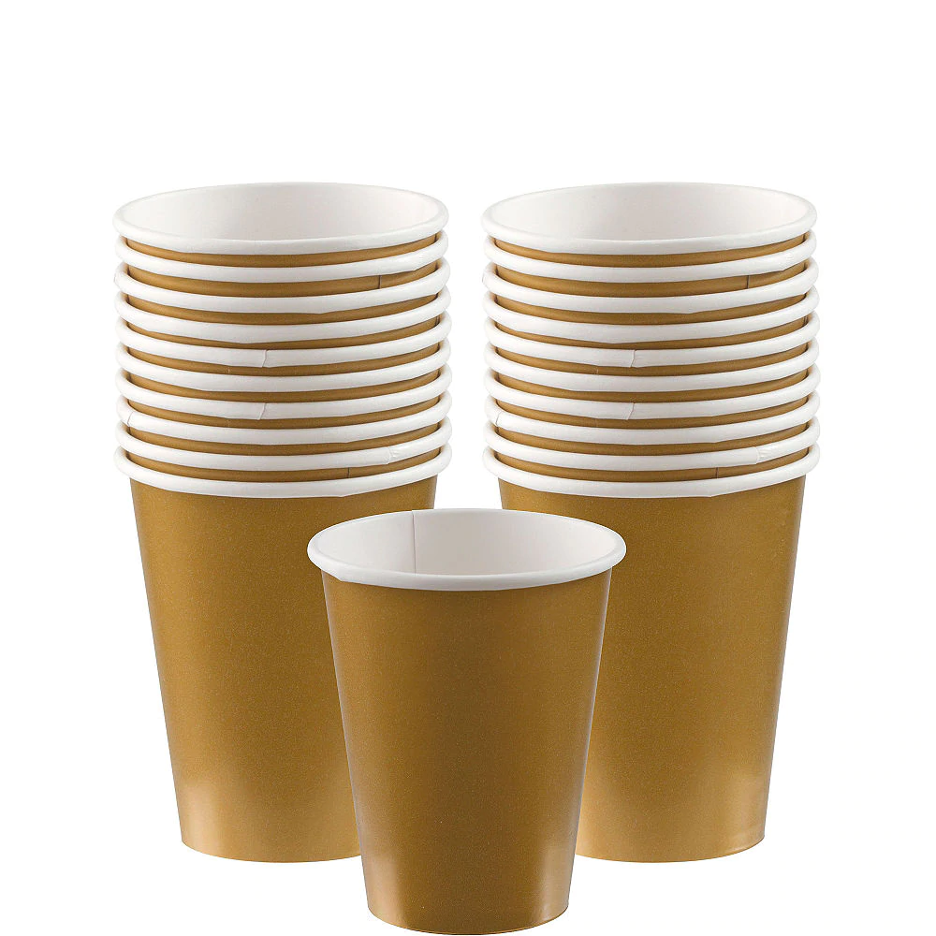
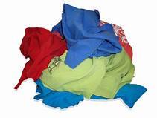
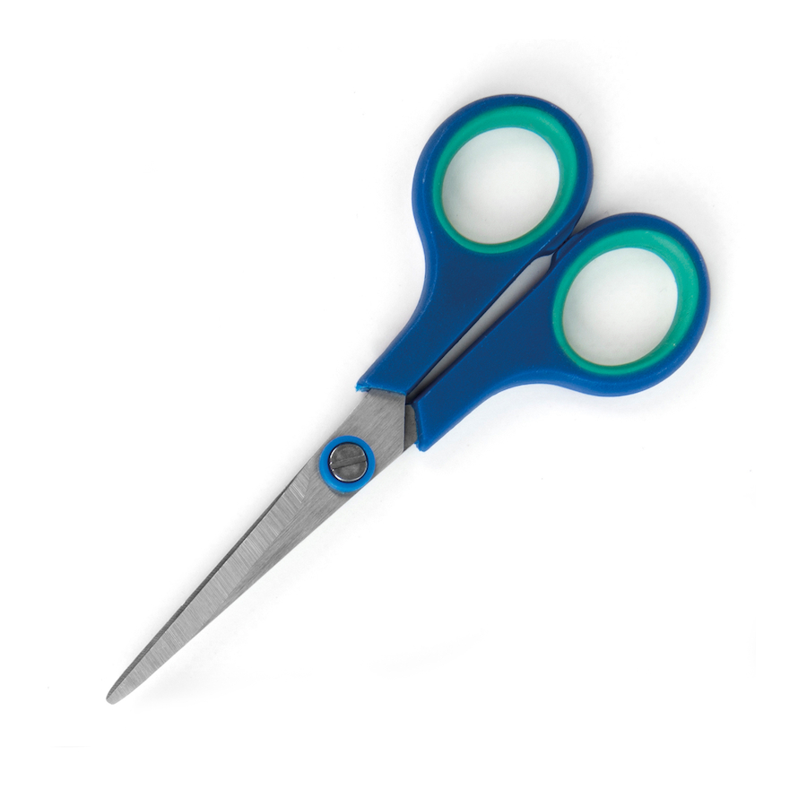


What you need:
Egg
Straws
Cotton Buds
Sticky Tape
Glue
Paper
Recycled Materials
e.g. paper, cups, rags, tins
Tools
Plastic Sheet

Slide 5
What you need to think about:
Strength
Protect the Egg
Crumple Zone
Rotation (Will It Turn Upside-Down?)
Safety (Tools, Stand Away from Drop)
Reinforcement
Clean Up Afterwards

Slide 6
Scoring:
Did the egg survive?
Completely = 10
Cracked = 7
Cracked and fluid came out = 4
Mostly destroyed = 2
Totally destroyed = 0
Design:
Poor = 2 to Very Good = 10
Teamwork
- Poor = 2 to Very Good = 10

Slide 7
Egg
Cushioning
Structure
Crumple Zone

Slide 8
Safety First!!!
Will Your Egg
Survive
The Drop?
Plastic Sheet

Slide 9
Team Name | Survival | Design | Teamwork | Total

Slide 10
It is GRAVITY that destroys the egg when it hits the floor
Wrong !!!
It is the floor that causes the damage.
Nothing has ever been caused to be damaged because of Gravity
And the floor is held together by Electro-Magnetic force, not gravity

Slide 11
Well Done, Everyone

Slide 12

Well Done
Thank You

