Slide 1

Welcome
These challenges were developed by Derrick Willer MBE and colleagues.
They are free to download and use in an education environment.
Please ensure that there is adult supervision, complete adherence to Health and Safety, and adequate PPE.
Derrick is a STEM Ambassador and volunteer Liaison Officer for schools.
He has supported education in schools and colleges for over 30 years, initially as a Neighbourhood Engineer in the 1980’s, leading the local Year of Engineering Success campaign in 1996 and the Campaign to Promote Engineering from 1997 to 2004.
He was awarded an MBE for services to Education in 2018.

Slide 2
Guide
This exercise introduces pupils to simple electrical cirduits.
Risks
Mandatory: close supervision by a competent adult
Item | Risk | Avoidance Action
Tools | Injury | Close supervision, use of safety glasses, etc.
Batteries | Injury, Fire | Close supervision, store separately
Circuit components | Breakage | Close supervision, Not that the gears are plastic and liable to break if too much effort is used. Please not that if this is broken we may need to charge the school for the replacement.
Aggression between those present | Injury | Close supervision and immediate action to defuse aggression
Do not allow the pupils to switch on the circuit until it has been checked by a supervisor.
Danger – Batteries my short-circuit, become very hot and cause a fire.

Slide 3
Welcome
I very much hope that you will enjoy this fun activity and learn about electricity.
We suggest that all the pupils are given slides 23 and 24 to take home to show their parents or guardians.

Slide 4
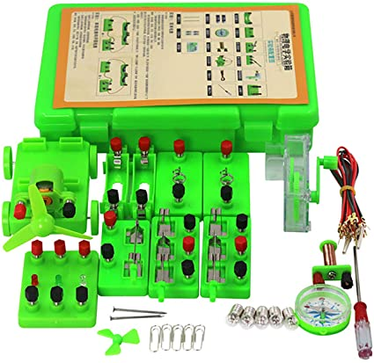
This activity utilises a simple kit available from several sources.
AchidistviQ Physics Science Lab Circuit Learning Electronics Exploration Kit, STEM Electric Education Tools for Beginner, Junior and Senior High School Pupils.
And a multimeter
It is recommended that slides 21 and 22 showing the circuits are provided to each pupil to take home.

Slide 5
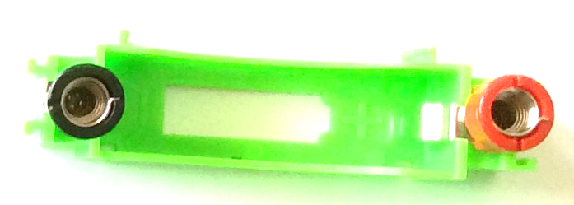
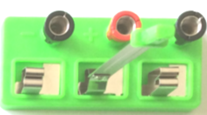
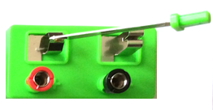
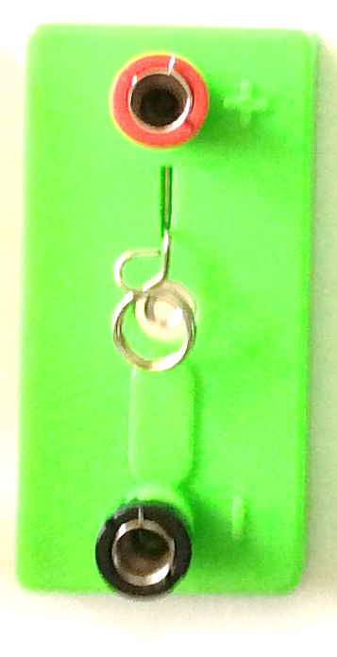

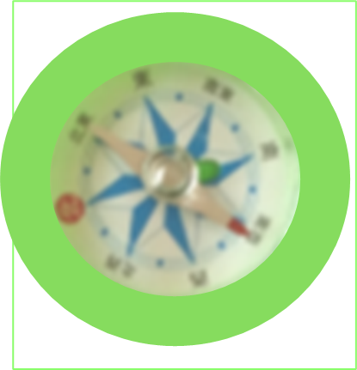
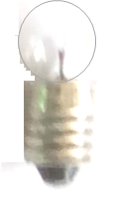
The kit consists of:
Two Battery Holders
LED Diode Lights
Two Cross-Over Switches
Motor
One On-Off Switch
Inductor Coil
Two Bulb Holders
Compass
Four Bulbs
Continued

Slide 6
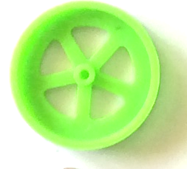
The kit consists of:
Base (e.g. for car)
Connecting Gears
Connecting Wires
Gear Handle
Four Wheels
Small and Large Propeller
Two Axles
Paper Clips and Nails
Through Tube and Bolt
You also need 2 AA 3V Batteries

Slide 7



Supervision
Please ensure that the batteries are put into the holders correctly
Also the holders clip together as above
Or like this but with a lead

Slide 8
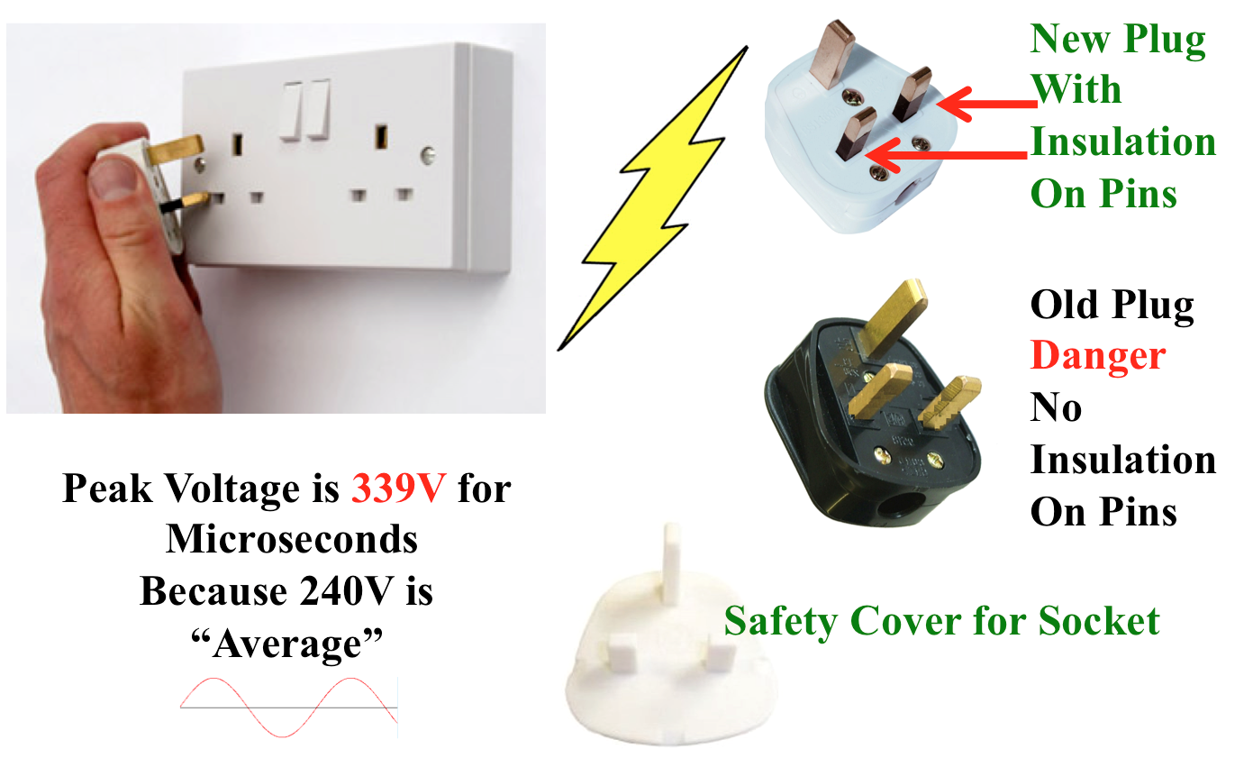
Danger – 240 Volts AC

Slide 9
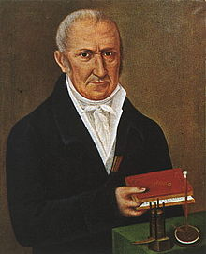
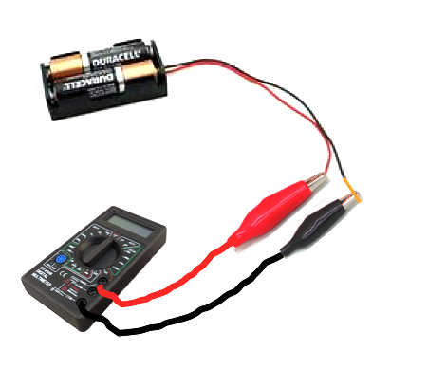
Volt
(like “force”)
Named after Italian Count Allessandro Volta

Slide 10
Volt
(like “force”)
Named after Italian Count Allessandro Volta
Never connect the battery before a teacher has checked the circuit !!
If you get it wrong the battery will get hot and burn !!

Slide 11
Volt
(like “force”)
Named after Italian Count Allessandro Volta
First turn the selector to 20 Volts DC
(be careful)
Connect the Multimeter
How much Voltage is there?

Slide 12
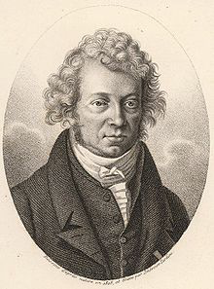
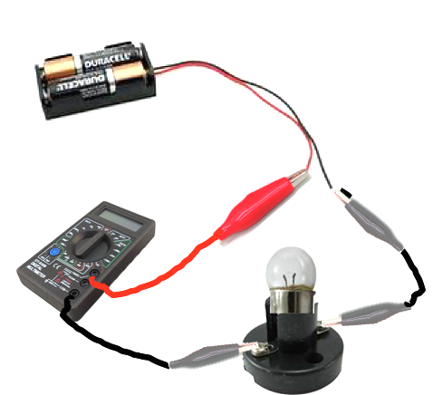
Amp
for current
Named after Frenchman André-Marie Ampere
First turn the selector to 10 A
(be careful)
Connect the lamp and
Multimeter
How much Current is there?

Slide 13
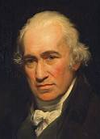
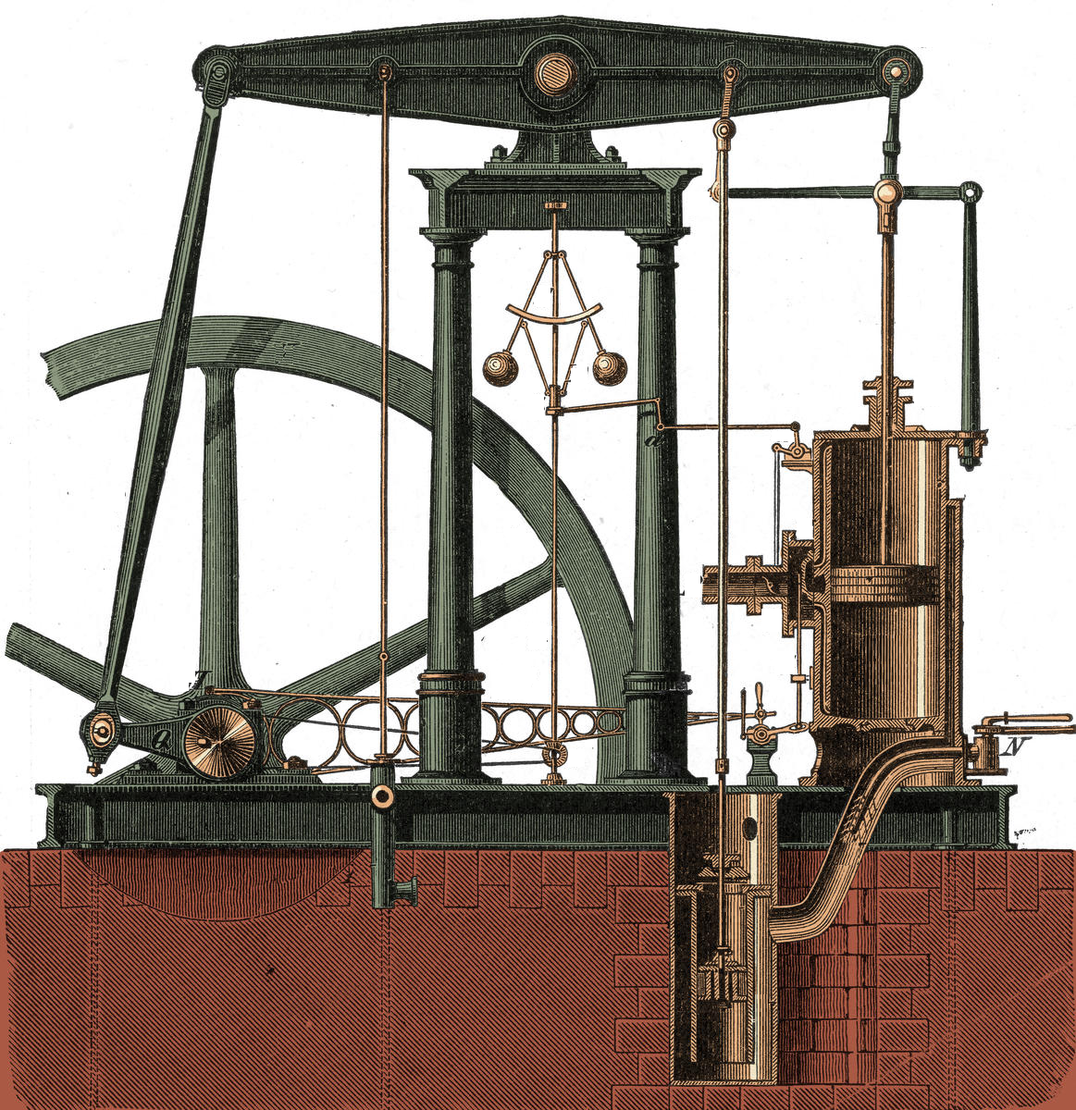
Watts Are Power
Named after James Watt
Watts = Volts X Amps
James Watt invented an
improved steam engine

Slide 14

Now lets bright sparks
Make some electric circuits

Slide 15
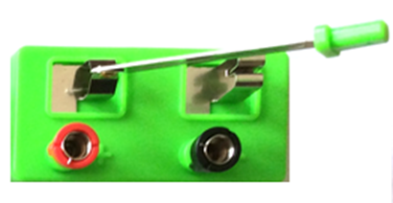

Circuit No 1
This is the circuit diagram
This is the circuit using the parts
Switch
Tun switch on and off
Bulb
Put batteries in holders
Clip holders together
Battery
Put bulb in holder

Slide 16
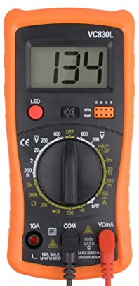


Circuit No 1
Now measure the Voltage
3.00
`

Slide 17
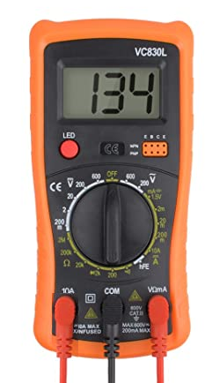
Circuit No 1
Now measure the current
1.13

Slide 18

Circuit No 2
This is the circuit diagram
Use two bulbs
This is the circuit using the parts
Tun switch on and off
Switch
Now measure the voltage across one bulb
Bulbs in
Series
One after
Another
Put batteries in holders
Clip holders together
Battery
What happens to the light from the bulbs?

Slide 19
Circuit No 3
This is the circuit using the parts
This is the circuit diagram
Tun switch on and off
Switch
Now measure the voltage across one bulb
Put batteries in holders
Clip holders together
Bulbs in
Parallel
One
Alongside
Another
Battery

Slide 20
Circuit No 1
Circuit No 2
Series
Circuit No 3
Parallel
Switch
Switch
Switch
Battery
Battery
Give to pupils to take home

Slide 21
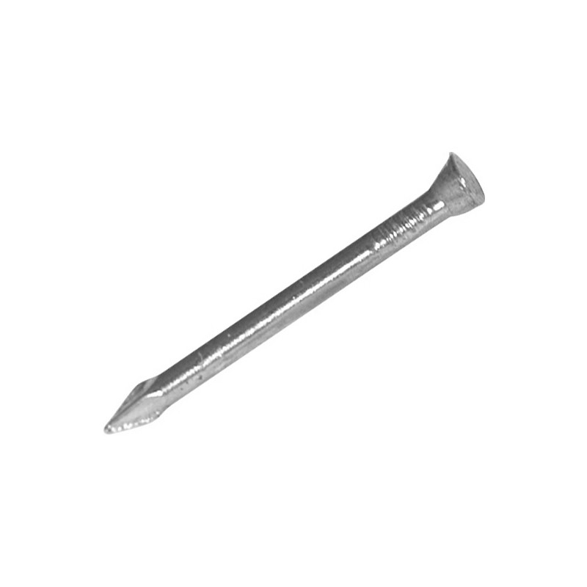
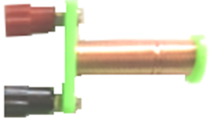

Circuit No 4
This is the circuit diagram
Use the Coil
This is the circuit using the parts
The coil becomes a magnet when the current flows
Test with a nail, paper-clip and the compass
Switch
Now measure the resistance of the coil
Coil
Called and
Inductor

Slide 22

Circuit No 5
This is the circuit diagram
This is the circuit using the parts
Use the LEDs (Light Emitting Diodes)
Two Way Switch
When you change the switch the red and then the green LED is lit
Note that the white LED does not light because the polarity is wrong
Green
White
LEDS
Red

Slide 23
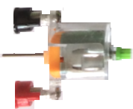
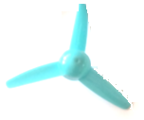

Circuit No 6
This is the circuit diagram
This is the circuit using the parts
Use the motor and propeller
Switch
Electric
Motor
Fix the Propeller to the shaft

Slide 24
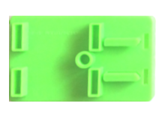

Circuit No 6
Make the car using the same circuit
This is the circuit using the parts
Watch it run across the floor
Axles

Slide 25
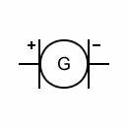

Circuit No 7
Let’s make electricity
This is the circuit diagram
This is the circuit using the parts
Insert the motor into the gear holder
Turn the handle GENTLY to generate electricity to light the LED
Insert the handle into the other side of the gear holder

Slide 26

Well Done
Thank You

Slide 28
Coventry and Warwickshire Schools Liaison Community
Derrick Willer
24, Woodloes Avenue South
Warwick
CV34 5TF
01926 490 456
07764 970 273
www.dwiller.com
AchidistviQ Physics Science Lab Circuit Learning Electronics Exploration Kit.
STEM Electric Education Tools for Beginner, Junior and Senior High School Pupils.
Eight kits.
www.dwiller.com/CWSLC.htm

Slide 29
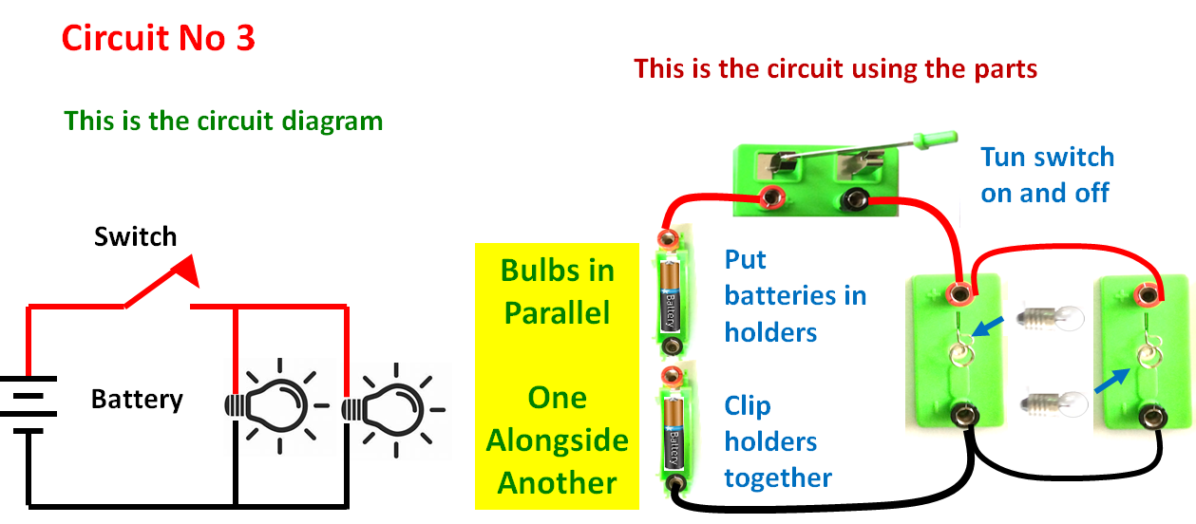

Slide 30
