Slide 1

Welcome
These challenges were developed by Derrick Willer MBE and colleagues.
They are free to download and use in an education environment.
Please ensure that there is adult supervision, complete adherence to Health and Safety, and adequate PPE.
Derrick is a STEM Ambassador and volunteer STEM Ambassador for schools.
He has supported education in schools and colleges for over 30 years, initially as a Neighbourhood Engineer in the 1980’s, leading the local Year of Engineering Success campaign in 1996 and the Campaign to Promote Engineering from 1997 to 2004.
He was awarded an MBE for services to Education in 2018.

Slide 2
Guide
This exercise introduces pupils to simple electrical circuits including LEDs and Multivibrators to make some flashing lights for a festive occasion.
It I suggested that pupils work in small teams..
Risks
Mandatory: Close supervision by a competent adult
Item | Risk | Avoidance Action
Tools | Injury | Close supervision, use of safety glasses, etc.
Soldering Irons | Injury | Close supervision, use of safety glasses, etc.
Batteries | Injury, Fire | Close supervision, store separately
Aggression between those present | Injury | Close supervision and immediate action to defuse aggression
Do not allow the pupils to switch on the circuit until it has been checked by a supervisor.
Danger – Batteries my short-circuit, become very hot and cause a fire.

Slide 3
Welcome
I very much hope that you will enjoy this fun activity and learn about electronics.

Slide 4
Welcome

Slide 5
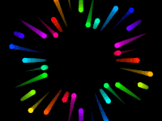
Flashing Lights
Make your own
Christmas, Diwali, Hanukkah, Eid, etc. Lights

Slide 6
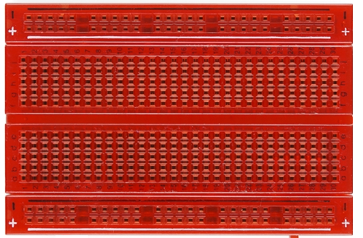
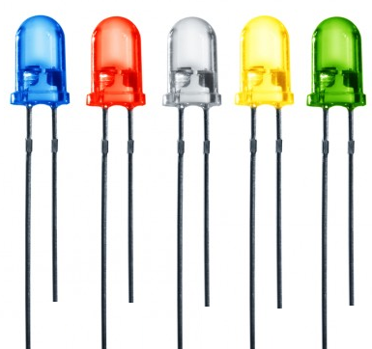
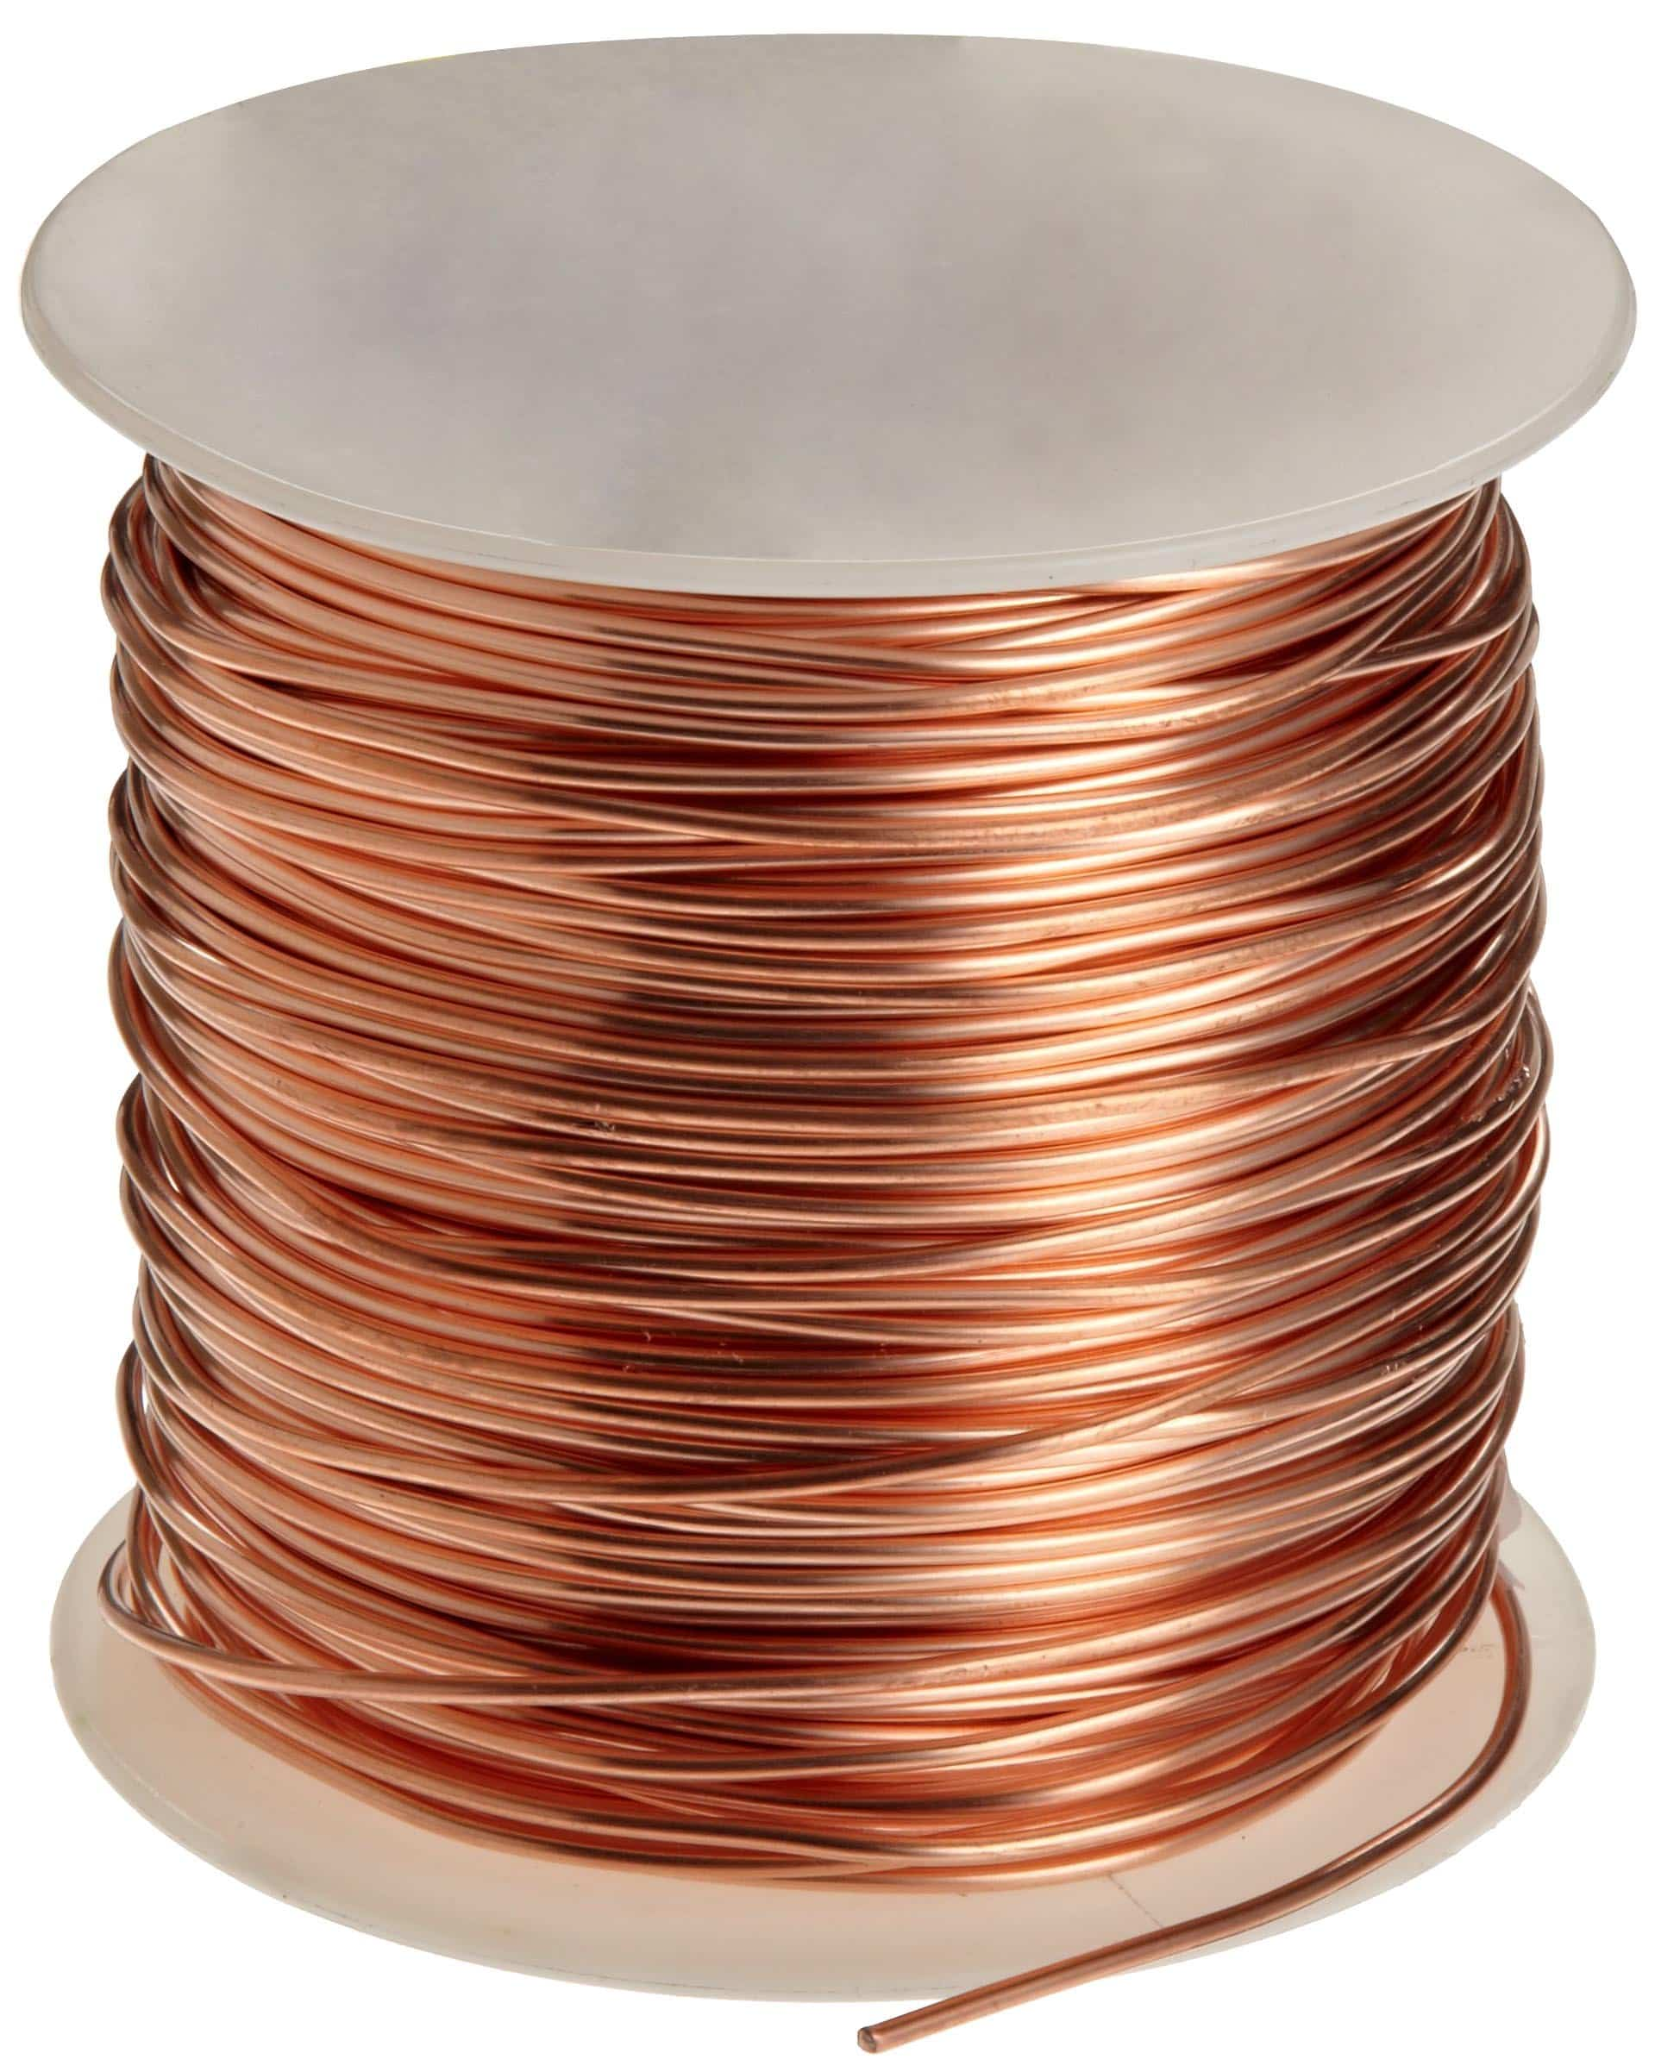
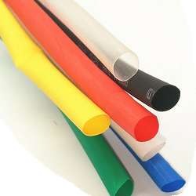
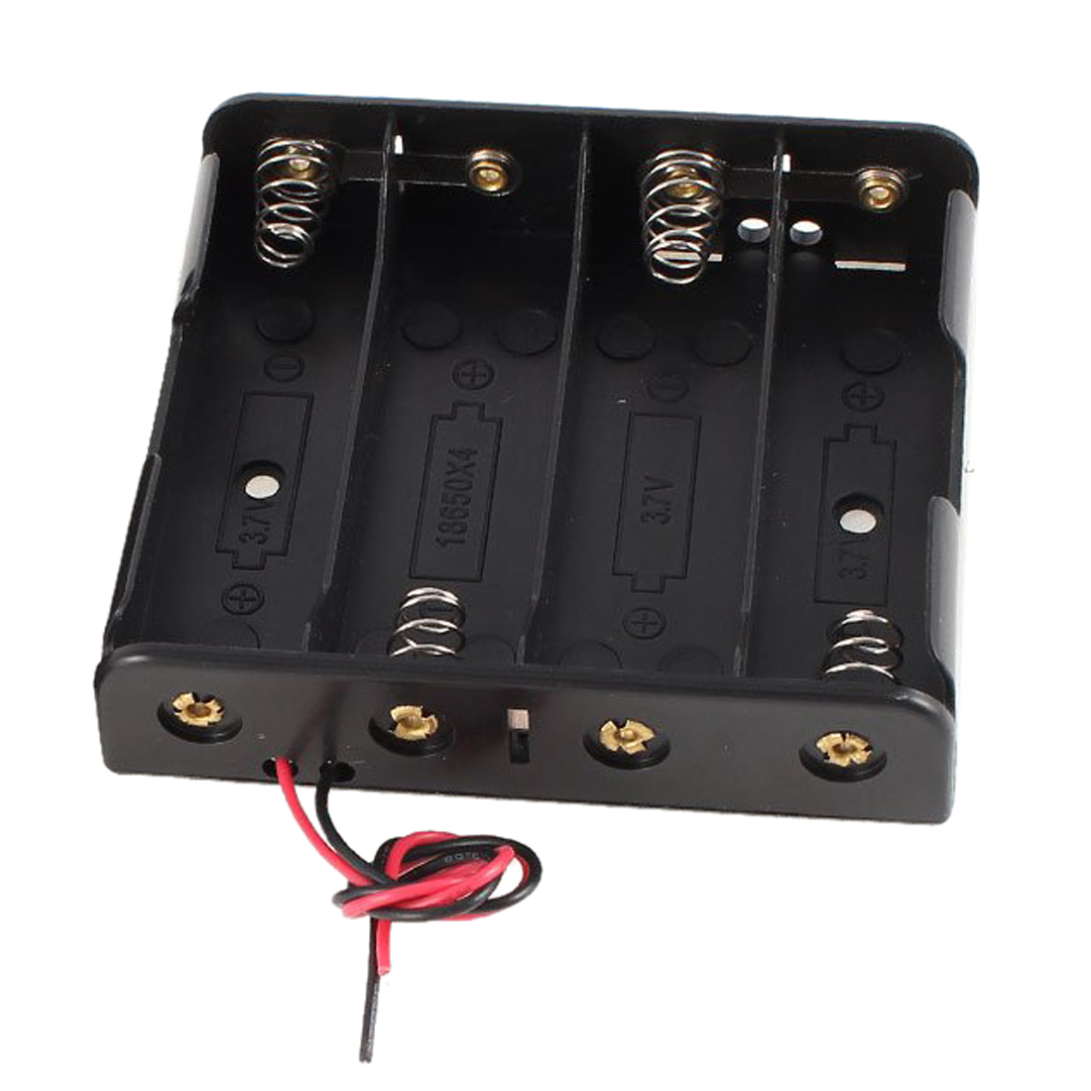
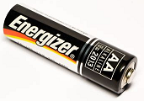
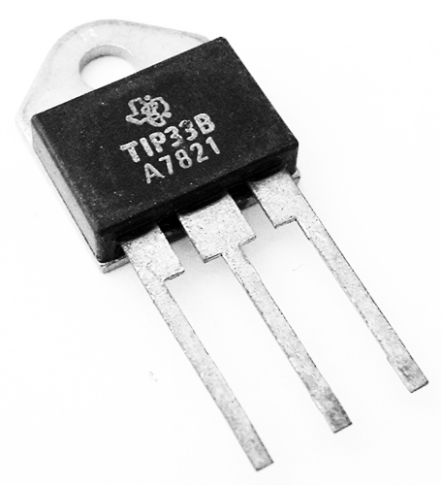
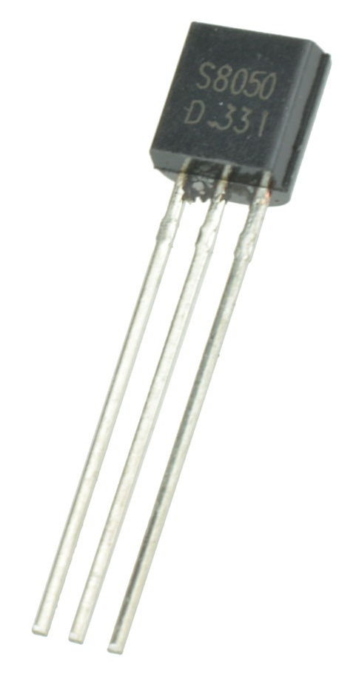
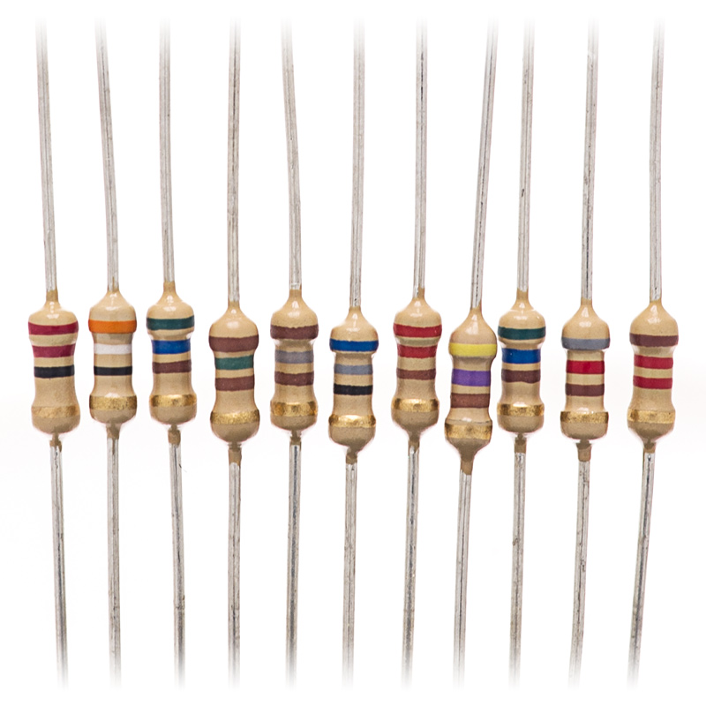
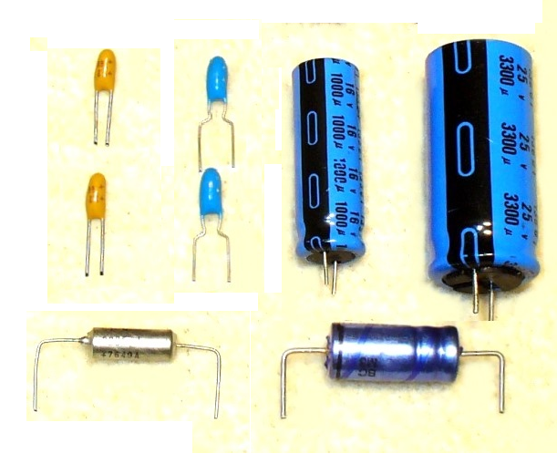
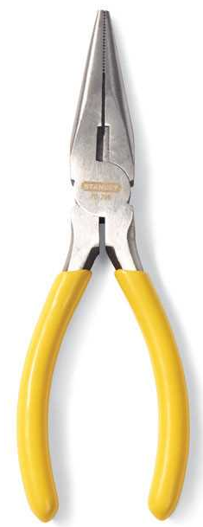


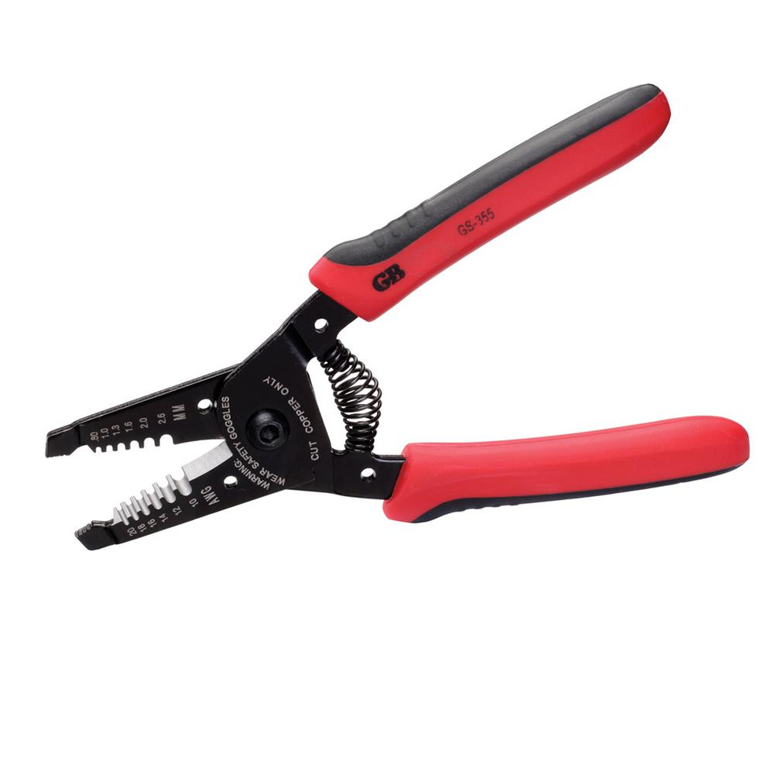
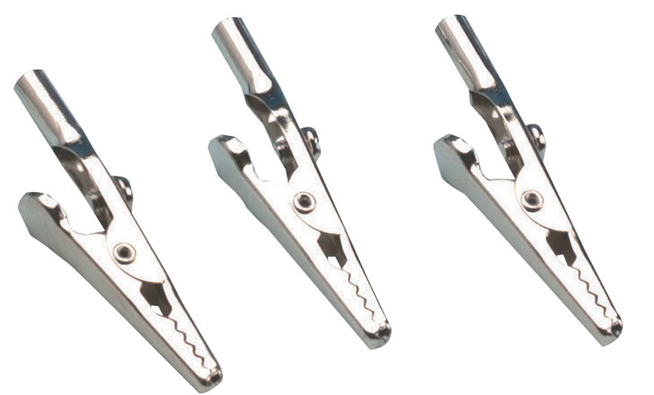
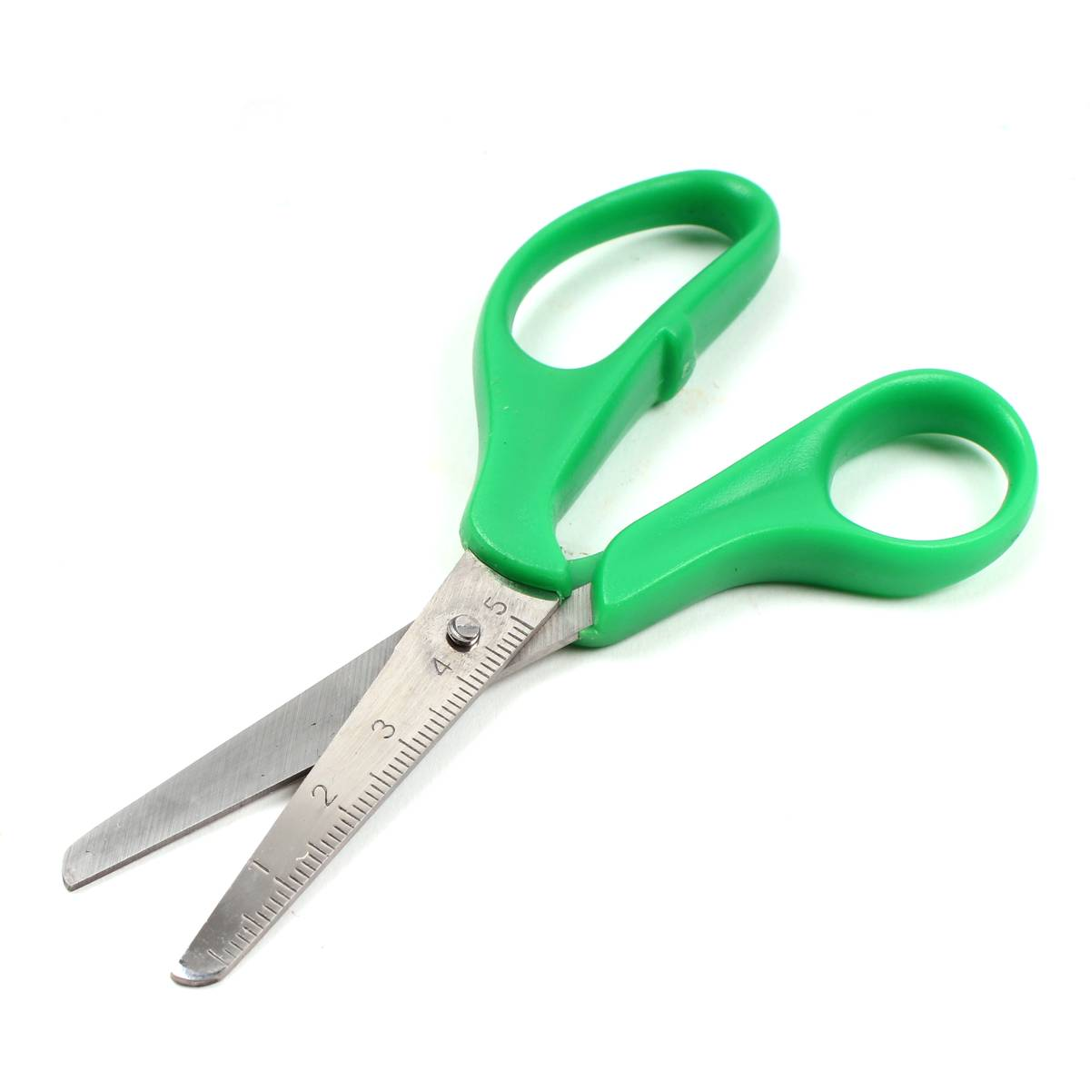
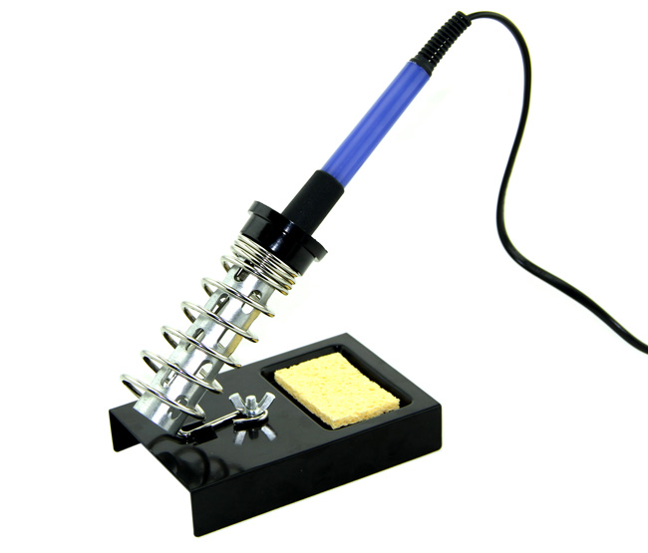
What you need
Solderless Breadboard
LEDs
Wire
Coloured Insulation
Battery Holder and 4 x 1.5V AA Batteries
NPN Power Transistors 3Amp
NPN Transistors
A Range of Resistors
A Range of Capacitors
Crocodile Clips
Tools

Slide 7
What you need
Coloured Insulation – you may wish to strip the insulation from some wires
NPN Power Transistors 3Amp – e.g. TIP31C transistor
We suggest a 3A Transistor to avoid overheating
NPN Transistors – e.g. 2N4401 Low Power NPN Transistor
A Range of Resistors – e.g. 6𝞨, 10𝞨, 500𝞨, 1K𝞨, 100K𝞨, 1M𝞨, 10M𝞨, 100M𝞨
– several of each
A Range of Capacitors – e.g. 2𝞵F, 1𝞵F, 0.1𝞵F, 0.01𝞵F, 100𝞺F, 50𝞺F
– several of each

Slide 8
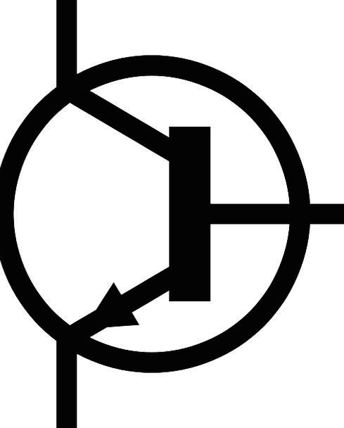
+6V
This is the circuit that you should build
three times for Red, Blue and Green LEDS
It is called an A-Stable Multivibrator
R1
R2
R3
Lights
C1
C2
R4
A-Stable means that it does not
become stable on one “side” or the other.
It switches continuously.
T1
T2
-V

Slide 9
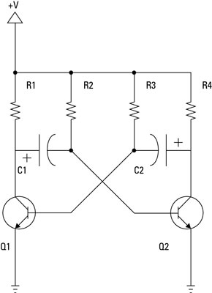
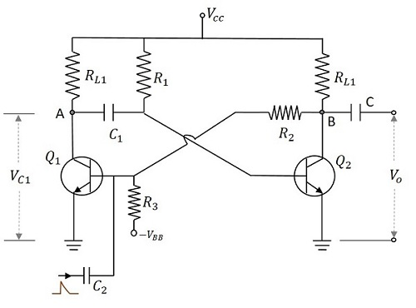
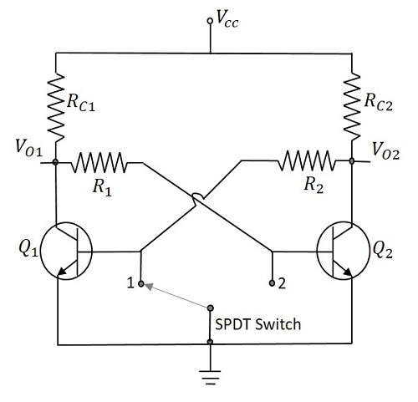
Mono-Stable
Multivibrator
Always finishes on
one side
Bi-Stable
Multivibrator
Always switches to
the side chosen
A-Stable
Multivibrator
Always switches continuously

Slide 10

Either solder the wires
or wrap them tightly but
carefully.
How to wire the lights
Resistance R4
How to choose R4 to limit the current
Each LED needs 0.020A so if you have
10 LEDs in the line you need 0.2A
The formula is V=IR where V=Volts,
I=Current, R-Resistance
With a 6V supply and 10 LEDs you need
6 = 0.2R so R=6 0.2 = 30𝞨
Black Sleeving
Red Sleeving
Blue Sleeving
Green Sleeving
R4
Red Lights
+V
Blue Lights
R4
Green Lights
R4
Approximately equal distances – e.g. 15cm
Longer lead to +V Shorter lead to other wire

Slide 11
Either solder the wires
or wrap them tightly but
carefully.
Or wire the lights randomly
Black Sleeving
Red Sleeving
Blue Sleeving
Green Sleeving
R4
Red Lights
+V
Blue Lights
R4
Green Lights
R4
Approximately equal distances – e.g. 15cm
Longer lead to +V Shorter lead to other wire

Slide 12
1 2 3 4 5 6 7 8 9 0 1 2 3 4 5 6 7 8 9 0 1 2 3 4 5 6 7 8 9 0

Slide 13
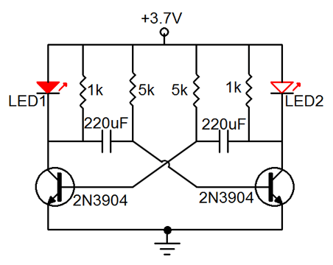
Reminder
This is the circuit that you should build
three times for Red, Blue and Green LEDS
It is called an A-Stable Multivibrator
+V
R1
R2
R3
Lights
C1
C2
A-Stable means that it does not
become stable on one “side” or the other.
It switches continuously.
T1
T2
-V

Slide 14
Reminder
Choose the values of the resistors and capacitors for
each of the three circuits
Use different values for each circuit to change the timing
of the switch-overs
The Time formula is:
Time = Resistance X Capacitance
e.g. 2sec = 2M𝞨 X 1𝞵F
M=Mega = x 1,000,000 = 1 Million
𝞵 = Micro = x 0.000,001 = 1 Millionth
+V
R1
R2
R3
Lights
C1
C2
T1
T2
-V

Slide 15
Choosing the values of the resistors and capacitors
Time = Resistance X Capacitance
Examples:
Choose both R1, R2 and both C1 and C2 as 2M𝞨 X 1𝞵F = 2 Sec
The red light will come on for 2 sec and then go off for 2 sec.
Choose both R3, R4 and both C3 and C4 as 1M𝞨 X 1𝞵F = 1 Sec
The red light will come on for 1 sec and then go off for 1 sec.
Choose both R5, R6 and both C5 and C6 as 1M𝞨 X 1.5𝞵F = 1.5 Sec
The red light will come on for 1 sec and then go off for 1.5 sec.
Problem: the lights will synchronise

Slide 16
Choosing the values of the resistors and capacitors
Time = Resistance X Capacitance
Examples:
But choose your own values and try to calculate what will happen
By choosing values related to prime numbers the lights will not synchronise for the cycle times multiplied together
3.8 X 3.4 X 2.6 = 33.592 seconds
Or will they?
Choose both R1, R2 and both C1 and C2 as 1.9M𝞨 X 1𝞵F = 1.9 Sec
The red light will come on for 1.9 sec and then go off for 1.9 sec.
Choose both R3, R4 and both C3 and C4 as 1.7M𝞨 X 1𝞵F = 1.7 Sec
The red light will come on for 1.7 sec and then go off for 1.7 sec.
Choose both R5, R6 and both C5 and C6 as 1.3M𝞨 X 1𝞵F = 1.3 Sec
The red light will come on for 1.3 sec and then go off for 1.3 sec.
The lights will appear not to synchronise for many seconds

Slide 17

1 2 3 4 5 6 7 8 9 0 1 2 3 4 5 6 7 8 9 0 1 2 3 4 5 6 7 8 9 0

Slide 18
1 2 3 4 5 6 7 8 9 0 1 2 3 4 5 6 7 8 9 0 1 2 3 4 5 6 7 8 9 0

Slide 19

How did you do?

Slide 20

You learnt:
- About LEDs
About electronics
About multivibrators
To work in teams
To work as engineers
Well Done Everyone !!!

Slide 21

