Slide 1
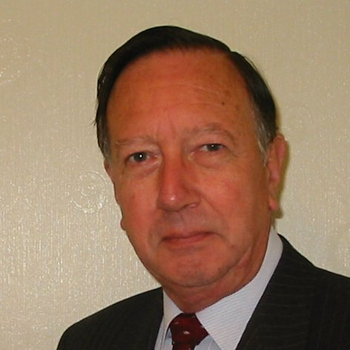
Welcome
These challenges were developed by Derrick Willer MBE and colleagues.
They are free to download and use in an education environment.
Please ensure that there is adult supervision, complete adherence to Health and Safety, and adequate PPE.
Derrick is a STEM Ambassador.
He has supported education in schools and colleges for over 30 years, initially as a Neighbourhood Engineer in the 1980’s, leading the local Year of Engineering Success campaign in 1996 and the Campaign to Promote Engineering from 1997 to 2004.
He was awarded an MBE for services to Education in 2018.

Slide 2
Guide
This exercise introduces pupils to fossils and helps them make a replica fossil.
Risks
Mandatory close supervision by a competent adult
Item | Risk | Avoidance Action
Tools | Injury | Close supervision
Oven | Injury | Close supervision
Aggression between those present | Injury | Close supervision and immediate action to defuse aggression

Slide 3
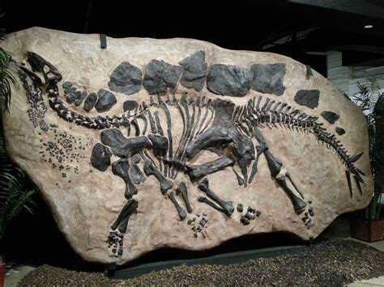
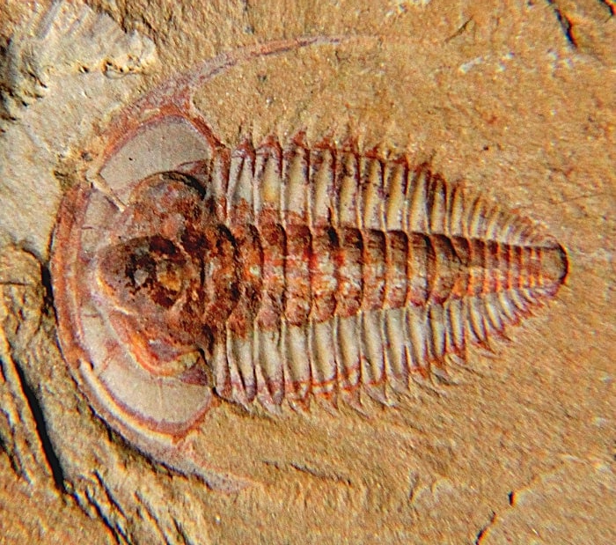
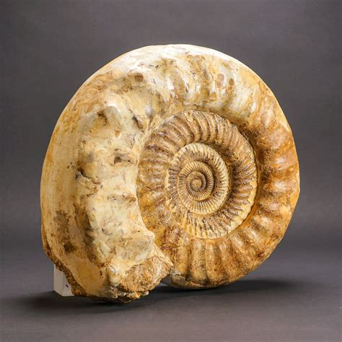
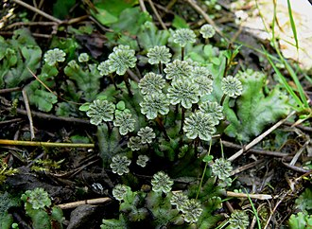
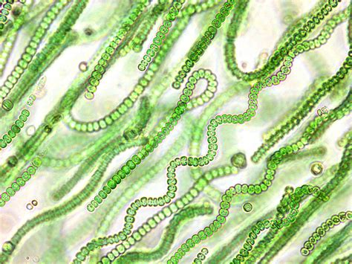
What are Fossils?
Fossils are the outlines of dead animals and plants trapped in rock or limestone
They are many millions of years old
Dinosaur fossils are about 60 to 100 millions old
Trilobite fossils may be as old as 500 million years
Ammonite fossils may also be as old as 500 million years
Leaves may be also over 500 million years old
Some bacteria fossils are over 3 billion years old
Dinosaur
Trilobite
Ammonite
Marchantia
Cyanobacteria

Slide 4
Where are Fossils found?
Fossils are found in rock or limestone
There are many places where they are commonly found
In the UK the Jurassic Coast in Doeset
In the USA in Oregan Utah, Ohio, S. Carolina
In Asia, China, south Asian contries
In Africa, most countries in East Africa and South Africa
In Australiasia, mostly in south-east Australia and some in Antarctica
Dinosaur
Trilobite
Ammonite
Marchantia
Cyanobacteria

Slide 5
Lets all make a Fossil

Slide 6
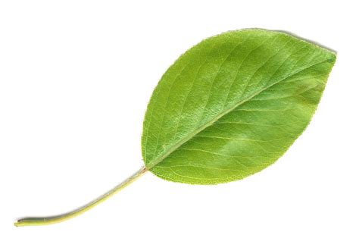
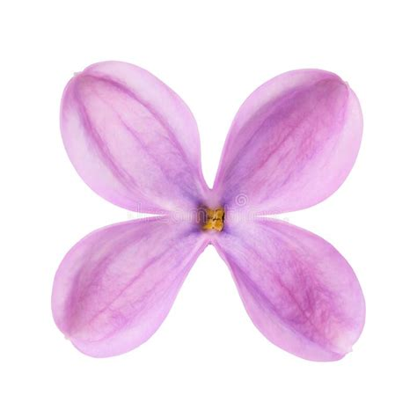
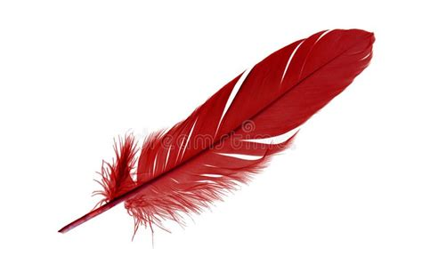
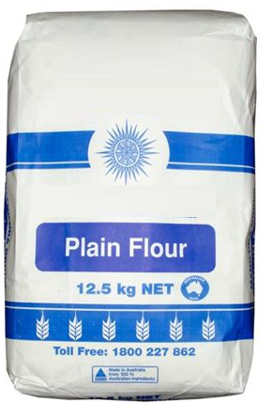
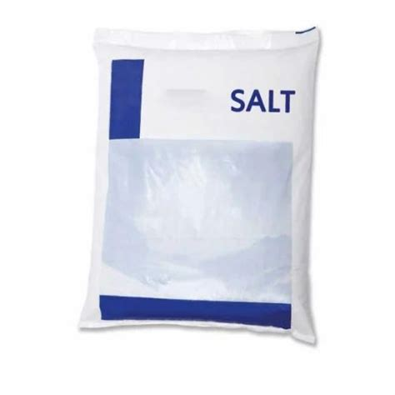
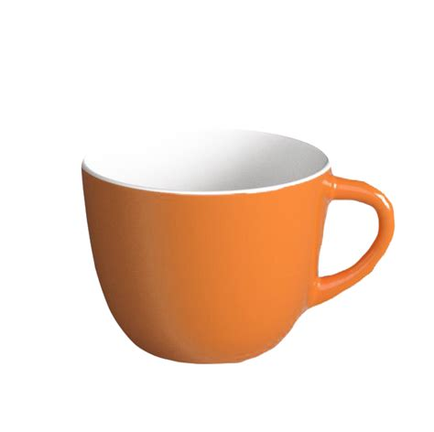
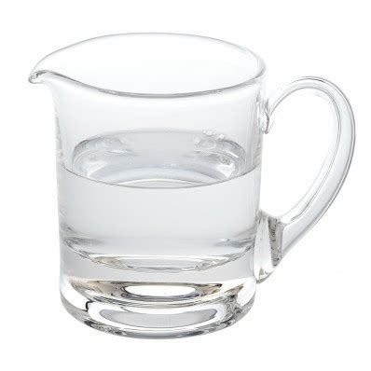
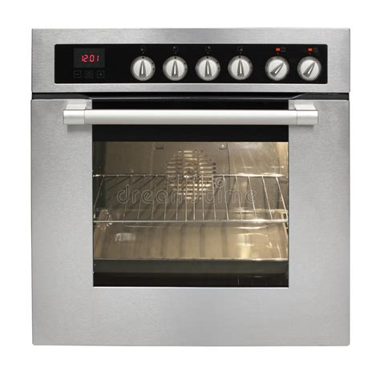
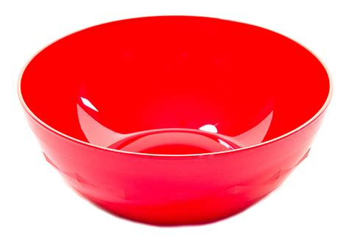
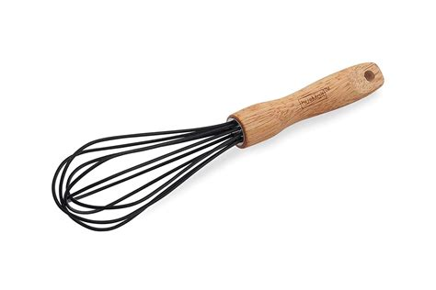
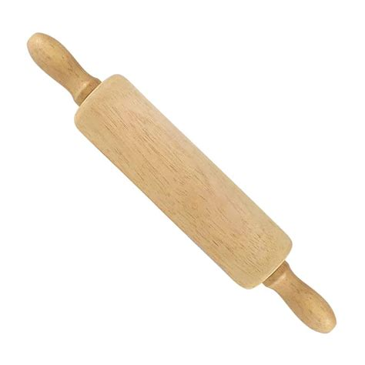
You need:
Leaves, flower petals or feathers
I cup of plain flour
Half a cup of salt
Half a cup of water
A bowl
Whisk for mixing
Rolling pin
Oven
Adult supervision

Slide 7
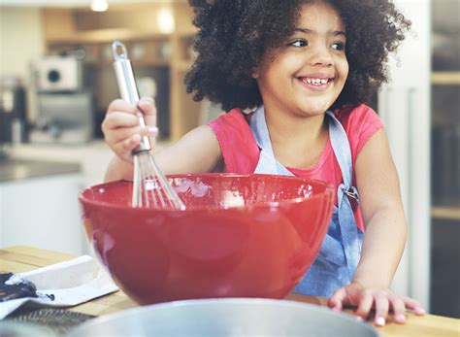
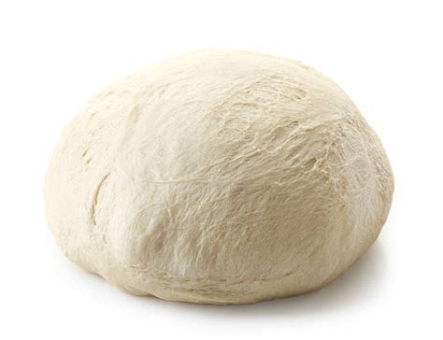
What To Do:
Mix the flour and salt in a bowl
Add water a drop at a time and mix with the whisk
Mix until it forms a dough
Sprinkle some flour onto a clean surface
Take a piece of dough and roll into a ball
Adult supervision

Slide 8
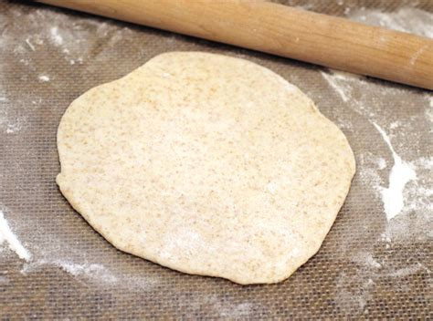
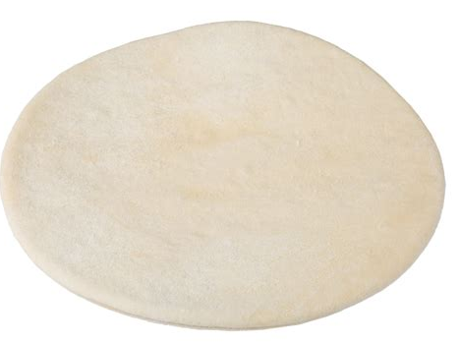
What To Do:
Flatten the dough with you hand or the rolling pin until it is just bigger than your specimen (the leaf, petal or feather)
Press the specimen into the dough, use the rolling pin
Peel away the specimen
Bake your fossil in the oven at 100ºC for 1 to 2 hours
Adult supervision

Slide 10
Well Done

