Slide 1
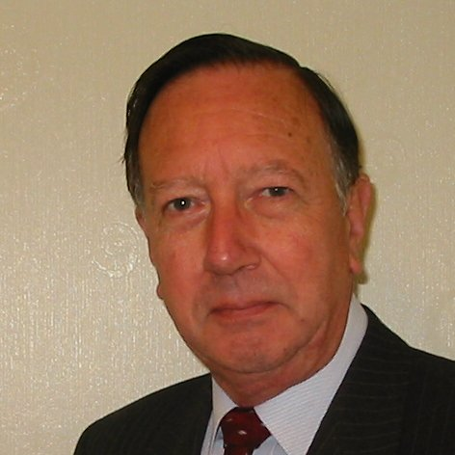
Welcome
These challenges were developed by Derrick Willer MBE and colleagues.
They are free to download and use in an education environment.
Please ensure that there is adult supervision, complete adherence to Health and Safety, and adequate PPE.
Derrick is a STEM Ambassador and volunteer Liaison Officer for Schools.
He has supported education in schools and colleges for over 30 years, initially as a Neighbourhood Engineer in the 1980’s, leading the local Year of Engineering Success campaign in 1996 and the Campaign to Promote Engineering from 1997 to 2004.
He was awarded an MBE for services to Education in 2018.

Slide 2
Guide
This activity is for pupils to solve maths problems
Risks
Mandatory: close supervision by a competent adult
Item | Risk | Avoidance Action
Aggression between those present | Injury | Close supervision and immediate action to defuse aggression

Slide 3
Welcome
I very much hope that you will enjoy this fun maths activity and learn new things

Slide 4
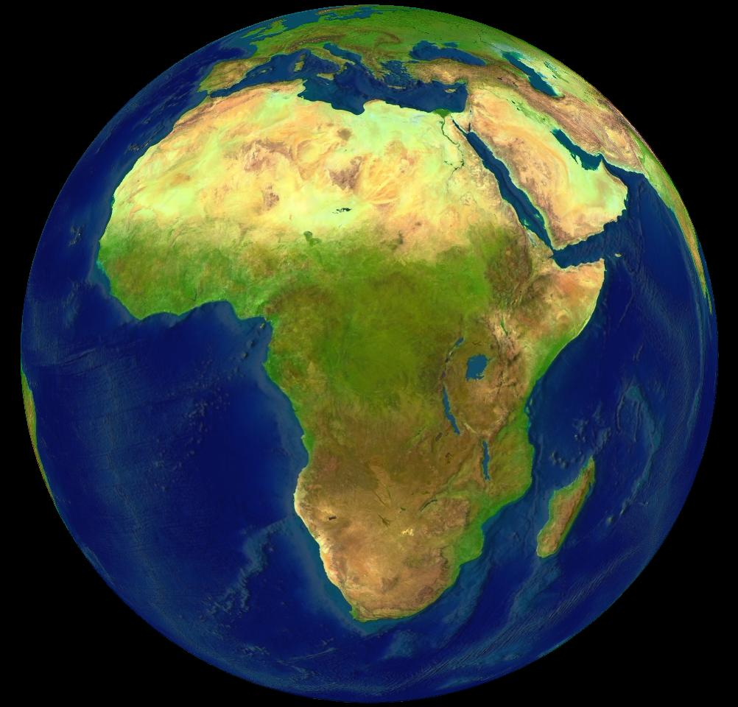

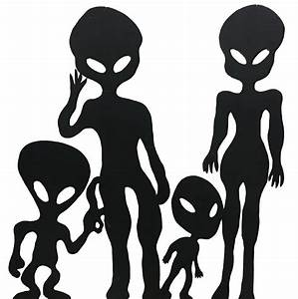
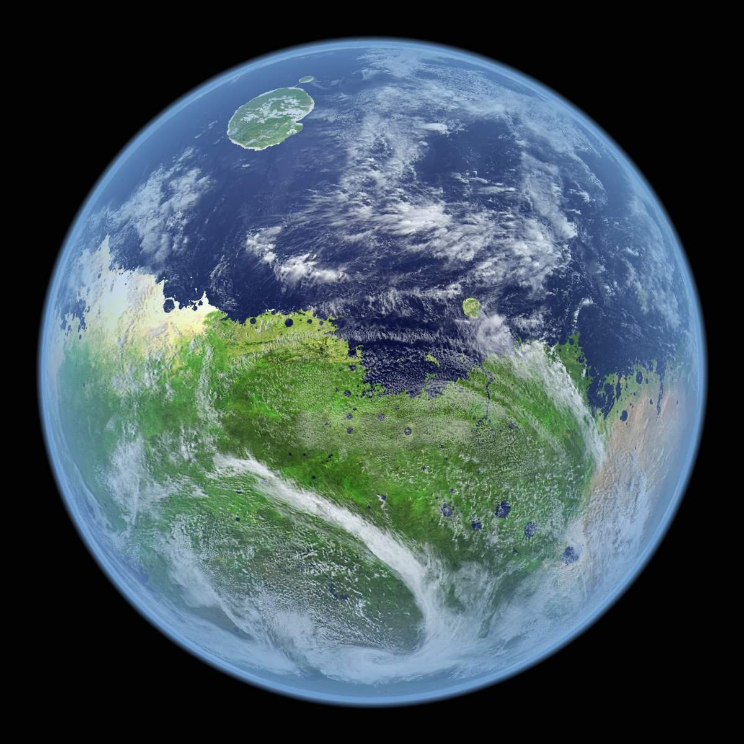
Here are some unusual if not funny mathematics
We will look at ourselves, some ancient peoples and some aliens
to see how they might do basic mathematics
Alien Planet

Slide 5
What am I doing?
1
2
10
11
12
20
21
22
100
101
1
2
3
4
5
6
7
8
9
10
I am counting
I am counting in threes
Ternary
That is very unusual

Slide 6
Counting
1
2
3
4
5
6
7
8
9
10
Why do we count in tens?
Some civilisations used different counting methods.
We think that the Aztecs used 20.
The Babylonians have used 60.
There are some indigenous groups of people in South America who used 3 or 4.
We think that it is because we have five digits on each hand

Slide 7
Counting
1
2
3
4
5
6
7
8
9
10
So how would this alien count?
Counting in Sixes
It has three digits on each arm.
So it might count in threes
But more likely I sixes
1
2
3
4
5
10
11
12
13
14
15
20
21
22
23
24
25
30
31
32
33
34
35
40
41
42
43
44
45
50
51
52
53
54
55
100

Slide 8
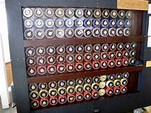
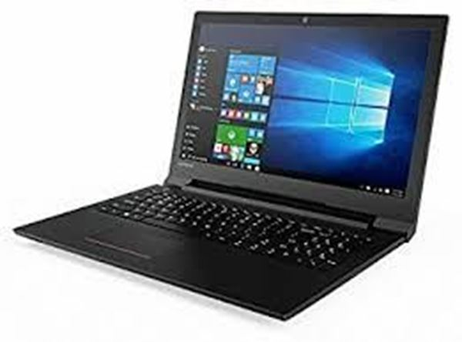
Counting
First Computer – The Bomb – WW2
1
2
3
4
5
6
7
8
9
10
So how am I
counting now?
1
10
11
100
101
111
1000
1001
1010
1011
I am counting in twos
Binary
Just like a computer

Slide 9

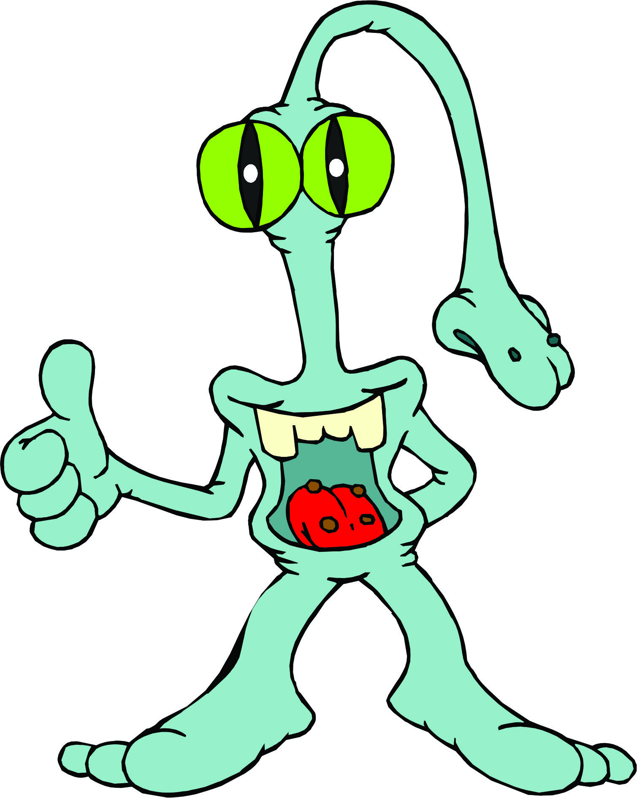
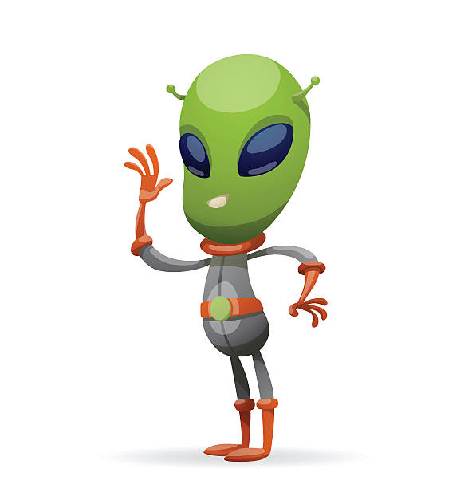
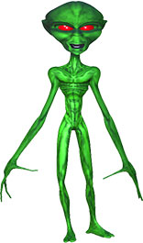
Counting
Across the universe which method of counting would we expect to discover?
Does it depend on how many “fingers” are on an alien’s “hand” and how many “arms” it has?
1
10
11
100
101
111
1000
1001
1010
1011
Any very intelligent alien should have discovered the nature of germanium and silicon?
So they would have made computers and these count in binary

Slide 10
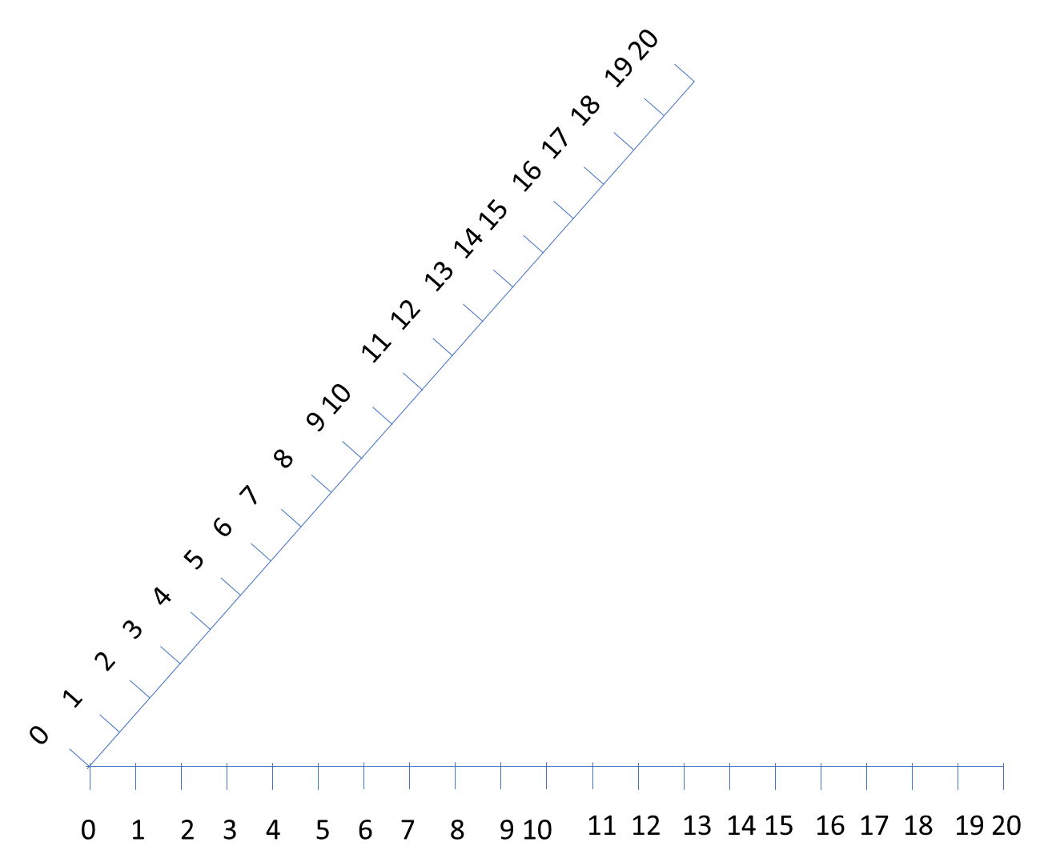
Multiplication
How can you multiply by using two lines at an angle?
Hippocrates of Chios was
first to discover this in
Ancient Greece
He uses geometry
Suppose we need to work out 4 x 5
First draw two grids with equal spaces
Between number
It does not matter what angle you choose

Slide 11
Multiplication
Multiplication using
Hippocrates of Chios
Now join the points 5 and 1

Slide 12
Multiplication
Multiplication using
Hippocrates of Chios
Using the same slope connect
all the points from 2,3 and 4
You get the correct answer that 4 x 5 = 20

Slide 13
Multiplication
And you can also do Division
Divide 18 by 3
Connect 18 and 3 and copy the slpes of the lies
You get the correct answer that 18 divided by 3 = 6

Slide 14
Square Roots
Hippocrates of Chios also discovered how to calculate square roots using geometry
He uses the Mesolabe Compass
√X
X
1

Slide 15
Square Roots
Any triangle where the base is a diameter and the peak is on the circumference is always a right-angled triangle
In this triangle two sides are equal to the radius so the two angles α are equal
(Equilateral Triangle)
The same for this triangle two sides are equal to the radius so the two angles β are equal
β
α
First draw the other radius
α
β
This is known as Thales' theorem
The sum of all the angles in the large triangle (the two smaller ones combined) are equal to 180º
So 2α plus 2 β = 180º So α + β = 90º

Slide 16
Square Roots
Mesolabe Compass
Say we want to calculate or measure the square root of X
Draw a circle diameter X + 1
Measure the vertical at distance X
The length of this vertical is √X
0 1 2 3 4 5 6 7 8 9 10
B
C
A
Why?
D
1
X

Slide 17
Square Roots
In the triangle ABC this angle is always a right angle
(Thales Theorem)
And the other angles are similar
So the two smaller triangles are similar
Mesolabe Compass
0 1 2 3 4 5 6 7 8 9 10
B
So the ratio DC to BD is the same as BD to AD
DC = BD so DC x AD = BD x BD
BD AD
But DC = 1 so AD = BD²
So BD = √AD
A
D
C
1

Slide 18
Square Roots
Now you know how it works
Measure the square root of the following
16, 25
And if you have large enough sheets of paper
36, 49
Mesolabe Compass
0 1 2 3 4 5 6 7 8 9 10
B
C
A
D
1

Slide 19
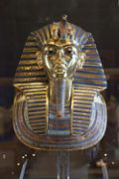
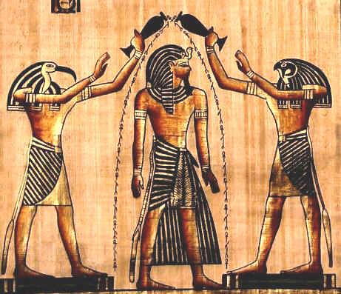
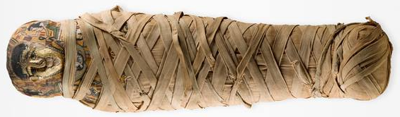
Egyptian Counting
Please pretend you are an Egyptian at the time of Tutankarmun
You have a problem with multiplying and dividing by any number except 2
How can you multiply, say, 17 X 23 ?
Don’t ask your Mummy

Slide 20
Egyptian Counting
15 X 23 = ?
17
16
8
4
2
1
17
First of all put the numbers 1,2,4,8 …… to a number below 17 and arrange them largest first
Which of these adds up to 17?
Cross out the ones which are not needed

Slide 21
Egyptian Counting
15 X 23 = ?
17
16
8
4
2
1
17
23
23
46
92
184
368
Now write under the 23 put 2X23 etc., double each line
Now cross out the numbers opposite those crossed out under 17
Add those that are left
391
391 is the correct answer

Slide 22
Egyptian Counting
15 X 23 = ?
17
16
8
4
2
1
17
23
23
46
92
184
368
Now please do some sums of your own using the Egyptian method.
1
0
0
0
1
17
1
2
4
8
16
17
Did you notice these are Binary numbers?
Like the computer uses to do sums.
10001 in Binary is 16 in Decimal
391

Slide 23
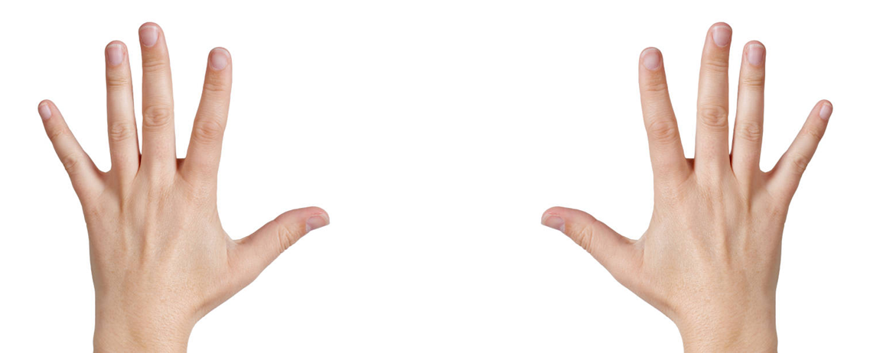
Handy Multiplication
How can you multiply together two numbers from 6 to 10 by using your hands?

Slide 24
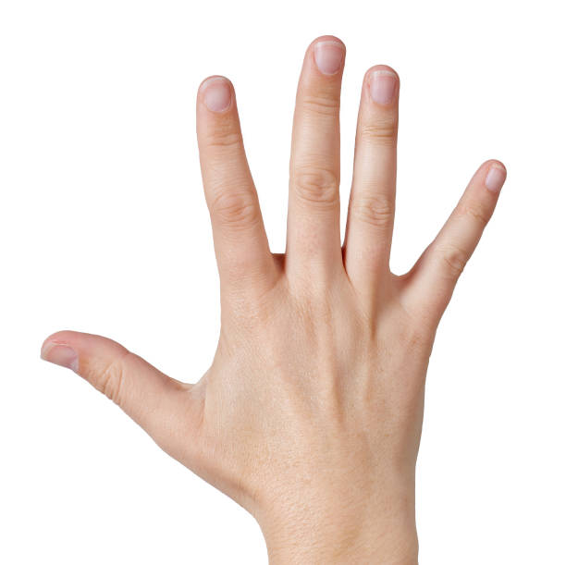
Handy Multiplication
First of all allocate the numbers 6 to 10 to your fingers
Begin with the thumb.

Slide 25
Handy Multiplication
First of all allocate the numbers 6 to 10 to your fingers
Begin with the thumb.
9
8
9
8
7
7
10
10
Now let us try 7 X 8
6
6

Slide 26
Handy Multiplication
Now let us try 7 X 8
Move each hand so the 7 on one hand is opposite the 8 on the other
9
8
7
9
8
10
7
10
6
6
Draw a line above the two fingers 7 and 8 pointing to each other

Slide 27
Handy Multiplication
Now let us try 7 X 8
There are five fingers below the line – this is the tens figure = 50
9
8
7
9
8
10
7
10
6
6

Slide 28
Handy Multiplication
Now let us try 7 X 8
Can you prove that it works for any number 6,7,8,9 or 10
Try some other numbers to learn how it works
Above the line there are 3 fingers on one hand and 2 on the other
Multiply these together = 3 X 2 = 6
This is the units figure
9
8
7
Add the tens and units figures = 50 + 6 = 56 Correct
9
8
10
7
10
6
6

Slide 29
Handy Multiplication
The Proof
Start by using a number A for one hand and B for the other
A and B each represent any number
(10-A Fingers)
(10-B Fingers)
A
B
Above the line there are (10-A) fingers on one hand and (10-B) on the other.

Slide 30
Handy Multiplication
The Proof
Below the line we have
(10-A Fingers)
(10-B Fingers)
A
B
Below the line there are 5-(10-A) and 5-(10-B) fingers.
Add these we get 5-10+A + 5-10+B = A+B-10
So (A+B-10) is out tens figure = 10 x (A+B-10) = 10A + 10B - 100

Slide 31
Handy Multiplication
The Proof
Above the line there are (10-A) fingers on one hand and (10-B) on the other.
(10-A Fingers)
(10-B Fingers)
A
B
Multiply these together (10-A) x (10-B)
To do this we multiply each part of the (10-A) by each part of (10-B)
We get 10x10 - 10xB – 10xA + AxB
Equals 100 – 10B – 10A + AB

Slide 32
Handy Multiplication
The Proof
10A + 10B – 100 is out tens figure
100 – 10B – 10A + AB is our units figure
So we have proved that the method for all numbers 6 up to 10
(10-A Fingers)
(10-B Fingers)
X
Y
Now add our two answers together.
10A+10B-100 + 100-10B-10A+AB =AB
But when we write AB it means A X B

Slide 33
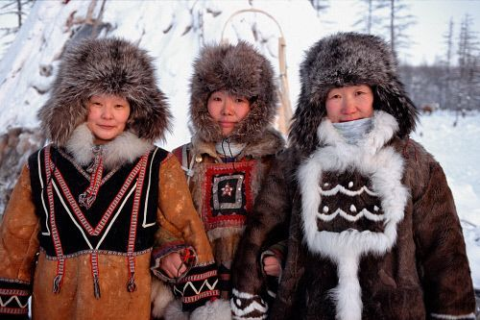
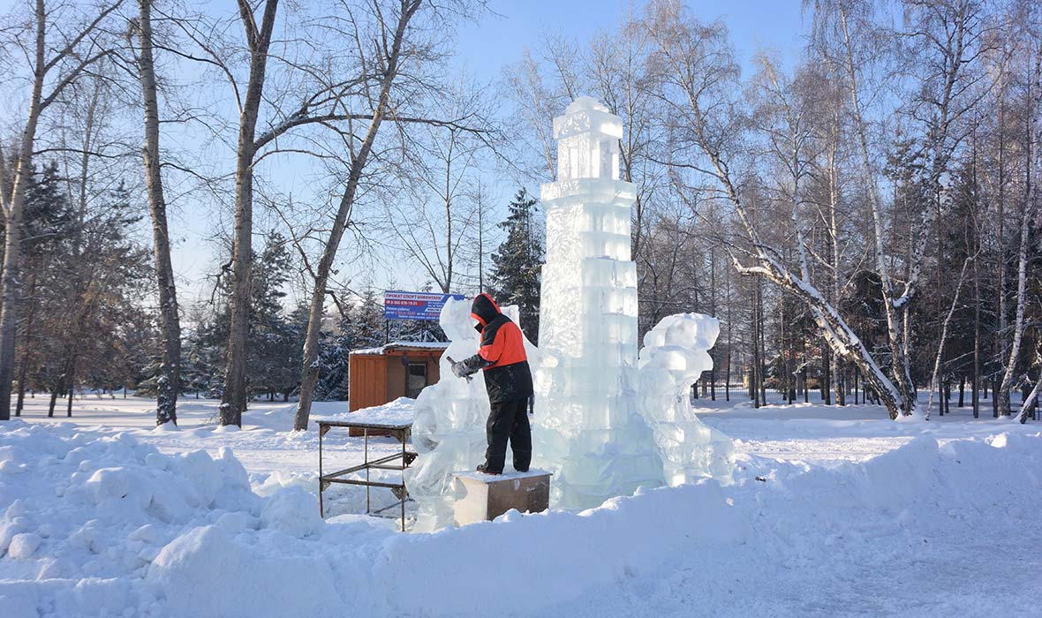
Siberian Counting
Now the Russians and particularly the Siberians have yet another method of multiplying.
I will show you using 17 X 23

Slide 34
Siberian Counting
Write down 17
Write down half of 17 = 8 ½
Russians do not like fractions so delete the ½
Half of 8 is 4, then halve again = 2, and again = 1
17
8½
4
2
1

Slide 35
Siberian Counting
Now write down 23
Under it write down 2 X 23 = 46,
then double this, etc
until you are level with the 1.
17
8½
4
2
1
23
46
92
184
368

Slide 36
Siberian Counting
Now please do some sums of your own using the Siberian method.
Russians also do not like even numbers as well as fractions.
So cross out the lines with even numbers
17
8½
4
2
1
23
46
92
184
368
Now add up the numbers left under the 23
391
391 is the correct answer

Slide 37
Sum Roman Arithmetic
I = 1
V = 5
X = 10
L = 50
C = 100
D = 500
M = 1000
Convert to our normal numbers
What does
XIX = ?
XIX = 19
What does
XCV1 = ?
XCV1 = 96
What does
MCDLXVI = ?
MCDLXVI = 1466

Slide 38
Sum Roman Arithmetic
So lets try multiplication
Despite all of these problems the Romans had many good accountants
XIX x X111 = ?
XIX x X111 = CCXLVII
XL x LX1 = ?
XL x LX1 = MMCDXL
Did you convert each sum to our number system 1,2,3,…..99,100

Slide 39
Sum Roman Arithmetic
So lets try multiplication
What is
XIX x X111 = ?
19 x 13 = ?

Slide 40
Sum Roman Arithmetic
So lets try multiplication
It is actually easy to demonstrate doing it in our normal numbers
We multiply each digit at a time and add the result
XIX x X111 = ?
First multiply by the 10 in 13
using each digit of the 19 10 X 10 = 100
10 x 9 = 90
Now by the 3 in 13 3 X 10 = 30
3 X 9 = 27
-------------
Add them = 147
19 x 13 = ?

Slide 41
Sum Roman Arithmetic
So lets try multiplication
Multiply by X in XIX X x X = C
X x III = XXX
Now do the same with
Roman Numbers
Well done if you
managed to do
Roman Multiplication
Multiply by I in IX -I x X = -X
Remember to subtract -I X III = -III
XIX x X111 = ?
Multiply by last X in XIX X x X = C
X x III = XXX
We multiply each digit
at a time and add the result
-----------------
Add and Subtract = CCXXXXXX-X –III
Subtract one X = CCXXXXX-III
But XXXXX=L = CCL – III
And L-III is XL+VIII =CCXLVII

Slide 42

Thank You

