Slide 1
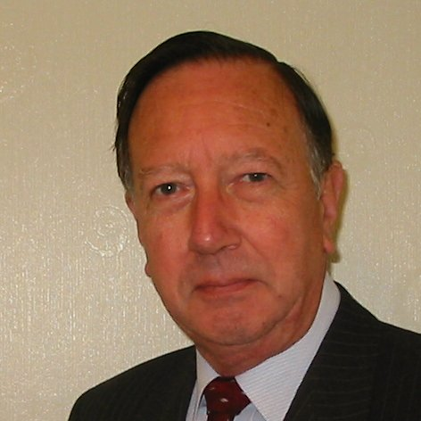
Welcome
These challenges were developed by Derrick Willer MBE and colleagues.
They are free to download and use in an education environment.
Please ensure that there is adult supervision, complete adherence to Health and Safety, and adequate PPE.
Derrick is a STEM Ambassador and volunteer Liaison Officer for Schools.
He has supported education in schools and colleges for over 30 years, initially as a Neighbourhood Engineer in the 1980’s, leading the local Year of Engineering Success campaign in 1996 and the Campaign to Promote Engineering from 1997 to 2004.
He was awarded an MBE for services to Education in 2018.

Slide 2
Guide
This exercise introduces pupils to aerofoil sections and helicopters
Please use slides at the end for the helicopter body
Risks
Mandatory: close supervision by a competent adult
Item | Risk | Avoidance Action
Tools | Injury | Close supervision
Glue | Spillage | Close supervision, sponge and water. If glue is ingested rinse moth with water and give water to drink.
Aggression between those present | Injury | Close supervision and immediate action to defuse aggression
Click to print the first appropriate slide for the pupils to cut out and colour

Slide 3



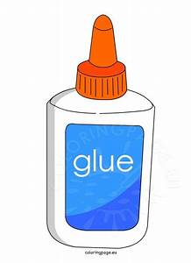
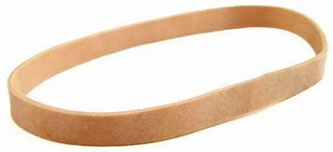
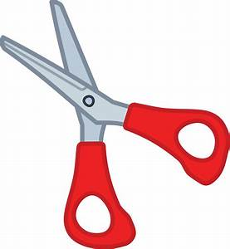
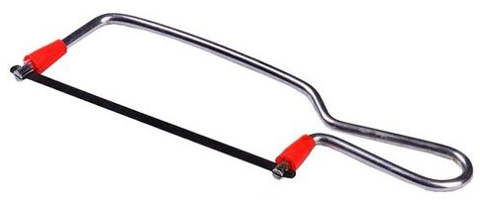
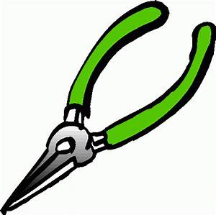
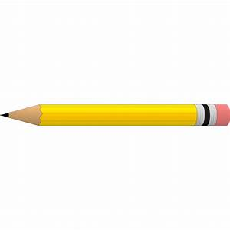
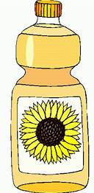
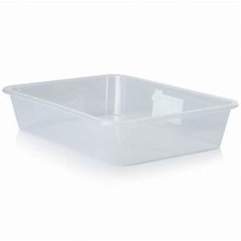
What You Need
Four A4 sheets of paper
Two ball-point pens
Two paper clips
Elastic band
Glue
Tools
1cm diam. dowel (or similar)
Pencil
Oil
Toothpick
Plastic

Slide 4
1cm
Make the tube for the elastic band.
Glue the end section of one sheet of paper.
Wind round a dowel or similar that is about 1cm diameter.
Take care not to glue the paper to the dowel.
Allow the glue to dry.
Glue
This
Area

Slide 5
Make the rotors.
Cut one sheet of paper in half and then into four equal sections.
Glue one edge section of each.
Fold the paper round a pencil so that you get an aerofoil shape.
Flatten one end about 1cm long.
Glue four blades together with flat side down and leading edges towards the rotation side.
Mark the exact centre where the blades are joined.

Slide 6
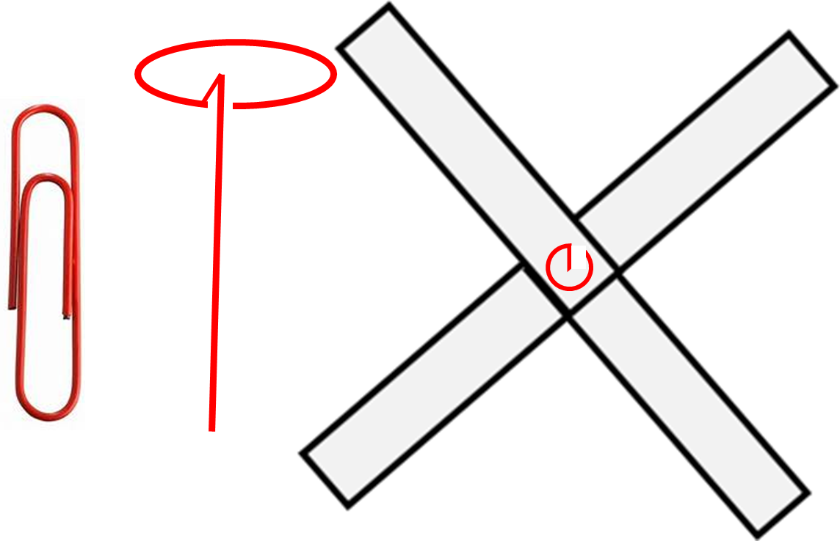
Make the hook.
Using wire like a paper clip.
Bend the wire to make a circle at one end.
Bend the wire towards the centre of the circle.
Bend the wire at the centre of the circle down.
Push the wire through the centre of the blades.
Glue the wire to the blades.

Slide 7

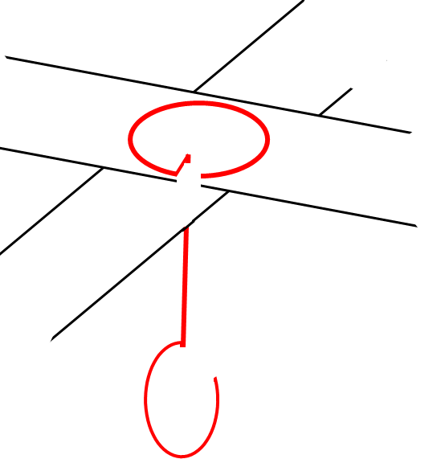
Make the hook.
Cut two circles from plastic about 2cm diameter.
Carefully saw off the tops of two plastic pens.
Place one plastic circle by the blades.
Place the two pen tips.
Place the other plastic circle.
Now carefully make the hook at the other end.
Use a toothpick to add a small drop of cooking oil to lubricate the pent tips.
Pen Tips

Slide 8
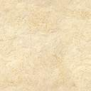

Assemble the complete rotor.
Put the elastic band onto the hook.
Carefully lower the elastic band into the tube.
Push the band through the tube with a pen or pencil.
Secure the bottom end of the elastic band with another paper clip.

Slide 9
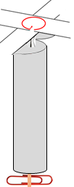
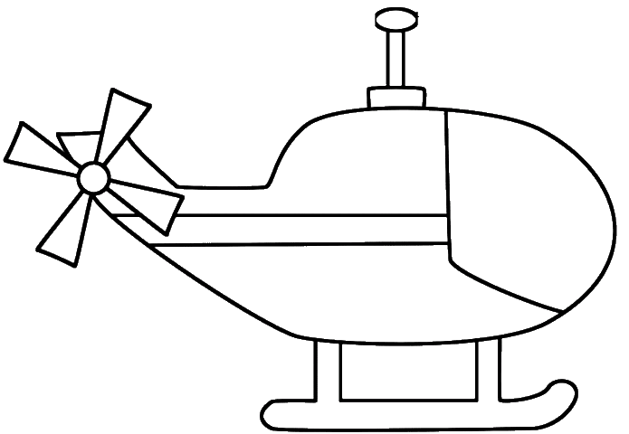
Assemble the body.
Choose a helicopter body and decorate it.
Carefully stick one side of the body to the tube.
Carefully align the other side of the body and stick to the tube.
Allow the glue to dry.

Slide 10
Fly the helicopter.
Wind the rotor counter-clockwise for about 50 turns.
Release the helicopter and see how high it flies.
Compare your helicopter with other pupils.
Which flies best?
Which is best made?
Which is best decorated?

Slide 11

What have you learnt?
To build a helicopter.
About aerofoil sections.
About using tools.
To work as an engineer.
Well Done Everyone

Slide 13
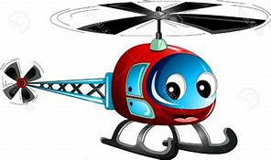
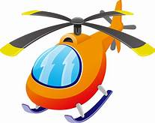
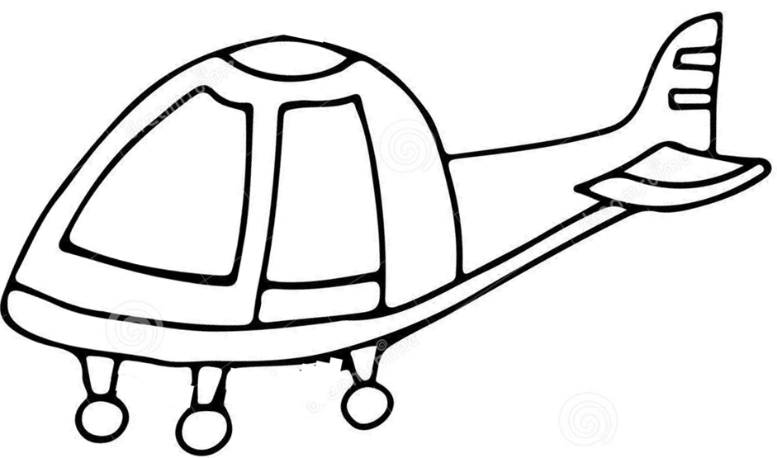
Helicopter
Copyright © Derrick Willer 2020
www.dwiller.com

Slide 14
Helicopter
Copyright © Derrick Willer 2020
www.dwiller.com

Slide 15
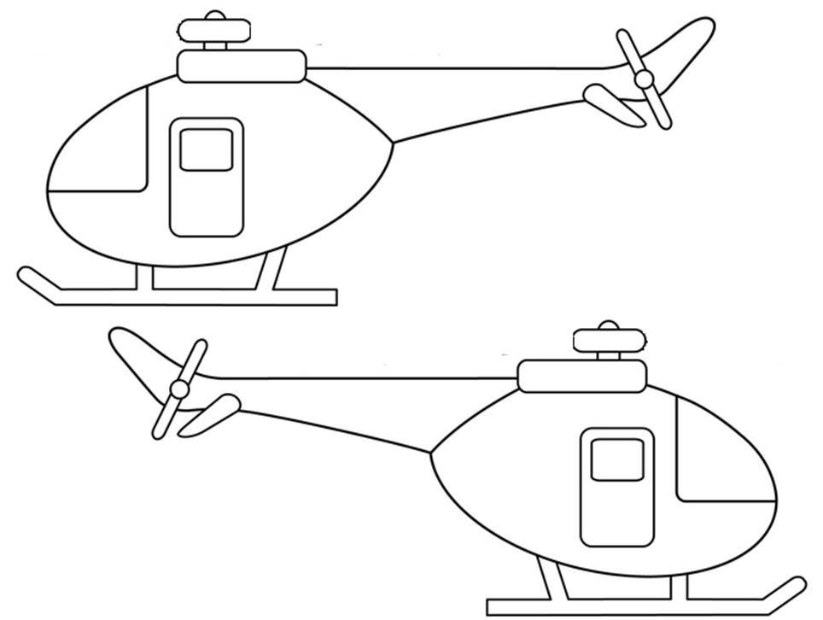

Slide 16
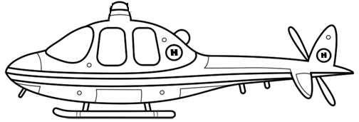

Slide 17
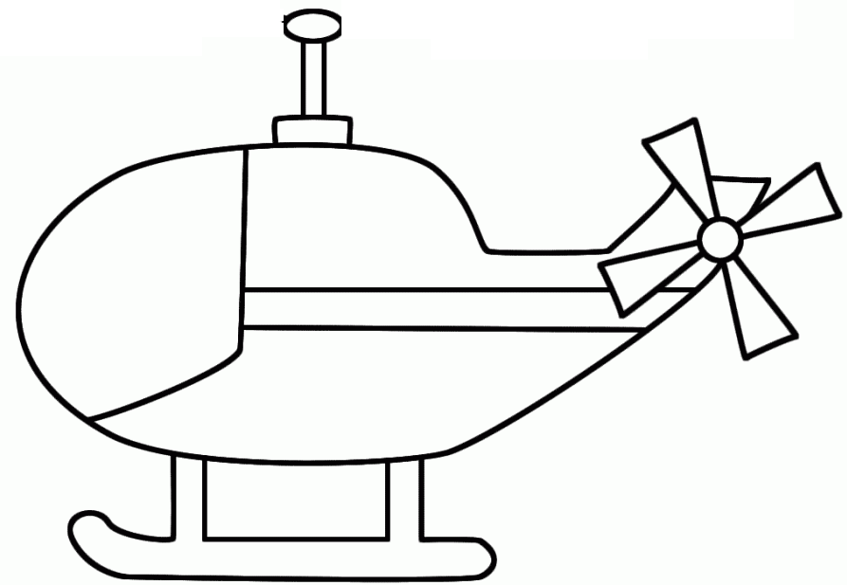

Slide 18
