Slide 1
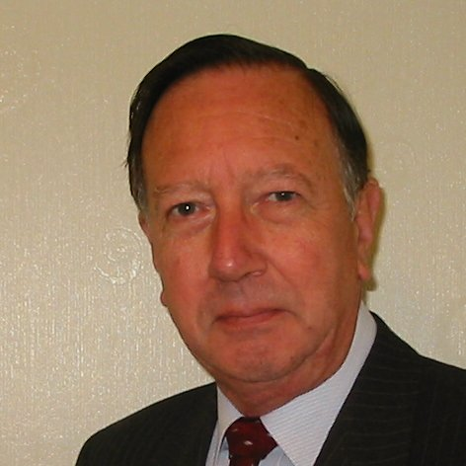
Welcome
These challenges were developed by Derrick Willer MBE and colleagues.
They are free to download and use in an education environment.
Please ensure that there is adult supervision, complete adherence to Health and Safety, and adequate PPE.
Derrick is a STEM Ambassador and volunteer Liaison Officer for Schools.
He has supported education in schools and colleges for over 30 years, initially as a Neighbourhood Engineer in the 1980’s, leading the local Year of Engineering Success campaign in 1996 and the Campaign to Promote Engineering from 1997 to 2004.
He was awarded an MBE for services to Education in 2018.

Slide 2
Guide
This exercise introduces pupils to the need to support the environment.
The pupils in team also design and make a mock-up of a product using recycled materials,
Risks
Mandatory: close supervision by a competent adult
Item | Risk | Avoidance Action
Equipment | Misuse and Mistakes Injury | Close supervision
Aggression between those present | Injury | Close supervision and immediate action to defuse aggression

Slide 3
Materials
Please make the following available
Laptop
Projector
Scissors
Stapler
Glue
Sticky Tape
Recycled Materials
such as paper, cloth, tin and plastic cans and bottles

Slide 4
Timing
Introduction and setting up teams 10 minutes
Discussion about rubbish 15 minutes
Teams prepare drawings about rubbish 15 minutes
Present drawings – 3 mins each 20 minutes
Discussion about making glass 30 minutes
Outline the project to make a gadget 10 minutes
Design 30 minutes
Make 60 minutes
Present 20 minutes
Winners 5 minutes
Close 5 minutes
Total 3 hrs 40 min

Slide 5
Rubbish !
What would your town look like
if the Bin-Men were not there!
Pictures and Words

Slide 6

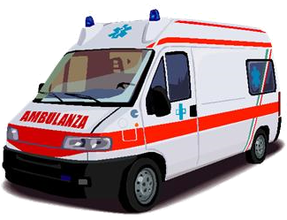


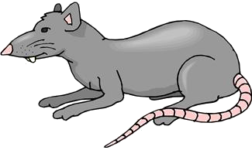

Rubbish !

Slide 7

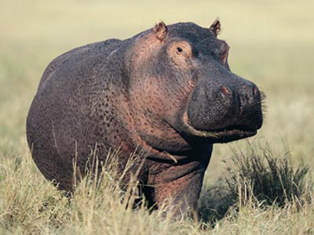
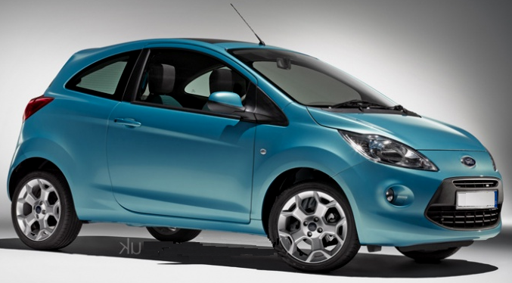
What Is Similar ?
Notes:
Enterprise capability includes the following skills:- organisation, inventiveness & creativity, risk management, decision making, leadership, perseverance, self confidence, competitiveness, flexibility
Financial capability includes: increasing your knowledge and understanding of cost & price, budgeting, financial planning & taking responsibility for the impact of financial decisions.
Business & Economic Understanding includes: gaining knowledge of the market place, competition, advertising/promotional material, needs & wants, supply & demand. Need to make decisions & realise the need to make effective use of limited resources.

Slide 8

I Ton Of
Rubbish
Per Family !

Slide 9
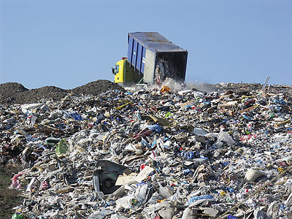
Notes:
Enterprise capability includes the following skills:- organisation, inventiveness & creativity, risk management, decision making, leadership, perseverance, self confidence, competitiveness, flexibility
Financial capability includes: increasing your knowledge and understanding of cost & price, budgeting, financial planning & taking responsibility for the impact of financial decisions.
Business & Economic Understanding includes: gaining knowledge of the market place, competition, advertising/promotional material, needs & wants, supply & demand. Need to make decisions & realise the need to make effective use of limited resources.

Slide 10
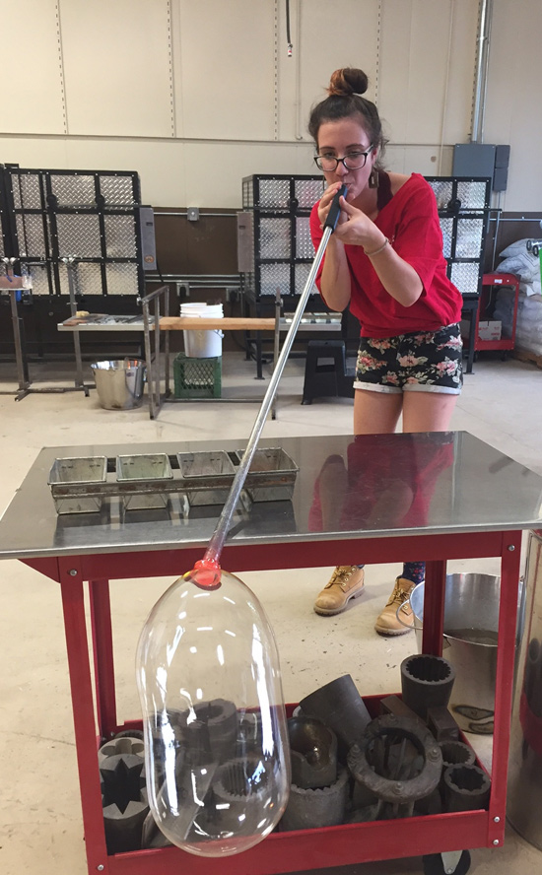
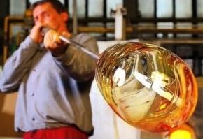
The Glass Blowers
Many years ago a village in the middle of a European country started glass blowing, based in their homes.
They used wood for their fires because they lived in a great forest.

Slide 11
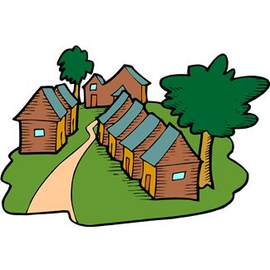
Let me show you how to make glass

Slide 12

I love making glass
Our forest is lovely
So they chopped down lots of trees

Slide 13
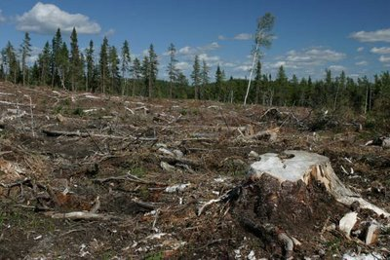
Until they had destroyed most of the nearby forest
And had to go miles away for their wood

Slide 14

Then one of the village elders had a bright idea
Every time we chop down a tree we plant three new small ones
=

Slide 15


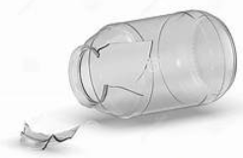
So they thought that they had solved the problem
But another problem reared its head
Broken Glass During Transit

Slide 16

And there were lots of returns of broken glass

Slide 17
So they needed to cut down more trees to make the cardboard packaging

Slide 18

Moral
Make sure you replenish trees
Make sure you recycle packaging
And you will help save the planet

Slide 19
Your Gadget
Working in teams
Please think of a useful item
Design your item
Make a mock-up using recycled materials
You will be marked on
Your design
Your finished product
Your presentation about your product
Teamwork
Please think about the following

Slide 20
We are learning to:
Create and design a new gadget to use in our House of Gadgets, which has to :
Be sustainable
Be environmentally friendly
Use renewable energy sources

Slide 21
We are learning to:
Research the market:
Who will buy our product?
Why will they want it?
What will they use it for?
What will the benefit of it be?
How much will you charge them for it?

Slide 22
We are learning to:
Design and create our sustainable gadget;
with the resources we have been given

Slide 23
We are learning to:
Give a presentation to sell our gadget for the House of Gadgets
This should include:
Name of your company & show logo
Which sector you chose
Results of your research
What your gadget is called
What the benefit of your gadget is
Why your gadget should earn a place in the House of Gadgets
2 minutes

Slide 24




Each team has five minutes for the presentation
Our
Gadget

Slide 25
We have learnt to:
Work and think as engineers by being creative, designing and building with the resources given
Understand the importance of sustainability
Work as a team with new people

Slide 26
Well Done, Everyone

Slide 27

Well Done
Thank You

