Slide 1

Welcome
These challenges were developed by Derrick Willer MBE and colleagues.
They are free to download and use in an education environment.
Please ensure that there is adult supervision, complete adherence to Health and Safety, and adequate PPE.
Derrick is a volunteer STEM Ambassador.
He has supported education in schools and colleges for over 30 years, initially as a Neighbourhood Engineer in the 1980’s, leading the local Year of Engineering Success campaign in 1996 and the Campaign to Promote Engineering from 1997 to 2004.
He was awarded an MBE for services to Education in 2018.

Slide 2
Guide
This activity is for pupils to understand the Japanese Multiplication method
of multiplying two two-digit numbers.
Mandatory: Competent Adult Supervision
Risks
Item | Risk | Avoidance Action
Pen or Pencil, Ruler | Injury | Close supervision.
Aggression between participants | Injury | Close supervision and immediate action to defuse aggression

Slide 3
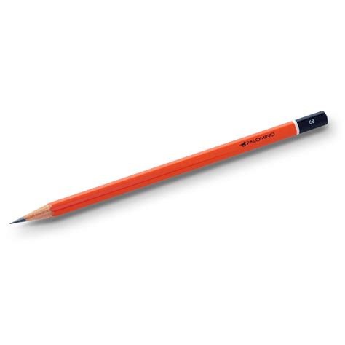
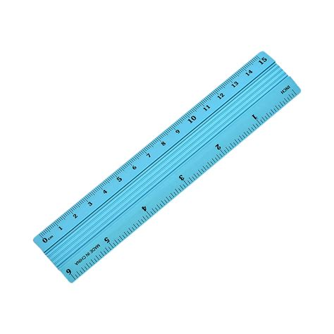
What you need
Pencil or Pen
Paper
Ruler

Slide 4
Example
Multiply 42 by 23
For 42 draw 4 lines for the 40 and 2 for the 2 at 45 Deg
For 23 draw 2 lines for the 20 and 3 for the 3 at -45 Deg
Now draw 2 arcs to segregate the left from the right and the centre

Slide 5
Example
Tens
Multiply 42 by 23
Count the number of intersections in the left section = hundreds = 8
Hundreds
Units
Count the number of intersections in the centre section = tens = 16
Count the number of intersections in the right section = units = 6
Add these 800 + 160 + 6 = 966 √

Slide 6
Try some others for yourself
Multiply 34 by 25
Count the number of intersections in the left section = number of hundreds = 6
Count the umber of intersections in the centre section = number of tens = 23
Count the number of intersections in the right sector = number of units = 20
Add these 600 + 230 + 20 = 850 √

Slide 7
Why does this always work?
Let us try with numbers 10A+B and 10C + D
Multiply these together:
(10A+B) x (10C+D) = 100AC+10AD+10BC+BD

Slide 8
Why does this always work?
Let us try with numbers 10A+B and 10C + D
Multiply these together:
(10A+B) x (10C+D) = 100AC+10AD+10BC+BD
Now put these into the diagram
A Lines
D Lines
B Lines
C Lines

Slide 9
Left =
Hundreds
No Of
Intersections
= AxC x 100
Why does this always work?
Right
= units
= BxD
Left side = hundreds = AxC
A Lines
D Lines
Centre= tens = (AxD) + (BxC)
Centre
= tens
=(AxD) + (BxC)
Right = units = BxD
B Lines
C Lines

Slide 10
Left =
Hundreds
No Of
Intersections
= AxC x 100
Why does this always work?
Right
= units
= BxD
Left side = hundreds = A+C
A Lines
D Lines
Centre= tens = (AxD) + (BxC)
Adding up:
100(AxC) + 10(AxD) + 10(BxC) + BxD
= 100AC+10AD+10BC+BD = (10A+B) x (10C+D)
Centre
= tens
=(AxD) + (BxC)
Right = units = BxD
B Lines
C Lines

Slide 11
So we have learnt to multiply two two-digit numbers using the Japanese Method.
And we have proved the method.
But we have drawn lines !!!
So we have used both Geometry and Algebra to solve the method.

Slide 12

Well Done

