Slide 1
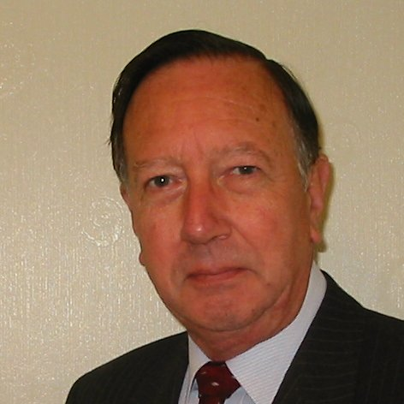
Welcome
These challenges were developed by Derrick Willer MBE and colleagues.
They are free to download and use in an education environment.
Please ensure that there is adult supervision, complete adherence to Health and Safety, and adequate PPE.
Derrick is a STEM Ambassador and volunteer Liaison Officer for Schools.
He has supported education in schools and colleges for over 30 years, initially as a Neighbourhood Engineer in the 1980’s, leading the local Year of Engineering Success campaign in 1996 and the Campaign to Promote Engineering from 1997 to 2004.
He was awarded an MBE for services to Education in 2018.

Slide 2
Guide
This exercise introduces pupils to gravity.
They learn to calculate the force of gravity with experiments and then use the results to weigh the earth.
Risks
Mandatory: close supervision by a competent adult
Item | Risk | Avoidance Action
Components | Mistakes | Close supervision
Aggression between those present | Injury | Close supervision and immediate action to defuse aggression

Slide 3
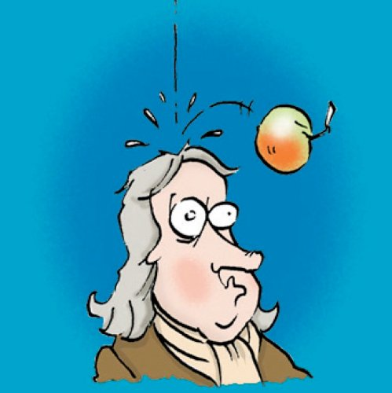
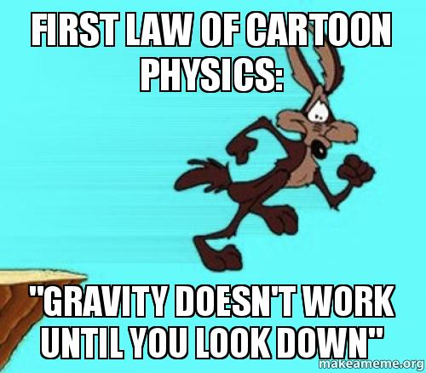
Lets Be Specific About Gravity
This time we will find the formula for Gravity
Calculate the Gravity Constant
And try to weigh the Earth

Slide 4
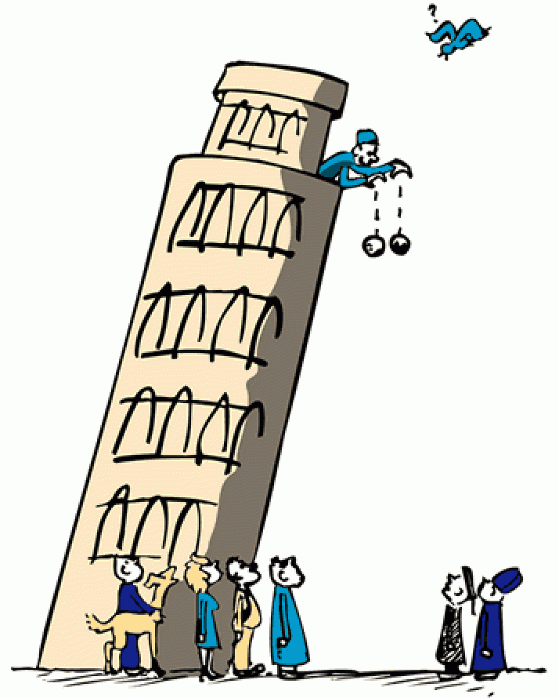
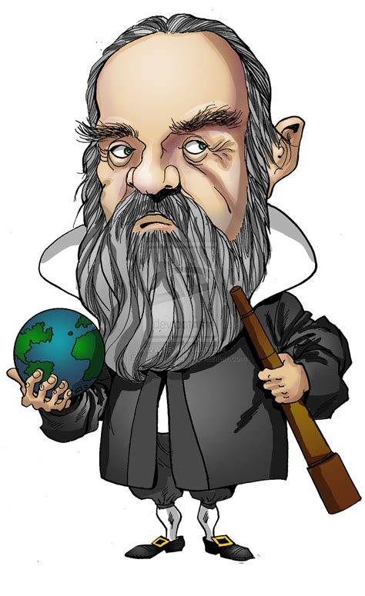
In about 1590 Gallileo dropped two different
heavy weights from the top of the
Leaning Tower of Piza to prove they
hit the ground at the same time

Slide 5
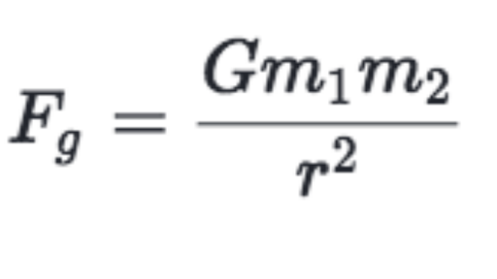
One more Newton Formula we need is
Force = Mass x Acceleration
In about 1590 Gallileo dropped two different
heavy weights from the top of the
Leaning Tower of Piza to prove they
hit the ground at the same time
In about 1680 Newton devised the
Gravitation Formula
but the value of G = 6.674 x 10⁻¹¹
was not known until Cavendish experimented
in 1798 to get a very close result

Slide 6
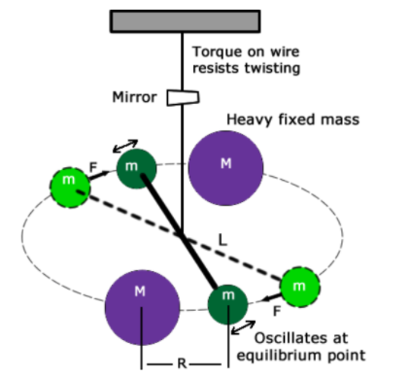
This is a very
elegant formula
G = 6.674 x 10⁻¹¹
G = 6.674
1Million X 100,000
It is very, very small
The experiment to find G uses
an a very accurate apparatus and should be in
a vacuum so we will not be doing this

Slide 7
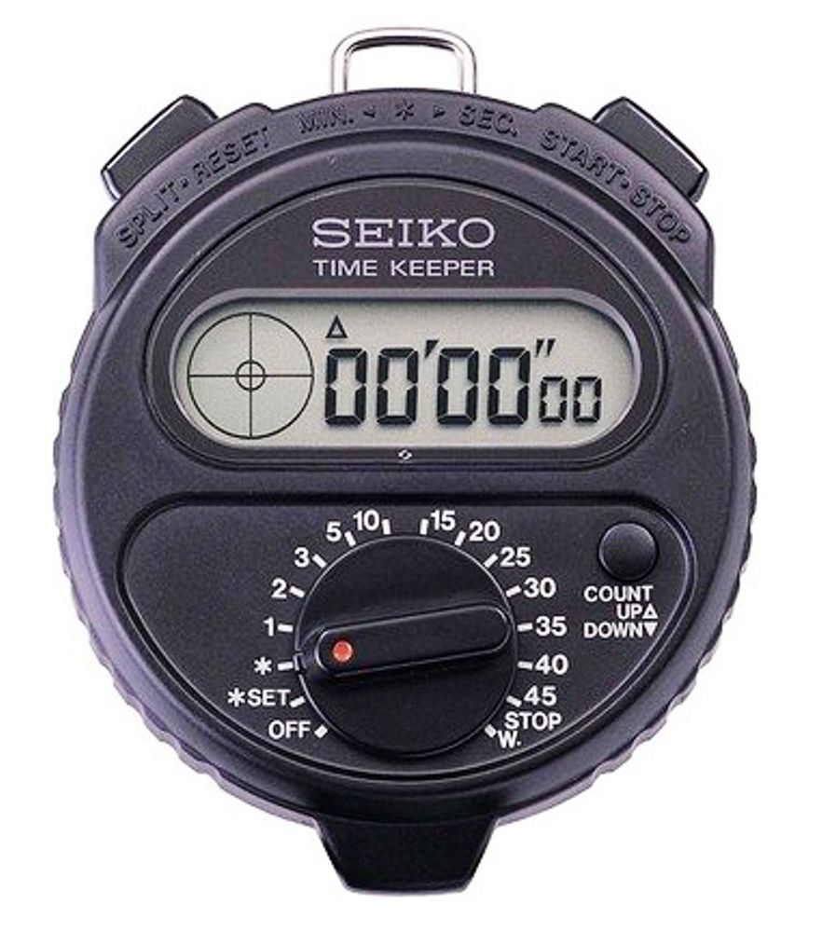
Lets see what happens to
a ball rolling down a slope
Let the ball roll down the slope using only Gravity
About 7M Long

Slide 8
Lets see what happens to
a ball rolling down a slope
Let the ball roll down the slope using only Gravity
0
1
2
Please mark where the ball is
At the start point
After 1 second
After 2 seconds
After 3 seconds
3
Please check this a few times

Slide 9
Lets see what happens to
a ball rolling down a slope
A good way to do this is to use five pupils:
Pupil 1 says, slowly, “Go and 1 and 2 and 3”)
Pupil 2 lets the ball go on “Go”
Pupil 3 marks the point at “1”
Pupil 4 marks the point at “2”
Pupil 5 marks the point at “3”
Then average the results for, say, six teams
0
1
2
Please mark where the ball is
At the start point
After 1 second
After 2 seconds
After 3 seconds
3

Slide 10
Lets see what happens to
a ball rolling down a slope
The ball goes twice as far in the second second
And three times as far in the third second
0
1
The ball is accelerating
2
Now measure the distances
0 to 1 =
1 to 2 =
2 to 3 =
3

Slide 11

Lets try to find out the acceleration
of a ball free-falling under Earths gravity
We would like to measure the drop after 1 second.
To do this over a one second fall you will need to have
a drop of about ten metres which is about three floors.
Some schools only have two floors so you will need
to time the drop over half a second.
But we will need to be very, very accurate.
To do this we will film it together with a superfast clock
and play the film back in slow motion

Slide 12
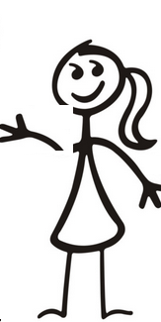

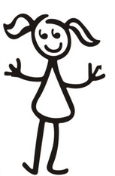
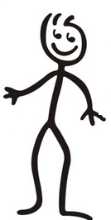
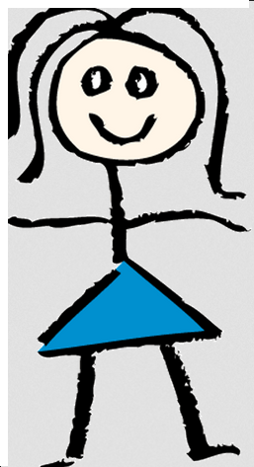
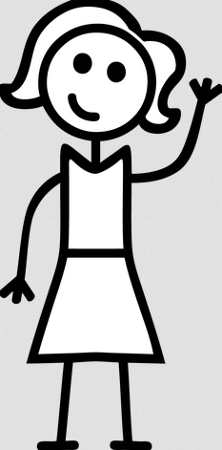
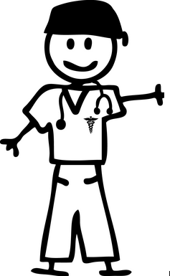

This is what we plan to do
Using the measure at
least 3 metres long
0
1
2
3
Pillow
If you use a heavy ball put a pillow on the floor to protect the floor

Slide 13
https://stopwatch.onlineclock.net/
But we will use a high speed clock
and video the drop and the clock
with two laptops.
And play it back in slow motion
0
1
2
3
Pillow

Slide 14
On the command “GO”
Start the clock and the video
Wait about I second and let the ball go
Stop the video after the ball hits the floor
Save the video
https://stopwatch.onlineclock.net/
0
1
2
3

Slide 15
Now play back the video using a slow motion video
(e.g. Free From Microsoft) on ¼ speed
Stop the video and record the clock reading
when the ball is released
You may need to try this several time to get it as
accurately as you can
Stop the video at ½ second.
How far has the ball dropped?
0
1
2
3
Pillow

Slide 16
How far has the ball dropped?
Your answer should be 3.266 for ½ second.
Remember the ball rolled twice as far down
the ramp in the second time section.
So if the ½ second result is 3.266 the whole
second will be 3 x 3.266 = 9.798 which is
wrong by only 2mm.
The real value is 9.8 metres.
0
1
2
3
Pillow

Slide 17
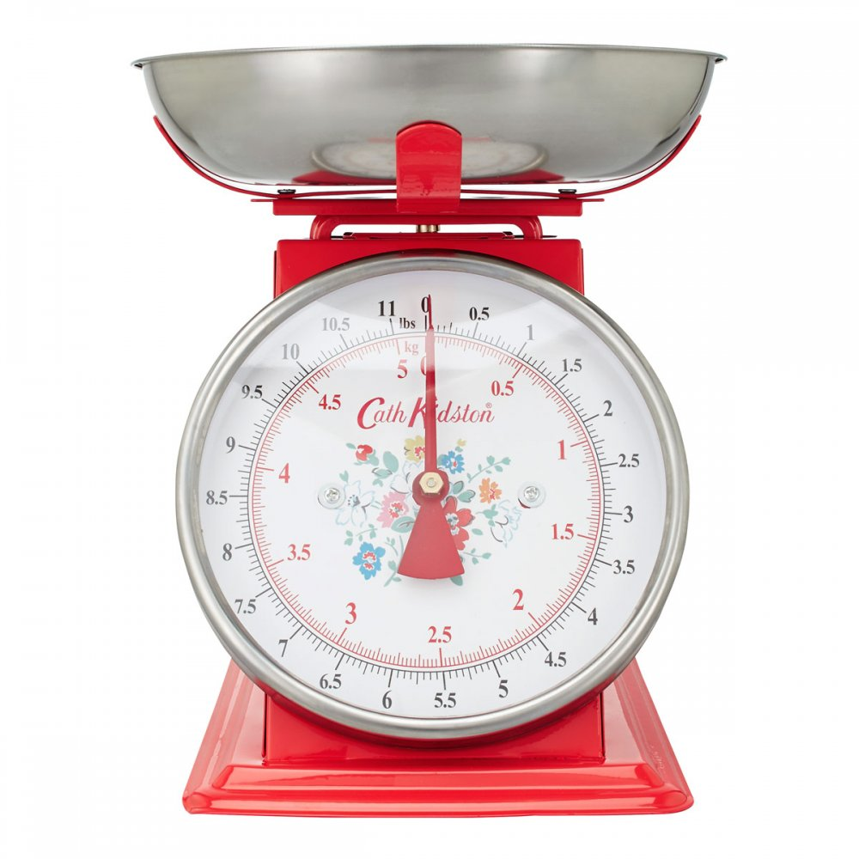
Now we know enough to be able to weigh the Earth
Gravity Constant = G = 6.673 x 10⁻¹¹
G = 6.673
1Million X 100,000
Acceleration = 9.8m per sec. per sec.

Slide 18
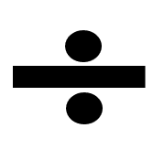
Now we know enough to be able to weigh the Earth
Force (Gravity) = G x M_{Earth} x M_{ball} (r x r)
r = radius of Earth ≈ 6,371 Kilometers = 6.371M Metres
Force (Acceleration) = Acceleration x M_{ball}

Slide 19
Now we know enough to be able to weigh the Earth
But our experiment used the
force due to Earths gravity
So
Force (Acceleration) = Force (Gravity)

Slide 20
So
Force = G x M_{Earth} x M_{ball} (r x r) = M_{ball} x Acceleration
Put the figures in
6.673 x M_{Earth} x M_{ball} = M_{ball} x 9.8
6Mx100K 6,371M x 6.371M
If we do the same thing to each side of the equation
the equation remains true
So divide both sides by M_{ball}
And multiply by 6Mx100K x 6.371M x 6.371M
10¹¹
Earth’s
radius

Slide 21
So
Force = G x M_{Earth} x M_{ball} (r x r) = M_{ball} x Acceleration
Put the figures in
6.673 x M_{Earth} = 9.8 x 6Mx100K x 6.371M x 6.371M
Divide both sides by 6.673
M_{Earth} = 9.8 x 6Mx100K x 6.371M x 6.371M
6.673
You can try to use your calculator to do this but most calculators cannot cope with such large numbers

Slide 22
So
Force = G x M_{Earth} x M_{ball} (r x r) = M_{ball} x Acceleration
Put the figures in
6.673 x M_{Earth} = 9.8 x 6Mx100K x 6.371M x 6.371M
Divide both sides by 6.673
M_{Earth} = 9.8 x 6Mx100K x 6.371M x 6.371M
6.673
So your teacher worked it our for you!
5,960,000,000,000,000,000,000,000 Kg
Mass Of Earth =
5.96 Trillion Trillion Kg

Slide 23
We have learned:
About Gravity
( Two formula F=G x M₁ x M₂ and F=MA )
R²
That under gravity things travel twice as far in the second equal time period than in the first
(the ball rolling down the slope)
To calculate acceleration
(How far did the ball fall in ½ second)
To calculate the weight of the Earth
5.96 Trillion Trillion Kg

Slide 24
Well Done, Everyone

Slide 25

Well Done
Thank You

