Slide 1
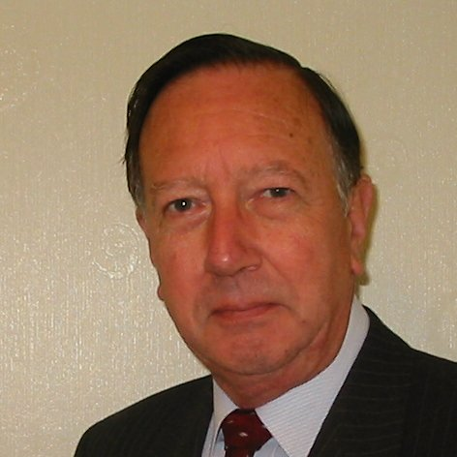
Welcome
These challenges were developed by Derrick Willer MBE and colleagues.
They are free to download and use in an education environment.
Please ensure that there is adult supervision, complete adherence to Health and Safety, and adequate PPE.
Derrick is a STEM Ambassador and volunteer Liaison Officer for Schools.
He has supported education in schools and colleges for over 30 years, initially as a Neighbourhood Engineer in the 1980’s, leading the local Year of Engineering Success campaign in 1996 and the Campaign to Promote Engineering from 1997 to 2004.
He was awarded an MBE for services to Education in 2018.

Slide 2
Guide
This activity is for pupils to various logic and maths activities to solve.
Risks
Mandatory: close supervision by a competent adult
Item | Risk | Avoidance Action
Aggression between those present | Injury | Close supervision and immediate action to defuse aggression

Slide 3
Welcome
I very much hope that you will enjoy this fun logic activity and learn new things

Slide 4
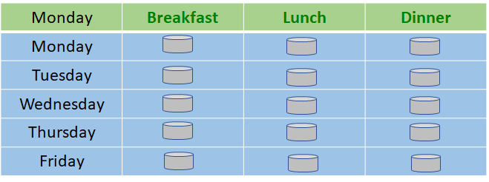
Tricky Pills
Your prescription has 15 pills..
You are told to take 3 each day after main meals.
If today is Monday.
Which day will you run out of pills?
Hint: Monday + 5 days = Saturday
You will run out of pills on Friday
taking the last pill after dinner

Slide 5
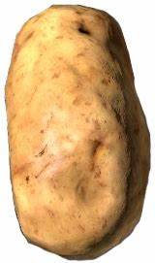
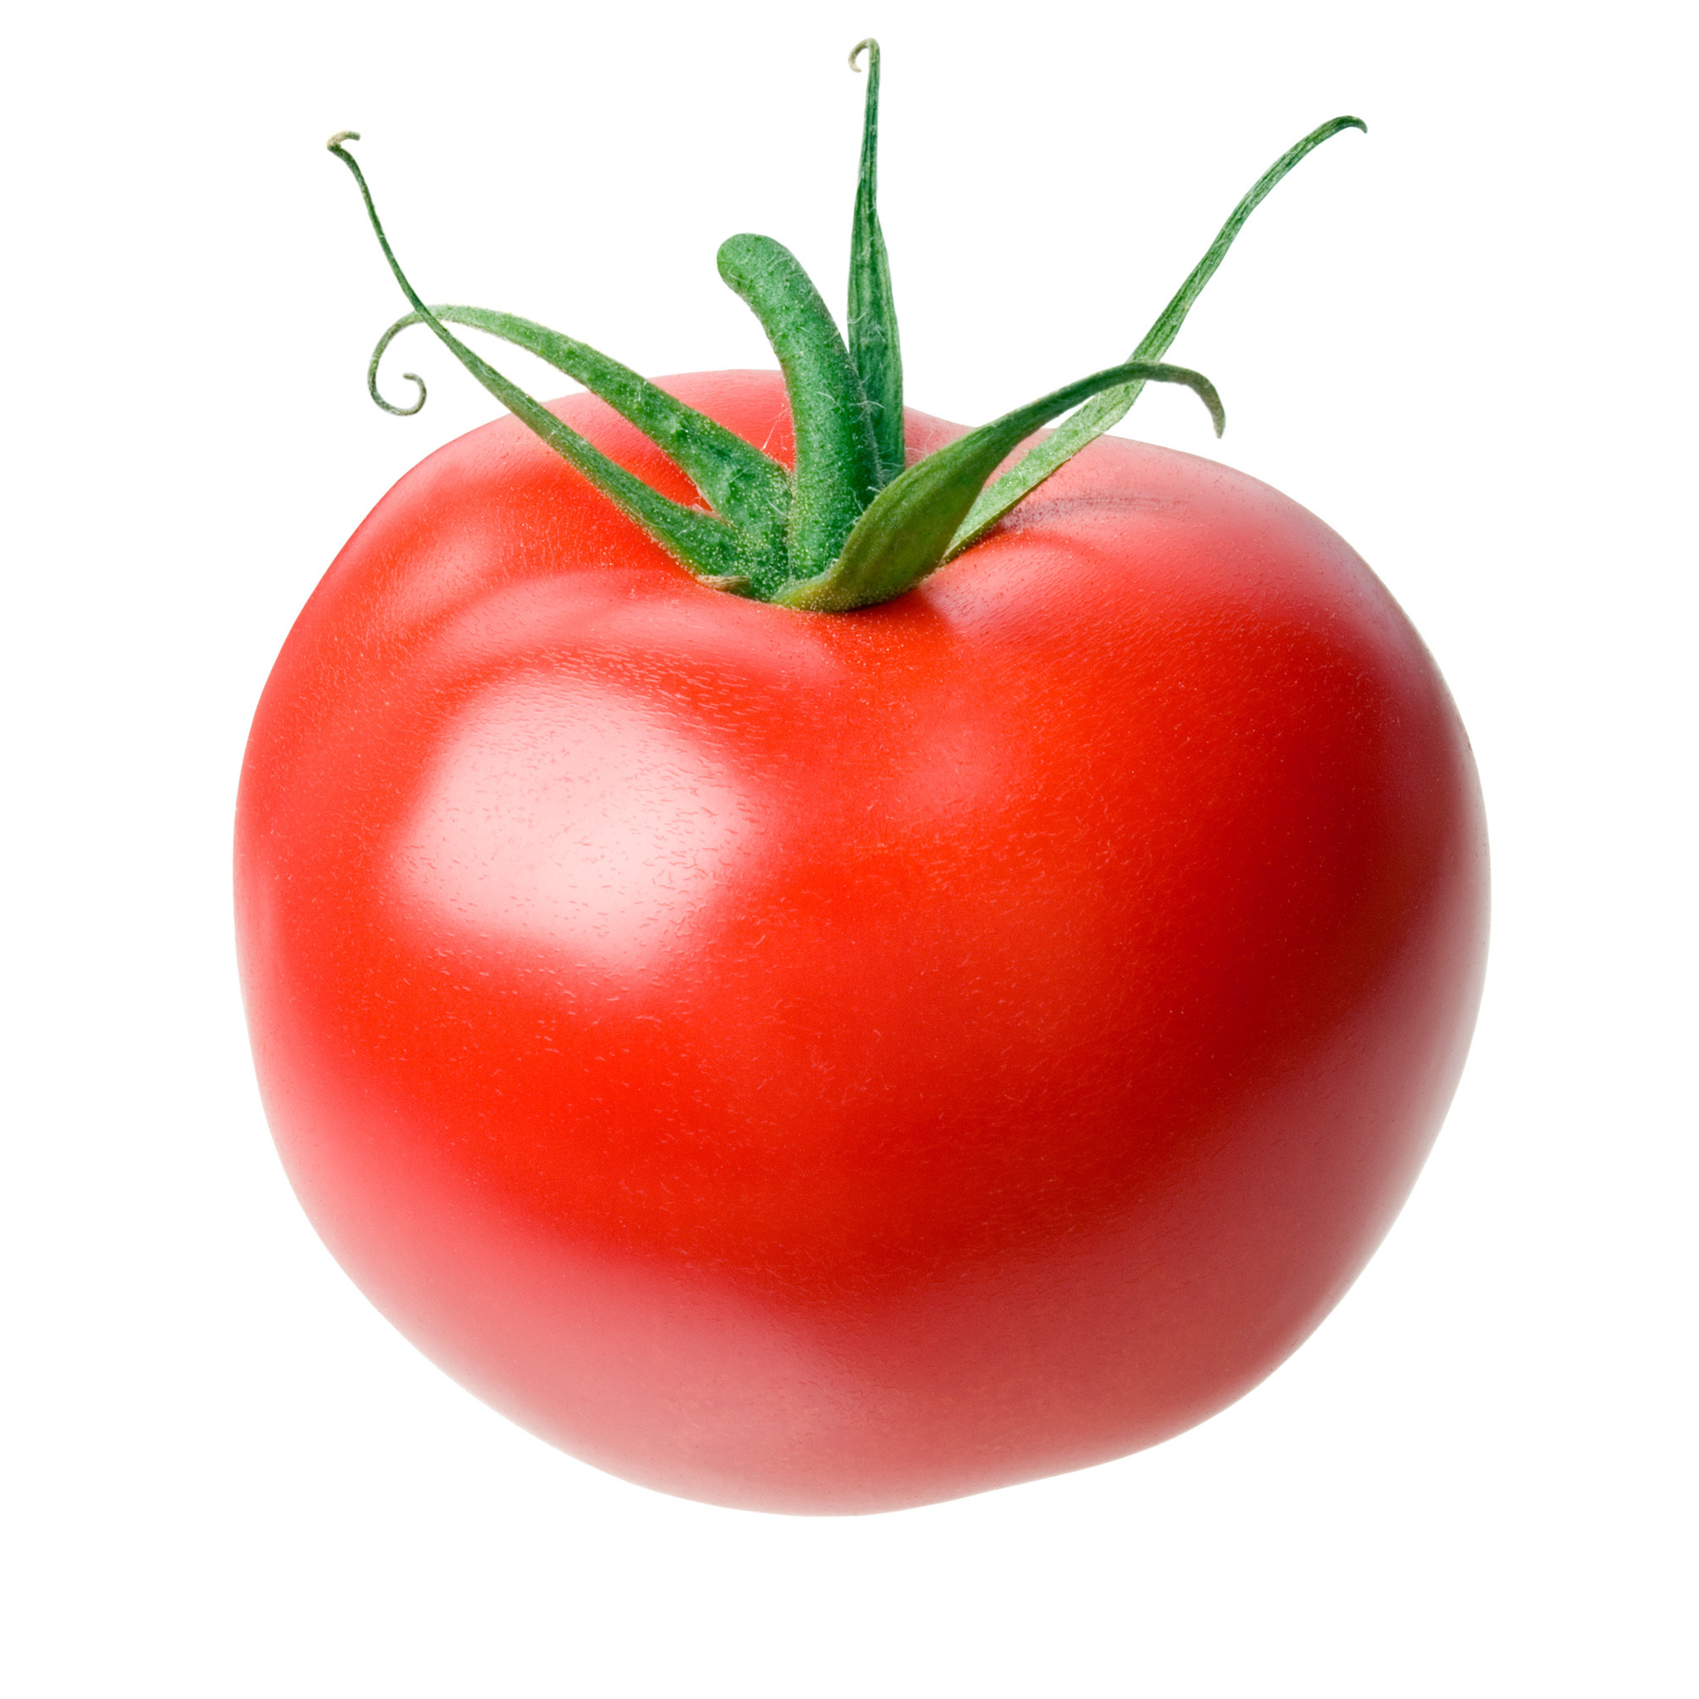
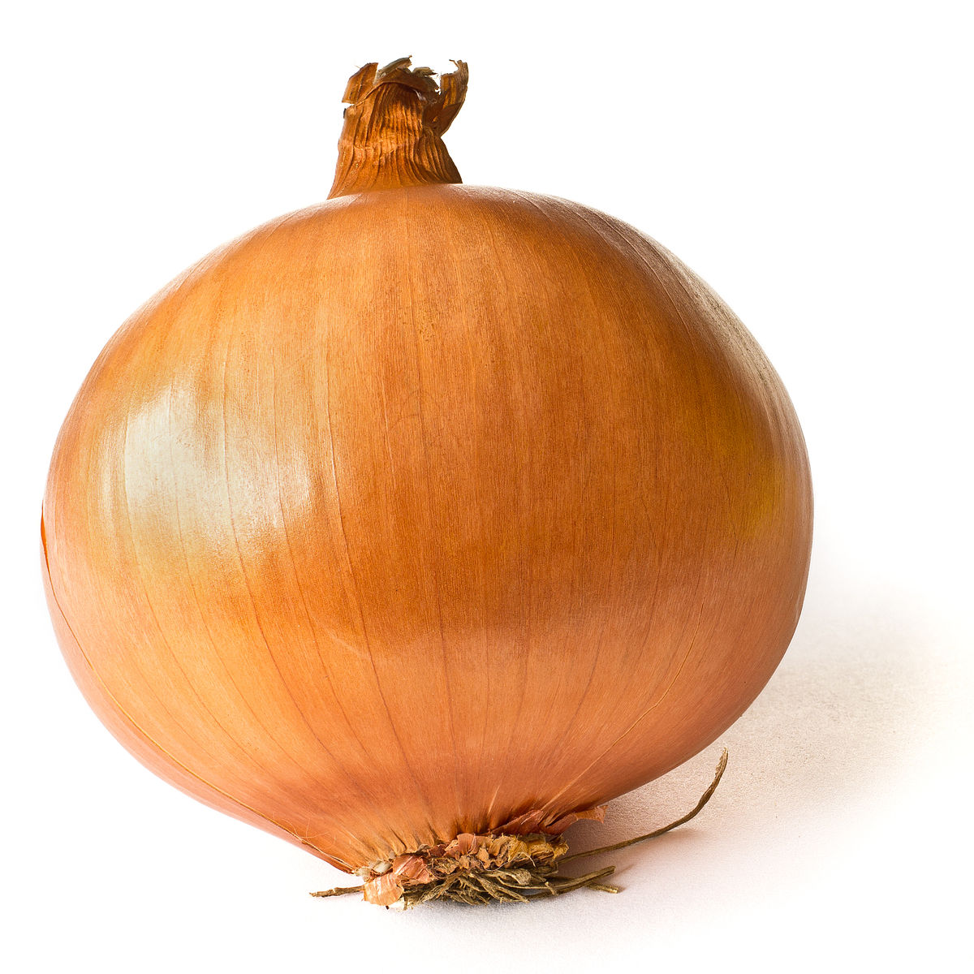
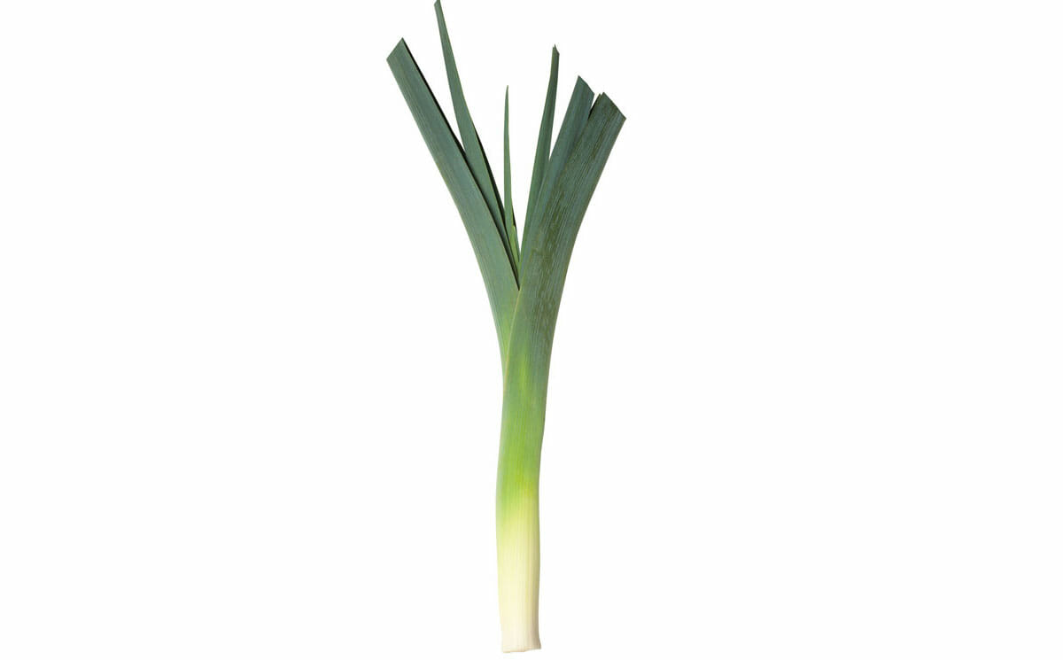
Odd Vegetables
Which is the odd vegetable?
Potato Tomato Onion Leek
The tomato contains seeds so it is a fruit
the others are not fruits.

Slide 6
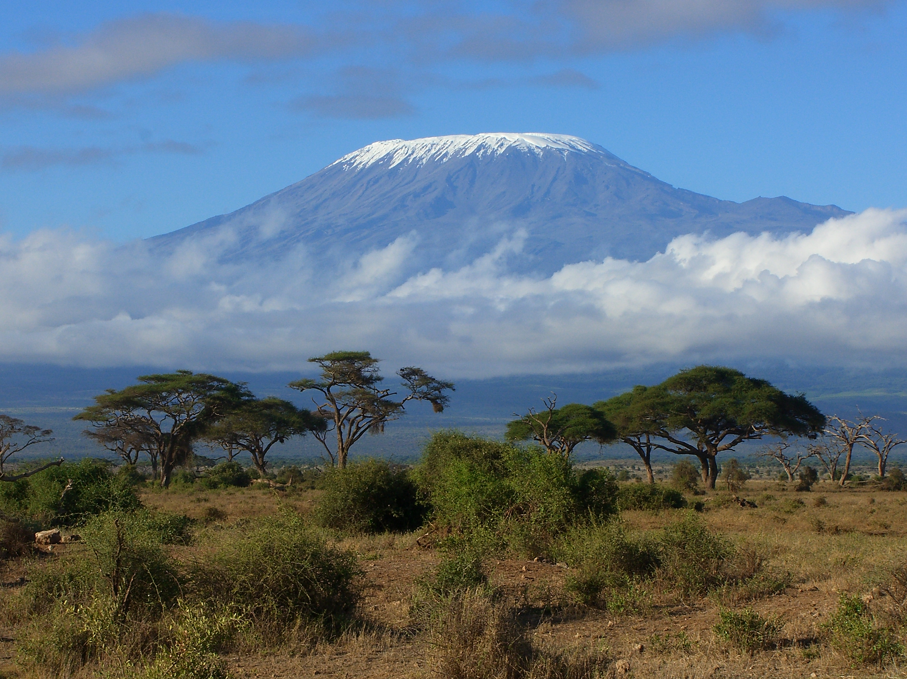
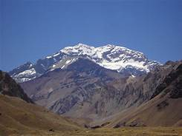
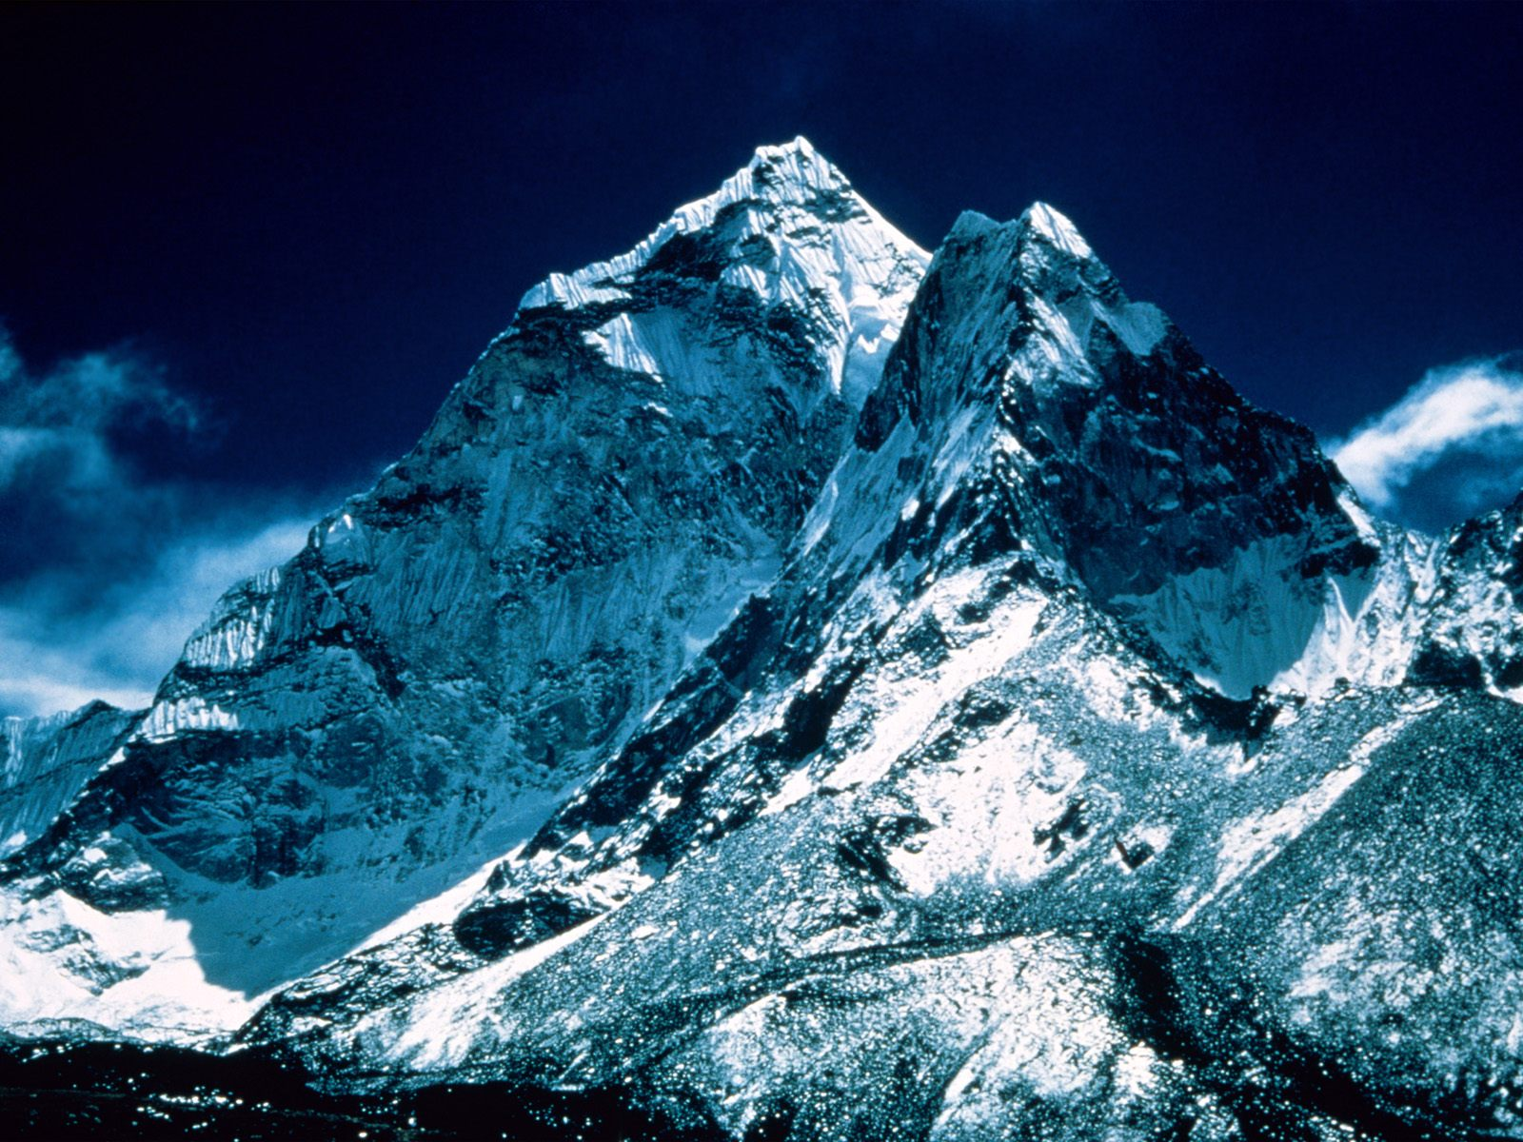
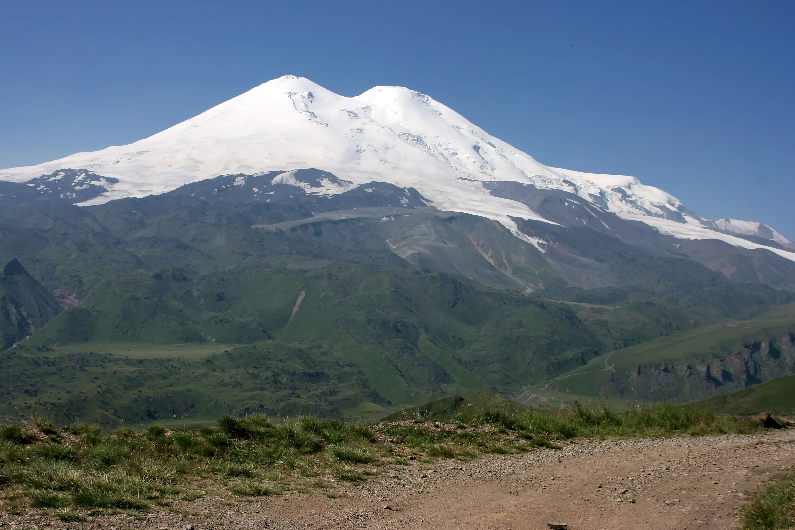
Mountains
Before Mt. Everest was discovered, which was the highest mountain?
Everest
Even though it had not been discovered
E.g.
Mt. Kilimanjaro in Africa,
Mt. Aconcagua in Andes,
Mt. Elbrus in Russia

Slide 7
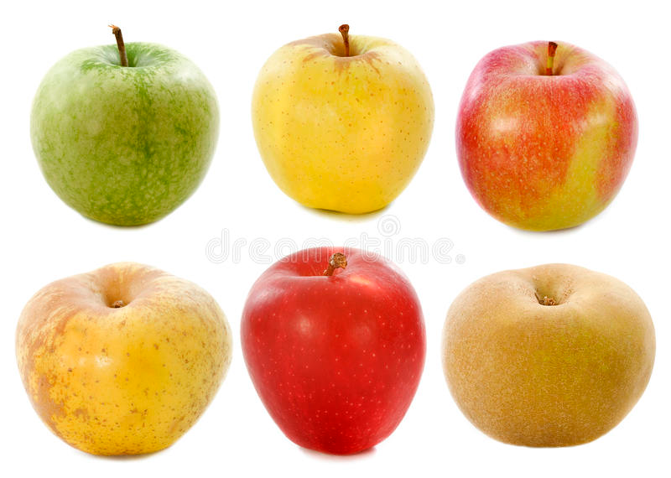
Apples Don’t Make Pairs
There are six apples on the table.
You take away two.
How many apples do you now have?
You have the two that you took away.

Slide 8
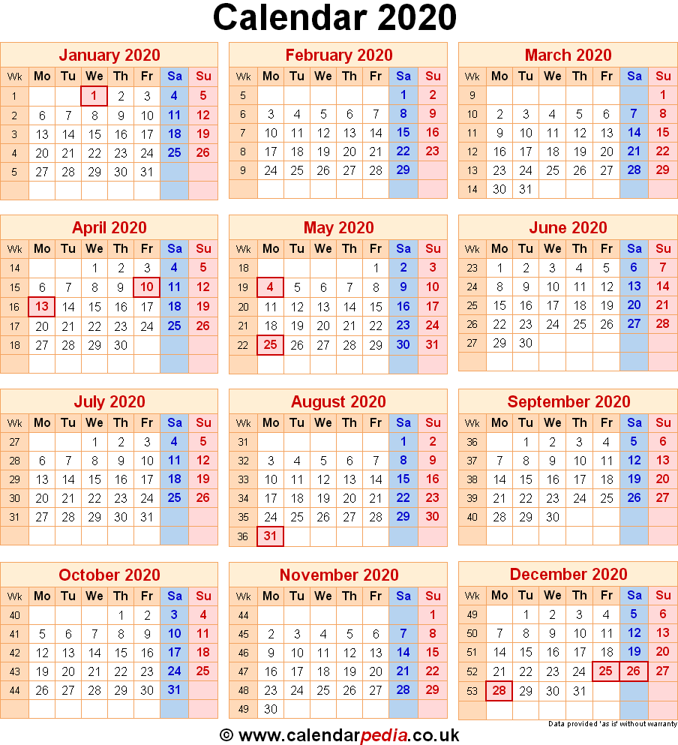
Most Years Have 365 Days
Which is the most recent year where New Year falls before Christmas?
New Year
Christmas
Last year because New Year always falls before Christmas?

Slide 9
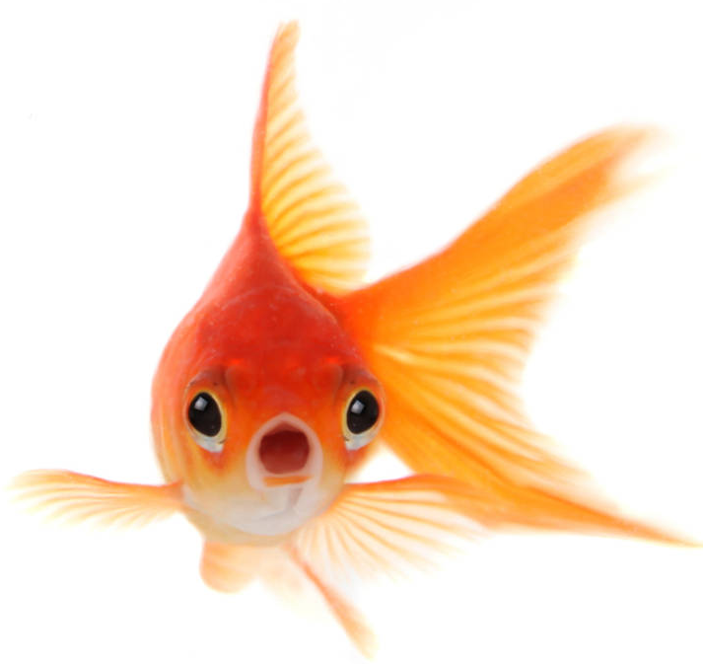
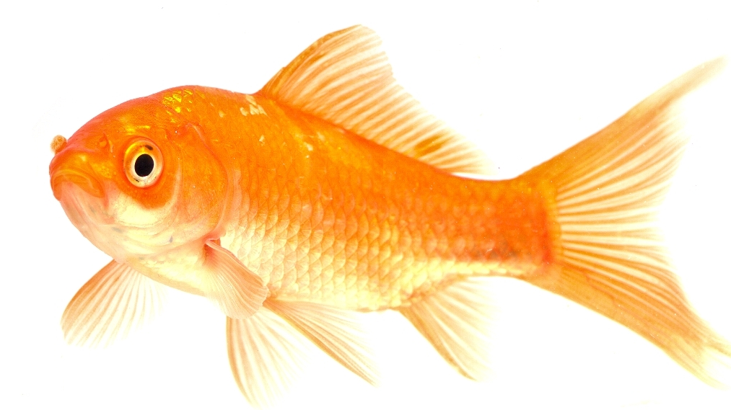
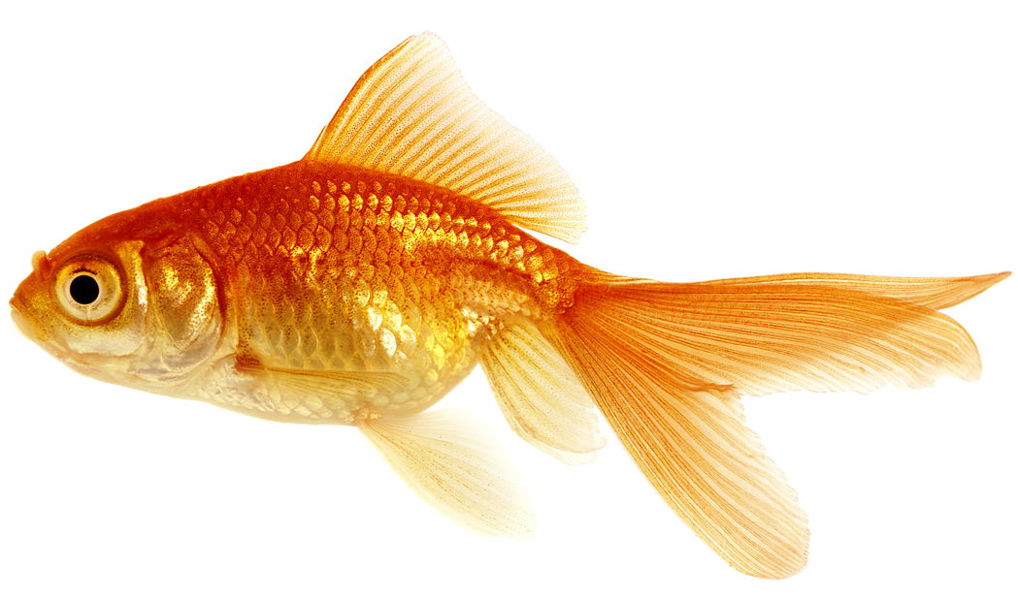
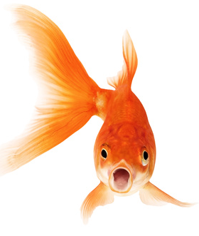
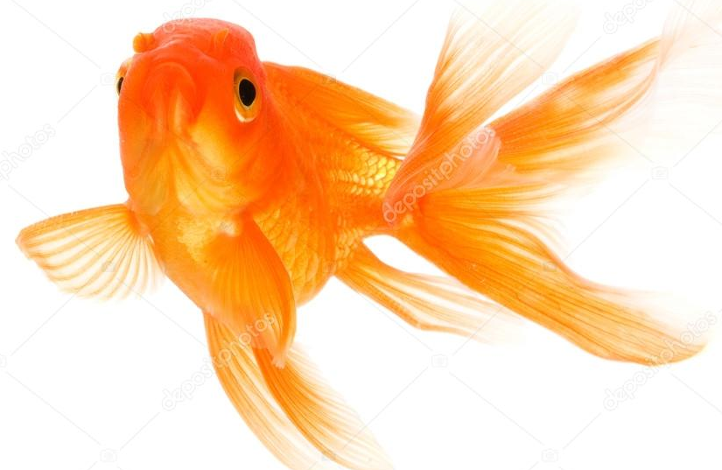
A Fishy Story
There are 12 fish in a pond.
If half of them drowned how many would there be?
Twelve, because fish do not drown

Slide 10


Cops and Robbers
After a burglary, the policeman said the man who had stolen jewels had been convicted.
The owner said “Give me his name and I will get my brother to sue him for the value as he is a solicitor.”
In court the thief accused the solicitor of conniving with his brother.
The solicitor said that he did not have a brother.
Who is lying? The thief or the solicitor.
Nobody, the person who lost the jewels was a woman.

Slide 11



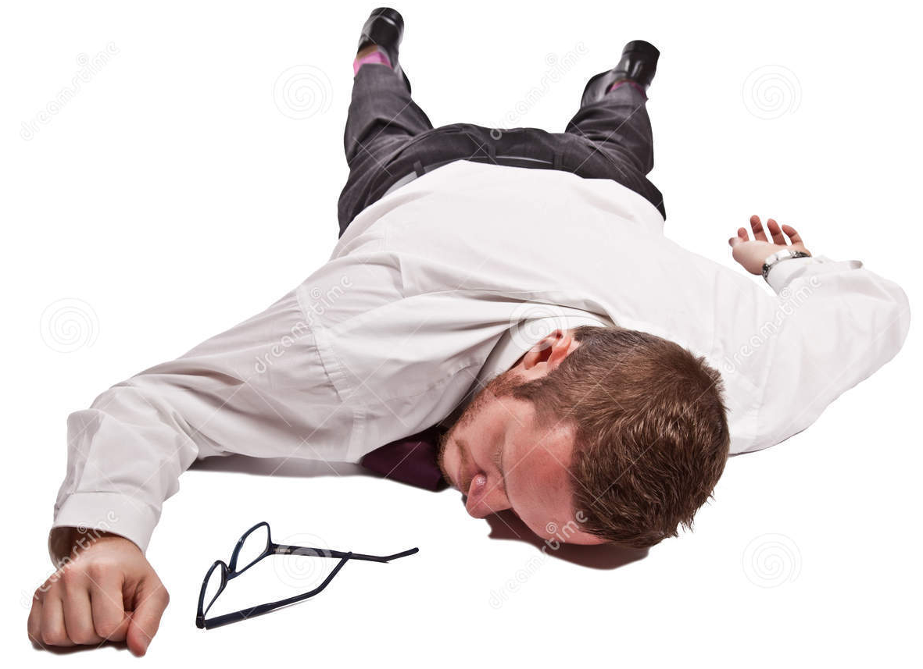
Suicide or Murder
The man on the floor was dead and had clearly committed suicide having jumped from the window near the top of the building.
The detective decided to check the building.
She went to the window on the top floor, opened it and looked down to see if that was the window the dead man used.
She did the same for every window on that floor, and to be sure, on every floor. She also checked the access to the roof which was locked.
She returned to the policeman and said “This is a murder, not a suicide”
How did the detective know?
All the windows were shut and the access to the roof was locked so someone else would have closed the windows.

Slide 12
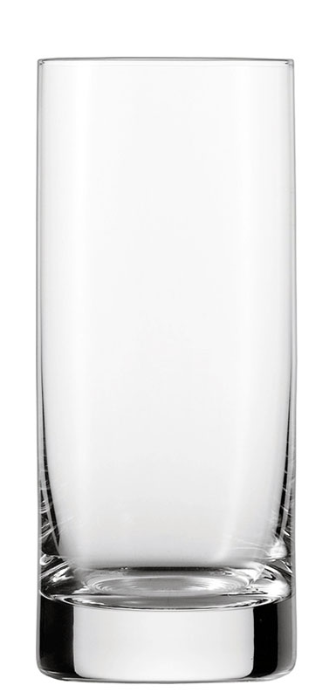
Get Some Glasses To Solve The Problem
You have a 50ml glass and a 30ml glass.
How can you get one glass with just 40ml in it?
Fill the 50ml glass with water and pour 30ml into the other glass.
You have 20ml left in the 50ml glass
Empty the 30ml glass
Pour the 20ml from the 5oml glass into the 30ml glass
Fill the 50ml glass
Pour the water from the 50ml glass into the 3oml glass until it is full.
You now have 40ml in the 50ml glass.

Slide 13



C Into F Won’t Go
Which coin will drop to the bottom of the bucket filled with water first?
The one over the bucket at 20^{O}C
At 20^{O}F the water in this bucket is frozen
20^{O}C
20^{O}F

Slide 14

Thank You

