Slide 1
Welcome
These challenges were developed by Derrick Willer MBE and colleagues.
They are free to download and use in an education environment.
Please ensure that there is adult supervision, complete adherence to Health and Safety, and adequate PPE.
Derrick is a STEM Ambassador and volunteer Liaison Officer for Schools.
He has supported education in schools and colleges for over 30 years, initially as a Neighbourhood Engineer in the 1980’s, leading the local Year of Engineering Success campaign in 1996 and the Campaign to Promote Engineering from 1997 to 2004.
He was awarded an MBE for services to Education in 2018.

Slide 2
Guide
This exercise introduces pupils to roman catapults and suggests how they can be made using rolled up recycled paper
Risks
Mandatory: close supervision by a competent adult
Item | Risk | Avoidance Action
Scissors and Hole Punches | Injury | Close supervision
Water | Spillage | Close supervision
Aggression between those present | Injury | Close supervision and immediate action to defuse aggression

Slide 3
Paper Catapult
Safely and Accurately
Catapult a Ball
to Hit a Target
A Team Exercise
Copyright including Intellectual Copyright © IET Coventry and Warwickshire Network 2015

Slide 4
Paper Catapult
Working in teams:
- using recycled materials
- paper
- nuts and bolts
- elastic bands
- string
- sticky tape
- balls
- etc.
You will Design, Make and Test a device
for throwing a ball at a target.

Slide 5
Programme:
Design the catapult
Make the design
Test the product

Slide 6
Some Examples

Slide 7
Catapults and Slings date back
many thousands of years
David slaying Goliath in the Christian Bible,
Jewish Torah and Isamic Qur’an
Siege Weapons use by the Romans
the Onager and the Trebuchet

Slide 8
Weighted Catapult
or
Onager

Slide 9
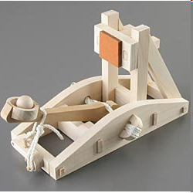
Sprung Catapult
or
Onager
Image of a model kit from
www.RLT.com

Slide 10
Roman
Trebuchet

Slide 11
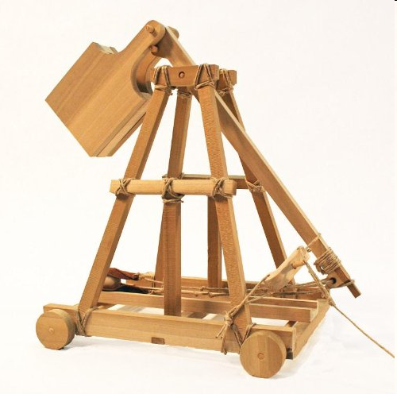
Image of a model kit from www.RLT.com

Slide 12
Demonstrate and Test
Catapult
Ball
3
2
4
2-3 metres
1
3
5
2
4
Table
Target
3

Slide 13
Some Design Ideas

Slide 14
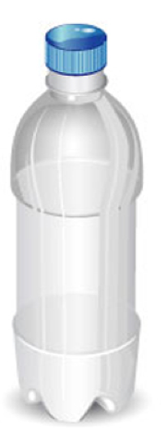
Bottle
Fill with
Water to
Adjust
Range

Slide 15
Elastic Bands

Slide 16
Some Ideas for Construction
Punch Holes
Tube
Roll Round a Dowel
& Stick
With Tape
Folded Paper
L-Shaped
Folded Paper
You may have some other ideas
For extra strength use more than one sheet

Slide 17
Use the dowels to roll up the paper and glue the final turn
You can roll up the paper longways or widthways and also cut the roll to size
Use a hole punch to make the holes for the bolts and nuts

Slide 18
Secure with Nuts and Bolts

Slide 19
Some More Ideas

Slide 20
Another Idea

Slide 21
Use paper sheet to
make shape rigid
Secure with Nuts and Bolts

Slide 22
Design
You have ten minutes
to think about a design
and draw a sketch.
Teachers help pupils - stress triangles for strength

Slide 23
Build
Please follow the
following slides
to make your
catapult.

Slide 24
6 Long Tubes
6 Short Tubes
Make two
catapult
supports
Teachers should make an example
Bolts and Nuts

Slide 25
Join them like this
Reinforce them like this

Slide 26
Throwing Arm
“Cup”
For The
Ball
Two Long Tubes
Additional tubes
Will help
strengthen the
arm
Join With
Sticky
Tape
The Cup
Is
Like
This
See
Next
Slide
Teachers should make an example

Slide 27
“Cup” For The Ball
Teachers should make an example
1
2
3
Mark 5½cm
and Cut
Solid Line
5½cm
Fold In
Half and
Fold Up
Fold
A4
into 4
5½cm
4
5
6
Fold
Along
Sides and
Glue
Fold In
Half and
Fold Up
Like
This

Slide 28
Mounting The Throwing Arm
Some Ideas
Use an elastic
band to hold
the throwing arm
to cross tube(s)
Use an elastic
band to hold
the throwing arm
without a cross tube
Use two short tubes and sandwich the
arm between them

Slide 29
Demonstrate and Test
Catapult
Ball
3
2
4
2-3 metres
1
3
5
2
4
Table
Target
3

Slide 30
What was your score?
Team
1=
2=
3=
4=
5=
6=
7=
8=
9=
10=
Ball
3
2
4
1
3
5
2
4
Table
Target
3

Slide 33
Thank You

Slide 37
Teams of 5 or 6
Timing
Allow 10-15 minutes to introduce the challenge.
Allow 45 minutes to 1 hour to make the catapult.
Allow 15 minutes to test and
modify their design.
Allow 3 minutes per team to demonstrate
throwing the ball to the skittles.
Allow 5-10 minutes for close

