Slide 1
Welcome
These challenges were developed by Derrick Willer MBE and colleagues.
They are free to download and use in an education environment.
Please ensure that there is adult supervision, complete adherence to Health and Safety, and adequate PPE.
Derrick is a STEM Ambassador and volunteer Liaison Officer for Schools.
He has supported education in schools and colleges for over 30 years, initially as a Neighbourhood Engineer in the 1980’s, leading the local Year of Engineering Success campaign in 1996 and the Campaign to Promote Engineering from 1997 to 2004.
He was awarded an MBE for services to Education in 2018.

Slide 2
Guide
This activity is for pupils to make a boat from recycled materials.
Mandatory close supervision by a competent adult
Risks
Item | Risk | Avoidance Action
Tools | Injury | Close supervision, Wear protective glasses
Glue | Injury, Damage to Clothing | Close supervision. Sponge and water to clean spillage and hands. Ensure that glue is not put in mouth or injected. Water to rinse mouth and drink.
Aggression between those present | Injury | Close supervision and immediate action to defuse aggression

Slide 3
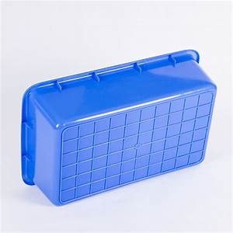
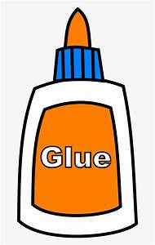
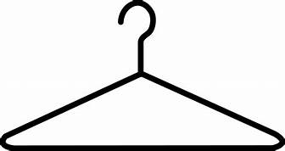
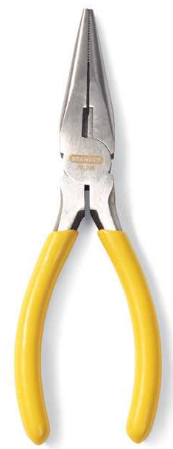
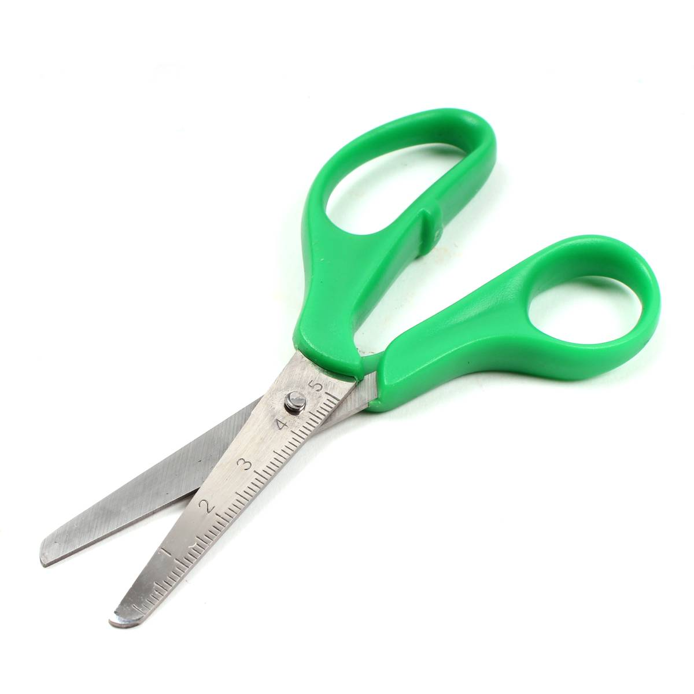
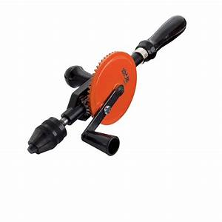
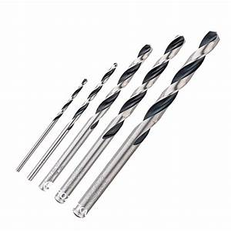
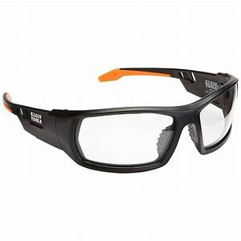
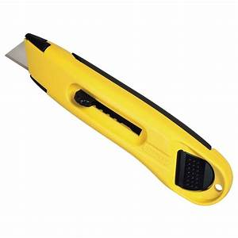
What you need
Recycled plastic trays and/or bottles
Paper
Glue
Used ball point pens or dowels.
Some steel (e.g. coathanger)
Tools

Slide 4
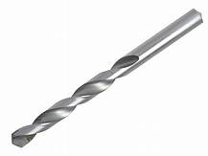
Make the boat from the trays
Match the second tray to the other diagonally at 45^{O} to form the bow.
Cut this section (yellow) out.
Glue it to the other section ensuring a watertight seal.
Ensure the glue has set.

Slide 5
Make the boat from the trays
Cut a section from the cut tray that is the exact width of the other tray.
Drill a hole for the pen.
Glue it to the other section ensuring a watertight seal.
Glue this to the main boat.
Insert and glue in the pen.
Ensure the glue has set.

Slide 6
Make the boat from the bottle
Glue the top ensuring a watertight seal.
Drill a hole the same size as the diameter of the pen.
Glue the pen in place.
Ensure the glue has set.

Slide 7
Make the keel
The keel is needed to ensure that the boat does not turn over.
Cut the keel shape from the spare tray (yellow).
Cut some steel from the coathanger. We recommend four pieces.
Glue the steel to the bottom of the keel.
Ensure the glue has set.
Coathanger
steel

Slide 8
Glue the keel to the boat
Ensure the glue has set.

Slide 9
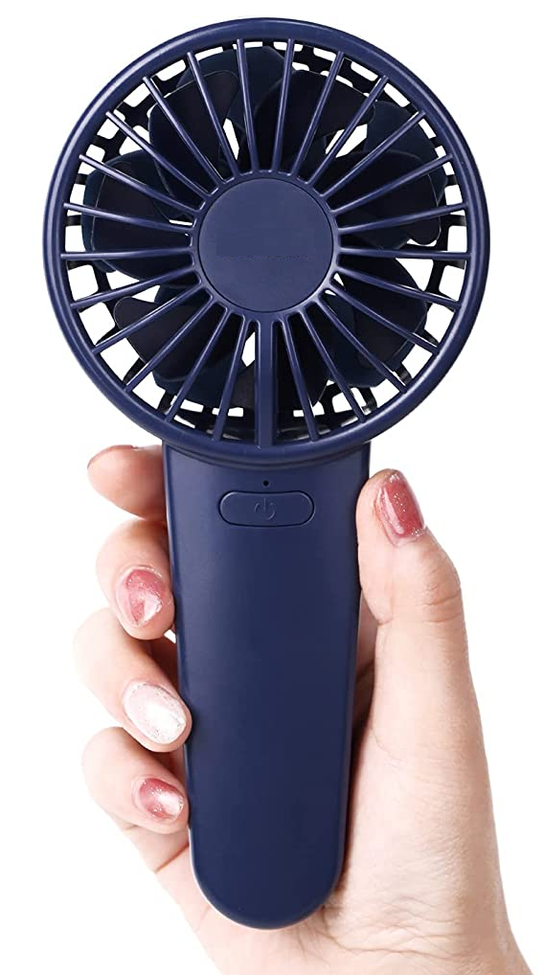
Make the sails and glue them to the boat
Ensure the glue has set.
You can use multiple masts and join two pens together with their ink-holders and glue.
If you add more weight to the top then add more steel to the keel.
Use a hand-held fan to provide wind

Slide 10
Who had the fastest boat? Time the boat round a 5m circle!
Who’s boat went the farthest in one minute?
Who’s boat was the best made?
Who’s boat was best designed?
Who’s boat is best overall?
Category | My Vote
Fastest Car
Farthest Distance
Best made
Best Designed
Best Overall

Slide 11
We have learnt:
- to make a boat out of recycled materials.
about thrust pushing the boat forward.
to work like engineers.
to have fun while learning.

Slide 12
Well Done

Slide 14
