Slide 1
Welcome
These challenges were developed by Derrick Willer MBE and colleagues.
They are free to download and use in an education environment.
Please ensure that there is adult supervision, complete adherence to Health and Safety, and adequate PPE.
Derrick is a STEM Ambassador.
He has supported education in schools and colleges for over 30 years, initially as a Neighbourhood Engineer in the 1980’s, leading the local Year of Engineering Success campaign in 1996 and the Campaign to Promote Engineering from 1997 to 2004.
He was awarded an MBE for services to Education in 2018.

Slide 2
v = d
t
Guide
This exercise introduces pupils to the Maths behind Rockets
d = ½ g t²
Risks
Mandatory: Competent adult supervision
Item | Risk | Avoidance Action
Tools (e.g. scissors) | Injury | Close supervision and advice
Glue | Damage to Clothing Injury | Close supervision, sponge and water. If glue is ingested rinse mouth with water and give water to drink.
Aggression between participants | Injury | Close supervision and immediate action to defuse aggression

Slide 3
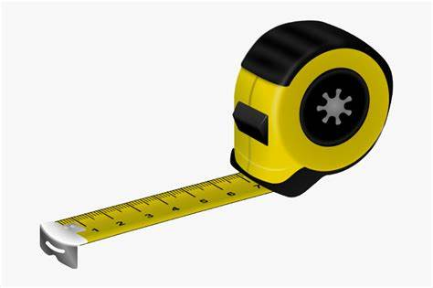
What you need
Paper
Empty Ball Point Pen
Glue
Seconds Timer
3 Metre Measure
Paper

Slide 4
Make your Rocket
Use the empty pen
Add fins near to the bottom
Glue the fins in place
Paper

Slide 5
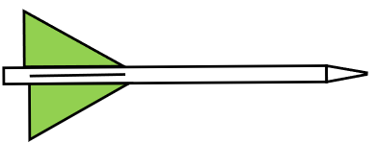
Horizontal Flight
Throw the rocket horizontally as fast as you can
Ask a colleague to time the flight (e.g. 3,2,1,Throw)
Use the measure to measure the distance
Do this several times and record the results

Slide 6
Sum Maths
We will use the laws of motion discovered by Sir Irate sorry Isaac Newton
Velocity = Distance divided by Time v = d
t
Vertical Distance = ½ Gravity x Time Squared d = ½ g t²
t² is 1 multiplied twice (the ²) by t
Sir “Irate” Newton
Gravity (g) is 9.80665 m/s

Slide 7
Horizontal Flight
Do the calculations using v = d t
Test No. | Distance | Time | Average Velocity
1
2
3

Slide 8
Horizontal Flight
Throw the rocket horizontally as fast as you can
Ask a colleague to time the flight (e.g. 3,2,1,Throw)
Use the measure to measure the distance
Do this several times and record the results

Slide 9
Vertical Flight
Throw the rocket vertically as fast as you can
Ask a colleague to time the flight (e.g. 3,2,1,Throw)
Use the timer to measure the time
Do this several times and record the results

Slide 10
Sum Maths
This time we use the other equation
Vertical Distance = ½ Gravity X Time Squared d = ½ g t²
t² is 1 multiplied twice (the ²) by t
Sir “Irate” Newton

Slide 11
Vertical Flight
This time we use the second half of the trajectory
This is because you threw the rocket from a standing position
Use the formula v = gt²
Use this half of the
Trajectory
Test No. | Time | ½ Time | Average Velocity
1
2
3

Slide 12
Results
Horizontal
Vertical
Test No. | Distance | Time | Average Velocity
1
2
3
Test No. | Time | ½ Time | Average Velocity
1
2
3
And you can graph the results
Time
Time
Distance
Distance

Slide 13
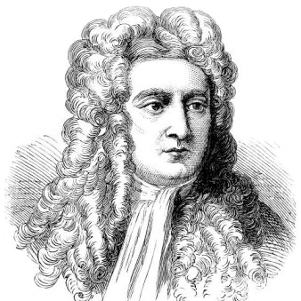
We have learnt
Sir Isaac Newton
To make a rocket
About Newton’s Laws of Motion
About the relationship between velocity, time and gravity
And we used Maths
1643 to 1727
v = d
t
d = ½ g t²

Slide 14
Well Done

