Slide 1

Welcome
These challenges were developed by Derrick Willer MBE and colleagues.
They are free to download and use in an education environment.
Please ensure that there is adult supervision, complete adherence to Health and Safety, and adequate PPE.
Derrick is a STEM Ambassador and volunteer Liaison Officer for Schools.
He has supported education in schools and colleges for over 30 years, initially as a Neighbourhood Engineer in the 1980’s, leading the local Year of Engineering Success campaign in 1996 and the Campaign to Promote Engineering from 1997 to 2004.
He was awarded an MBE for services to Education in 2018.

Slide 2
Guide
This activity is for pupils to make a fun roundabout and decorate it for a festive season.
Mandatory close supervision by a competent adult
Risks
Item | Risk | Avoidance Action
Use of tools | Injury | Close supervision.
Glue | Injury | Close supervision. Sponge and water to clean spillage and hands. Ensure that glue is not put in mouth or injected. Water to rinse mouth and drink.
Aggression between those present | Injury | Close supervision and immediate action to defuse aggression

Slide 3

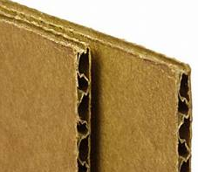


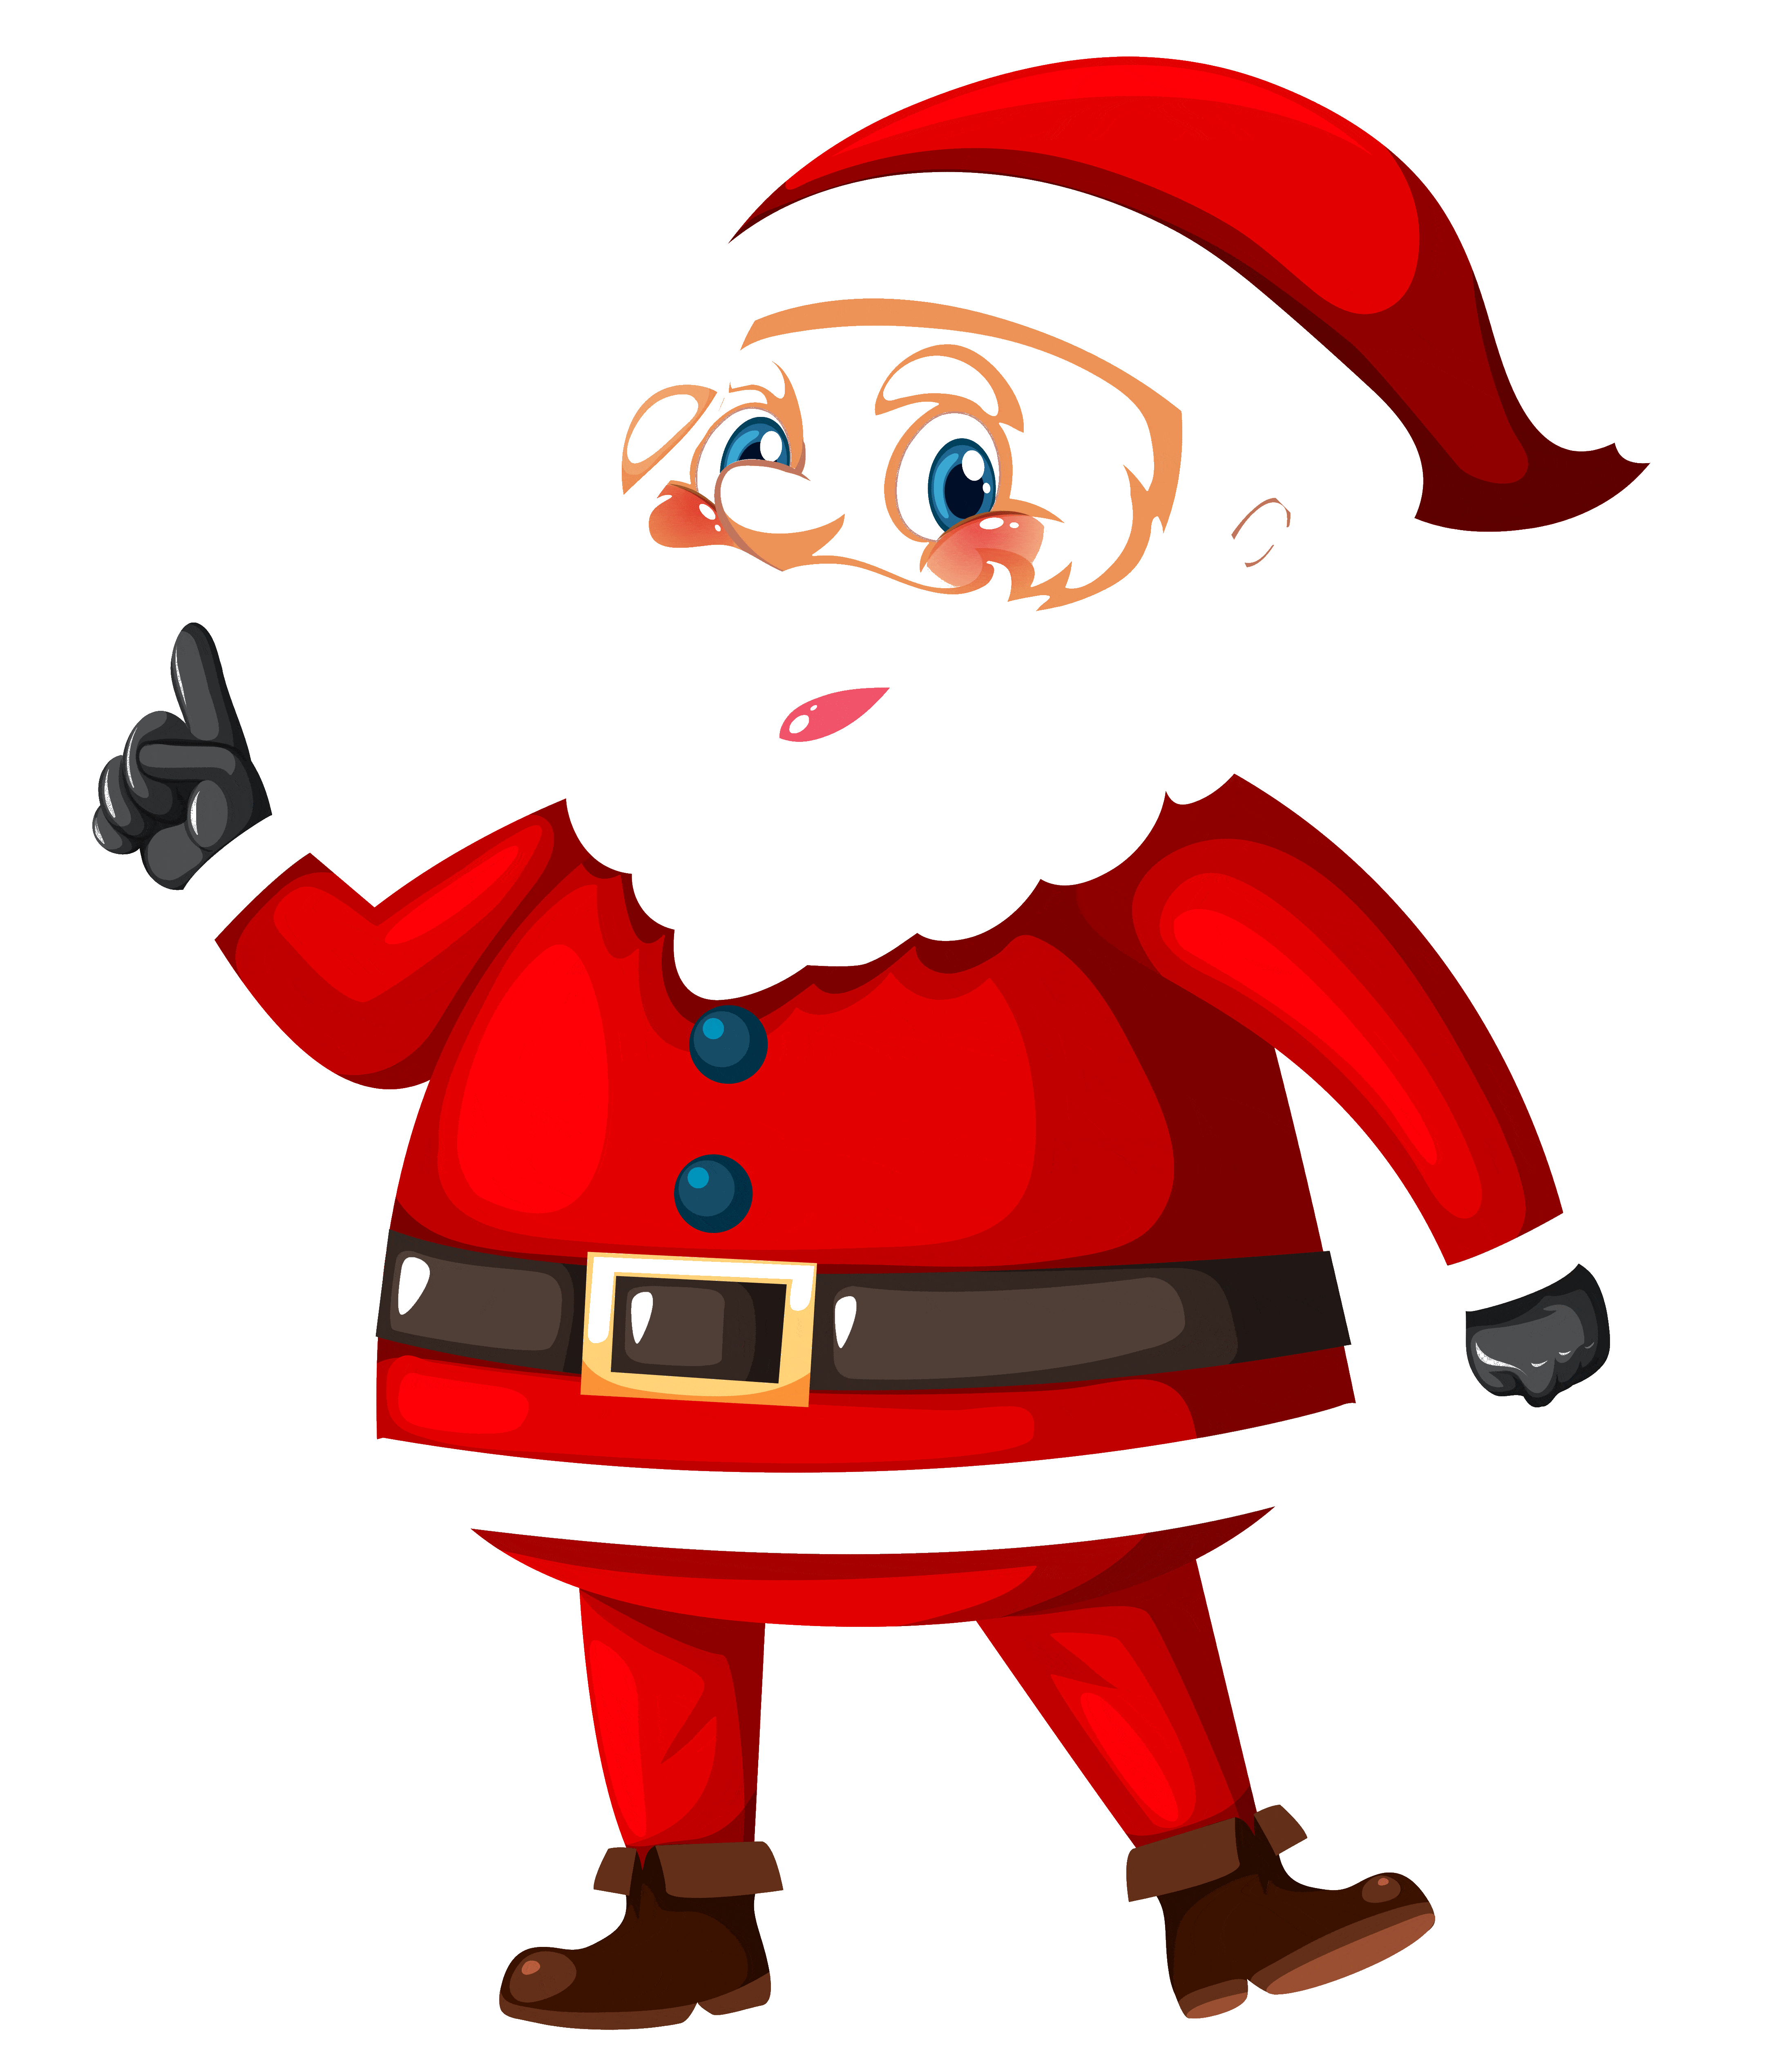

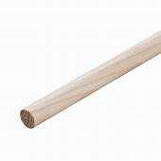




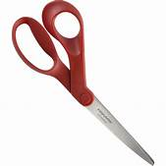


What you need
Two sheets of corrugated cardboard
at east 25cm x 35cm
Two sheets of plain paper
Recycled ball-point pen
6mm Dowel
Tools
Glue

Slide 4
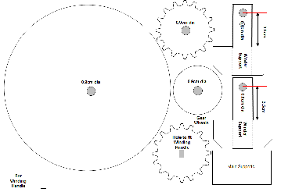
What you do
Photocopy the diagram on the next slide.
Paste it onto a sheet of corrugated cardboard.
Let the glue stick firmly.
Cut out the circles, gears and winding handle parts and make the holes.
Glue the edges of the wheels, the
gears, winding handle and the support to reinforce these items.

Slide 5
4
4
0.9cm dia
0.8cm dia
3.5cm
Winder
Support
4
0.9cm dia
0.9cm dia
0.8cm dia
3.5cm
Gear
Wheels
Winder
Support
4
Hole to fit Winding Handle
Dowel
Main Supports
For
Winding
Handle

Slide 6

What you do
Glue the small circle to the large one, ensure they are centred.
Glue the gear with the round hole to the small circle, ensure they are centred.
Let the glue stick firmly.
Large Circle
Small Circle
Gear Wheel with round hole
The Ball Pint Pen
will act as the pivot through the holes and can be used to align the holes.

Slide 7

What you do
Using the second sheet of corrugated cardboard.
Glue the Ball Point Pen in the centre 10cm from one end.
Glue one support around the pen and to the base.
Glue the other support around the other one and to the base.
Let the glue dry.
Put the circles onto the pen.
10cm

Slide 8
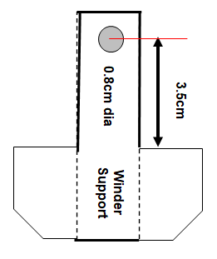
What you do
Make the winding handle supports.
Fold along the dotted lines. Glue the sections of each one together.
Let the glue dry
Make the handle with the dowel and supports.
Let the glue dry.
Put the handle through the supports.
Glue the other gear to the handle.
Let the glue dry.
Dowel
4

Slide 9
What you do
Put the winding mechanism so that the gears mesh.
If needed raise the circles or winding mechanism with paper or card.
Glue the support by the gear to the base.
Align the handle support so that it is outside the rings.
Glue the other support to the base so you can use the handle.
Let the glue dry.

Slide 10
What you do
Test the mechanism to be sure it turns the circles.
Make any adjustments.

Slide 11
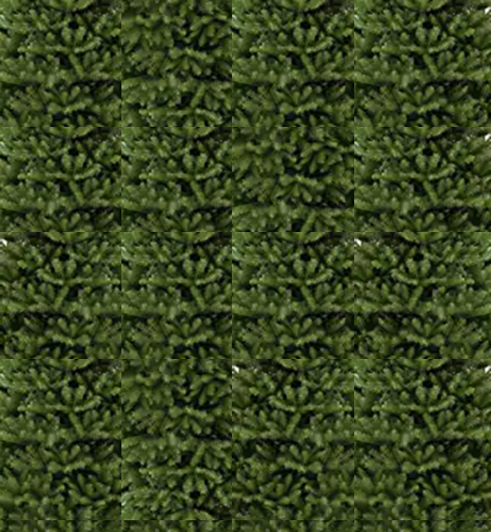
What you do
Now make the tree.
Cut out the tree.
Colour and decorate it.
You can use items from the slide with decorations.
Glue the tab to the back so it is round.

Slide 12
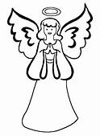

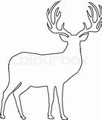
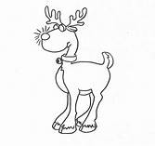




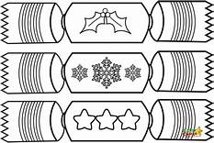






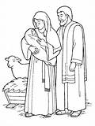
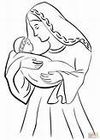


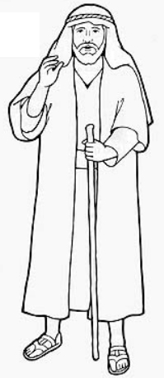

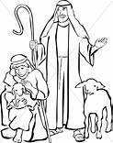
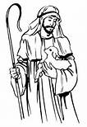
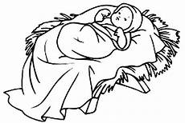
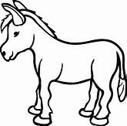
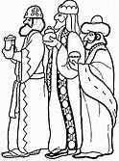
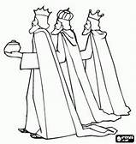
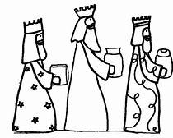
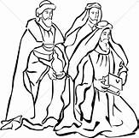
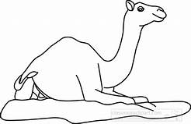
Carefully cut out and colour these
or use your own
If you want, you can copy the image and resize it.

Slide 13
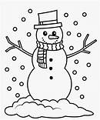
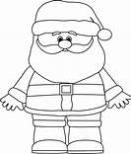
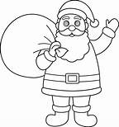
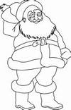
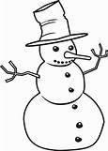
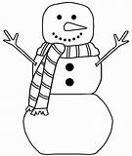
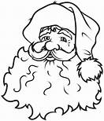
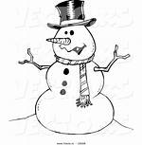


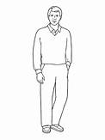
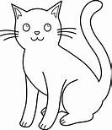

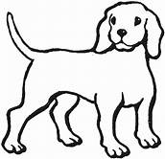
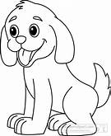

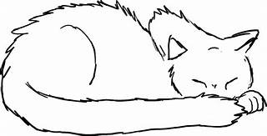





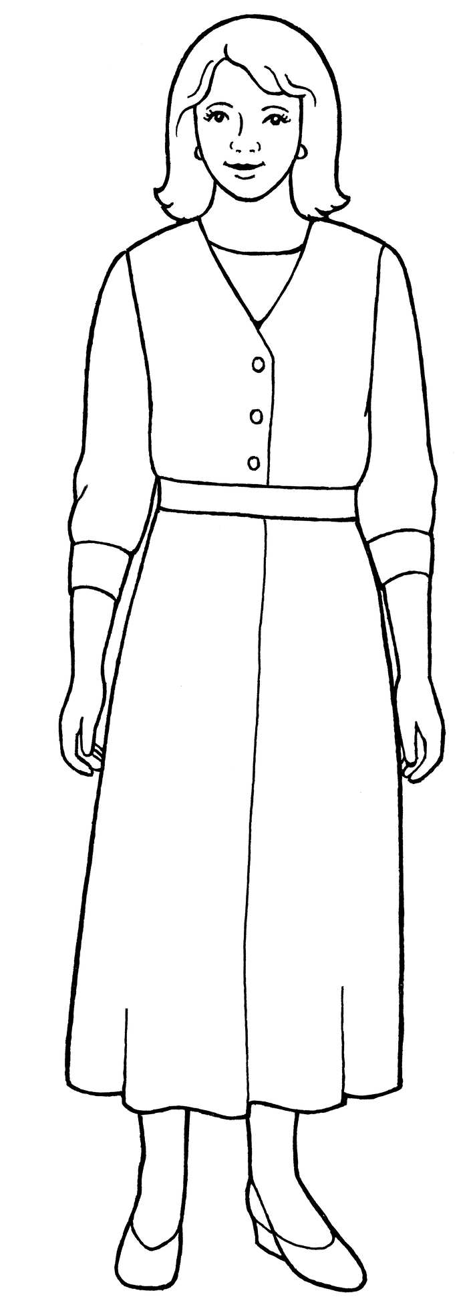
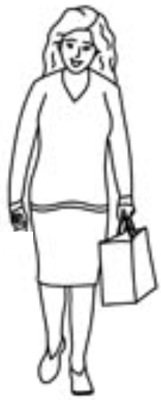

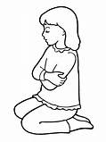

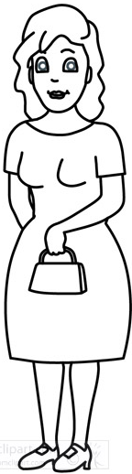
Carefully cut out and colour these
or use your own
If you want, you can copy the image and resize it.

Slide 14
What you do
Now make the tree.
Cut out the tree.
Colour and decorate it.
You can use items from the slide with decorations.
Glue the tab to the back so it is round.

Slide 15
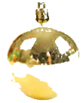


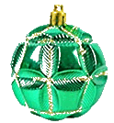
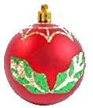
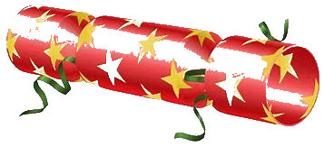
What you do
Now put the tree onto the roundabout.

Slide 16

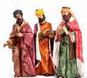
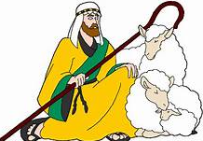
What you do
Now glue your chosen figures onto the roundabout using L shaped mounts.
L shaped mounts

Slide 17








What you do
Or a May Day scene.

Slide 18
What have you learnt?
How to make a roundabout that works.
To use a sharp knife and scissors carefully
To make gears and a handle.
To make a paper tree and decorate it.
To put images of your choice onto the roundabout.
And much more !!!

Slide 19

Well Done !!!
and
Thank You

