Slide 1
Welcome
These challenges were developed by Derrick Willer MBE and colleagues.
They are free to download and use in an education environment.
Please ensure that there is adult supervision, complete adherence to Health and Safety, and adequate PPE.
Derrick is a STEM Ambassador and volunteer Liaison Officer for Schools.
He has supported education in schools and colleges for over 30 years, initially as a Neighbourhood Engineer in the 1980’s, leading the local Year of Engineering Success campaign in 1996 and the Campaign to Promote Engineering from 1997 to 2004.
He was awarded an MBE for services to Education in 2018.

Slide 2
Guide
This activity is for pupils to make a boat using a matchbox, pencil and paper
Mandatory close supervision by a competent adult
Risks
Item | Risk | Avoidance Action
Tools | Misuse Injury | Close supervision
Glue | Injury | Close supervision. Sponge and water to clean spillage and hands. Ensure that glue is not put in mouth or injected. Water to rinse mouth and drink.
Batteries | Injury | Close supervision. Check batteries are inserted properly. Beware short circuiting batteries which get hot and can cause a fire
Aggression between those present | Injury | Close supervision and immediate action to defuse aggression

Slide 3
Welcome
I very much hope that you will enjoy this activity
Click for the next slide

Slide 4
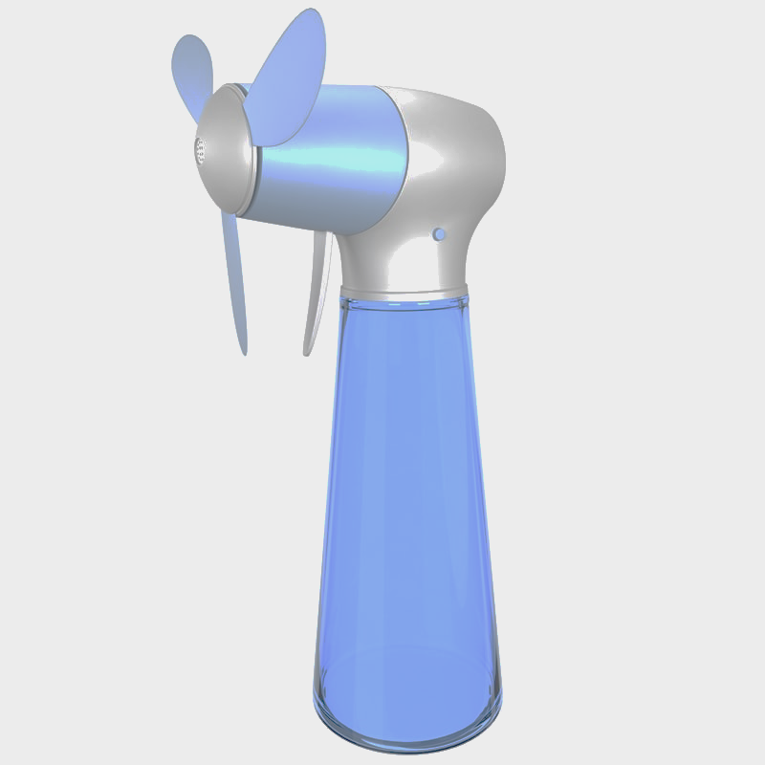
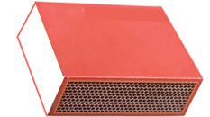
Sail A Matchbox
c

Slide 5
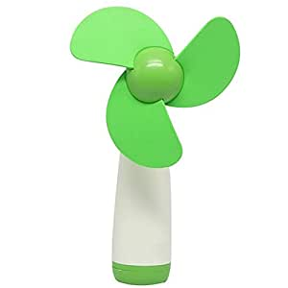
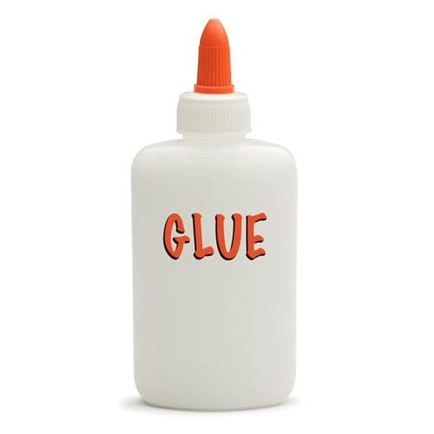
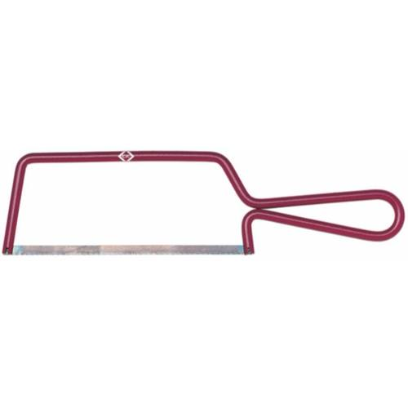
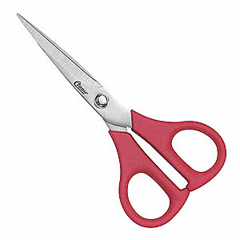
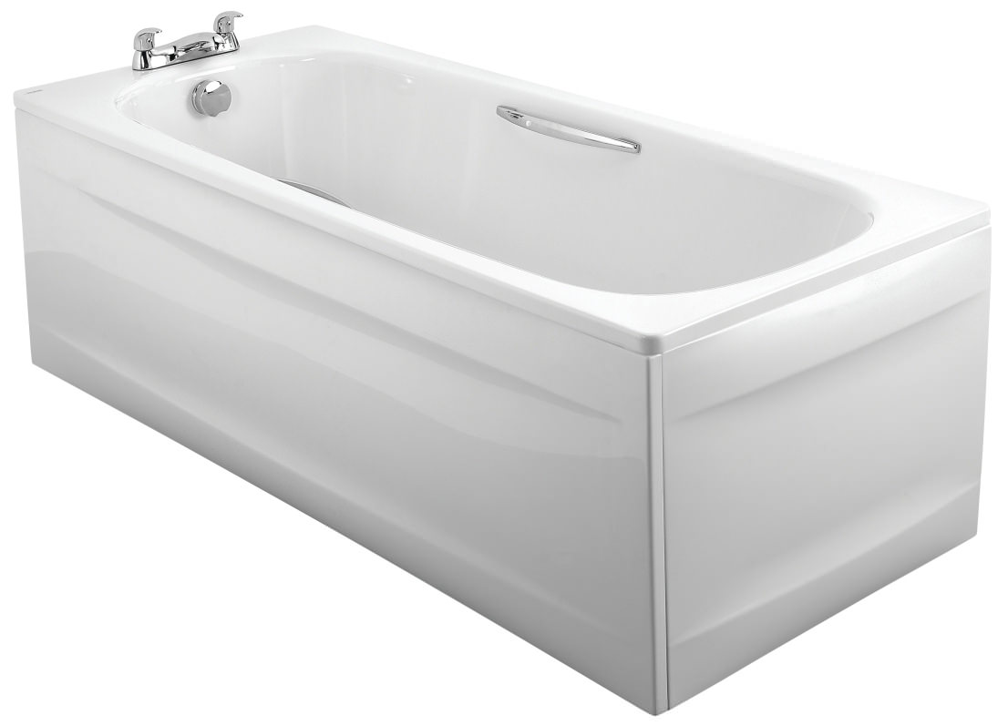
What you need:
Matchbox
3 Pencils
Paper
Fan
Quick Drying Glue
Crayons
Scissors
Saw
Bath

Slide 6
Make the Boat:
Adult Supervision Mandatory
Cut the rubber off the end of one pencil with the hacksaw
Make a small hole in the centre of the matchbox for the vertical pencil to go in
Insert one pencil into the hole and take it out again
Put some glue onto the end of the pencil and push it back into the hole, glue around the pencil and matchbox
Saw here
Make hole here

Slide 7
Make the Boat:
Glue the two pencils onto the base of the matchbox
Cut out the sail
Fix the sail onto the upright pencil

Slide 8
Make the Boat:
Cut out the flag and colour it on both sides
Glue the flag to the top of the pencil

Slide 9
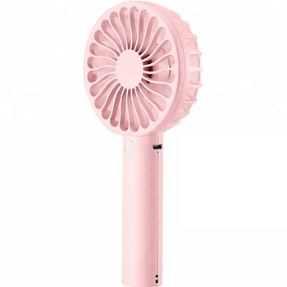
Sail the Boat:
Wind
Why not have a race round the bath or pond – Adult Supervision

Slide 10
Well Done

