Slide 1
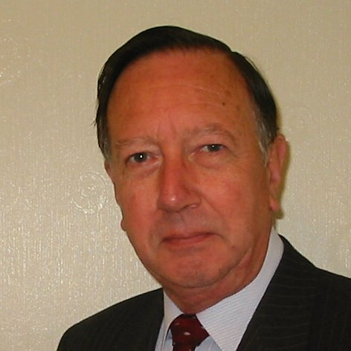
Welcome
These challenges were developed by Derrick Willer MBE and colleagues.
They are free to download and use in an education environment.
Please ensure that there is adult supervision, complete adherence to Health and Safety, and adequate PPE.
Derrick is a STEM Ambassador and volunteer Liaison Officer for Schools.
He has supported education in schools and colleges for over 30 years, initially as a Neighbourhood Engineer in the 1980’s, leading the local Year of Engineering Success campaign in 1996 and the Campaign to Promote Engineering from 1997 to 2004.
He was awarded an MBE for services to Education in 2018.

Slide 2
Guide
This activity is for pupils to make a spectroscope using recycled materials
Mandatory close supervision by a competent adult
Risks
Item | Risk | Avoidance Action
Tools | Misuse Injury | Close supervision
CD | Injury | Close supervision, ensure CD is not broken, clear up broken CDs immediately. Ensure CDs are not put into mouth or injested.
Sun | Injury | Close supervision. Do not ever look at the sun without dark galsses
Aggression between those present | Injury | Close supervision and immediate action to defuse aggression

Slide 3
Welcome
I very much hope that you will enjoy this activity to understand spectroscopy and make a spectroscope

Slide 4
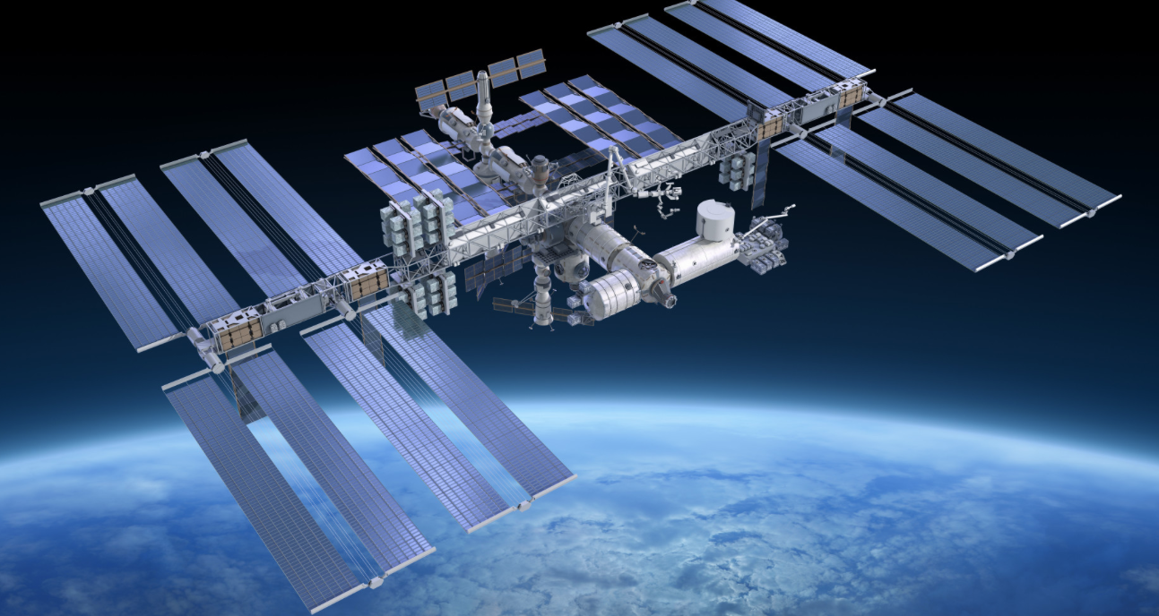
Science, Technology
and Engineering
Takes You Around The World
And into Space

Slide 5
Spectrum,
Spectroscopes
and
Spectroscopy

Slide 6
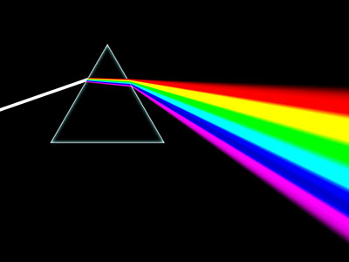
When light enters and leaves a medium of different density it is bent and different wavelengths are bend differently
Light dispersed by a glass prism

Slide 7
History
Let us start with understanding the history of spectroscopy

Slide 8
History
Isaac Newton Experiments 1666-1672
The history of spectroscopy began with Isaac Newton's optics experiments (1666–1672).
Newton applied the word "spectrum" to describe the rainbow of colors that combine to form white light
The rainbow is revealed when the white light is passed through a prism.

Slide 9
History
Joseph von Faunhofer Experiments
Joseph von Fraunhofer made experimental advances with dispersive spectrometers. His invention is dated 1814.
This enabled spectroscopy to become a more precise and a quantitative scientific technique.
Since then, spectroscopy has played and continues to play a significant role in chemistry, physics and astronomy.

Slide 10
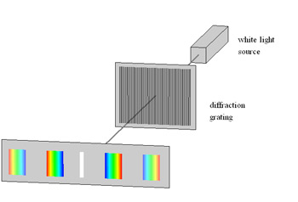
History
Joseph von Fraunhofer - 1821
Then, Joseph von Fraunhofer made a significant experimental leap forward by replacing a prism with a DIFFRACTION GRATING as the source of wavelength dispersion.
Fraunhofer built off the theories of light interference developed by Thomas Young, François Arago and Augustin-Jean Fresnel.

Slide 11
History
Joseph von Fraunhofer - 1821
Then, Joseph von Fraunhofer made a significant experimental leap forward by replacing a prism with a DIFFRACTION GRATING as the source of wavelength dispersion.
Fraunhofer built off the theories of light interference developed by Thomas Young, François Arago and Augustin-Jean Fresnel.
Solar spectrum with Fraunhofer lines as it appears visually.

Slide 12
There are two types of spectrum associated with the elements
Emission (emitting light)
and
Absorption (absorbing light)
Courtesy Dreamstime

Slide 13
Light Emission Spectrum
White
Light
When an element is vaporised it is energised and it emits light of specific frequency/wavelength.
Here are some examples.

Slide 14
Light Emission Spectrum
White
Light
Hydrogen
Helium
Oxygen
Carbon

Slide 15
Light Emission Spectrum
White
Light
Hydrogen
These lines are specific to the individual element
Helium
Oxygen
Carbon

Slide 16
Light Absorbtion Spectrum
White
Light
When light passes through an element the light of specific frequency/wavelength is absorbed and causes a black line in the spectrum.
Here are some examples.

Slide 17
Light Absorbtion Spectrum
White
Light
Hydrogen
Helium
Oxygen
Carbon
The black lines indicate the present of an element

Slide 18
Light Absorbtion Spectrum
White
Light
Again, these lines are specific to the individual element
Hydrogen
Helium
Oxygen
Carbon
The black lines indicate the present of an element

Slide 19
Sunlight

Slide 20
Sunlight
Hydrogen
Hydrogen emits and absorbs light of
specific frequency/wavelength
So we know the Sun has Hydrogen

Slide 21
Sun = Nuclear Fusion
Hydrogen
4+ MºK
Helium
Carbon
16+ MºK
Nitrogen
Oxygen
Iron

Slide 22
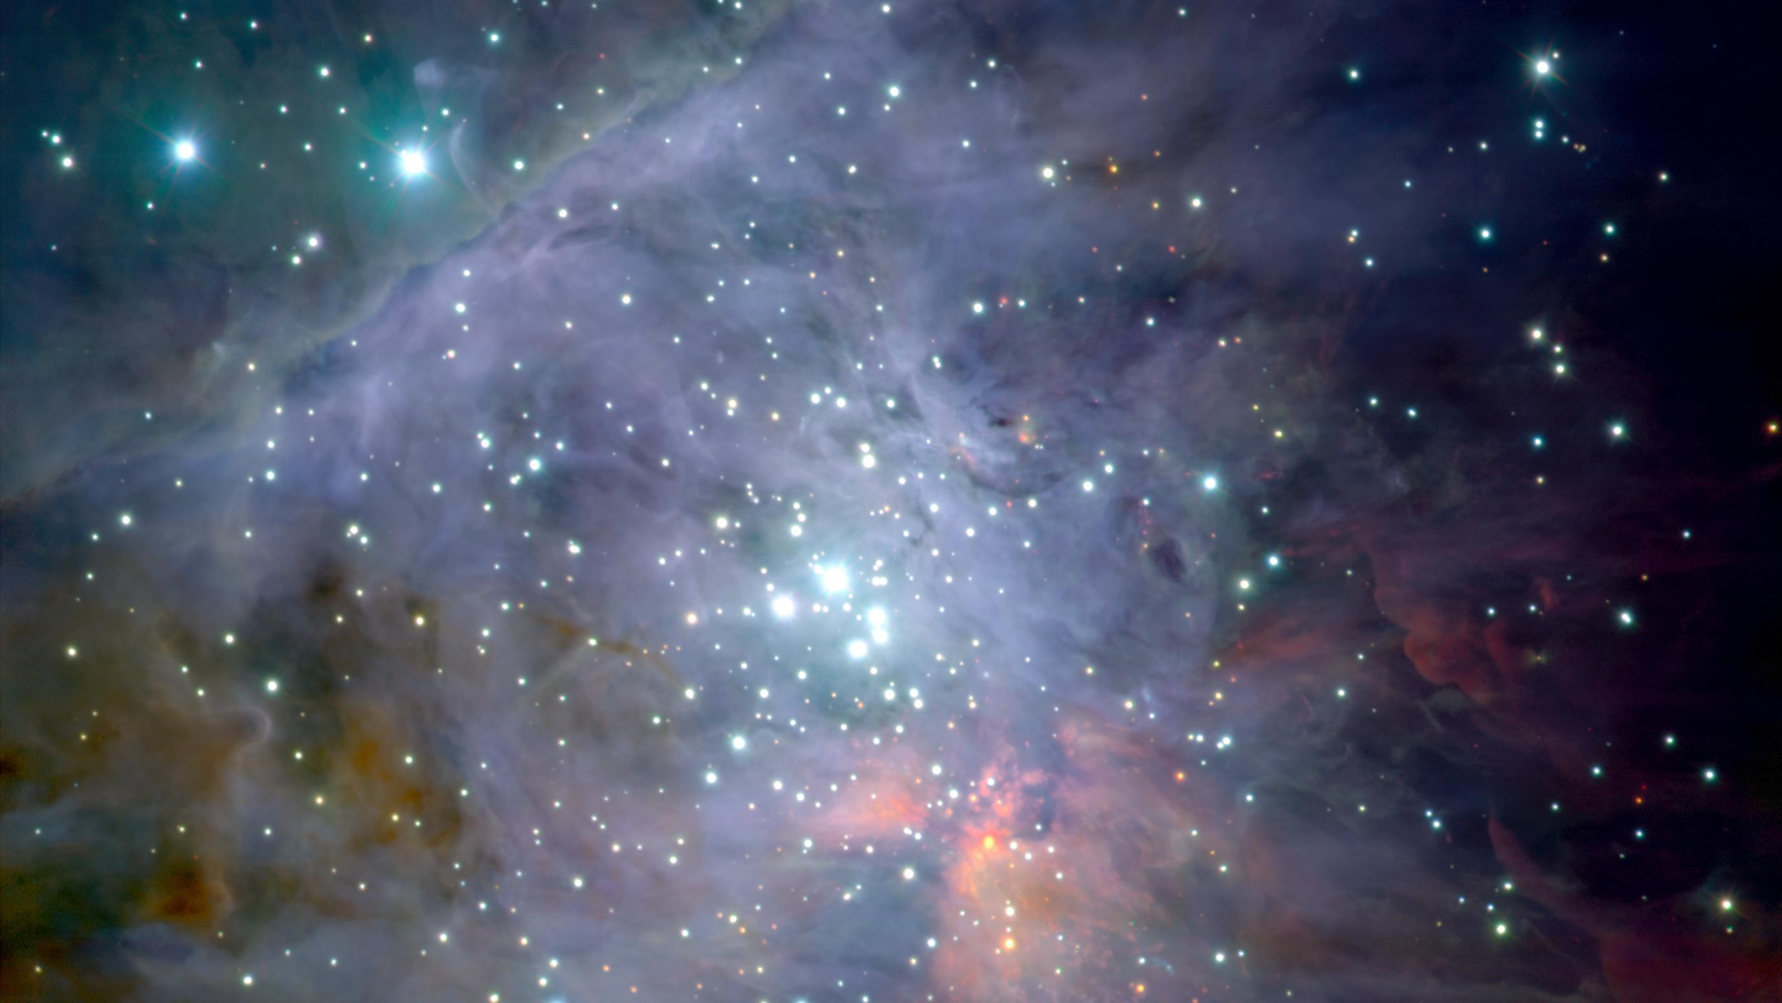
The Universe
Using Spectrum
We can find out what
stars are made of

Slide 23
The Universe
Using Spectrum
We can find out what
stars are made of
Mostly Hydrogen …… But

Slide 24
Hydrogen
Our Sun

Slide 25
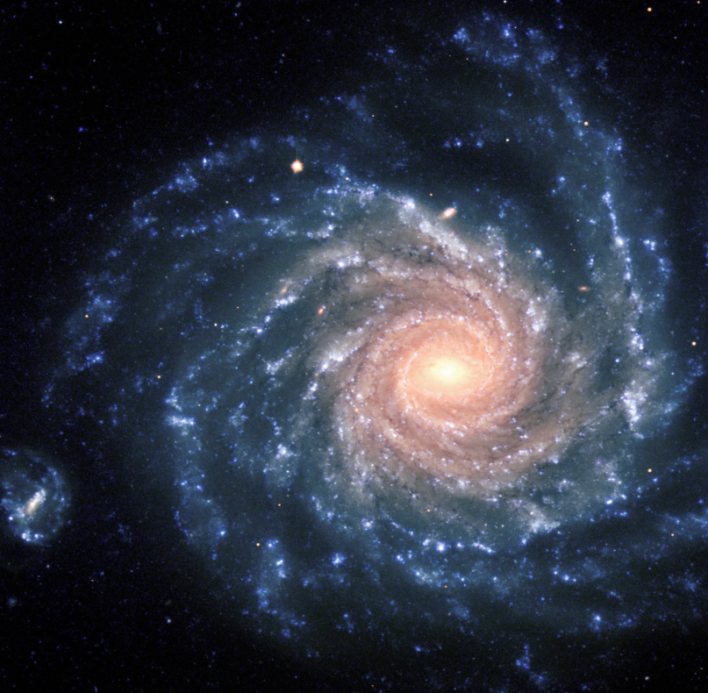
Hydrogen
Our Sun
Distant Galaxy

Slide 26
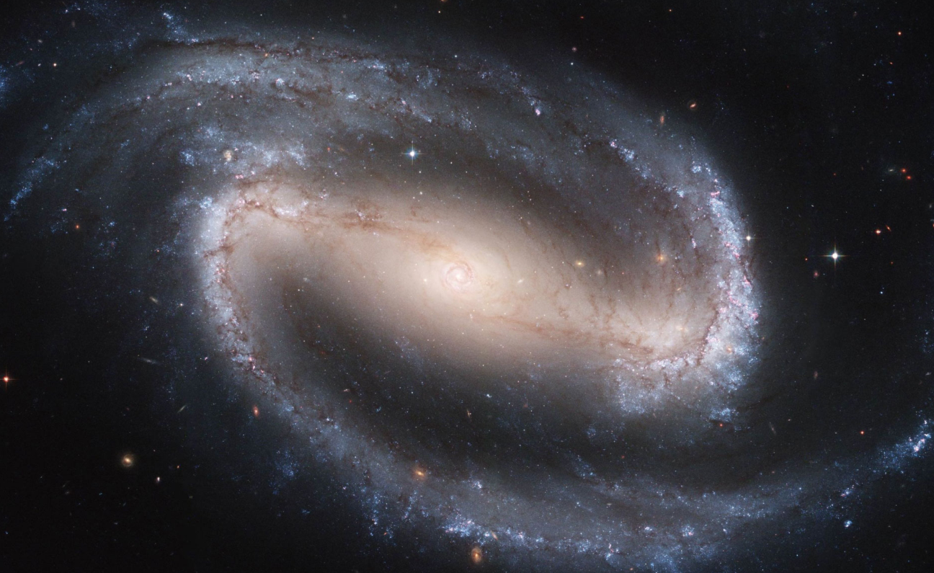
Hydrogen
Our Sun
Distant Galaxy
Even More Distant Galaxy

Slide 27
Hydrogen
The lines are shifted towards red
Our Sun
What in heavens is going on?
Distant Galaxy
Even More Distant Galaxy

Slide 28
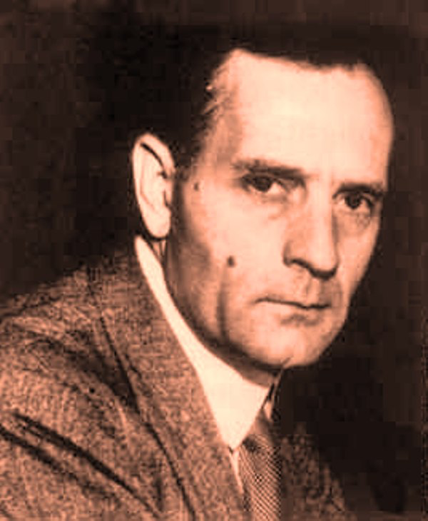
Hydrogen
The lines are shifted towards red
What in heavens is going on?
Our Sun
Distant Galaxy
Doppler Effect
First discovered by Edwin Hubble in 1929
Even More Distant Galaxy

Slide 29
Hydrogen
Distant galaxies are moving away from us
The further they are away the faster they are receding
This means that the universe is expanding!
Our Sun
Distant Galaxy
Even More Distant Galaxy

Slide 30
Hydrogen
So the Universe is Expanding
Our Sun
If we reverse this process using maths
Distant Galaxy
Even More Distant Galaxy

Slide 31
If we reverse this process using maths
Hydrogen
So the Universe is Expanding
Earlier in time the universe was smaller
Our Sun
Distant Galaxy
Even More Distant Galaxy

Slide 32
If we reverse this process using maths
Hydrogen
So the Universe is Expanding
Earlier in time the universe was smaller
In fact, we can calculate that
13.7 billion years ago it
was no size at all!!
Our Sun
Distant Galaxy
Even More Distant Galaxy

Slide 33
Hydrogen
So the Universe is Expanding
The Big Bang!!!
Our Sun
The Start of the Universe!!!
Distant Galaxy
Even More Distant Galaxy

Slide 34
So lets make a
Spectroscope
So we can see the light refracting
and the lines made by the elements

Slide 35
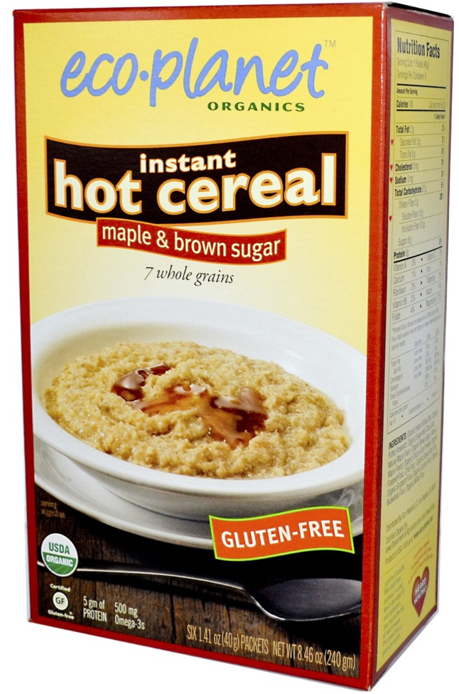
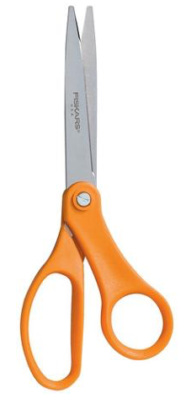
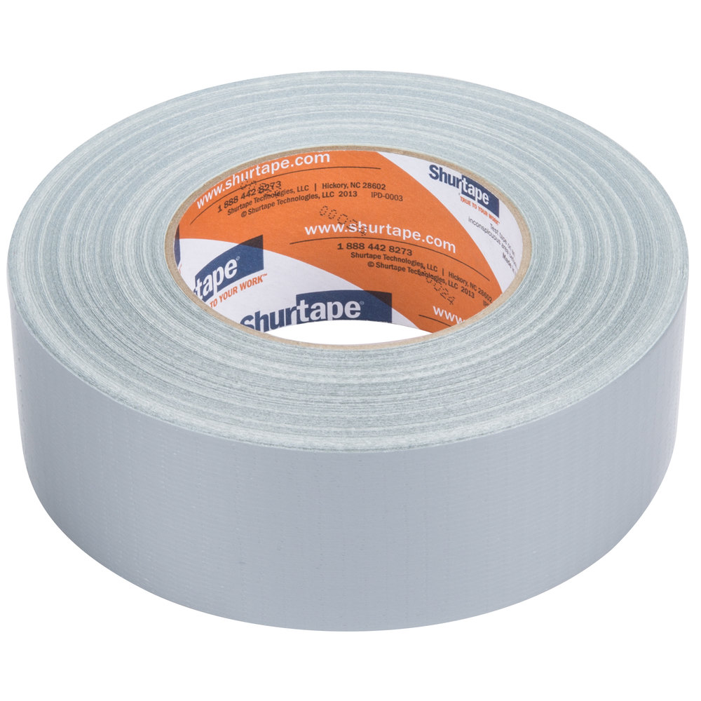
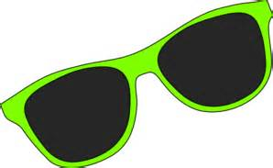
So lets make a
Spectroscope
What you need:
Cardboard Box
CD disk
Card
Tape
Scissors
Dark Glasses
Business Card
Jane Doe

Slide 36
Spectroscope
1 - Cut two holes very carefully
2 - Cut a slot
for the CD
Slide the CD in recording side up
Smaller than the business card
30º

Slide 37
Spectroscope
1 - Cut two holes very carefully
2 - Cut a slot
for the CD
Slide the CD in recording side up
3 - Mount two cards over this hole so that the gap is the thickness of two cards and exactly parallel
Secure with the tape so light can only enter through the slit
30º

Slide 38
Spectroscope
1 - Cut two holes very carefully
2 - Cut a slot
for the CD
Slide the CD in recording side up
3 - Mount two cards over this hole so that the gap is the thickness of two cards and exactly parallel
Secure with the tape so light can only enter through the slit
30º
You may need to exclude light from the edges of the CD and Cards with black tape

Slide 39
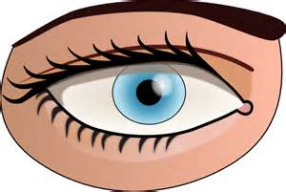
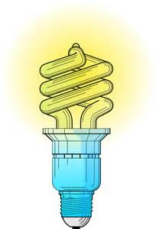
Spectroscope
Incandescent
Bulb
Candle
Energy
Saving Bulb
Sodium Street
Lamp
Only try to view the sun with dark glasses

Slide 40
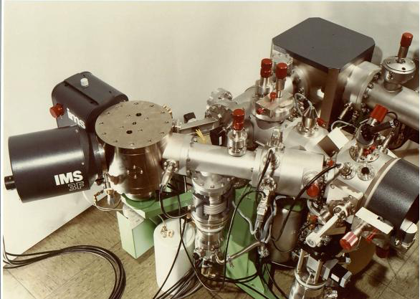
What are
Spectroscopes
Used for
The most used is a Mass Spectrometer
These vaporise the sample
Look at the spectrum
Analyse which elements are present

Slide 41
Mass Spectroscopes
Replica of Sir Joseph John Thomson’s mass spectrometer
Measures Mass to Charge Ratio
Early spectrometry devices that measured the mass-to-charge ratio of ions were called mass spectrographs which consisted of instruments that recorded a spectrum of mass values on a photographic plate.
Ions are deflected by electro-magnetism and the deflection amount is recorded on a photographic plate.

Slide 42
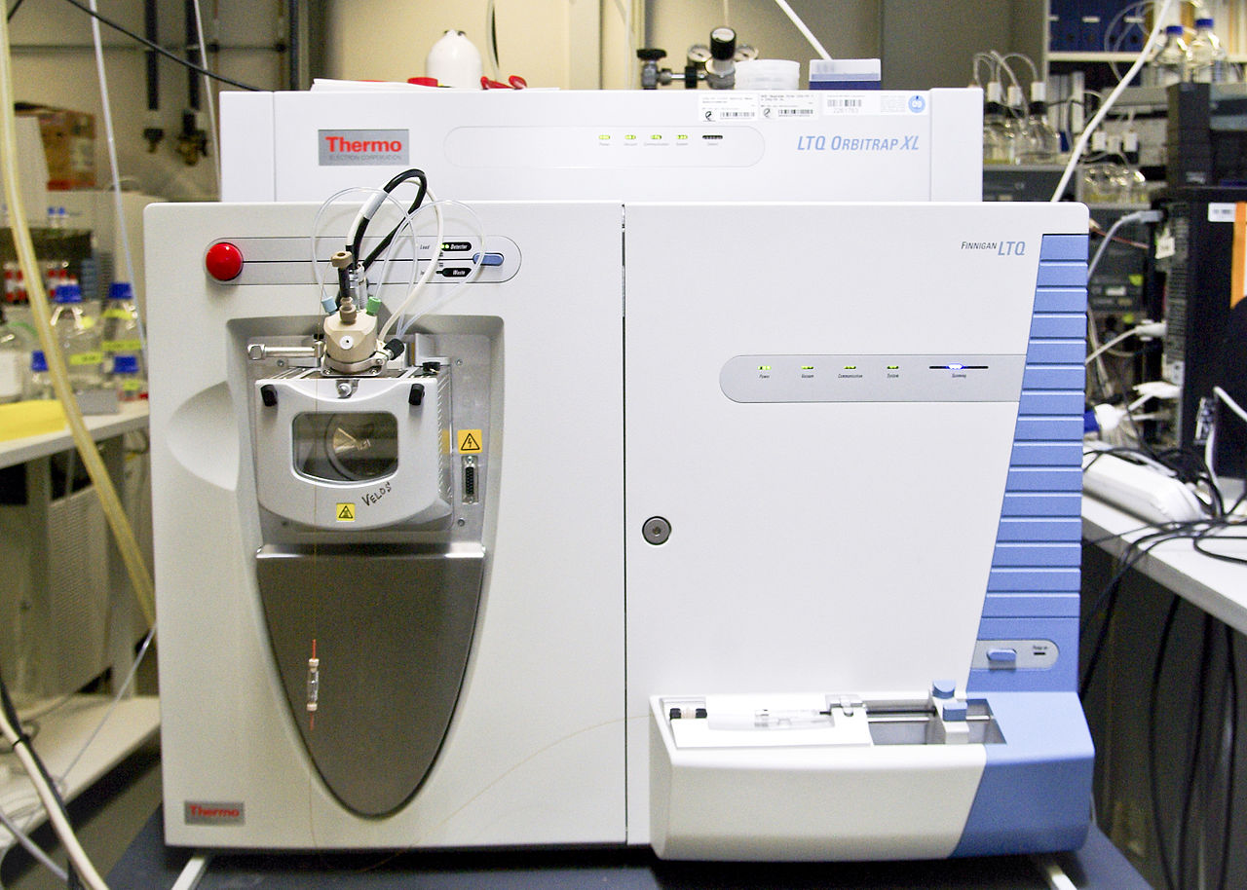
What are
Spectroscopes
Used for

Slide 43
What are
Spectroscopes
Used for
- Forensics

Slide 44
What are
Spectroscopes
Used for
- Forensics
Space exploration
Looking at Stars
Looking at Exo-planets
Looking at Asteroids

Slide 45
What are
Spectroscopes
Used for
- Forensics
Space exploration
Looking at Stars
Looking at Exo-planets
Looking at Asteroids
Assessing fossil ages

Slide 46
What are
Spectroscopes
Used for
- Forensics
Space exploration
Looking at Stars
Looking at Exo-planets
Looking at Asteroids
Assessing fossil ages
Pharmaceuticals

Slide 47
What are
Spectroscopes
Used for
- Forensics
Space exploration
Looking at Stars
Looking at Exo-planets
Looking at Asteroids
Assessing fossil ages
Pharmaceuticals
Medicine

Slide 48
What are
Spectroscopes
Used for
- Forensics
Space exploration
Looking at Stars
Looking at Exo-planets
Looking at Asteroids
Assessing fossil ages
Pharmaceuticals
Medicine
Making precise alloys
For aerospace
For automotive

Slide 49
What have
You learned about
Spectroscopes
You know how they work
You have made one
You know how to use a spectroscope
You know what they are used for

Slide 50
Thank You

