Slide 1
Welcome
These challenges were developed by Derrick Willer MBE and colleagues.
They are free to download and use in an education environment.
Please ensure that there is adult supervision, complete adherence to Health and Safety, and adequate PPE.
Derrick is a STEM Ambassador and volunteer Liaison Officer for Schools.
He has supported education in schools and colleges for over 30 years, initially as a Neighbourhood Engineer in the 1980’s, leading the local Year of Engineering Success campaign in 1996 and the Campaign to Promote Engineering from 1997 to 2004.
He was awarded an MBE for services to Education in 2018.

Slide 2
Guide
This activity is for pupils to do sums using bricks
It includes addition, subtraction, multiplying, dividing and a logic problem. Also Pythagoras and triangles.
The pupils can make their own bricks and triangles out of paper
Mandatory close supervision by a competent adult
Risks
Item | Risk | Avoidance Action
Tools | Misuse Injury | Close supervision
Bricks | Injury | Close supervision to prevent putting bricks in mouth or injecting the bricks.
Aggression between those present | Injury | Close supervision and immediate action to defuse aggression

Slide 3
Sum Fun With Arithmetic Bricks
Welcome
I very much hope that you will enjoy this activity as well as learning to do sums
Click for the next slide

Slide 4
Sum Arithmetic Bricks
We can use bricks to do sums including
Adding
Subtracting
Multiplying
Dividing
and much more
See last slide for Bricks
made from card
Click for the next slide

Slide 5
1
Sum Adding Bricks
We can use bricks to do adding up
Here is an example
Click for the next slide

Slide 6
Sum Adding Bricks
We can use bricks to do adding up
Add 5 and 4
1
2
3
4
5
1
2
3
4
Place five bricks in a line
1 2 3 4 5 6 7 8 9
Now add four to the line and count them all
5 + 4 = 9
Click for the next slide

Slide 7
Sum Adding Bricks
Now Add 5 and 9
Place five bricks in a line
1
2
3
4
5
1
2
3
4
5
6
7
8
9
1 2 3 4 5 6 7 8 9 10 11 12 13 14
Now add nine to the line and count them all
5 + 9 = 14
Click for the next slide

Slide 8
Sum Adding Bricks
Now Add 5 and 9
But it is better to arrange them in tens like this
1
2
3
4
5
6
7
8
9
10
11
12
13
14
5 + 9 = 14
Click for the next slide

Slide 9
Sum Adding Bricks
Now Add 13 and 9
Place 13 bricks in lines of tens
1
2
3
4
5
6
7
8
9
10
11
12
13
1
2
3
4
5
6
7
8
9
Now add nine to the line and count them all
You can immediately see two rows of ten = 20 and a row of four, hence 24
13 + 9 = 22
Click for the next slide

Slide 10
Sum Adding Bricks
You can do lots of your own sums like this
Well done - give your selves a big clap!

Slide 11
2
Sum Subtracting Bricks
We can use bricks to do subtracting sums
Here is an example
Click for the next slide

Slide 12
We can use bricks to do subtracting
Take 4 from 9
1
2
3
4
5
6
7
8
9
Place nine bricks in a line
Now take four from the line and count the rest
9 - 4 = 5
Click for the next slide

Slide 13
Take 9 from 24
Place 24 bricks in lines of tens
1
2
3
4
5
6
7
8
9
10
11
12
13
14
15
16
17
18
19
20
21
22
23
34
Now take nine from them and count the rest
You can easily see a row of ten and a row of five to make 15
24 - 9 = 15
Click for the next slide

Slide 14
Sum Subtracting Bricks
You can do lots of your own sums like this
Well done - give your selves a big clap!

Slide 15
3
Sum Multiplying Bricks
We can use bricks to do multiplying sums
Here is an example
Click for the next slide

Slide 16
Sum Multiplying Bricks
We can use bricks to do multiplying sums
Lets multiply four by three
Lay four bricks in a line
Lay two more rows, three in all
An count them
4 x 3 = 12
Click for the next slide

Slide 17
Sum Multiplying Bricks
We can use bricks to do multiplying sums
Lets multiply four by three
Now rearrange them in tens
4 x 3 = 12
It is easy to see that the answer is 12
Click for the next slide

Slide 18
Sum Multiplying Bricks
We can use bricks to do multiplying sums
Lets multiply seven by three
Lay seven bricks in a line
Lay two more rows, three in all
An count them
7 x 3 = 21
Click for the next slide

Slide 19
Sum Multiplying Bricks
We can use bricks to do multiplying sums
Lets multiply seven by three
Now rearrange them in tens
7 x 3 = 21
It is easy to see that the answer is 21
Click for the next slide

Slide 20
Sum Multiplying Bricks
You can do lots of your own sums like this
Well done - give your selves a big clap!

Slide 21
4
Sum Dividing Bricks
We can use bricks to do dividing sums
Here is an example
Click for the next slide

Slide 22
Lets try by dividing 24 by 6
1
2
3
4
5
6
7
8
9
10
Count out 24 bricks
11
12
13
14
15
16
17
18
19
20
21
22
23
24
Click for the next slide

Slide 23
Lets try by dividing 24 by 6
1
2
3
4
5
6
7
8
9
10
11
12
Count out 24 bricks
13
14
15
16
17
18
Now arrange them in lines of six
19
20
21
22
23
24
You now have four rows of six
So 24 ÷ 6 = 4
Click for the next slide

Slide 24
Now try by dividing 24 by 8
Arrange them in lines of eight
You now have three rows of eight
So 24 ÷ 8 = 3
Click for the next slide

Slide 25
Now try by dividing 21 by 7
Count out 21 bricks
Arrange them in lines of seven
You now have three rows of seven
So 21 ÷ 7 = 3
Click for the next slide

Slide 26
Now try by dividing 21 by 5
Arrange them in lines of five
You now have four rows of five and one left over
We can write the one left over as ¹/₅
meaning one fifth
So 21 ÷ 5 = 4 ¹/₅
Click for the next slide

Slide 27
Sum Dividing Bricks
You can do lots of your own sums like this
Well done - give your selves a big clap!

Slide 28
5
Sum Squares
We can use bricks to do sums like
Calculating Squares
Click for the next slide

Slide 29
4
Sum Squares
Using cube blocks construct squares with 1, 2 , 3, 4 and 5 sides.
How many blocks are there in each group?
Click for the next slide

Slide 30
Sum Squares
1
2 X 2 = 4
3 X 3 = 9
4 X 4 = 16
5 X 5 = 25
Click for the next slide

Slide 31
Sum Squares
1
But we can do a lot more multiplication sums using bricks
2 X 2 = 4
3 X 3 = 9
4 X 4 = 16
5 X 5 = 25
Click for the next slide

Slide 32
Sum More Multiples
1
3 X 2 = 6
4 X 3 = 12
5 X 4 = 20
6 X 5 = 30
Click for the next slide

Slide 33
6
Sum Climbing
There is a box of toys Dad put away on top of the wardrobe 2m high. He has given permission to bring it down.
Toys
The only problem is that he has locked the step ladder away.
2m
But you do have some bricks which are 20cm cubes, just right for climbing on safely.
You can just reach up 1 metre safely.
How many bricks do you need safely to reach the toy box, providing steps.
20cm
Click for the next slide

Slide 34
Sum Climbing
You do have some bricks which are 20cm cubes, just right for climbing on.
Toys
You can just reach up 1 metre safely.
1m
How many bricks do you need safely to reach the toy box, providing steps.
First build up 5 bricks
5 x 20cm = 100cm = 1m
and you can reach the top.
Now make the steps.
So you need 5+4+3+2+1 bricks = 15 bricks.
Click for the next slide

Slide 35
Sum Climbing
Toys
How many yellow bricks are there?
1m
What is the ratio of the yellow bricks to all the bricks?
Ratio is yellow ÷ total
That is right = 3/15 = 1/5 √
Click for the next slide

Slide 36
Some Climbing Safety
Did you know about climbing safety?
Well done - give your selves a big clap!
Click for the next slide

Slide 37
7
Do you remember this
1
2 X 2 = 4
3 X 3 = 9
4 X 4 = 16
5 X 5 = 25
Click for the next slide

Slide 38
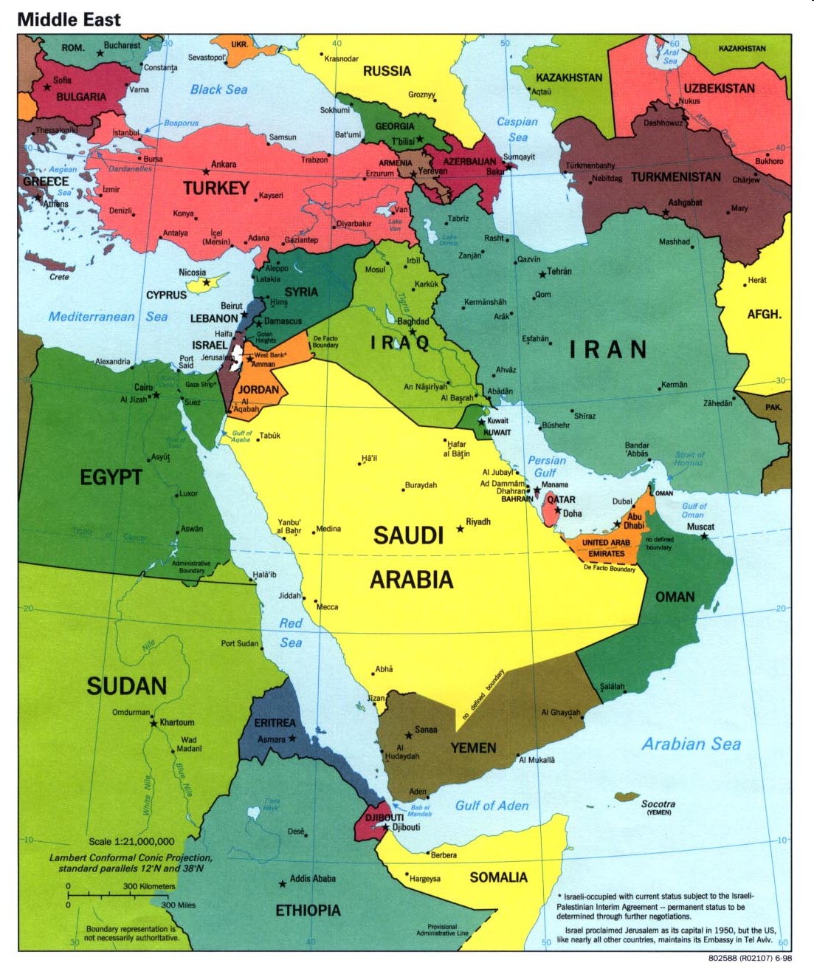
Now try this
A 3, 4 , 5 triangle always has a right angle marked with a square
5
Babylonia
3
This was known to the ancient Egyptians and
Babylonians over
6000 years ago!
Egypt
4
Click for the next slide

Slide 39
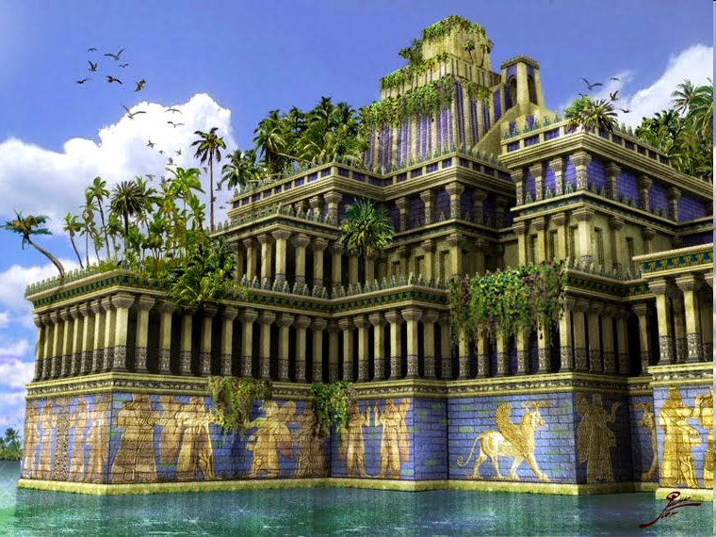
Egyptian Pyramids
5
Hanging Gardens Of Babylon
3
4
Click for the next slide

Slide 40
There is something very special about all Right Angled Triangles
Would you please construct a square on each side like this
3
5
4
Now add together the number of squares on the shorter sides
Click for the next slide

Slide 41
There is something very special about all Right Angled Triangles
Would you please construct a square on each side like this
Now add together the number of squares on the shorter sides
3
5
4
They equal the number of squares on the longest side
Click for the next slide

Slide 42
In our example
3x3 + 4x4 = 5x5
Let’s call the sides A, B and C
C
We found that
AxA + BxB = CxC
A
3
5
4
B
We usually write this
A² + B² = C²
where ² means “Squared”
Click for the next slide

Slide 43
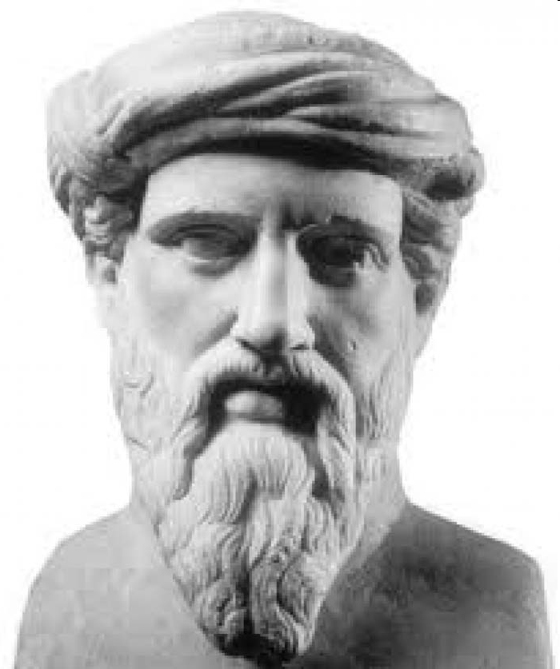
In absolutely all Right Angled Trianges
A² + B² = C²
This was fist proven by Pythagoras, a Greek Philosopher and Mathematician
570 to 495 BC
C
A
3
5
4
B
Click for the next slide

Slide 44
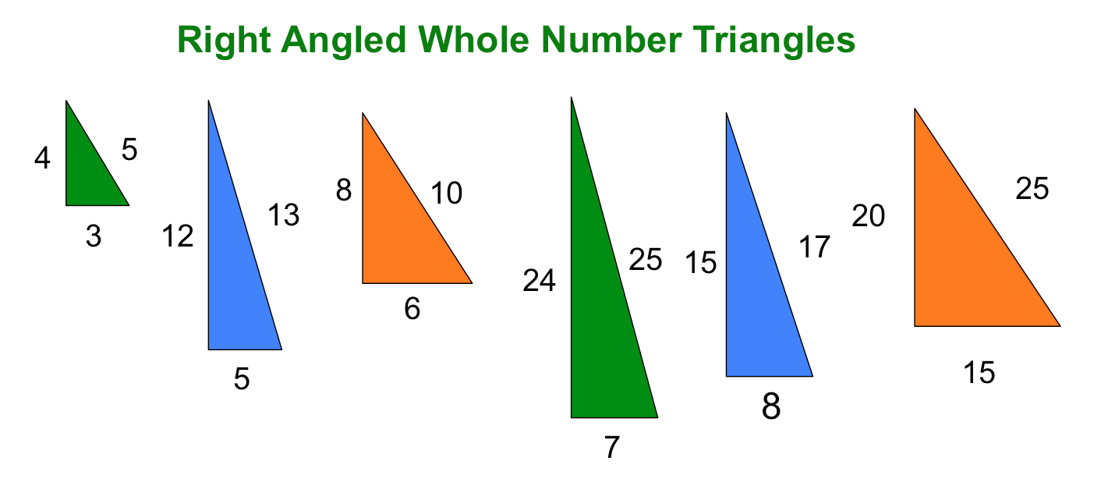
In absolutely all Right Angled Trianges
A² + B² = C²
C
A
3
5
4
B
Try out some of these
Click for the next slide

Slide 45
8
Sum More Bricks
Please measure the sides of one of your bricks.
Without building with bricks, how many bricks will you need to build a tower more than 30cm high?
Now check out your calculation by building the tower with bricks?
Your bricks may be a different size from the ones in this display
Click for the next slide

Slide 46
Sum More Bricks
Well done - give your selves a big clap!
Click for the next slide

Slide 47
Sum Triangles
Cut your cube in half like this
or make up the triangular shape
See last slide
Click for the next slide

Slide 48
Sum Triangles
Build a triangle like this
four bricks wide and two high
That is half of its base times its height
½
½
Base = 4
Height = 2
Base x Height = 8
½
½
½
½
½
½
Calculate the area of the front face
Area of this Triangle
= Half Base x Height
It is four bricks worth of area.
Click for the next slide

Slide 49
Sum Triangles
Now build a triangle like this
three bricks wide and three high
That is half of its base times its height
Base = 3
Height = 3
Base x Height = 9
That is the same formula as the previous triangle
Calculate the area of the front face
Area of this Triangle
= Half Base x Height
It is four and a half bricks worth of area.
Click for the next slide

Slide 50
Sum Triangles
Now build a triangle like this
three bricks wide and three high
That is half of its base times its height
Base = 3
Height = 3
Base x Height = 9
In fact this is always true
Triangle Area = 1/2 Base x Height
Calculate the area of the front face
Area of this Triangle
= Half Base x Height
It is four and a half bricks worth of area.
Click for the next slide

Slide 51
Sum Triangles
If we cut the brick like this half way along the top
And build this 3 bricks wide and 3 high
A
A
½ Brick Length
B
B
A
A
A
A
B
B
A
B
We have an area of 6 As and 4 Bs
Click for the next slide

Slide 52
Any A + B = 1 Brick
And 2As = ½Brick
But
A+B = 1Brick
and
4As = 1 Brick
That is the same formula again
Area of Triangle
=
½ Base x Height
A
A
½ Brick Length
B
B
A
A
A
A
A
B
B
A
A
A
So the area = 4½ Bricks
= ½ Base x Height
Click for the next slide

Slide 53
Sum Triangles
Proove that the area of a triangle = ½ Base x Height
1. On a piece of paper draw any triangle
2. Turn it so the base is horizontal
3. Copy the triangle
Click for the next slide

Slide 54
Sum Triangles
Proove that the area of a triangle = ½ Base x Height
4. Draw a vertical line from the peak of the second triangle
5. Cut the second triangle down the line
Click for the next slide

Slide 55
Sum Triangles
Proove that the area of a triangle = ½ Base x Height
4. Turn the two sections of the second triangle 180 degrees
5. Move the two sections
6. You now have a rectangle
area Base x Height made from two identical triangles
7. So one triangle area
= ½ Base x Height
Click for the next slide

Slide 56
Sum Triangles
Proove that the area of a triangle = ½ Base x Height
4. Turn the two sections of the second triangle 180 degrees
QED
5. Move the two sections
6. You now have a rectangle
area Base x Height made from two identical triangles
That is “Quad Erat Demonstrandum”
Latin for “Which was to be shown.”
7. So one triangle area
= ½ Base x Height
Or is it “Quite Easily Done!”
Click for the next slide

Slide 57
Thank You
Well done - give your selves a big clap!
Click for the next slide

Slide 58
Cube

Slide 59
Cubic Triangle

