Slide 1
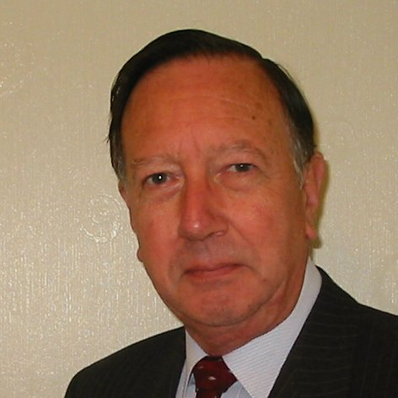
Welcome
These challenges were developed by Derrick Willer MBE and colleagues.
They are free to download and use in an education environment.
Please ensure that there is adult supervision, complete adherence to Health and Safety, and adequate PPE.
Derrick is a STEM Ambassador and volunteer Liaison Officer for Schools.
He has supported education in schools and colleges for over 30 years, initially as a Neighbourhood Engineer in the 1980’s, leading the local Year of Engineering Success campaign in 1996 and the Campaign to Promote Engineering from 1997 to 2004.
He was awarded an MBE for services to Education in 2018.

Slide 2
Guide
This activity is for pupils to sing the song, count the numbers of time you sing a specific word and then do some sums using these numbers.
We then sing Three Bind Mice to do some more sums
Mandatory close supervision by a competent adult
Risks
Item | Risk | Avoidance Action
Aggression between those present | Injury | Close supervision and immediate action to defuse aggression

Slide 3
1
Lets all sing together
Click to start animation
Oh, the grand old Duke of York,
He had ten thousand men,
He marched them up to the top of the hill
And he marched them down again.
And when they were up they were up,
And when they were down they were down,
And when they were only half way up
They were neither up nor down.

Slide 4
Now lets all sing again but count the number of times we sing the word Down
Oh, the grand old Duke of York,
He had ten thousand men,
He marched them up to the top of the hill
And he marched them down again.
And when they were up they were up,
And when they were down they were down,
And when they were only half way up
They were neither up nor down.
Click for the next slide

Slide 5
Now lets all count the number of times we sing the word Down
Now can you work out without singing how many times we would sing “Down” if we sang the song three times?
That is right.
We sang “down”
four times.
Oh, the grand old Duke of York,
He had ten thousand men,
He marched them up to the top of the hill
And he marched them down again.
And when they were up they were up,
And when they were down they were down,
And when they were only half way up
They were neither up nor down.
That is right.
We would sing “down”
twelve times because
3 x 4 = 12.
Click for the next slide

Slide 6
Now lets all count the number of times we sing the word Up
Now can you work out without singing how many times we would sing “Up” if we sang the song three times?
That is right.
We sang “up”
five times.
Oh, the grand old Duke of York,
He had ten thousand men,
He marched them up to the top of the hill
And he marched them down again.
And when they were up they were up,
And when they were down they were down,
And when they were only half way up
They were neither up nor down.
That is right.
We would sing “up”
twelve times because
3 x 5 = 15.
Click for the next slide

Slide 7
So we sang DOWN four times and UP five times.
So let’s add four to five, what is the answer
4 + 5 = 9 √
So let’s multiply four by five, what is the answer
4 x 5 = 20 √
And we did all of this by singing the Grand Old Duke of York
What is the difference between our answers
Difference = 20 - 9
20 - 9 = 11 √
So now lets divide 20 by 4
(the number of “Downs”)
20 ÷ 4 = 5 √
Click for the next slide

Slide 8
Well done - give your selves a big clap!
Click for the next slide

Slide 9
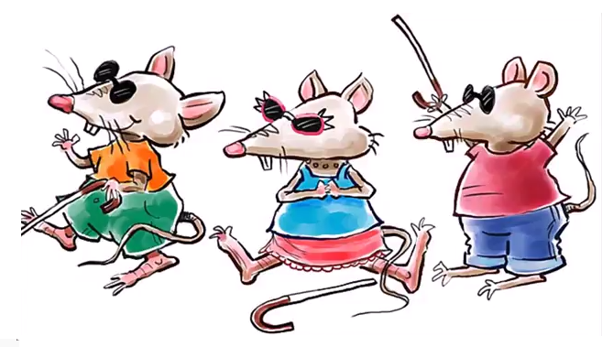
Sum Fun WithThree Blind Mice
Lets now sing about
Three Blind Mice

Slide 10
Sum Fun WithThree Blind Mice
Sing together
Three blind mice, Three blind mice
See how they run, See how they run!
They all ran after the farmer’s wife
She cut off their tails With a carving knife
Did you ever see such a sight in your life
As three blind mice?

Slide 11
Sum Fun WithThree Blind Mice
Now many times did we sing
“Three Blind Mice”
That is right – three times
Now how many mice were there?
That is right – three

Slide 12
Sum Fun WithThree Blind Mice
How many do we get if we multiply the number of times we sang “Three Blind Mice” by the number of mice?
That is right – three time three = nine
Now let’s multiply nine by the number of tails that the mice have.
Wrong
They all had their tails cut off
Nine times none = none
Nine times three = 27

Slide 13
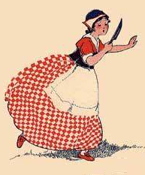
Sum Fun WithThree Blind Mice
How many people were involved?
That is right, just one, the farmer’s wife
How many animals were involved?
That is right, four
Because humans are also animals

Slide 14
Sum Fun WithThree Blind Mice
Thank You

