Slide 1
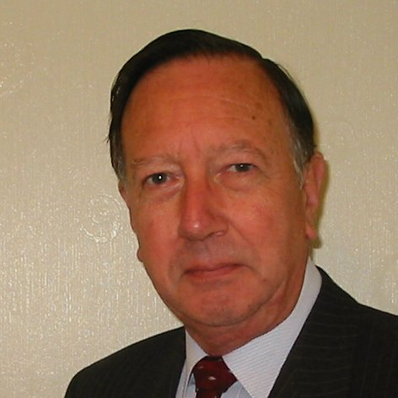
Welcome
These challenges were developed by Derrick Willer MBE and colleagues.
They are free to download and use in an education environment.
Please ensure that there is adult supervision, complete adherence to Health and Safety, and adequate PPE.
Derrick is a STEM Ambassador and volunteer Liaison Officer for Schools.
He has supported education in schools and colleges for over 30 years, initially as a Neighbourhood Engineer in the 1980’s, leading the local Year of Engineering Success campaign in 1996 and the Campaign to Promote Engineering from 1997 to 2004.
He was awarded an MBE for services to Education in 2018.

Slide 2
Guide
This activity is for pupils to discover how to build towers or bridges using sweets and sticks
Mandatory close supervision by a competent adult
Risks
Item | Risk | Avoidance Action
Scissors | Injury | Close supervision
Sucks | Injury | Close supervision, do not allow anyone to put into their moth or to prick themselves or pthers.
Aggression between those present | Injury | Close supervision and immediate action to defuse aggression

Slide 3
Welcome
I very much hope that you will enjoy this activity as well as learning about building safe sructures

Slide 4
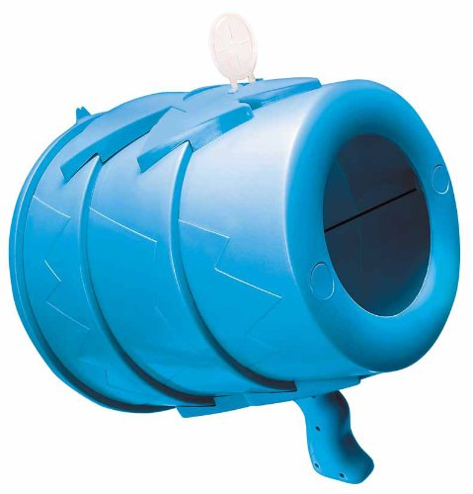
To test the structure we suggest using an Air Zuka to create a strong wind
Air Zuka

Slide 5
Make A Tower out of Marshmallows and Straws
Make A Bridge out of Marshmallows and Straws
Ctrl+Click for the one
you want to use
Make A Tower out of Jelly Beans and Toothpicks
Make A Bridge out of Jelly Beans and Toothpicks

Slide 6
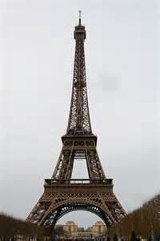
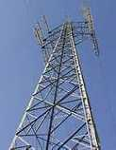
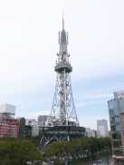
Make a Tower
out of Marshmallows and Straws
Eiffel
Tower
in
Paris
TV
Tower
TV
Tower
in
Japan
Electricity
Pylon

Slide 7
Make the sections like this
What is the Problem?
It is not stable

Slide 8
But make the sections like this
It is very stable
The Diagonal Straws
are longer than the others

Slide 9
Then
Build
High

Slide 10
How well did you do?
Who built the best one?
Click For Next Slide

Slide 11
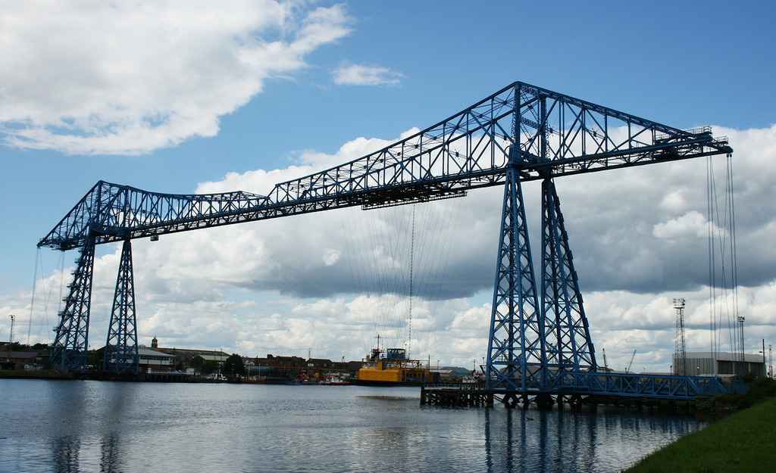
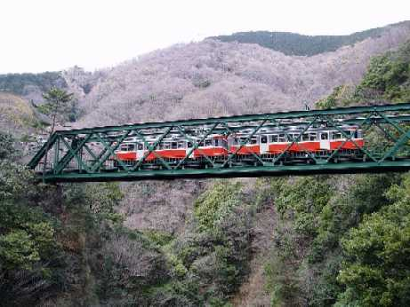
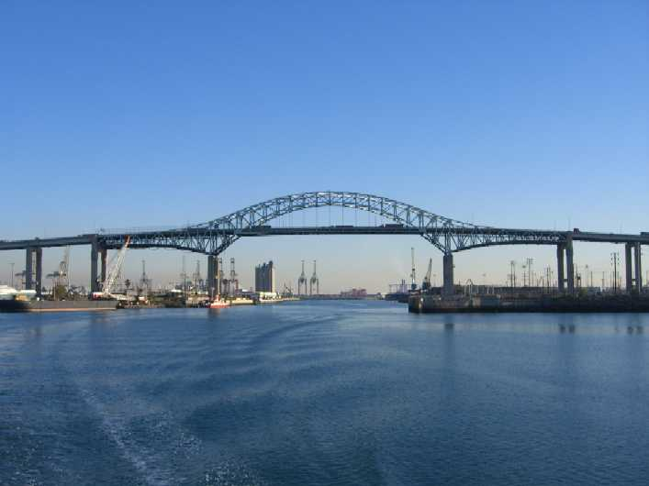
Make a Bridge
out of Marshmallows and Straws

Slide 12
Make the sections like this
What is the Problem?
It is not stable

Slide 13
But make the sections like this
It is very stable
The Diagonal Straws
are longer than the others

Slide 14
Then
Build
Long

Slide 15
How well did you do?
Who built the best one?
Click For Next Slide

Slide 16
Make a Tower
out of Jelly Beans and Toothpicks
Eiffel
Tower
in
Paris
TV
Tower
TV
Tower
in
Japan
Electricity
Pylon

Slide 17
Make the sections like this
What is the Problem?
It is not stable

Slide 18
But make the sections like this
It is very stable
The Diagonal Sticks
are longer than the others

Slide 19
Then
Build
High

Slide 20
How well did you do?
Who built the best one?
Click For Next Slide

Slide 21
Make a Bridge
out of Jelly Beans and Toothpicks

Slide 22
Make the sections like this
What is the Problem?
It is not stable

Slide 23
But make the sections like this
It is very stable
The Diagonal Sticks
are longer than the others

Slide 24
Then
Build
Long

Slide 25
How well did you do?
Who built the best one?
Click For Next Slide

Slide 27
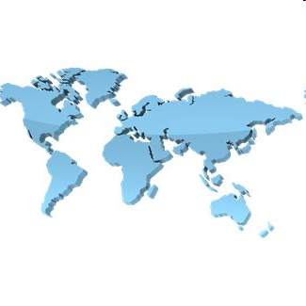
Thank You

