Slide 1
Welcome
These challenges were developed by Derrick Willer MBE and colleagues.
They are free to download and use in an education environment.
Please ensure that there is adult supervision, complete adherence to Health and Safety, and adequate PPE.
Derrick is a STEM Ambassador and volunteer Liaison Officer for Schools.
He has supported education in schools and colleges for over 30 years, initially as a Neighbourhood Engineer in the 1980’s, leading the local Year of Engineering Success campaign in 1996 and the Campaign to Promote Engineering from 1997 to 2004.
He was awarded an MBE for services to Education in 2018.

Slide 2
Guide
This activity is for pupils to power a rocket using vinegar.
Mandatory close supervision by a competent adult
Risks
Item | Risk | Avoidance Action
Tools | Misuse, Injury | Close supervision
Speed of Rocket | Injury | Safety glasses to be worn
Liquids | Spillage Injury | Close supervision. Sponge, mop and bucket
Vinegar | Injury | Close supervision, do not drink vinegar, water to rinse mouth and to drink
Aggression between those present | Injury | Close supervision and immediate action to defuse aggression

Slide 3
Welcome
I very much hope that you will enjoy discovering about the way vinegar acts with baking soda

Slide 4
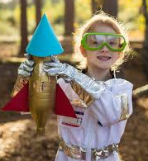
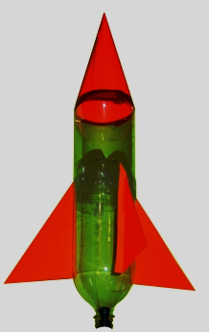
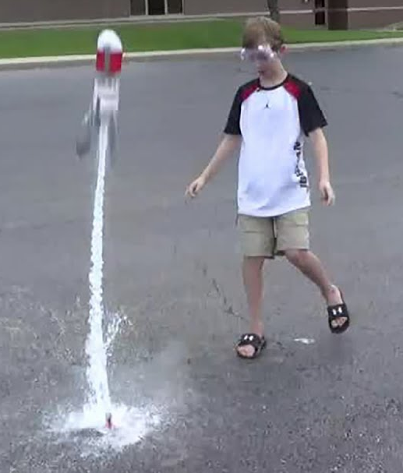
Make a Rocket out of a Bottle, Vinegar and Soda

Slide 5
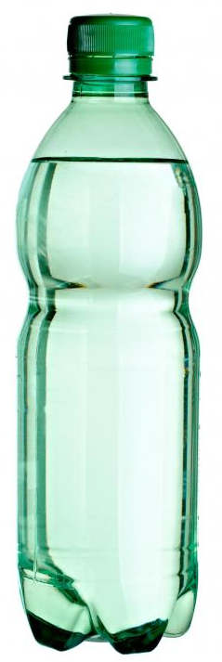
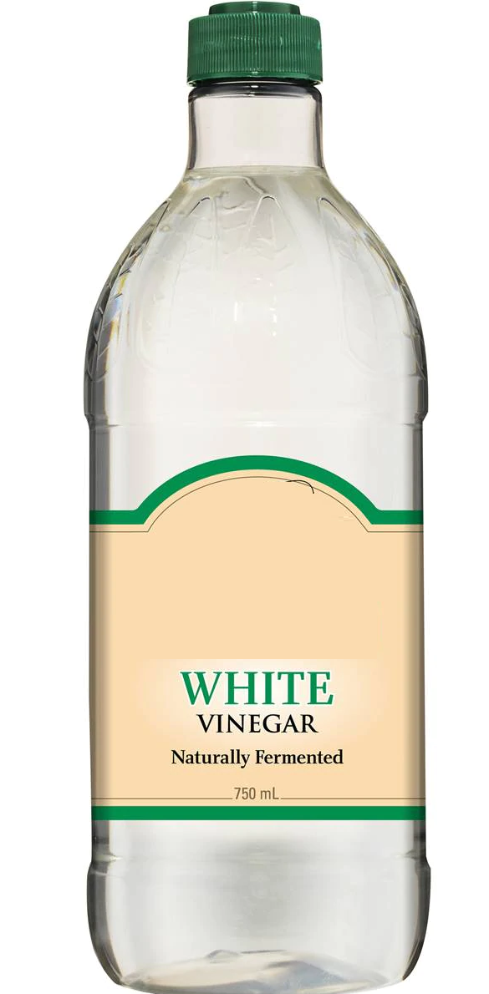
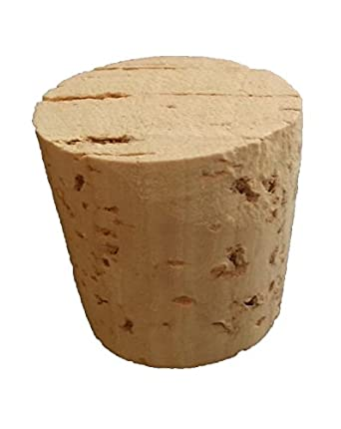
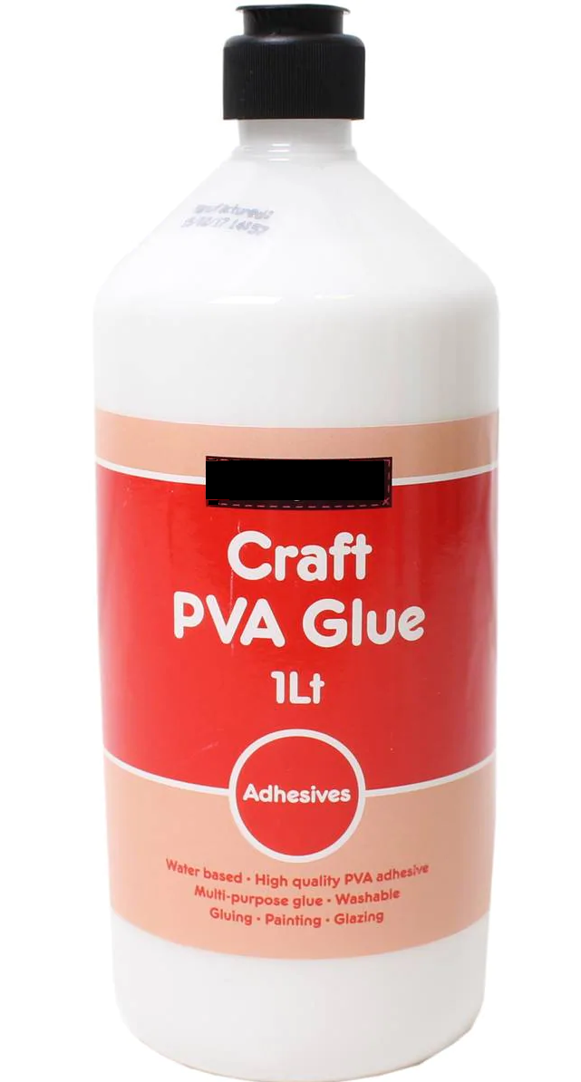
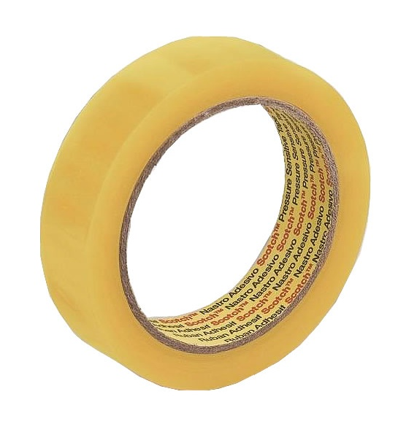
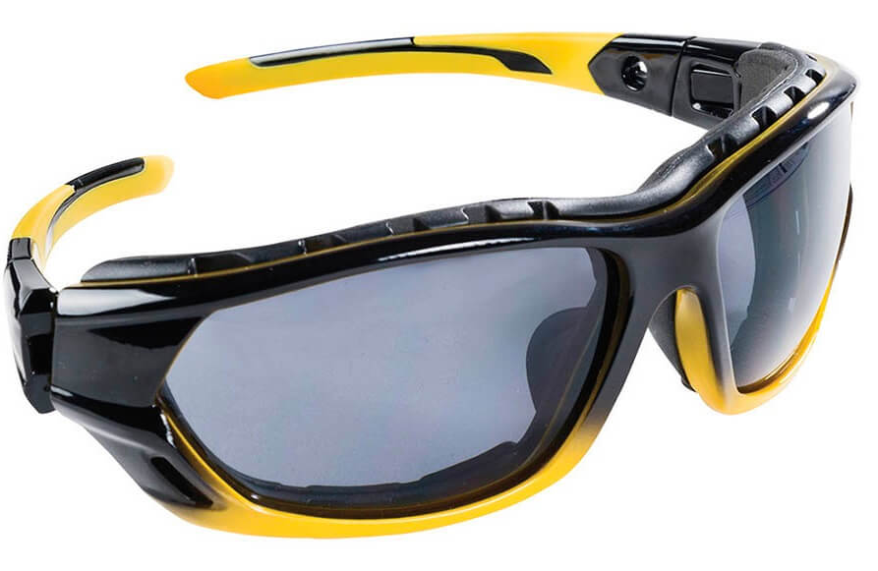
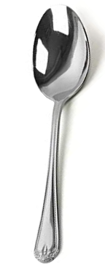
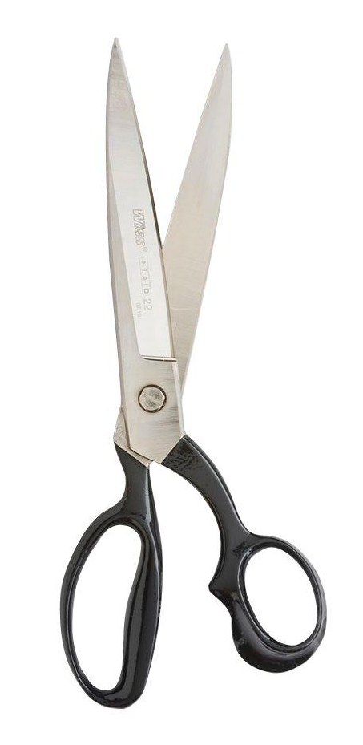
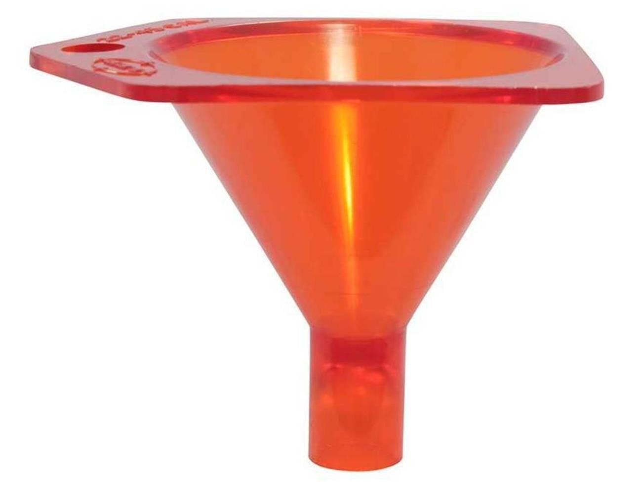
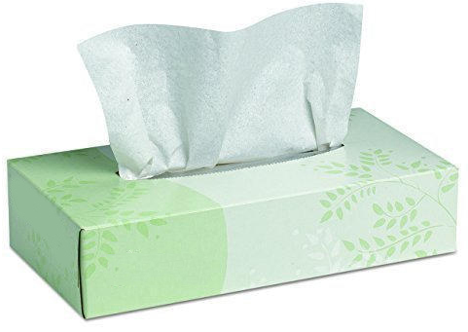
Want you need:
Plastic Bottle
Cork that fits the bottle
Card
Vinegar
Baking Soda
Glue or Sticky Tape
Scissors
Safety Glasses
Funnel
Tissue Paper
Spoon

Slide 6
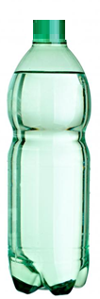
If you want you can also make a nose-cone and fix it to the base of the bottle

Slide 7
Make four triangular fins to support the rocket
Fix them to the bottle with glue or sticky tape

Slide 8
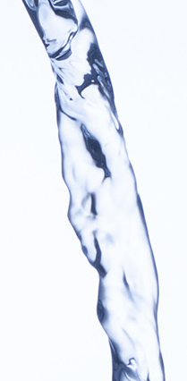
Put your safety
glasses on now
Carefully pour the vinegar into the bottle

Slide 9
Safety Glasses Please
Carefully pour two or three
dessert spoons of soda onto
a tissue
Fold the soda into the tissue to make a thin tube (so it will go into the bottle) with the ends folded over

Slide 10
`
Safety Glasses Please
Very quickly Push the soda in the tissue into the bottle
Push in the cork
Upturn the bottle
Stand Away

Slide 11
Safety Glasses Please
Watch the rocket fly

