Slide 1
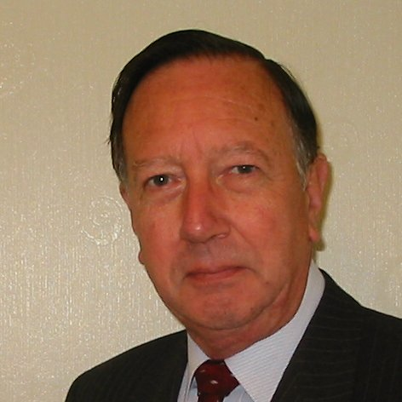
Welcome
These challenges were developed by Derrick Willer MBE and colleagues.
They are free to download and use in an education environment.
Please ensure that there is adult supervision, complete adherence to Health and Safety, and adequate PPE.
Derrick is a STEM Ambassador.
He has supported education in schools and colleges for over 30 years, initially as a Neighbourhood Engineer in the 1980’s, leading the local Year of Engineering Success campaign in 1996 and the Campaign to Promote Engineering from 1997 to 2004.
He was awarded an MBE for services to Education in 2018.

Slide 2
Guide
This activity is for pupils to make a water clock
Risks
Mandatory close supervision by a competent adult
Item | Risk | Avoidance Action
Tools, Scissors, etc. | Injury | Close supervision.
Glue | Spillage Ingestion | Close supervision, sponge and water. Water to rinse mouth if ingested and to drink.
Paint | Injury, Staing of Clother | Close supervision, paint removal sponge, water, etc.
Aggression between pupils | Injury | Close supervision and immediate action to defuse aggression

Slide 3
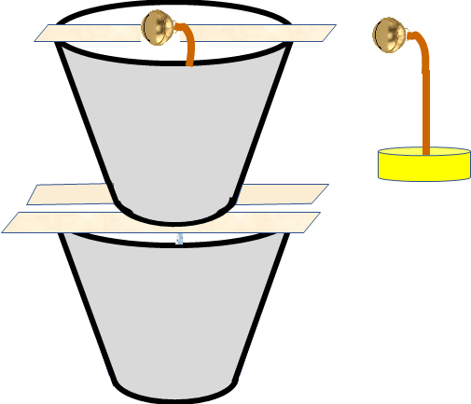
Make a Water Clock
The project involves:
Making the clock
Timing the clock with a
stopwatch
Calculating the amount of
time needed for different
amounts of water

Slide 4
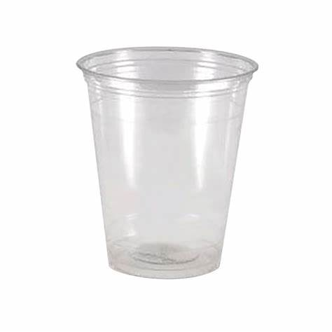
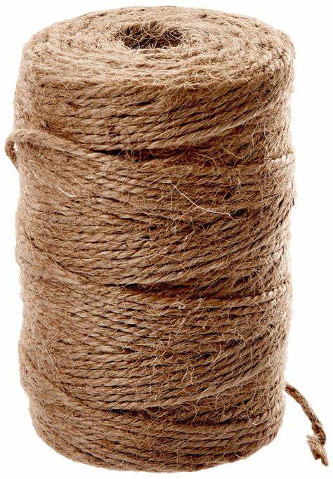
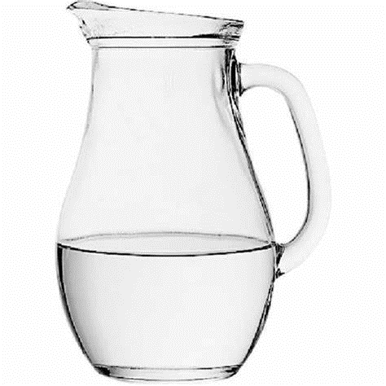
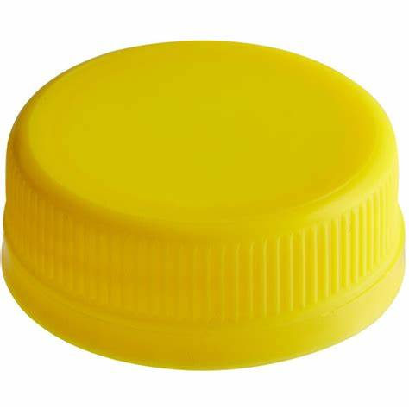
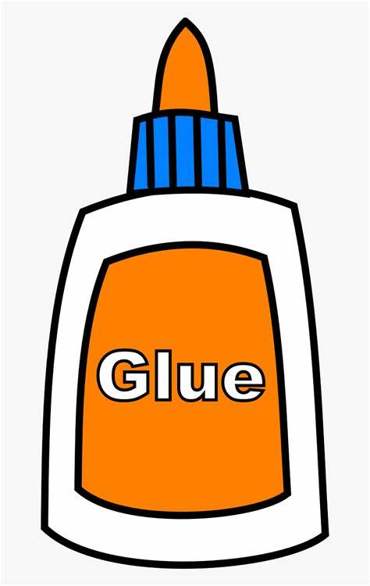
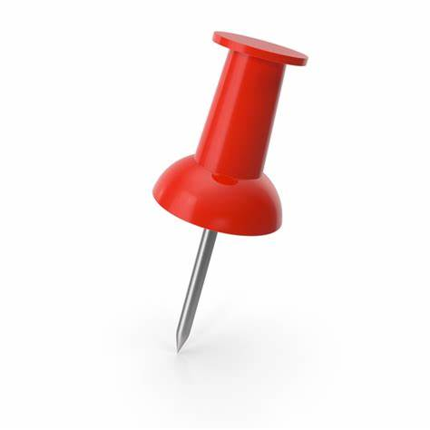
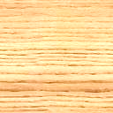
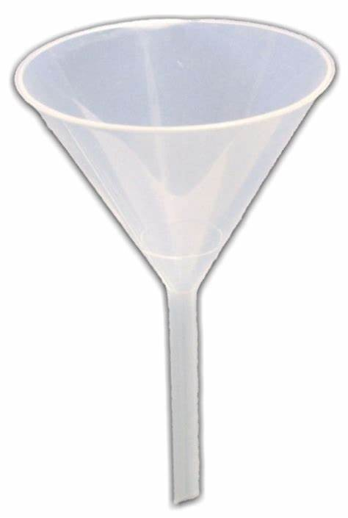
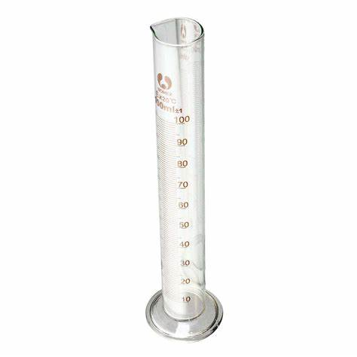
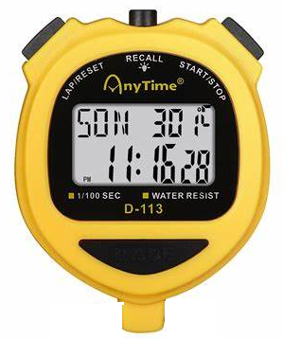
What you need
Two plastic cups
A length of thin twine
A spherical bell
A cap from a milk bottle
Glue
A pin or needle
Water
Three Lollipop Sticks
Funnel
Measuring cylinder
Stopwatch

Slide 5
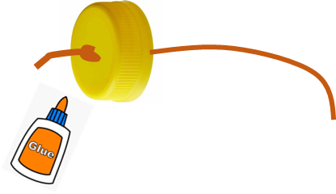
What to do
Using the pin, pierce a hole in the centre of the bases of one of the plastic cups and the milk bottle top
Thread about 15cm of twine through the hole in the bottle top, you may need to widen the hole
Tie a big knot in the end of the twine and pull it up to the hole
Glue the twine into the hole ensuring the hole is filled with glue

Slide 6
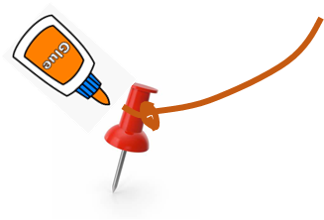
What to do next
Measure the depth of the plastic cup
Tie the bell onto the twine so that the distance to the bottle top is about 2/3 of the depth of the cup
Tie about 15cm of twine to the pin
Glue the twine to the pin
Put the pin in the hole of the cup
depth
2/3
depth

Slide 7
Twine connected to the pin in the base of the top cup
Assemble the clock
Using the lollipop stick mount the top cup onto the other one
Put the bell onto the top lollipop stick onto the top cup
Measure 100ml of water into the measuring cylinder

Slide 8
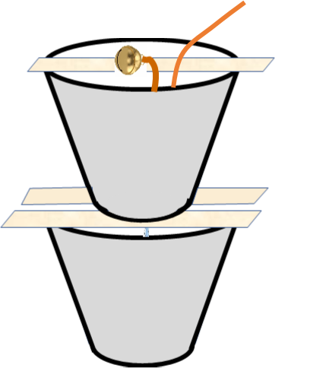
Start the clock
Measure 100ml of water into the measuring cylinder
Using the funnel pour the water into the top cup
Take care not to get water into the milk bottle top
Simultaneously start the stopwatch and pull out the pin from the bottom of the top cup
When the water has flowed out of the top cup the weight of the bottle top will pull the bell off the lollipop stick and the bell will ring
Stop the stopwatch
100ml

Slide 9
Repeat the clock
Repeat the experiment several time with the same 100ml
Repeat the experiment with other volumes of water, e.g. 150ml, 50ml
List the results in a table
Fined the averages for each amount of water
Draw graphs of average time against amount of water
Time
Amount of Water | Time 1 | Time 2 | Time 2 | Average Time
100ml
60
30
50
100
150
Water Volume

Slide 10
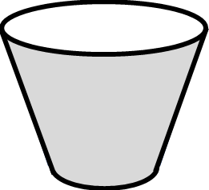


We have learnt
How to make a water clock
We have timed our clock against a stopwatch
Using different amounts of water
Calculated average times
Graphed the average times

Slide 11

Well Done!!!

