Slide 1

Welcome
These challenges were developed by Derrick Willer MBE and colleagues.
They are free to download and use in an education environment.
Please ensure that there is adult supervision, complete adherence to Health and Safety, and adequate PPE.
Derrick is a STEM Ambassador and volunteer Liaison Officer for Schools.
He has supported education in schools and colleges for over 30 years, initially as a Neighbourhood Engineer in the 1980’s, leading the local Year of Engineering Success campaign in 1996 and the Campaign to Promote Engineering from 1997 to 2004.
He was awarded an MBE for services to Education in 2018.

Slide 2
Guide
This activity is for pupils to make a water wheel drive a generator to light an LED
Risks
Mandatory close supervision by a competent adult
Item | Risk | Avoidance Action
Tools, Scissors, etc. | Injury | Close supervision.
Glue | Damage to Clothing Injury | Close supervision, sponge and water. If glue is ingested rinse mouth with water and give water to drink.
Paint | Injury, Staing of Clother | Close supervision, paint removal sponge, water, etc.
Aggression between pupils | Injury | Close supervision and immediate action to defuse aggression

Slide 3
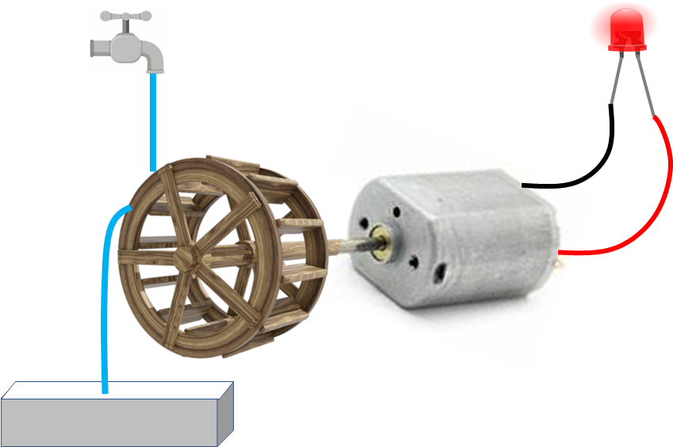
Make a Water Wheel drive a
Generator to power an LED
The project involves:
Making the wheel
Connecting to a 3V motor
used as a generator
Connecting to an LED
Light Emitting Diode

Slide 4
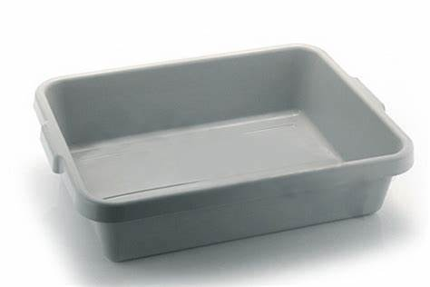
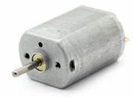
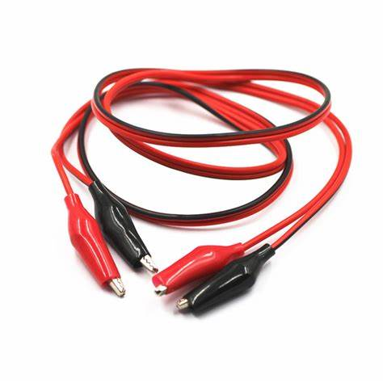

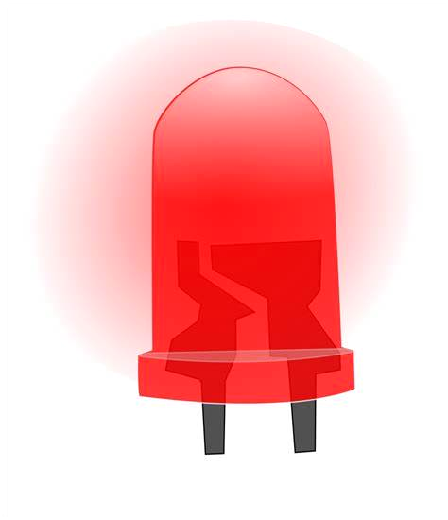
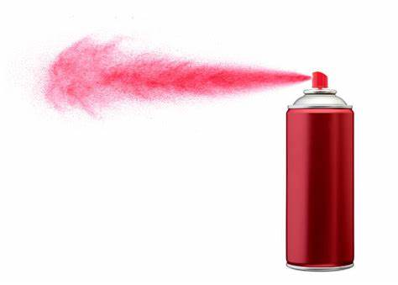
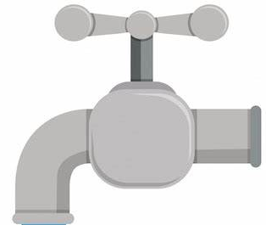

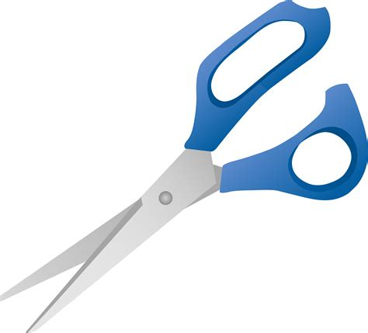

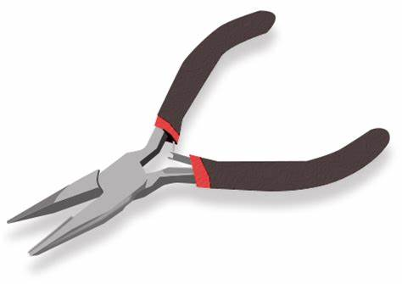
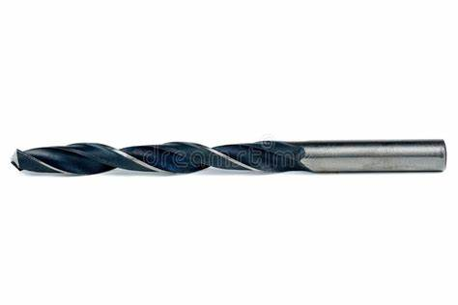
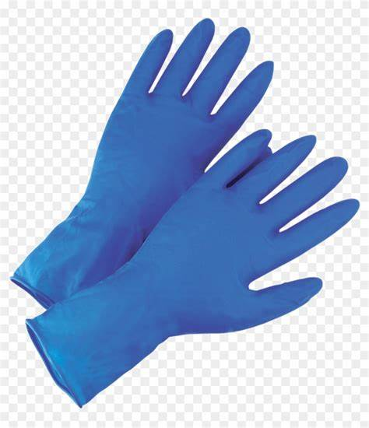
What you need
Plastic tray
Plastic to make the wheel
3V motor and support
LED
Dowel and wooden block 20cm high
Leads with crocodile clips
Water tap connected to mains
Glue
Paint
Tools and Gloves
Plastic

Slide 5
Make the wheel
2cm
Firstly measure the diameter of the motor spindle
Drill a hole in the centre of the dowel the same size as the motor spindle
Cut two 10cm diam. circles out of flat plastic sheet
Drill a centre hole in each circle the same size as the diameter of the dowel
Glue the dowel onto the two circles with the circles 2cm apart
10cm

Slide 6
Make the wheel
2cm x 1 cm
Cut eight rectangles 2cm x 1cm
Glue them into position around the wheel equally spaced

Slide 7

Mount the motor and connect the LED
Use crocodile clip leads to connect the LED
Mount the water wheel
Glue the dowel to the motor spindle

Slide 8
Test the water wheel
Put the wheel assembly into the big plastic tub
Position the wheel under the tap
Turn on the water for a few seconds
Ensure all splashes go into the big tub
Did the wheel light the LED?

Slide 9
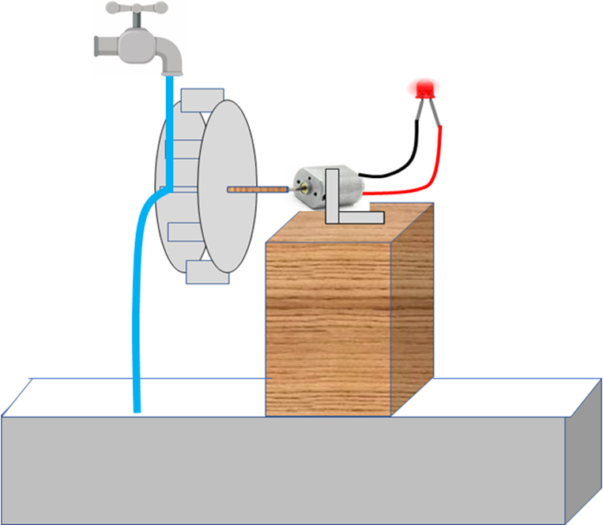
We have learnt
How to make a water wheel
Used the wheel to power a generator and light an LED
We have used tools, glue and paint
We have learnt about electricity

Slide 10

Well Done!!!

