Slide 1
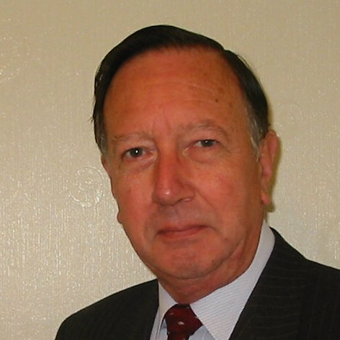
Welcome
These challenges were developed by Derrick Willer MBE and colleagues.
They are free to download and use in an education environment.
Please ensure that there is adult supervision, complete adherence to Health and Safety, and adequate PPE.
Derrick is a STEM Ambassador,
He has supported education in schools and colleges for over 30 years, initially as a Neighbourhood Engineer in the 1980’s, leading the local Year of Engineering Success campaign in 1996 and the Campaign to Promote Engineering from 1997 to 2004.
He was awarded an MBE for services to Education in 2018.

Slide 2
Guide
This activity is for pupils to understand probability
Risks
Mandatory: Close supervision by a competent adult
Item | Risk | Avoidance Action
Aggression between participants | Injury | Close supervision and immediate action to defuse aggression

Slide 3
Welcome
I very much hope that you will enjoy this fun activity to discover logic and maths

Slide 4
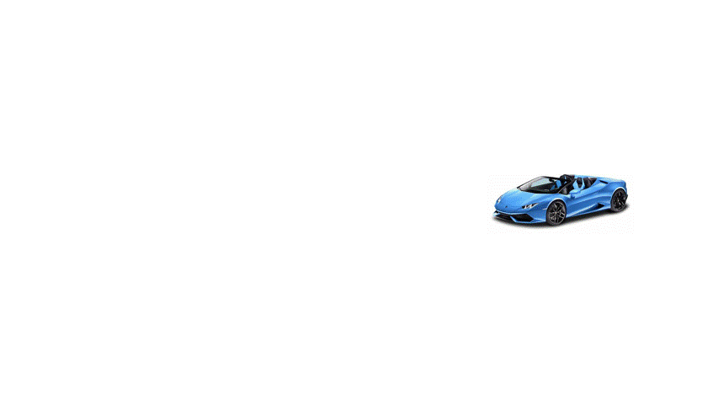
Win A Car
Behind one of the doors is a car but there is nothing behind the other doors
You choose a door and the host then opens another door which does not have the car
Do you keep to your choice or change it?
What should you do to maximise your chance of winning the car?

Slide 5
Win A Car
At first sight the car is either behind your door or the other one so the chance is 0.5 or 50%
If you switch doors the car is either behind your new door or the original one you selected so the chance is still 0.5 or 50%
But if you check each possibility the probability changes

Slide 6
Win A Car
Create table for each possibility – keep your door or switch
No Switch | Your First Selection | Door 2 | Door 3
1 | Car | Empty | Empty | Win
2 | Empty | Car | Empty | Lose
3 | Empty | Empty | Car | Lose
Switch | Your First Selection | Door 2 | Door 3
1 | Car | Empty | Empty | Lose
2 | Empty | Car | Empty | Win because you know the empty door
3 | Empty | Empty | Car | Win because you know the empty door
So you have 1 in three chances if you do not switch and 2 in 3 if you switch

Slide 7
We have leant
That the obvious chance of winning may not be the best
That it may be better to switch if you know the empty door
We created a table of possibilities
And we used logic which is Maths

Slide 8
Well Done
Thank You

Slide 11
