Slide 1

Project in a Box
Paper Bridges
Free permission to copy for use in schools and for instructing children of school age
and for use by children of school age
Copyright © Derrick Willer 1997, Updated 2021
www.dwiller.com

Slide 2
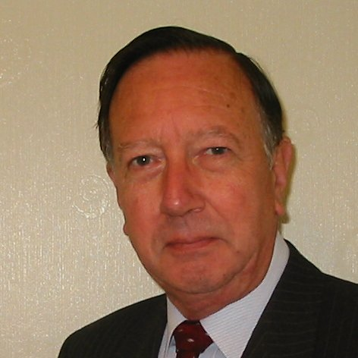
Welcome
These challenges were developed by Derrick Willer MBE and colleagues.
They are free to download and use in an education environment.
Please ensure that there is adult supervision, complete adherence to Health and Safety, and adequate PPE.
Derrick is a STEM Ambassador and volunteer Liaison Officer for Schools.
He has supported education in schools and colleges for over 30 years, initially as a Neighbourhood Engineer in the 1980’s, leading the local Year of Engineering Success campaign in 1996 and the Campaign to Promote Engineering from 1997 to 2004.
He was awarded an MBE for services to Education in 2018.

Slide 3
Guide
This simple bridge is made from A4 paper.
Please copy the appropriate slide for the pupils to use.
As well as building some bridges and testing them the pupils should create a table of results and draw graphs of these results.
Ask the pupils to bring in some model cars.
Alternatively use coins or plastic bricks.
Risks
Mandatory: close supervision by a competent adult
Item | Risk | Avoidance Action
Scissors | Injury | Close supervision
Glue | Sticky Hands | Close supervision Water to clean hands and clothes
 | Glue on clothes | Water to clean hands and clothes
 | Injury | If glue is ingested rinse mouth with water and give water to drink.
Aggression between pupils | Injury | Close supervision and immediate action to defuse aggression

Slide 4

Using a photocopy of the next slides.
Cut out the bridge supports and glue them together
Place the bridge paper onto the two supports
Now place wrights onto the bridge such as a model car
What happens?
Whoops
Remember this result

Slide 5
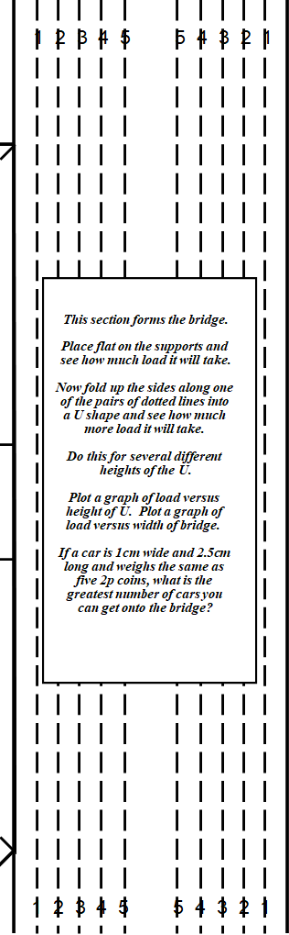
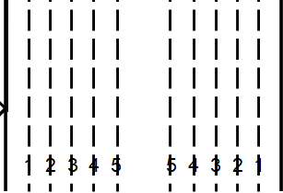
Now fold the bridge section into a U shape using the first dotted lines, arrowed.
This time it will hold one or two cars
Remember this result

Slide 6
Now fold the bridge section into a U shape using the second, then third and up to the fifth dotted lines.
Each time it will hold more and more cars
Remember these results

Slide 7
Please create a table of results recording the depth of the U shape and the number of cars the bridge held and also the width of the bridge.
Here is an example
Depth of U | No of Cars | Width of Bridge
0 | 0 | 14
1 | 1 | 12
2 | 2 | 10
3 | 4 | 8
4 | 7 | 6
5 | 10 | 4
Now we will create some graphs

Slide 8
Height
Of
U-Section
The Higher
The U-Section
The More Cars
5
4
3
2
1
0
No. Of Cars
0 1 2 3 4 5 6 7 8 9 10 11 12 13 14

Slide 9
Height
Of
U-Section
5
4
3
2
1
0
The Higher
The U Section
The Less Width and the area for cars
Width of Bridge
0 1 2 3 4 5 6 7 8 9 10 11 12 13 14
Minimising Material Costs
Whilst Maximising Vehicle
Throughput

Slide 10

We have learnt to:
Work and think as engineers
Understand the principles of bridges
Understand the design concepts for bridges
Thank You

Slide 11
1 2 3 4 5 5 4 3 2 1
Cut along bold lines
Fold along dotted lines
A free licence to copy this document is
provided for use in schools in the United
Kingdom of Great Britain and Northern
Ireland, it is a condition of this licence that
the document is not provided to any person
company organisation which is not a school or
schools advisory organisation.
This section forms the bridge.
Place flat on the supports and
see how much load it will take.
Now fold up the sides along one
of the pairs of dotted lines into
a U shape and see how much
more load it will take.
Do this for several different
heights of the U.
Plot a graph of load versus
height of U. Plot a graph of
load versus width of bridge.
If a car is 1cm wide and 2.5cm
long and weighs the same as
five 2p coins, what is the
greatest number of cars you
can get onto the bridge?
These form the bridge
support pillars
1 2 3 4 5 5 4 3 2 1

Slide 12
1 2 3 4 5 5 4 3 2 1
Cut along bold lines
Fold along dotted lines
A free licence to copy this document is
provided for use in schools in the United
Kingdom of Great Britain and Northern
Ireland, it is a condition of this licence that
the document is not provided to any person
company organisation which is not a school or
schools advisory organisation.
This section forms the bridge.
Place flat on the supports and
see how much load it will take.
Now fold up the sides along one
of the pairs of dotted lines into
a U shape and see how much
more load it will take.
Do this for several different
heights of the U.
Plot a graph of load versus
height of U. Plot a graph of
load versus width of bridge.
If a car is 1cm wide and 2.5cm
long and weighs the same as
five 2p coins, what is the
greatest number of cars you
can get onto the bridge?
These form the bridge
support pillars
1 2 3 4 5 5 4 3 2 1

Slide 13
1 2 3 4 5 5 4 3 2 1
1 2 3 4 5 5 4 3 2 1
This section forms the bridge.
Place flat on the supports and
see how much load it will take.
Now fold up the sides along one
of the pairs of dotted lines into
a U shape and see how much
more load it will take.
Do this for several different
heights of the U.
Plot a graph of load versus
height of U. Plot a graph of
load versus width of bridge.
If a car is 1cm wide and 2.5cm
long and weighs the same as
five 2p coins, what is the
greatest number of cars you
can get onto the bridge?
This section forms the bridge.
Place flat on the supports and
see how much load it will take.
Now fold up the sides along one
of the pairs of dotted lines into
a U shape and see how much
more load it will take.
Do this for several different
heights of the U.
Plot a graph of load versus
height of U. Plot a graph of
load versus width of bridge.
If a car is 1cm wide and 2.5cm
long and weighs the same as
five 2p coins, what is the
greatest number of cars you
can get onto the bridge?
1 2 3 4 5 5 4 3 2 1
1 2 3 4 5 5 4 3 2 1

Slide 14
If you bend down the sides the bridge will carry more cars
Whoops
That’s Better
Whoops Again
O Dear! It carries more weight but now there is insufficient space for the cars to be on the bridge.

Slide 15
The Higher
The U-Section
The More Cars
By Weight
Height
Of
U-Section
The Higher
The U Section
The Less Area
For Cars
No. Of Cars
Minimising Material Costs
Whilst Maximising Vehicle
Throughput
Professional Home For Life ® For Engineers and Technicians

Slide 16
The challenge can be extended
See next slides

Slide 17
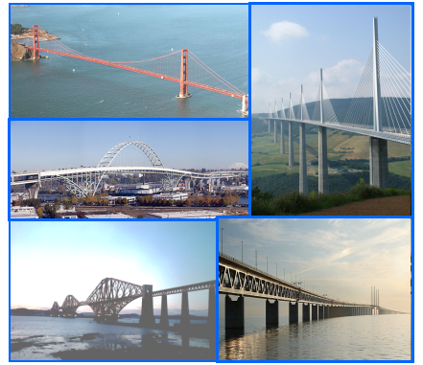
The Bridge Challenge
Using A4 Paper, Glue and Sticky Tape Make a Bridge.
It must:
+ take the weight of 1Kg
+ span 60cm between two chairs
The winner will be the lightest
bridge that meets the
specification.
Good Luck
Professional Home For Life ® For Engineers and Technicians

Slide 18
Fold a sheet of A4 paper into different
shapes and glue.
See how much weight it will take when
supported only at each end
Note that you have used the same amount of material for
each shape but some are stronger than others.
Box
Section
Tube
Section
I
Section
Triangle
Section
Invent
Your
Own
Section!
Cross
Section
Professional Home For Life ® For Engineers and Technicians

