Slide 1

Welcome
These challenges were developed by Derrick Willer MBE and colleagues.
They are free to download and use in an education environment.
Please ensure that there is adult supervision, complete adherence to Health and Safety, and adequate PPE.
Derrick is a STEM Ambassador and volunteer Liaison Officer for Schools.
He has supported education in schools and colleges for over 30 years, initially as a Neighbourhood Engineer in the 1980’s, leading the local Year of Engineering Success campaign in 1996 and the Campaign to Promote Engineering from 1997 to 2004.
He was awarded an MBE for services to Education in 2018.

Slide 2
Guide
This activity is for pupils to think abut protecting people on a car if it crashes.
The pupils are given a concept paper car which has a crumple zone
Pupils can then make the car themselves or design their own and test it
Risks
Mandatory: close supervision by a competent adult
Item | Risk | Avoidance Action
Tools | Misuse Injury | Close supervision
Glue | Spillage Injury | Close supervision, sponge and water. If glue is ingested rinse moth with water and give water to drink.
Aggression between those present | Injury | Close supervision and immediate action to defuse aggression

Slide 3


Using the available parts
And any others you can get for free
Create your own car
Make a safety zone for the passengers
And a crumple zone to protect them in a crash

Slide 4









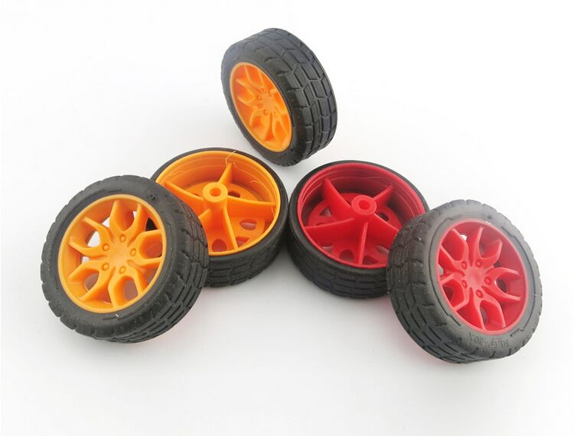
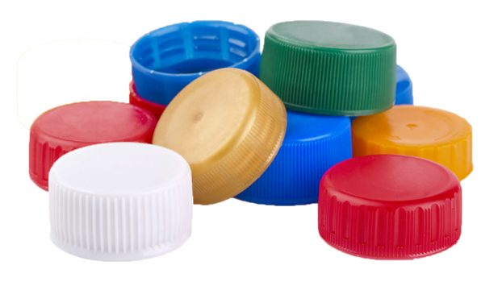

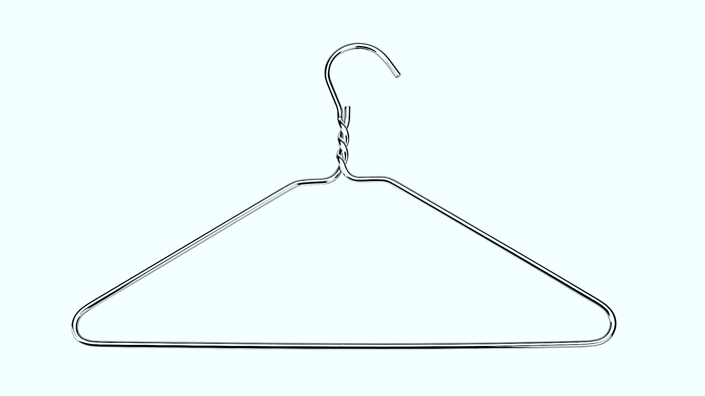
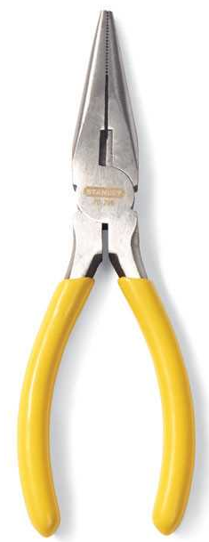

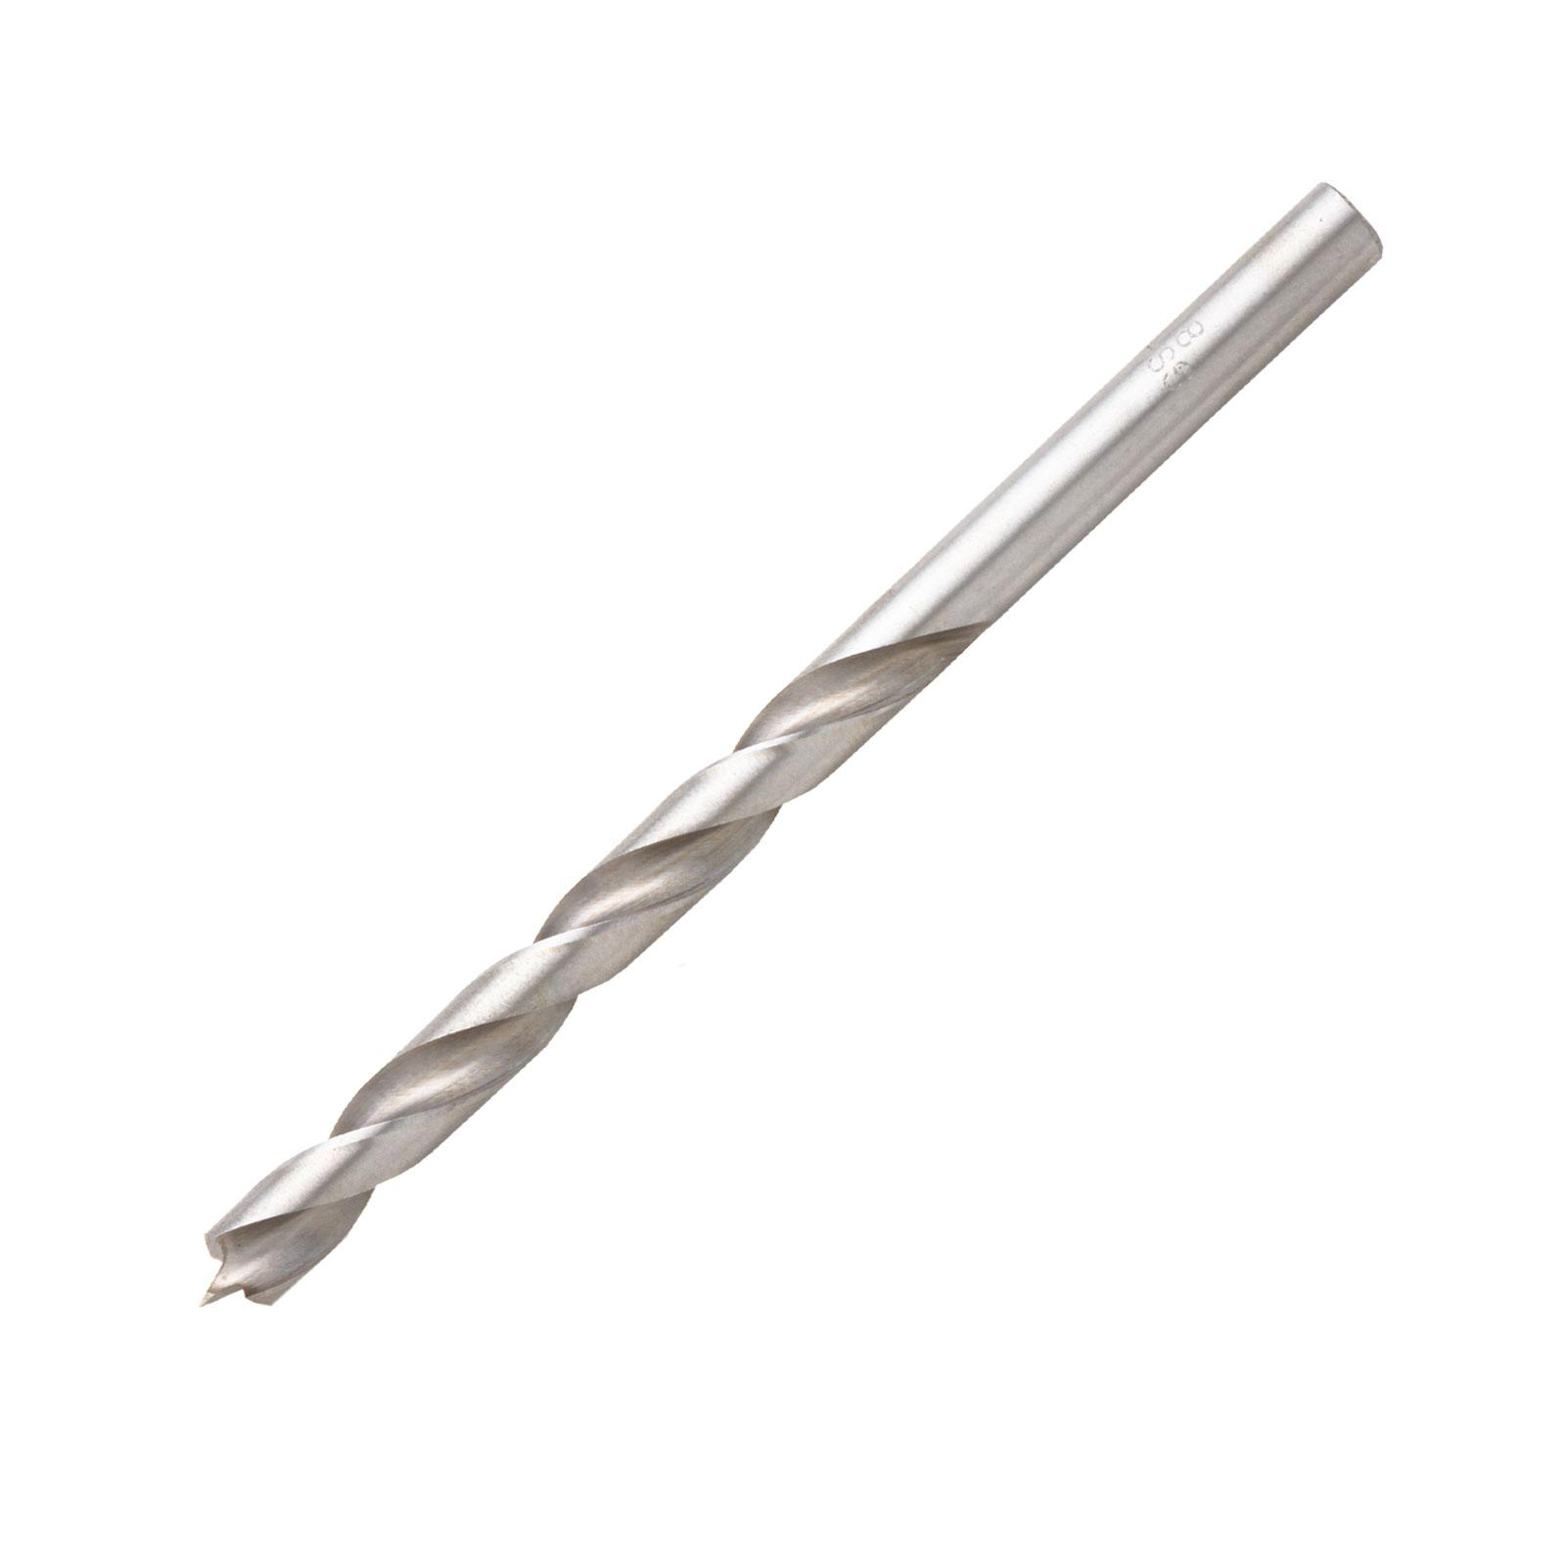
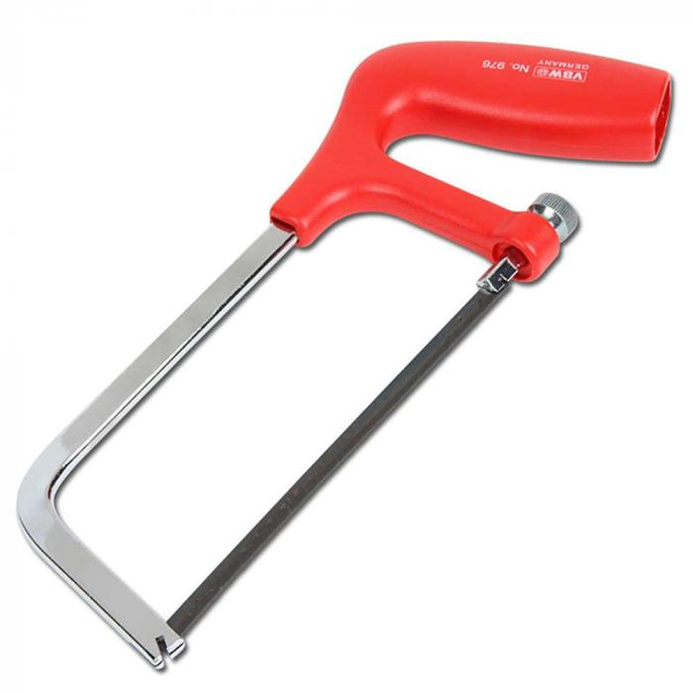
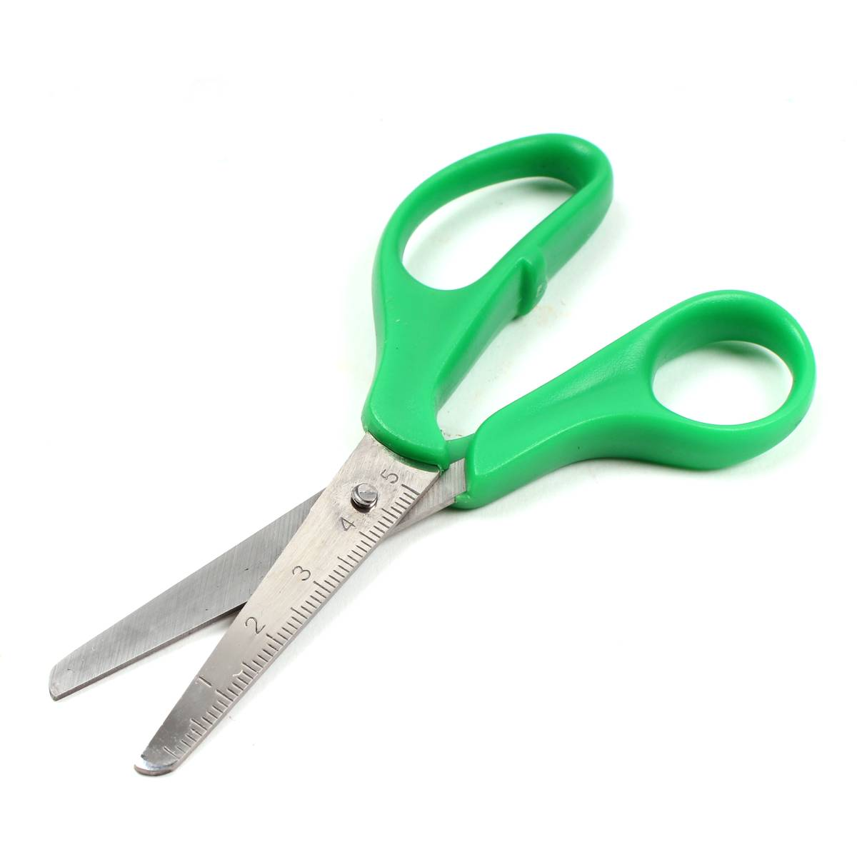
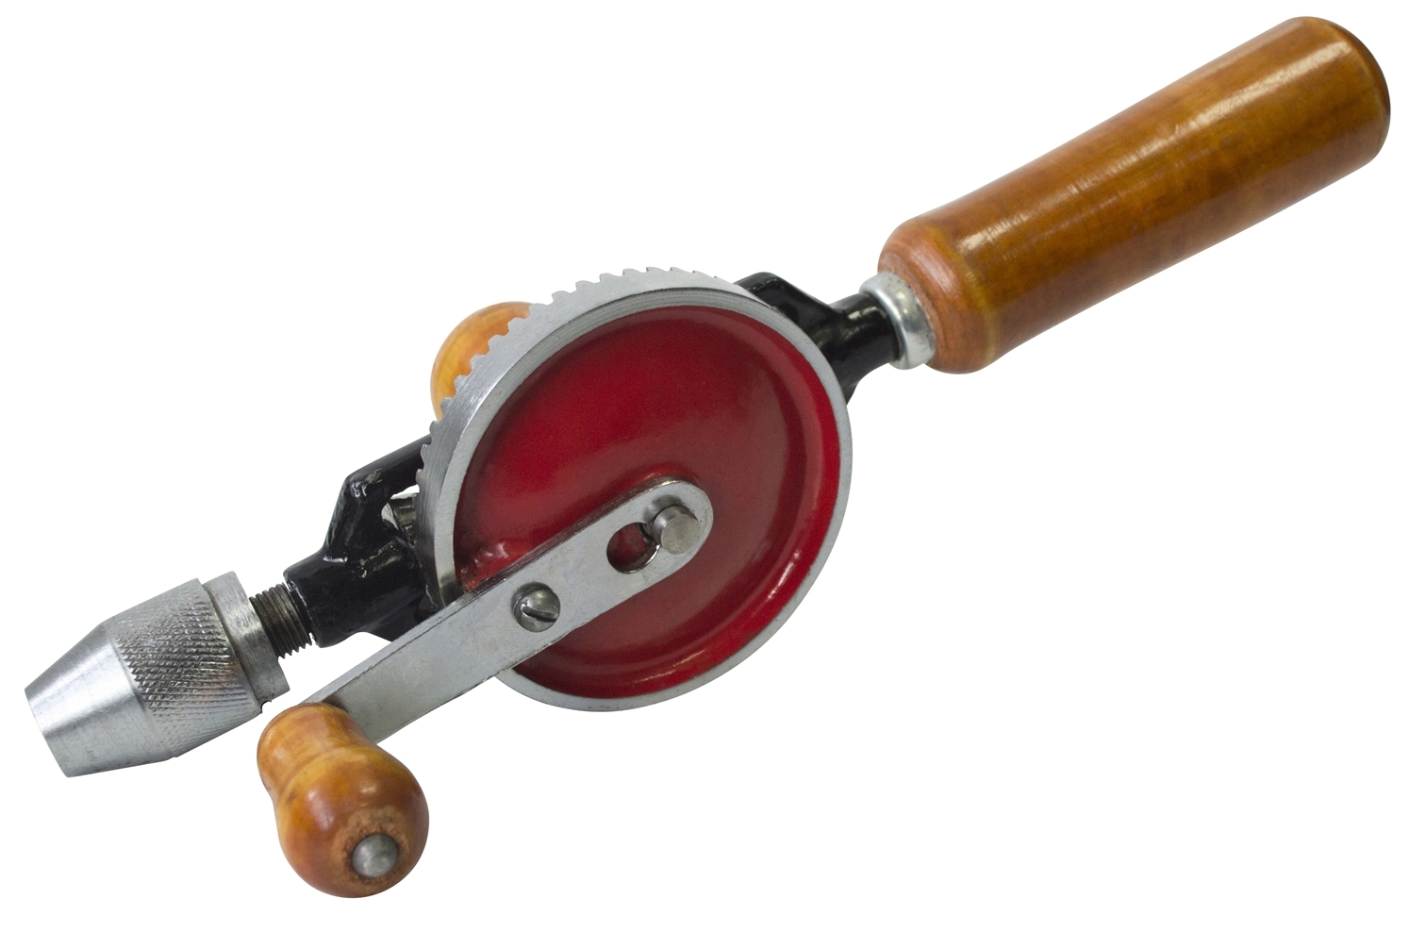
What you might need:
Paper
Glue
Sticky Tape
Straws
Wood
Plastic
Metal
Cardboard
Wheels
Clips
Nuts and Bolts
Coat Hangers
Tools
Drill holes in
bottle tops

Slide 5
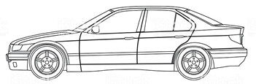
Some Car Design Elements
A, B and C “Posts” Create Strength
Front Crumple Zone
Rear Crumple Zone
Strengthend Dash-Board

Slide 6
Some Car Design Elements
Strengthend Angled Foot-Well
In crash engine deflected downwards

Slide 7
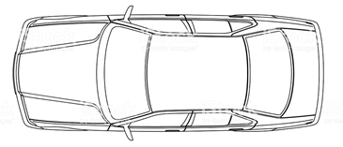
Some Car Design Elements
A, B and C “Roll Over Bars” Create Strength
Within the Roof
Front to Back
Reinforced
Roof Edge

Slide 8
Here is a possible example for you to cut out and construct
See Also
Next Slide
Front Seat Covers
Rear
Seat
Cover
Dashboard
Cut Out
Cut Out
Cut Out
Cut Out
Inside
Base
Roof
Cut Out
Cut Out
Cut Out
Fold Seat Back Up
Cut Out
Dashboard
Cut Out Windows

Slide 9
Here is a possible example for you to cut out and construct
Slide 2
Front Seat Covers
Rear
Seat
Cover
Cut Out
Use tubes
of rolled paper
or straws to
strengthen
vital areas
Cut Out
c
Cut Out
Cut Out
Cut Out
Cut Out
Cut Out
Fold Seat Back Up
Use paper clips or nuts and bolts to position the wheels
Cut Out
Dashboard
Cut Out Windows

Slide 10
Well Done, Everyone

Slide 11


