Slide 1
Welcome
These challenges were developed by Derrick Willer MBE and colleagues.
They are free to download and use in an education environment.
Please ensure that there is adult supervision, complete adherence to Health and Safety, and adequate PPE.
Derrick is a STEM Ambassador and volunteer Liaison Officer for Schools.
He has supported education in schools and colleges for over 30 years, initially as a Neighbourhood Engineer in the 1980’s, leading the local Year of Engineering Success campaign in 1996 and the Campaign to Promote Engineering from 1997 to 2004.
He was awarded an MBE for services to Education in 2018.

Slide 2
Guide
This activity is for pupils to discover threats and benefits to our planet.
Risks
Mandatory: close supervision by a competent adult
Item | Risk | Avoidance Action
Aggression between those present | Injury | Close supervision and immediate action to defuse aggression

Slide 3
Welcome
I very much hope that you will enjoy discovering about planet Earth and our ecosystems

Slide 4
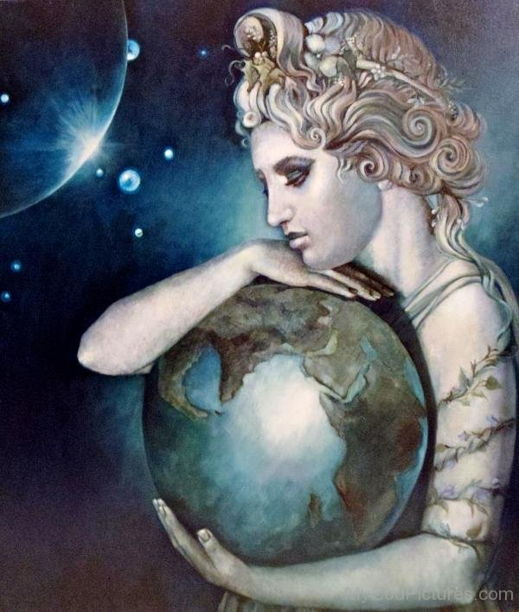
Gaia
Who or what is Gaia?
So what is going wrong?
Gaia is Greek goddess of the Earth
Gaia philosophy is the idea that living organisms on a planet will affect the nature of their environment in order to make the environment more suitable for life.
Click for next slide

Slide 5
So what is going wrong?
Please list all problems and their causes you can think of and also list the solutions.
Click for next slide

Slide 6
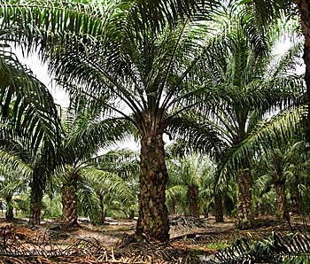
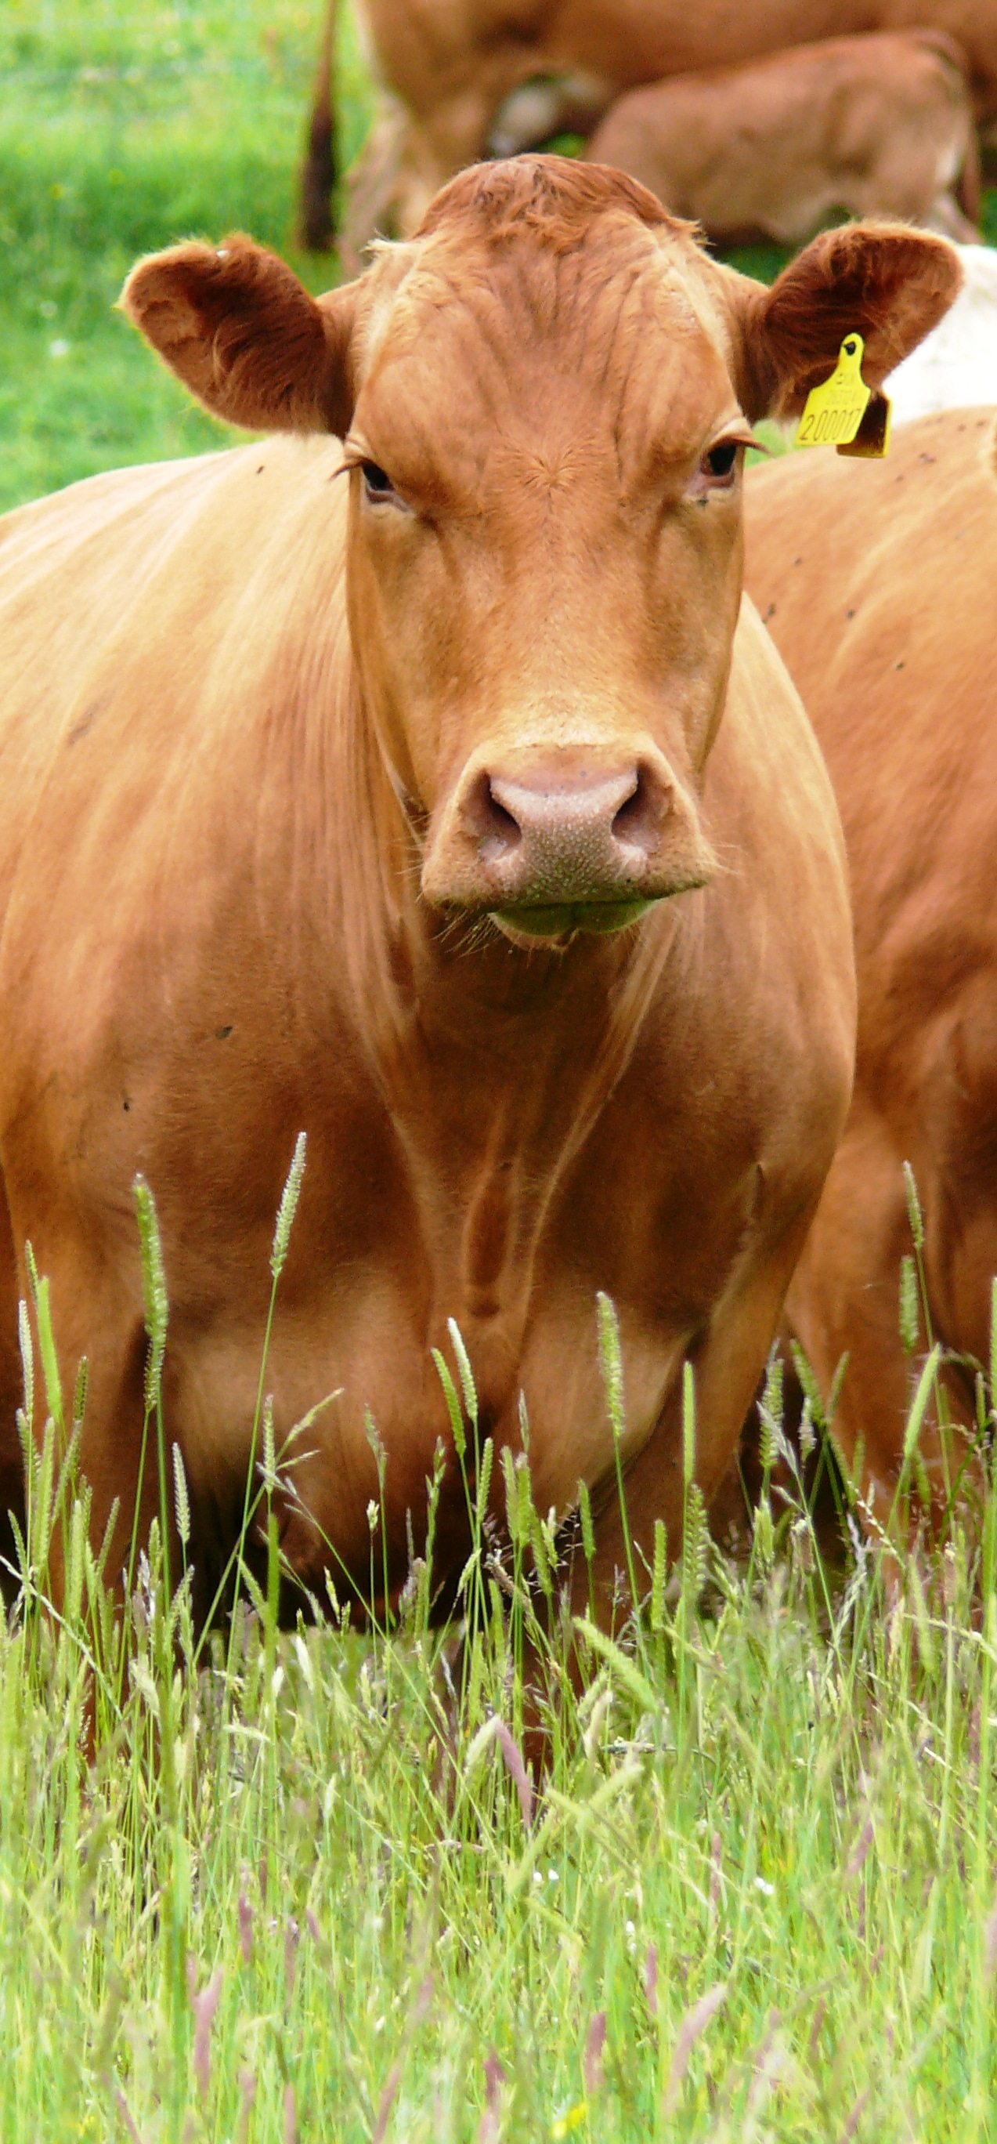
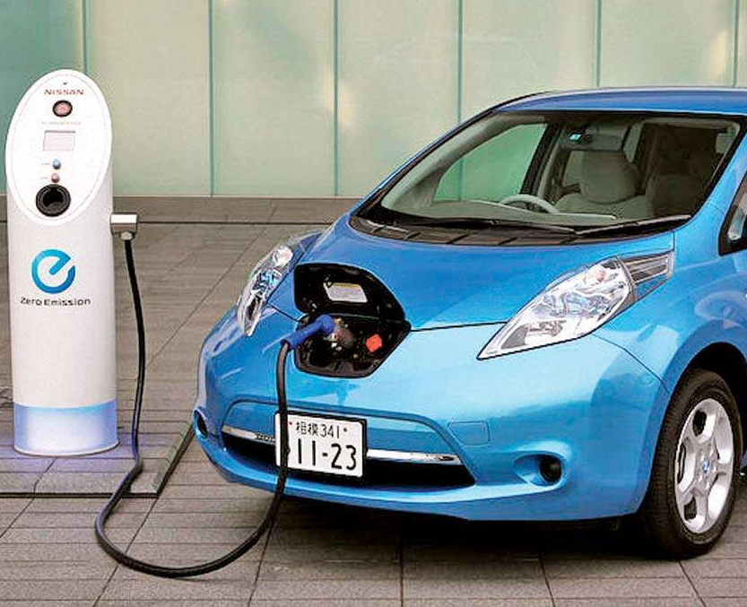
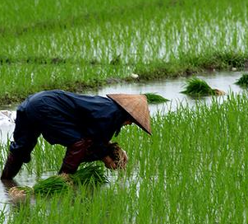
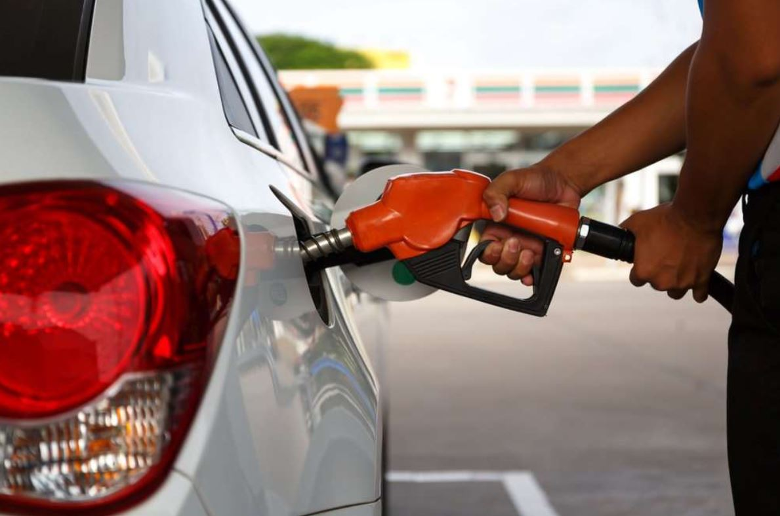
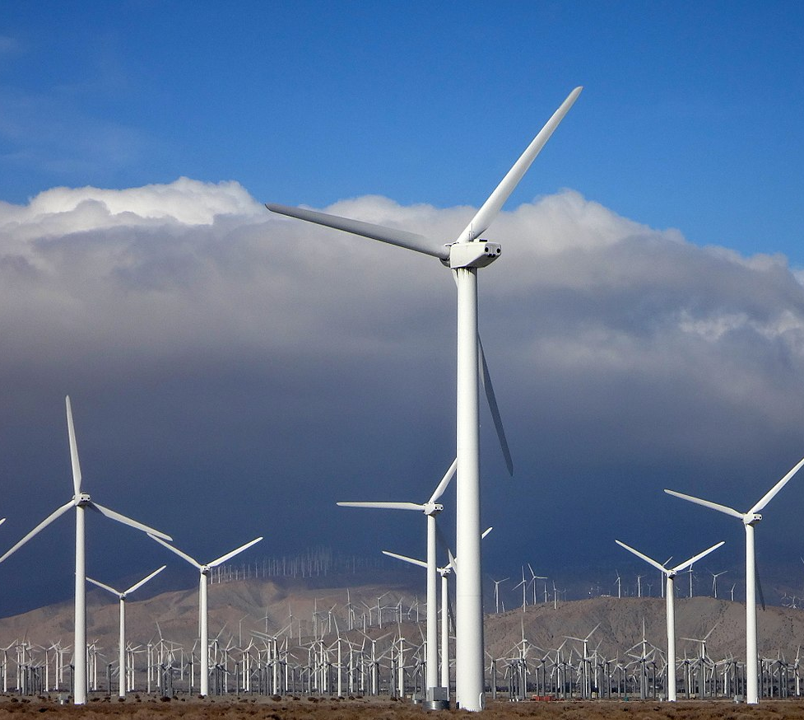
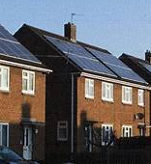
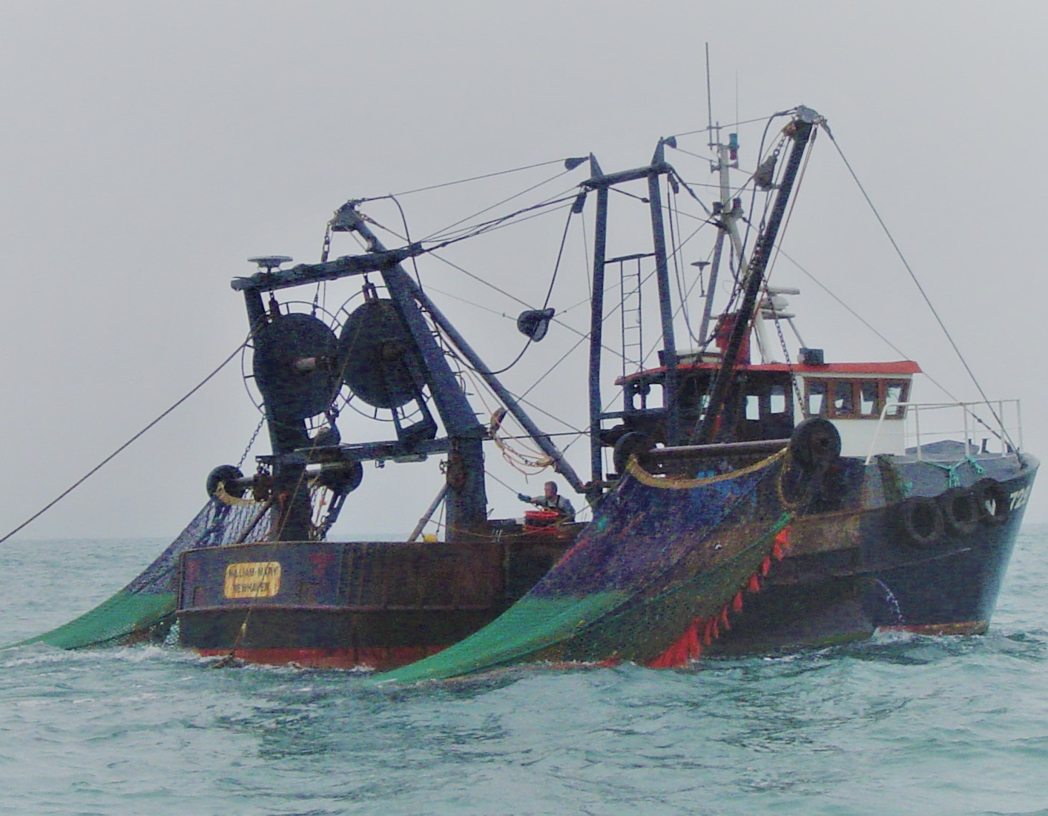
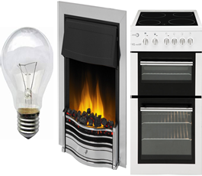
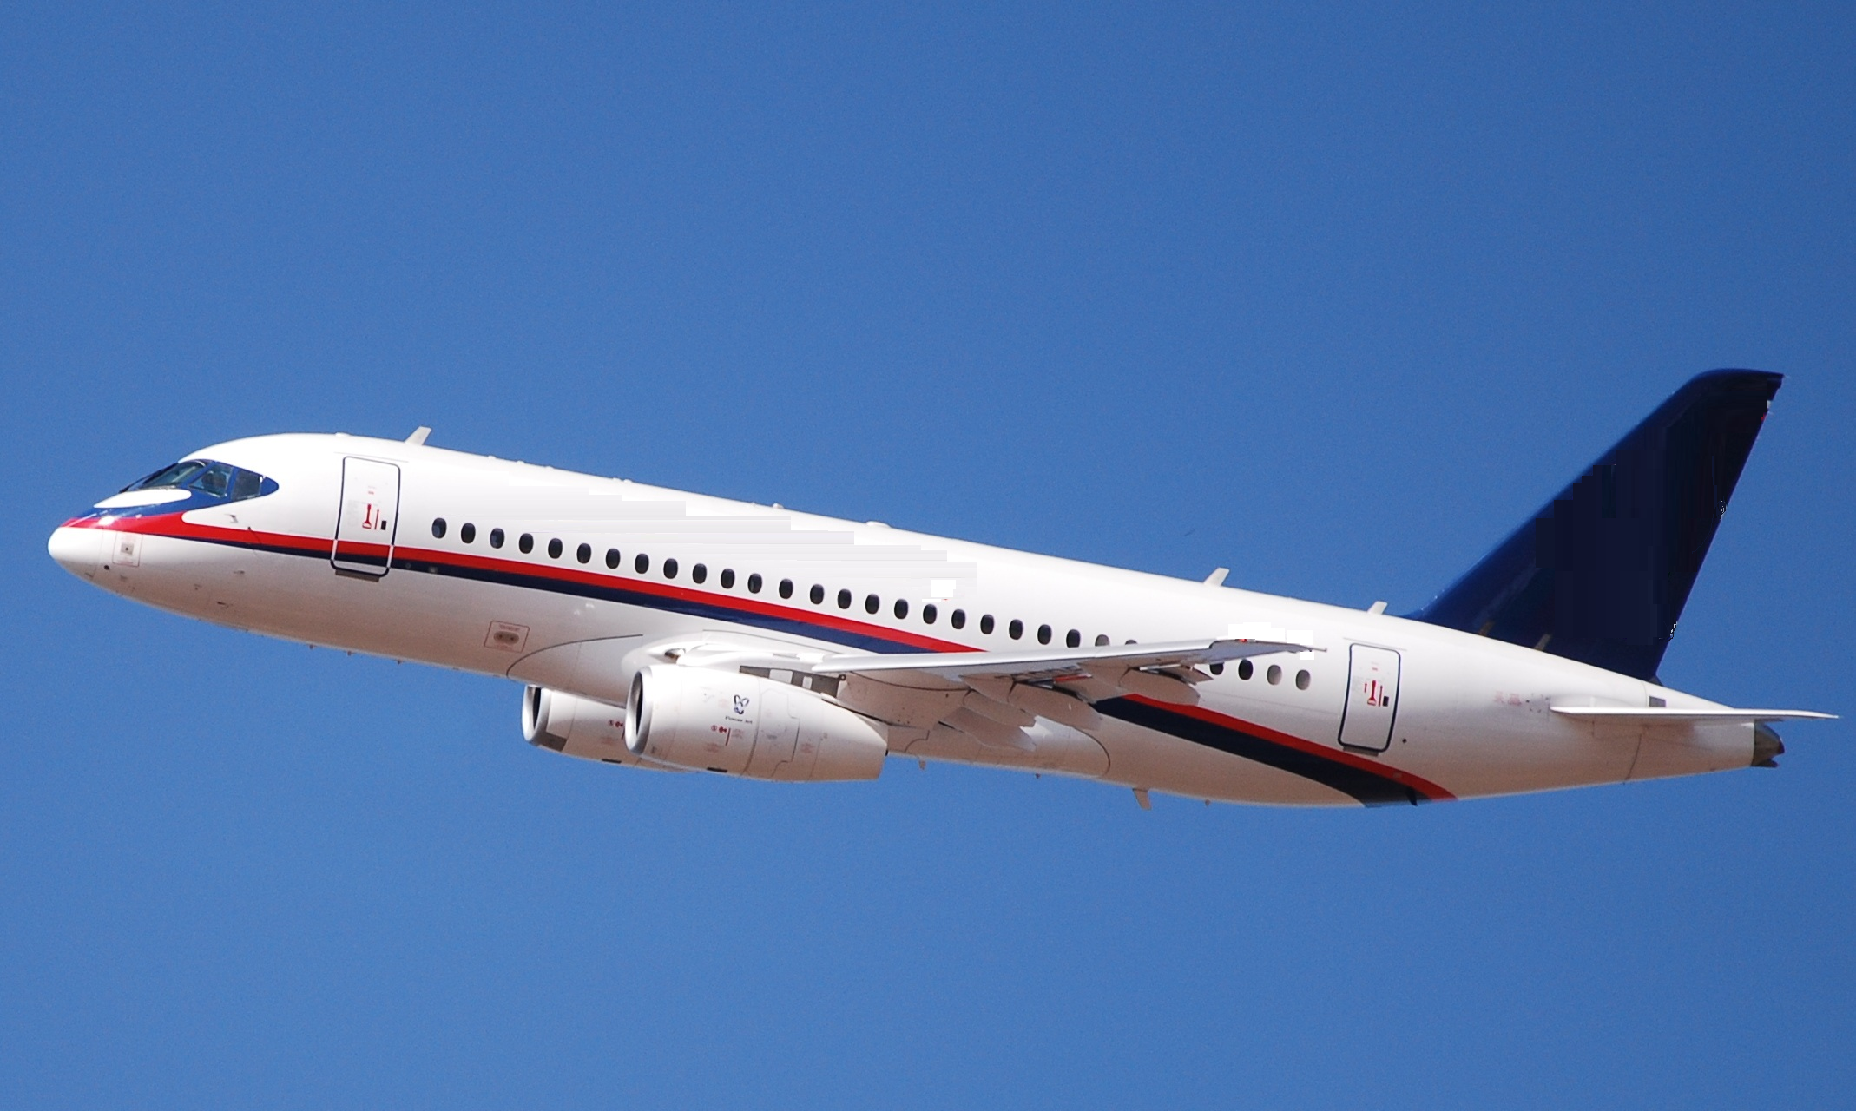
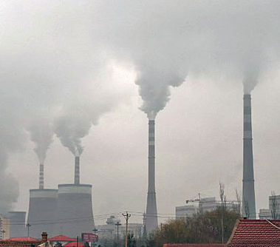
Please click on the problem or solution to see if you are correct
Click to end

Slide 7
Cows produce milk and meat..
From the milk we get butter, yoghurt, cheese, ice-cream and is used for milk chocolate.
Definitely a threat to Giai
The problem is we eat far too much beef, cheese and butter.
So there are too many cows which takes up too much land, causing forests to be cut down for farms.
Click to go back
Cows, farmland, CH₄
However, cows pass wind and burp methane, CH₄.
Methane is about 25 times worse than carbon dioxide, CO₂, for global warming.

Slide 8
Petrol and diesel cars produce nitrous oxide, NO, and carbon dioxide, CO₂
Nitrous oxide, NO, is poisonous and can cause dizziness and even death. It can lead to bone marrow and neurological (brain) problems.
Definitely a threat to Giai
Click to go back
Carbon dioxide, CO₂ , is a major contributor to global warming.
Petrol and Diesel Cars Gasses NO and CO₂
The worst countries for using petrol and diesel are USA and Europe.

Slide 9
Palm oil is used to produce diesel for cars, lorries, trains and ships.
Definitely a threat to Giai
Forests are cut down to grow palm oil trees so there is a loss of habitat.
But the diesel is a pollutant, producing NO, a poison, and CO₂ which causes global warming.
Palm Oil Trees
Click to go back

Slide 10
Solar panels a quite efficient at generating electricity so can help reduce global warming
Definitely a benefit to Giai
However a lot of energy is need to make them, transport and install them.
And if they get dirty they become far less efficient.
So you must keep them clean.
Solar Panels Generating Electricity
Click to go back
So they need to work for several years before they give a net contribution to reducing global warming.

Slide 11
Jet engines produce Carbon Dioxide, CO₂, Nitrous Oxide, NO, Sulphur Dioxide, SO₂ and Sulphur Trioxide, SO₃.
Definitely a threat to Giai
Carbon Dioxide creates global warming
Sulphur Trioxide and Carbon Dioxide create acids which contaminate the air and then the sea.
Air Travel Passenger and Freight
If the sea becomes more acid it causes corals to die and prevents shellfish from growing shells so they too die, as do the fish that feed on them.
Click to go back
The countries with the greatest air travel are USA and the EU

Slide 12
Electric cars should help counter global warming because they can use electricity generated from solar cells and wind-power
Will become a benefit to Giai
However there is a problem, the batteries deteriorate reducing the range that the car can go without recharging.
Click to go back
So we need to replace the batteries which have a very high need for energy to make and distribute them.
Electric Cars
We are searching for better batteries and should solve this problem within a few years.

Slide 13
Many millions of farms exist around the world created to feed the human population and the farm animals which give us food.
Definitely a threat to Giai
But every farm was created from wild forest, woodland and grassy plain conditions.
Click to go back
This severely limited the habitat of all other animals and plants.
Feeding the Billions of People and all the Farm Animals
And also enabled the numbers of humans to increase because of more and better food, so demanding even more farms.

Slide 14
Fishing is important to provide food for the billions of humans.
Definitely a threat to Giai
However, more humans means more fish is needed to feed them.
So we overfish and the fish population is severely reduced.
Feeding the Billions of People through Fishing
So we introduce quotas so that we do not overfish.
Click to go back
But many countries do not introduce a quota system so fish numbers continue to decline.

Slide 15
We are building winfarms to generate electricity from wind-power.
Will become a benefit to Giai
Winds are crated by the sun whose energy is free as long as the sun can last.
Click to go back
Scientists are sure that the sun will continue to shine for several billion years.
Windfarms to Generate Electricity
However it does take energy to make, transport, install and maintain the turbines, so there is a delay before they provide a pay-back.

Slide 16
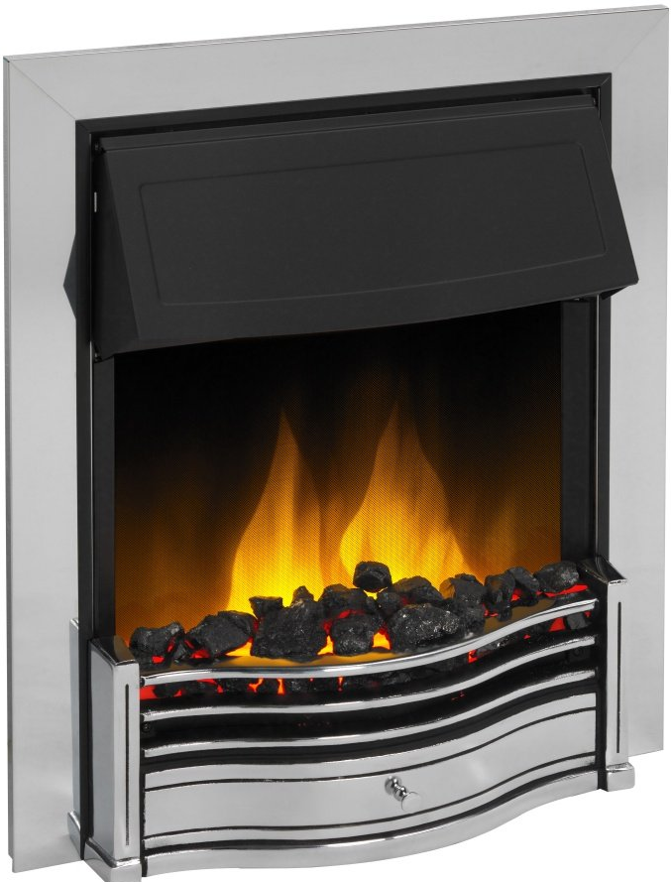
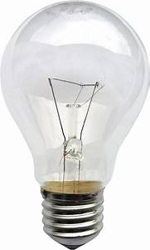
Every human family should be able to see at night, heat their houses and cook their food.
Could be a threat to Giai
So it is important that lights, fires and cookers use as little energy as possible.
And it is important that as much energy as possible is generated using solar cells and wind farms.
Click to go back

Slide 17
Every human family should have a house to live in.
But the increasing human population means we need more houses.
Definitely a threat to Giai
So we build more houses where there used to be forests, woodland, grassy plains, etc.
This encroaches even more on the habitat.
Houses
But we do not like the temperature inside the house so we heat it in winter and cool it in summer – using energy.
Click to go back
This creates additional global warming.

Slide 18
We all need energy to heat our homes, cook our food, etc.
But coal fired power stations create smoke and carbon dioxide.
Definitely a threat to Giai
The smoke contains killer poisons and the carbon dioxide creates global warming.
The worst countries for using coal fired power stations are China, then India, then USA.
Coal Fired Power Stations
Click to go back

Slide 19
Click to go back

Slide 20
Humans and Gaia
Strangely, we humans are obeying the Gaia rule to make the planet better for ourselves.
More food and more energy to make our lives easier.
But we are making it worse for everything else.
So, in the end, we will make it worse for ourselves.
Gaia needs your help NOW!!
Click for next slide

Slide 21
Well Done

