Slide 1

Welcome
These challenges were developed by Derrick Willer MBE and colleagues.
They are free to download and use in an education environment.
Please ensure that there is adult supervision, complete adherence to Health and Safety, and adequate PPE.
Derrick is a STEM Ambassador and volunteer Liaison Officer for Schools.
He has supported education in schools and colleges for over 30 years, initially as a Neighbourhood Engineer in the 1980’s, leading the local Year of Engineering Success campaign in 1996 and the Campaign to Promote Engineering from 1997 to 2004.
He was awarded an MBE for services to Education in 2018.

Slide 2
Guide
This activity is for pupils to write computer programmed and then use the kit to make a mock-up of a fun product also using recycled materials.
Risks
Mandatory: close supervision by a competent adult
Item | Risk | Avoidance Action
Tools | Misuse Injury | Close supervision
Computers | Misuse | Close supervision
Aggression between those present | Injury | Close supervision and immediate action to defuse aggression

Slide 3
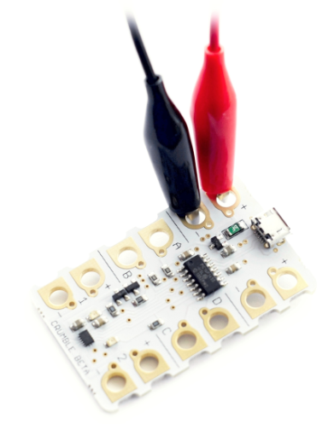
Let’s Crumble
A teachers’ guide to using the
Crumble Computer
in Primary Schools
Free use for educational purposes

Slide 4
Programming
Please download the appropriate programming
tool from
https://redfernelectronics.co.uk/crumble-software
Select from Windows, MAC OS X, Chrome OS
and Linux (deb)

Slide 5


Slide 6
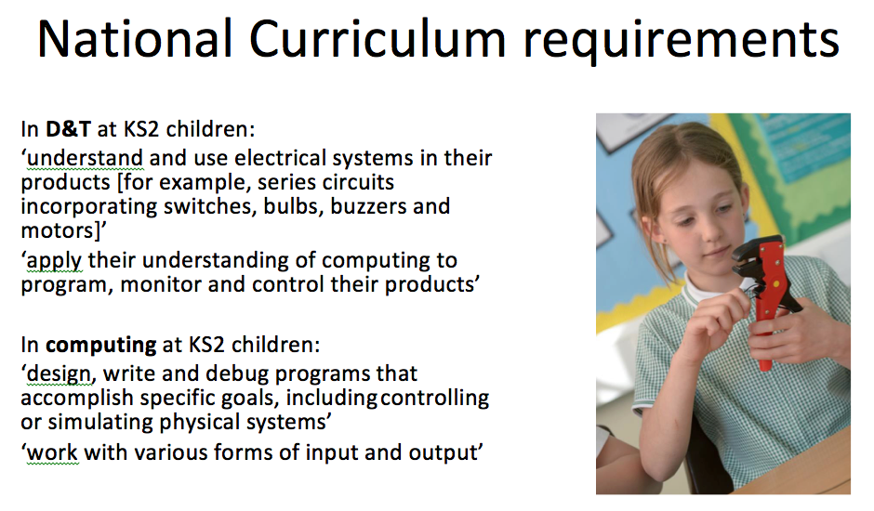

Slide 7
Some Basics
Inputs
Processes
Outputs
We start with Inputs
Then do some Processing
To get the required Outputs

Slide 8
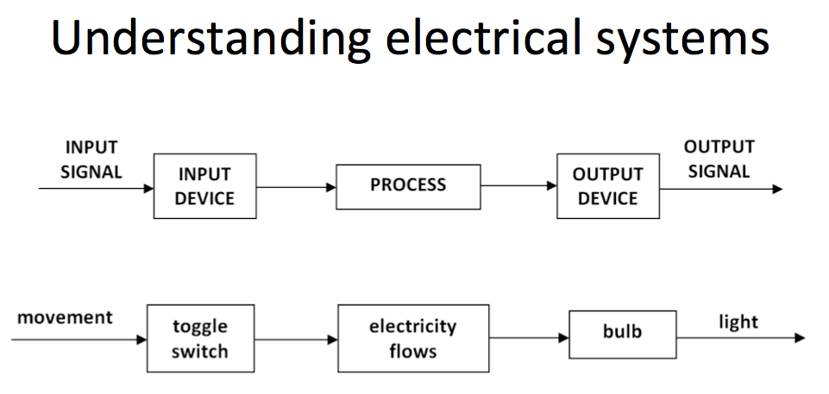

Slide 9
Automatic Nightlight
Light
Level
Night
Light
Light
Sensor
Computer
Programme
LED
Light Emitting Diode

Slide 10
Automatic Money Box
Coin Delivered Into Box
Coin
Coin
Sensor
Computer
Programme
Motor

Slide 11
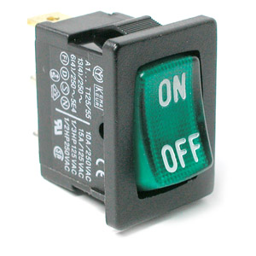
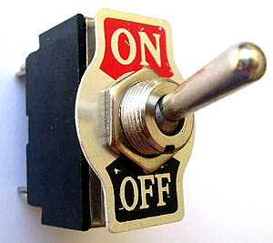
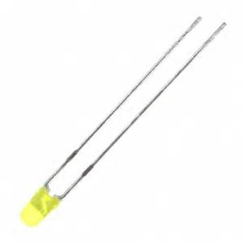
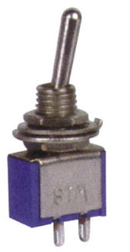
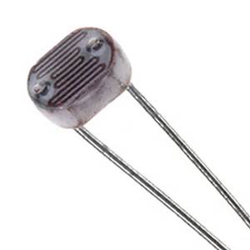
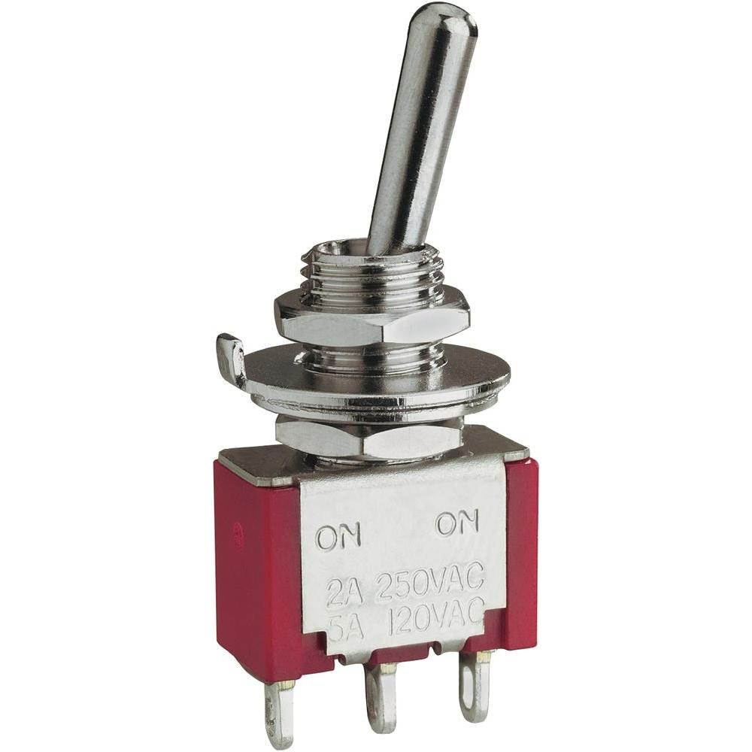
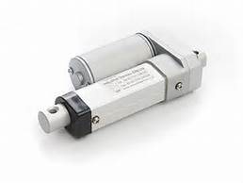
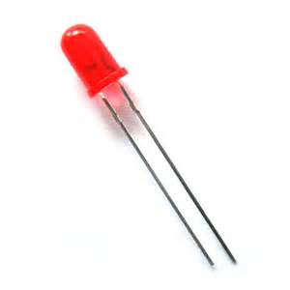
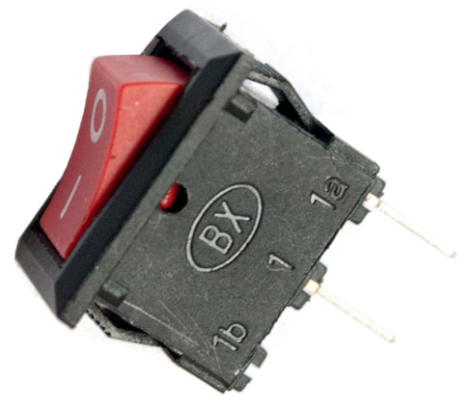
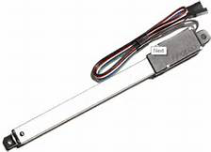
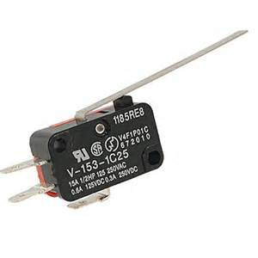
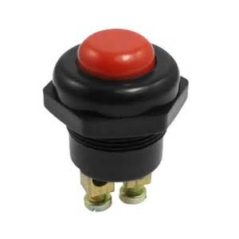
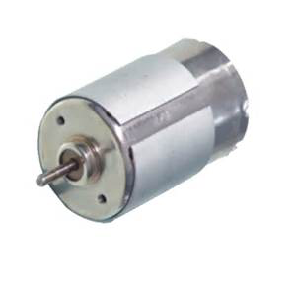
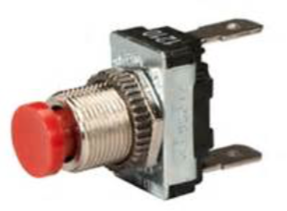
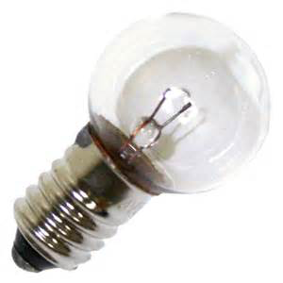
Some Basics
Inputs
Processes
Outputs
What are Inputs?
Which of these are are Inputs?

Slide 12
Some Basics
Inputs
Processes
Outputs
What are Inputs?
Which of these are are Inputs?
✓
✓
✓
✓
✓
✓
✓
✓
✓

Slide 13
Some Basics
Inputs
Processes
Outputs
✓
✓
Toggle Switch
Centre Pin is “Common”
Lever to Right then Centre is
Connected to Right Pin
and Left Pin is Open
One Way Switch

Slide 14
Some Basics
Inputs
Processes
Outputs
✓
✓
✓
This is a Light Sensitive Resistor
Off when Dark
On when Light
The Lighter it is The Less the Resistance
These are Push Switches
They can be:
- Push to Make the Circuit
- Push to Break the Circuit

Slide 15
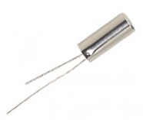

Some Basics
Inputs
Processes
Outputs
✓
OFF
ON
This is a Microswitch
The Tag Underneath is Common
The Top Tag is Made when Operated
The Lower Tag is Open when Operated
We also suggest you buy a Tilt Switch
Do not buy the Mercury variety
Mercury is Poisonous

Slide 16
Some Basics
Inputs
Processes
Outputs
So all these are Outputs?
LEDs (Light Emitting Diodes)
Actuator
The Centre Pin
Is Pushed Out when
Activated
Bulb
Motor Actuator
Here the Centre
Turns 90°
Motor

Slide 17
Let’s Crumble
Some Basics
Inputs
Processes
Outputs
So all these are Outputs?
LEDs (Light Emitting Diodes)
When buying these ensure they have built in resistors to stop them “popping”

Slide 18
Let’s Crumble
Some Basics
Inputs
Processes
Outputs
Processes
Look at the Inputs
and
Decide What Outputs to Activate
and
At What Level (e.g. % of Voltage)
Controlled by Your Programme

Slide 19

Let’s Crumble
Health and Safety
Remind children about mains electricity and electric shock
- All sockets switched OFF when not in use
Teach children how to avoid making short circuits
- Why? The Batteries Get Very Hot! Can BURN you!
Switch off the Battery Box when not in use
- Why ? To avoid discharging the battery and getting
short circuits by mistake

Slide 20
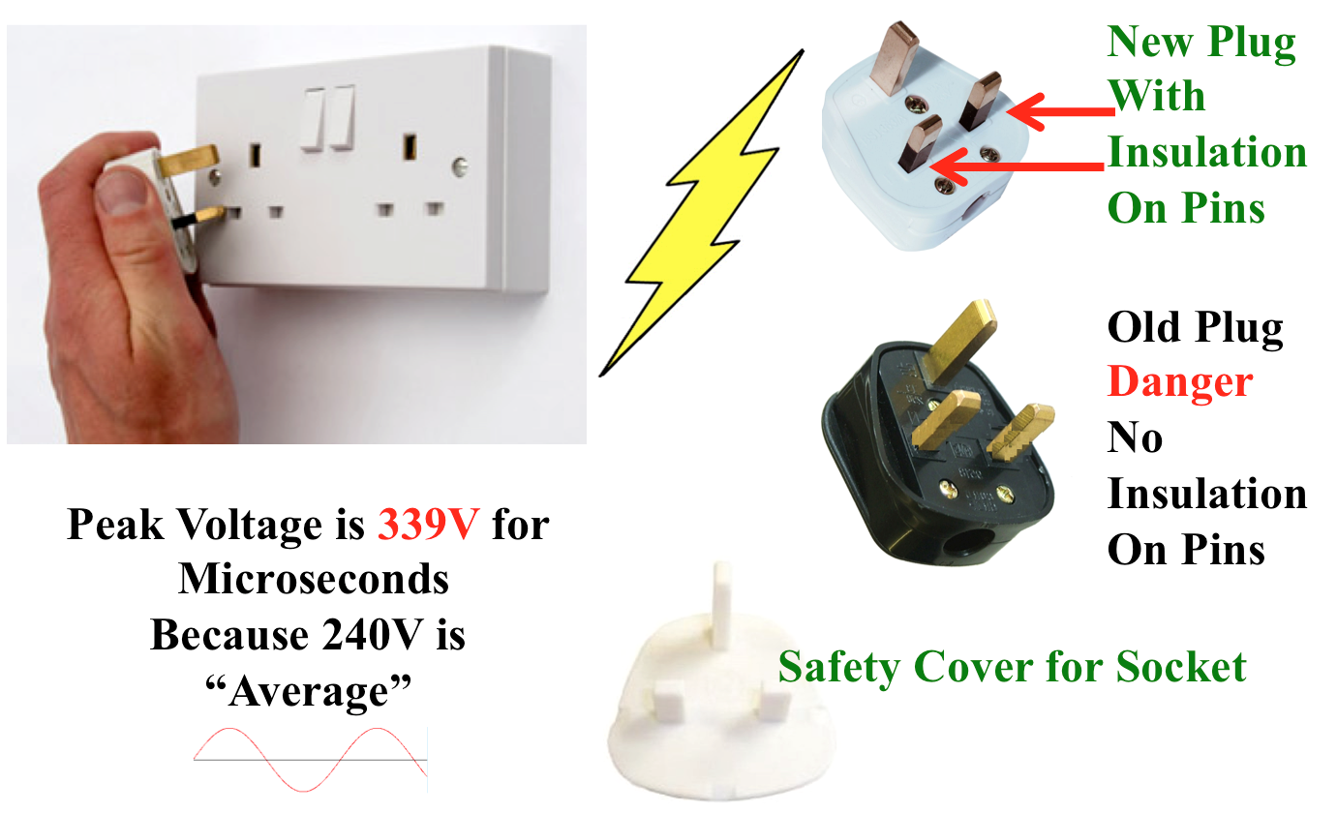
Danger – 240 Volts AC

Slide 21
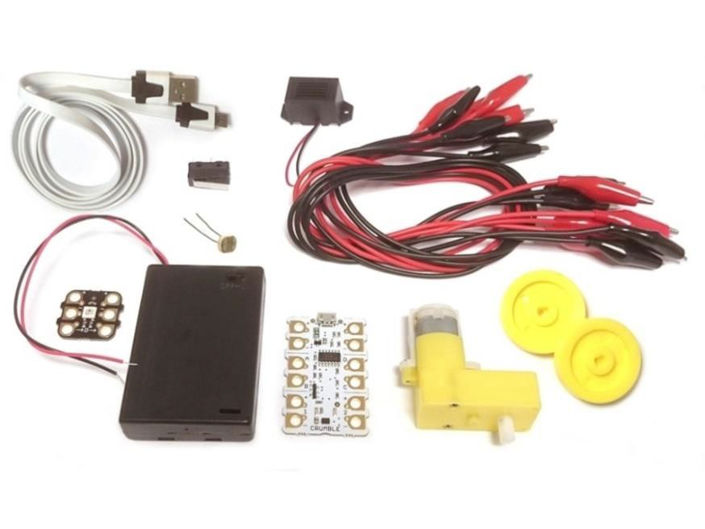
Crumble Starter Kit
Each kit includes:
1 x Crumble controller
1 x Sparkle
2 x Gearboxes
8 x Crocodile Clip leads
1 x Light Dependent Resistor (LDR)
1 x Micro switch
2 x Ultra-bright Light Emitting Diodes (LEDs)
1 x Buzzer
1 x Switched Battery Box
1 x USB to Micro USB lead
Extras to make the kit suitable for KS2
2 x 4.5v bulb,
2 x bulb holder,
3 x LEDs with internal resistors (red, yellow, green),
6 x 1.5v AA zinc carbon batteries,
1 x tilt switch,
1 x toggle switch

Slide 22
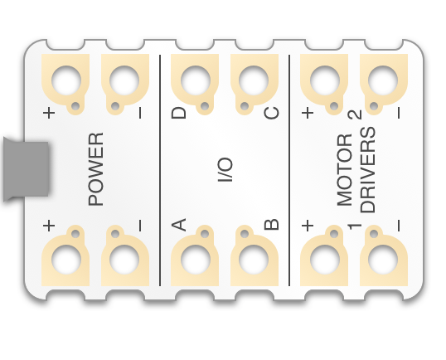
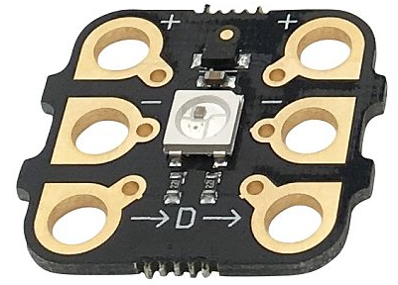
Crumble Vocabulary
Micro USB – To connect to a computer
Pads – terminals where crocodile clips are connected
I/O – Inputs/Outputs
Motor 1 Driver
Sparkles – full-colour LEDs
Blocks – instructions in the programming software

Slide 23
Crumble Vocabulary
Power Out
I/O Input / Output
Motor No 2

Slide 24
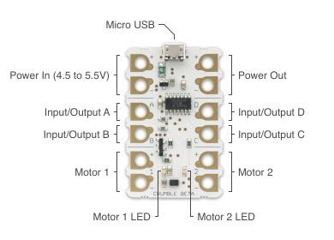
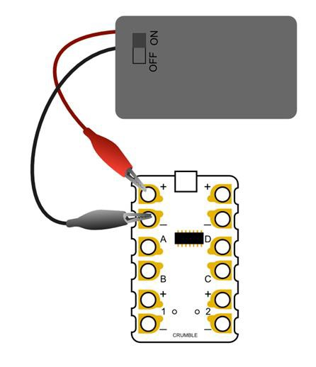
Connecting the Crumble to the Battery Box

Slide 25
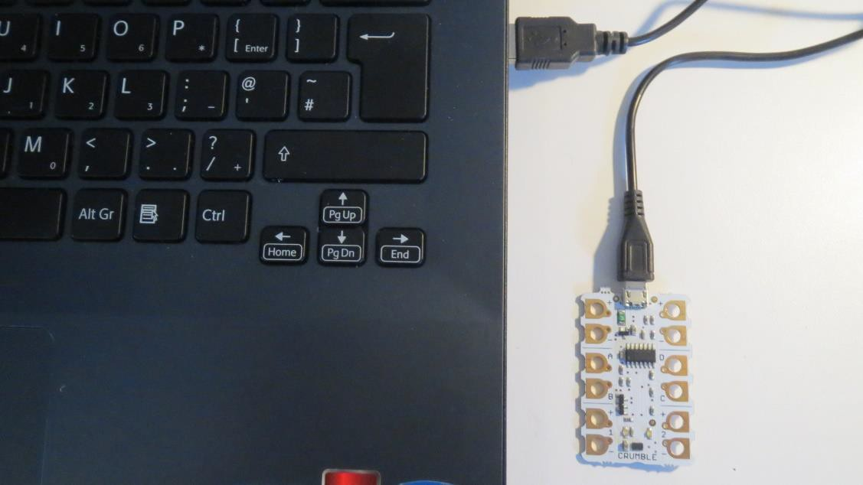
Connecting the Crumble to the computer
Crumble Programming Software can be downloaded from Redfern Electronics
http://redfernelectronics.co.uk/crumble-software/

Slide 26

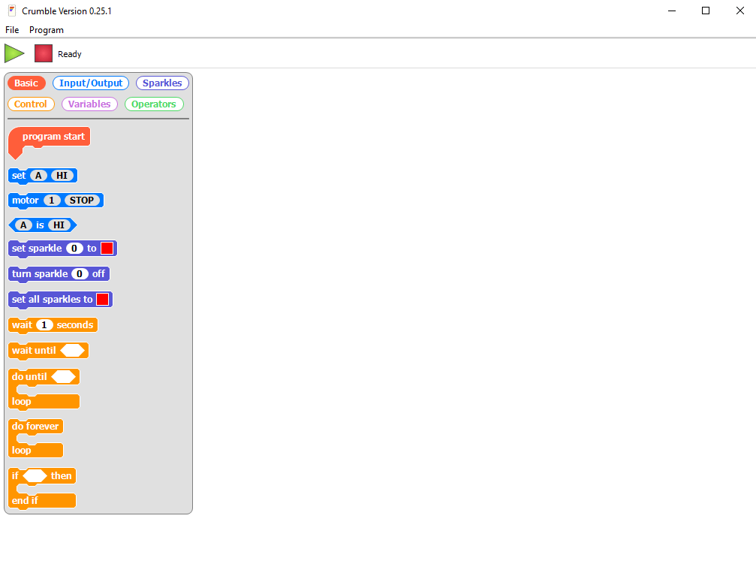
Load the
Crumble Software
Connect the Crumble to the Computer
Crumble Programming Software can be downloaded from Redfern Electronics
http://redfernelectronics.co.uk/crumble-software/

Slide 27
Crumble Software
Change the icon list by clicking on the appropriate tag
Basic Input/Output Sparkles
Control Variables Operators
To write a program drag the icon from the list to the right

Slide 28
Using an LED
The +ve lead is connected to the long leg of the LED and the –ve lead to the short leg
Try this code first
This code block switches the LED On and then Off
This code block switches the LED On and Off continuously
Once the Crumble has been programmed, it will remember the program and run it automatically when the USB is disconnected

Slide 29
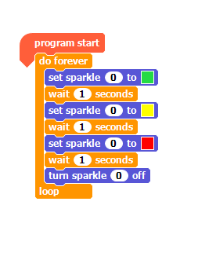
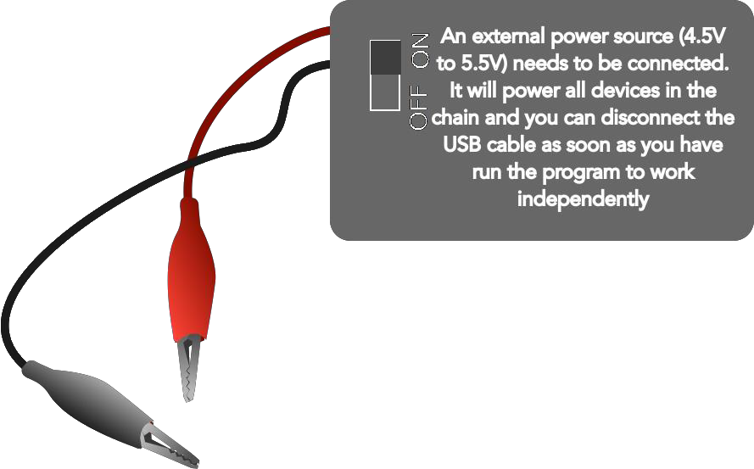
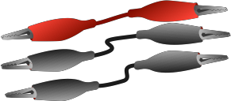

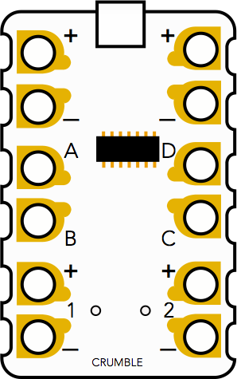
Using a Sparkle
Once the Crumble has been programmed, it will remember the program and run it automatically when the USB is disconnected
Use the ‘D’ output for sparkles

Slide 30
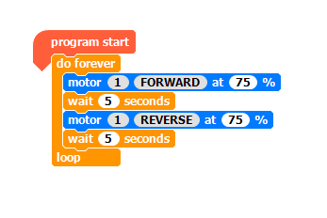
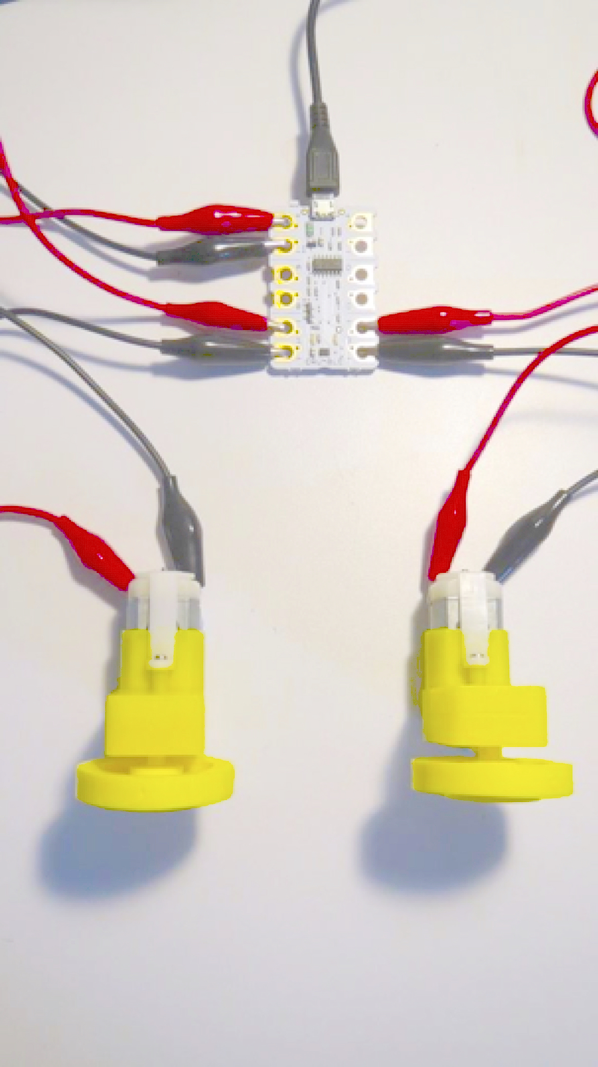
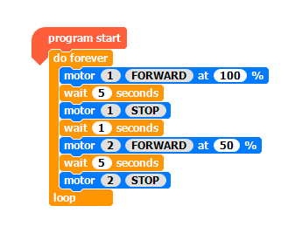
Using Motors

Slide 31
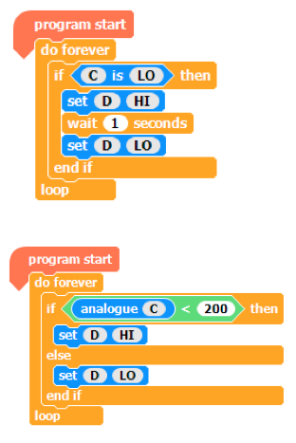
Using a Light Detecting Resistor (LDR) and a Light Emitting Diode (LED)
This code works only if it is completely dark
This code works when it is nearly dark
LED – connect +ve to D and -ve to Power Out
LDR – connect -ve to C and +ve Power Out

Slide 32
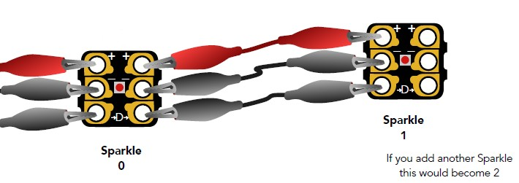
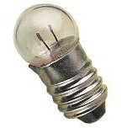
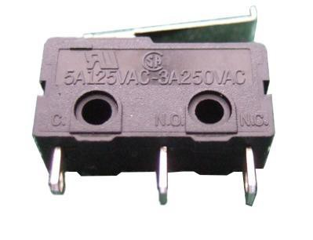
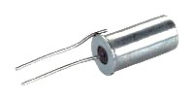
Crumble Challenges
1. Sparkles – connect another sparkle to the first one and adapt the program to make them flash on and off in different colours
2. Bulbs – use a motor output to control a 4.5v bulb and explore how it can be made dimmer and brighter
3. LED – use a micro switch and then a tilt switch to operate the LED (set input C to HI)
If you add another Sparkle it will be Sparkle 2

Slide 33
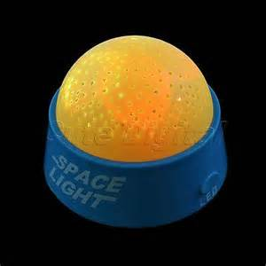
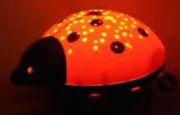
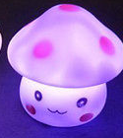
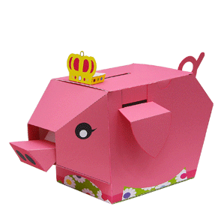
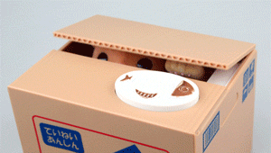
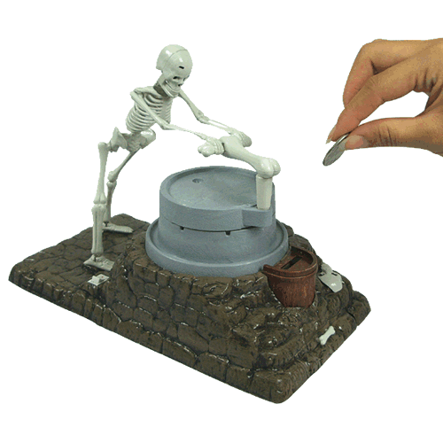

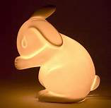
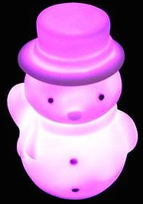
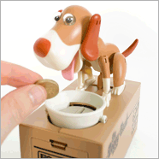
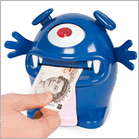

Design Challenges
Design And Make An Automatic Nightlight
Design And Make An Electronic Toy Moneybox
Use recycled materials where you can

Slide 34
Design And Make An Automatic Nightlight
Some Ideas
Use a tilt switch so that turn light upside down to turn off
Programme a timer to turn the light off after, say, 20 minutes because you are now asleep
Programme the timer to dim the light progressively

Slide 35
Design And Make An Electronic Toy Moneybox
Some Ideas
Use the microswitch to detect the coin
Programme a mechanical device to capture the coin into the box
Add a flashing light for a limited time after the coin is captured

Slide 36
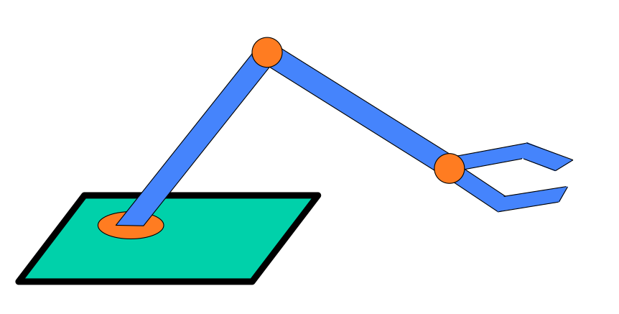




Additional Crumble Challenges
Traffic Lights
Car and Maze
Robot
Motors Drive
Each Arm and the Gripper Separately
(Use Relays for
Forwards and Reverse )
Motors Drive
Each Front Wheel Separately
(Use Relays for
Forwards and Reverse )
Use 2 Sparkles for the
Light Sequence
Red,
Red+Orange,
Green,
Orange,
Red

Slide 37
We have learnt
About Computers
About Electricity and Danger
About Input Components
About Output Components
About Programming
About Making Things from Recycled Materials
And we have had a very enjoyable time

Slide 38

Well Done

Slide 40


Let’s Crumble
Shopping Basket
We suggest you buy the following:
Crumble Controller (To claim your free beta Crumble controller from Mindsets quote code CRM2014)
2 x Crumble Controller Starter Pack (e.g. from Mindsetsonline) £24
Sparkles (strip of 5) (e.g. from Redfern Electronics) £6
Additional Items (e.g. from Mindsetsonline)
- 2 x 4.5V Bulb and Bulb Holders £1
- 3 x LEDs with Internal Resistors (e.g. 1 of each colour, red,
yellow, green) £2
- 6 x 1.5V AA Zinc Carbon or Zinc Chloride Batteries £2
(Do not buy other types as they can overheat if shorted,
e.g. if output wires touch each other)
- 1 Tilt Switch £1.50
- 1 Toggle Switch 75p
- 1 Microswitch 78p
You may also want to use:
- Reed Switch (Use a Magnet to Operate) 70p
(e.g. from MindsetsonlineAmazon, RS Components, Farnell)
- Bar Magnet (for the switch) 40p
1 x Crumble controller
1 x Sparkle
2 x Gearboxes
8 x Crocodile Clip leads
1 x Light Dependant Resistor
1 x Microswitch
2 x Ultra-bright LEDs
1 x D.C. Buzzer
1 x Switched Battery Box
1 x USB to Micro USB 'noodle' lead.
Instructions & Project Suggestions
Starter Pack

