Slide 1

Welcome
These challenges were developed by Derrick Willer MBE and colleagues.
They are free to download and use in an education environment.
Please ensure that there is adult supervision, complete adherence to Health and Safety, and adequate PPE.
Derrick is a volunteer STEM Ambassador and leads the new Schools Liaison Community.
He has supported education in schools and colleges for over 40 years, initially as a Neighbourhood Engineer in the 1980’s, leading the local Year of Engineering Success campaign in 1996 and the Campaign to Promote Engineering from 1997 to 2004.
He was awarded an MBE for services to Education in 2018.

Slide 2
Guide
This activity is for pupils to make an anemometer and measure wind speed.
Risks
Item | Risk | Avoidance Action
Scissors | Injury | Close supervision
Glue | Damage to Clothing | Close supervision, water to remove glue
Aggression between pupils | Injury | Close supervision and immediate action to defuse aggression

Slide 3

Measure Wind Speed
Make an Anemometer out of some plastic sheets, a dowel, a pin and a heavy base
.
.
.
.
Click for next slide

Slide 4
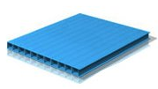
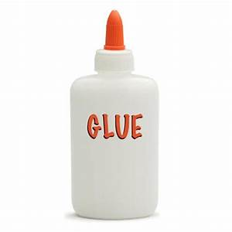
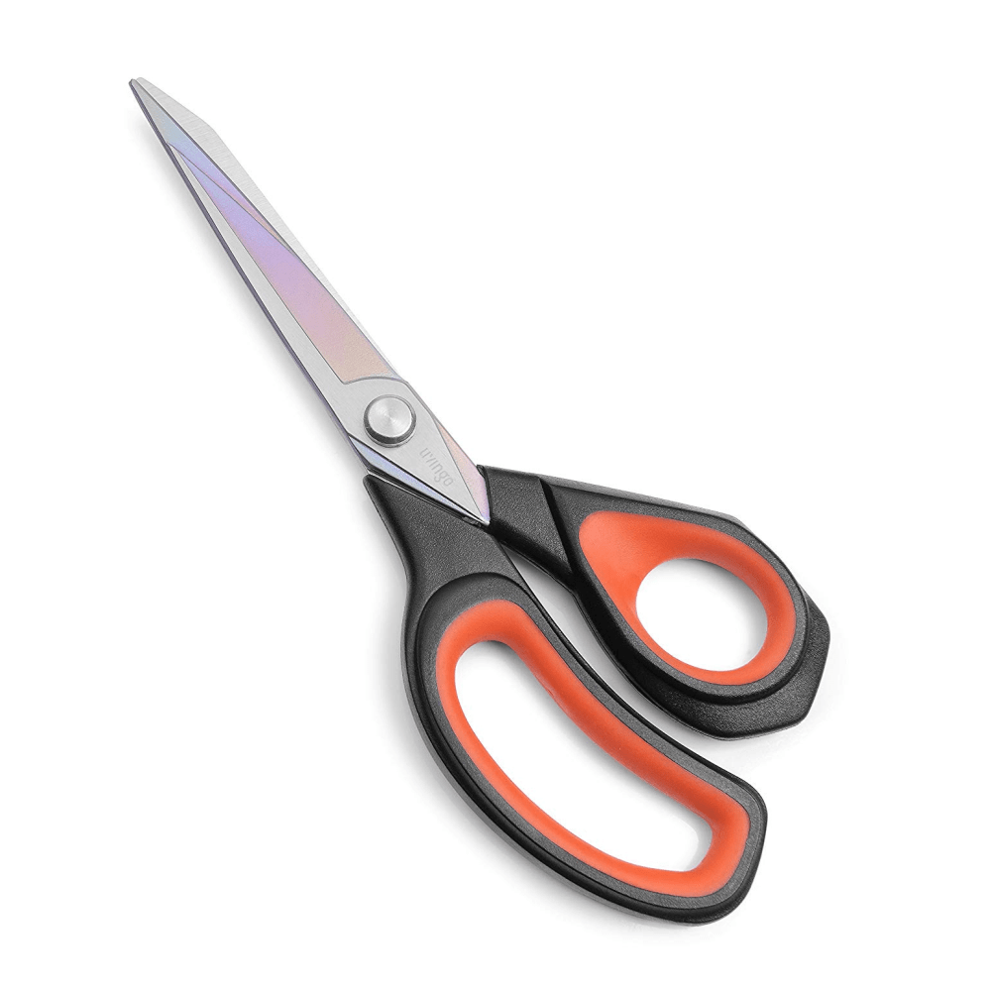
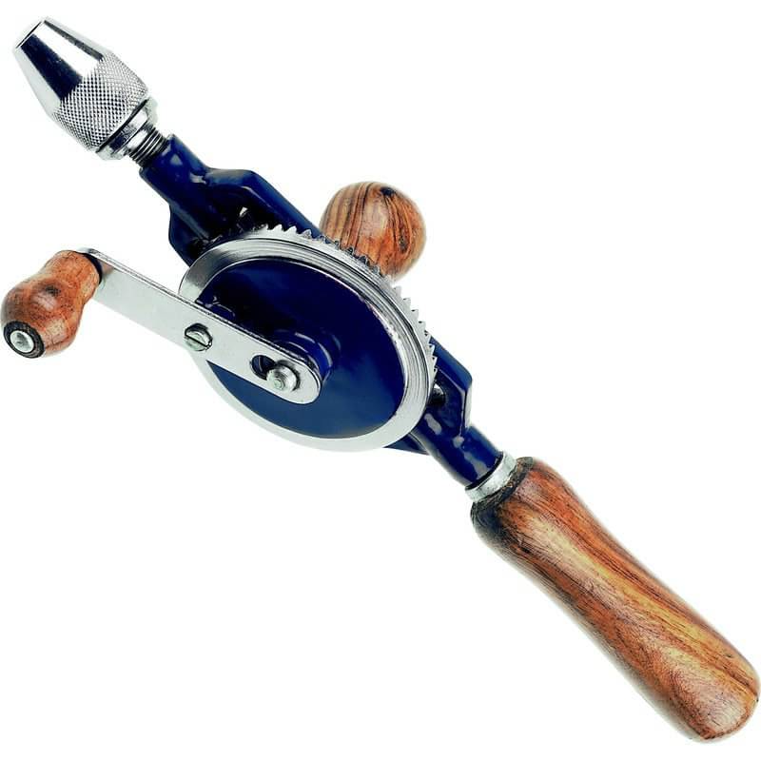
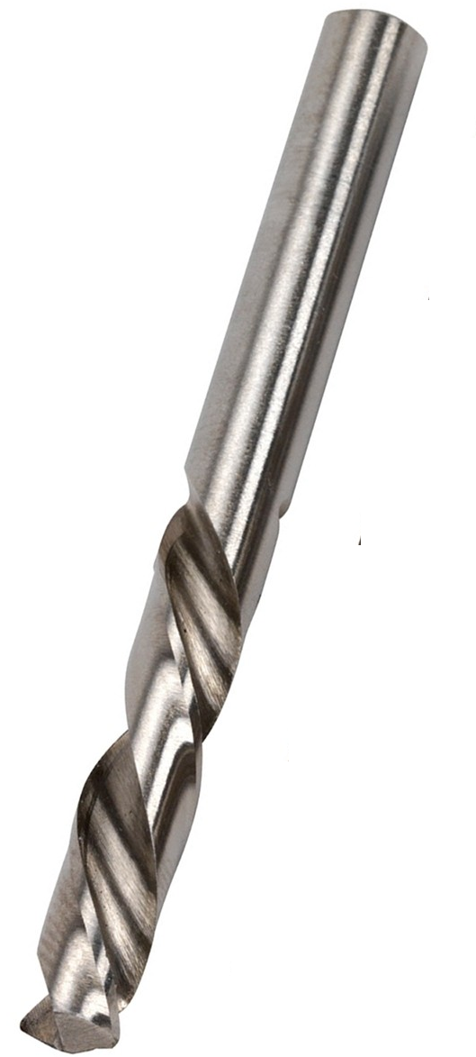
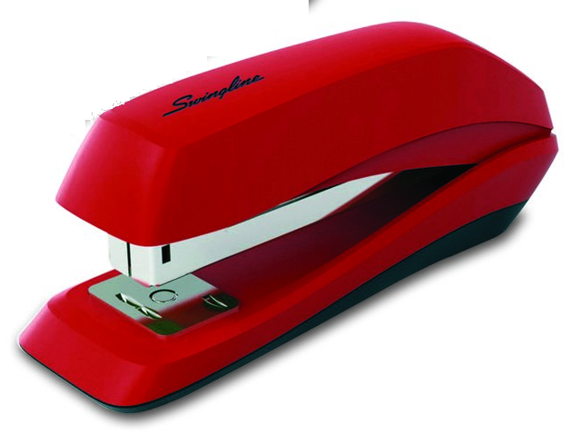
You Need:
Corrugated plastic sheet
Thin plastic sheet
Dowel
Base
Pin
Quick drying glue
Tools
Click for next slide

Slide 5
First make the cones:
Using the thin plastic sheet
Cut a triangle
Fold it into a cone and glue the edges
Use a staple to hold the cone while the glue dries
Make four cones like this
Staple

Slide 6
Make the arms:
Using the corrugated plastic sheet
Cut an X shape with equal arms

Slide 7
Make the arms:
Glue the cones onto the arms and staple them to hold them while the glue dries
Staple

Slide 8
Make the support:
Use a drill bit the same size as the dowel
Drill a hole in the centre of the base
Glue and insert the dowel into the base

Slide 9
.
.
Finish making the anemometer
- Mount the anemometer
onto the dowel and secure
with the pin
.
.

Slide 10
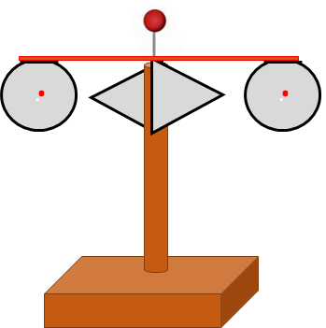
Use the anemometer
- Take the anemometer
outside on several days and times
to see how it measures wind speed
Record the rotations per minute
Compare your answers with the
results from your local weather
forecasts
Compare the published wind speeds
with your rotations per minute
to get a conversion factor
WEDNESDAY

Slide 11

Well Done
Click for next slide

