Slide 1
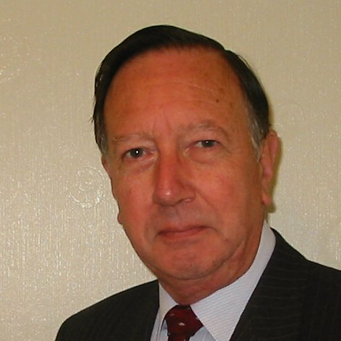
Welcome
These challenges were developed by Derrick Willer MBE and colleagues.
They are free to download and use in an education environment.
Please ensure that there is adult supervision, complete adherence to Health and Safety, and adequate PPE.
Derrick is a STEM Ambassador.
He has supported education in schools and colleges for over 30 years, initially as a Neighbourhood Engineer in the 1980’s, leading the local Year of Engineering Success campaign in 1996 and the Campaign to Promote Engineering from 1997 to 2004.
He was awarded an MBE for services to Education in 2018.

Slide 2
Guide
This activity is for pupils to understand various logic and maths questions.
Risks
Mandatory: close supervision by a competent adult
Item | Risk | Avoidance Action
Batteries | Injury | Close supervision. Circuits to be checked before allowing participant to switch on. Beware short circuiting the batteries, risk of fire and burning.
Micro-bit | Damage | Close supervision. Circuits to be checked before allowing participant to switch on.
Aggression between participants | Injury | Close supervision and immediate action to defuse aggression

Slide 3
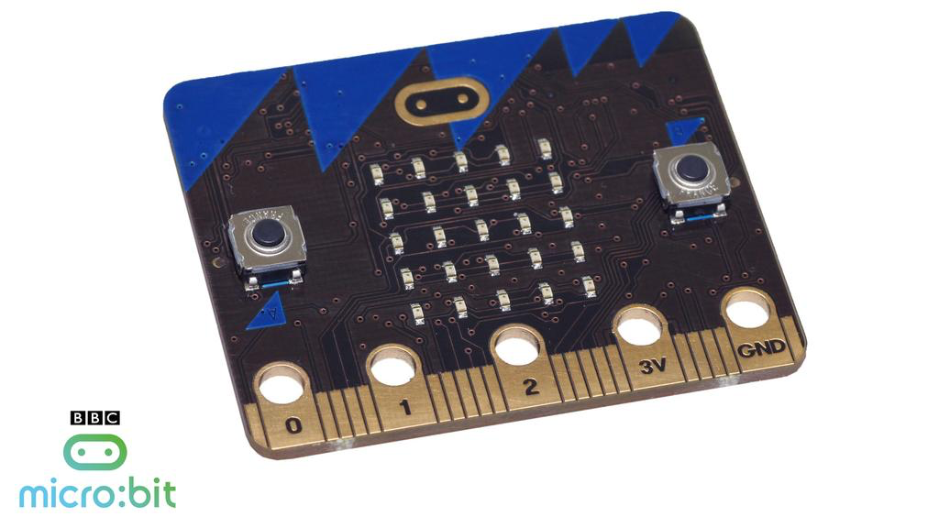
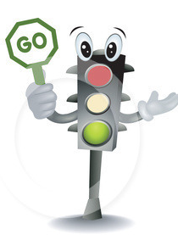
Make
Traffic Lights With BBC Micro-bit

Slide 4
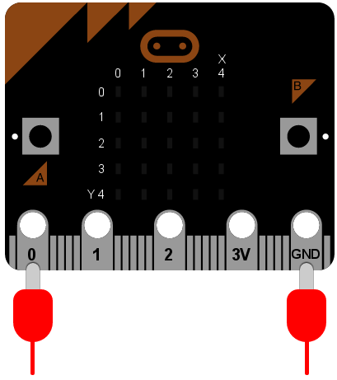
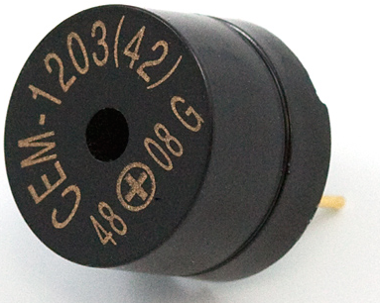
Intermittent Buzzer
Connect the buzzer between 0 and GND
First let’s try a simple circuit with a buzzer using Python programming language

Slide 5
Intermittent Buzzer
Connect the buzzer between 0 and GND
Python Code
The device is put into an infinite loop and immediately switches pin 0 on. This causes the speaker to emit a beep. While the speaker is beeping, the device sleeps for twenty milliseconds and then switches pin 0 off. This gives the effect of a short bleep. Finally, the device sleeps for 480 milliseconds before looping back and starting all over again. This means you’ll get two bleeps per second (one every 500 milliseconds).
from microbit import *
while True:
pin0.write_digital(1)
sleep(20)
pin0.write_digital(0)
sleep(480)

Slide 6
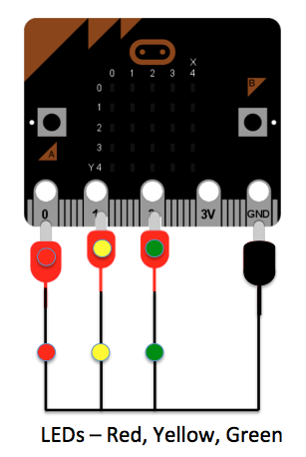
UK Traffic Lights – Just One Set
Now let’s try a single Traffic Light set
Can you write the Python Code for this?

Slide 7
UK Traffic Lights – Just One Set
Python Code
from microbit import *
while True:
pin0.write_digital(1)
sleep(15000)
pin1.write_digital(1)
sleep(7000)
pin0.write_digital(0)
pin1.write_digital(0)
pin2.write_digital(1)
sleep(15000)
pin1.write_digial(1)
pin2.write_digital(0)
sleep(7000)
pin1.write_digital(0)
Red on for 15 seconds
Red and Yellow for 7 seconds
Green for 15 seconds
Yellow for 7 seconds
Then start again

Slide 8
Cross Roads Traffic Lights
Cross Roads have opposite lights but you cannot assume if the North-South Red is on the opposite East-West Green is on.
1 2 3 4
1 2 3 4
North-South Sequence
East-West Sequence

Slide 9
Cross Roads
Cross Roads have opposite lights but you cannot assume if the North-South Red is on the opposite East-West Green is on
The Traffic Light Sequence is:
Sequence | Red | Yellow | Green | Red | Yellow | Green
1 | On |  |  |  |  | On
2 | On | On |  |  | On
3 |  |  | On | On
4 |  | On |  | On | On
We need Four Conditions but the BBC-Micro-bit only gives Three outputs! Can you think of a solution?

Slide 10
Cross Roads
The Traffic Light Sequence is:
Sequence | Red | Yellow | Green | Red | Yellow | Green
1 | On |  |  |  |  | On
2 | On | On |  |  | On
3 |  |  | On | On
4 |  | On |  | On | On
We need Four Conditions but the BBC-Micro-bit only gives Three outputs! Can you think of a solution?
Whenever any Yellow Light is ON – all the Green Lights are OFF !!
In fact the Yellow Lights are always ON together

Slide 11
Cross Roads
The Traffic Light Sequence is:
Sequence | Red | Yellow | Green | Red | Yellow | Green
1 | On |  |  |  |  | On
2 | On | On |  |  | On
3 |  |  | On | On
4 |  | On |  | On | On
Whenever any Yellow Light is ON – all the Green Lights are OFF !!
We need a switch which is OFF if the Yellow Lights are ON

Slide 12
Cross Roads
Whenever any Yellow Light is ON – all the Green Lights are OFF !!
We need a switch which is OFF if the Yellow Lights are ON
Lets try a relay!
When the current flows the Green Contact is Broken = OFF
Coil
0V
+3V
Green Lights
Magnetic
Contact
Common
Terminal
Normally Closed Terminal

Slide 13
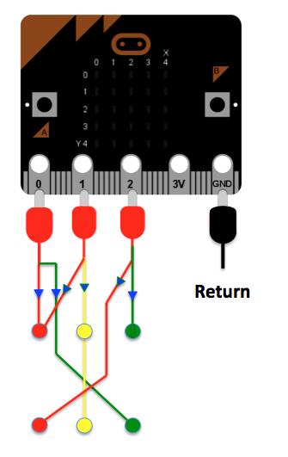
Diodes
We need Diodes to stop the current from the Red going to light the Green when the Yellow is on

Slide 14
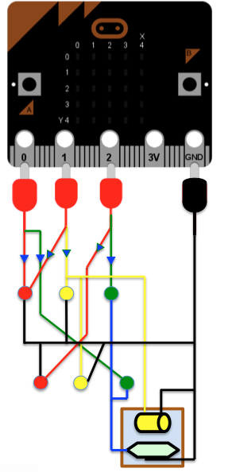
Now lets see the circuit with the Relay in place
Return
Coil
Terminals
Diodes
Normally Open
Common
Normally Closed

Slide 15
Now for the Python Code
from microbit import *
while True:
pin0.write_digital(1)
sleep(15000)
pin0.write_digital(0)
pin1.write_digital(1)
sleep(7000)
pin1.write_digital(0)
pin2.write_digital(1)
sleep(15000)
pin2.write_digital(0)
pin3.write_digial(1)
sleep(7000)
pin3.write_digital(0)
NS Red and EW Green on for 15 seconds
NS Red and both Yellows ON for 7 seconds, Relay ON and turns All Green OFF
EW Red ON and NS Green ON for 15 seconds
EW Red and both Yellows ON for 7 seconds, Relay ON and turns All Green Off
Then start again
`
Diodes

Slide 16
Now for the Python Code
from microbit import *
while True:
pin0.write_digital(1)
sleep(15000)
pin0.write_digital(0)
pin1.write_digital(1)
sleep(7000)
pin1.write_digital(0)
pin2.write_digital(1)
sleep(15000)
pin2.write_digital(0)
pin3.write_digial(1)
sleep(7000)
pin3.write_digital(0)
Q.E.D.
Quite Easily Done
No!
Quad Erat Demonstrandum
NS Red and EW Green on for 15 seconds
NS Red and both Yellows ON for 7 seconds, Relay ON and turns All Green OFF
EW Red ON and NS Green ON for 15 seconds
EW Red and both Yellows ON for 7 seconds, Relay ON and turns All Green Off
Then start again

Slide 17
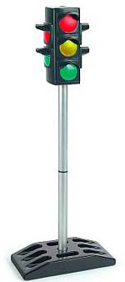
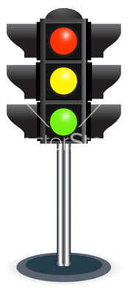
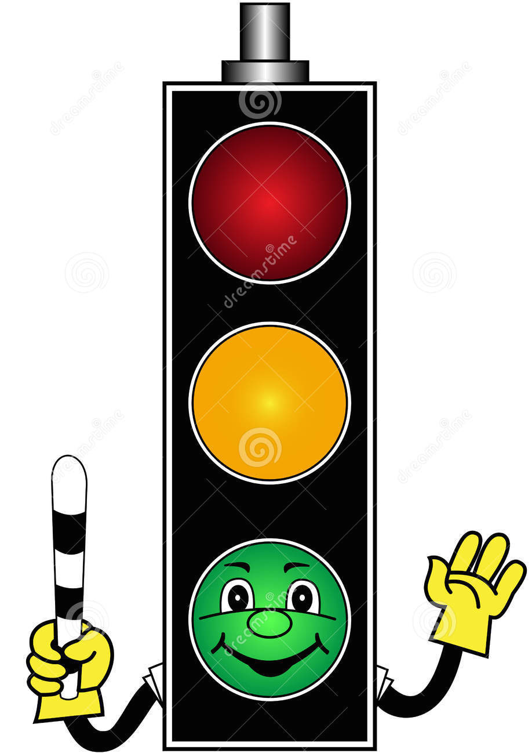
Now lets make the Traffic Lights out of Recycled Materials

Slide 18
We have learnt to:
Work and think as engineers
Understand BBC Micro-bit
Understand Python Programming
Understand Electric Circuits
Work as a team
Build with the resources available

Slide 20
Thank You

Slide 21
These challenges were developed by Derrick Willer MBE and colleagues.
They are free to download and use.
Please ensure that there is adult supervision, complete adherence to Health and Safety, and adequate PPE.
Derrick is a STEM Ambassador and volunteer Schools Liaison Officer for the IET Coventry and Warwickshire Network.
He has supported education in schools and colleges for some 30 years, initially as a Neighbourhood Engineer in the 1980’s, leading the local Year of Engineering Success campaign in 1996 and the Campaign to Promote Engineering from 1997 to 2004.
Derrick was awarded an MBE for services to Education in 2019.

Slide 23
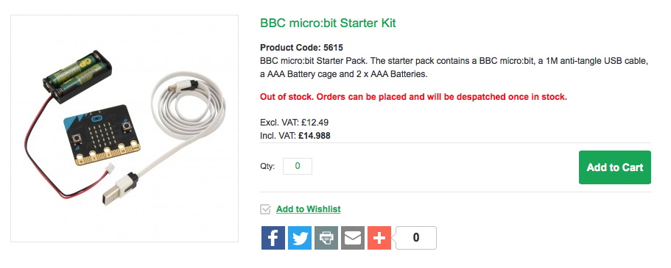
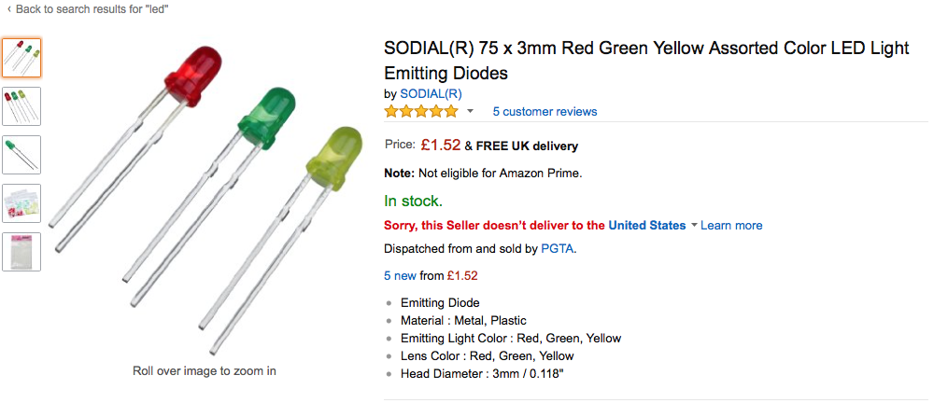
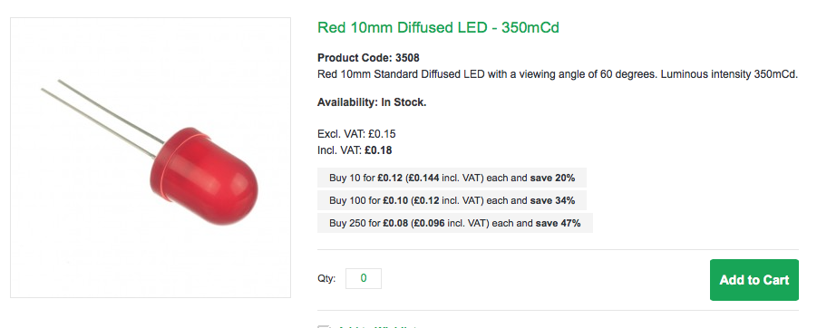
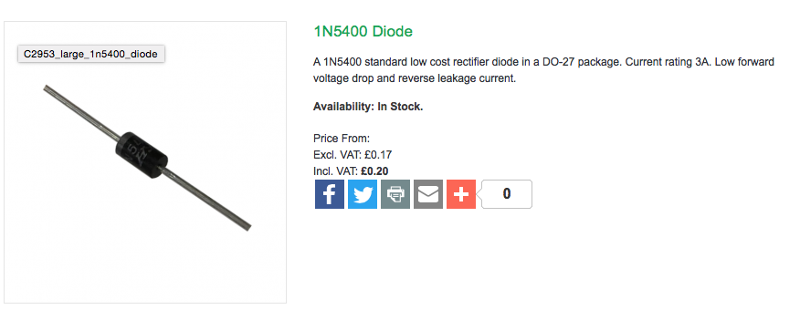
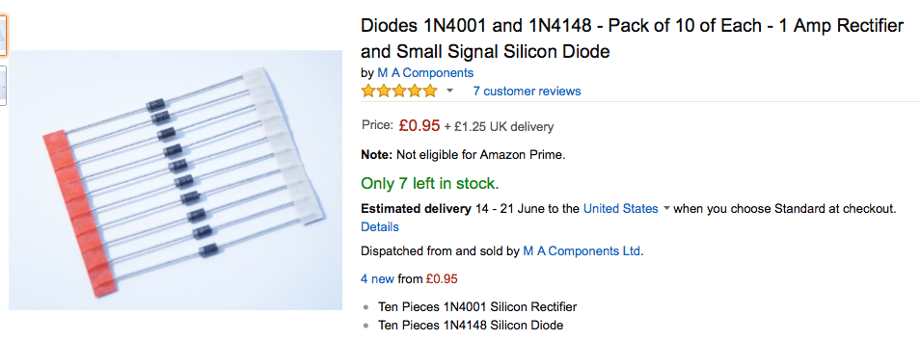
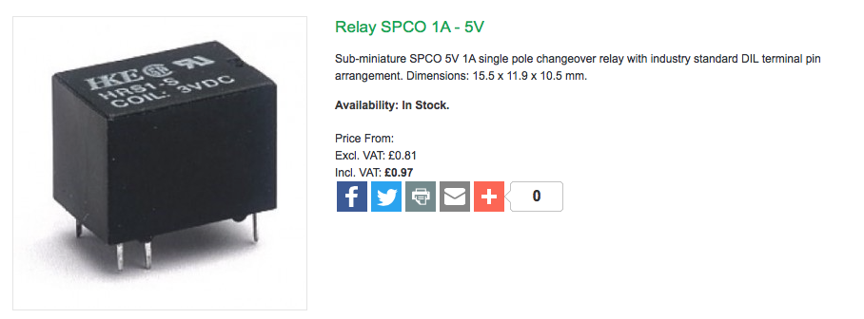
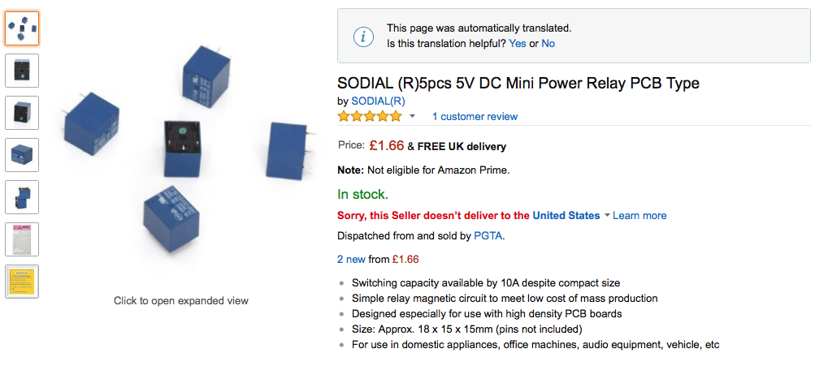
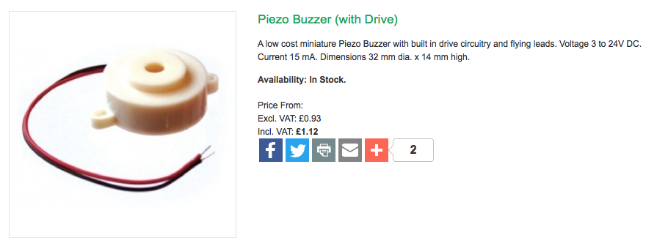
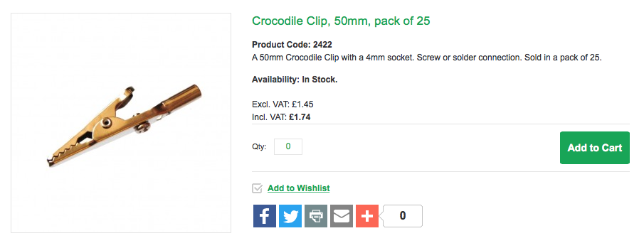
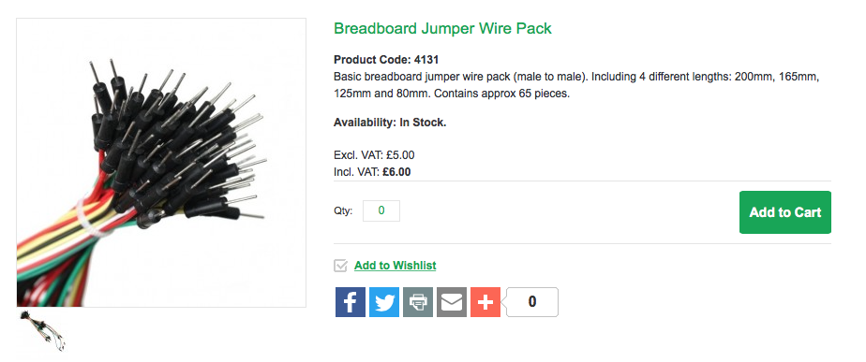
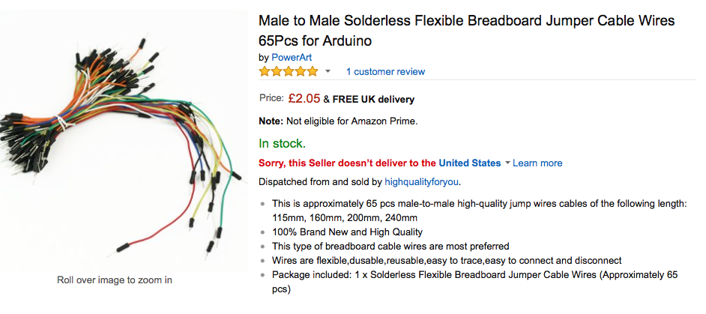
Materials
BBC Micro-bit (e.g. Kitronic)
LEDs 2 Red, 2 Yellow, 2 Green
(e.g. Kitronic, Amazon)
Diodes – 6
(e.g. Kitronic, Amazon)
Relay – 1
(e.g. Kitronic, Amazon)
Buzzer 3V+ - 1
(e.g. Kitronic, Amazon)
Crocodile Clips – 20
(e.g. Kitronic, Amazon)
Wire – Multicolours Male to Male

