Slide 1

Welcome
These challenges were developed by Derrick Willer MBE and colleagues.
They are free to download and use in an education environment.
Please ensure that there is adult supervision, complete adherence to Health and Safety, and adequate PPE.
Derrick is a STEM Ambassador and volunteer Liaison Officer for Schools.
He has supported education in schools and colleges for over 30 years, initially as a Neighbourhood Engineer in the 1980’s, leading the local Year of Engineering Success campaign in 1996 and the Campaign to Promote Engineering from 1997 to 2004.
He was awarded an MBE for services to Education in 2018.

Slide 2
Guide
This activity is for pupils to make a simple barometer our of a jam jar or similar container
They compare their readings with the weather forecasts to establish a relationship
Risks
Mandatory: close supervision by a competent adult
Item | Risk | Avoidance Action
Broken Glass | Injury | Close supervision
Tools | Misuse Injury | Close supervision
Glue | Spillage Injury | Close supervision, sponge and water. If glue is ingested rinse mouth with water and give water to drink.
Aggression between those present | Injury | Close supervision and immediate action to defuse aggression

Slide 3
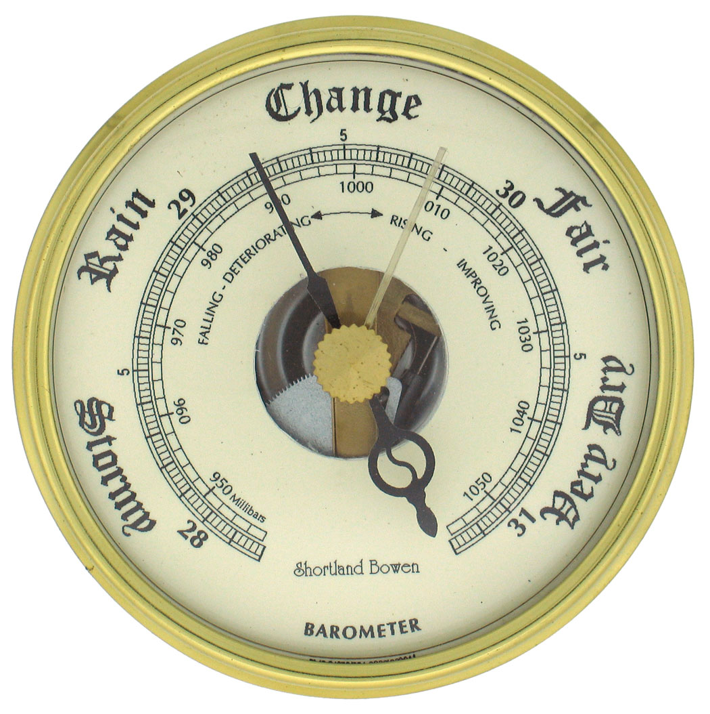
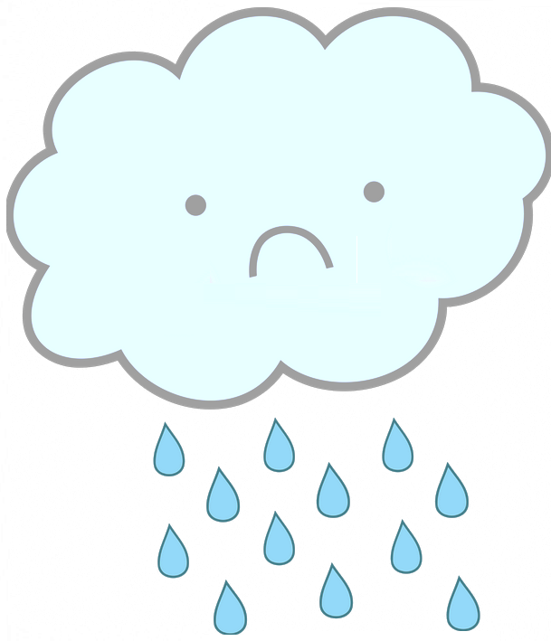
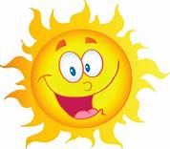
Make A Barometer
Tip – make your barometer on a day when it is cloudy and raining which is when the air pressure is low
Click for Next Slide

Slide 4
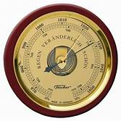
Evangelista Torricelli invented the Barometer in 1643
Early Mercury Barometer
Modern Aneroid Barometer

Slide 5
Mercury Barometer
The earliest barometers were Mercury Barometers.
A mercury barometer has a glass tube filled with mercury but with a vacuum at the sealed end and a flexible bulb at the other end.
Whenever there is an increase in air pressure the mercury is forced up the tube, and visa versa.
Early Mercury Barometer

Slide 6
Aneroid Barometer
An aneroid barometer has a capsule which has quite flexible sides.
The air has been pumped out of this capsule.
Therefore, whenever there is a change in the pressure, the size of this capsule changes.
This is amplified by levers which then turn the pointer from Low to High pressure.
Modern Aneroid Barometer

Slide 7
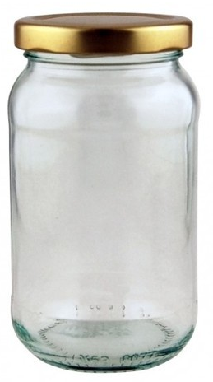
Our sealed container is a Jam Jar:
We are going to use a jam jar as the sealed container.
We will use a long pointer as a lever to amplify the change in pressure.

Slide 8
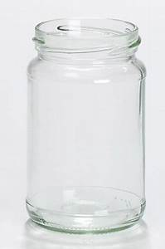
There are two options:
Using the jam-jar lid with a hole made in it to secure a rubber seal.
Using a rubber band to secure a rubber seal/
Click on the picture to go to the first slide
This requires drilling a hole in the lid and sawing round near the edge. Then using the lid to secure a thin rubber sheet over the jar.
This requires using a rubber band to help seal a thin rubber sheet onto the jar.

Slide 9
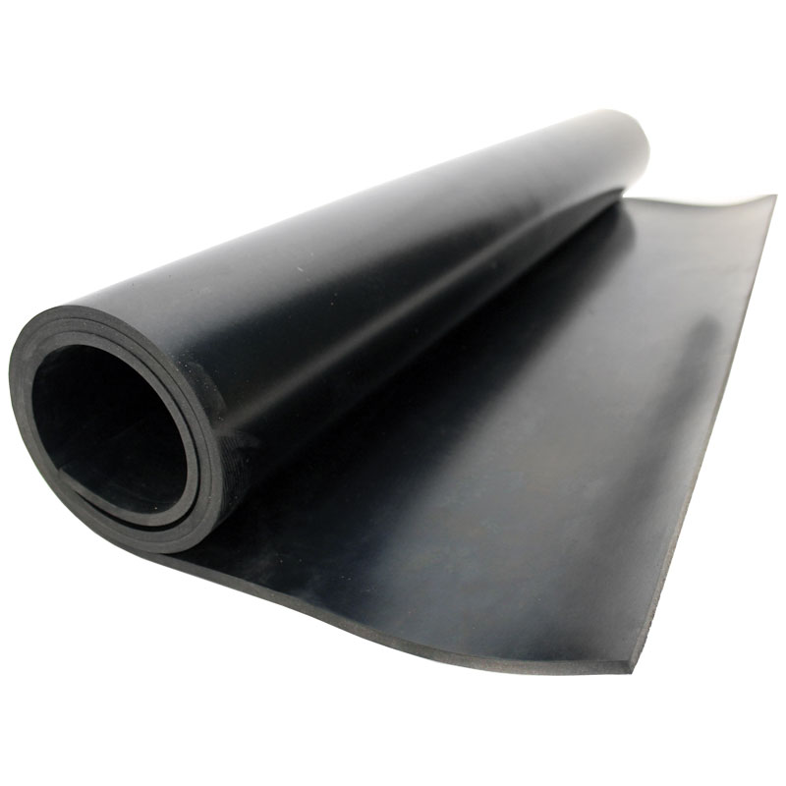
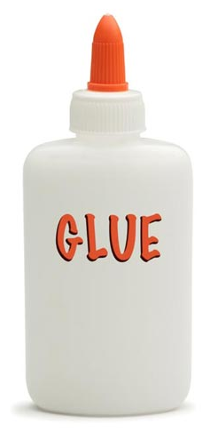
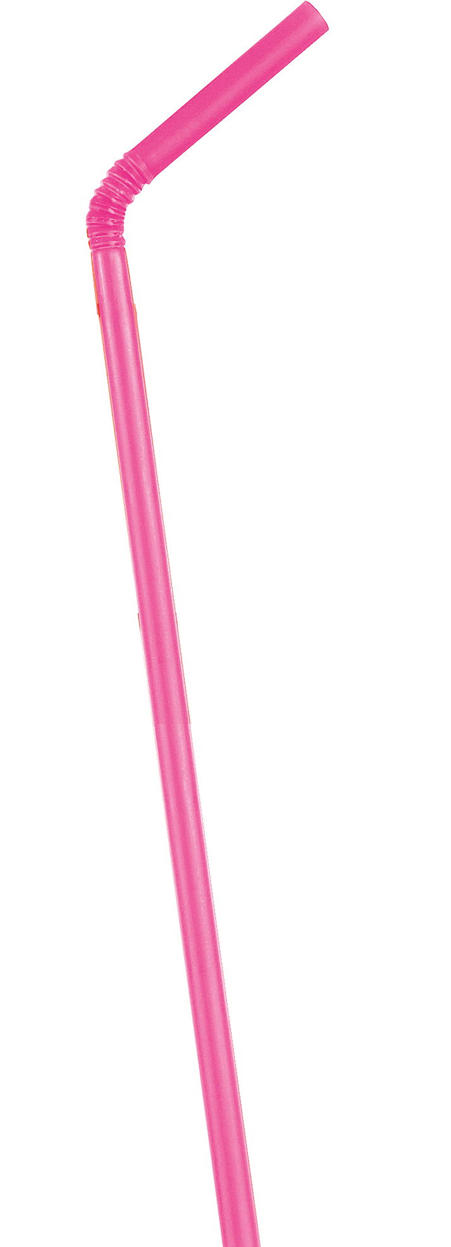

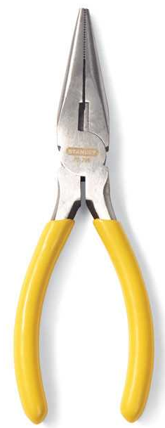
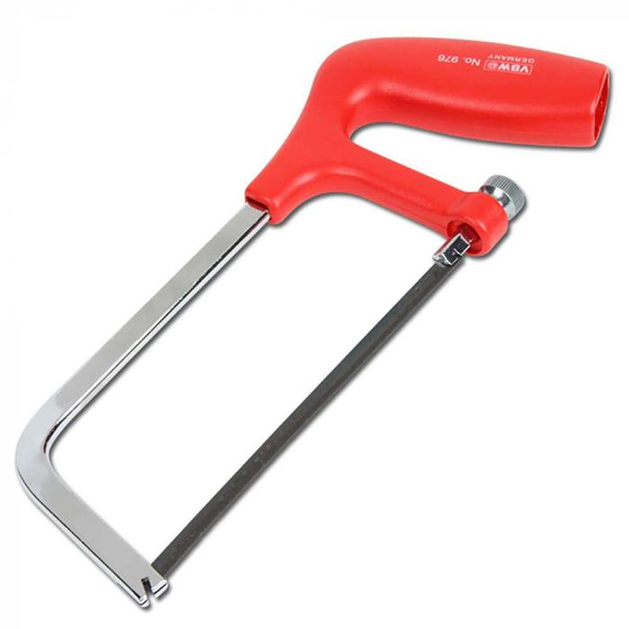
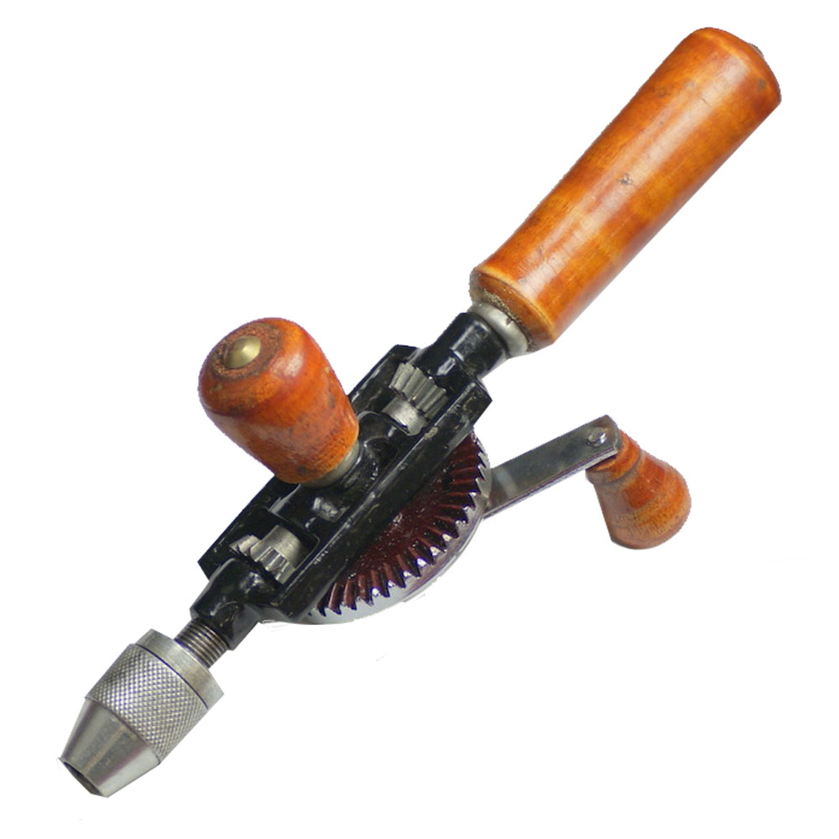
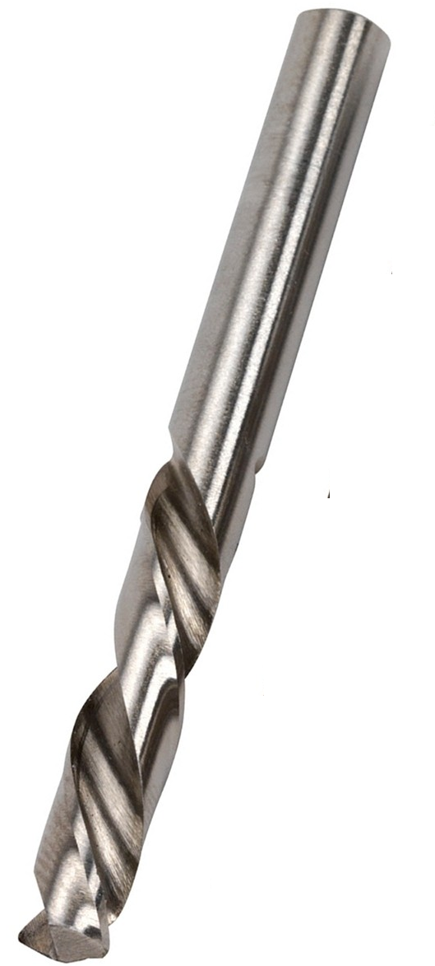
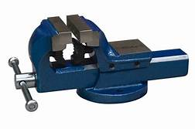
What you need:
A large glass jar – e.g. jam-jar
Some thin rubber sheet – about 3cm larger the the opening of the jar
A straw
Quick drying glue
Graph Paper
Tools
Click for Next Slide

Slide 10
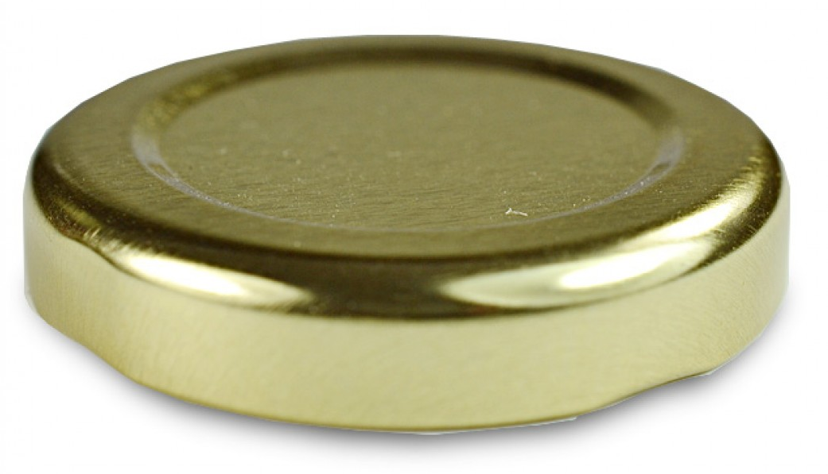
Make the barometer:
First make a hole in the lid
Clamp the lid into a vice
Drill a hole about ½ cm from the edge
Disassemble the saw
Put the blade through the hole and reassemble the saw
Saw around the centre of the lid
Dissassemble and remove the saw
Click for Next Slide

Slide 11

Make the barometer:
Put a large amount of glue round the top of the jar so you can make an air-tight seal.
Cut a circle of rubber about 2cm bigger than the lid.
Put the rubber onto the jar.
Fold the rubber down.
Clamp the rubber onto the jar with the lid.
Leave for 24 hours for the glue to set.
Click for Next Slide

Slide 12
Make the barometer:
Cut the straw to make a pointer
Mount the straw onto the rubber and glue it onto the rubber at the centre point
Click for Next Slide

Slide 13
How does the barometer work:
The pressure of the air in the jar is fixed because it is sealed in by the rubber
As the pressure of the air outside increases the air in the jar is compressed and the rubber will be pulled into the jar
The end of the straw will go up because it pivots on the edge of the jar
And I will go down if the outside air pressure decreases
Click for Next Slide

Slide 14
Make the graph record:
Mark the graph paper with the days of the week and morning and evening
Mark a line for the pressure today and “High” and “Low”
Mark a line for the time you recorded the pressure
Mark a line for the state of the cloud
Mark a line for the state of the sun
Mark a line for the state of the rain
Mon
AM PM
Tue
AM PM
Wed
AM PM
Thu
AM PM
Day
Now
High
Pressure
Low
Time
Cloud
Sun
Rain
Click for Next Slide

Slide 15
Record your results:
You will see the air pressure changing from day to day and morning to evening
I have used H=high, L=low, 0= no change
Also for Cloud, Sun and Rain I used V for Very, L for Light, N for None, etc.
Mon
AM PM
Tue
AM PM
Wed
AM PM
Thu
AM PM
Day
Now
High
H H H
Pressure
0
0
Low
L L L
Time
8 8 8 8 8 8 8 8
Cloud
LC C VC VC C LC LC LC
Sun
LS NS NS NS LS LS S VS
Can you see any relationship between pressure and the weather?
Rain
NR NR SR VR SR NR NR NR
Click for Next Slide

Slide 16
Well Done, Everyone
Click for Next Slide

Slide 17
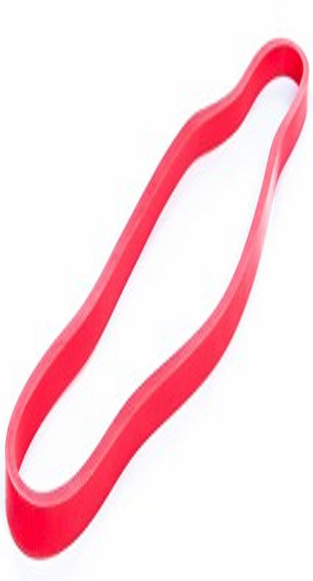
What you need:
A large glass jar – e.g. jam-jar
Some thin rubber sheet – about 3cm larger than the opening of the jar
A straw
Thick rubber band
Quick drying glue
Graph Paper
Tools
Click for Next Slide

Slide 18
Make the barometer:
Cut a circle of rubber about 2cm bigger than the lid.
Put plenty of glue all round the top of the jar to make an air-tight seal.
Put the rubber onto the jar and fold down to secure with the glue .
Clamp the rubber onto the jar with the rubber band.
Leave for 24 hours for the glue to set.
Click for Next Slide

Slide 19
Make the barometer:
Cut the straw to make a pointer
Mount the straw onto the rubber and glue it onto the rubber at the centre point
Click for Next Slide

Slide 20
How does the barometer work:
The pressure of the air in the jar is fixed because it is sealed in by the rubber
As the pressure of the air outside increases the air in the jar is compressed and the rubber will be pulled into the jar
The end of the straw will go up because it pivots on the edge of the jar
And I will go down if the outside air pressure decreases
Click for Next Slide

Slide 21
Make the graph record:
Mark the graph paper with the days of the week and morning and evening
Mark a line for the pressure today and “High” and “Low”
Mark a line for the time you recorded the pressure
Mark a line for the state of the cloud
Mark a line for the state of the sun
Mark a line for the state of the rain
Mon
AM PM
Tue
AM PM
Wed
AM PM
Thu
AM PM
Day
Now
High
Pressure
Low
Time
Cloud
Sun
Rain
Click for Next Slide

Slide 22
Record your results:
You will see the air pressure changing from day to day and morning to evening
I have used H=high, L=low, 0= no change
Also for Cloud, Sun and Rain I used V for Very, L for Light, N for None, etc.
Mon
AM PM
Tue
AM PM
Wed
AM PM
Thu
AM PM
Day
Now
High
H H H
Pressure
0
0
Low
L L L
Time
8 8 8 8 8 8 8 8
Cloud
LC C VC VC C LC LC LC
Sun
LS NS NS NS LS LS S VS
Can you see any relationship between pressure and the weather?
Rain
NR NR SR VR SR NR NR NR
Click for Next Slide

Slide 23
Well Done, Everyone
Click for Next Slide

Slide 24
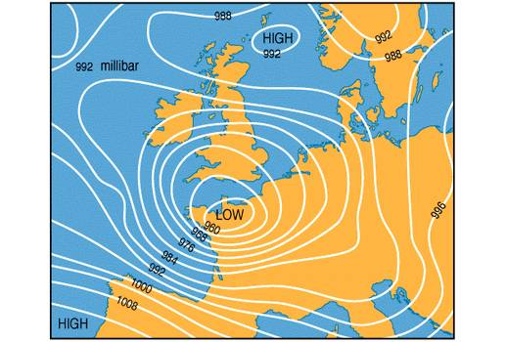
When you see a weather map such as on the television there are lines which are called Isobars.
These join points of equal atmospheric pressure.
Generally when the pressure is high the day is sunny and the night is starry.
When the pressure is low the day and night are cloudy and there is often rain.
Click for Next Slide

Slide 25
In Summer:
When the pressure is high it is sunny and warmer.
When the pressure is low it is cloudy and colder.
In Winter:
The opposite temperatures.
When the pressure is high it is sunny and colder.
When the pressure is low it is cloudy and warmer.
Why?
During the day:
The sun heats the earth’s surface.
If it is a clear day it gets hotter than when it is cloudy. More so in summer than in winter.
At night:
The heat from the earth’s surface escapes into outer space.
If it is cloudy the clouds prevent a lot of the heat from escaping, so it stays warmer.
If it is a clear night more heat escapes so it gets colder.
But in summer we get more heat from the sun during the day than we lose at night.
The opposite for winter.
Click for Next Slide

Slide 26

Click for Next Slide

