Slide 1
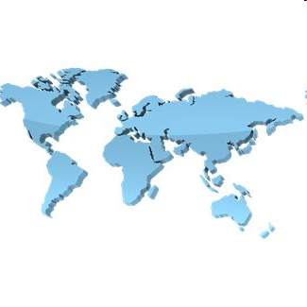
Welcome
Make an Earthquake Resistant Tower
Teacher Guide

Slide 2
Guide
This exercise introduces pupils to towers using rolled up recycled paper and then subject them to “eathquakes” to see if they still stand.
Risks
Mandatory: close supervision by a competent adult
Item | Risk | Avoidance Action
Scissors and Hole Punches | Injury | Close supervision
Aggression between participants | Injury | Close supervision and immediate action to defuse aggression

Slide 3
Teacher Guide
Timing
Introduction – about 15 minutes
Design – about 30 minutes
Make – 60-90 minutes
Test – 3 minutes per team
Scoring
Design – 20 points
Budget = 20 points
Teamwork – 20 points
Construction – 20 points
Spend v Budget -1 point per Aureus
underspend budget excluding contingency
overspend budget + contingency
Eqrthquake – 40 points reducing to zero
Innovation – 20 points
(pupil teams vote - give these points as 1st. = 20, 2nd.= 15,
3rd. = 10 points, 4tn = 5points)
Materials
Recycled paper
Scissors
Hole punches
Nuts and bolts
Sticky tape
Aureus money
Trays (e.g. from refectory) or home made earthquake
generator or board to simulate earthquake
Earthquake = teacher shakes the tray or earthquake generator
Chairs or similar for bridge version (bridge spans the chairs)
Scales
Container (e.g. milk bottle)
Dowels (e.g. 10mm dia - for rolling the paper into tubes)
Teams
Usually 4 or 5

Slide 4
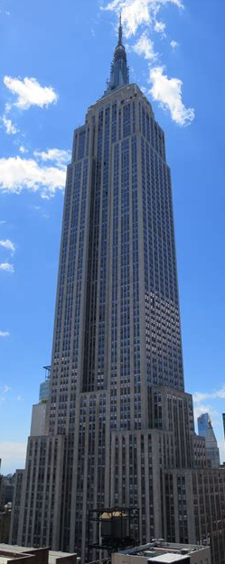
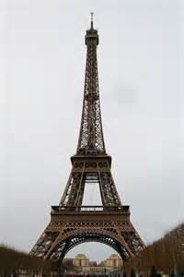
Empire State
Building
New Youk
Toronto
Tower
Eiffel
Tower
in
Paris
Shard
London

Slide 5
Paper Towers
Design, Cost, Build and Test
A Tower Made From
Recycled Paper
Test it For Earthquake Resistance
A Team Exercise

Slide 6
Paper Towers
Working in teams:
- using recycled materials
- paper
- nuts and bolts
- sticky tape
- scissors
- hole punches
You will Design, Make and Test your Tower
against Earthquakes

Slide 7
Paper Towers
Programme:
Design - 20 min.
Request funding - 10 min
Make the design - 60 min.
Demonstrate and test - 3 min. each
the product

Slide 8
Contingency needed for the things you forgot - usually 10% to 20%
You will be charged 1 point per Aureas (a type pf Roman money) for
underspending your budget excluding contingency
overspending your budget including contingency

Slide 9
Paper Towers
Teams will be judged on:
- your design 20 points
- your budget 20 points
- your product 20 points
- cost v budget -1 point per Aureus
underspend budget
overspend budget + contingency
- earthquake test 40 points
- tower height 1 point per centimetre
- innovation 20, 15, 10, 5 points
(teams vote for innovation)

Slide 10
Paper Towers
Teams will be judged on:
- your design 30 points
- your budget 20 points
- your product 20 points
- cost v budget -1 point per Aureus
underspend budget
overspend budget + contingency
- earthquake test 30 points
- tower height 1 point per centimetre
- innovation 20, 15, 10, 5 points
(teams vote for innovation)
Cost control and sound budgeting is a
vital part of engineering and technology

Slide 11
Some Ideas for Construction

Slide 12
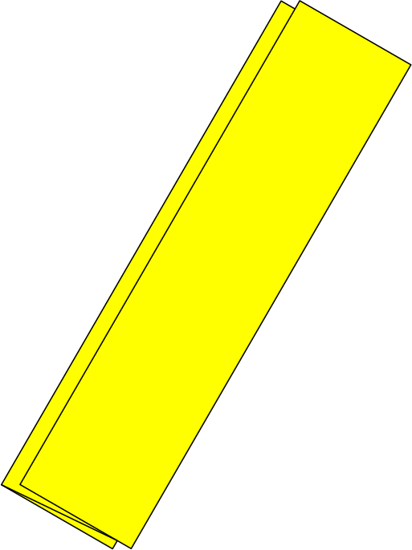
Some Ideas for Construction
Punch Holes
Folded Paper
For extra strength use more than one sheet
You may have some other ideas

Slide 13
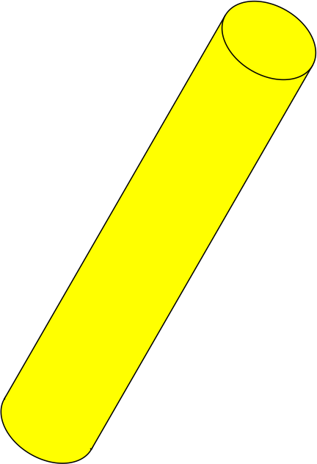
Some Ideas for Construction
Punch Holes
Tube
Roll Round a Dowel
& Stick
With Tape
Folded Paper

Slide 14
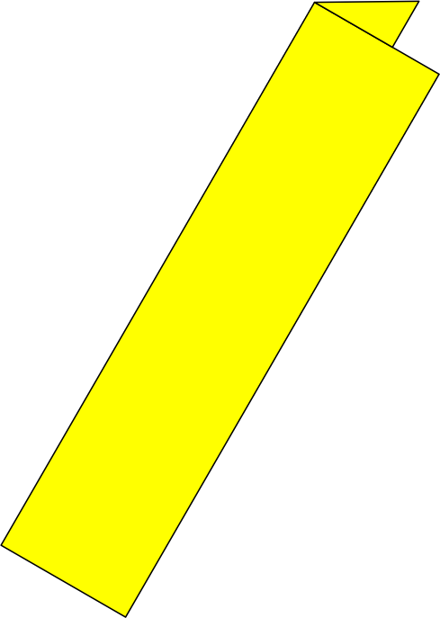
Some Ideas for Construction
Punch Holes
Tube
Roll Round a Dowel
& Stick
With Tape
Folded Paper
L-Shaped
Folded Paper
For extra strength use more than one sheet

Slide 15
Some Ideas for Construction
Punch Holes
Tube
Roll Round a Dowel
& Stick
With Tape
You may have some other ideas
Folded Paper
L-Shaped
Folded Paper
For extra strength use more than one sheet

Slide 16
Use the dowels to roll up the paper and glue the final turn
You can roll up the paper longways or widthways and also cut the roll to size
Use a hole punch to make the holes for the bolts and nuts

Slide 17
Secure with Nuts and Bolts

Slide 18
Some More Ideas

Slide 19
Another Idea

Slide 20
Use paper sheet to
make shape rigid
Secure with Nuts and Bolts

Slide 21
Some
Ideas
But You Need
To Build In
3 Dimensions!!

Slide 22
Paper Towers
Working in teams:
- using recycled materials
- paper
- nuts and bolts
- sticky tape
- scissors
- hole punches
You will Design, Make and Test your Tower
against Earthquakes

Slide 23
Paper Towers
Programme:
Design - 20 min.
Request funding - 10 min
Make the design - 60 min.
Demonstrate and test - 3 min. each
the product

Slide 24
You will be charged 1 point per Aureus for
underspending your budget excluding contingency
overspending your budget including contingency

Slide 25
Paper Towers
Teams will be judged on:
- your design 20 points
- your budget 20 points
- your product 20 points
- cost v budget -1 point per Aureus
underspend budget
overspend budget + contingency
- earthquake test 40 points
- tower height 1 point per centimetre
- innovation 20, 15, 10, 5 points
(teams vote for innovation)
Cost control and sound budgeting budgeting is a
vital part of engineering and technology

Slide 26
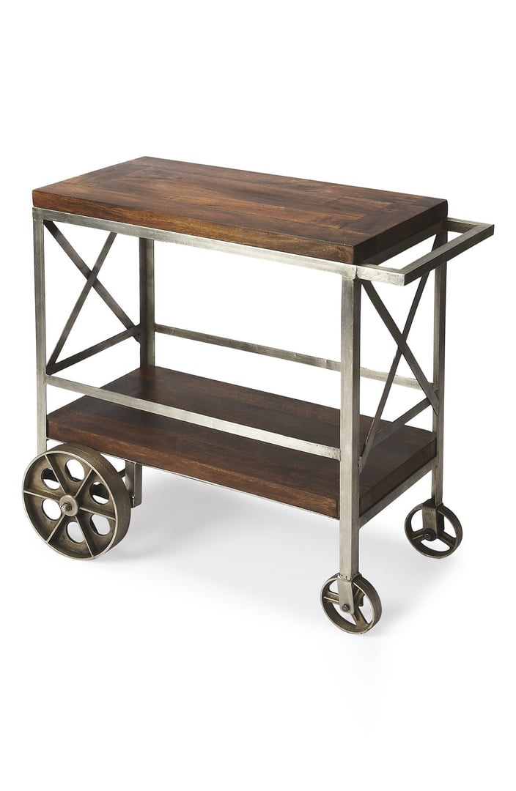
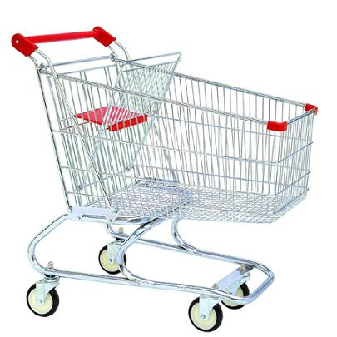
Testing
Earthquake
- no effect = 40 points
- small effect but does not collapse = 30 points
- big effect but does not collapse = 15 points
- collapse = 0 points
Earthquake
Trolley
Kitchen
Tray

Slide 27
We have learnt to:
Work and think as engineers by being innovative
Design and build with the resources available
Understand the importance of design
Understand the importance of stable structures
Understand the importance of budgets and cost control
Work as a team

Slide 28
The Winners

Slide 29
Thank You

Slide 31
Earthquake Trolley
Wooden Sheet
handles
swivel legs
Minimum 1m x 1m for Tower
2m x 50cm for Bridge
Shake back and forth and side to side
about 15cm/6in
once every 3-4 seconds
Omit earthquake test if impractical

Slide 32
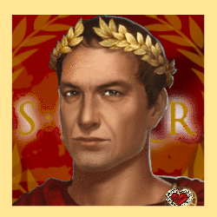
A 1
A 5
A 5
A 10
A 10
A 20

Slide 34
Score Sheet
Team
1
2
3
4
5
6
7
8
Design
Budget
Height
Construction
Earthquake
Spend v Budget
Teamwork
Innovation
Total

