Slide 1
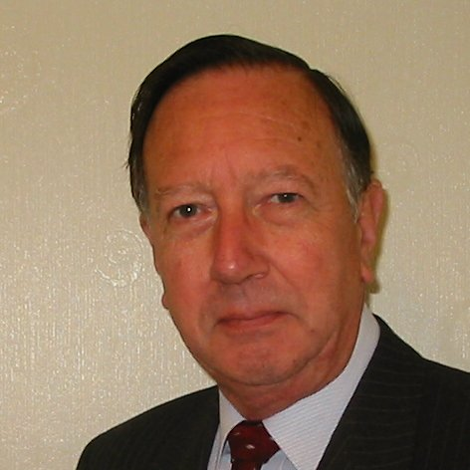
Welcome
These challenges were developed by Derrick Willer MBE and colleagues.
They are free to download and use in an education environment.
Please ensure that there is adult supervision, complete adherence to Health and Safety, and adequate PPE.
Derrick is a STEM Ambassador and volunteer STEM Ambassador.
He has supported education in schools and colleges for over 30 years, initially as a Neighbourhood Engineer in the 1980’s, leading the local Year of Engineering Success campaign in 1996 and the Campaign to Promote Engineering from 1997 to 2004.
He was awarded an MBE for services to Education in 2018.

Slide 2
Guide
This activity is for pupils to understand how energy is stored in food
Risks
Item | Risk | Avoidance Action
Bunsen Burner and Burning Food | Injury | Close supervision and immediate action to put out any fire
Hot Water | Injury | Close supervision and immediate action to cool any heat injury
Danger to Eyes | Injury | All to wear safety glasses
Allergies | Illness | Avoid
Aggression between pupils | Injury | Close supervision and immediate action to defuse aggression

Slide 3
Welcome
I very much hope that you will enjoy this fun activity to discover how food provides energy for your body

Slide 4
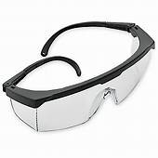

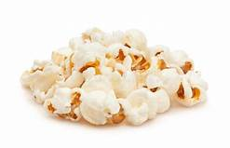
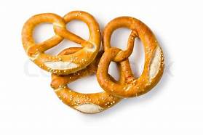
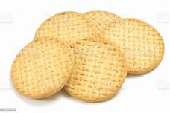
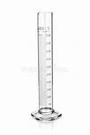

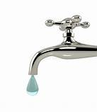

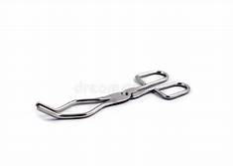
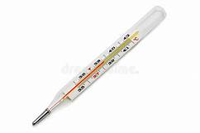
What Is Needed
Safety Glasses
Food e.g. crisps, popcorn, pretzels, biscuits
chopped into small pieces about 1cm³
Water
Measuring cylinder
Test Tube
Test Tube Clamp
Bunsen Burner
Gas
Tongs
Thermometer

Slide 5
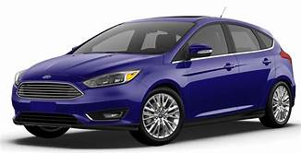
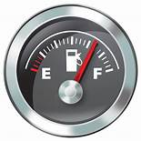
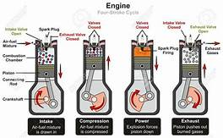
Everyone is aware that cars
burn fuel to make them move
Suck – Squeeze – Bang - Blow

Slide 6
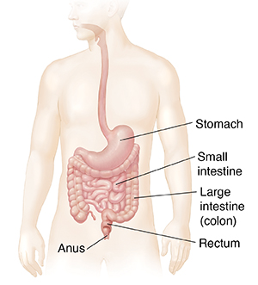
Digestion
Digestion starts in the mouth where teeth chew the food into small pieces and the saliva starts the digestion process.
Digestion continues in the stomach where acids beak down the food into a mush.
Digestion then continues in the intestines where proteins, carbohydrates and vitamins are transferred to the blood.

Slide 7
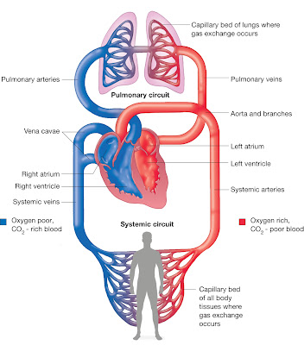
And the human body does exactly the same
We burn fuel to keep us alive and make us move
The blood takes the proteins, etc. to the parts of the body that need it.
Then the blood takes oxygen to the muscles, etc. where it is burnt with carbon to form CO₂
And the lungs expel the CO₂ and take in oxygen from the air into the blood.

Slide 8


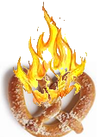

We are actually going to burn the food under the water in the test tube to see how much the temperature rises.
STOP
And
WAIT

Slide 9
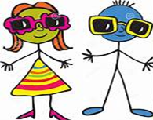
Put on the safety glasses
Fill the measuring cylinder with exactly 100ml of water
Mount the test tube onto the stand
The top must be close to the grips
Pour the water into the test tube
Measure and record the temperature of the water

Slide 10
Turn on the gas and light the Bunsen burner
Hold the sample such as the pretzel in the tongs
Set fire to the pretzel
Turn off the Bunsen burner
Place the pretzel which is on fire under the test tube
After the pretzel has burned read and record the water temperature
How much has the temperature increased?

Slide 11
Put your answers into the table of results
Food | Start Temperature | Finish Temperature | Temperature Gain
Pretzel
Crisps
Popcorn
Biscuit
You can try other foods such as white bread,
brown bread, dry meat such as ham, chocolate,
dried lettuce leaves.

Slide 12
We have leant
That food burns in air using oxygen
That we burn food inside our bodies to enable us to live
That different foods provide different amounts of energy when burnt
And therefore when we eat them we get energy

Slide 13

Thank You

Slide 16


