Slide 1

Welcome
These challenges were developed by Derrick Willer MBE and colleagues.
They are free to download and use in an education environment.
Please ensure that there is adult supervision, complete adherence to Health and Safety, and adequate PPE.
Derrick is a STEM Ambassador and volunteer Schools Liaiason Officer.
He has supported education in schools and colleges for over 30 years, initially as a Neighbourhood Engineer in the 1980’s, leading the local Year of Engineering Success campaign in 1996 and the Campaign to Promote Engineering from 1997 to 2004.
He was awarded an MBE for services to Education in 2018.

Slide 2
Guide
This exercise introduces pupils to chemistry and physics including
Fizzy chemistry
Making a thermometer
Making a magnifying glass
Bending water – static electricity
Calculating speed of the Earth
How much Oxygen in air
Mento®risckopy
Cleaning copper, etc
Gravity and acceleration
Making plastic from milk
Risks
Item | Risk | Avoidance Action
Chemicals and Water | Injury | Close supervision
Equipment and Materials | Misuse and Mistakes | Close supervision
Aggression between pupils | Injury | Close supervision and immediate action to defuse aggression

Slide 3

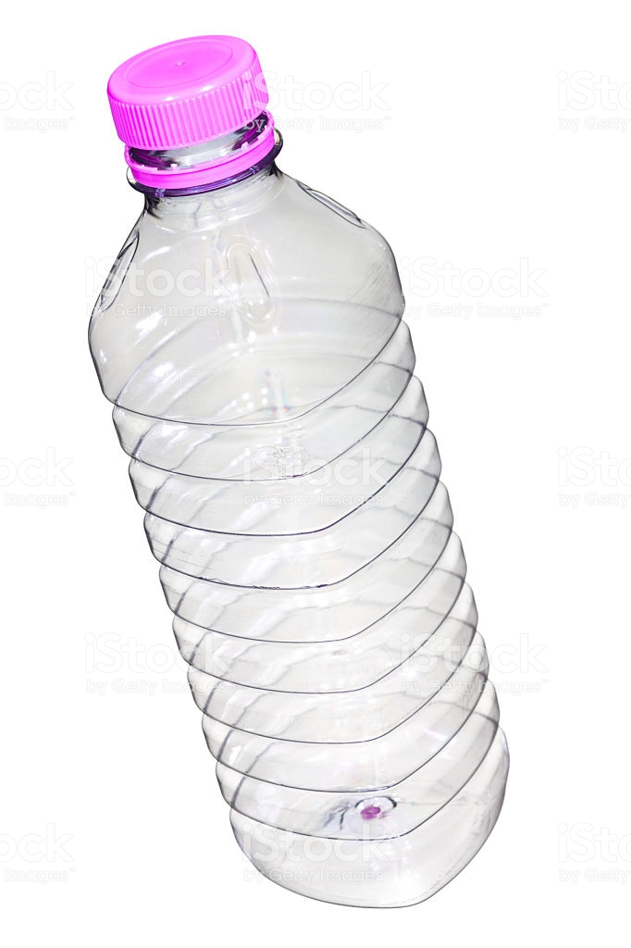
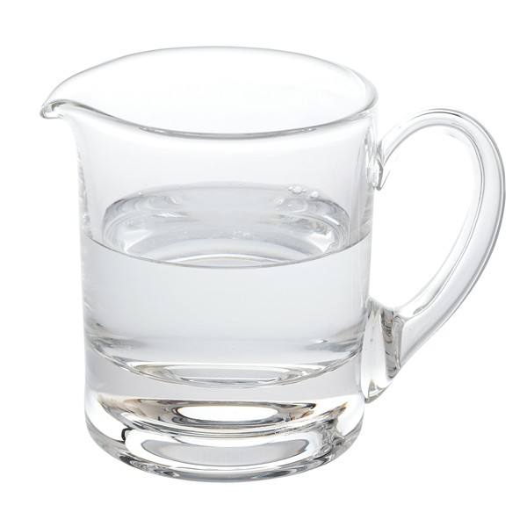
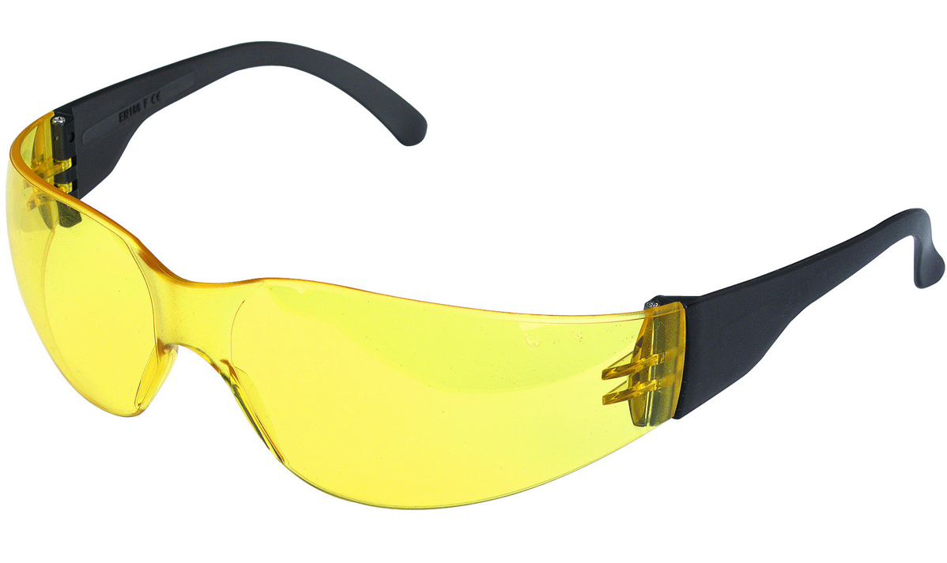
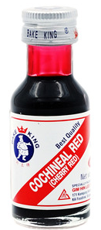
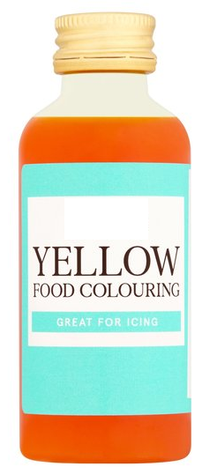
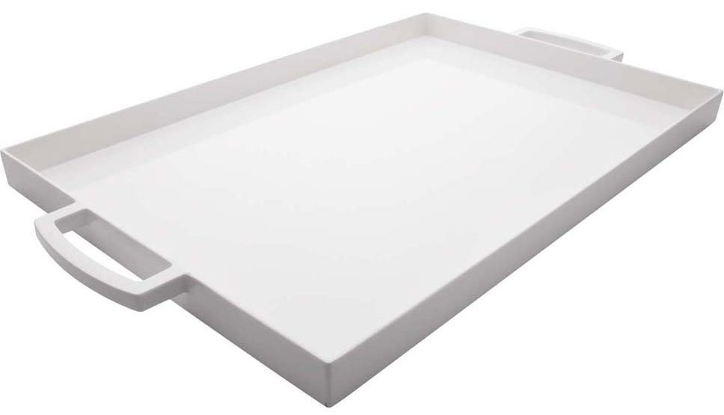
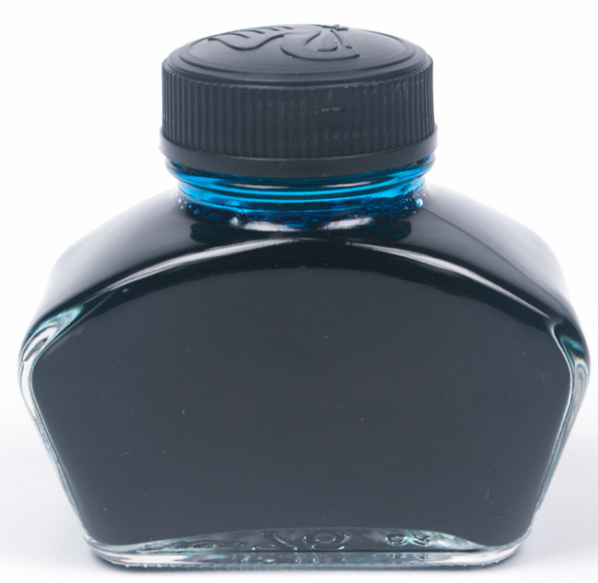
Fizzy Chemystery
1
Lets Make a Fizz
You Need:
- Safety glasses
a Plastic Bottle
Water
Baking Soda
Vinegar
Colourant (e.g. ink, cochineal)
Tray
Click for next slide

Slide 4
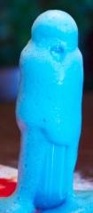
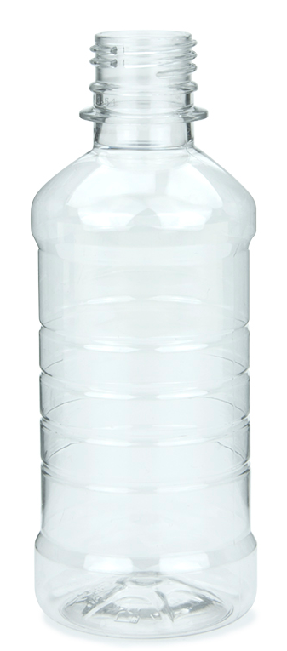
Fizzy Chemystery
Half fill the bottle with water and vinegar:
Use some colourant if you wish
Spoon in the baking soda very slowly
Cover the tray, shake the bottle and leave it standing
Watch the fizz
Lots of Fizz
Tray
Click for next slide

Slide 5
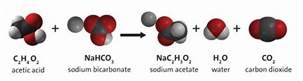
Fizzy Chemystery
Click for next slide
Why?
Baking Soda (Sodium Bicarbonate) has
a chemical formula NaHCO₃
Vinegar is CH₃COOH
Where Na is Sodium, H is Hydrogen,
C is Carbon and O is Oxygen
The reaction has the formula
NaHCO3 + CH₃COOH → CO₂ + H₂O + Na⁺ + CH₃COO
CO₂ (Carbon Dioxide) is a gas at room
temperature so it expands to create the foam
Lots of Fizz
Tray

Slide 6

Fizzy Chemystery
Well Done
Click for next slide

Slide 7
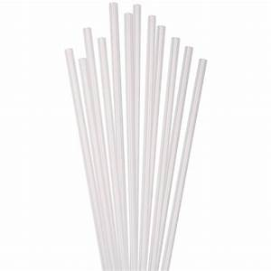
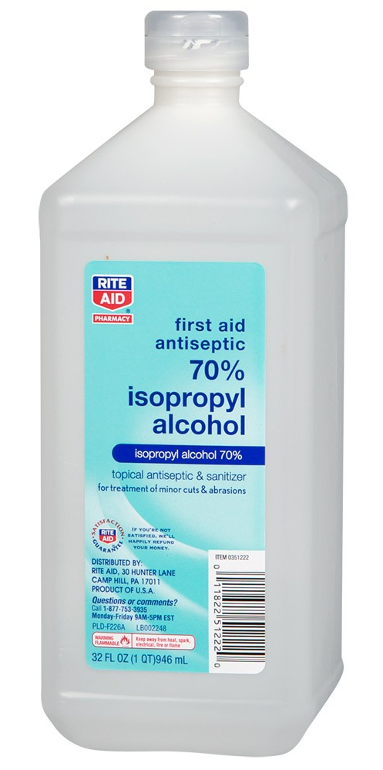
Make A Thermometer
2
You Need:
Plastic Bottle and Top
White Straw
Drill and 6mm Dia Bit
Thermometer
Water
Medical Alcohol (Optional)
Colour (e.g. ink, cochineal)
Card
Cut to
5cm x 15cm
Click for next slide

Slide 8

Make A Thermometer
Put the
alcohol in
the freezer
for 1 hour.
Drill a hole in
the bottle top.
Put the straw
through
the hole.
Using a glove. fill the bottle with
half water and half alcohol and a few drops of colour
Assemble the top with straw to the bottle
Glue the card to the straw
To the top
So you can see the colour through the bottle
Click for next slide

Slide 9
Make A Thermometer
Leave your thermometers in the room for an hour.
Check the temperature on the digital thermometer – e.g. 20^{O}C
Mark the level as 21 on the card
Leave your thermometers in a refrigerator for ten minutes
Check the temperature on the digital thermometer – e.g. 5^{O}C
Mark the level as on the card
Leave your thermometers outside for ten minutes
Check the temperature on the digital thermometer – e.g. 15^{O}C
Mark the level as on the card
20ºC
15ºC
5ºC
Click for next slide

Slide 10
Make A Thermometer
Now you have three “Calibrated” temperatures on your card.
e.g.
20ºC
15ºC
5ºC
Now judge the temperatures between the known ones and mark the card with equal spaces.
You can extend the marks above and below the marked temperatures.
20
15
10
5
Click for next slide

Slide 11
Make A Thermometer
20
You can now use your thermometer to measure different temperatures
Why not use it to record the daily temperatures at mi-day and bed-time and put them on a graph?
Perhaps you can do this throughout the year
to find out how temperatures change from
autumn, through winter and spring to summer
15
25
20
15
10
5
0
10
Mid-Day
Bedtime
5
Mon Tue Wed Thu Fri Sat Sun
Click for next slide

Slide 12
Make A Thermometer
Well Done
Click for next slide

Slide 13
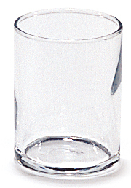
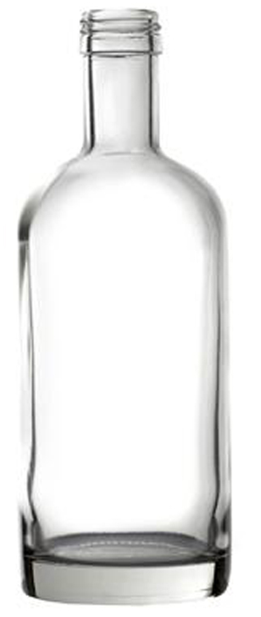
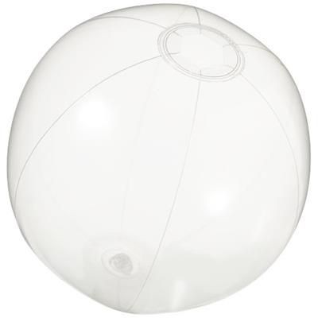
Make A Magnifying Glass
3
You Need:
A straight Sided Glass or Clear Bottle
Water
Marble – Completely clear if possible
Or a clear inflatable ball
Click for next slide

Slide 14


Make A Magnifying Glass
Fill the glass with water and look at your friend.
The face is distorted – it has been made wider
Click
Click for next slide

Slide 15

Make A Magnifying Glass
This is what has happened.
In the Horizontal where the glass is round -
The light from the mouth is bent as it enters the glass and water and bent back when it leaves.
But the net effect is to enlarge the horizontal view but the vertical view is unchanged because the glass is a cylinder and not a sphere.
Click for next slide

Slide 16
Now look through the marble
If you cannot get a clear marble
use a clear inflatable ball filled with water.
Make A Magnifying Glass
Click
Click for next slide

Slide 17

Make A Magnifying Glass
Now look through the marble and the whole face is enlarged.
This is because the marble/ball is a sphere and the magnification is all round, or universal.
Click for next slide

Slide 18
Make A Magnifying Glass
Well Done
Click for next slide

Slide 19
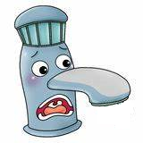
Lets Bend Some Water
4
That is not possible
But You Can Do It
Click
Here’s How
Click for next slide

Slide 20
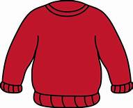
Lets Bend Some Water
Here’s How
You need
Stream of Water
Plastic Tube
Woollen Pullover
Click for next slide

Slide 21
Lets Bend Some Water
Here’s How
Turn on the tap so there is a slow continuous stream of water
Turn it off
Click
Rub the plastic on the pullover for a minute or so
Click for next slide

Slide 22
Lets Bend Some Water
Here’s How
Turn on the tap as before
Move the plastic tube towards the water
What happens?
Click
The stream of water is bent!!
Click for next slide

Slide 23
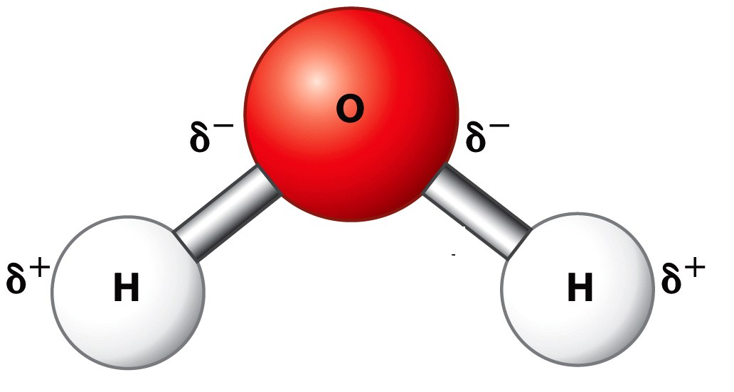
Lets Bend Some Water
Why was the water bent?
There is an electrostatic charge on the plastic tube
caused by rubbing it on the wool.
This charge is negative.
The water molecule has electric charges on each atom.
The Oxygen is negatively charged.
The Hydrogen is positively charged.
And the molecule has a shape like this.
-
-
+
+
Click for next slide

Slide 24
Lets Bend Some Water
Why was the water bent?
-
The water molecule has a shape and
electric charge like this.
So the Hydrogen atoms are attracted to the
plastic tube, and the Oxygen atoms are repelled
But the Oxygen atoms are further away so
there is slightly more force on the Hydrogen.
So the water is pulled towards the plastic tube.
+
+
-
+
-
+
Click for next slide

Slide 25
Lets Bend Some Water
Well Done
Click for next slide

Slide 26

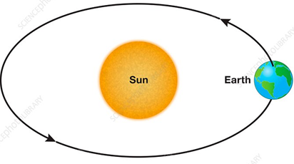
What is your speed?
5
Are you sitting comfortably?
So you would be surprised that you are actually moving!
At about 290 M per second!
And also at 29.8 Km per second!
Earth’s Rotation
Please work out these speeds !
Click for next slide

Slide 27
What is your speed?
Are you sitting comfortably?
What is the circumference of the earth?
Circumference of the earth = 40,000Km
So what speed is it rotating at?
Earth’s Rotation
Speed of rotating = 462 M/sec
But this is the speed at the equator!
What is your speed? Hint, London is at Latitude 51^{O}
Click for next slide

Slide 28
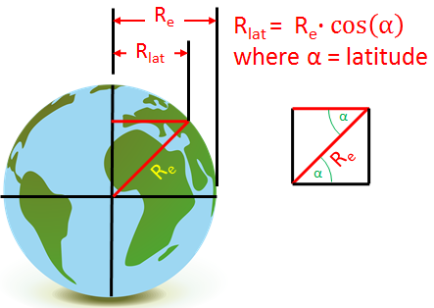
What is your speed?
Are you sitting comfortably?
Speed of rotating = 462 M/sec
But this is the speed at the equator!
What is your speed?
Hint, London is at Latitude 51^{O}
290M/sec
Earth’s Rotation
Speed of rotating at London = 290 M/sec
Because London is at Latitude 51^{O} and the formula
uses cosine. Cos 51^{O} = 0.629.
So speed = 462*0.629 = 290M/sec
Click for next slide

Slide 29
What is your speed?
29.8 Km per second
Are you sitting comfortably?
The calculation is similar except that
You need to find the distance of Earth from the Sun
And remember how many days there are in a year
(don’t forget Leap Years)
The answer should be about 29.8 Km per second

Slide 30
What is your speed?
Well Done
Click for next slide

Slide 31
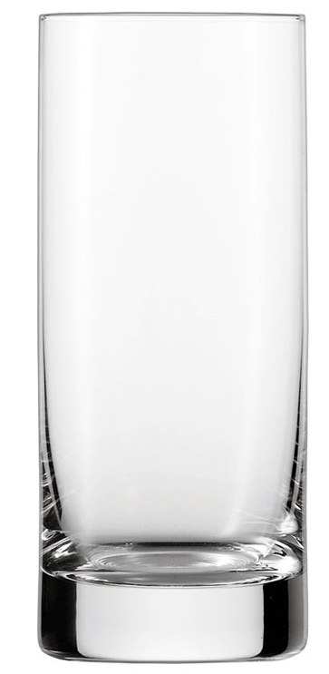
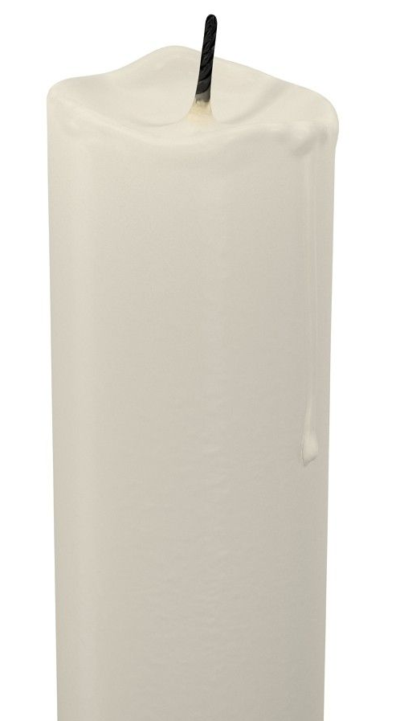
Oxygenetics
6
How much Oxygen is there in Air?
What you need:
A large glass or plastic container – e.g. large tumbler
A larger glass or plastic containers – e.g. casserole bowls
Candle
Water
Ruler
Click for next slide

Slide 32
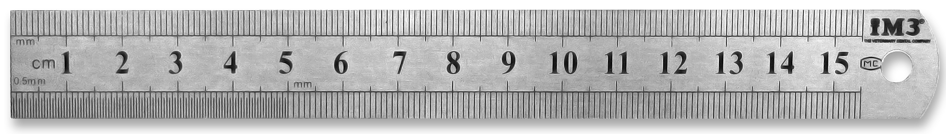

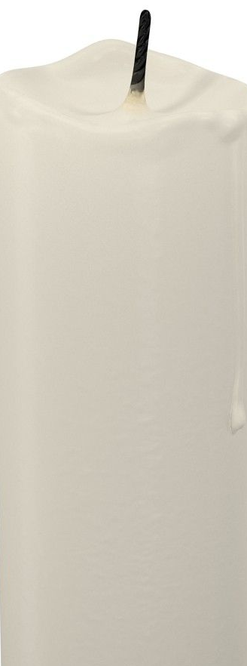
Oxygenetics
6
How much Oxygen is there in Air?
Carefully measure the inside depth of the tumbler.
Fix the candle into the centre of the bowl.
Fill the bowl half full of water
Light the candle
Hold the tumbler absolutely vertically and put the tumbler upside down onto the candle so that no water goes into the tumbler
Watch!
Click for next slide

Slide 33

Oxygenetics
6
How much Oxygen is there in Air?
The water should have risen about 21% of the inside height of the glass
because Oxygen is about 21% of the volume of air
Watch!
The water is sucked up into the glass and the candle goes out!
Carefully measure how far up the glass the water has risen.
What proportion of the inside height of the glass has the water risen?
Click for next slide

Slide 34

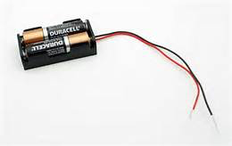

Oxygenetics
6
Now lets put the Oxygen back?
Sulphuric Acid
Adult Supervision Mandatory
What you need:
In addition to what you already have
A battery holder and two 1.5V batteries
Insulated wire with crocodile clips
Dilute sulphuric acid (maximum 10% acid)
Click for next slide

Slide 35

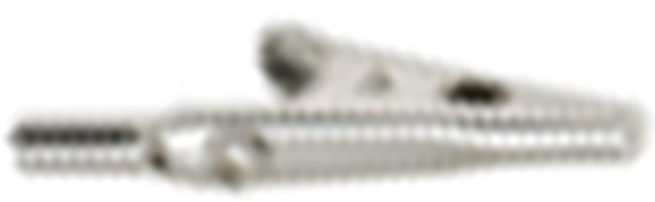
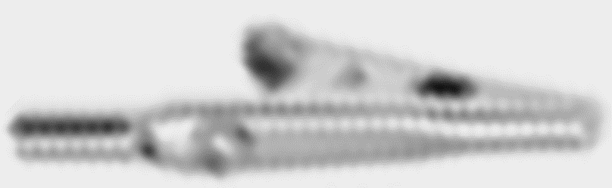
Oxygenetics
Now lets put the Oxygen back?
Create the circuit with one crocodile clip outside the tumbler and one inside:
Put about 5cc (teaspoon) of dilute sulphuric acid into the water.
Do not connect this one yet
Click for next slide
Anode
Batteries
Cathode

Slide 36
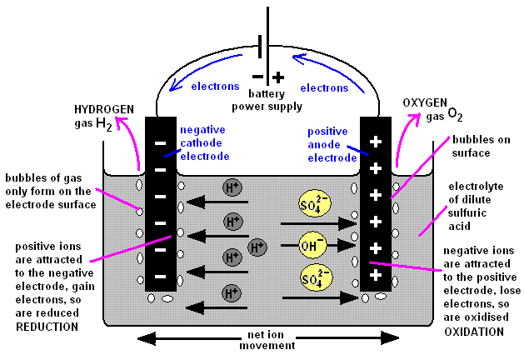
Oxygenetics
Now lets put the Oxygen back?
When you pass an electric current through water with sulphuric acid in it the current causes the atoms of sulphuric acid to split into ions (H₂, SO₄ and OH) and move to the anode and cathode.
Sulphuric Acid
Adult Supervision Mandatory
The sulphuric acid ions are Hydrogen (H⁺) which goes to the Cathode (Negative) and SO₄⁻ goes to the Anode (Positive) where it reacts with the hydrogen in the water (changing back to H₂SO₄) and releasing the Oxygen
Also the water divides into Hydrogen (H⁺) which goes to the Cathode (Negative) and HO⁻ which goes to the Anode (Positive)
Click for next slide

Slide 37
Oxygenetics
Now lets put the Oxygen back?
With the circuit in place but disconnected
Repeat the original experiment
When it has finished
Connect the circuit
Watch the water drop as the oxygen is replaced
Anode
Batteries
Cathode
Click for next slide

Slide 38
Oxygenetics
Well Done
Click for next slide

Slide 39
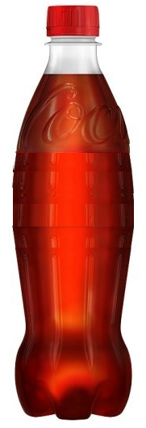
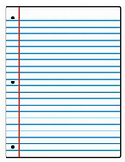
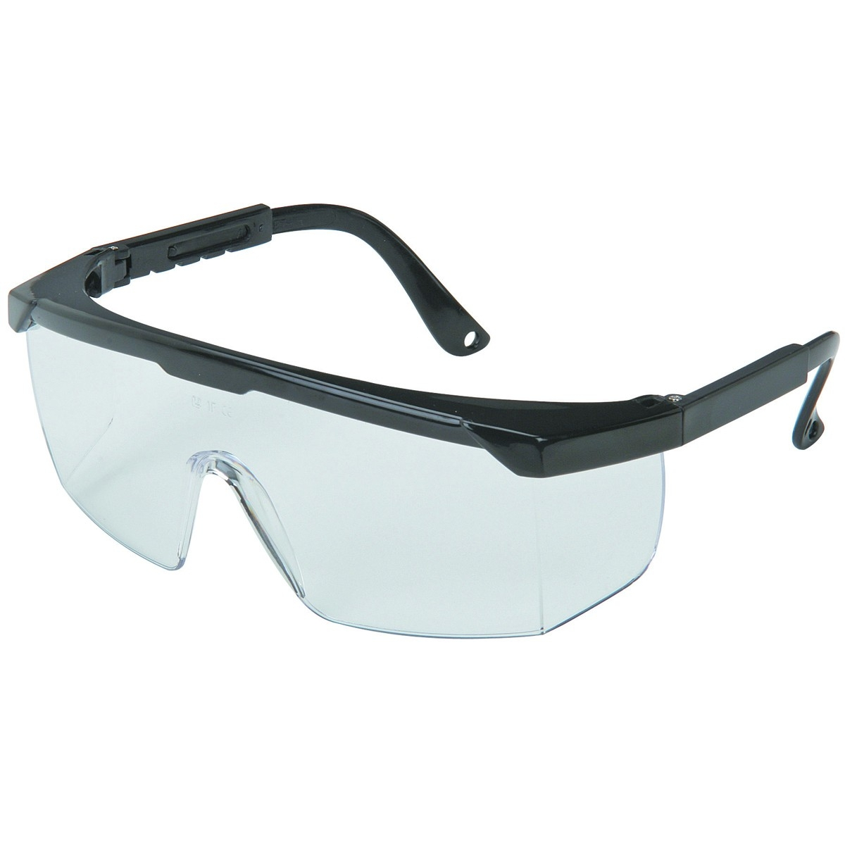
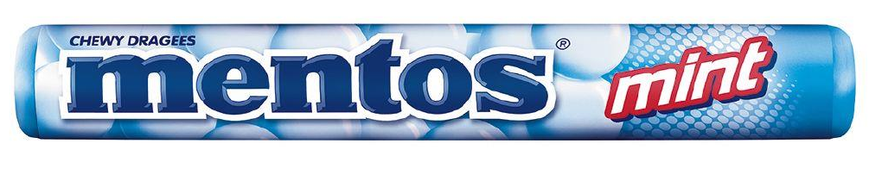
Mento®risckopy
7
What happens when you mix Mentos® and Coke?
What you need:
A tube of Mentos®
A bottle of coke
Paper
Safety glasses
Click for next slide

Slide 40


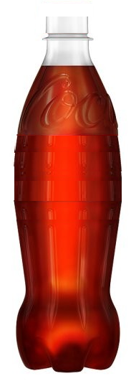
Mento®risckopy
What happens when you mix Mentos® and Coke?
Firstly find a clear open space at least 3m x 3m
Roll up some paper into a tube and seal one end
Crush the Mentos® and put into the paper tube
Fix the bottle upright firmly in the ground and remove the cap
Put on the safety glasses
Get ready to move away quickly
Pour the Mentos® into the bottle, move away and watch
Click for next slide

Slide 41
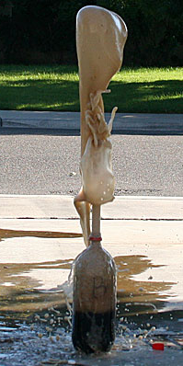
Mento®risckopy
What happens when you mix Mentos® and Coke?
So what is happening?
Physics or Chemistry or both?
Click for next slide

Slide 42
Mento®risckopy
What happens when you mix Mentos® and Coke?
So what is happening? Physics or Chemistry or both?
Just Physics
Coke has Carbon Dioxide (CO₂) gas in solution.
If you shake the bottle you can see it bubbling up and out of the bottle
If some CO₂ comes into contact with an impurity it will cause it to bubble out of the bottle
So if you put lots of crushed Mentos® they are impurities and will all help to increase the effect may times
Click for next slide

Slide 43
Mento®risckopy
Well Done
Click for next slide

Slide 44
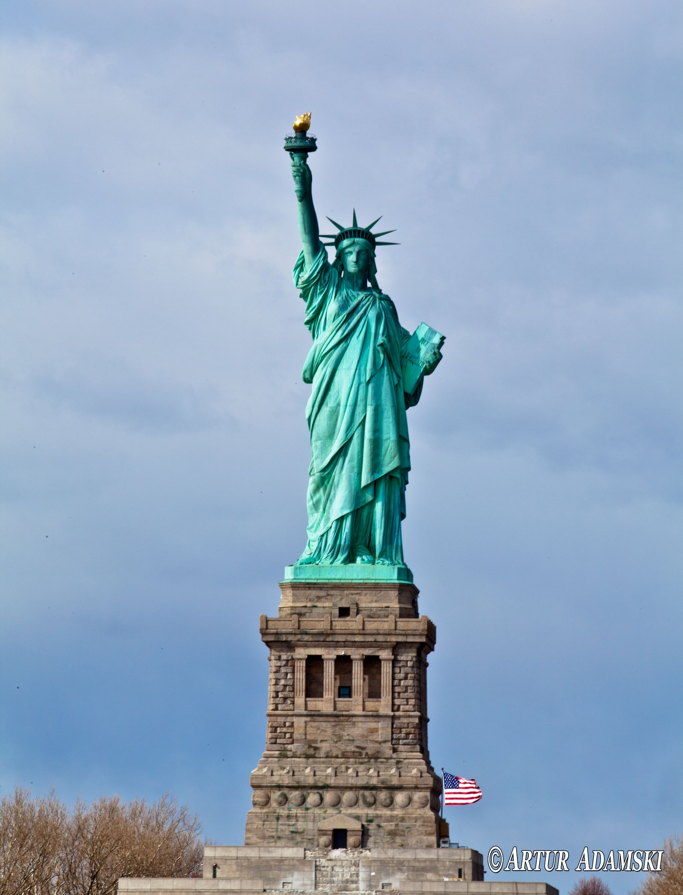
Chemystery Takes A Liberty
8
Why is the Statue of Liberty blue-green in colour?
Because it is clad in copper and the copper discolours because of the sea water, the oxygen in the air and the acids in the air
How does that happen?
We can make it happen with some copper coins
Click for next slide

Slide 45
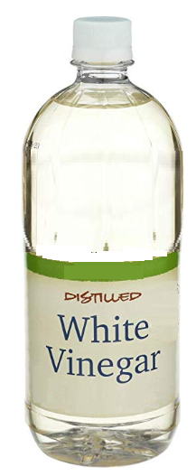
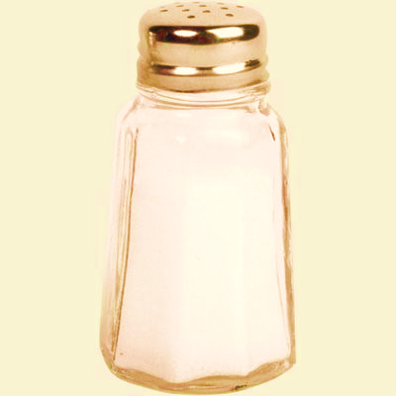
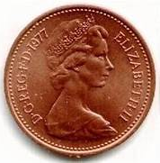
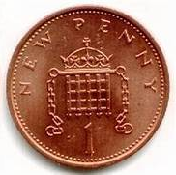
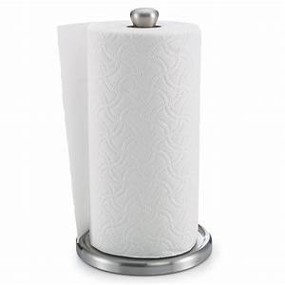
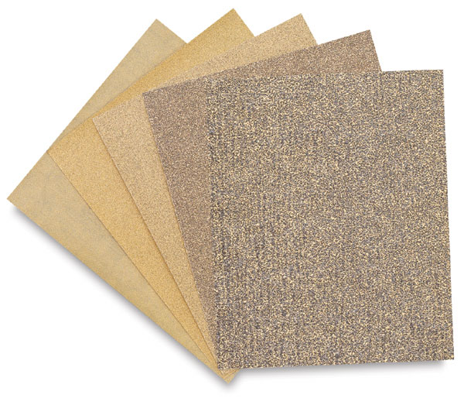
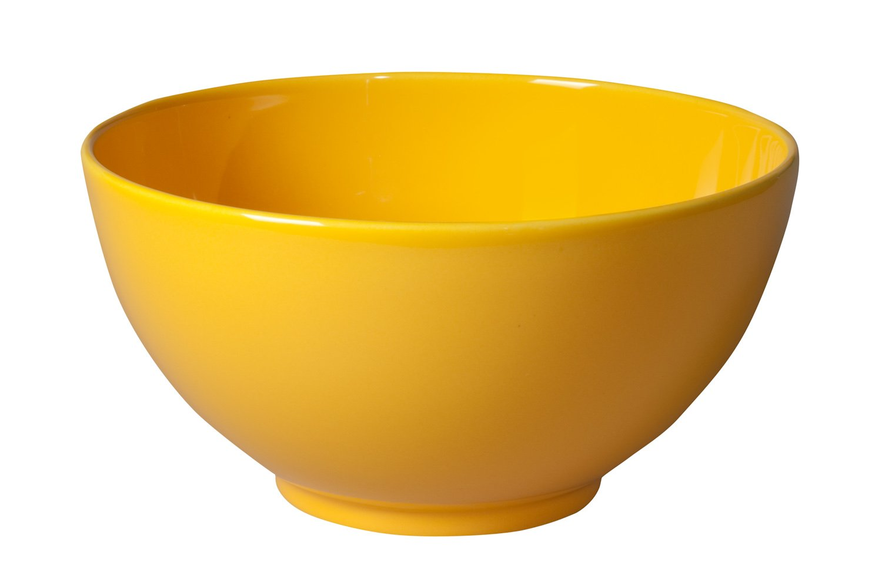
Chemystery Takes A Liberty
What you need
Vinegar (CH₃COOH)
Salt (NaCl)
Copper (Cu) – use 6 or 8 copper coins
A bowl
Kitchen towel
Sandpaper
Click for next slide

Slide 46
Chemystery Takes A Liberty
What you should do:
Clean the copper coins with detergent and scrubbing brush
Rough the surface with the sandpaper
Mix the vinegar and salt in a bowl
Put the coins in the bath
Wait for at least an hour
Click for next slide

Slide 47
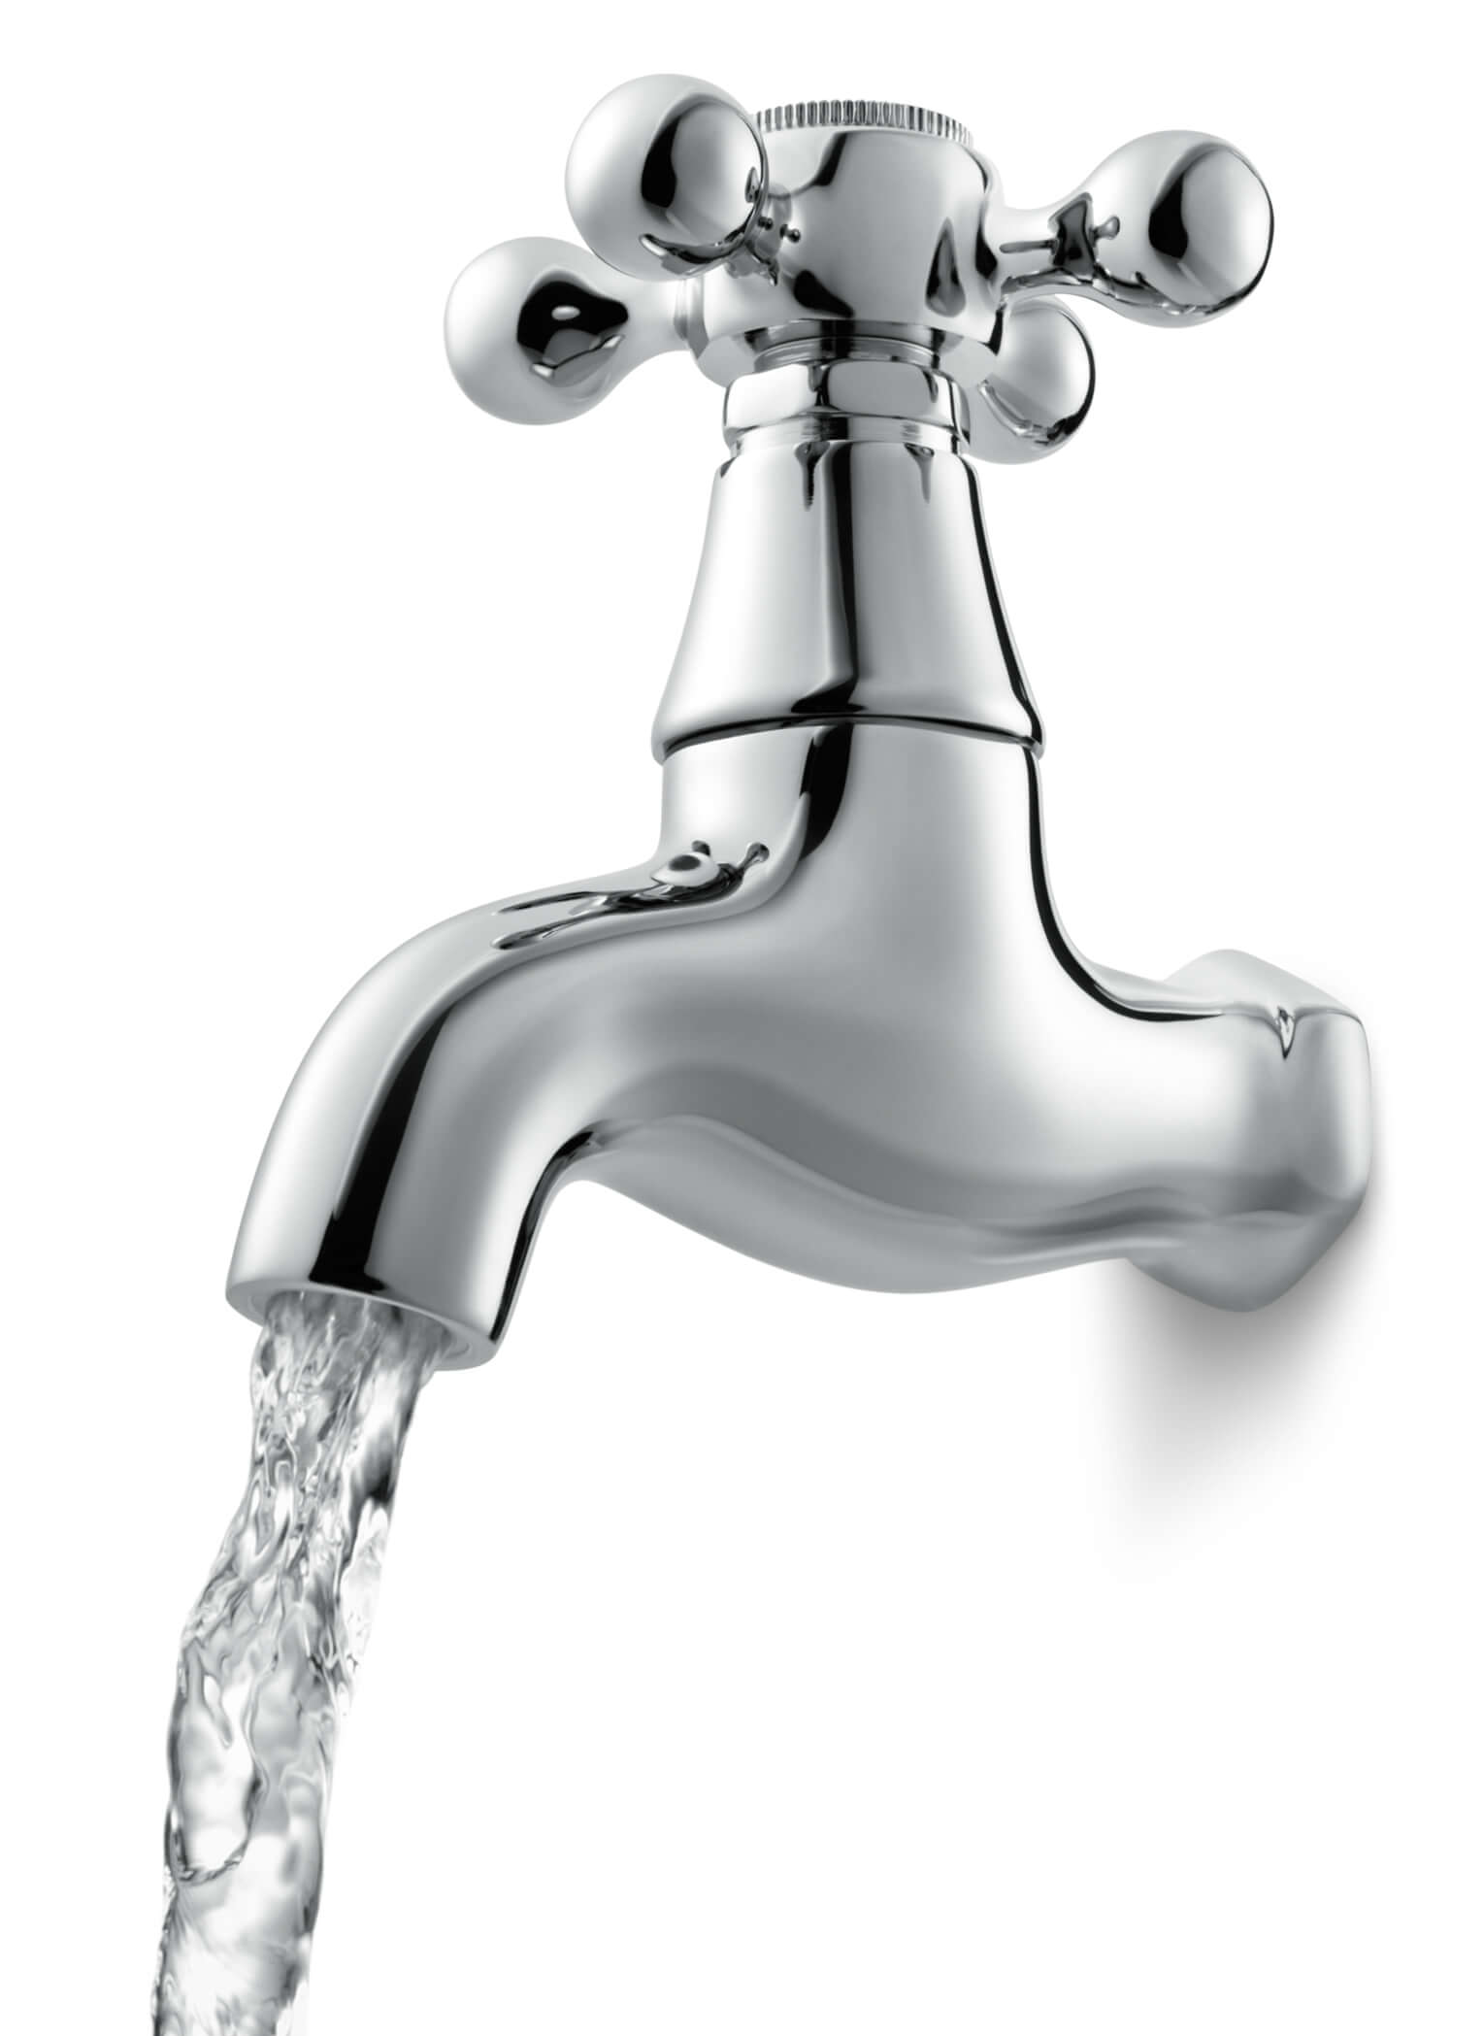
Chemystery Takes A Liberty
What you should do:
Wait for at least an hour
Mark one sheet of the paper towel as Clean and one as Contaminated
Remove the coins – do not dry them
Rinse half the coins in water and put onto the Clean towel
Put the others onto the Contaminated towel
Wait for at least an hour
What has happened to the coins?
Clean
Contaminated
Click for next slide

Slide 48
Chemystery Takes A Liberty
What happened:
Clean
The contaminated coins are showing blue-green spots
Explanation
Vinegar is CH₃COOH, Salt is NaCl, Copper is Cu
When the coins were in the salt and vinegar solution the copper was ionised as were the salt and vinegar
The formula is:
3(CH3COO⁻) + 3H⁺ + 2OH⁻ + Na⁺ + Cl⁻ + Cu⁺2
The + and - indicate the charge (positive and negative)
Explanation
Then the contaminated coins were then put out in the air when the Oxygen in the air reacted with the vinegar and copper
The reaction turned the Copper into Copper Carbonate which is blue-green in colour
2CH3COO + 4O2 + 4Cu = 4CuCO3 + 3H2
Contaminated
Click for next slide

Slide 49
Chemystery Takes A Liberty
Well Done
Click for next slide

Slide 50
Sum Acceleration
9
Calculate the acceleration due to Acceleration by rolling a ball down a slope
4m
25cm
4.5m
Click for next slide

Slide 51
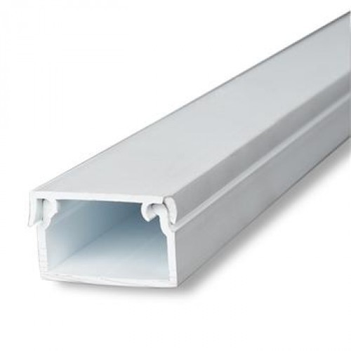
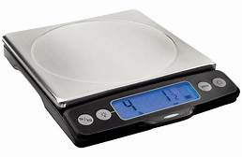
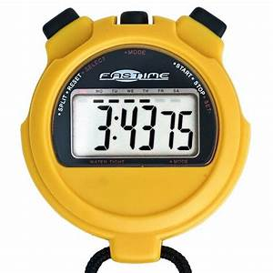
Sum Acceleration
9
Calculate the acceleration due to Accelleration by rolling a ball down a slope
What you need:
A slope OF OVER 4m that will keep the ball from falling sideways – e.g. plastic electrical trunking with top removed
A table tennis ball
Weigh-scales
Stopwatch with 100^{ths} of a second
4m
25cm
α
4.5m
Click for next slide

Slide 52
Sum Acceleration
8
Mark a Zero point and the 4m point on the slope
Set up the slope so that it is 25cm high and 4m long.
The angle α will be about 3.6^{O}
Zero
4m
25cm
α
4.5m
Click for next slide

Slide 53
Sum Acceleration
8
Do this ten times and average your results
This helps to minimise errors
Place the ball at the zero mark and a second person goes to the 4m mark with the stopwatch
Coordinate the start by calling “3, 2, 1, GO” . Release the ball and start the timer
Stop the timer when the ball reaches the 4M marks
Zero
4m
25cm
α
4.5m
Click for next slide

Slide 54
Sum Acceleration
8
Ref. | Time(sec)
1 | 3.5
2 | 3.7
3 | 3.6
4 | 3.6
5 | 3.5
6 | 3.6
7 | 3.7
8 | 3.7
9 | 3.5
10 | 3.6
Total | 36
Average | 3.6
The formula for Acceleration and distance is
d= ½at² where d is distance, a is acceleration
and t is time
Using my results opposite the Acceleration is
a = 2d/(t²) = (2 x 4) / (3.6 x 3.6) = 0.61m/sec²
Click for next slide

Slide 55
Sum Acceleration
8
a = 2d/(t²) = (2 x 4) / (3.6 x 3.6) = 0.61m/sec²
Actually, on Earth
g = 9.80665 m/sec²
So we have a close result
But the Acceleration is due to Gravity
And the slope is at an angle α
So the force acting on the ball is g sin α – see diagram
Sin α is the ratio of Opposite (O) side divided by the Hypotenuse (H) = 0.25m / 4m = 1/16
O
g sin α
g cos α
g
H
α
So Gravity g = 16 x a = 16 x 0.61 = 9.76m/sec²
Click for next slide

Slide 56
Oxygenetics
Well Done
Click for next slide

Slide 57
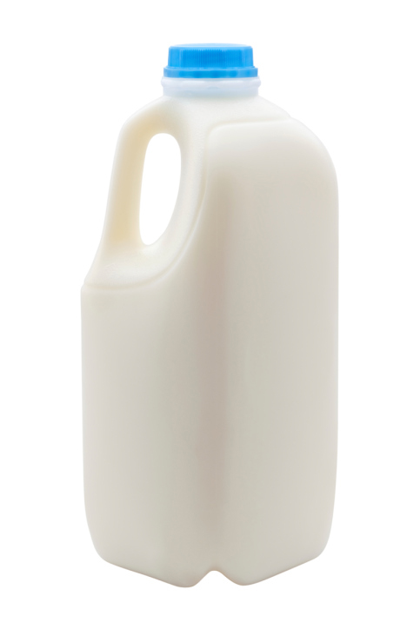
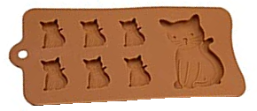
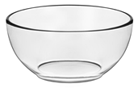
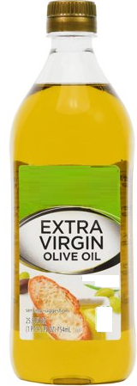








Plastic Milk
10
How to make plastic from milk!!
What you need:
Milk
Vinegar
Two glass bowls
Kitchen towels
Olive Oil
Clingfilm
Fun Moulds
Click for next slide

Slide 58
Plastic Milk
10
How to make plastic from milk!!
1. Heat one cup of milk in the glass bowl.
Heat on 50% power for 5 min.
The milk should be at hot chocolate
temperature.
If the milk is not hot enough after 5 min,
repeat heating in 2 min intervals until
ready.
Add 4 tablespoons of vinegar to the mug.
Carefully add the hot milk to mug and begin stirring.
Curds will begin to form immediately.
Click for next slide

Slide 59
Plastic Milk
10
How to make plastic from milk!!
3. Layer paper towels, 5 to 6 sheets thick,
upon a surface that may become damp.
5. Begin kneading and moulding the
plastic into various shapes and figures
in your moulds.
4. Spoon the curds from the bowl, while
draining the excess liquid in the sink.
Press additional paper towels on the
curds to remove liquid. This is now
Casein Plastic.
6. The plastic will need to sit for 48 hours
until fully hard and dry.
Click for next slide

Slide 60
Plastic Milk
10
How to make plastic from milk!!
How It Works:
Plastics are all similar, containing molecules that are repeated over and over again into a chain called polymers.
Milk contains molecules of a protein called Casein.
When milk is added to an acid, such as vinegar, the pH of the milk changes.
The pH change causes the Casein molecules to unfold and reorganize into long chains, curdling the milk.
The curds can then be kneaded and moulded as Casein Plastic.
Fun Facts:
Casein plastic is commonly used to make fountain pens!
Casein plastic is extremely environmentally friendly,
because it will decompose over time, unlike plastics
made from petroleum products.
Companies are beginning to research and develop ways
to manufacture plastic from renewable resources, such
as plants.
Casein plastic was first manufactured in London in 1900.
It was used to make jewellery and buttons.
Click for next slide

Slide 61
Plastic Milk
Well Done
Click for next slide

