Slide 1

Welcome
These challenges were developed by Derrick Willer MBE and colleagues.
They are free to download and use in an education environment.
Please ensure that there is adult supervision, complete adherence to Health and Safety, and adequate PPE.
Derrick is a STEM Ambassador and volunteer Liaison Officer for Schools.
He has supported education in schools and colleges for over 30 years, initially as a Neighbourhood Engineer in the 1980’s, leading the local Year of Engineering Success campaign in 1996 and the Campaign to Promote Engineering from 1997 to 2004.
He was awarded an MBE for services to Education in 2018.

Slide 2
Guide
This exercise introduces pupils to levers and pulleys.
They discover the mechanical advantage of levers and then pulleys.
Risks
Mandatory: close supervision by a competent adult
Item | Risk | Avoidance Action
Clamps | Injury | Close supervision
Components | Misuse and Mistakes | Close supervision
Aggression between those present | Injury | Close supervision and immediate action to defuse aggression

Slide 3
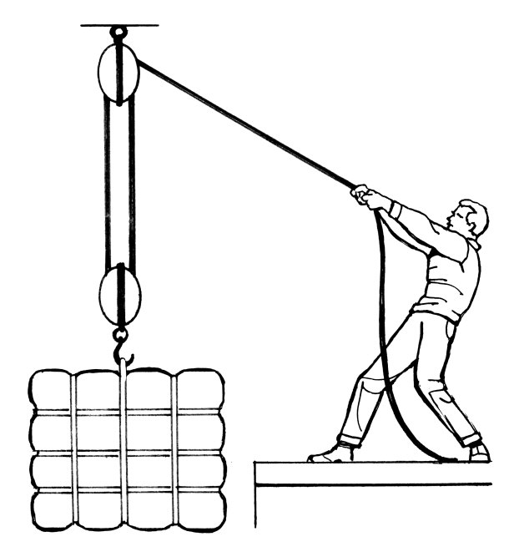
An Exercise With Levers and Pulleys
to find Mechanical Advantage

Slide 4
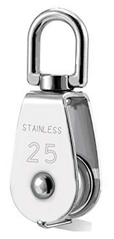

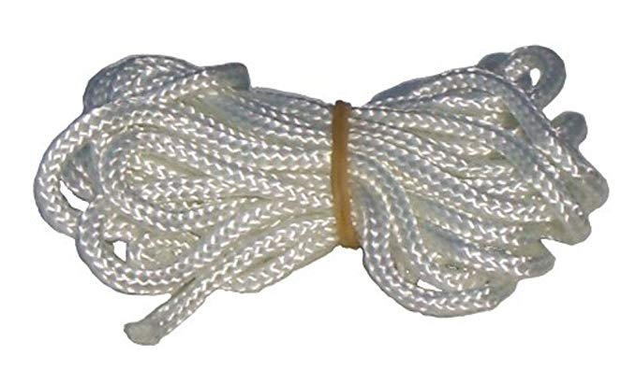
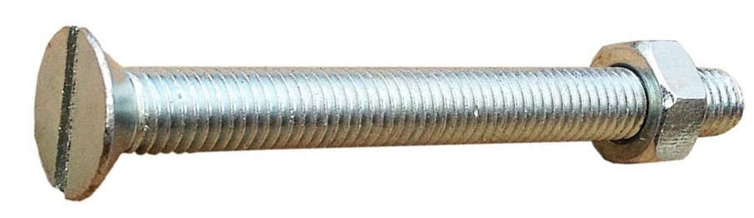
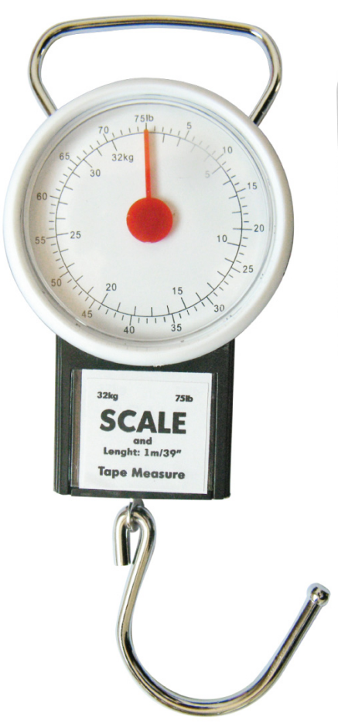
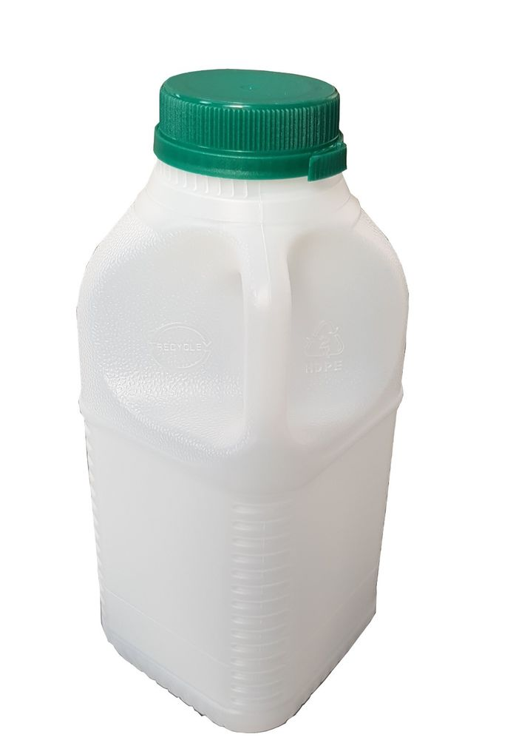
You need for
each kit:
45cm Minimum, 11 holes equally spaced, each 1cm dia
Wood or Steel Bar with
11 holes
Dowel
3cm long, 0.5cm dia
FourPulleys
One Bench Clamp
Strong Chord
3 to 4M
Wooden Mount
For the Bar
1cm dia hole
with nut & bolt
Luggage Scales
Heavy Weights
1Kg, 2Kg, etc
also filled bottles
Knotted String
15cm

Slide 5
Levers
Using the bar, clamp, chord, scales and a table

Slide 6
Load the bar onto a table and secure it with the clamps
Wood/Steel Bar
Mount
Hole Number
0 1 2 3 4 5 6 7 8 9 10
Clamp
It should overhang the table
Table

Slide 7
Knotted String
0 1 2 3 4 6 7 8 9 10
Find the weight of the Bar
Record This
Hole Number |  | 1 | 2 | 3 | 4 | 5 | 6 | 7 | 8 | 9 | 10
Weight | 700 grams
Mechanical Advantage

Slide 8
Knotted String
Hole Number |  | 1 | 2 | 3 | 4 | 5 | 6 | 7 | 8 | 9 | 10
Weight | 1000 grams
Mechanical Advantage
Weigh the weight
Record the Weight

Slide 9
0 1 2 3 4 6 7 8 9 10
Knotted String
Using Chord Load the Weight to Hole 5 in the
Middle of the Bar
And Weigh It
Record the Weight
Hole Number |  | 1 | 2 | 3 | 4 | 5 | 6 | 7 | 8 | 9 | 10
Weight | 1700 grams
Mechanical Advantage

Slide 10
0 2 3 4 5 6 7 8 9 10
Using Chord Load the Weight to Each Hole
In Turn
And Weigh It
Record the Weight
Hole Number |  | 1 | 2 | 3 | 4 | 5 | 6 | 7 | 8 | 9 | 10
Weight | 1700 grams |  |  |  |  | 1700 grams
Mechanical Advantage |  |  |  |  |  | 1

Slide 11
0 2 3 4 5 6 7 8 9
Calculate the
Mechanical Advantage
By Dividing the Weight in Hole 1 by the Weight in Hole 5
And so forth for each hole
Hole Number |  | 1 | 2 | 3 | 4 | 5 | 6 | 7 | 8 | 9 | 10
Weight | 1000 grams | 8500 | 4250 | 2833.333 | 2125 | 1700 | 1416.667 | 1214.286 | 1062.5 | 944.4444 | 850
Mechanical Advantage

Slide 12
0 2 3 4 5 6 7 8 9
Calculate the
Mechanical Advantage
By Dividing the Weight in Hole 1 by the Weight in Hole 5
Hole Number |  | 1 | 2 | 3 | 4 | 5 | 6 | 7 | 8 | 9 | 10
Weight | 1000 grams | 8500 | 4250 | 2833 | 2125 | 1700 | 1417 | 1214 | 1062 | 944 | 850
Mechanical Advantage |  | 0.2 | 0.4 | 0.6 | 0.8 | 1 | 1.2 | 1.4 | 1.6 | 1.8 | 2

Slide 13
You should find that these are also the ratio of the hole numbers
Hole 1 = 1/5 = 0.20
0 2 3 4 5 6 7 8 9
Calculate the
Mechanical Advantage
By Dividing the Weight in Hole 1 by the Weight in Hole 5
Hole Number |  | 1 | 2 | 3 | 4 | 5 | 6 | 7 | 8 | 9 | 10
Weight | 1000 grams | 8500 | 4250 | 2833 | 2125 | 1700 | 1417 | 1214 | 1062 | 944 | 850
Mechanical Advantage |  | 0.2 | 0.4 | 0.6 | 0.8 | 1 | 1.2 | 1.4 | 1.6 | 1.8 | 2

Slide 14
0 1 2 3 4 6 7 8 9 10
You can do this again when the
weight is in different holes

Slide 15

Well Done

Slide 16
Now for Pulleys

Slide 17
Now for Pulleys
First pass the knotted string through the pulleys

Slide 18
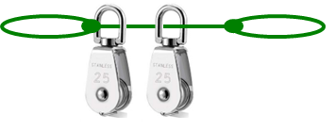

Pulleys
Bar, Mount, Clamp, 4 Pulleys, Chord, and Table

Slide 19


Make the Crane Like this
Use one Pulley
at first
Use the dowel to fix the loops together

Slide 20
Weigh the Weight
Record the weight
No Of Pulleys
Weight of Load (grams) | 1000
Weight of Pulleys Attached to Load
Total Weight of Load and Pulleys Attached to Load | 1000
No Of Vertical Pulley Connections | N/A
Measured Load
Mechanical Advantage

Slide 21
Weigh the Pulley
Record the weight
No Of Pulleys
Weight of Load (grams) | 1000
Weight of Pulleys Attached to Load | 250
Total Weight of Load and Pulleys Attached to Load | 1000
No Of Vertical Pulley Connections | N/A
Measured Load
Mechanical Advantage

Slide 22
Using one pulley
Record the weight and the
mechanical advantage
No Of Pulleys |  | 1
Weight of Load (grams) | 1000 | 1000
Weight of Pulleys Attached to Load | 250 | 0
Total Weight of Load and Pulleys Attached to Load | 1000 | 1000
No Of Vertical Pulley Connections | N/A | 1
Measured Load |  | 1000
Mechanical Advantage |  | 1
Use one Pulley
at first
About
30cm

Slide 23
Using two pulleys
Record the weight and the
mechanical advantage
No Of Pulleys |  | 1 | 2
Weight of Load (grams) | 1000 | 1000 | 1000
Weight of Pulleys Attached to Load | 250 | 0 | 250
Total Weight of Load and Pulleys Attached to Load | 1000 | 1000 | 1250
No Of Vertical Pulley Connections | N/A | 1 | 2
Measured Load |  | 1000 | 625
Mechanical Advantage |  | 1 | 2

Slide 24

Using three pulleys
Record the weight and the
mechanical advantage
No Of Pulleys |  | 1 | 2 | 3
Weight of Load (grams) | 1000 | 1000 | 1000 | 1000
Weight of Pulleys Attached to Load | 250 | 0 | 250 | 500
Total Weight of Load and Pulleys Attached to Load | 1000 | 1000 | 1250 | 1500
No Of Vertical Pulley Connections | N/A | 1 | 2 | 3
Measured Load |  | 1000 | 625 | 500
Mechanical Advantage |  | 1 | 2 | 3

Slide 25
Using four pulleys
Record the weights and n
mechanical advantage
No Of Pulleys |  | 1 | 2 | 3 | 4
Weight of Load (grams) | 1000 | 1000 | 1000 | 1000 | 1000
Weight of Pulleys Attached to Load | 250 | 0 | 250 | 500 | 500
Total Weight of Load and Pulleys Attached to Load | 1000 | 1000 | 1250 | 1500 | 1500
No Of Vertical Pulley Connections | N/A | 1 | 2 | 3 | 4
Measured Load |  | 1000 | 625 | 500 | 325
Mechanical Advantage |  | 1 | 2 | 3 | 4

Slide 26
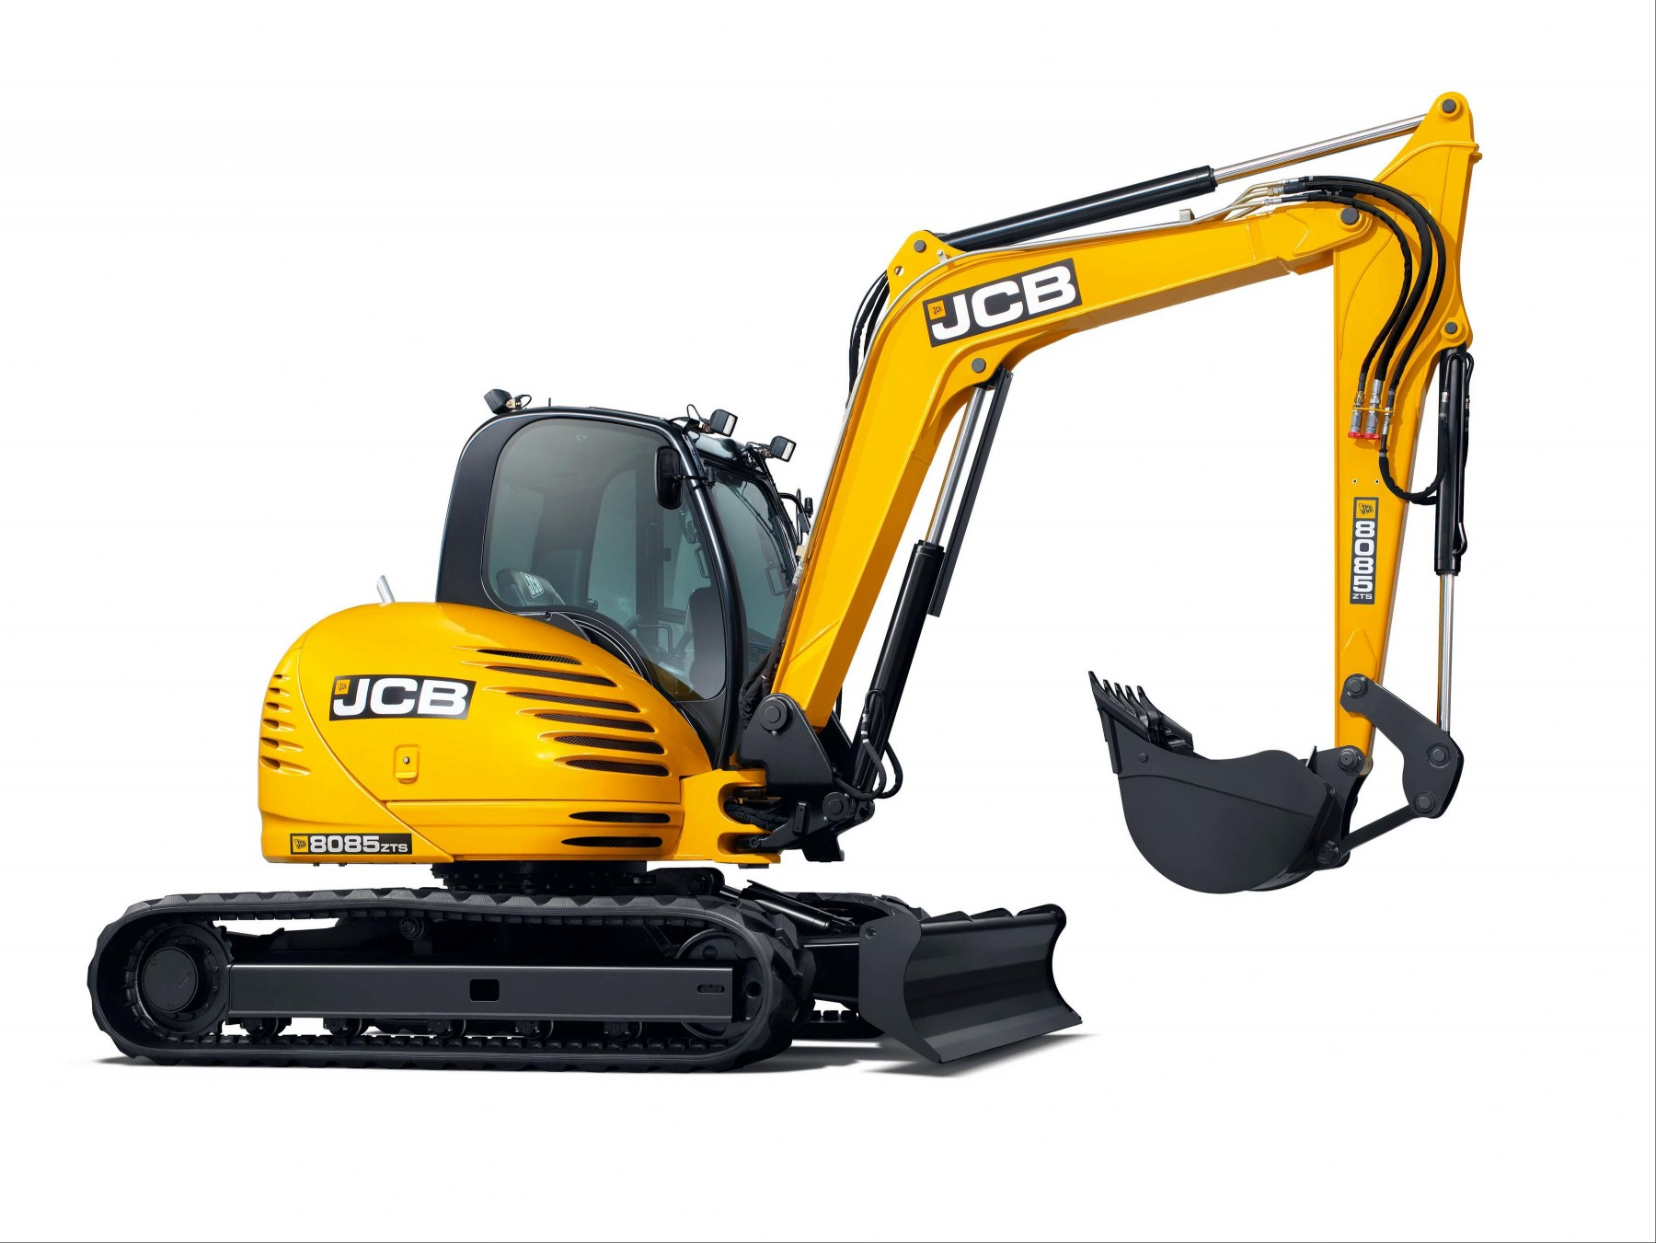
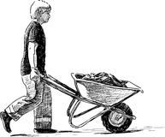
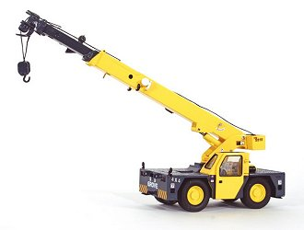
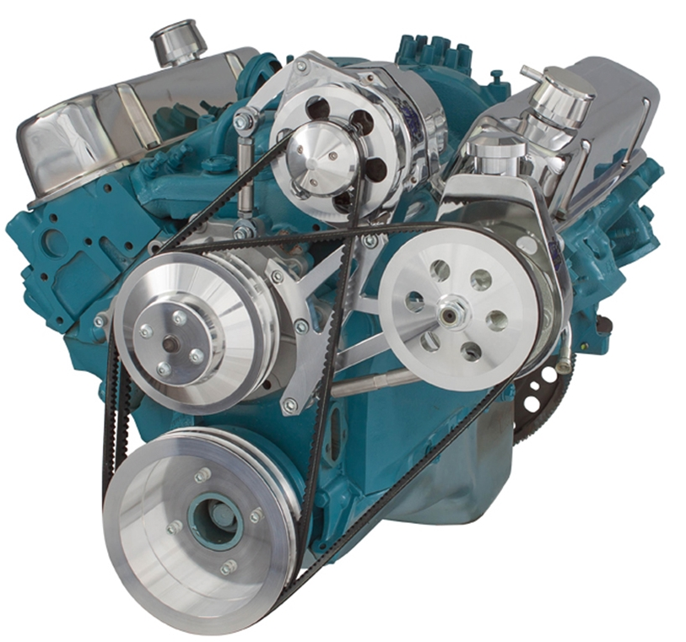
You have learnt:
About Levers and Mechanical Advantage
Two examples using levers
About Pulleys and Mechanical Advantage
Two examples using pulleys

Slide 27
Well Done
Thank You

Slide 29
37mm
13mm
Approximate Dimensions
100mm
12mm
32mm
80mm

