Slide 1

Welcome
These challenges were developed by Derrick Willer MBE and colleagues.
They are free to download and use in an education environment.
Please ensure that there is adult supervision, complete adherence to Health and Safety, and adequate PPE.
Derrick is a STEM Ambassador and volunteer Liaison Officer for Schools.
He has supported education in schools and colleges for over 30 years, initially as a Neighbourhood Engineer in the 1980’s, leading the local Year of Engineering Success campaign in 1996 and the Campaign to Promote Engineering from 1997 to 2004.
He was awarded an MBE for services to Education in 2018.

Slide 2
Guide
This activity is for pupils to various logic and maths activities to solve.
Risks
Mandatory: close supervision by a competent adult
Item | Risk | Avoidance Action
Aggression between those present | Injury | Close supervision and immediate action to defuse aggression

Slide 3
Welcome
I very much hope that you will enjoy this fun maths activity and learn new things

Slide 4
All Even Numbers are Divisible By 2
All Odd Numbers are not Divisible by 2
What happens when we multiply them?
Work together for ten minutes to see if you can
We all know that
Even Numbers are 2,4,6,8,10,12,14,16,18, etc.
Odd Numbers are 1,3,5,7,9,11,13,15,17, etc.
And
All Even Numbers are Divisible By 2
All Odd Numbers are not Divisible by 2
Can you prove it?
And
An Even Number multiplied by and Even Number is always an Even Number
An Odd Number multiplied by an Even Number is always an Even Number
An Odd Number multiplied by an Odd Number is always an Odd Number

Slide 5
All Even Numbers are Divisible By 2
All Odd Numbers are not Divisible by 2
What happens when we multiply them?
Here is how I prove it:
Let X be any number
Then 2X is divisibly by 2 and is an even number
The 2X+1 is not divisible by 2 and is an odd number
So 2X x 2Y should be an even number
And 2X x (2y+1) should be an even number
And (2X+1) x (2y+1) should be an odd number
Next Slide for the proof

Slide 6
All Even Numbers are Divisible By 2
All Odd Numbers are not Divisible by 2
What happens when we multiply them?
So 2X x 2Y should be an even number
2X x 2Y = 4XY and 4 is divisible by 2 so 4XY must also be divisible by 2 √
And 2X x (2y+1) should be an even number
2X x (2Y+1) = 4XY + 2X and both 4XY and 2X are divisible by 2 √
And (2X+1) x (2y+1) should be an odd number
(2X+1) x (2Y+1) = 4XY+2X+2Y+1
but 4X+2X+2Y is divisible by 2 so,
by adding 1, 4X+2X+2Y+1 is not divisible by 2 √

Slide 7
Triangular Numbers
These triangles represent triangular numbers where the dots inside are aligned.
What is the next triangle ?
What is the formula for the number of dots in each triangle ?

Slide 8
Triangular Numbers
What is the formula for the number of dots in each triangle ?
1
3
6
10
15
1
1+2
1+2+3
1+2+3+4
1+2+3+4+5
So what is the formula for the n^{th.} Triangle?

Slide 9
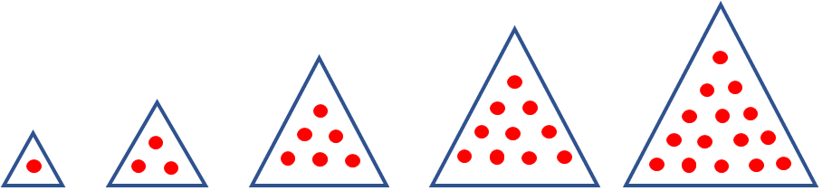
Triangular Numbers
So what is the formula for the n^{th.} Triangle?
Did you work this out for yourselves?
Try the formula for several numbers and see if it is correct
Start by working out how many dots there will be in the tenth triangle
1+2+3+4+5+6+7+8+9+10
This is the same as (1+10) + (2+9)+(3+8)+(4+7)+(5+6) = 5 x 11 = ½(10) x (10+1)
But we could replace the 10 by N for any number
= ½(N)x(N+1) = ½(N²+N) or = ½N(N+1)

Slide 10
The answer is always 1089
Pick a number e.g. 741
Reverse 147
-----
Subtract smaller from larger
594
Reverse 495
-----
Add 1089
Try your own number
Can you prove it?

Slide 11
The answer is always 1089
This is one proof
Action | Hundreds | Tens | Units
Start | A | B | C
Add 90+10-100 = 0 So No Change | A-1 | B+9 | C+10
Reverse the original | C | B | A
Subtract | A-1-C | 9 | C+10-A
Reverse | C+10-A | 9 | A-1-C
Add | 9 | 18 | 9
Rationalise | 10 | 8 | 9

Slide 12

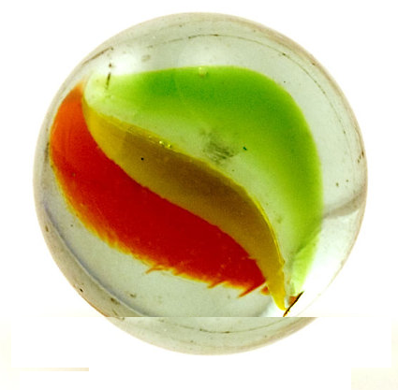


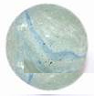
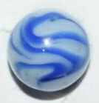

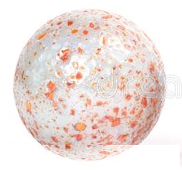
Marbles and Pots
I have a number of marbles and pots
If I put four marbles in each pot one pot will have nothing in it
If I put three marbles in each pot I will have one marble left over.
How many marbles and pots do I have?
By trial and error I get 16 marbles and 5 pots
but can you do it using maths

Slide 13
Marbles and Pots
How many marbles and pots do I have?
Were you able to prove it?
Let M = number of marbles
and P = number of pots.
Form the details given
4 = M/(P-1) so 4(P-1)=M
3 = (M-1)/P
Substitute M=4(P-1) in 3=(M-1)/P
3=4(P-1)-1/P
Multiply both side by P
so 3P = 4P-4-1
Add 5 to each side
so 3P+5=4P
Subtract 3P from each side
so P=5
And M=4P-4 = 20-4 = 16

Slide 14
Letters Mean Numbers
Please solve the problem:
From 4 x A = D where D cannot be more than 9
A must be 1 or 2
But 4 x D = A so A must be an even number
A can only be 2
A B C D
x 4
--------------
D C B A

Slide 15
Letters Mean Numbers
Please solve the problem:
2 B C D
x 4
--------------
D C B 2
Because 4 X A = 4 X 2 plus any 10s carried forward
means that D = 8 or 9
But 4 x D = 2 plus a number of 10s
So if D = 9 then 4 x D = 36 but A = 2 so D ≠ 9
So D must be 8 to make 4 X D = 32
Already shown
A = 2

Slide 16
Letters Mean Numbers
Please solve the problem:
Using 4 X C = B and because we carried 30 forward
If C is 1 then B is 7
If C is 3 then B is 5
If C is 4 then B is 9
If C is 5 then B is 3
If C is 6 then B is 7
If C is 7 then B is 1
If C is 9 then B is also 9 so this is wrong
So C is either 5, 7, or 9
2 B C 8
x 4
--------------
8 C B 2
Now 4 x 8 = 32 so we have 30 to carry forward
x C +3 = B plus a number of 10s
C cannot be 2 or 8 because
these numbers are already used
Already shown
A = 2
D = 8

Slide 17
Letters Mean Numbers
So C can only be 1,3,4,5,7 or 9
And B is either 1, 5, 7, or 9
But 10s cannot be carried forward to 4 x 2 = 8
Please solve the problem:
2 B C 8
x 4
--------------
8 C B 2
Using 4 x C + 3 = B | Then B = | Using 4 x B plus some 10s = C |  |  | OK
If C = | Then B = | If B = | Then C = | Are 10s Carried Forward
1 | 7 | 7 | 1 | Yes | No
3 | 5 | 5 | 3 | Yes | No
4 | 9 | 9 | 6 or more |  | No
5 | 3 | 3 | 5 | Y | No
7 | 1 | 1 | 7 | No | Yes
9 | 9 | They can’t both be 9 |  |  | No

Slide 18
Letters Mean Numbers
So the answer is:
2 1 7 8
x 4
--------------
8 7 1 2

Slide 19

The Odd Marble Problem
You have twelve marbles.
All are the same weight except one.
Using the scales what is the minimum number of times you must weigh to identify the odd marble?.
You do not know is the odd one is heavier or lighter!
What is your answer
We can do it with three

Slide 20
The Odd Marble Problem
Number the marbles 1 to 12
Weigh 1,2,3 and 4 against 5,6,7 and 8
If they balance
9,10,11,12 has odd one.
If they don’t
9,10,11,12 are normal
Weigh 1,2,3 against 9,10,11
Weigh 1,5,6 against 2,7,8
If they don’t
and 2,7,8 is heavy then
either 7 or 8 are heavy
and 1 is light (or visa versa)
If they balance
then the odd one is 12
If they don’t
then the odd one
is in 9,10,11 and you now
know if it is heavy or light.
If they balance
then the odd one is 3 or 4
Weigh 3 against 9 to find
the odd marble.
If equal then 4 is odd and you also know if
it is heavy or light
from 1,2,3,4 versus 5,6,7,8
Weigh 12 against 1 to find
If it is heavier or lighter.
Weigh 7 against 8
(For visa versa 5 v 6)
If they balance 1 is the odd one. (for visa versa 2)
If they do not you know which of 7 and 8 is odd.
Weigh 9 against 10
If they balance 11 is the
odd one
If they do not you know which
of 9 and 10 is the odd one.

Slide 21
How Many Triangles
A geometric observation challenge
Calculate how many triangles you can see within the big triangle.
Answer = 18

Slide 22

Thank You

