Slide 1

Welcome
These challenges were developed by Derrick Willer MBE and colleagues.
They are free to download and use in an education environment.
Please ensure that there is adult supervision, complete adherence to Health and Safety, and adequate PPE.
Derrick is a STEM Ambassador and volunteer Liaison Officer for schools.
He has supported education in schools and colleges for over 30 years, initially as a Neighbourhood Engineer in the 1980’s, leading the local Year of Engineering Success campaign in 1996 and the Campaign to Promote Engineering from 1997 to 2004.
He was awarded an MBE for services to Education in 2018.

Slide 2
Guide
This activity is for pupils to understand various logic and maths questions.
Risks
Mandatory: close supervision by a competent adult
Item | Risk | Avoidance Action
Aggression between pupils | Injury | Close supervision and immediate action to defuse aggression

Slide 3
Welcome
I very much hope that you will enjoy this fun quiz and learn new things

Slide 4
1
7XX
Here is a division sum
The X’s represent numbers from 0 to 9
You are given two numbers. Each is a seven
Can you work out the sum?
Sum clues are on the next slides!
XXX
XXXXXXX
XXX
7XX
XXX
No Remainder
Click for
Next Slide

Slide 5
7XX
7XX
XXX
XXXXXX
XXX
XXXXXX
XXX
XXX
7XX
7XX
XXX
XXX
Because there are no numbers here
what can you deduce about the
Numbers coloured X?
And then the one coloured X?
When you have worked out
The value of XXX
What is the only result for those
coloured X?
Click for
Next Slide

Slide 6
7XX
Your turn !!
XXX
XXXXXX
XXX
7XX
XXX
No Remainder
But click for my working out

Slide 7
1
7XX
2
7XX
3
7XX
XXX
XXXXXX
XXX
1XXXXX
XXX
1XX
10XXXX
9XX
9XX
7XX
7XX
XXX
7XX
XXX
XXX
These must be 1 and 9
because
there is no X here
Please note there
is no remainder
So this must be 1
And this a 0
Click for
Next Slide

Slide 8
4
5
7XX
7XX
14X
100XXX
1XX
100XXX
99X
99X
7XX
7XX
XXX
XXX
This must be a 4 because
990 divided by 7 = 141+
And 999 divided by 7 = 142+
And this must also be 9
because there is no X here
and this must also be a 0
Click for
Next Slide

Slide 9
7XX
7XX
6
7
14X
100XXX
142
100XXX
99X
994
7XX
7XX
XXX
XXX
This must be a 1 or a 2 because
990 divided by 7 = 141+
And 999 divided by 7 = 142+
This must be a 2
and here is a 4
because
7 X 142 = 994
And 7 X 141 = 987 Too Small
Click for
Next Slide

Slide 10
This must be 0 because
XX is less than 142
70X
70X
8
9
142
100XXX
142
100XXX
994
994
7XX
7XX
XXX
XXX
Let’s look at how we can
make this a 7
Click for
Next Slide

Slide 11
9
70X
705
10
142
100XXX
142
100XXX
994
994
7XX
710
XXX
XXX
142 X 1 = 142
142 X 2 = 284
142 X 3 = 426
142 x 4 = 578
142 x 5 = 710
142 x 6 = 852
142 x 7 = 994
142 x 8 = 1136 = too big
Only This Works
Click for
Next Slide

Slide 12
705
11
142
100978
Now you fill in all the other X’s
994
710
710
Click for
Next Slide

Slide 13
Now you have the answer
7XX
705
11
XXX
XXXXXX
142
100978
XXX
994
7XX
710
XXX
710
No Remainder
Click for
Next Slide

Slide 14
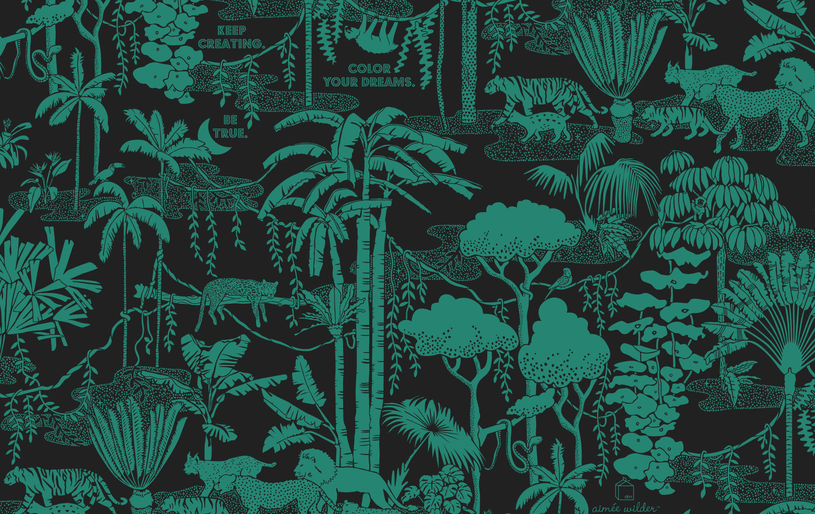
2
Wallpaper!
I am looking into the window of a shop selling wallpaper.
Suddenly I like the wallpaper that is
1M wide and has a 1M pattern.
I cannot remember the size of the room
and I really like the pattern
I suddenly decide to paper the wall at the weekend.
But I do not know the size of the wall.
But the shop owner says the us about to close
for the Bank Holiday weekend
Click for
Next Slide

Slide 15
Wallpaper!
Garden
1M
The paper is 1M wide and has a 1M pattern.
I now want to paper the wall of the living room that
does not have a door.
I own a small one bedroomed ground floor flat.
I remember that bedroom length is twice the
size of the living room.
Unusually, both rooms are square
The ceiling is over 2m high.
I cannot remember the size of the living room but
I do remember that the flat is 117 SqM.
Bedroom
1M
Living Room
Click for
Next Slide
How much wallpaper should I buy?

Slide 16
Wallpaper!
Garden
1M
I am in the shop selling wallpaper. I like one that is
1M wide and has a 1M pattern.
I want to paper the wall of the living room that
does not have a door.
I own a small one bedroomed ground floor flat.
The remember that bedroom length is twice the
size of the living room.
Unusually, both rooms are square
The ceiling is over 2m high.
I cannot remember the size of the living room but
I do remember that the flat is 117 SqM.
Bedroom
I need to buy 27M
Did you get it right?
Click for my working out
1M
Living Room
Click for
Next Slide
How much wallpaper should I buy?

Slide 17
Wallpaper!
Garden
Bedroom
Let the room sizes be a and b
I know that one room length and width
is half the size of the other
So A=1.5B
The total area is 117SqM
So A² + B² = 117
B
A
Living Room
Click for
Next Slide

Slide 18
Wallpaper!
1M
If A = 1.5B then A² = (1.25B)²
Put this into the equation
A² + B² = 117
(1.25B)² = 2.25 B² + B² = 117
3.25 B² = 117
B² = 117/3.25 = 36
B = 6
So A = 1.5B = 9
I need to buy 9 lengths of wallpaper
Each 3M long
(because I need to match the patterns)
Garden
Bedroom
1M
B
I need to buy 27M
A
Living Room
Click for
Next Slide

Slide 19
What a Raquet
3
I want to buy a tennis raquet but I do not have any money.
So I borrow £10 from Dad and £10 from Mum.
The raquet cost me £17
I gave Dad £1 and Mum £1 and keep £1
So I owe each of them £9
2 X £9 = £18, plus the £1 that I have equals £19
Where has the other £1 gone?
Still owed to Mum | £9
Still owed to Dad | £9
Amount I have | £1
Sub Total | £19
Where has the £1 gone?
Click for
Next Slide

Slide 20
What a Raquet
The concept for the sum is wrong
Two are what you owe
- let’s call this a group of pears
One is what you still have
- let’s call this a group of apples
They are not the same
- you cannot add apples to pears
and get a total number of pears
The correct sum is:
Also
Cost of Raquet | £17
Returned to Mum | £1
Returned to Dad | £1
I still have | £1
Total | £20
Still owed to Mum | £9
Still owed to Dad | £9
Less cost of Raquet | -£17
Sub Total | £1
This is the amount I still have
Click for
Next Slide

Slide 21
X marks the spot SUM
 | XXX
 | XX
 | X
X(2X)(3X)
In the sum opposite
X is always the same number
So if X was 1 the answer is
the lower sum, which is correct
Which other numbers give a
correct answer?
 | 111
 | 11
 | 1
123
Click for
Next Slide

Slide 22
X marks the spot SUM
 | XXX
 | XX
 | X
X(2X)(3X)
In the sum opposite
X is always the same number
So if X was 1 the answer is
the lower sum, which is correct
There are only two other numbers
which give a correct answer.
222 |  | 333
22 |  | 33
2 |  | 3
246 |  | 369
Click for
Next Slide

Slide 23

4
Minus 40 = Minus 40
Clue
Is that not obvious?
But can you prove it?
If you can you could get a degree!
Click for
Next Slide

Slide 24
Minus 40 = Minus 40
Convert -40 DegF to Centigrade
And so we get a new
Conversion Formula
(DegF +40) X 5 = (DegC +40) X 9
Which is much easier to remember
DegC = (DecF -32) X 5 9)
So for -40DegF
DegF = (-40 -32) X 5 9
= - 72 X 5 9
= -40
Click for
Next Slide

Slide 25
Minus 40 = Minus 40
So we have a simpler formula for converting degF to degC
(DegF +40) X 5 = (DegC +40) X 9
Try checking this for two known temperatures
Freezing Point of Water = 0 degC = 32 degF
Boiling Point of Water = 100 degC = 212 degF
Click for
Next Slide

Slide 26
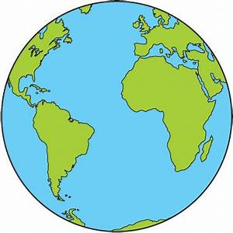
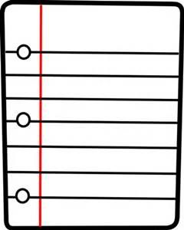



Mind the Gap
5
Imagine a metal ring going all the way round the equator just touching the ground.
If I add 25 metres to the length of the metal ring, will the gap be large enough to:
Push a sheet of paper under the ring?
2. Push a can of baked beans under it?
Squeeze your wheely-bin under it?
Walk under it?
Diam. Approx
12,000Km
Click for
Next Slide

Slide 27
Mind the Gap
Hands up those who think it is:
Push a sheet of paper under the ring?
2. Push a can of baked beans under it?
Squeeze your wheely-bin under it?
Walk under it?
Diam. Approx
12,000Km
Click for
Next Slide

Slide 28
Mind the Gap
The circumference of the Earth is
2𝞹 x 6000 = 12000 𝞹 Km= Length of the Original Ring
So the gap under the New Ring is
½ (0.025Km/ 𝞹) = ½ 25M/ 𝞹 = 3.9M
The circumference of the Extended Ring is
2𝞹 x 6000 + 25M = 12000 𝞹 + 0.025Km
Don’t bother to do the arithmetic – we will leave 𝞹 as it is
Diam. Approx
12,000Km
Now divide the length of the New Ring by 𝞹
to get the Diameter
The Diameter of the New Ring is
12000 + (0.025Km/ 𝞹)
So you can walk under it
Click for
Next Slide

Slide 29
6
A Pythy Problem (spoken as Pilthy?)
The triangle opposite has sides of 5M and 8M
5M
5M
What is it’s area?
6M
Click for
Next Slide

Slide 30
6
A Pythy Problem (spoken as Pilthy?)
The triangle opposite has sides of 5M and 8M
Who solved it by cutting out the triangle
And measuring the height?
5M
5M
H
What is it’s area?
Who solved it by algebra?
H² + 3² = 5²
Area? = ½ Base X Height
6M
Click for
Next Slide

Slide 31
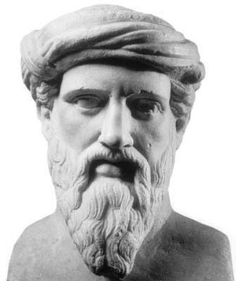
6
A Pythy Problem
The triangle opposite has sides of 5M and 8M
Area = (½ X 3 x 4) X 2 = 12 SqM
5M
5M
What is it’s area?
Who recognised it as
two 3, 4, 5 Right Angled
Pythorean Triangles?
6M
Click for
Next Slide

Slide 32
7
A Treeky Problem
You are the Landscape Architect
You have 10 trees.
The owner of the garden wants you
to plant them in five rows
each row to have four trees
How to do this?
Click for
Next Slide

Slide 33
7
A Treeky Problem
Tip
Try setting out five lines that cross
four other lines
Then put a tree where they cross
Click for
Next Slide

Slide 34
A Treeky Problem
Row 1
Row 2
Here is one way of solving this
Nobody said they had to be equidistant
Row 3
Row 4
Click for
Next Slide
Row 5

Slide 35
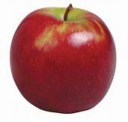
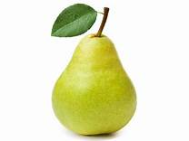
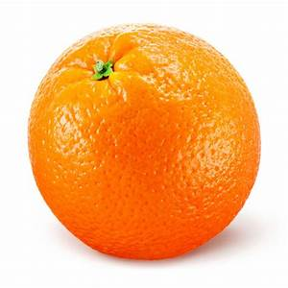
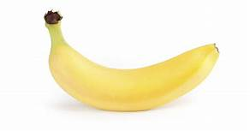
8
Can Fruit do Algebra?
A bowl has the following fruit:
Twice as many apples as pears
Twice as many pears as oranges
And five bananas
There are less than 40 pieces of fruit.
If the number of pieces of fruit is a prime number.
How many of each are there?
Tip
Construct a spreadsheet
19
Click for
Next Slide

Slide 36
Can Fruit do Algebra?
Answer
19
My Spreadsheet
Fruit | Formula | Calculations
Apples | A = 2P | 4 | 8 | 12 | 16 | 20 | 24
Pears | B=2O | 2 | 4 | 6 | 8 | 10 | 12
Oranges | O | 1 | 2 | 3 | 4 | 5 | 6
 | Sub Total | 7 | 14 | 21 | 28 | 35 | 42
Bannanas |  | 5 | 5 | 5 | 5 | 5 | 5
 | Total | 12 | 19 | 26 | 33 | 40 | 47
 | Prime | No | Yes | No | No | No | Yes
 |  |  |  |  |  | To Many

Slide 37
9
Sum Tangential Thinking
I have to clean the window It’s top is 4M from the ground
The ladder should, ideally, be at an angle of 60^{O}
4M
How long must the ladder be?
60^{O}

Slide 38
Sum Tangential Thinking
The problem is also a Right-Angled Pythagorean Triangle
Look up the Tangent Tan 60^{O} = √3 = 1.732051
It would be sensible to
round this up
So the ladder should be 5M long
Tangent = Opposite/Adjacent, and Opposite = 4M
4M
L
So Y = Adjacent = 4M / 1.732051 = 2.309M
So from Pythagoras L² = 4² + 2.3092
= 16 + 5.333
= 21.333
60^{O}
Y
So L = 4.618802
Click for
Next Slide

Slide 39
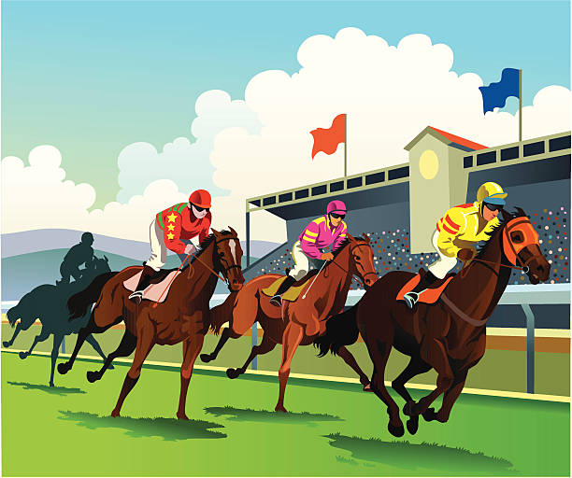
10
First Past The Post
I like going to the races and having
a small flutter.
I do not bet too much but it adds to the excitement.
I often win but, because I bet on
all the races I usually do not make
a profit.
Click for
Next Slide

Slide 40
10
First Past The Post
I plan to bet on today’s five races,
but I want to estimate my chance of
winning
I can work it
out like this
I know that, on average, one in
three favourites wins the race,
so I will bet on favourites.
What are my odds of wining.
Click for
Next Slide

Slide 41
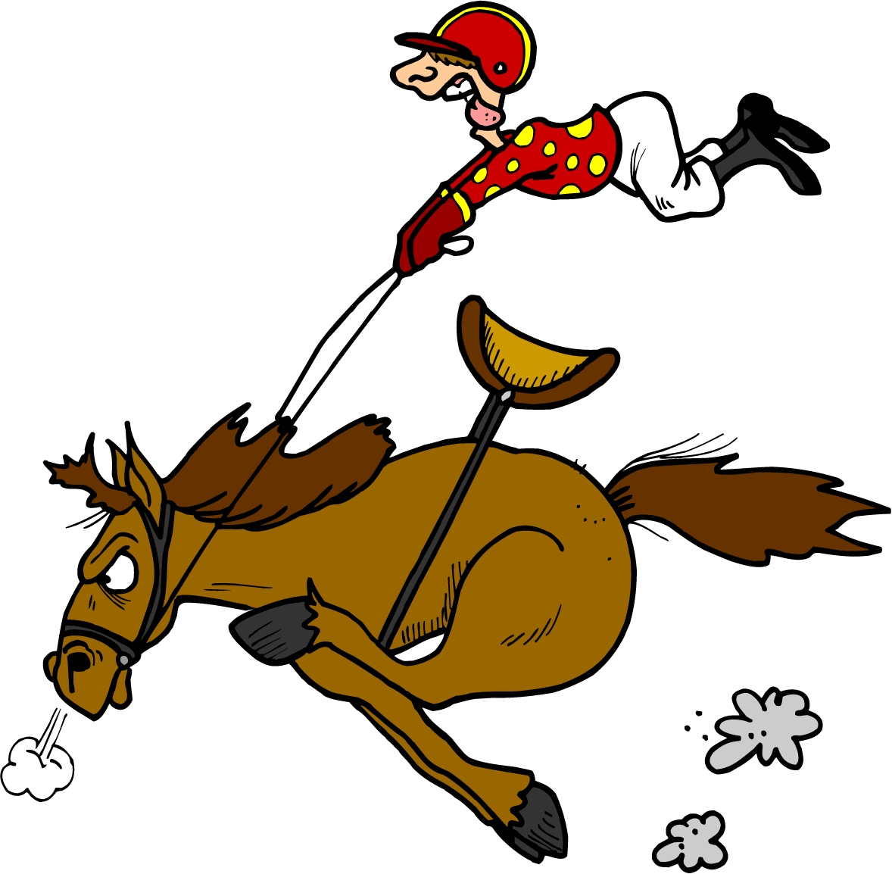
Whoops
That Is Absurd.
I remember winning before
First Past The Post
I can work it out like this
My chance of winning in any race is 1 in 3
I seem to remember that you
multiply the odds
So my chance of winning in any one of
five races is:
⅓ X ⅓ X ⅓ X ⅓ X ⅓ = ¹/₂₄₃
Click for
Next Slide

Slide 42
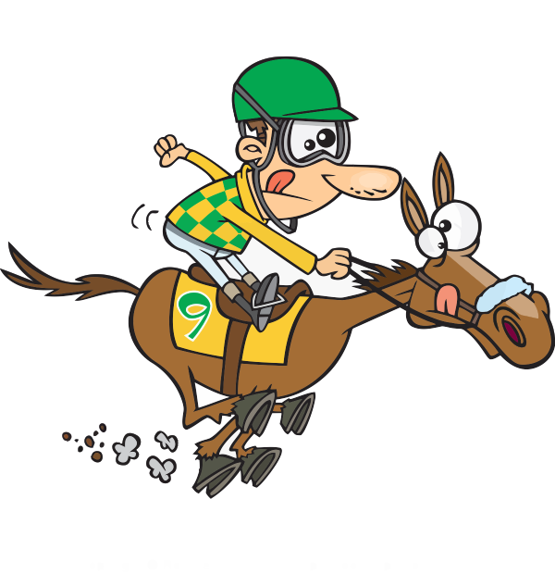
But I lost
every time at
the last racecourse
First Past The Post
Perhaps I can work it out like this
My chance of winning in any race is 1 in 3
I will try adding the odds
⅓ + ⅓ + ⅓ + ⅓ + ⅓ = ⁵/₃
That is – I MUST win
Click for
Next Slide

Slide 43
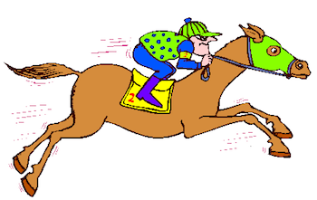
First Past The Post
How would YOU work it out?
Click for
Next Slide

Slide 44
But this is only the probability of winning at least one race
First Past The Post
We should really work out the
probability of losing.
Then the probability of winning is
One - Losing
The probability of Losing every race is
⅔ X ⅔ X ⅔ X ⅔ X ⅔ = ³²/₂₄₃
So the probability of Winning is
1 - ³²/₂₄₃ = ²¹¹/₂₄₃ = 0.868 = 86.8%
Click for
Next Slide

Slide 45
First Past The Post
Do you remember
“I can work it out like this”
⅓ X ⅓ X ⅓ X ⅓ X ⅓ = ¹/₂₄₃
This is actually the chance of
winning all five races
Click for
Next Slide

Slide 46

Thank You

