Slide 1

Welcome
These challenges were developed by Derrick Willer MBE and colleagues.
They are free to download and use in an education environment.
Please ensure that there is adult supervision, complete adherence to Health and Safety, and adequate PPE.
Derrick is a STEM Ambassador.
He has supported education in schools and colleges for over 30 years, initially as a Neighbourhood Engineer in the 1980’s, leading the local Year of Engineering Success campaign in 1996 and the Campaign to Promote Engineering from 1997 to 2004.
He was awarded an MBE for services to Education in 2018.

Slide 2
Guide
This exercise introduces pupils to pendulums and swings and the formula for time and frequency.
Risks
Mandatory: close supervision by a competent adult
Item | Risk | Avoidance Action
Tools | Injury | Close supervision, use of safety glasses, etc.
Aggression between participants | Injury | Close supervision and immediate action to defuse aggression

Slide 3
Welcome
I very much hope that you will enjoy this fun activity and learn about pendulums.

Slide 4
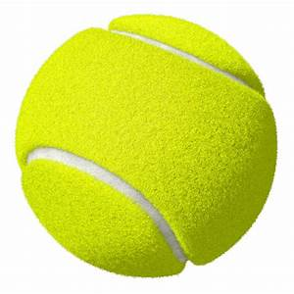
Lets have some fun with pendulums
We are going to swing a tennis ball and a cricket ball like a pendulum.
Clearly the cricket ball is heavier than the tennis ball so we would expect the way they swing to be different.
In particular, the heavier ball must surely swing slower than the light one?
And then we will see if our results work for a garden or playground swing.

Slide 5

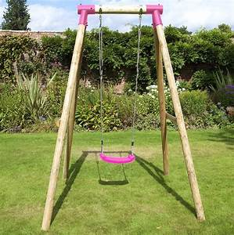
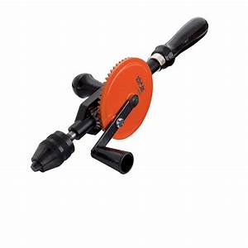
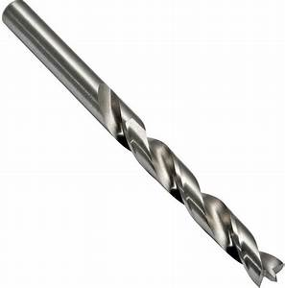
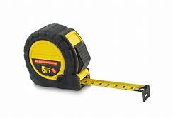
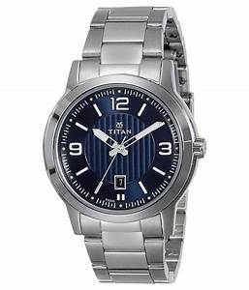
What you need:
A tennis ball and a
cricket ball
4m of string
Drill and 4mm bit
Measure
Watch with second hand
And a garden swing

Slide 6
What you should do to prepare:
Drill a hole through the diameter of the two tennis balls.
Thread 2m of string through the two straws.
You can use a long needle or a piece of wire with a loop at one end.
Tie the ends securely so they cannot pull through the hole.
Mark both strings at exactly the following distances from the centre of the ball.
25cm, 50cm, 75cm, 1M, and 30cm, 60cm, 80cm, 90cm, 120cm.

Slide 7
What you do:
At each of the points
set the tennis ball swinging
and record the time for
at least 50 swings.
Record your results
in a table.
(a spreadsheet is best)
See table opposite for
the best sequence.
120cm
Length | No of Swings | Time of Swing | Ratio
First set
25cm |  |  | Set to 1
50cm
75cm
1M
Second set
30cm |  |  | Set to1
60cm
90cm
120cm
1M
90cm
75cm
60cm
50cm
30cm
25cm

Slide 8
What can you see?
Length | Time for 50 swings (Secs) | Time Per Swing | Ratio
First Set
0.25 | 50 | 1 | 1.00
0.5 | 71 | 1.42 | 1.42
0.75 | 87 | 1.74 | 1.74
1 | 100 | 2.00 | 2.00
Second Set
0.3 | 55 | 1.10 | 1.00
0.6 | 78 | 1.56 | 1.42
0.9 | 95 | 1.90 | 1.73
1.2 | 110 | 2.20 | 2.00
To double the time of the
swing you have to increase
the length 4 times
2 is the square root of 4 so the pendulum time could be related to the square root of the length?

Slide 9
What you do:
120cm
Length | Time for 50 swings (Secs) | Time Per Swing | Ratio
First Set
0.25 | 50 | 1 | 1.00
0.5 | 71 | 1.42 | 1.42
0.75 | 87 | 1.74 | 1.74
1 | 100 | 2.00 | 2.00
Second Set
0.3 | 55 | 1.10 | 1.00
0.6 | 78 | 1.56 | 1.42
0.9 | 95 | 1.90 | 1.73
1.2 | 110 | 2.20 | 2.00
Now do the same with the
Cricket ball.
This ball is much heavier
So the times must be
different
1M
90cm
But they were all the same
So the weight (mass) of the
ball does not matter
75cm
60cm
50cm
30cm
25cm

Slide 10
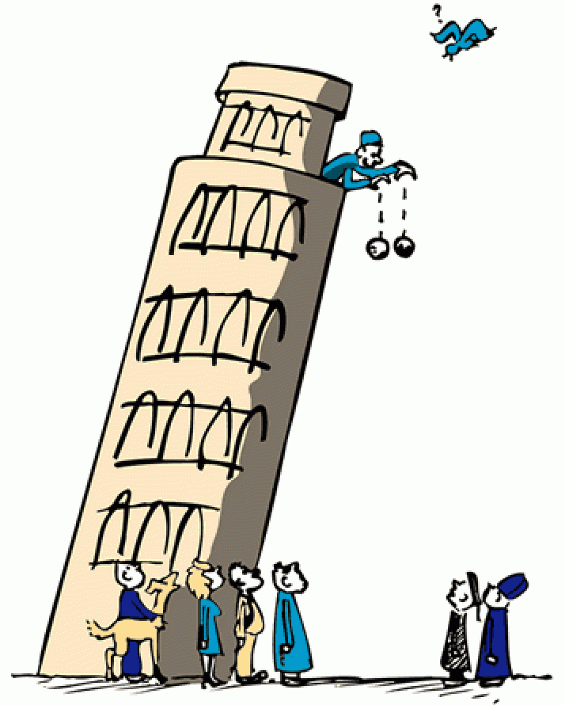
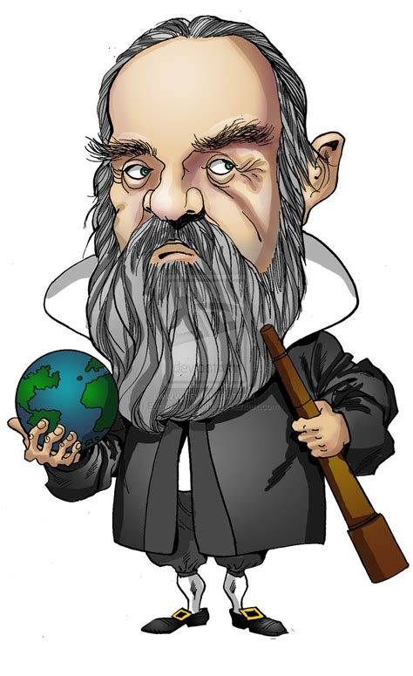
In about 1590 Gallileo dropped two different
heavy weights from the top of the
Leaning Tower of Piza to prove they
hit the ground at the same time.
This is similar to the Gallileo Experiment
So the weight (mass) of the
ball does not matter

Slide 11
In about 1590 Gallileo dropped two different
heavy weights from the top of the
Leaning Tower of Piza to prove they
hit the ground at the same time.
In fact Gallileo was the first to discover the pendulum formula

Slide 12
How well does this fit with our results?
Use 𝞹 = 3.14159
And Gravity, G = 9.80665 M/sec²
Put the calculated answers into your spreadsheet against the lengths you used.

Slide 13
Here are some results
Length | Time for 50 swings (Secs) | Time Per Swing | Ratio | 𝞹 | Gravity M/s² | √(L/G) | Calculated Time Per Swing | Time for 50 Swings (Secs) | Swings Per Minute (Frequency) | Calculated Ratio
First Set
0.25 | 50 | 1 | 1.00 | 4.14159 | 9.80665 | 0.159665 | 1.003204 | 50.160190 | 59.808386 | 1.000000
0.5 | 71 | 1.42 | 1.42 |  |  | 0.225800 | 1.418744 | 70.937221 | 42.290915 | 1.414214
0.75 | 87 | 1.74 | 1.74 |  |  | 0.276548 | 1.737600 | 86.879998 | 34.530388 | 1.732051
1 | 100 | 2.00 | 2.00 |  |  | 0.319330 | 2.006408 | 100.320380 | 29.904193 | 2.000000
Second Set
0.3 | 55 | 1.10 | 1.00 |  |  | 0.174904 | 1.098955 | 54.947735 | 54.597337 | 1.000000
0.6 | 78 | 1.56 | 1.42 |  |  | 0.247352 | 1.554157 | 77.707832 | 38.606147 | 1.414214
0.9 | 95 | 1.90 | 1.73 |  |  | 0.302943 | 1.903445 | 95.172269 | 31.521787 | 1.732051
1.2 | 110 | 2.20 | 2.00 |  |  | 0.349808 | 2.197909 | 109.895470 | 27.298668 | 2.000000

Slide 14
Does it work for your playground swing?
Measure the length of the swing
assuming your centre of gravity
is by the handles of the swing.
Pivot
Length
Get a teacher to do the swinging as well because they are heavier than most pupils. The result should be the same.
Handles
How well does your result fit with the formula?

Slide 15

Well Done
Thank You

