Slide 1
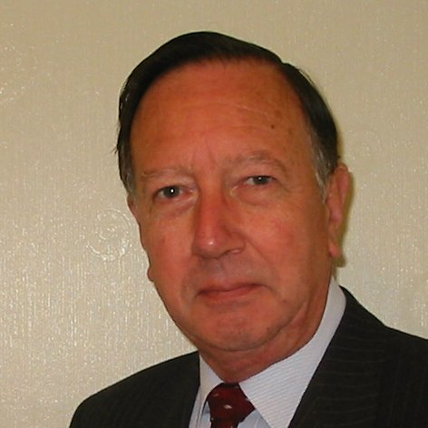
Welcome
These challenges were developed by Derrick Willer MBE and colleagues.
They are free to download and use in an education environment.
Please ensure that there is adult supervision, complete adherence to Health and Safety, and adequate PPE.
Derrick is a STEM Ambassador and volunteer STEM Ambassador.
He has supported education in schools and colleges for over 30 years, initially as a Neighbourhood Engineer in the 1980’s, leading the local Year of Engineering Success campaign in 1996 and the Campaign to Promote Engineering from 1997 to 2004.
He was awarded an MBE for services to Education in 2018.

Slide 2
Guide
This activity is for pupils to understand various logic and maths activities.
Risks
Item | Risk | Avoidance Action
Computers | Misuse Damage Eyestrain | Close supervision. Participants to look away from the screen every five minutes to rest their eyes.
Aggression between those present | Injury | Close supervision and immediate action to defuse aggression

Slide 3
Welcome
I very much hope that you will enjoy this fun coding activity and learn new things

Slide 4
Pythagorean Triangles
We all know the 345 Triangle is a Right-Angled Triangle
What other Right-Angled Triangles have whole number sides
up to a side length of x (say 50) for shortest side

Slide 5
Download Basic Programming Language
Just BASIC from http://justbasic.com
Please read the introduction

Slide 6
For a new file - Click “File” and “New Basic Source File
To save click “Save” and enter the file name if it is a new file

Slide 7
To run your program click Run
To Debug (show errors) click DeBug

Slide 8
Reserved Words
rem or ' is a remark which does nothing in the
program
input for inputting data
anyname$ is an alpha-numeric string of
data (e.g. "abcde1234:;.,<>#%")
anyname (without the $) is numeric data
for a = 1 to 99 starts a cycle of 99 actions
next a cycles again until action 99 is completed
print anyname$ displays anyname$
len (anyname$) is the length of anyname$
There are more reserved words which you will learn later

Slide 9
More Reserved Words
a*a = a x a (a multiplied by a) sqr(x) = the square root of x
chr$(13) = end of line, start new line
str$(x) = the string or character “x” rather than the number x
int(x) = integral (whole number part) of x

Slide 10
rem is a b c a right-angled triangle where a b and c are integers (whole numbers).
rem input the maximum length for one side as x
input "maximum length for one side > ";x
rem use for a = 1 to x for one side
answer$ = "The following are Right-Angled Triangles" +chr$(13)
for a = 1 to x
rem use for b = 1 to x for another side
for b = 1 to x
c = sqr(a*a + b*b)
print a,b,c
if int(c)=c then
rem we have a right angled triangle sides a, b, c
rem use str$(x) to print x inside a string called answer$
answer$ = answer$ + str$(a) + " " + str$(b) + " " + str$(c) + chr$(13)
end if
next b
next a
print answer$
end

Slide 11
We have learnt to:
Work and think as engineers by;
programming
being creative

