Slide 1
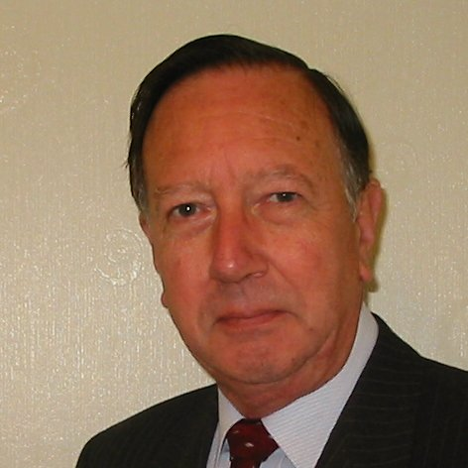
Welcome
These challenges were developed by Derrick Willer MBE and colleagues.
They are free to download and use in an education environment.
Please ensure that there is adult supervision, complete adherence to Health and Safety, and adequate PPE.
Derrick is a STEM Ambassador and volunteer STEM Ambassador.
He has supported education in schools and colleges for over 30 years, initially as a Neighbourhood Engineer in the 1980’s, leading the local Year of Engineering Success campaign in 1996 and the Campaign to Promote Engineering from 1997 to 2004.
He was awarded an MBE for services to Education in 2018.

Slide 2
Guide
This activity is for pupils to use logic and maths to solve the problems
Risks
Mandatory close supervision by a competent adult
Item | Risk | Avoidance Action
Packs of Cards | Damage | Close supervision
Aggression between those present | Injury | Close supervision and immediate action to defuse aggression

Slide 3
Welcome
I very much hope you enjoy the quiz about STEM
Science, Technology, Engineering and Maths

Slide 4
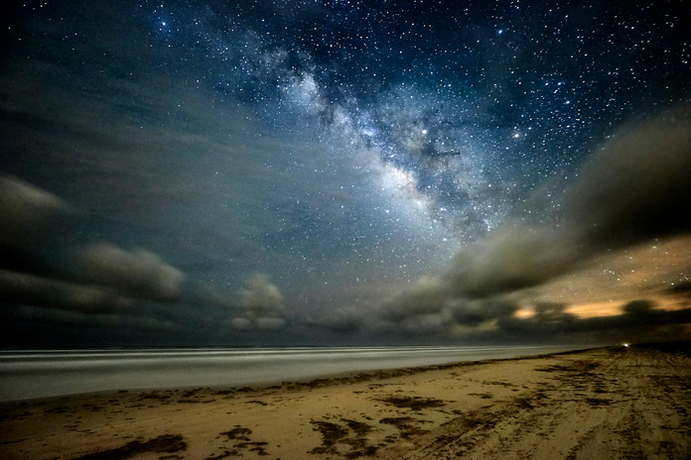
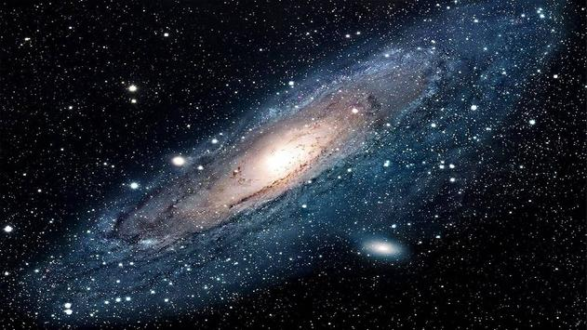
What is the "Milky Way"?
The Milky Way is the name of the galaxy of stars of which our solar system is a small part.
The Milky Way is spiral galaxy with our Sun near where the pointer is.

Slide 5
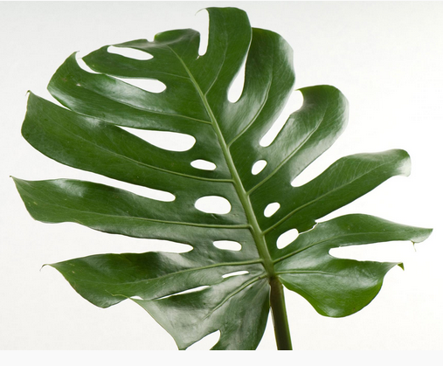
What is the green pigment in plants that helps it absorb sunlight?
Chlorophyll helps the plant utilise sunlight.
It enables the plant to convert CO₂ (Carbon Dioxide) into Carbon to build the plant and Oxygen for us to breathe.

Slide 6
Is fifty-one a Prime Number?
No, because it is 3 X 17.
Prime numbers are only divisible by 1 and themselves
Here are the Prime Numbers up to 100
2, 3, 5, 7, 11, 13, 17, 19,
23, 29, 31, 37, 41, 43, 47,
53, 59, 61, 67, 71, 73, 79,
83, 89, 97

Slide 7
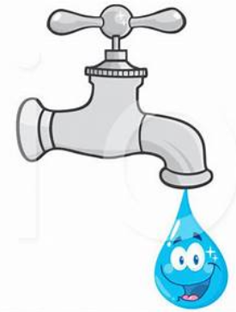
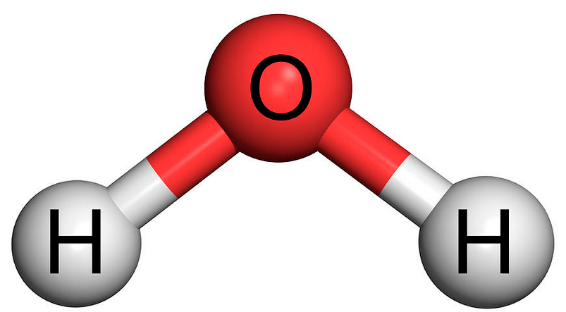
What is the chemical formula for Water?
H₂O Two hydrogen atoms and one oxygen atom.

Slide 8
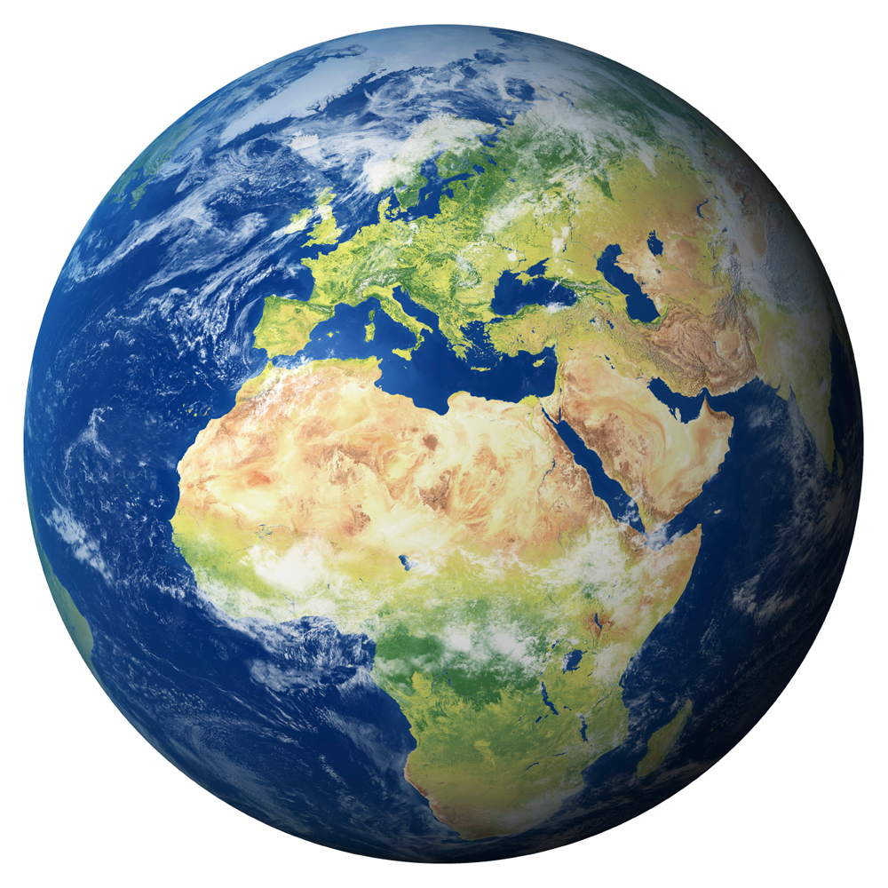
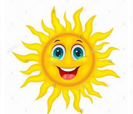
Why do we get summers and winters?
Because the Earth is rotating about an axis that is sloping at about 23 degrees.
The northern hemisphere is sloping away from the Sun so gets less light and heat so it has winter
The northern hemisphere is sloping towards the Sun so gets more light and heat so it has summer
Axis of rotation
Earth’s orbit around the Sun

Slide 9
What is the relationship between volts, current and resistance.
V=IR is the formula relating Volts (V), Current (I) and Resistance (R)
I
This is the symbol for a resistor
This is the symbol for a battery
V
R

Slide 10
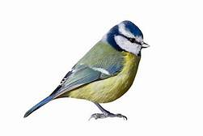
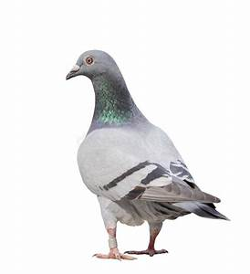

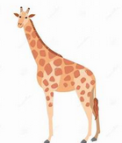
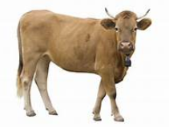
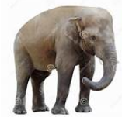
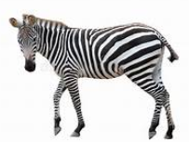
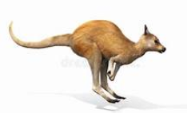
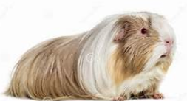
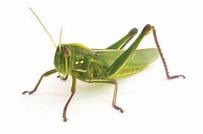
What are "Herbivores”
Animals that eat plants such as cows, sheep, horses, zebras, locust, hippopotamus, kangaroo,
guinea pig, rabbit, bluetit, pigeon

Slide 11
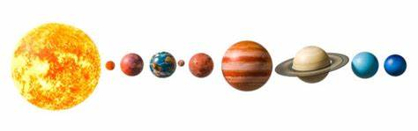
What is the name of the planet nearest the Sun?
Nearest the sun is the planet Mercury. It and is also the smallest planet.
Sun, Mercury, Venus, Earth, Mars, Jupiter, Saturn, Uranus, Neptune

Slide 12
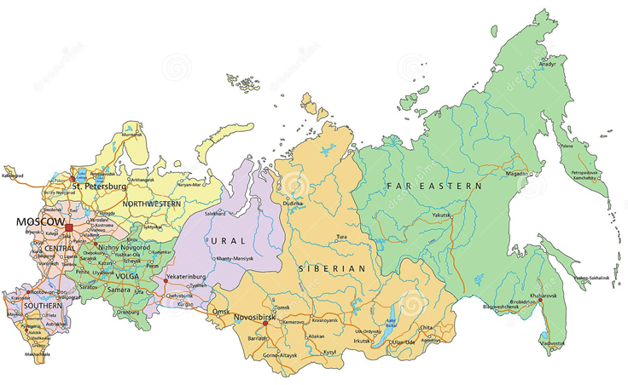
Which is the largest country in the world?
Russia is the largest, and includes the vast Siberia region.
Population 143 Million People

Slide 13
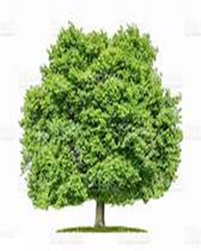
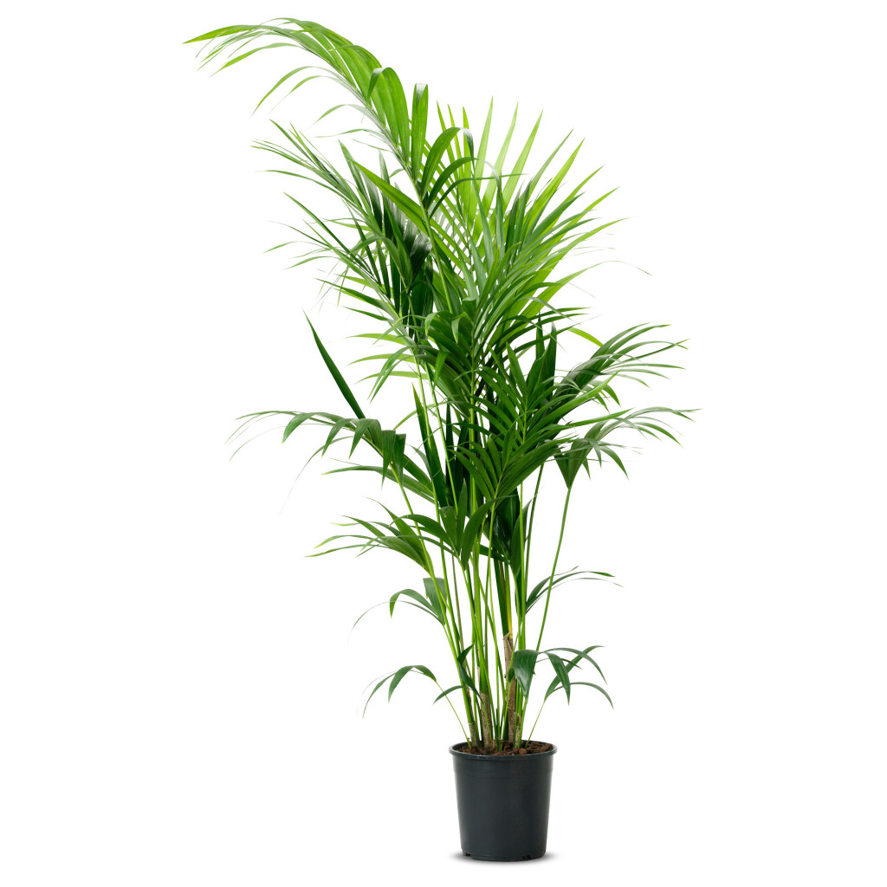
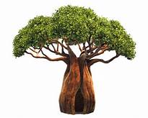
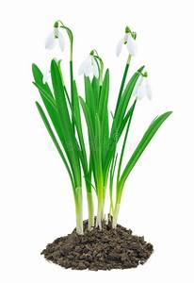
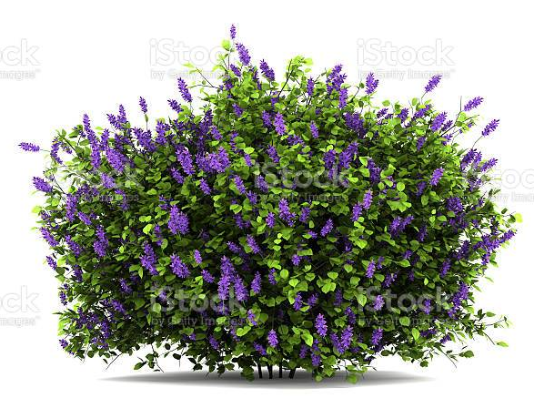
What does a Botanist study?
A Botanist studies plants.
Beobab Tree Houseplant Oak Tree Seaweed Lilac Sequoia Snowdrop

Slide 14
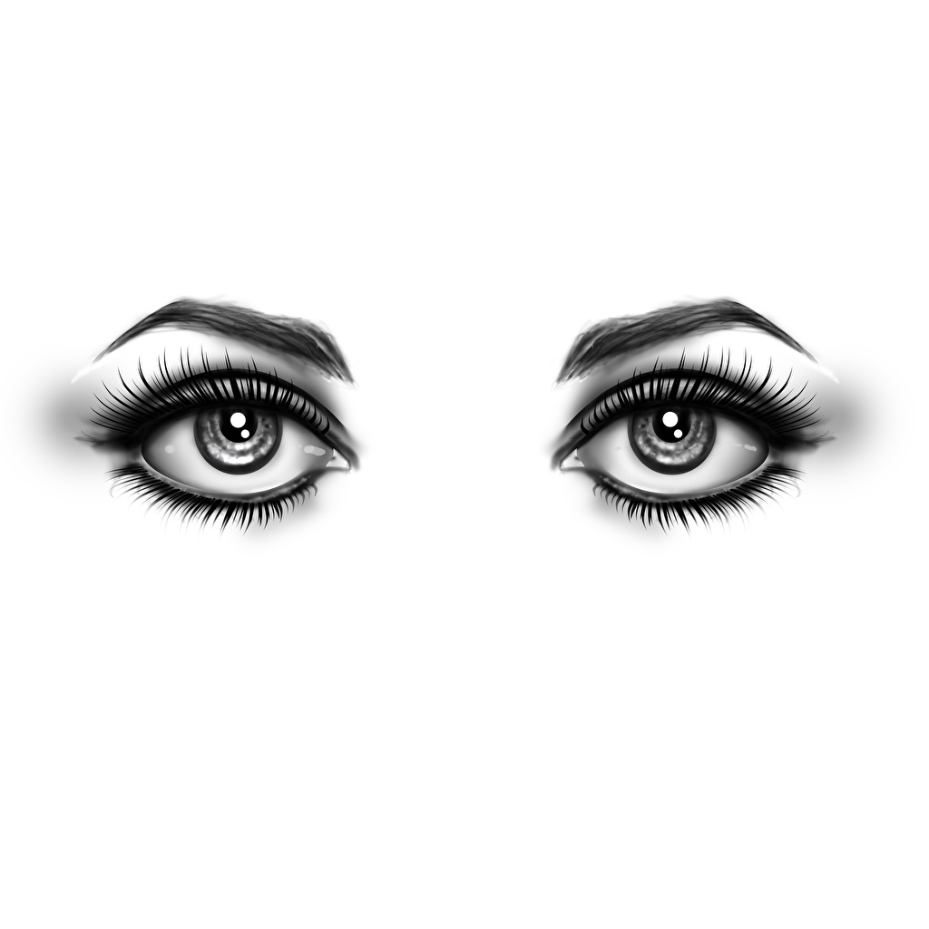
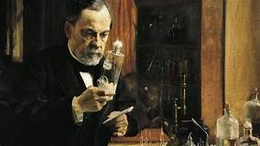
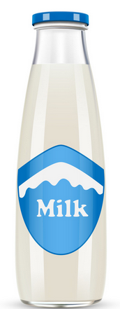
Milk is usually labelled as Pasteurised. What does this mean?
Pasteurisation is the process of heating the product to kill off germs. Named after Frenchman, Louis Pasteur who first used it for wine.

Slide 15
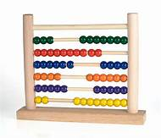
What is an Abacus?
An Abacus is a counting frame. First used by Sumerians (in modern day Iraq) some 4500 years ago.

Slide 16
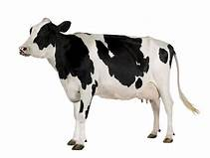
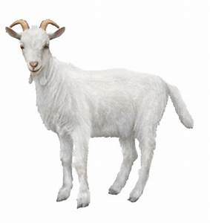

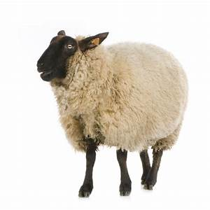
What is cheese made from?
Cheese is made from Milk. Some are made for cows milk, others from milk from sheep, goats and buffalo.

Slide 17
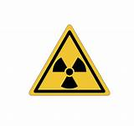
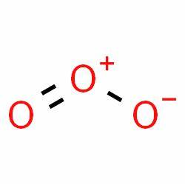
How does the Ozone Layer help protect life on Earth?
The layer helps to stop harmful rays such as ultra-violet from reaching the ground
Ozone Layer
15 to 30Km above surface
Danger from ultraviolet light, cosmic rays
Ozone is three Oxygen atoms forming a group

Slide 18
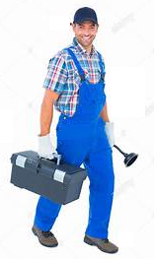
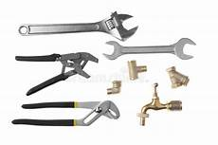
What is the name of the element with the symbol Pb?
Lead. From the Latin Plombem. Also giving the name Plumbers who originally used lead for water pipes.

Slide 19
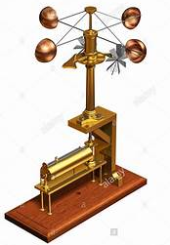
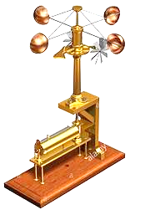
What does an Anemometer measure?
An Anemometer measures wind speed.
Cup
Like a weather-vane it always points towards the wind so you know the wind direction.
The cups are driven round by the wind according to the wind speed

Slide 20
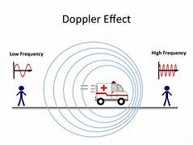
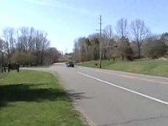
What is the Doppler Effect?
The doppler effect is the change in frequency of light or sound according to its relative motion towards or away from the observer.
An example is the sound of a car horn or police siren is higher pitched as the police car comes towards you and then is a lower pitch as the car moved away.

Slide 21
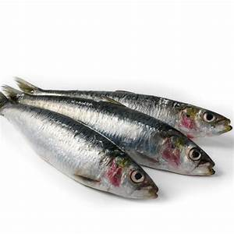
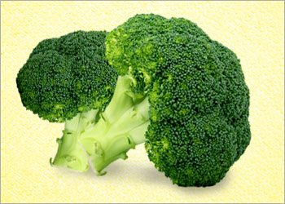
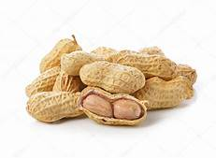
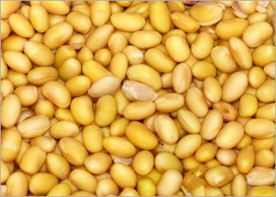
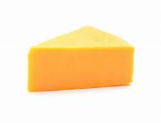
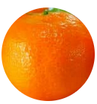
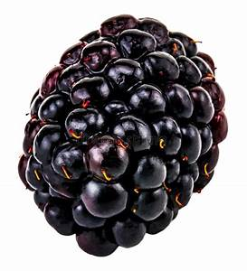
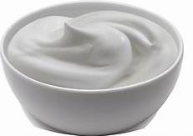
Which mineral is necessary to make our bones?
Calcium is an essential mineral to make bones
Calcium is found in milk, green leafy vegetables, sardines, peanuts, beans, cheese, yoghurt, oranges, blackberries

Slide 22
What is the profession of a person who studies animals?
A Zoologist studies animals.

Slide 23
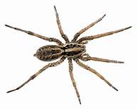
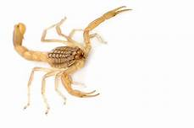
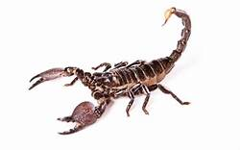



What are "Arachnids"?
Arachnids are eight legged animals including spiders, scorpions and mites.
Please protect spiders because they kill and eat bugs that carry diseases

Slide 24

We hope you enjoyed our little quiz
Thank You

