Slide 1
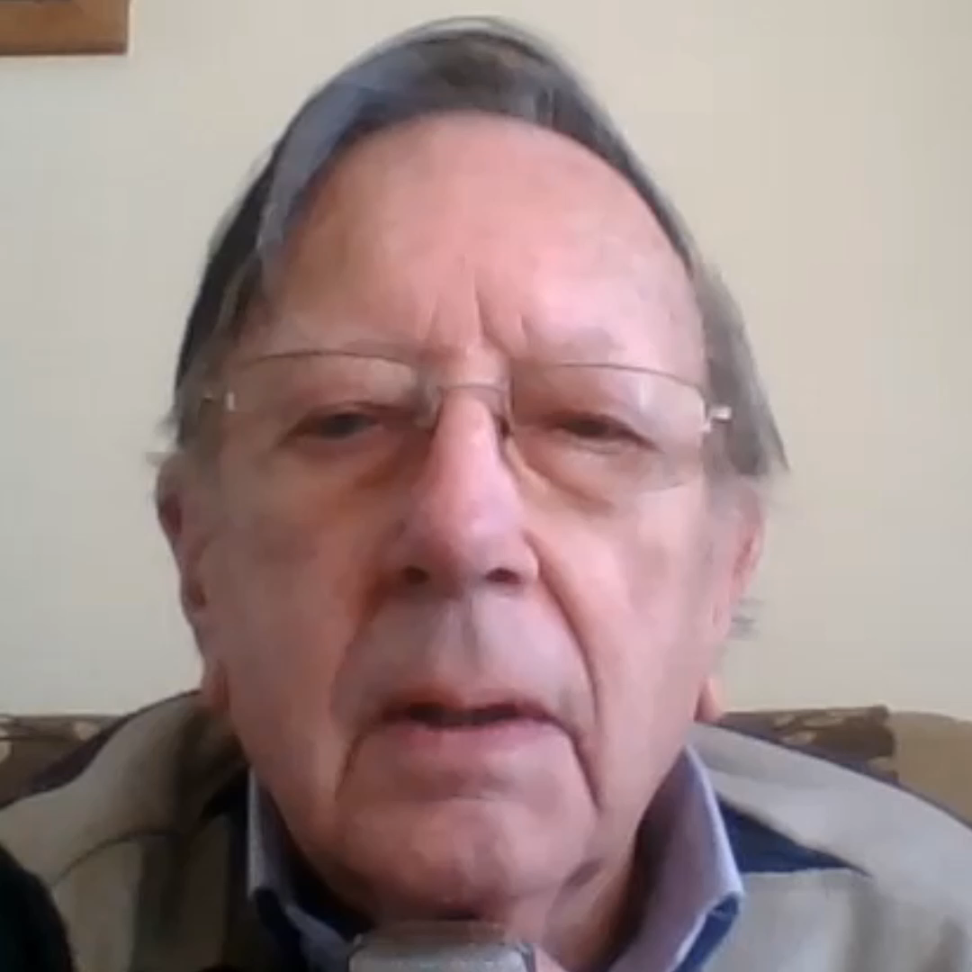
Contents
Topic
21 Card Trick
Cat, Tortoise and Table
Resistance
Pair of Poker Cards
Lets Go Fishing
Confusing Numbers
Clever Bubbles
Steel Band
Guess My Weight
Is My Bank Giving Me Money?

Slide 2

Risks
Item | Risk | Avoidance Action
Tools | Injury | Close supervision and immediate action to render first aid, etc
Electricity | Injury | Close supervision and immediate to render first aid, etc
Aggression between pupils | Injury | Close supervision and immediate action to defuse aggression

Slide 3
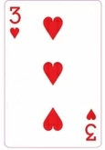



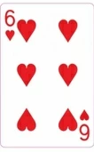




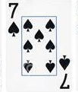


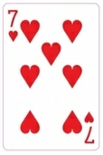



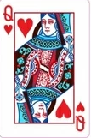
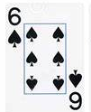
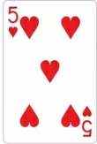

21 Card Trick
Column 1 2 3
Lay out 21 cards in three columns
Ask a friend to choose a card
Ask them to tell you which column the card is in
Pick up the piles with the column where your friend’s card is
in the middle
Turn the cars over (face down) and lay out the cards again
in threes face up
Ask your friend to tell you which column the card is in
Do this again
Count out ten cards and tell your friend the next card will be the one they chose!

Slide 4
21 Card Trick
Column 1 2 3
When you lay out the cards for the second time the seven in
the chosen column are in position 4 & 5 in column 1,
3, 4, & 5 in column 2 and 3, 4, & 5 in column 3
If the next choice is column 3 then the third time the cards are
spread the cards in are in position 4 in each column
The next deal has the seven cards from the wrong pile and the
fourth from the chosen pile so the eleventh card is the chosen
card.
Similarly for the chosen card in other columns.

Slide 5
21 Card Trick
Column 1 2 3
We have learnt
A card trick to play on our friends
We used the position of the card, geometry, to solve the game
We also used arithmetic and logic
So we used maths to solve the game

Slide 6
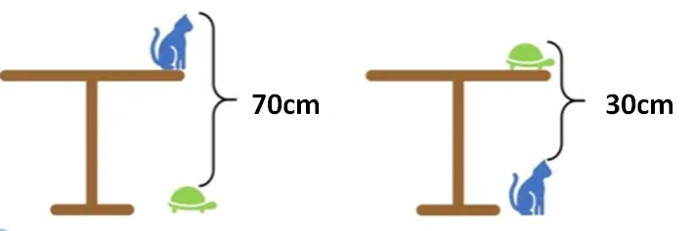
The Cat and The Tortoise
Given the dimensions of the diagram
How high is the table?

Slide 7
The Cat and The Tortoisec
Given the dimensions of the diagram
How high is the table?
Cat + Table – Tortoise = 70cm
Tortoise + Table – Cat = 30cm
Adding
Table + Table = 100cm
So the table is 50cm high

Slide 8
The Cat and The Tortoise
We have learnt
To use algebra to solve the problem
Because we used the variables “Cat”, “Tortoise” and “Table”

Slide 9
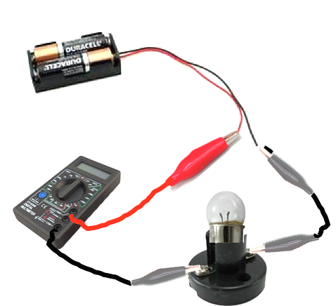
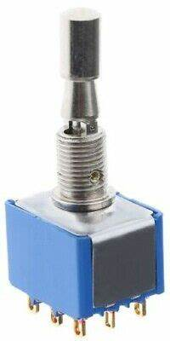
Resistance
What you need
Two 1.5V Batteries
Battery holder
Lamp holder
Incandescent bulb
Connecting leads with crocodile clips
Multimeter
Switch

Slide 10

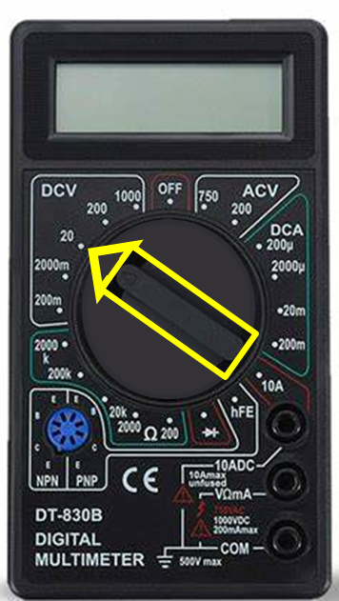
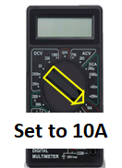
Resistance
We are going to make two electrical circuits
We represent these with schematic diagrams using electrical symbols
Switch
Switch
Lamp
Battery
Battery
Lamp
Set to 20V DC
Multimeter
Multimeter

Slide 11
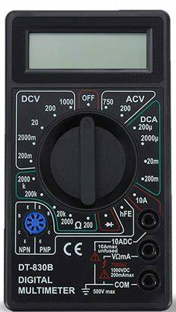

Resistance
Connecting the circuit
Ensure that the switch is turned off
Connect the circuit
Set the multimeter to measure current
Get the circuit checked by a teacher
Turn on the circuit
Read the multimeter
Now move the multimeter and set to
DC Volts
Read the voltage across the lamp
Turn off the circuit and the multimeter
Set to 10A
Set to 20V DC

Slide 12
Resistance
Now calculate the resistance of the bulb
If you do not know the formula for electrical resistance please search the internet
The formula linking voltage to current and resistance is V = IR
Here V in voltage in Volts, I is current in Amps and R is resistance in Ohms
What was your answer
Compare your answer with those of other pupils

Slide 13
Resistance
We have learnt
To make an electrical circuit
To measure current and voltage
To calculate electrical resistance
And we use a mathematical formula V = IR

Slide 14
Pair Of Poker Cards
When you play Poker you can have several different hands including a pair of cards such as two tens
You can have:
  One pair
  Two pairs
  Three of a kind
  Flush, all the same suit
  Full House, three of a kind and a pair
  A running flush, all the same suit and consecutive numbers
  Four of a kind
  A Royal Flush, 9 to King of the same suit
What is the probability that you get a pair of cards in the five you have been dealt?

Slide 15
Pair Of Poker Cards
Whichever card you get first does not
matter
The probability of getting a match for the second card
is 3 out of the 51 cards left
If you still have not got a match the chance for the third
card is 3 out of 50
For the fourth card it is 3 out of 49
Then for the fifth 3 out of 48
Is the total chance then 3/52 x 3/50 x 3/49 x 3/48
= 0.0000135054 or 0.000135054% or 13 chances in a million
We have forgotten that we do not need to proceed if we already have a pair after each card is dealt!
How do we account for this?
That is obviously wrong
What have we forgotten?

Slide 16
Pair Of Poker Cards
We actually need to find the chance of not have a pair
The probability of not getting a pair for the second
card is 48 out of the 51 cards left
If you still have not got a match the chance for the
third card is 47 out of 50
For the fourth card it is 46 out of 49
Then for the fifth 45 out of 48
Is the total chance then 48/51 x 47/50 x 46/49 x 45/48
= 0.778631453 or 77.8631453%
So the chance of getting a pair is 100%-77.8631453% = 22,1368547%

Slide 17
Pair Of Poker Cards
We have learnt
To play poker
To calculate probability
And we used maths

Slide 18

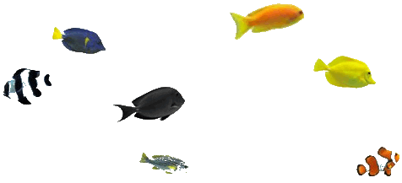
Let’s Go Fishing
A visitor asked the owner about the fish in the pond.
The owner said they were all good to eat
The visitor asked how much they weighed

Slide 19
Let’s Go Fishing
How much does each fish weigh?
The owner said I checked them all yesterday.
The gold one weighed 100grams plus ¾ of it’s weight
The yellow one weighed 100grams plus ⅔ of it’s weight
The grey one was 100grams plus ⅘ of it’s weight
The blue one was 100 grams plus ⅝ of it’s weight
The zebra coloured was 100grams plus ⅗ of its weight
And the other striped one was 100grams plus ⅞ of its weight

Slide 20
Let’s Go Fishing
Some of you may try guessing and get some of the answers correct.
However if we use Algebra we can find out the answers
Using the same method please calculate the weights of the other fish
For the gold fish
G = 100 + ¾ G
So G - ¾ G = 100
So G = 400
The gold fish weighs 400 grams
Let’s name the fish as the first letter of their colour

Slide 21
Let’s Go Fishing
Did you get the answers correct?
Gold fish weighs 400grams
The Yellow fish weight 300 grams
The Grey fish weighs 500 grams
The Blue fish weighs 266.67grams
The Zebra fish weighs 250 grams
The other coloured fish weighs 800grams

Slide 22
Let’s Go Fishing
We have learnt
About fractions
To use algebra to solve a problem
So we used maths again

Slide 23
Confusing Numbers
On first glance the sum 9 + 5 = 2 cannot be correct.
However by adding some more the answer will be correct
But you are not allowed to add numbers
What is the answer?
9 + 5 = 2

Slide 24
Confusing Numbers
9 + 5 = 2
+ 5hrs =
What is the answer?
There are two answers
9am + 5 hours = 2pm
9pm plus 5 hours = 2am
Did you “clock” it?

Slide 25
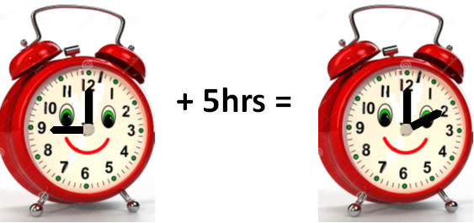
Confusing Numbers
9 + 5 = 2
We have learnt
That we have to think
“Outside The Box”
And we use time to solve the problem
And also maths again

Slide 26
Clever Bubbles
2 cm diameter
Bubbles are very clever
They always form a sphere because this is the largest volume for a given amount of soapy water
Can you demonstrate that this is true by comparing the bubble with a cube of the same volume?
I Know My Maths

Slide 27
Clever Bubbles
2 cm diameter
First you need to find out the formulae for spheres – volume and surface area
Pause the video while you do this
I Know My Maths

Slide 28
Clever Bubbles
2 cm diameter
Bubbles are very clever
For a sphere the formulae are
Volume = 4/3 𝞹 r³
Surface area = 4 𝞹 r²
And for a cube of length L
The volume is L³
The surface area is 6 x L²
I Know My Maths

Slide 29

Clever Bubbles
2 cm diameter
Bubbles are very clever
The volume of the bubble is
4 3 x 𝞹 x 1³ = 4.1889 cm³
The surface area is
4 x 𝞹 x 1² = 12.56637cm²
I Know My Maths

Slide 30
Clever Bubbles
Bubbles are very clever
The volume of the cube is
L³ = 4.1889 cm³ so L = 1.61201
The surface area is
6 x L² = 15.5946cm²
I Know My Maths

Slide 31

Clever Bubbles
And it can be shown that the sphere wins over every other straight-sided figure
Bubbles are very clever
For the same volume
The surface area of the sphere is 12.56637cm²
The surface area of the cube is 15.5946cm²
So the sphere wins as it has less surface area for the same volume

Slide 32
Clever Bubbles
We have learnt
The formulae for the volume and surface area of spheres
That a sphere has the largest volume for the same surface area
To use 𝞹 to calculate the answers needed to solve the problem
That spheres and bubbles can do maths??
Sorry folks
Bubbles cannot do maths
It is all down to physics
Please see
https://physics.aps.org/articles/v9/21
I Know My Maths

Slide 33
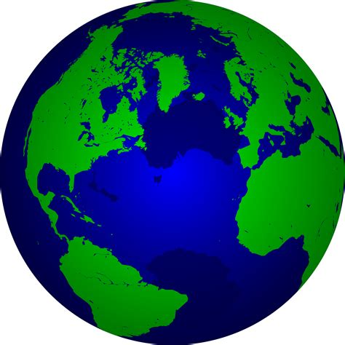
Steel Band
Please imagine a steel band going right around the equator which just touches the ground all round the world
The world is about 13,000 kilometres diameter
How long is the steel band?
No, not the musicians

Slide 34
Steel Band
The band will be 40,840.7 Km
Now add just 30 metres to the length of the band so it raises
up evenly around the equator
Which of these animals do you think could pass under the raised band, and prove it!
a flea, a robin, a cat, a child, a person, a horse, an elephant

Slide 35
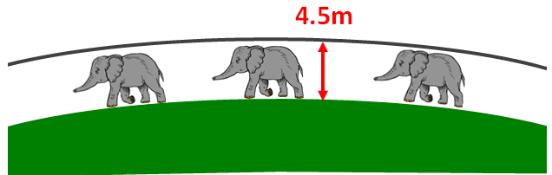
Steel Band
The answer is all of the animals
Why?
The band is now 40,840,730 metres long
So it’s diameter is 40,840,730 metres divided
by 𝞹 = 13,000,009 metres
So the diameter has increased by 9 metres
and the radius by 4½ metres
Even an elephant, height about 4 metres, can pass under

Slide 36
Steel Band
We have leant
Not to use intuition when answering a problem because almost everyone said an elephant could not pass under the steel bar
To use 𝞹, the formula for circles and
arithmetic to solve the problem
We used maths again!

Slide 37

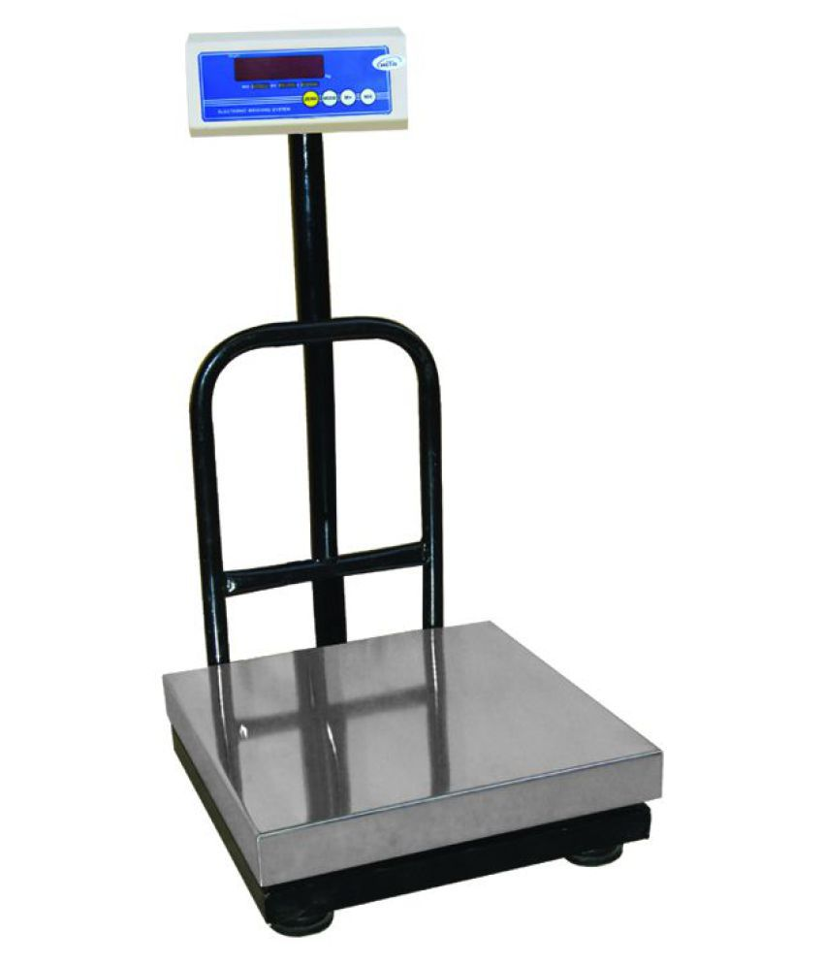
Guess My Weight
There are five pupils who want to know their
weight
However the teacher said that they can only
weigh two at a time in pairs
The weights the teacher recorded are
54Kg, 53Kg, 52Kg, 50Kg, 49Kg, 48Kg, 47Kg, 46Kg, 45Kg, 44Kg
The teacher also said no pupil weighs the same as any other!
How much does each pupil weigh?

Slide 38
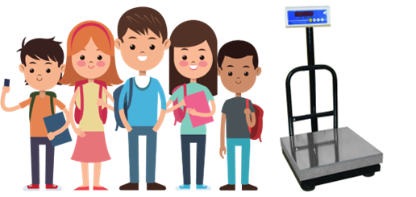
Guess My Weight
We are going to have to use Algebra again!
Perhaps you can use a,b,c,d and e as the weights of the pupils
As a tip, may I introduce the sign > meaning “greater than”

Slide 39
Guess My Weight
We are going to have to use Algebra again!
Use a,b,c,d and e as the weights of the pupils
Also use a > b > c > d > e as a condition
So we have
the heaviest pair a+b = 54
the next heaviest pair a+c=53
the lightest pair d+e = 44
the next lightest pair c+e=45
Also the total of all their weights is 488Kg, and each was weighed four times
So a+b+c+d+e=488/4=122Kg

Slide 40
Guess My Weight
We are going to have to use Algebra again!
We know the sum of all of them is 122Kg = a+b+c+d+e
Also a+b=54 and d+e=44
So c=122-a-b-d-e, c=122-(a+b)-(d+e), c=122-54-44, c=24

Slide 41
Guess My Weight
We are going to have to use Algebra again!
c=24
Now use a+c=53 and c+e=45 and a+b=54
a+c=53, a=53-c, a=53-24, a=29
c+e=45, e=45-c, e=45-24., e=21
a+b=54, b=54-a, b=54-29, b=25
Finally use a+b+c+d+e=122
d=122-a-b-c-e
d=122-29-25-24-21
d= 23
So the answers are
a=29 Kg, b=25 Kg, c=24 Kg, d=23 Kg, e=21 Kg

Slide 42
Guess My Weight
We have learnt
About weight
To use algebra again
About using “greater than” >
And we used maths yet again

Slide 43
Is My Bank Giving Me Money?
I looked at my bank account recently
I started with £100 and then spent the following with the balance as shown
Where | Spent | Balance
Petrol | 50 | 50
Supermarket | 25 | 25
Chemist | 10 | 15
Newsagent | 8 | 7
Toy Shop | 5 | 2
Café | 2 | 0
Totals | 100 | 99
Where has the
missing pound
gone?

Slide 44
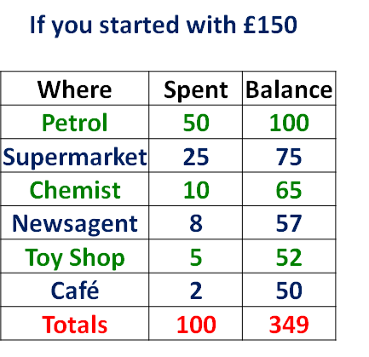
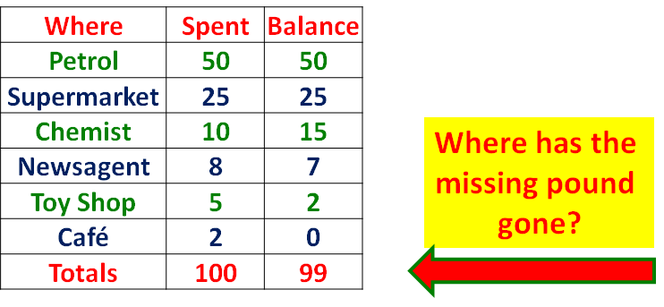
Is My Bank Giving Me Money?
The two columns are actually measuring different things
If you started with £101
Where | Spent | Balance
Petrol | 50 | 51
Supermarket | 25 | 26
Chemist | 10 | 16
Newsagent | 8 | 8
Toy Shop | 5 | 3
Café | 2 | 1
Totals | 100 | 104

Slide 45
Is My Bank Giving Me Money?
And if you started with £X the table becomes
Where | Spent | Balance
Petrol | 50 | X-50
Supermarket | 25 | X-50-25
Chemist | 15 | X-50-25-10
Newsagent | 7 | X-50-25-10-8
Toy Shop | 2 | X-50-25--10-8-57
Café | 0 | X-50-25--10-8-57-2
Totals | 100 | 6X-50-50-25-50-25-10-50-25-10-8-50-25-10-8-5-50-25-10-8-5-2

Slide 46
Is My Bank Giving Me Money?
We have learnt
That total bank spending and the total sum of the remaining balances are not actually related
And we used four different scenarios to show this
And we used maths again

Slide 47


Thank You

