Slide 1

Welcome
These challenges were developed by Derrick Willer MBE and colleagues.
They are free to download and use in an education environment.
Please ensure that there is adult supervision, complete adherence to Health and Safety, and adequate PPE.
Derrick is a STEM Ambassador and volunteer STEM Ambassador.
He has supported education in schools and colleges for over 30 years, initially as a Neighbourhood Engineer in the 1980’s, leading the local Year of Engineering Success campaign in 1996 and the Campaign to Promote Engineering from 1997 to 2004.
He was awarded an MBE for services to Education in 2018.

Slide 2
Guide
This activity is for pupils to understand maths
Risks
Item | Risk | Avoidance Action
Tools | Injury | Close supervision and immediate action to render first aid, etc
Electricity | Injury | Close supervision and immediate to render first aid, etc
Aggression between pupils | Injury | Close supervision and immediate action to defuse aggression

Slide 3
Welcome
I very much hope that you will enjoy this fun activity to discover mathematics

Slide 4
Contents
Topic | Slide Number | Link
Why Lag Your House | 5 | Slide 5
Paper Bridges | 35 | Slide 35
What A Racquet | 42 | Slide 42
9 divided by 5 and -40 | 45 | Slide 45
Sum Dice | 48 | Slide 48
Square A Two Digit Number | 51 | Slide 51
Three Balls | 55 | Slide 55
(N+1) x (N-1) = Geometry | 58 | Slide 58
Water Bottle Challenge | 61 | Slide 61
Fake Coin | 65 | Slide 65
The Train and The Tunnel | 70 | Slide 70

Slide 5
Why Lag Your House?
Heat Conservation
How Effective Is Lagging Your House?
An exercise to show how household bills can be reduced by proper lagging.

Slide 6
Why Lag Your House?
First Build A House Without Lagging
Use the slides below (Click Here)
Cut out each side, base and roof of your house
Optionally, Cut out each Window and Door,
Use Clingfilm to represent Glass
(Put Clingfilm on before you glue the parts together)
Put the lamp into the house with wires coming out to the battery pack
Insert the thermometer where you can read it
Glue the base, sides and roof together

Slide 7


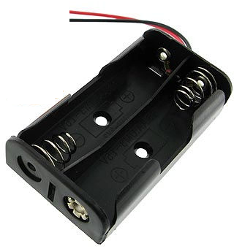
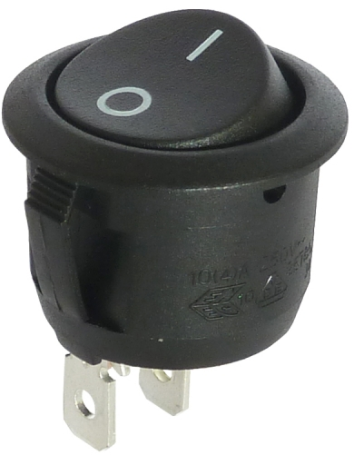

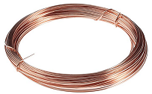

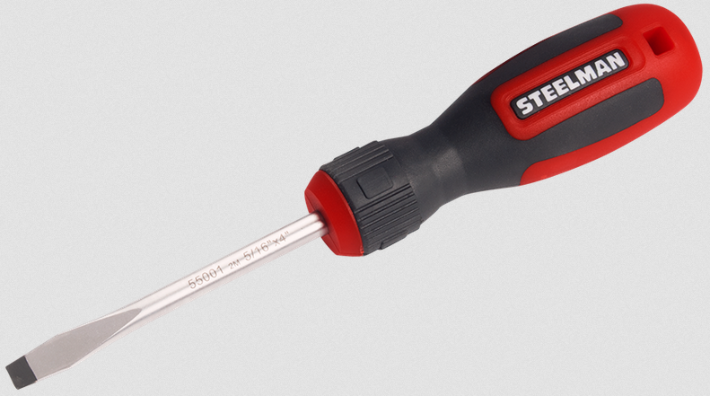

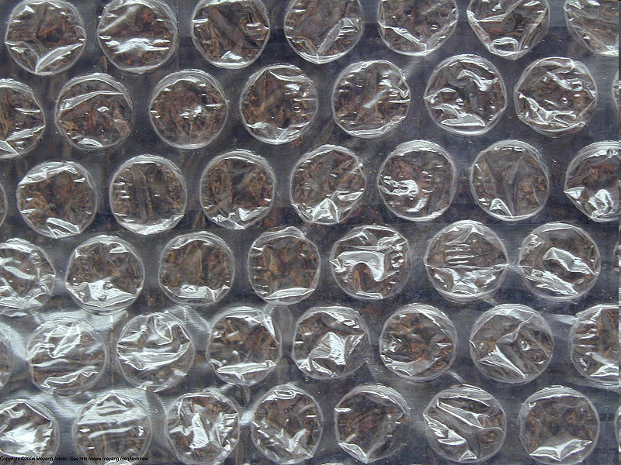
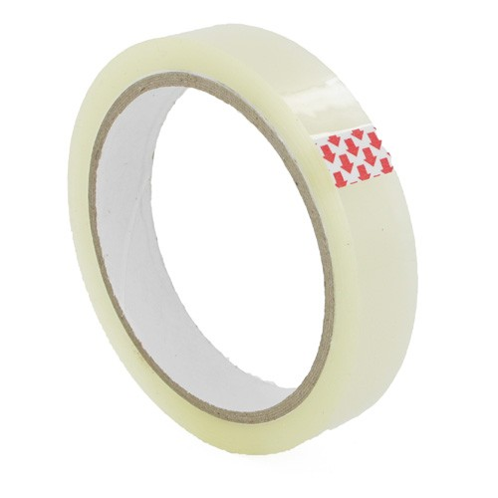
Why Lag Your House?
What you need:
Two 1.5V Batteries
Battery Holder
Switch
Three Lamp Holders
Three 3V Bulbs
Wire
Three Terminal Blocks
Screwdriver
Scissors
Paper
Bubble-wrap
Clingfilm (optional)
Sticky Tape
A4
Paper
Please ensure the batteries are kept separately to avoid short-circuiting

Slide 8
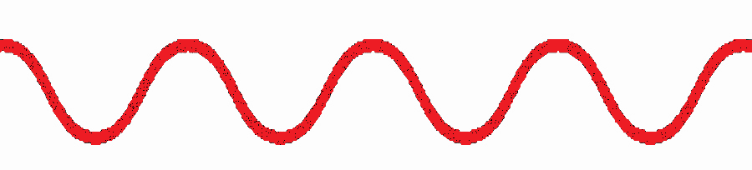
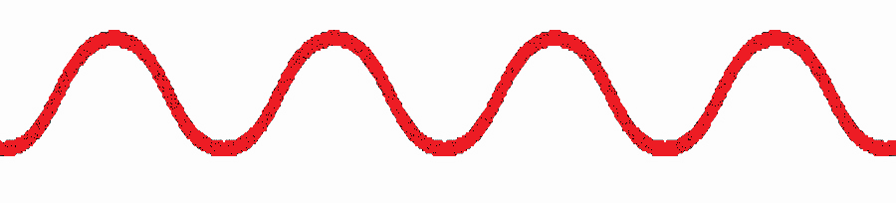
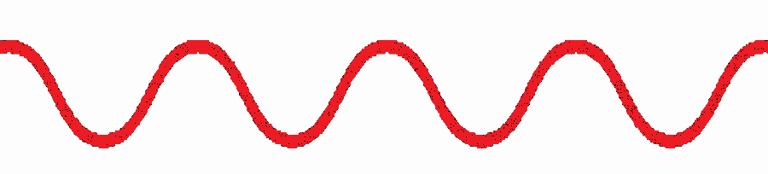


Why Lag Your House?
The Circuit
Wire the Circuit Like This
Screwdriver
Batteries
Bulb
Switch
Bulb
Holder
Battery
Holder
Terminal Blocks
DO NOT Switch On Until the Teacher Has Checked Your Circuit
Danger From Overheating Batteries if
Short Circuited

Slide 9
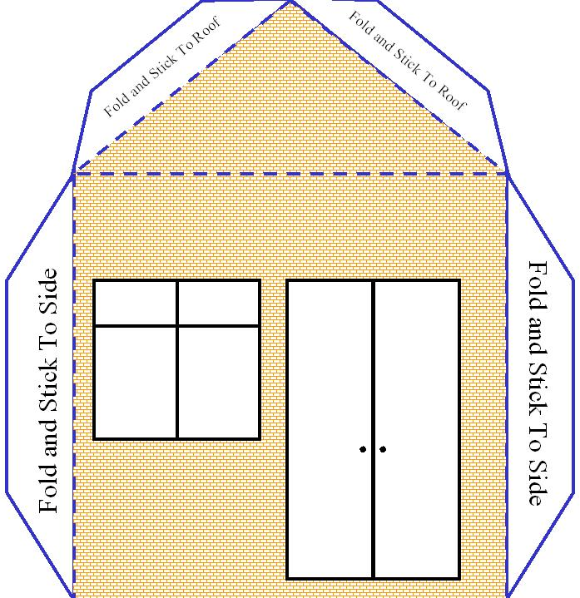
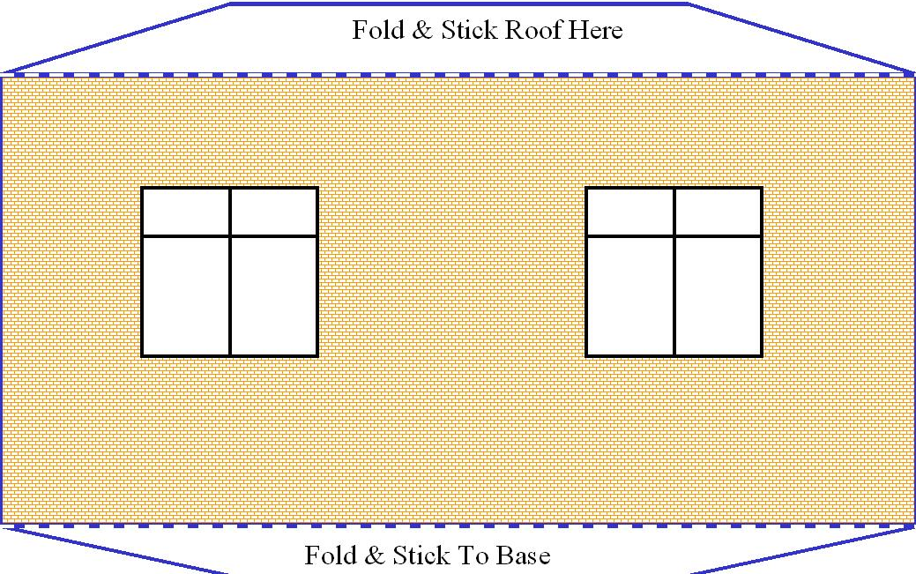
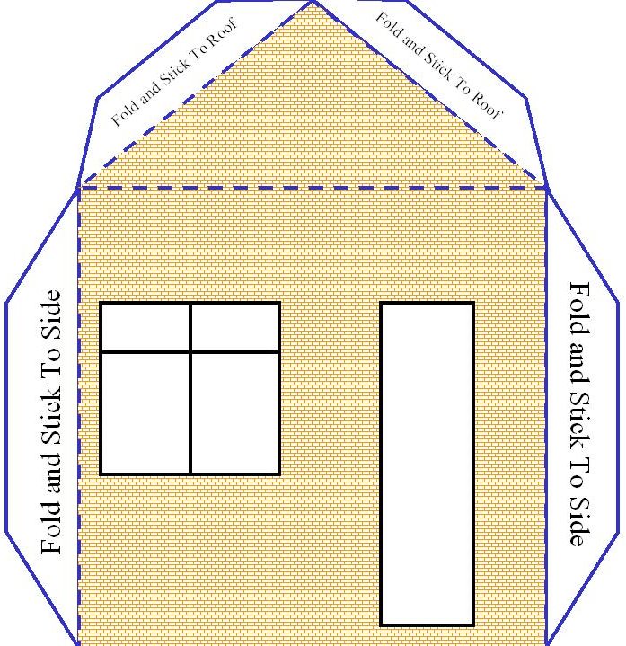

Why Lag Your House?
Cut out each side, base and roof of your house

Slide 10
Why Lag Your House?
Build A House Without Lagging
Cut out each Window and Door,
Use Clingfilm to represent Glass
Teachers can print the templates at the end of the slide-show
Teachers may need to pierce the windows so pupils can cut out with blunt scissors
Base

Slide 11

Why Lag Your House?
Build A House Without Lagging
Put the lamp in the base with wires coming out
to the Switch and Battery Pack
Roof
Put the Thermometer on the base
so you can see it through a window
Base

Slide 12

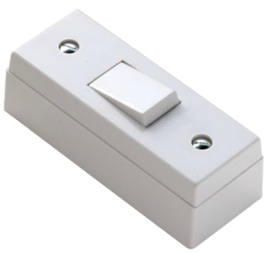
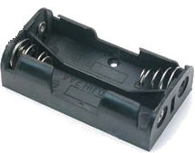
Why Lag Your House?
Build A House Without Lagging
Build the House
Glue the flaps to the roof, sides and base
Insert the Thermometer
Take a Thermometer Reading - go for a 10 minute break

Slide 13
Why Lag Your House?
Build A House Without Lagging
Take and Record a Thermometer Reading
Turn on the Light
Go for a 10 minute break
Put Batteries In

Slide 14
Why Lag Your House?
Build A House Without Lagging
After 10 Minutes
Take and Record a Thermometer Reading
Turn Off the Light
Write down how much the temperature has changed

Slide 15
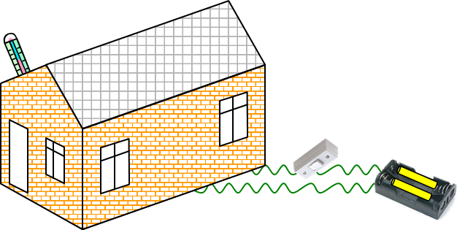

Why Lag Your House?
Build A House With Lagging
Now Stick Bubble-Wrap Inside Each Wall And Roof.
Also Put The House Onto A Layer Of Bubble Wrap.
Or you may just be measuring the temperature of the table.

Slide 16

Why Lag Your House?
Build A House With Lagging
Take and Record a Thermometer Reading
Turn on the Light
Go for a 10 minute break

Slide 17
Why Lag Your House?
Build A House With Lagging
After 10 Minutes
Take and Record a Thermometer Reading
Write down how much the temperature has changed

Slide 18
Why Lag Your House?
Build A House With Lagging
You Should Find That The House
Insulated With Bubble Wrap
Has Risen To A Higher Temperature

Slide 19
Why Lag Your House?
What are Your Conclusions?

Slide 20
Why Lag Your House?
Further Work
Can you calculate how much
energy saving you could make?
Use the internet to find some answers!
http://www.propertypal.com/property-news/saving-energy-in-your-home
http://www.energysavingtrust.org.uk/
www.direct.gov.uk/en/Environmentandgreenerliving/Energyandwatersaving/Energyandwaterefficiencyinyourhome

Slide 21
Why Lag Your House?
We have learnt
That lagging your house can save energy and money
And we used thermometers to measure the change
So we used maths
Click for next activity

Slide 22
Cut Along Full Blue Lines
Cut out Windows & Doors and
Stick Clingfilm to Represent Glass
Fold Along Dotted Blue Lines
Fold & Stick Roof Here
Fold – DO NOT Stick To Base

Slide 23
Cut Along Full Blue Lines
Cut out Windows & Doors and
Stick Clingfilm to Represent Glass
Fold Along Dotted Blue Lines
Fold & Stick Roof Here
Fold – DO NOT Stick To Base

Slide 24
Fold and Stick To Roof
Fold and Stick To Roof
Cut Along Full Blue Lines
Fold Along Dotted Blue Lines
Cut out Windows & Doors
and Stick Clingfilm to
Represent Glass
Fold and Stick To Side
Fold and Stick To Side

Slide 25
Fold and Stick To Roof
Fold and Stick To Roof
Cut Along Full Blue Lines
Fold Along Dotted Blue Lines
Cut out Windows & Doors
and Stick Clingfilm to
Represent Glass
Fold and Stick To Side
Fold and Stick To Side

Slide 26
Roof

Slide 27
Bubble Wrap Size for House Sides - Cut Two

Slide 28
Bubble Wrap Size for
House Front and Rear
Cut Two

Slide 29
Bubble Wrap Size for House Roof - Cut One

Slide 30
Cut Along Full Blue Lines
Cut out Windows & Doors and
Stick Clingfilm to Represent Glass
Fold Along Dotted Blue Lines
Fold & Stick Roof Here
Colour In Yourself
Fold – DO NOT Stick To Base

Slide 31
Cut Along Full Blue Lines
Cut out Windows & Doors and
Stick Clingfilm to Represent Glass
Fold Along Dotted Blue Lines
Fold & Stick Roof Here
Colour In Yourself
Fold – DO NOT Stick To Base

Slide 32
Fold and Stick To Roof
Colour In Yourself
Fold and Stick To Roof
Cut Along Full Blue Lines
Fold Along Dotted Blue Lines
Cut out Windows & Doors
and Stick Clingfilm to
Represent Glass
Fold and Stick To Side
Fold and Stick To Side

Slide 33
Fold and Stick To Roof
Fold and Stick To Roof
Cut Along Full Blue Lines
Fold Along Dotted Blue Lines
Cut out Windows & Doors
and Stick Clingfilm to
Represent Glass
Fold and Stick To Side
Fold and Stick To Side

Slide 34
Roof
Colour In Yourself

Slide 35

Paper Bridges
Project in a Box
Paper Bridges
Free permission to copy for use in schools and for instructing children of school age
and for use by children of school age
Copyright © Derrick Willer 1997, Updated 2021
www.dwiller.com
Here you make a bridge out of A4 paper
Then you make the top of the bridge as a U shape with different depths
Then see how much weight it will hold (use cars, coins, etc.)

Slide 36
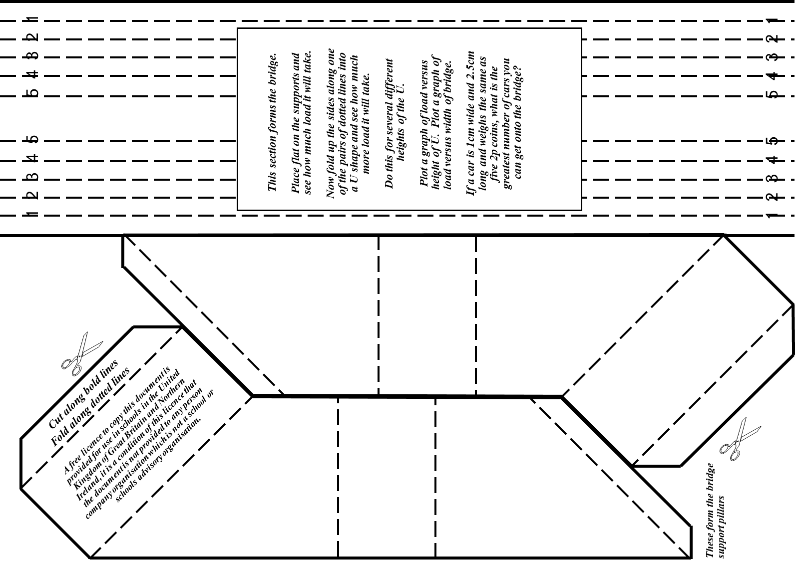
Cut This Out
Schools
Liaison
Community
Schools
Liaison
Community
Schools
Liaison
Community
Schools
Liaison
Community

Slide 37

Paper Bridges
Cut out the bridge supports and glue them together
Place the bridge paper onto the two supports
Whoops
Now see how many cars it will hold

Slide 38
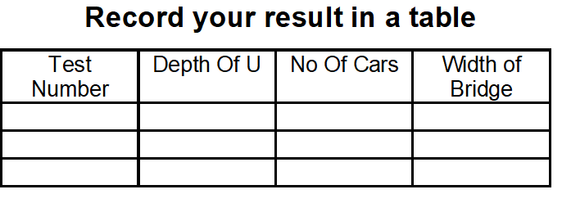


Paper Bridges
Now fold down one section of the U on each side of the bridge
How many cars will it hold before it collapses?

Slide 39
Paper Bridges
Please do the same five times and record the results e.g.

Slide 40
Paper Bridges
Please draw the following graphs
Depth of U against Width of Bridge
Depth of U against No Of Cars
7
6
5
4
3
2
1
0
Height of U
One is a straight line
The other is a curve
0 2 4 6 8 10 12 14
Width of Bridge and No Of Cars

Slide 41
Paper Bridges
We have leant
To make a bridge
That U shapes make bridges stronger
To graph our results
To use Maths

Slide 42
What a Racquet
I want to buy a tennis racquet but I do not have any money.
So I borrow £10 from Dad and £10 from Mum.
The racquet cost me £17
I gave Dad £1 and Mum £1 and keep £1
So I owe each of them £9
2 X £9 = £18, plus the £1 that I have equals £19
Where has the other £1 gone?
Still owed to Mum | £9
Still owed to Dad | £9
Amount I have | £1
Total | £19
Where has the £1 gone?

Slide 43
What a Racquet
The concept for the sum is wrong
Two are what you owe
- let’s call this a group of pears
One is what you still have
- let’s call this a group of apple
They are not the same
- you cannot add apples to pears and get a total number of pears
The Correct Sum Is Cost of Racquet | £17
Returned to Mum | £1
Returned to Dad | £1
I still have | £1
Total | £20
Also Still owed to Mum | £9
Still owed to Dad | £9
Less cost of Racquet | -£17
Total | £1
This is the amount I still have

Slide 44
What a Racquet
We have learnt
To add money
That apples and pears cannot be added together to get a number of apples
That what I owe has nothing to do with what I own
And to use Maths

Slide 45

9 divided by 5 and -40
Are you able to connect the above to make sense?
Suppose we do the sum 40 x 9 divided by 5
We get 360/5 = 72
How About This
Now add 72 to -40 we get 32
Does 32 help?

Slide 46
9 divided by 5 and -40
Are you able to connect the above to make sense?
Centigrade
O Deg C. – 40 - -40 Deg C.
Fahrenheit
32 Deg F – 72 = -40 DegF
So -40 DegC = -40 Deg F
Which give us a new formula
(DegF +40) X 5 = (DegC +40) X 9
Which is much easier to remember

Slide 47
9 divided by 5 and -40
We have learnt
A new and very easy way to convert temperature from Fahrenheit to Centigrade and visa-versa
And we used Maths
(DegF +40) X 5 = (DegC +40) X 9
Which is much easier to remember

Slide 48
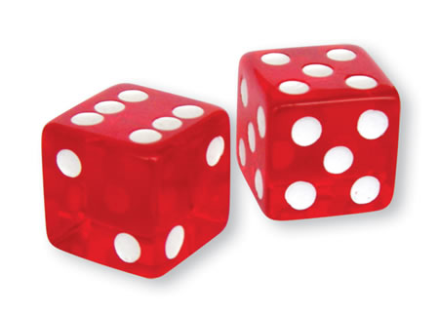
Sum Dice
The dealer has two dice
Which number should you bet on to maximise the chances of winning?

Slide 49
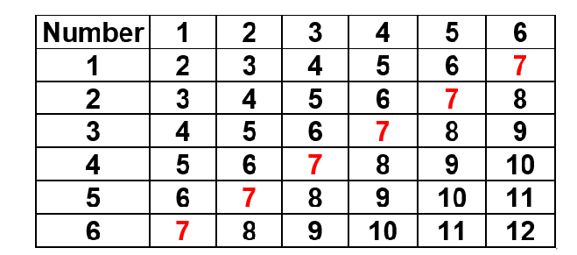
Sum Dice
What are the combinations that can happen?
Can you work this out?
So the 7 is the best number to bet on
But you only have 7 out of 36 chances of winning
That is just 19.44%
So you are almost bound to lose
The possible results are

Slide 50
Sum Dice
We have learnt
That 7 is the best number to bet on
But it only has 19.44% of winning
So it is better not to bet!
And we used Maths again

Slide 51
Square a Two Digit Number
Here is an example of an unusual method that always works
e.g. 37
What is next higher multiple of 10 = 40
What is the difference between 40 ad 37 = 3
Choose 40 – 3 – 3 = 34
Multiply 34 x 40 (easier) = 1360
Square the difference in step 2 = 3 x 3 = 9
Add step 4 to step 5 = 1360 + 9 = 1369
The result is correct
Can You Prove This?

Slide 52
Square a Two Digit Number
If we use A and B as the tens and units digit and follow the same procedure
e.g. 37
Next higher multiple of 10 = 40
Difference between 40 ad 37 = 3
40 – 3 – 3 = 34
Multiply 34 x 40 = 1360
10A+10
10-B
10A+10-20+2B = 10A-10+2B
(10A-10+2B) (10A+10) x
100A²+100A-100A-100+20AB+20B
100A2+20AB-100+20B

Slide 53
Square a Two Digit Number
If we use A and B as the tens and units digit and follow the procedure
e.g. 37
4. Multiply 34 x 40 = 1360
5. Square the difference = 3 x 3 = 9
6. Add step 4 to step 5
= 1360 + 9 = 1369
The result is correct
100A²+20AB-100+20B
(10-B)² = 100-20B+B²
100A²⁺20AB-100-20B+100+20B+B²
100A²+20AB+B²
(10A+B)² = 100A²+20AB+B²

Slide 54
Square a Two Digit Number
We have leant
A new way to square a number that make is easier to do
We proved it works with the number 10A+B
Which means it will work for any number
even 4539 where A=453 and B=9
But over 100 the arithmetic becomes difficult
So we used two unknowns A and B
So we used Algebra again
And Maths

Slide 55
Three Balls
You have three balls
Please place them so that they are the same distance from each other

Slide 56
Three Balls
You have three balls
Please place them so that they are the same distance from each other
Three is a triangle touching each other and one on top touching the others

Slide 57
Three Balls
We have learnt
To think in three dimensions
And we used 3D geometry to solve the puzzle
And Maths again

Slide 58
(N+1)x(N-1) = N²-1
We can all do the algebra
(N+1) x (N-1)
= N² + N – N – 1
= N²-1
But can you prove this using just geometry?

Slide 59
(N+1)x(N-1) = N²-1
N
N+1
N²-1
N²
N
N-1
+1
Move bottom row
but turn 90º to here

Slide 60
(N+1)x(N-1) = N²-1
We have learnt
To use geometry to prove the result
So we used Maths again

Slide 61
Water Bottle Challenge
You have a small bottle of water, sheets of A4 recycled/used paper, sticky tape.
A4 is 29.7cm x 21.0cm.
You must support the bottle at least 10cm above the table using paper and/or sticky tape.
Each sheet of paper costs £1.
Sticky tape costs £0.50p per cm.
What is the lowest cost to complete the challenge?
How can you do this?
How would you do this?

Slide 62
Water Bottle Challenge
Mark this in four equal parts
Fold the paper in half longways
c
Now fold in to four and interlace the ends into a triangle

Slide 63
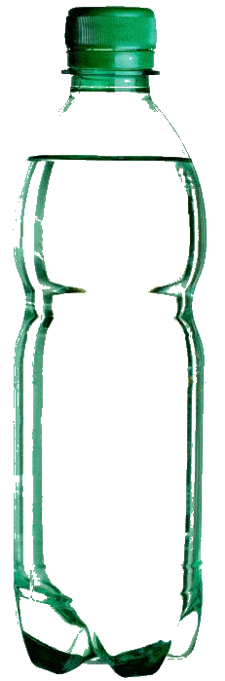
Water Bottle Challenge
Place the bottle onto the support
We asked you to support the bottle
So it is a good ideal to drink the water in the bottle to make it lighter
And we used just one sheet of paper costing £1 only
c
But it works even if the bottle ifs full of water

Slide 64
Water Bottle Challenge
We have learnt
To think outside the box
To use 3D geometry again
And used Maths yet again
Well
Done

Slide 65
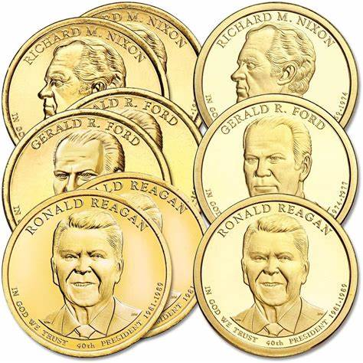
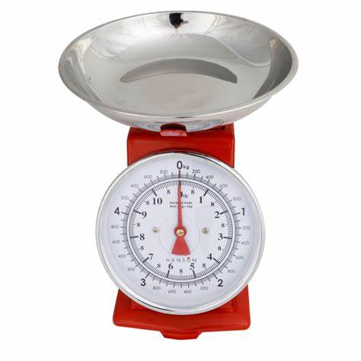
Fake Coin
There are nine coins but one is a fake
You can weigh the cons on the kitchen scales
What is the minimum number of times you nut weigh them to find the fake?

Slide 66
Fake Coin
If they are the same
2. Weigh two good ones against two of the other three
If equal then the last coin of set three is the bad one
3. If not equal weigh one of each against two good coins
If equal the last coin is the bad one
4. If not weigh one of the two which were bad against one of the good ones
If unequal the coin on the scales is bad
If equal the other of the last three is bad
1. Weigh three against three
If they are the same then these are good coins
If not then the last three are good, go to the next slide

Slide 67
Fake Coin
If not then the last three are good
2. Weigh three good ones against one of the other sets of three
If the same then the bad coin is in the third set, otherwise it is in the first set
3. Weigh two good coins against two of the three with the bad coin
If equal the bad coin is the coin remining in the bad set of three
4. If not equal one of the two coins from the bad set is bad.
5. Weigh a good coin against one of the remaining two where there is a bad coin
If equal the bad coin is the one remaining
If unequal you have found the bad coin

Slide 68
Fake Coin
For my method the minimum number of times you need to weigh coins to guarantee a result is five
Do you have abetter method?

Slide 69
Fake Coin
We have learnt
To simulate different scenarios for weighing the coins
We used logic
Logic is part of Maths

Slide 70




The train is 100 metres long
There is a tunnel 1Km long
If the train is going at 60Km per hour
How long does it take for the train to go through the tunnel?
WRONG
Answer 1Km divided by 60Km per hour = 1 minute

Slide 71
You forgot that the train is 100 metres long
There is a tunnel 1Km long
So it has to go IKm + 100M for all of the train to pass through
And the train is going at 60Km per hour
Answer
1.1Km divided by 60Km per hour = 1.1 minutes
or 1 minute and 6 seconds

Slide 72
We have learnt
To work out time from distance and speed
And used Maths again

Slide 73


For more fun with maths please see my new book
Thank You

Slide 75
Paper Bridges
Whoops

